Slide 1
3. The Logic of Quantified Statements (aka Predicate Logic) Summary
Aaron Tan
AY2025/26 Semester 1

Slide 2
Summary
3. The Logic of Quantified Statements
3.1 Predicates and Quantified Statements I
Predicate; domain; truth set
3.2 Predicates and Quantified Statements II
Negation of quantified statements; negation of universal conditional statements
Universal conditional statements; Implicit quantification
3.3 Statements with Multiple Quantifiers
Negations of multiply-quantified statements; order of quantifiers
Prolog
Universal quantifier ∀, existential quantifier ∃
Vacuous truth of universal statements
Variants of universal conditional statements (contrapositive, converse, inverse)
Necessary and sufficient conditions, only if
3.4 Arguments with Quantified Statements
Universal instantiation; universal modus ponens; universal modus tollens

Slide 3
Summary
3.1 Predicates and Quantified Statements I
Definition 3.1.1 (Predicate)
A predicate is a sentence that contains a finite number of variables and becomes a statement when specific values are substituted for the variables.
The domain of a predicate variable is the set of all values that may be substituted in place of the variable.
Definition 3.1.2 (Truth set)
If P(x) is a predicate and x has domain D, the truth set is the set of all elements of D that make P(x) true when they are substituted for x.
The truth set of P(x) is denoted {x ∈ D | P(x)}.

Slide 4
Summary
3.1 Predicates and Quantified Statements I
Definition 3.1.3 (Universal Statement)
Let Q(x) be a predicate and D the domain of x.
A universal statement is a statement of the form “∀x∈D, Q(x)”.
It is defined to be true iff Q(x) is true for every x in D.
It is defined to be false iff Q(x) is false for at least one x in D.
A value for x for which Q(x) is false is called a counterexample.
Definition 3.1.4 (Existential Statement)
Let Q(x) be a predicate and D the domain of x.
An existential statement is a statement of the form “∃x∈D such that Q(x)”.
It is defined to be true iff Q(x) is true for at least one x in D.
It is defined to be false iff Q(x) is false for all x in D.
∃! is the uniqueness quantifier symbol. It means “there exists a unique” or “there is one and only one”.

Slide 5


Summary
3.2 Predicates and Quantified Statements II
Theorem 3.2.1 Negation of a Universal Statement
The negation of a statement of the form
∀x$∈$D, P(x)
is logically equivalent to a statement of the form
∃x$∈$D such that ~P(x)
Symbolically,
~(∀x$∈$D, P(x)) ≡ ∃x$∈$D such that ~P(x)
Theorem 3.2.2 Negation of an Existential Statement
The negation of a statement of the form
∃x$∈$D such that P(x)
is logically equivalent to a statement of the form
∀x$∈$D, ~P(x)
Symbolically,
~(∃x$∈$D such that P(x)) ≡ ∀x$∈$D, ~P(x)

Slide 6
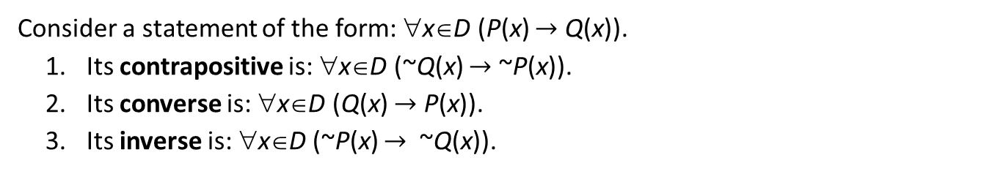
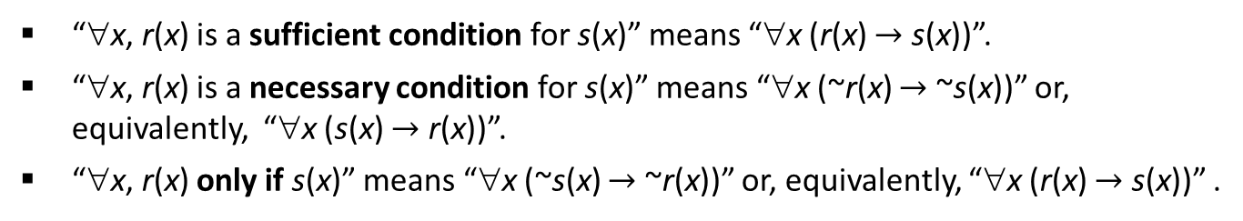
Summary
3.2 Predicates and Quantified Statements II
Definition 3.2.1 (Contrapositive, converse, inverse)
Consider a statement of the form: ∀x∈D (P(x) $→$ Q(x)).
Its contrapositive is: ∀x∈D (~Q(x) $→$ ~P(x)).
Its converse is: ∀x∈D (Q(x) $→$ P(x)).
Its inverse is: ∀x∈D (~P(x) $→$ ~Q(x)).
Definition 3.2.2 (Necessary and Sufficient conditions, Only if)
“∀x, r(x) is a sufficient condition for s(x)” means “∀x (r(x) $→$ s(x))”.
“∀x, r(x) is a necessary condition for s(x)” means “∀x (~r(x) $→$ ~s(x))” or, equivalently, “∀x (s(x) $→$ r(x))”.
“∀x, r(x) only if s(x)” means “∀x (~s(x) $→$ ~r(x))” or, equivalently, “∀x (r(x) $→$ s(x))” .

Slide 7
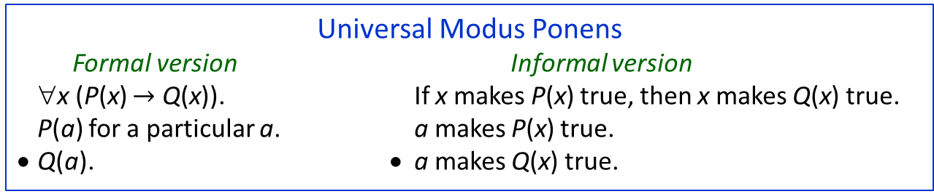
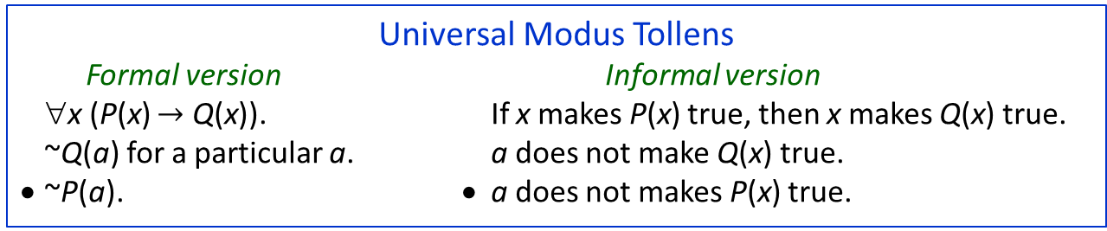
Summary
3.4 Arguments with Quantified Statements
Universal Modus Ponens
Formal version Informal version
∀x (P(x) $→$ Q(x)). If x makes P(x) true, then x makes Q(x) true.
P(a) for a particular a. a makes P(x) true.
• Q(a). • a makes Q(x) true.
Universal Modus Tollens
Formal version Informal version
∀x (P(x) $→$ Q(x)). If x makes P(x) true, then x makes Q(x) true.
~Q(a) for a particular a. a does not make Q(x) true.
• ~P(a). • a does not makes P(x) true.
Definition 3.4.1 (Valid Argument Form)
To say that an argument form is valid means the following: No matter what particular predicates are substituted for the predicate symbols in its premises, if the resulting premise statements are all true, then the conclusion is also true.
An argument is called valid if, and only if, its form is valid.

Slide 8
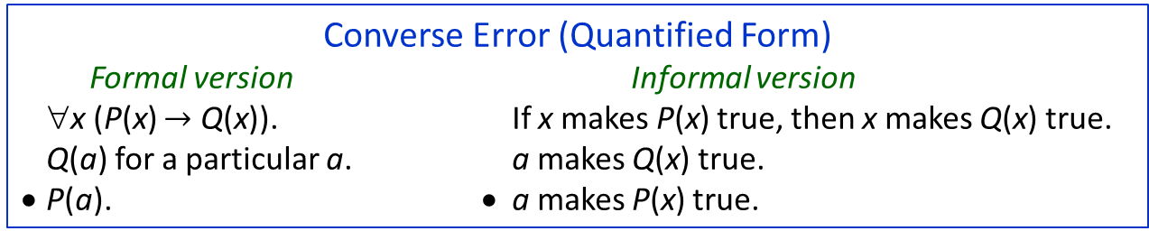
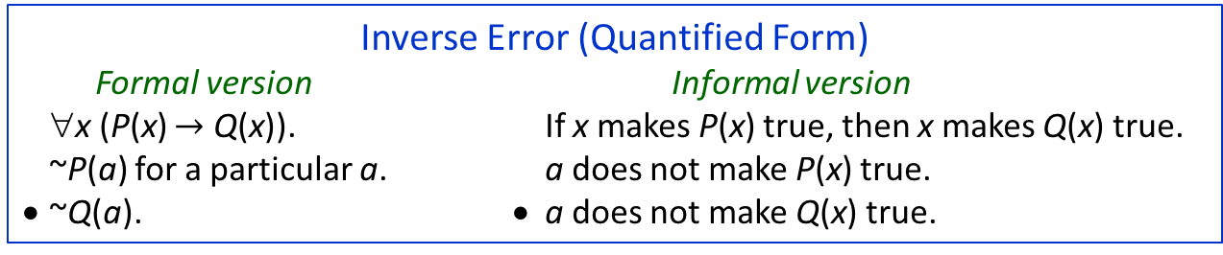
Summary
3.4 Arguments with Quantified Statements
Converse Error (Quantified Form)
Formal version Informal version
∀x (P(x) $→$ Q(x)). If x makes P(x) true, then x makes Q(x) true.
Q(a) for a particular a. a makes Q(x) true.
• P(a). • a makes P(x) true.
Inverse Error (Quantified Form)
Formal version Informal version
∀x (P(x) $→$ Q(x)). If x makes P(x) true, then x makes Q(x) true.
~P(a) for a particular a. a does not make P(x) true.
• ~Q(a). • a does not make Q(x) true.
Universal Transitivity
Formal version Informal version
∀x (P(x) → Q(x)). Any x that makes P(x) true makes Q(x) true.
∀x (Q(x) → R(x)). Any x that makes Q(x) true makes R(x) true.
• ∀x (P(x) → R(x)). • Any x that makes P(x) true makes R(x) true.

Slide 9
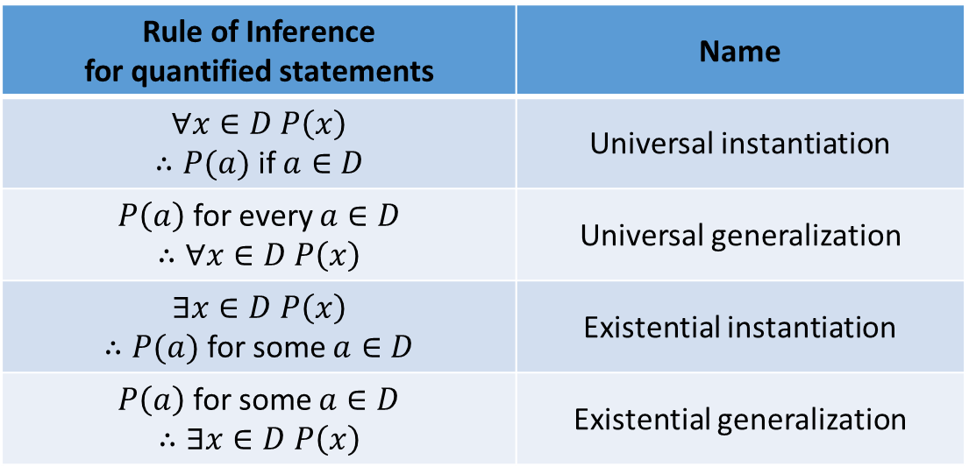
Summary
3.4 Arguments with Quantified Statements
Rule of Inference for quantified statements | Name
$$∀x∈D P\left(x\right)$$ $∴P(a)$ if $a∈D$ | Universal instantiation
$P\left(a\right)$ for every $a∈D$ $$∴∀x∈D P\left(x\right)$$ | Universal generalization
$$∃x∈D P\left(x\right)$$ $∴P(a)$ for some $a∈D$ | Existential instantiation
$P\left(a\right)$ for some $a∈D$ $$∴∃x∈D P\left(x\right)$$ | Existential generalization

Slide 10
END OF FILE

