Slide 1
Lecture #10: Counting and Probability I
Introduction Possibility Trees and Multiplication Rule Counting Elements of Disjoint Sets The Pigeonhole Principle
Aaron Tan
AY2025/26 Semester 1

Slide 2
Introduction Possibility Trees and Multiplication Rule Counting Elements of Disjoint Sets The Pigeonhole Principle
10. Counting and Probability 1
This lecture is based on Epp’s book chapter 9.
Hence, the section numbering is according to the book.
9.1 Introduction
Random process, sample space, event and probability
9.2 Possibility Trees and the Multiplication Rule
Possibility trees
9.3 Counting Elements of Disjoint Sets
The addition/sum rule
The multiplication/product rule
Permutations
9.4 The Pigeonhole Principle (PHP)
Pigeonhole principle, general pigeonhole principle
The difference rule
The inclusion/exclusion rule
Reference: Epp’s Chapter 9 Counting and Probability

Slide 3
Introduction Possibility Trees and Multiplication Rule Counting Elements of Disjoint Sets The Pigeonhole Principle
9.1 Introduction

Slide 4
Introduction Possibility Trees and Multiplication Rule Counting Elements of Disjoint Sets The Pigeonhole Principle
Introduction
Counting
Counting schemes covered
  Basics of counting: product/multiplication rule and sum/addition rule
  Permutations, with or without repetitions
  Combinations, with or without repetitions
  Inclusion-exclusion principle
  Pigeonhole principle (Dirichlet drawer principle)

Slide 5
Introduction Possibility Trees and Multiplication Rule Counting Elements of Disjoint Sets The Pigeonhole Principle
Introduction
Counting
Counting has important applications in Computer Science
  Determining complexity of algorithms
  Computing discrete probability of some events
Example: How many times is the routine this() called in the following algorithm?
process(n, m) {
while (n>0) {
for j ← 1 to m {
this(j);
}
n = n/2;
}
}

Slide 6
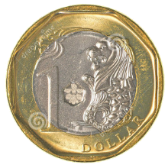
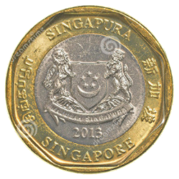
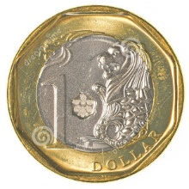

Introduction Possibility Trees and Multiplication Rule Counting Elements of Disjoint Sets The Pigeonhole Principle
Introduction
Tossing two coins
0, 1 or 2 heads?
Does each of these events occur about 1/3 of the time?
1/4
2/4
1/4
One head obtained
No heads obtained
Two heads obtained


Slide 7
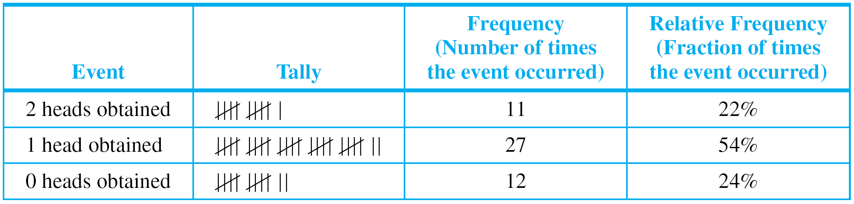
Introduction Possibility Trees and Multiplication Rule Counting Elements of Disjoint Sets The Pigeonhole Principle
Introduction
Table 9.1.1. Relative frequencies.
Formalizing the analysis, we introduce:
random process
sample space
event
probability

Slide 8
Introduction Possibility Trees and Multiplication Rule Counting Elements of Disjoint Sets The Pigeonhole Principle
Introduction
To say that a process is random means that when it takes place, one outcome from some set of outcomes is sure to occur, but it is impossible to predict with certainty which outcome that will be.
Definitions
A sample space is the set of all possible outcomes of a random process or experiment.
An event is a subset of a sample space.

Slide 9
Introduction Possibility Trees and Multiplication Rule Counting Elements of Disjoint Sets The Pigeonhole Principle
Equally Likely Probability
Notation
For a finite set A, |A| denotes the number of elements in A.
Note: Epp uses N(A) to denote the number of elements in A.
For consistency with earlier topic (Sets), we shall use |A|.
Also, we deal with finite sets here. Infinite sets will be discussed another time.
Equally Likely Probability Formula
If S is a finite sample space in which all outcomes are equally likely and E is an event in S, then the probability of E, denoted P(E), is
P(E) =
The number of outcomes in E
|E|
=
The total number of outcomes in S
|S|

Slide 10
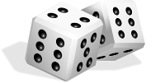
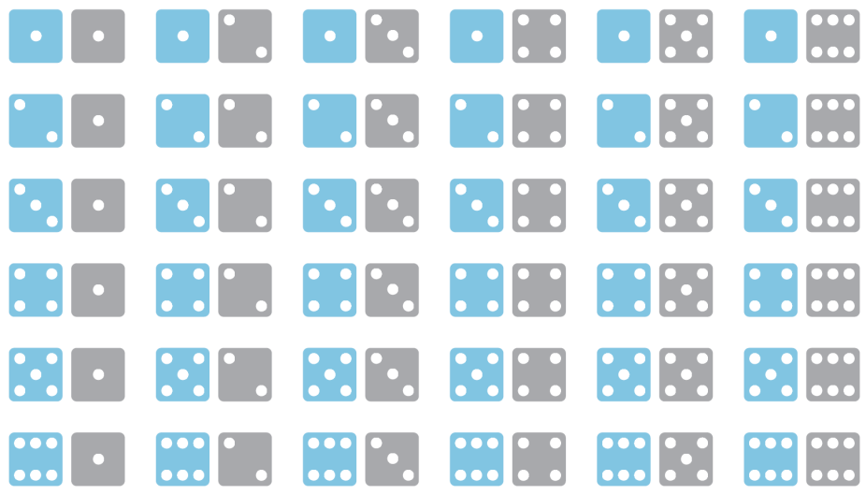
Introduction Possibility Trees and Multiplication Rule Counting Elements of Disjoint Sets The Pigeonhole Principle
Equally Likely Probability
Rolling a Pair of Dice

Slide 11

Introduction Possibility Trees and Multiplication Rule Counting Elements of Disjoint Sets The Pigeonhole Principle
Equally Likely Probability
A more compact notation identifies, say, with the notation 24, with 53, and so forth.
Use the compact notation to write the sample space S of possible outcomes.
Use set notation to write the event E that the numbers showing face up have a sum of 6 and find the probability of this event.
S = { 11, 12, 13, 14, 15, 16, 21, 22, 23, 24, 25, 26, 31, 32, 33, 34, 35, 36,
41, 42, 43, 44, 45, 46, 51, 52, 53, 54, 55, 56, 61, 62, 63, 64, 65, 66 }
E = { 15, 24, 33, 42, 51 }
P(E) = 5/36


Slide 12
Introduction Possibility Trees and Multiplication Rule Counting Elements of Disjoint Sets The Pigeonhole Principle
Counting the Elements of a List
Counting the Elements of a List
Some counting problems are as simple as counting the elements of a list.
Eg: How many integers are there from 5 through 12?
list: 5 6 7 8 9 10 11 12
count: 1 2 3 4 5 6 7 8
Theorem 9.1.1 The Number of Elements in a List
If m and n are integers and m ≤ n, then there are
n – m + 1
integers from m to n inclusive.

Slide 13

Introduction Possibility Trees and Multiplication Rule Counting Elements of Disjoint Sets The Pigeonhole Principle
Counting the Elements of a List
How many 3-digit integers (from 100 to 999 inclusive) are divisible by 5?
100 101 102 103 104 105 106 107 108 109 110 … 994 995 996 997 998 999
5×20
5×21
5×22
5×199
From Theorem 9.1.1, there are 199 – 20 + 1 = 180 such integers.
Hence, there are 180 3-digit integers that are divisible by 5.
What is the probability that a randomly chosen 3-digit integer is divisible by 5?
By Theorem 9.1.1, total number of integers from 100 through 999 = 999 – 100 + 1 = 900.
By part (a), 180 of these are divisible by 5.
Hence, answer = 180/900 = 1/5.


Slide 14
Introduction Possibility Trees and Multiplication Rule Counting Elements of Disjoint Sets The Pigeonhole Principle
9.2 Possibility Trees and the Multiplication Rule

Slide 15
Introduction Possibility Trees and Multiplication Rule Counting Elements of Disjoint Sets The Pigeonhole Principle
Possibility Trees
Possibility Trees
A tree structure is a useful tool for keeping systematic track of all possibilities in situations in which events happen in order.
Coin 1
H
T
Coin 2
H
T
H
T
Coin 3
H
T
H
T
H
T
H
T
Example 1: Possibilities for Tournament Play
Teams A and B are to play each other repeatedly until one wins two games in a row, or a total of three games.
One way in which this tournament can be played is for A to win the first game, B to win the second, and A to win the third and fourth games. Denote this by writing A–B–A–A.

Slide 16
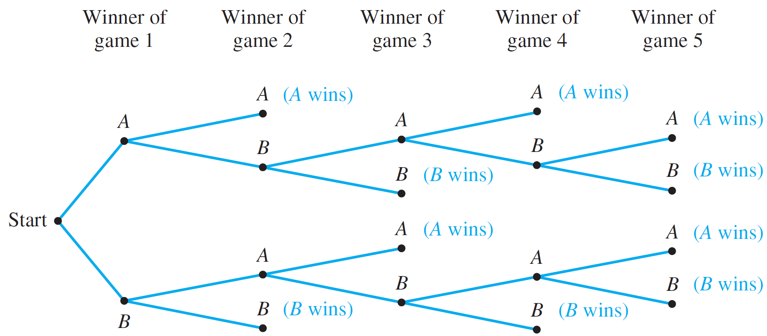
Introduction Possibility Trees and Multiplication Rule Counting Elements of Disjoint Sets The Pigeonhole Principle
Possibility Trees
Example 1: Possibilities for Tournament Play
How many ways can the tournament be played?
Possible ways are represented by the distinct paths from “root” (the start) to “leaf” (a terminal point) in the tree below.
Figure 9.2.1 The Outcomes of a Tournament

Slide 17
Introduction Possibility Trees and Multiplication Rule Counting Elements of Disjoint Sets The Pigeonhole Principle
Possibility Trees
Example 1: Possibilities for Tournament Play
How many ways can the tournament be played?
Ten paths from the root of the tree to its leaves ➔ ten possible ways for the tournament to be played.
A-A
A-B-A-A
A-B-A-B-A
A-B-A-B-B
A-B-B
B-A-A
B-A-B-A-A
B-A-B-A-B
B-A-B-B
B-B

Slide 18
Introduction Possibility Trees and Multiplication Rule Counting Elements of Disjoint Sets The Pigeonhole Principle
Possibility Trees
Example 1: Possibilities for Tournament Play
Assuming that all the ways of playing the tournament are equally likely, what is the probability that five games are needed to determine the tournament winner?
A-A
A-B-A-A
A-B-A-B-A
A-B-A-B-B
A-B-B
B-A-A
B-A-B-A-A
B-A-B-A-B
B-A-B-B
B-B
Probability that 5 games are needed = 4/10 = 2/5

Slide 19
Introduction Possibility Trees and Multiplication Rule Counting Elements of Disjoint Sets The Pigeonhole Principle
The Multiplication/Product Rule
The Multiplication/Product Rule
Consider the following example.
Suppose a computer installation has four input/output units (A, B, C, and D) and three central processing units (X, Y, and Z).
Any input/output unit can be paired with any central processing unit. How many ways are there to pair an input/output unit with a central processing unit?

Slide 20
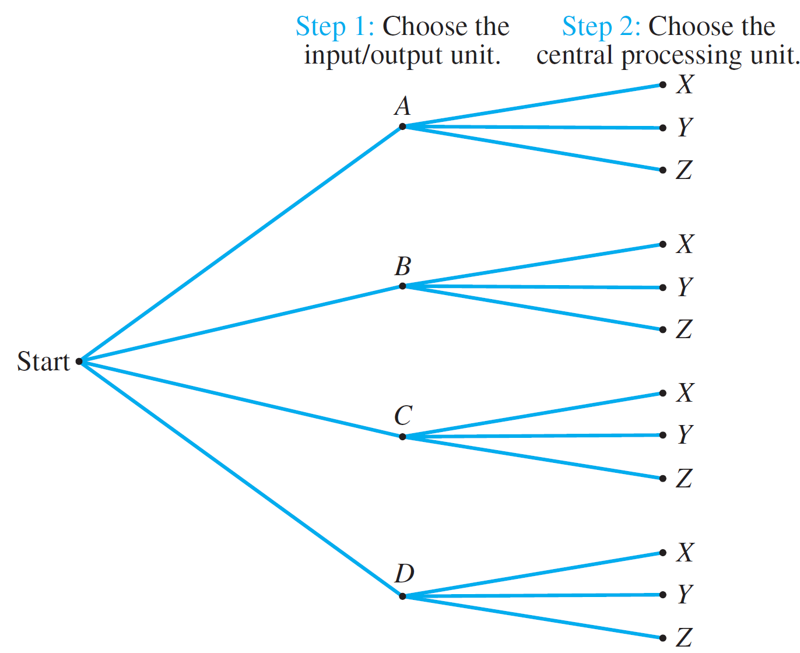
Introduction Possibility Trees and Multiplication Rule Counting Elements of Disjoint Sets The Pigeonhole Principle
The Multiplication/Product Rule
Possibility tree:
The total number of ways to pair the two types of units…
is the same as the number of branches of the tree:
3 + 3 + 3 + 3 = 4×3 = 12
Figure 9.2.2 Pairing Objects Using a Possibility Tree

Slide 21
Introduction Possibility Trees and Multiplication Rule Counting Elements of Disjoint Sets The Pigeonhole Principle
The Multiplication/Product Rule
Theorem 9.2.1 The Multiplication/Product Rule
If an operation consists of k steps and
the first step can be performed in n₁ ways,
the second step can be performed in n₂ ways (regardless of how the first step was performed),
:
the k^{th} step can be performed in n_{k} ways (regardless of how the preceding steps were performed),
Then the entire operation can be performed in
n₁ × n₂ × n₃ × … × n_{k} ways.

Slide 22
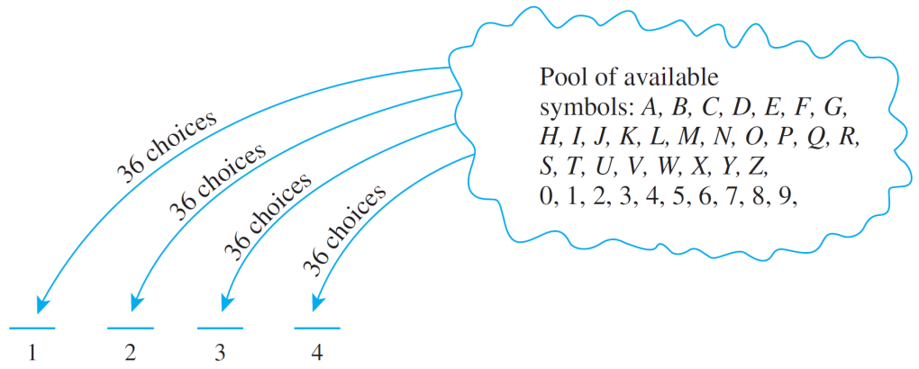
Introduction Possibility Trees and Multiplication Rule Counting Elements of Disjoint Sets The Pigeonhole Principle
The Multiplication/Product Rule
Example 2: No. of Personal Identification Numbers (PINs)
A typical PIN is a sequence of any four symbols chosen from the 26 letters in the alphabet and the ten digits, with repetition allowed. Examples: CARE, 3387, B32B, and so forth.
How many different PINs are possible?
You can think of forming a PIN as a four-step operation to fill in each
of the four symbols in
sequence.
Hence, by the multiplication rule, there are:
36×36×36×36 = 36⁴ = 1,679,616 PINs in all.

Slide 23
Introduction Possibility Trees and Multiplication Rule Counting Elements of Disjoint Sets The Pigeonhole Principle
The Multiplication/Product Rule
Example 3: No. of PINs without Repetition
Now, suppose that repetition is not allowed.
How many different PINs are there?
Step 1: Choose the 1st symbol.
Step 2: Choose the 2nd symbol.
Step 3: Choose the 3rd symbol.
Step 4: Choose the 4th symbol.
36 ways
Hence, by the multiplication rule, there are:
36×35×34×33 = 1,413,720 PINs in all with no repeated symbol.
35 ways
34 ways
33 ways
If all PINs are equally likely, what is the probability that a PIN chosen at random contains no repeated symbols?
1,679,616 PINS in all.
1,413,720 PINs with no repeated symbol.
1,413,720
≅ 0.8417
Hence, probability that a PIN chosen at random contains no repeated symbols:
1,679,616


Slide 24

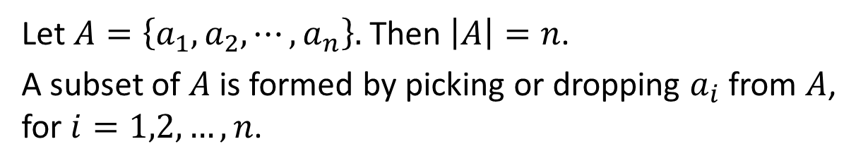



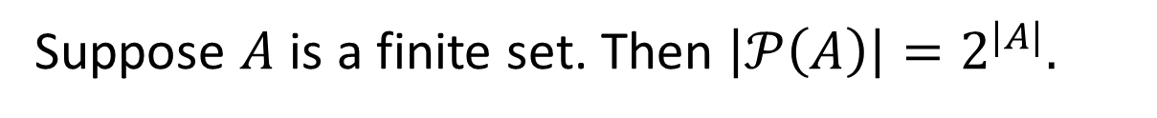
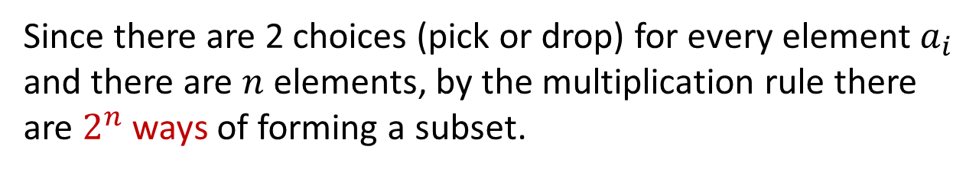
Introduction Possibility Trees and Multiplication Rule Counting Elements of Disjoint Sets The Pigeonhole Principle
The Multiplication/Product Rule
Power set
Theorem 5.2.4 (Sets)
Suppose $A$ is a finite set. Then $\left|𝒫\left(A\right)\right|=2^{|A|}.$
Let $A=\left\{a_{1},a_{2},⋯,a_{n}\right\}.$ Then $\left|A\right|=n$.
A subset of $A$ is formed by picking or dropping $a_{i}$ from $A$, for $i=1,2,…,n$.
Examples:
${\{ a}_{1}$ $a_{2}$ $a_{3}$ $a_{4}$ $⋯$ $a_{n} \}$
$$\{a_{1},a_{3},a_{n}\}$$






${\{ a}_{1}$ $a_{2}$ $a_{3}$ $a_{4}$ $⋯$ $a_{n} \}$
$$∅$$






Since there are 2 choices (pick or drop) for every element $a_{i}$ and there are $n$ elements, by the multiplication rule there are $2^{n}$ ways of forming a subset.

Slide 25
Introduction Possibility Trees and Multiplication Rule Counting Elements of Disjoint Sets The Pigeonhole Principle
When the Multiplication Rule is Difficult or Impossible to Apply
When the Multiplication Rule is Difficult/Impossible to Apply
Example 4: Consider the following problem:
Three officers – a president, a treasurer, and a secretary – are to be chosen from among four people: Ann, Bob, Cyd, and Dan. Suppose that, for various reasons, Ann cannot be president and either Cyd or Dan must be secretary. How many ways can the officers be chosen?
Is this correct?
It is natural to try to solve this problem using the multiplication rule. A person might answer as follows:
There are three choices for president (all except Ann), three choices for treasurer (all except the one chosen as president), and two choices for secretary (Cyd or Dan).
Therefore, by the multiplication rule, 3×3×2 = 18

Slide 26
Introduction Possibility Trees and Multiplication Rule Counting Elements of Disjoint Sets The Pigeonhole Principle
When the Multiplication Rule is Difficult or Impossible to Apply
It is incorrect. The number of ways to choose the secretary varies depending on who is chosen for president and treasurer.
For instance, if Bob is chosen for president and Ann for treasurer, then there are two choices for secretary: Cyd and Dan.
But if Bob is chosen for president and Cyd for treasurer, then there is just one choice for secretary: Dan.

Slide 27
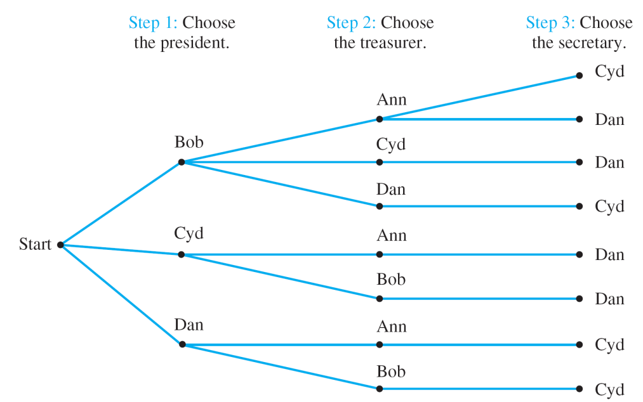
Introduction Possibility Trees and Multiplication Rule Counting Elements of Disjoint Sets The Pigeonhole Principle
When the Multiplication Rule is Difficult or Impossible to Apply
The clearest way to see all the possible choices is to construct the possibility tree, as shown below.
How many ways?
8 ways.
Figure 9.2.3

Slide 28
Introduction Possibility Trees and Multiplication Rule Counting Elements of Disjoint Sets The Pigeonhole Principle
When the Multiplication Rule is Difficult or Impossible to Apply
Example 5: A More Subtle Use of the Multiplication Rule
Reorder the steps for choosing the officers in the previous example so that the total number of ways to choose officers can be computed using the multiplication rule.
2 ways: Either Cyd or Dan.
Step 1: Choose the secretary.
Step 2: Choose the president.
Step 3: Choose the treasurer.
2 ways: Neither Ann nor the person chosen in step 1 may be chosen, but either of the other two may.
2 ways: Either of the 2 persons not chosen in steps 1 and 2 may be chosen.
Hence, total number of ways = 2 ×2 ×2 = 8

Slide 29
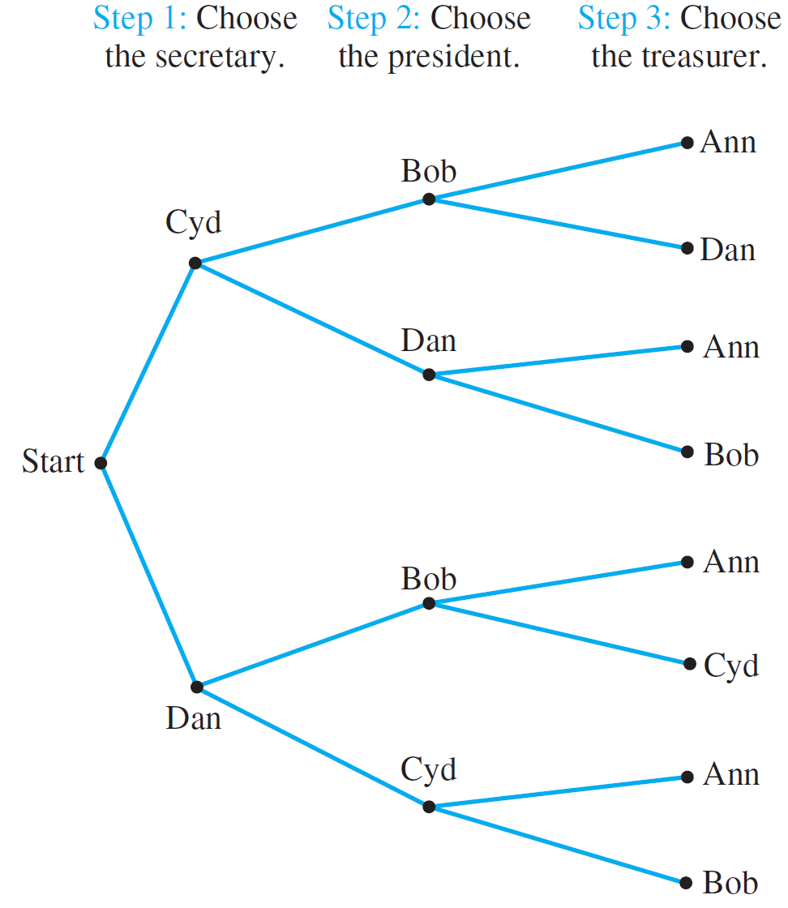
Introduction Possibility Trees and Multiplication Rule Counting Elements of Disjoint Sets The Pigeonhole Principle
When the Multiplication Rule is Difficult or Impossible to Apply
A possibility tree illustrating this sequence of choices:
Figure 9.2.4

Slide 30

Introduction Possibility Trees and Multiplication Rule Counting Elements of Disjoint Sets The Pigeonhole Principle
Given 26 scrabble tiles with letters ‘A’ to ‘Z’,
what is the probability of drawing “ICANDOIT” if…
you must not return the tile after it is drawn.
0
you must return the tile after it is drawn.
(1/26)⁸


Slide 31
Introduction Possibility Trees and Multiplication Rule Counting Elements of Disjoint Sets The Pigeonhole Principle
Summary
Principle of Product (or the Multiplication Principle)
If there are m ways of doing something and n ways of doing another thing, then there are mn ways of performing both actions.
Principle of Sum (or the Addition Principle)
If we have m ways of doing something and n ways of doing another thing and we cannot do both at the same time, then there are m+n ways to choose one of these actions.

Slide 32
Introduction Possibility Trees and Multiplication Rule Counting Elements of Disjoint Sets The Pigeonhole Principle
Permutations
Permutations
A permutation of a set of objects is an ordering of the objects in a row. For example, the set of elements a, b, and c has six permutations.
abc acb cba bac bca cab
In general, given a set of n objects, how many permutations does the set have?

Slide 33
Introduction Possibility Trees and Multiplication Rule Counting Elements of Disjoint Sets The Pigeonhole Principle
Permutations
Permutations
Imagine forming a permutation as an n-step operation:
Step 1: Choose an element to write first.
Step 2: Choose an element to write second.
Step 3: Choose an element to write third.
:
Step n: Choose an element to write nth.
← n ways
← n – 1 ways
← n – 2 ways
← 1 way
By the multiplication rule, there are
n × (n – 1) × (n – 2) × … × 2 × 1 = n!
ways to perform the entire operation.

Slide 34

Introduction Possibility Trees and Multiplication Rule Counting Elements of Disjoint Sets The Pigeonhole Principle
Permutations
Theorem 9.2.2 Permutations
The number of permutations of a set with n (n ≥ 1) elements is n!
0! is defined to be 1.
(See https://www.khanacademy.org/math/precalculus/x9e81a4f98389efdf:prob-comb/x9e81a4f98389efdf:combinatorics-precalc/v/zero-factorial-or-0)

Slide 35

Introduction Possibility Trees and Multiplication Rule Counting Elements of Disjoint Sets The Pigeonhole Principle
Permutations
Example 6 – Permutations of the Letters in a Word
How many ways can the letters in the word COMPUTER be arranged in a row?
All the eight letters in the word COMPUTER are distinct. Hence, 8! = 40320.
How many ways can the letters in the word COMPUTER be arranged if the letters CO must remain next to each other (in order) as a unit?
7! = 5040.
If letters of the word COMPUTER are randomly arranged in a row, what is the probability that the letters CO remain next to each other (in order) as a unit?
$$\frac{7!}{8!}=\frac{1}{8}$$


Slide 36
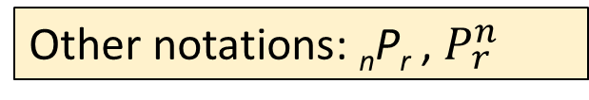
Introduction Possibility Trees and Multiplication Rule Counting Elements of Disjoint Sets The Pigeonhole Principle
Permutations of Selected Elements
Permutations of Selected Elements
Given the set {a, b, c}, there are six ways to select two letters from the set and write them in order.
ab ac ba bc ca cb
Each such ordering of two elements of {a, b, c} is called a 2-permutation of {a, b, c}?.
Definition
An r-permutation of a set of n elements is an ordered selection of r elements taken from the set.
The number of r-permutations of a set of n elements is denoted P(n, r).
Other notations: _{n}P_{r} , $P_{ r}^{n}$

Slide 37
Introduction Possibility Trees and Multiplication Rule Counting Elements of Disjoint Sets The Pigeonhole Principle
Permutations of Selected Elements
Theorem 9.2.3 r-permutations from a set of n elements
If n and r are integers and 1 ≤ r ≤ n, then the number of r-permutations of a set of n elements is given by the formula
P(n, r) = n(n – 1)(n – 2) … (n – r + 1) first version
or, equivalently,
P(n, r) = second version
n!
(n – r)!

Slide 38
Introduction Possibility Trees and Multiplication Rule Counting Elements of Disjoint Sets The Pigeonhole Principle
Permutations of Selected Elements
Evaluate P(5, 2).
P(5, 2) = 5! / (5 – 2)! = 5 × 4 = 20
How many 4-permutations are there of a set of seven objects?
P(7, 4) = 7! / (7 – 4)! = 7 × 6 × 5 × 4 = 840
How many 5-permutations are there of a set of five objects?
P(5, 5) = 5! / (5 – 5)! = 5! = 120


Slide 39
Introduction Possibility Trees and Multiplication Rule Counting Elements of Disjoint Sets The Pigeonhole Principle
9.3 Counting Elements of Disjoint Sets

Slide 40
Introduction Possibility Trees and Multiplication Rule Counting Elements of Disjoint Sets The Pigeonhole Principle
Counting Elements of Disjoint Sets: The Addition/Sum Rule
Counting Elements of Disjoint Sets: The Addition/Sum Rule
The addition rule (or sum rule) states that the number of elements in a union of mutually disjoint finite sets equals the sum of the number of elements in each of the component sets.
Theorem 9.3.1 The Addition/Sum Rule
Suppose a finite set A equals the union of k distinct mutually disjoint subsets A₁, A₂, …, A_{k}. Then
|A| = |A₁| + |A₂| + … + |A_{k}|.

Slide 41
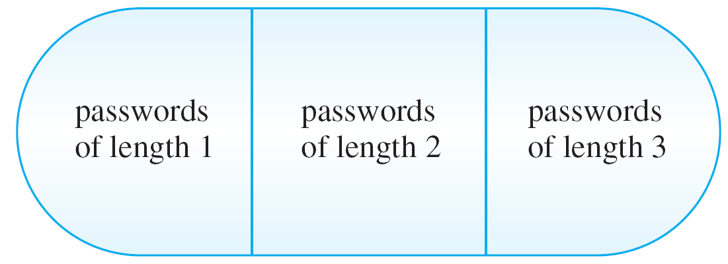
Introduction Possibility Trees and Multiplication Rule Counting Elements of Disjoint Sets The Pigeonhole Principle
Counting Elements of Disjoint Sets: The Addition/Sum Rule
Example 7 – Counting Passwords with 3 or fewer Letters
A computer access password consists of from one to three letters chosen from the 26 letters in the alphabet with repetitions allowed. How many different passwords are possible?
The set of all passwords can be partitioned into subsets consisting of those of length 1, length 2, and length 3:
Figure 9.3.1
Set of all passwords of length ≤ 3

Slide 42
Introduction Possibility Trees and Multiplication Rule Counting Elements of Disjoint Sets The Pigeonhole Principle
Counting Elements of Disjoint Sets: The Addition/Sum Rule
Example 7 – Counting Passwords with 3 or fewer Letters
By the addition rule, the total number of passwords equals the sum of the number of passwords of length 1, length 2, and length 3.
Number of passwords of length 1 = 26
Number of passwords of length 2 = 26²
Number of passwords of length 3 = 26³
Hence, total number of passwords = 26 + 26² + 26³
= 18,278.

Slide 43
Introduction Possibility Trees and Multiplication Rule Counting Elements of Disjoint Sets The Pigeonhole Principle
The Difference Rule
The Difference Rule
An important consequence of the addition rule is the fact that if the number of elements in a set A and the number in a subset B of A are both known, then the number of elements that are in A and not in B can be computed.
Theorem 9.3.2 The Difference Rule
If A is a finite set and B ⊆ A, then
|A \ B| = |A| – |B|.

Slide 44
Introduction Possibility Trees and Multiplication Rule Counting Elements of Disjoint Sets The Pigeonhole Principle
The Difference Rule
A
B
The difference rule holds for the following reason:
If B ⊆ A, then the two sets B and A \ B have no elements in common and B ∪ (A \ B) = A.
Hence, by the addition rule,
|B| + |A \ B| = |A|.
Subtracting |B| from both sides gives the equation
|A \ B| = |A| – |B|.

Slide 45
Introduction Possibility Trees and Multiplication Rule Counting Elements of Disjoint Sets The Pigeonhole Principle
The Difference Rule
Example 8 – Counting PINs with Repeated Symbols
A typical PIN (personal identification number) is a sequence of any four symbols chosen from the 26 letters in the alphabet and the ten digits, with repetition allowed.
How many PINs contain repeated symbols?
There are 36⁴ = 1,679,616 PINs when repetition is allowed, and there are 36 × 35 × 34 × 33 = 1,413,720 PINs when repetition is not allowed.
By the difference rule, there are
1,679,616 – 1,413,720 = 265,896
PINS that contain at least one repeated symbol.

Slide 46
Introduction Possibility Trees and Multiplication Rule Counting Elements of Disjoint Sets The Pigeonhole Principle
The Difference Rule
Example 8 – Counting PINs with Repeated Symbols
If all PINs are equally likely, what is the probability that a randomly chosen PIN contains a repeated symbol?
There are 1,679,616 PINs in all, and by part (a) 265,896 of these contain at least one repeated symbol.
Thus, the probability that a randomly chosen PIN contains a repeated symbol is
265,896
1,679,616
≅ 0.158

Slide 47
Introduction Possibility Trees and Multiplication Rule Counting Elements of Disjoint Sets The Pigeonhole Principle
The Difference Rule
Example 8 – Counting PINs with Repeated Symbols
An alternative solution to part (b) is based on the observation that if S is the set of all PINs and A is the set of all PINs with no repeated symbol, then S \ A is the set of all PINs with at least one repeated symbol.
It follows that:
|S \ A|
|S|
|S| – |A|
|S|
1,413,720
1,679,616
P(S \ A) =
=
P(A) =
|S|
|S|
|A|
|S|
≅ 0.842
=
–
P(S \ A) ≅ 1 – 0.842
≅ 0.158
= 1 – P(A)

Slide 48
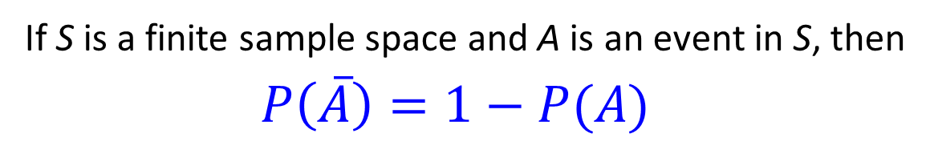
Introduction Possibility Trees and Multiplication Rule Counting Elements of Disjoint Sets The Pigeonhole Principle
The Difference Rule
Probability of the Complement of an Event
This solution illustrates a more general property of probabilities: that the probability of the complement of an event is obtained by subtracting the probability of the event from the number 1.
Formula for the Probability of the Complement of an Event
If S is a finite sample space and A is an event in S, then
$P\left(\overline{A}\right)=1−P(A)$

Slide 49
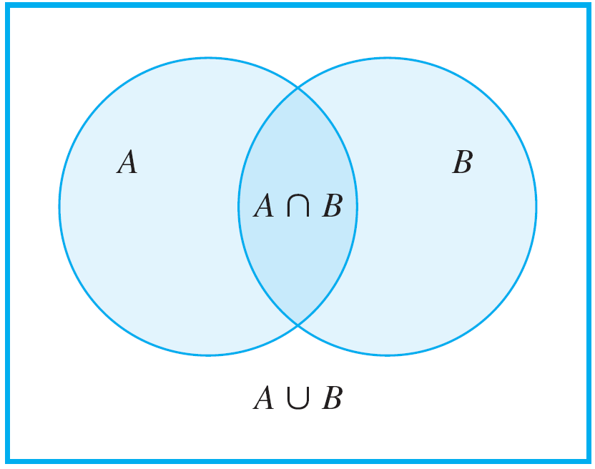
Introduction Possibility Trees and Multiplication Rule Counting Elements of Disjoint Sets The Pigeonhole Principle
The Inclusion/Exclusion Rule
The Inclusion/Exclusion Rule
The addition rule says how many elements are in a union of sets if the sets are mutually disjoint. Now consider the question of how to determine the number of elements in a union of sets when some of the sets overlap.
For simplicity, begin by looking at a union of two sets A and B, as shown in Figure 9.3.5.
Figure 9.3.5

Slide 50
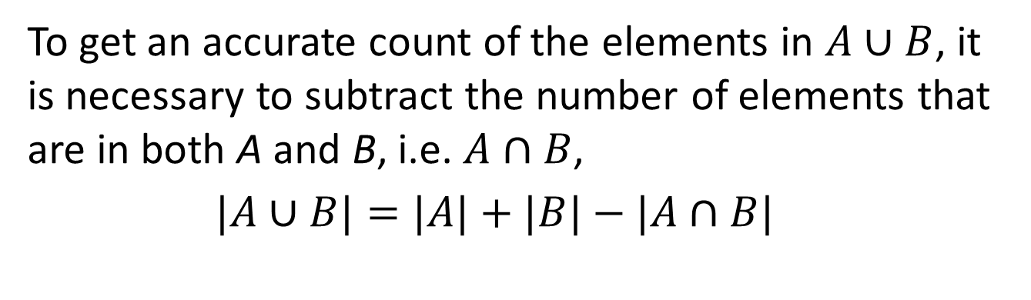
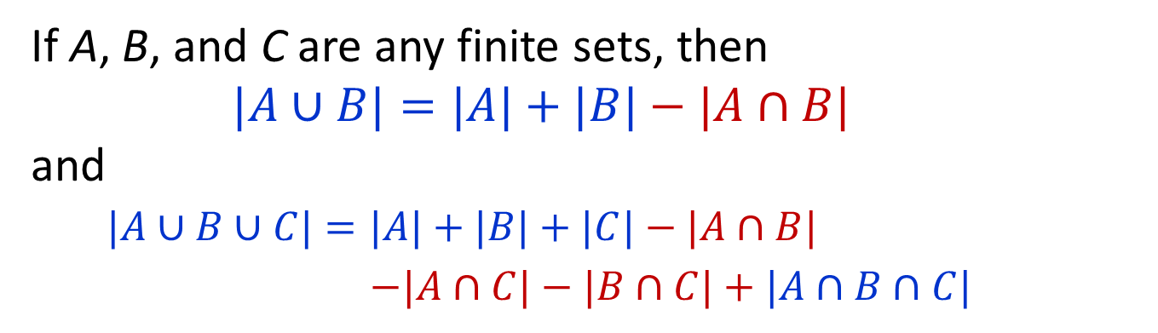
Introduction Possibility Trees and Multiplication Rule Counting Elements of Disjoint Sets The Pigeonhole Principle
The Inclusion/Exclusion Rule
To get an accurate count of the elements in $A∪B$, it is necessary to subtract the number of elements that are in both A and B, i.e. $A∩B$,
$|A∪B|=|A|+|B|−|A∩B|$
Theorem 9.3.3 The Inclusion/Exclusion Rule for 2 or 3 Sets
If A, B, and C are any finite sets, then
$|A∪B|=|A|+|B|−|A∩B|$
and
$|A∪B∪C|=|A|+|B|+|C|−|A∩B|$
$−|A∩C|−|B∩C|+|A∩B∩C|$

Slide 51
Introduction Possibility Trees and Multiplication Rule Counting Elements of Disjoint Sets The Pigeonhole Principle
The Inclusion/Exclusion Rule
Example 9 – Counting Elements of a General Union
How many integers from 1 through 1,000 are multiples of 3 or multiples of 5?
Let A = the set of all integers in [1, 1000] that are multiples of 3.
Let B = the set of all integers in [1, 1000] that are multiples of 5.
Then A ∪ B = the set of all integers in [1, 1000] that are multiples of 3 or 5.
Then A ∩ B = the set of all integers in [1, 1000] that are multiples of both 3 and 5
= the set of all integers in [1, 1000] that are multiples of 15.
Every multiple of 3 in [1, 1000] has the form 3k, for some integer k in [1, 333].
Hence,|A| = 333
Every multiple of 5 in [1, 1000] has the form 5k, for some integer k in [1, 200].
Hence,|B| = 200
Every multiple of 15 in [1, 1000] has the form 15k, for some integer k in [1, 66].
Hence,|A ∩ B| = 66
|A ∪ B| = |A| + |B| – |A ∩ B|
= 333 + 200 – 66 = 467
Thus, 467 integers from 1 through 1000 are multiples of 3 or multiples of 5.

Slide 52
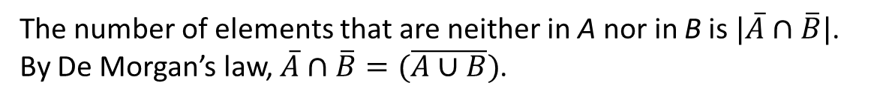
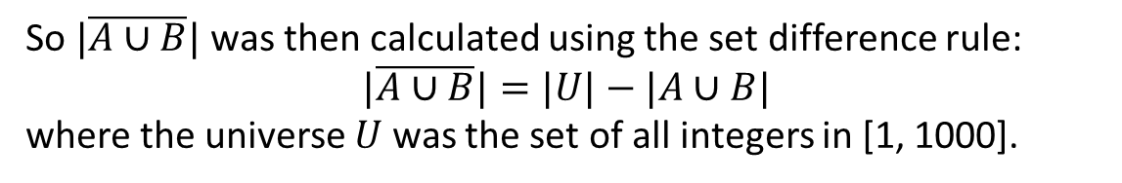
Introduction Possibility Trees and Multiplication Rule Counting Elements of Disjoint Sets The Pigeonhole Principle
The Inclusion/Exclusion Rule
How many integers from 1 through 1,000 are neither multiples of 3 nor multiples of 5?
There are 1000 integers in [1, 1000].
By part (a), 467 of these are multiples of 3 or multiples of 5.
Thus, by the difference rule, there are 1000 – 467 = 533 that are neither multiples of 3 nor multiples of 5.
Note that the solution to part (b) hid a use of De Morgan’s law.
The number of elements that are neither in A nor in B is $|\overline{A}∩\overline{B}|$.
By De Morgan’s law, $\overline{A}∩\overline{B}=(\overline{A∪B})$.
So $|\overline{A∪B}|$ was then calculated using the set difference rule:
$$|\overline{A∪B}|=|U|−|A∪B|$$
where the universe $U$ was the set of all integers in [1, 1000].

Slide 53
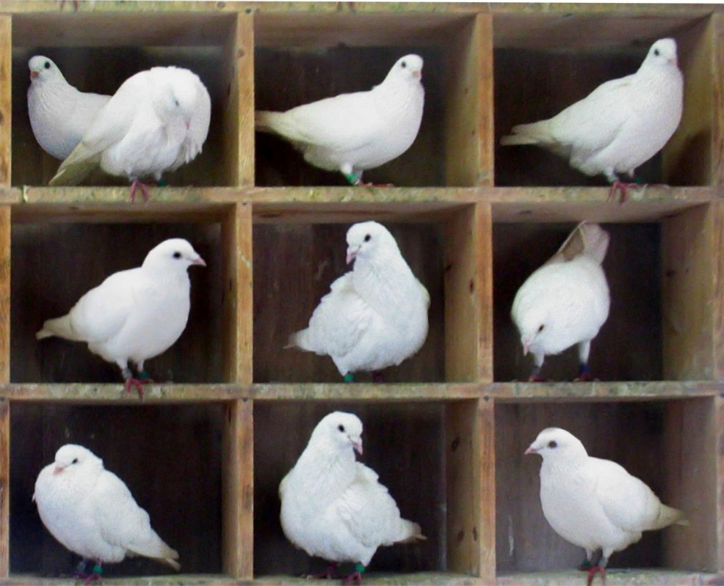
Introduction Possibility Trees and Multiplication Rule Counting Elements of Disjoint Sets The Pigeonhole Principle
9.4 The Pigeonhole Principle (PHP)

Slide 54
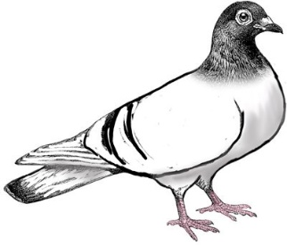
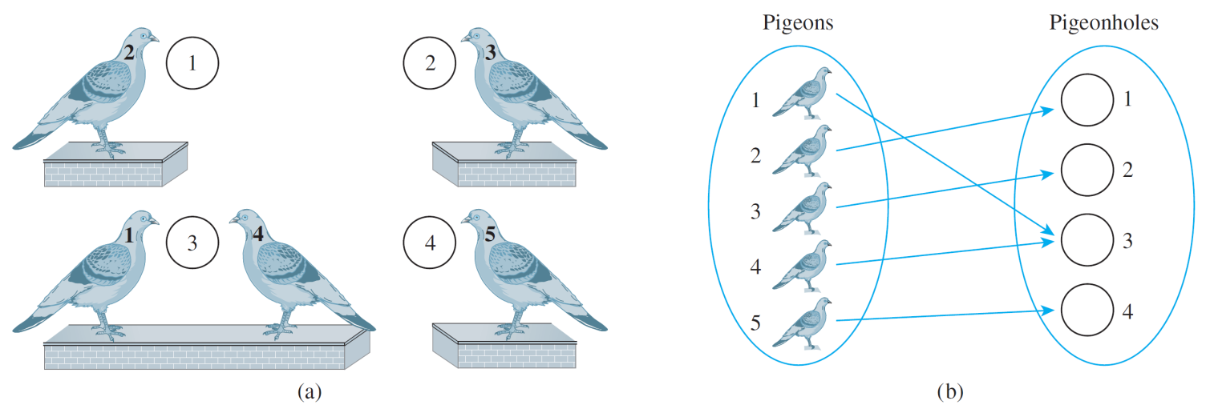
Introduction Possibility Trees and Multiplication Rule Counting Elements of Disjoint Sets The Pigeonhole Principle
The Pigeonhole Principle: Introduction
The Pigeonhole Principle: Introduction
If n pigeons fly into m pigeonholes and n > m, then at least one hole must contain two or more pigeons.
Figure 9.4.1 n = 5 and m = 4

Slide 55
Introduction Possibility Trees and Multiplication Rule Counting Elements of Disjoint Sets The Pigeonhole Principle
The Pigeonhole Principle: Introduction
The pigeonhole principle is sometimes called the Dirichlet box principle because it was first stated formally by J. P. G. L. Dirichlet (1805–1859).
Mathematical formulation:
Pigeonhole Principle (PHP)
A function from one finite set to a smaller finite set cannot be one-to-one: There must be at least 2 elements in the domain that have the same image in the co-domain.
Epp uses the terms one-to-one for injective, and onto for surjective.

Slide 56

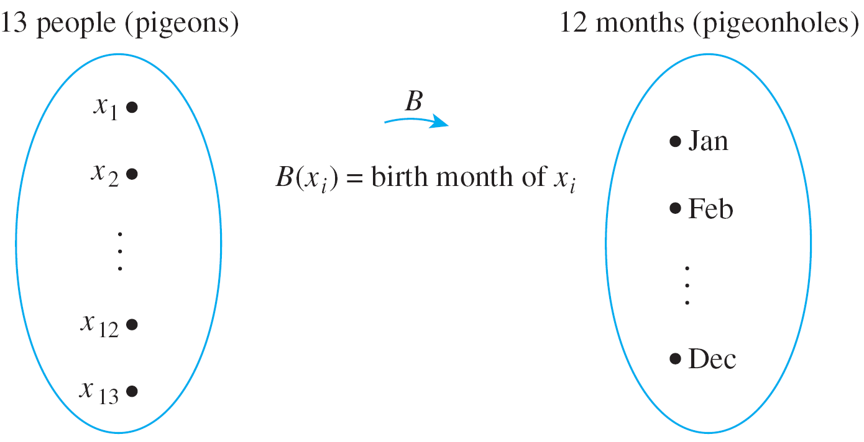
Introduction Possibility Trees and Multiplication Rule Counting Elements of Disjoint Sets The Pigeonhole Principle
The Pigeonhole Principle: Introduction
Example 10 – Applying the Pigeonhole Principle
In a group of six people, must there be at least two who were born in the same month?
In a group of 13 people, must there be at least two who were born in the same month? Why?
No.
Yes. At least 2 people must have been born in the same month.

Slide 57

Introduction Possibility Trees and Multiplication Rule Counting Elements of Disjoint Sets The Pigeonhole Principle
The Pigeonhole Principle: Introduction
Example 10 – Applying the Pigeonhole Principle
Among the population of Singapore, are there at least two people with the same number of hairs on their heads? Why?
Population of Singapore: 5.47m (June 2014).
Hairs on head: average up to 150,000; no more than 300,000.
Define a function H from the set of people in Singapore {x₁, x₂, … x_{p}} to the set {0, 1, 2, … 300000} as shown in the next slide.

Slide 58
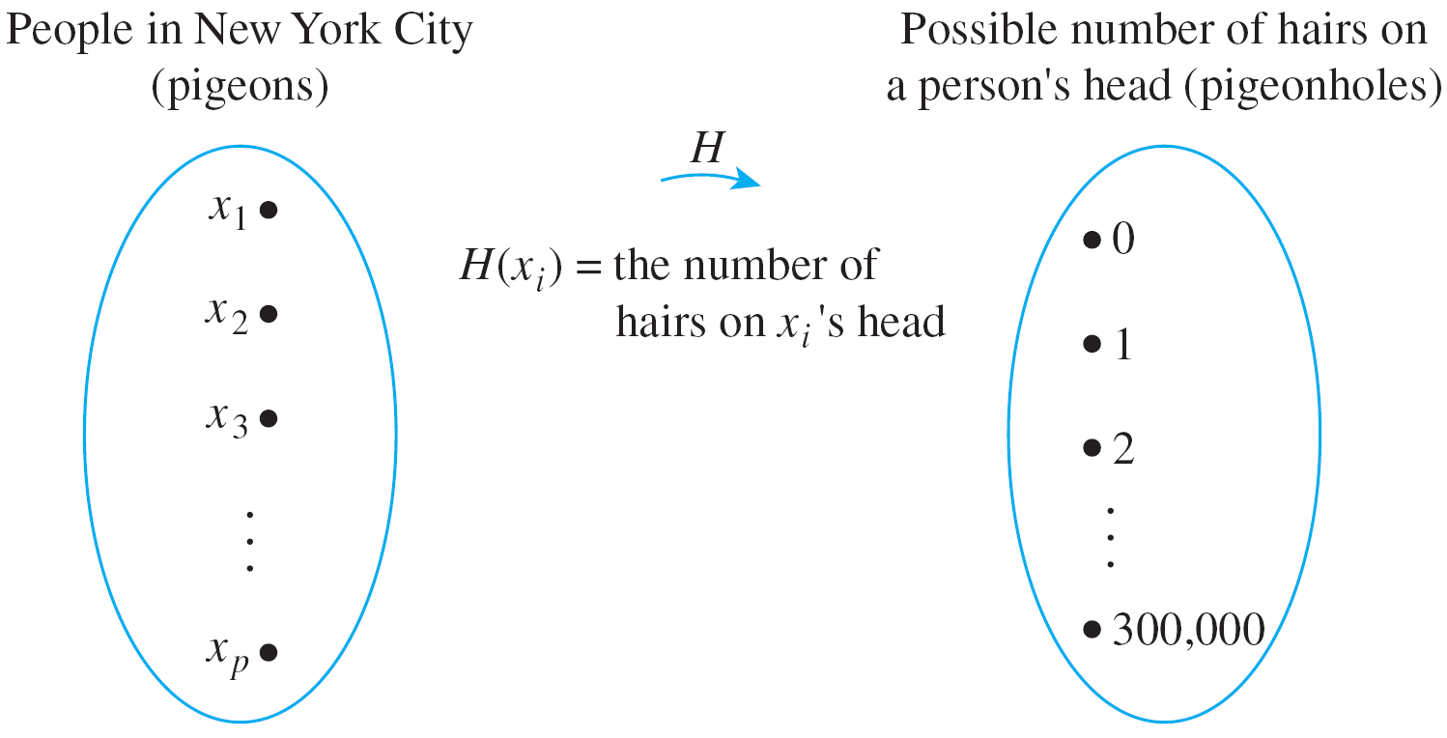
Introduction Possibility Trees and Multiplication Rule Counting Elements of Disjoint Sets The Pigeonhole Principle
The Pigeonhole Principle: Introduction
Example 10 – Applying the Pigeonhole Principle
Among the population of Singapore, are there at least two people with the same number of hairs on their heads? Why?
People in Singapore
Yes. At least 2 people must have the same number of hairs on their heads.

Slide 59
Introduction Possibility Trees and Multiplication Rule Counting Elements of Disjoint Sets The Pigeonhole Principle
Application to Decimal Expansions of Fractions
Application to Decimal Expansions of Fractions
One important consequence of the pigeonhole principle is the fact that the decimal expansion of any rational number either terminates or repeats.
A terminating decimal: 3.625
A repeating decimal: 2.38246
(2.38246246246246…)
A rational number can be written as a fraction a/b, b≠0.
When one integer is divided by another, it is the pigeonhole principle (together with the quotient-remainder theorem) that guarantees that such a repetition of remainders (and hence decimal digits) must always occur.

Slide 60
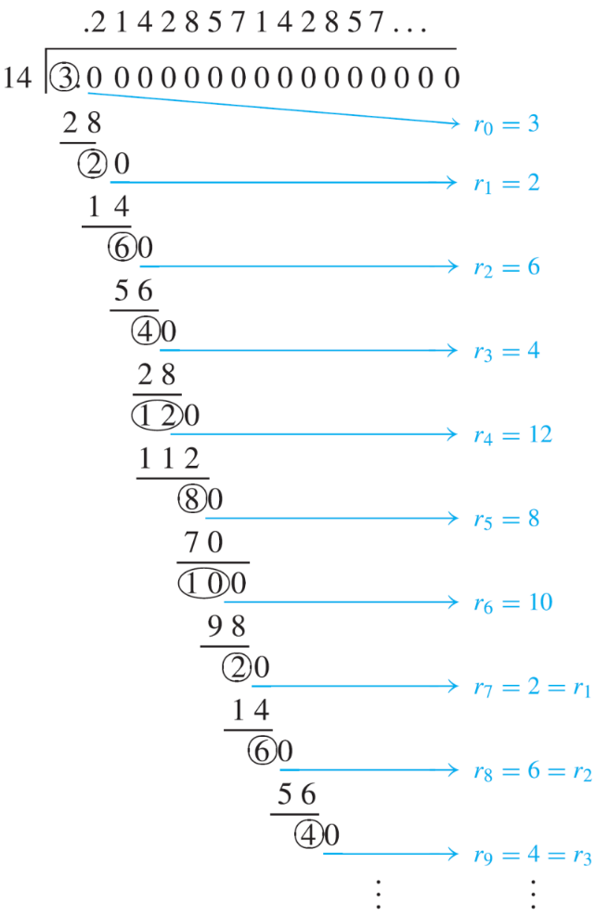
Introduction Possibility Trees and Multiplication Rule Counting Elements of Disjoint Sets The Pigeonhole Principle
Application to Decimal Expansions of Fractions
Consider a/b, where for simplicity assume that a and b are positive. The decimal expansion of a/b is obtained by dividing a by b as illustrated here for a = 3 and b = 14.
Let r₀ = a and let r₁, r₂, r₃, . . . be the successive remainders obtained in the long division of a by b.
By the quotient-remainder theorem (Theorem 8.1.16: Division Theorem), each remainder must be between 0 and b – 1. (Here, b is 14, and so the remainders are from 0 to 13.)
If some remainder r_{i} = 0, then the division terminates and a/b has a terminating decimal expansion. If no r_{i} = 0, then the division process and hence the sequence of remainders continues forever.

Slide 61
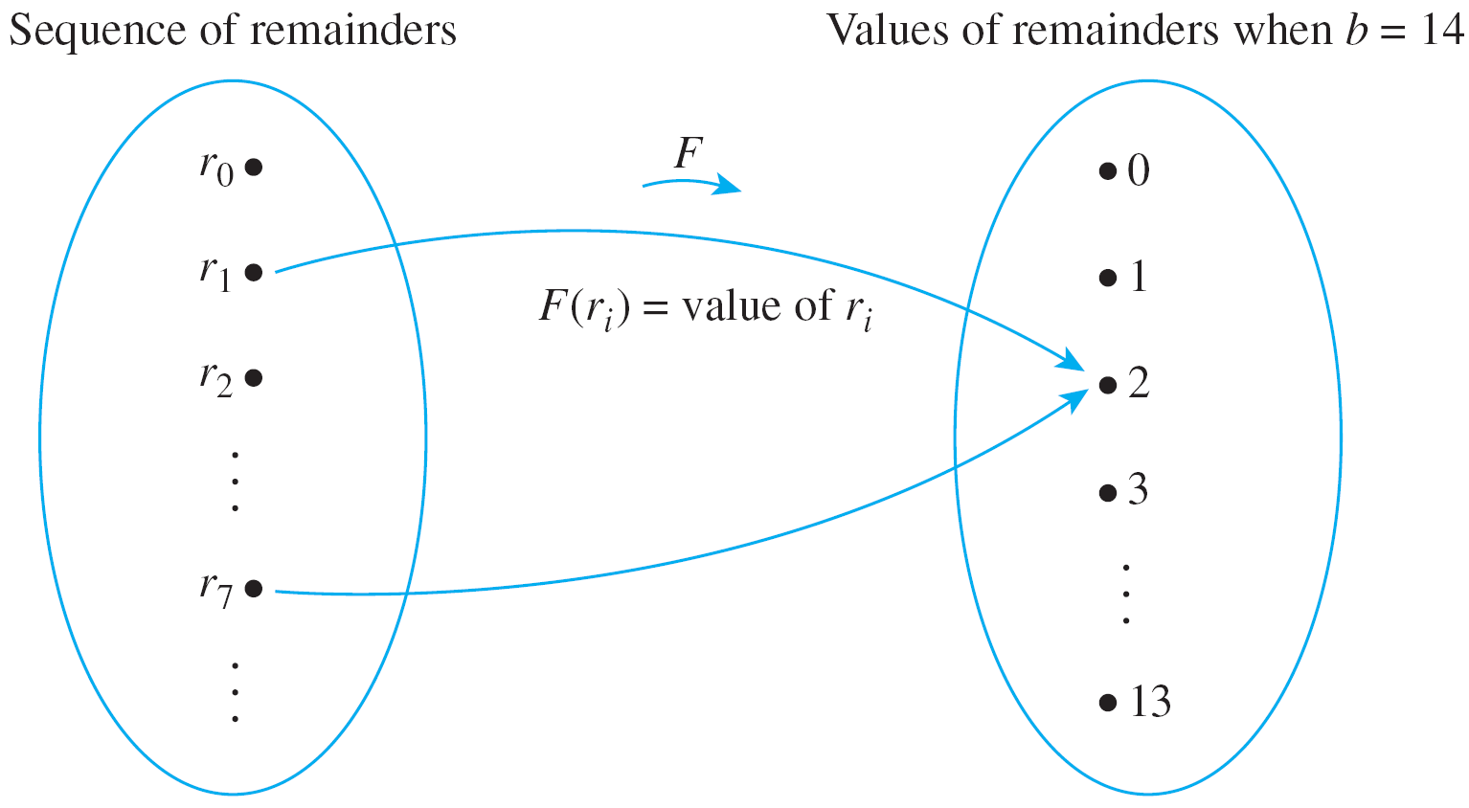
Introduction Possibility Trees and Multiplication Rule Counting Elements of Disjoint Sets The Pigeonhole Principle
Application to Decimal Expansions of Fractions
By the PHP, since there are more remainders than values that the remainders can take, some remainder value must repeat: r_{j} = r_{k}, for some indices j and k with j < k.
It follows that the decimal digits obtained from the divisions between r_{j} and r_{k – 1} repeat forever.
In the case of 3/14, the repetition begins with r₇ = 2 = r₁ and the decimal expansion repeats the quotients obtained from the divisions from r₁ through r₆ forever:
3/14 = 0.2142857

Slide 62
Introduction Possibility Trees and Multiplication Rule Counting Elements of Disjoint Sets The Pigeonhole Principle
Generalized Pigeonhole Principle
Generalized Pigeonhole Principle
If n pigeons fly into m pigeonholes and, for some positive integer k, k < n/m, then at least one pigeonhole contains k + 1 or more pigeons.
Generalized Pigeonhole Principle
For any function f from a finite set X with n elements to a finite set Y with m elements and for any positive integer k, if k < n/m, then there is some y ∈ Y such that y is the image of at least k + 1 distinct elements of X.

Slide 63
Introduction Possibility Trees and Multiplication Rule Counting Elements of Disjoint Sets The Pigeonhole Principle
Generalized Pigeonhole Principle
Example 11 – Applying the General Pigeonhole Principle
Show how the generalized pigeonhole principle implies that in a group of 85 people, at least 4 must have the same last initial (‘A’, ‘B’, …, ‘Z’).
In this example the pigeons are the 85 people and the pigeonholes are the 26 possible last initials of their names. Note that
3 < 85/26 ≅ 3.27

Slide 64
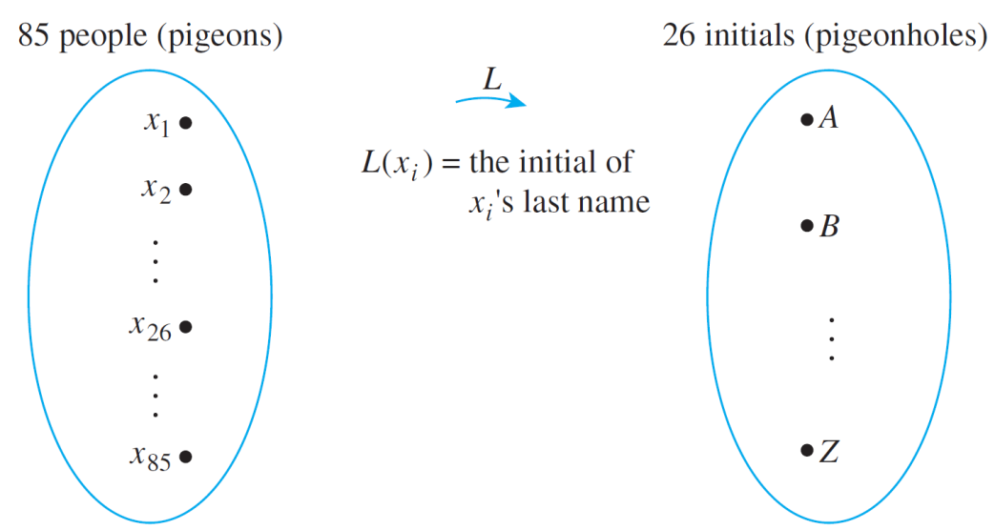
Introduction Possibility Trees and Multiplication Rule Counting Elements of Disjoint Sets The Pigeonhole Principle
Generalized Pigeonhole Principle
Example 11 – Applying the General Pigeonhole Principle
Consider the function L from people to initials defined by the following arrow diagram.
Since 3 < 85/26, the generalized pigeonhole principle states that some initial must be the image of at least four (3 + 1) people.
Thus, at least 4 people have the same last initial.
■

Slide 65
Introduction Possibility Trees and Multiplication Rule Counting Elements of Disjoint Sets The Pigeonhole Principle
Generalized Pigeonhole Principle
Consider the following contrapositive form of the generalized pigeonhole principle. You may find it natural to use the contrapositive form of the generalized pigeonhole principle in certain situations.
Generalized Pigeonhole Principle (Contrapositive Form)
For any function f from a finite set X with n elements to a finite set Y with m elements and for any positive integer k, if for each y ∈ Y, f ^{–1}({y}) has at most k elements, then X has at most km elements; in other words, n ≤ km.

Slide 66
Introduction Possibility Trees and Multiplication Rule Counting Elements of Disjoint Sets The Pigeonhole Principle
Generalized Pigeonhole Principle
For instance, the result of Example 11 can be explained as follows:
Suppose no 4 people out of the 85 had the same last initial. Then at most 3 would share any particular one.
By the generalized pigeonhole principle (contrapositive form), this would imply that the total number of people is at most 3 × 26 = 78. But this contradicts the fact that there are 85 people in all.
Hence at least 4 people share a last initial.

Slide 67
Introduction Possibility Trees and Multiplication Rule Counting Elements of Disjoint Sets The Pigeonhole Principle
Generalized Pigeonhole Principle
Example 12 – Using the General Pigeonhole Principle (Contrapositive)
There are 42 students who are to share 12 computers. Each student uses exactly 1 computer, and no computer is used by more than 6 students. Show that at least 5 computers are used by 3 or more students.
Using an Argument by Contradiction: Suppose not. Suppose that 4 or fewer computers are used by 3 or more students. [A contradiction will be derived.] Then 8 or more computers are used by 2 or fewer students.
Divide the set of computers into two subsets: C₁ and C₂.

Slide 68
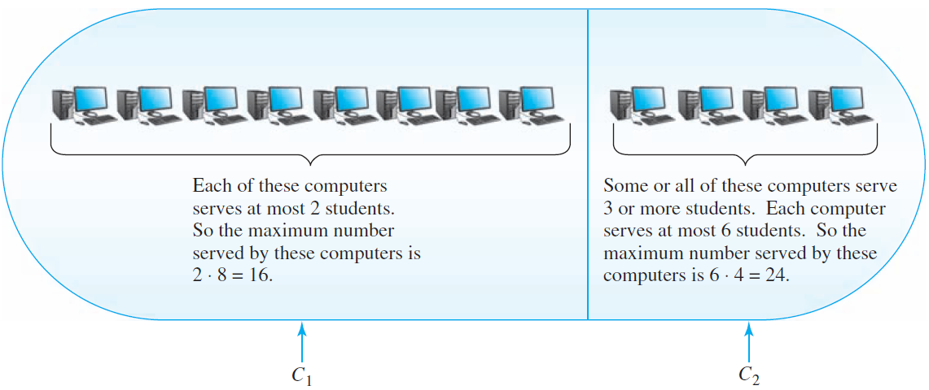
Introduction Possibility Trees and Multiplication Rule Counting Elements of Disjoint Sets The Pigeonhole Principle
Generalized Pigeonhole Principle
Into C₁ place 8 of the computers used by 2 or fewer students; into C₂ place the computers used by 3 or more students plus any remaining computers (to make a total of 4 computers in C₂).
Figure 9.4.3 The set of 12 computers

Slide 69
Introduction Possibility Trees and Multiplication Rule Counting Elements of Disjoint Sets The Pigeonhole Principle
Generalized Pigeonhole Principle
Since at most 2 students are served by any one computer in C₁, by the generalized pigeonhole principle (contrapositive form), the computers in set C₁ serve at most 2 × 8 = 16 students.
Since at most 6 students are served by any one computer in C₂, by the generalized pigeonhole principle (contrapositive form), the computers in set C₂ serve at most 6 × 4 = 24 students.
Total number of students served by the computers is at most 24 + 16 = 40.
This contradicts that there are 42 students, each served by a computer.
Therefore, the supposition is false.
Figure 9.4.3 The set of 12 computers

Slide 70
Introduction Possibility Trees and Multiplication Rule Counting Elements of Disjoint Sets The Pigeonhole Principle
Generalized Pigeonhole Principle
Using a Direct Argument: Let k be the number of
computers used by 3 or more students. [We must show that k ≥ 5.]
Because each computer is used by at most 6 students, these computers are used by at most 6k students (by the generalized PHP (contrapositive form)).
Each of the remaining 12 – k computers is used by at most 2 students.
Taken together, they are used by at most 2(12 – k) = 24 – 2k students (again, by the generalized PHP).
Thus the maximum number of students served by the computers is 6k + (24 – 2k) = 4k + 24.
Because 42 students are served by the computers, 4k + 24 ≥ 42.
Solving for k gives k ≥ 4.5, and since k is an integer, this implies that k ≥ 5.

Slide 71
Next week’s lectures
More on Counting!
Combinations
r-Combinations
Pascal’s Formula and the Binomial Theorem
Probability Axioms and Expected Value
Conditional Probability, Bayes’ Formula, and Independent Events

Slide 72
END OF FILE

