Slide 1
Lecture #12: Graphs
Summary
Aaron Tan
AY2025/26 Semester 1

Slide 2
Graphs: Introduction Trails, Paths, and Circuits Matrix Representations Isomorphism and Planar Graphs
10. Graphs and Trees
10.1 Graphs: Definitions and Basic Properties
Introduction, Basic Terminology
10.2 Trails, Paths, and Circuits
Definitions
The Concept of Degree
10.3 Matrix Representations of Graphs
Matrices and Directed Graphs; Matrices and Undirected Graphs
Matrix Multiplication
Special Graphs
Connectedness
Euler Circuits and Hamiltonian Circuits
10.4 Isomorphisms of Graphs/Planar Graphs
Definition of Graph Isomorphism
Counting Walks of Length N
Planar Graphs and Euler’s Formula
Reference: Epp’s Chapter 10 Graphs and Trees

Slide 3
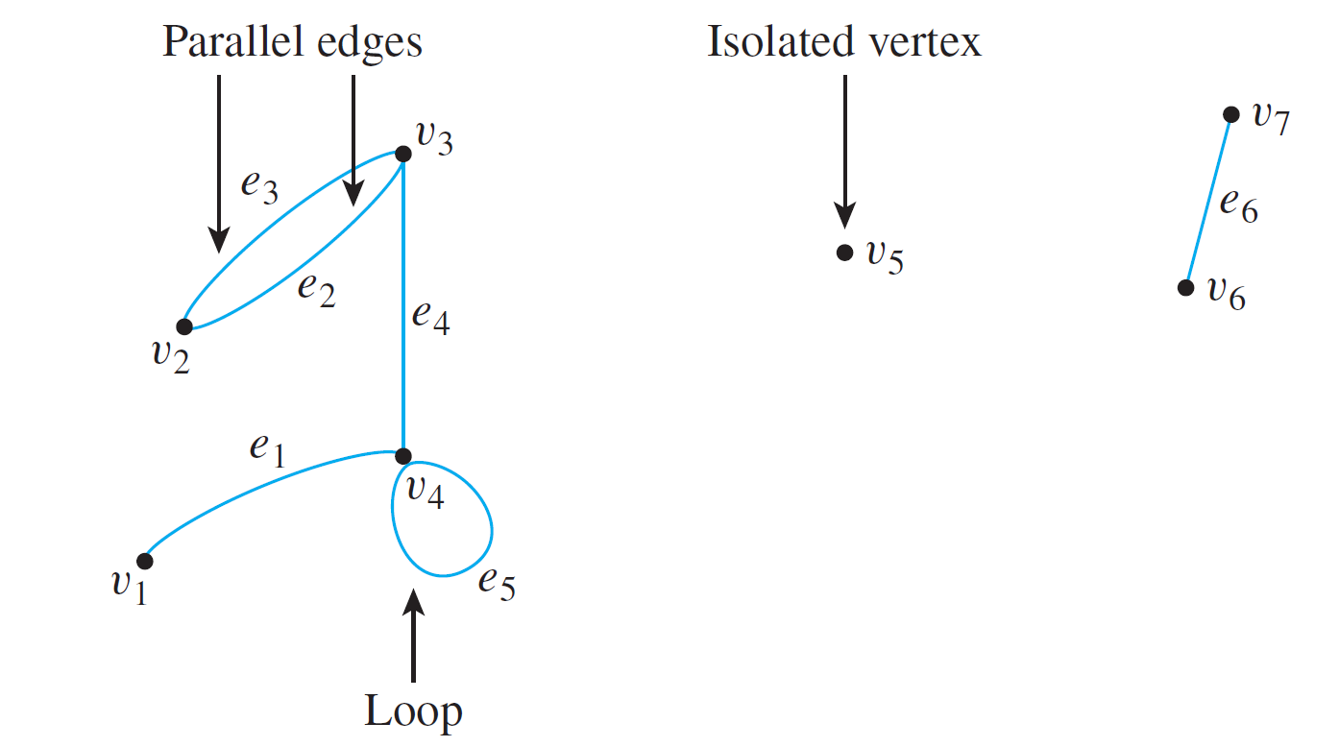
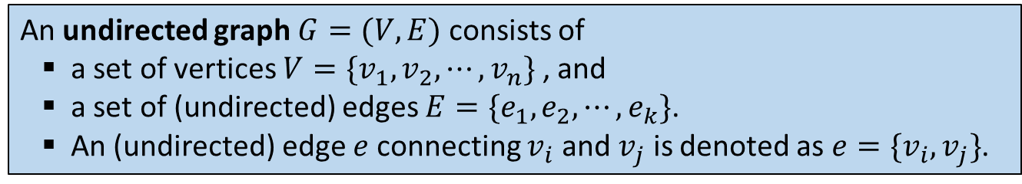
Summary
10.1 Definitions and Basic Properties
An undirected graph $G=(V,E)$ consists of
a set of vertices $V=\{v_{1},v_{2},⋯,v_{n}\}$ , and
a set of (undirected) edges $E=\{e_{1},e_{2},⋯,e_{k}\}$.
An (undirected) edge $e$ connecting $v_{i}$ and $v_{j}$ is denoted as ${e=\{v}_{i},v_{j}\}$.
V = {v₁, v₂, v₃, v₄, v₅, v₆, v₇}
E = {e₁, e₂, e₃, e₄, e₅, e₆}
e₁ = {v₁, v₄}
e₂ = e₃ = {v₂, v₃}
e₄ = {v₃, v₄}
e₅ = {v₄, v₄}
e₆ = {v₆, v₇}
Edges incident on v₄: e₁, e₄ and e_{5.}
Vertices adjacent to v₄: v₁, v₃ and v_{4.}
Edges adjacent to e₂: e₃ and e_{4.}

Slide 4
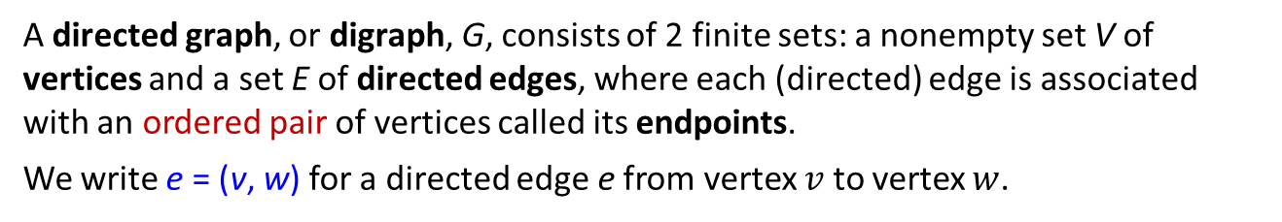
Summary
10.1 Definitions and Basic Properties
Definition: Undirected Graph
An undirected graph G consists of 2 finite sets: a nonempty set V of vertices and a set E of edges, where each (undirected) edge is associated with a set consisting of either one or two vertices called its endpoints.
An edge is said to connect its endpoints; two vertices that are connected by an edge are called adjacent vertices; and a vertex that is an endpoint of a loop is said to be adjacent to itself.
An edge is said to be incident on each of its endpoints, and two edges incident on the same endpoint are called adjacent edges.
We write e = {v, w} for an undirected edge e incident on vertices v and w.
Definition: Directed Graph
A directed graph, or digraph, G, consists of 2 finite sets: a nonempty set V of vertices and a set E of directed edges, where each (directed) edge is associated with an ordered pair of vertices called its endpoints.
We write e = (v, w) for a directed edge e from vertex $v$ to vertex $w$.

Slide 5
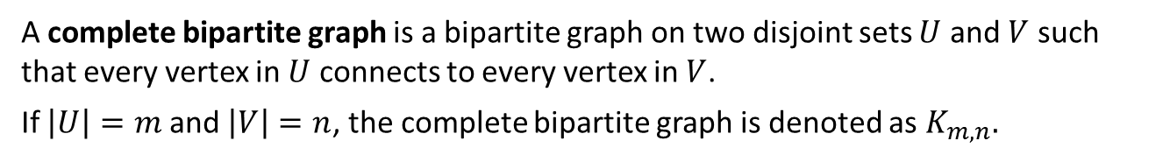
Summary
10.1 Definitions and Basic Properties
Definition: Simple Graph
A simple graph is an undirected graph that does not have any loops or parallel edges. (That is, there is at most one edge between each pair of distinct vertices.)
Definition: Complete Graph
A complete graph on n vertices, n > 0, denoted K_{n}, is a simple graph with n vertices and exactly one edge connecting each pair of distinct vertices.
Definition: Bipartite Graph
A bipartite graph (or bigraph) is a simple graph whose vertices can be divided into two disjoint sets $U$ and $V$ such that every edge connects a vertex in $U$ to one in $V$.
Definition: Complete Bipartite Graph
A complete bipartite graph is a bipartite graph on two disjoint sets $U$ and $V$ such that every vertex in $U$ connects to every vertex in $V$.
If $\left|U\right|=m$ and $\left|V\right|=n$, the complete bipartite graph is denoted as $K_{m,n}.$

Slide 6

Summary
10.1 Definitions and Basic Properties
Definition: Subgraph of a Graph
A graph H is said to be a subgraph of graph G iff every vertex in H is also a vertex in H, every edge in H is also an edge in G, and every edge in H has the same endpoints as it has in G.
Definition: Degree of a Vertex and Total Degree of a Graph
Let G be a graph and v a vertex of G. The degree of v, denoted deg(v), equals the number of edges that are incident on v, with an edge that is a loop counted twice.
The total degree of G is the sum of the degrees of all the vertices of G.
Theorem 10.1.1 The Handshake Theorem
If the vertices of G are v₁, v₂, …, v_{n}, where n ≥ 0, then the total degree of G
= deg(v₁) + deg(v₂) + … + deg(v_{n}) = 2 × (the number of edges of G).
Corollary 10.1.2
Proposition 10.1.3
The total degree of a graph is even.
In any graph there are an even number of vertices of odd degree.

Slide 7
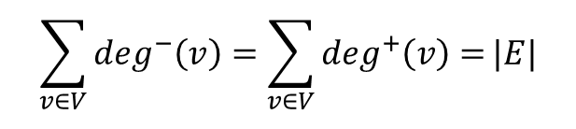
Summary
10.1 Definitions and Basic Properties
Definition: Indegree and outdegree of a Vertex of a Directed Graph
Let G=(V,E) be a directed graph and v a vertex of G. The indegree of v, denoted deg⁻(v), is the number of directed edges that end at v. The outdegree of v, denoted deg⁺(v), is the number of directed edges that originate from v.
Note that
$$\sum_{v∈V}{\deg^{−}\left(v\right)=\sum_{v∈V}{\deg^{+}\left(v\right)=}}|E|$$

Slide 8
Summary
10.2 Trails, Paths, and Circuits
Definitions
Let G be a graph, and let v and w be vertices of G.
A walk from v to w is a finite alternating sequence of adjacent vertices and edges of G. Thus a walk has the form v₀ e₁ v₁ e₂ … v_{n-1} e_{n} v_{n} , where the v’s represent vertices, the e’s represent edges, v₀=v, v_{n}=w, and for all i ∈ {1, 2, …, n}, v_{i-1} and v_{i} are the endpoints of e_{i}. The number of edges, n, is the length of the walk.
The trivial walk from v to v consists of the single vertex v.
A trail from v to w is a walk from v to w that does not contain a repeated edge.
A path from v to w is a trail that does not contain a repeated vertex.
A closed walk is a walk that starts and ends at the same vertex.
A circuit (or cycle) is a closed walk of length at least 3 that does not contain a repeated edge.
A simple circuit (or simple cycle) is a circuit that does not have any other repeated vertex except the first and last.
An undirected graph is cyclic if it contains a loop or a cycle; otherwise, it is acyclic.

Slide 9
Summary
10.2 Trails, Paths, and Circuits
Definition: Connectedness
Two vertices v and w of a graph G are connected iff there is a walk from v to w.
The graph G is connected iff given any two vertices v and w in G, there is a walk from v to w. Symbolically, G is connected iff ∀ vertices v, w ∈V(G), ∃ a walk from v to w.
Lemma 10.2.1
Let G be a graph.
If G is connected, then any two distinct vertices of G can be connected by a path.
If vertices v and w are part of a circuit in G and one edge is removed from the circuit, then there still exists a trail from v to w in G.
If G is connected and G contains a circuit, then an edge of the circuit can be removed without disconnecting G.
Definition: Connected Component
A graph H is a connected component of a graph G iff
The graph H is a subgraph of G;
The graph H is connected; and
No connected subgraph of G has H as a subgraph and contains vertices or edges that are not in H.

Slide 10
Summary
10.2 Trails, Paths, and Circuits
Definitions: Euler Circuit and Eulerian Graph
Let G be a graph. An Euler circuit for G is a circuit that contains every vertex and every edge of G.
An Eulerian graph is a graph that contains an Euler circuit.
Theorem 10.2.2
If a graph has an Euler circuit, then every vertex of the graph has positive even degree.
Contrapositive Version of Theorem 10.2.2
If some vertex of a graph has odd degree, then the graph doesn’t have an Euler circuit.
Theorem 10.2.3
If a graph G is connected and the degree of every vertex of G is a positive even integer, then G has an Euler circuit.
Theorem 10.2.4
A graph G has an Euler circuit iff G is connected and every vertex of G has positive even degree.

Slide 11
Summary
10.2 Trails, Paths, and Circuits
Definition: Euler Trail
Let G be a graph, and let v and w be two distinct vertices of G. An Euler trail/path from v to w is a sequence of adjacent edges and vertices that starts at v, ends at w, passes through every vertex of G at least once, and traverses every edge of G exactly once.
Corollary 10.2.5
Let G be a graph, and let v and w be two distinct vertices of G. There is an Euler trail from v to w iff G is connected, v and w have odd degree, and all other vertices of G have positive even degree.

Slide 12
Summary
10.2 Trails, Paths, and Circuits
Definitions: Hamiltonian Circuit and Hamiltonian Graph
Given a graph G, a Hamiltonian circuit for G is a simple circuit that includes every vertex of G. (That is, every vertex appears exactly once, except for the first and the last, which are the same.)
A Hamiltonian graph (also called Hamilton graph) is a graph that contains a Hamiltonian circuit.
Proposition 10.2.6
If a graph G has a Hamiltonian circuit, then G has a subgraph H with the following properties:
H contains every vertex of G.
H is connected.
H has the same number of edges as vertices.
Every vertex of H has degree 2.

Slide 13
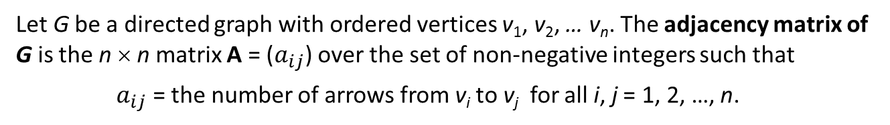
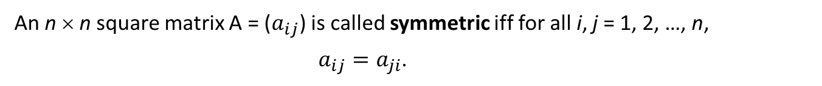
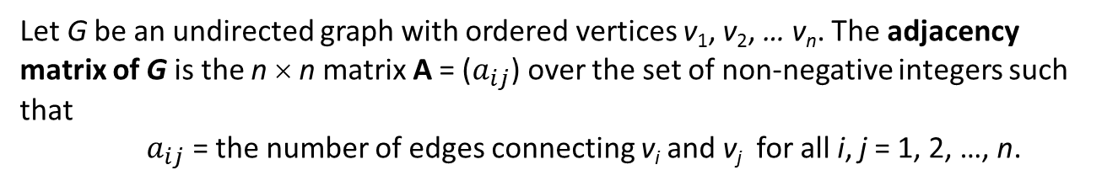
Summary
10.3 Matrix Representations of Graphs
Definition: Adjacency Matrix of a Directed Graph
Let G be a directed graph with ordered vertices v₁, v₂, … v_{n}. The adjacency matrix of G is the n × n matrix A = ($a_{ij}$) over the set of non-negative integers such that
$a_{ij}$ = the number of arrows from v_{i} to v_{j} for all i, j = 1, 2, …, n.
Definition: Adjacency Matrix of an Undirected Graph
Let G be an undirected graph with ordered vertices v₁, v₂, … v_{n}. The adjacency matrix of G is the n × n matrix A = ($a_{ij}$) over the set of non-negative integers such that
$a_{ij}$ = the number of edges connecting v_{i} and v_{j} for all i, j = 1, 2, …, n.
Definition: Symmetric Matrix
An n × n square matrix A = ($a_{ij}$) is called symmetric iff for all i, j = 1, 2, …, n,
$a_{ij}=a_{ji}$.

Slide 14
Summary
10.3 Matrix Representations of Graphs
Definition: n^{th} Power of a Matrix
For any n × n matrix A, the powers of A are defined as follows:
A⁰ = I where I is the n × n identity matrix
A^{n} = A A^{n – 1} for all integers n ≥ 1
Theorem 10.3.2
If G is a graph with vertices v₁, v₂, …, v_{m} and A is the adjacency matrix of G, then for each positive integer n and for all integers i, j = 1, 2, …, m,
the ij-th entry of A^{n} = the number of walks of length n from v_{i} to v_{j}.

Slide 15
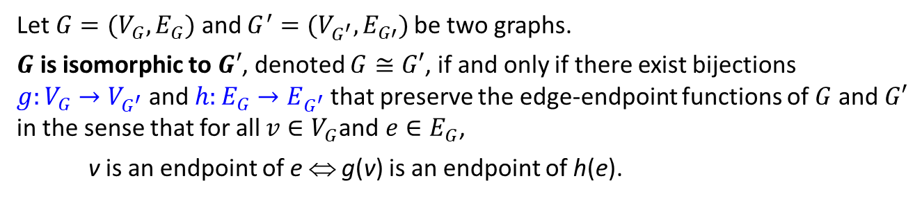
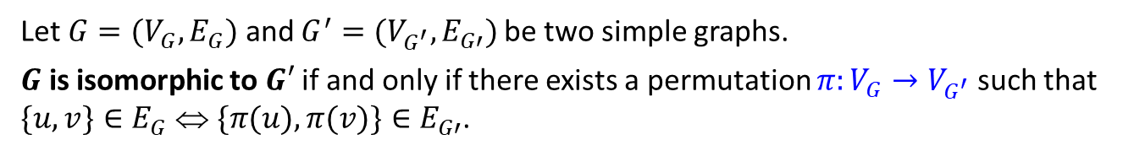
Summary
10.4 Planar Graphs
Definition: Isomorphic Graph
Let $G=(V_{G},E_{G})$ and $G^{′}=(V_{G^{′}},E_{G′})$be two graphs.
$G$ is isomorphic to $G′$, denoted $G≅G′$, if and only if there exist bijections
$g:V_{G}{→V}_{G^{′}}$ and $h:E_{G}{→E}_{G^{′}}$that preserve the edge-endpoint functions of $G$ and $G′$ in the sense that for all $v∈V_{G}$and $e∈E_{G}$,
v is an endpoint of e ⇔ g(v) is an endpoint of h(e).
Alternative definition (for simple graphs)
Let $G=(V_{G},E_{G})$ and $G^{′}=(V_{G^{′}},E_{G′})$be two simple graphs.
$G$ is isomorphic to $G′$ if and only if there exists a permutation $π:V_{G}{→V}_{G^{′}}$ such that $\{u,v\}∈E_{G}$ ⇔$\{π(u),π(v)\}∈E_{G′}$.
Theorem 10.4.1 Graph Isomorphism is an Equivalence Relation
Let S be a set of graphs and let $≅$ be the relation of graph isomorphism on S.
Then $≅$ is an equivalence relation on S.

Slide 16
Summary
10.4 Planar Graphs
Definition: Planar Graph
A planar graph is a graph that can be drawn on a (two-dimensional) plane without edges crossing.
Euler’s Formula
For a connected planar simple graph G = (V, E) with e = |E| and v = |V|, if we let f be the number of faces, then
f = e – v + 2

Slide 17
END OF FILE

