Slide 1
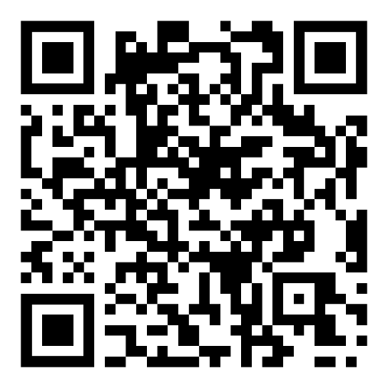

CS1231S Discrete Structures
AY2026/27 Semester 1
CS1231S (AY2026/27 Sem1)
QnA

Slide 2
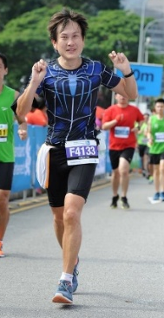
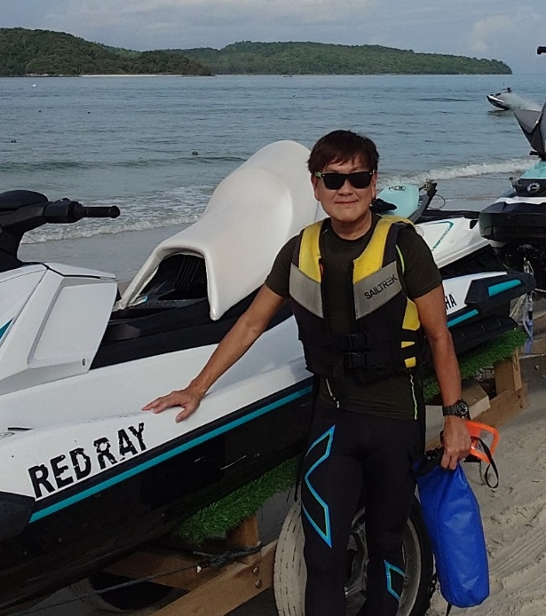

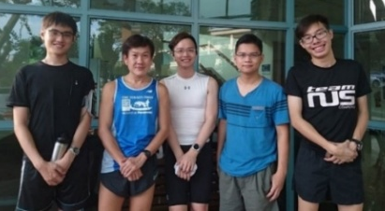
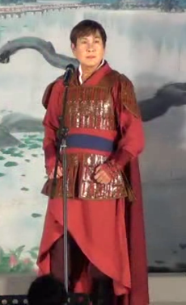
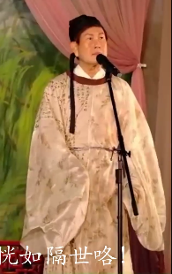
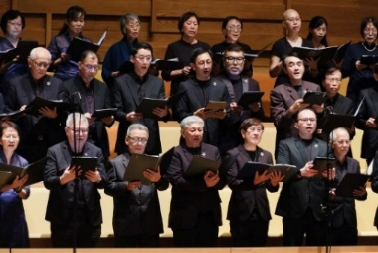
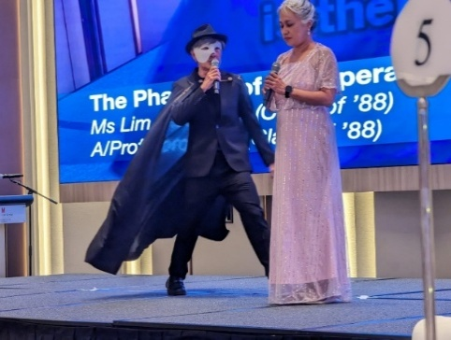
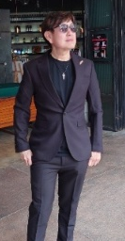
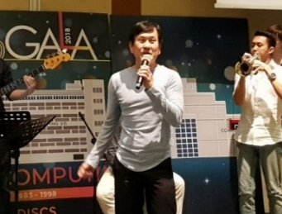
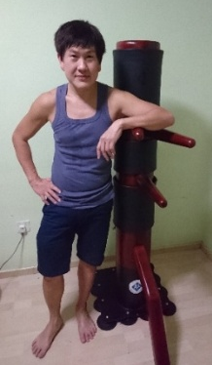
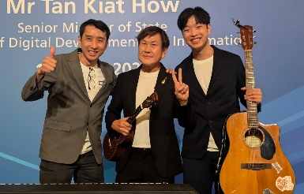
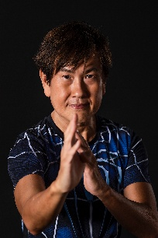
Welcome to CS1231S
1. Coordinator/Lecturer
Running
Cantonese opera
Used to have weekly runs with students every week (pre-Covid days)
Full marathon
Choir
Langkawi, February 2026
A/P Tan Tuck Choy, Aaron
Office: COM1-03-12
Email: tantc@comp.nus.edu.sg
Joy Chorale
Singing
SoC 25th Anniversary
July 2023
Wing Chun
Admin appointment:
Assistant Dean (Undergraduate Studies
& Student Life)
SoC Gala Dinner 2018
Computing 50th Anniversary
1st August 2025

Slide 3
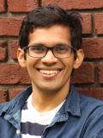
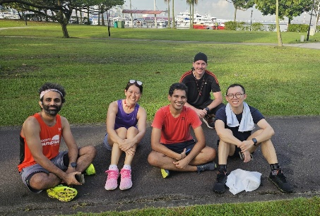
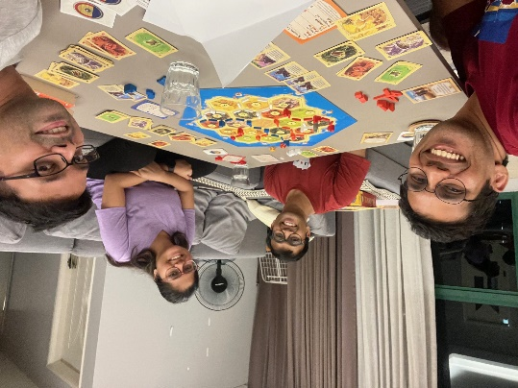
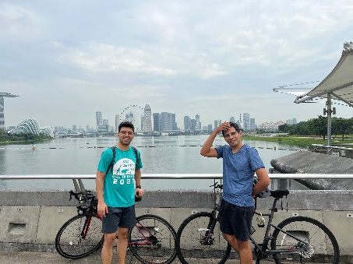
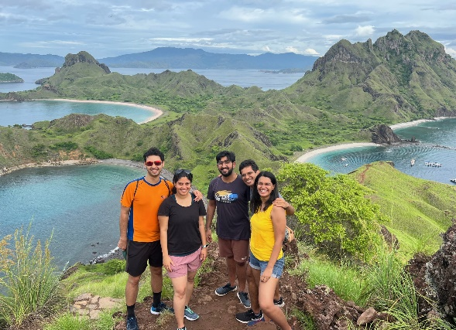
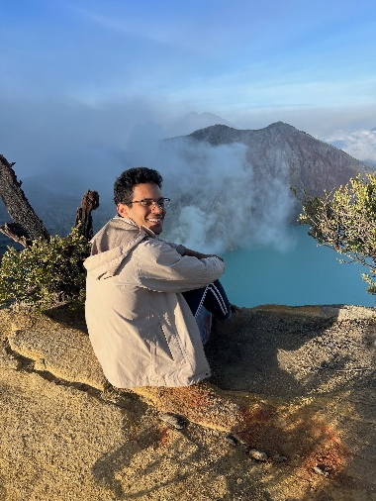
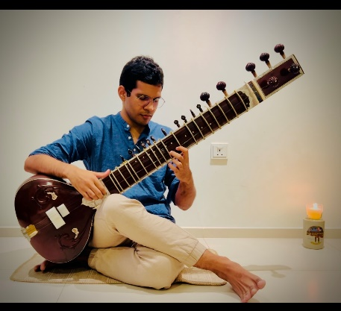
Welcome to CS1231S
1. Lecturers
Weekly Jogging
Board Games
Cycling
Dr Ashish Deepak Dandekar
Office: COM2-03-58
Email: dcsashi@nus.edu.sg
Traveling
Classical Music
Hiking

Slide 4
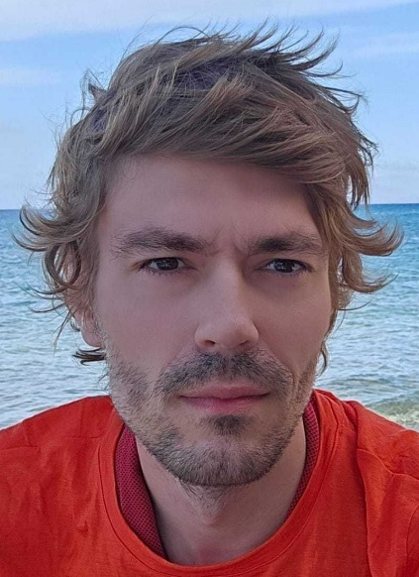
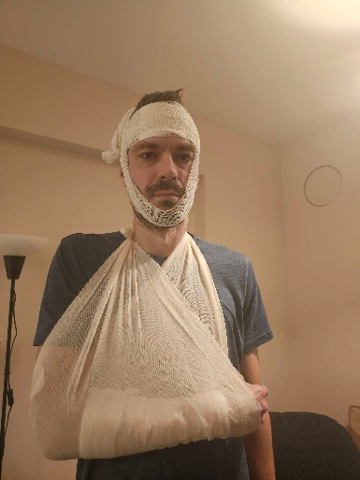
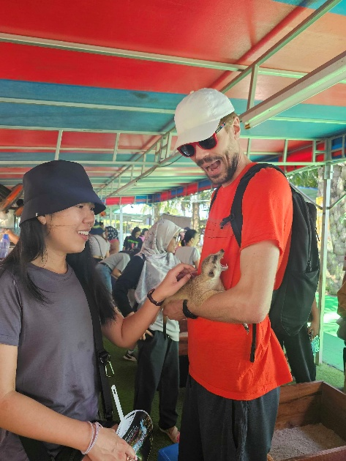
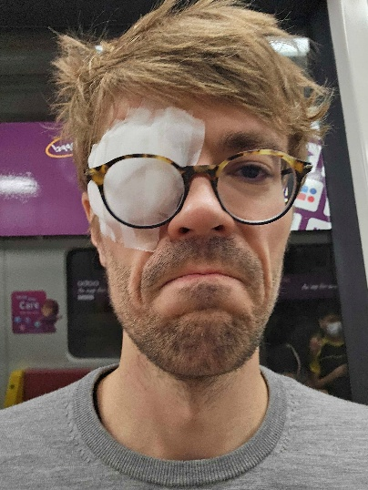
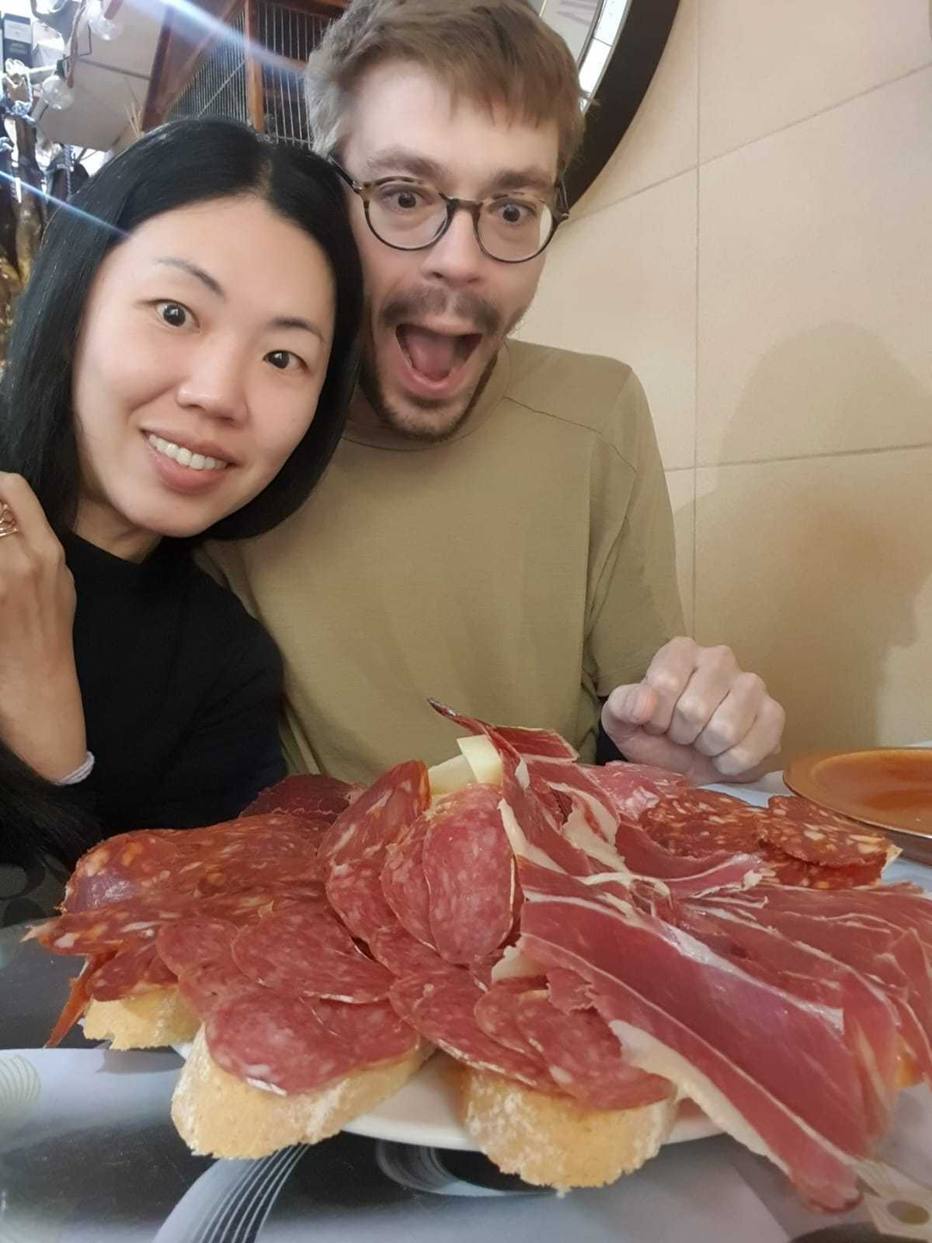
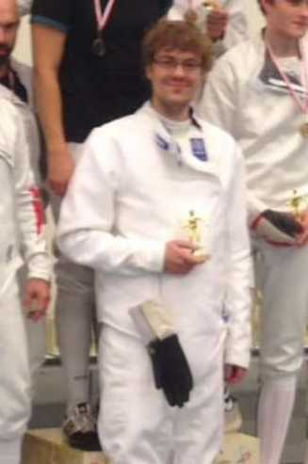
Welcome to CS1231S
1. Lecturer (CS1231R)
Professional first aid model
Meerkats!!!!
Dr Maciej Lukasz Obremski
Office: COM2-02-16
Email: cqtmlo@nus.edu.sg
Happiest day of my life
Stabbing people
Amateur pirate

Slide 5
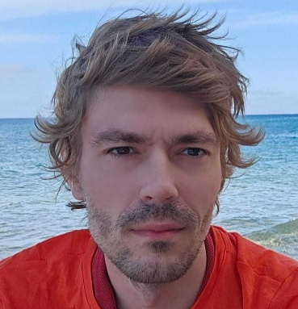
CS1231R
For students who find CS1231S too easy and are looking for more challenges!
CS1231R – 1 unit, credited in the NEXT semester if you complete it.
Additional lectures will be conducted by Dr Maciej Lukasz Obremski. (Time slot to be decided later – we will do a poll.)
Additional assignments will be given out.
Dr Maciej Obremski
Research Assistant Professor
Works on theoretical CS, mostly cryptography.
Some possible topics (may subject to changes): Analysis of algorithms (recurrences); Cryptography (fields/groups (mod arithmetics), polynomials, Chinese reminder theorem, encryption, secret sharing); Randomness (union bounds, probabilistics proofs).
Limited spots, thus there might be an entrance test!
Plan:
  Sign-up (+ test): week 2, (Test: Friday 16-18.00)
  Lectures start in week 3, Friday 16-18.00

Slide 6

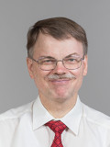





























Welcome to CS1231S
1. Tutors
Dr Eldon Chung
Prof Frank Stephan
Theodore
(lead TA)
Brian Cheong
Ben Robinson
Sherwin Chang
Chwa Channe
Duan Yuhan
Dylan Tay
Hoang Cong Duc
Ivan Adrian
Michael Cenreng
Mikhalchuk Valentin
Ng
Ting Hui
Nguyen
Phuc Truong
Praneeth Suresh
Raisa Nishat
Rajavel Aishwarya
Rishav Gupta
Saswata Mukherjee
Ser
Yi Zhe
Sue
Zheng Yong
Tze Tzun (Joseph)
Thu Rein
Toh
Jun Yee
Too Justin
Tse Henry
Vu
Dang Khoa
Yeoh Khang Sian
Zhou Haoran
Zhu Jiahang

Slide 7
Welcome to CS1231S
2. Objectives
To develop mathematical maturity – the ability to formalize concepts, work from definitions, think rigorously, reason concisely, and construct a theory.
To provide basic mathematical prerequisites relevant to Computer Science.

Slide 8
Welcome to CS1231S
3. Topics
Topics include:
Propositional logic and predicate logic
Proof techniques
Sets
Relations
Mathematical Induction
Functions
Cardinality
Counting and Probability
Graphs and Trees

Slide 9
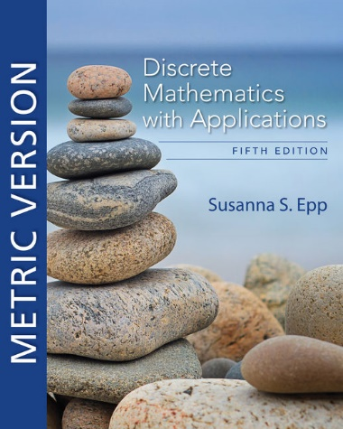
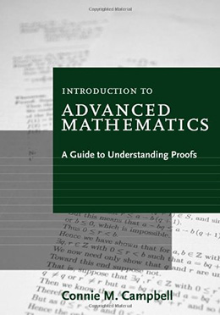
Welcome to CS1231S
4. Reference Books
Discrete Mathematics with Applications
5th Edition
Author: Susanna S. Epp
Publisher: Cengage Asia
ISBN-13: 9780357114087
ISBN-10: 0357114086
Online resource
Introduction to Advanced Mathematics:
A Guide to Understanding Proofs
Author: Connie M. Campbell
Publisher: Cengage Asia
ISBN-13: 9780547165387
ISBN-10: 0547165382
It’s ok if you get the 4th edition.

Slide 10
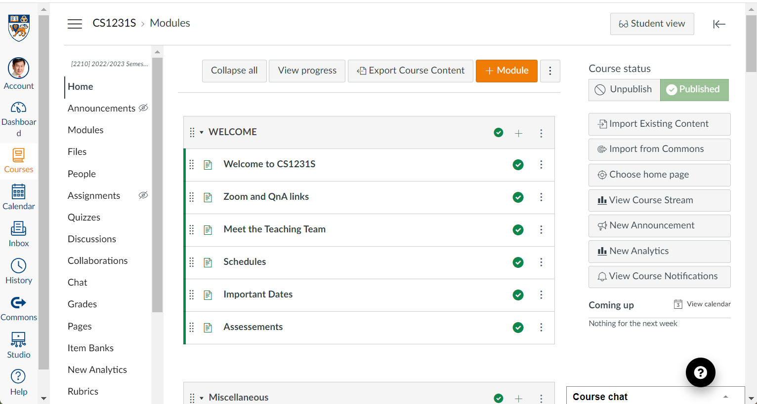
Welcome to CS1231S
5. Online Resources (1/3)
Canvas: https://canvas.nus.edu.sg

Slide 11
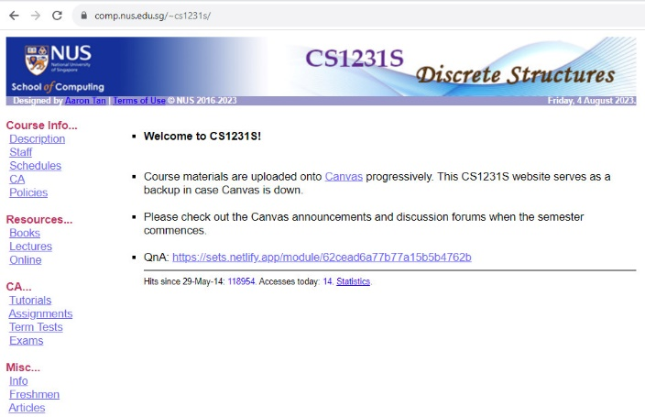
Welcome to CS1231S
5. Online Resources (2/3)
CS1231S module website: https://www.comp.nus.edu.sg/~cs1231s
As backup in case Canvas is down.

Slide 12
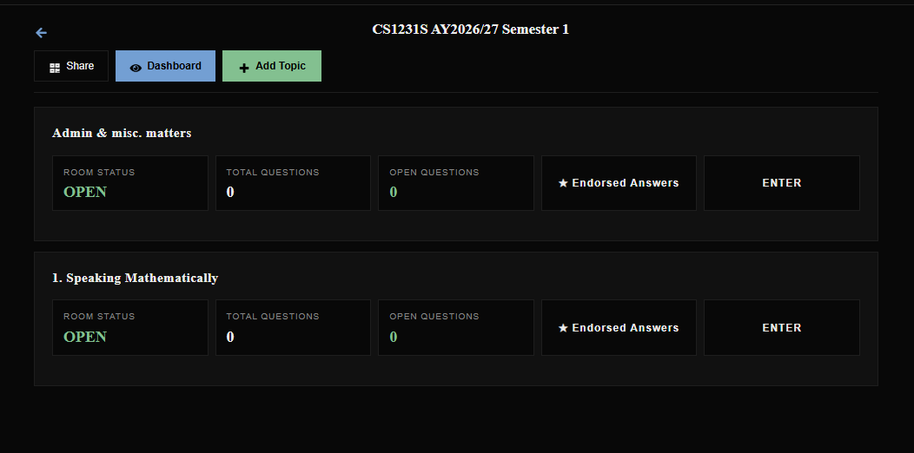
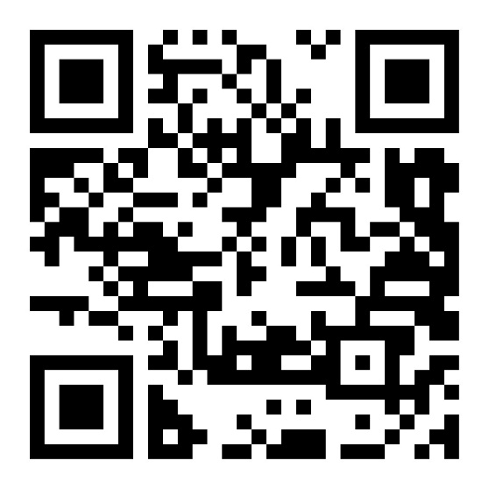
Welcome to CS1231S
5. Online Resources (3/3)
We will call it QnA for simplicity
https://setsify.com/space/6a0532f67be1d8eac8fddaf9
Post your questions here. More rooms will be created as we progress.
CS1231S (AY2026/27 Sem1)
QnA

Slide 13
Welcome to CS1231S
6. Assessments
CA component | Date | Weightage
Tutorial attendance | - | 5%
2 assignments & 3 in-tutorial quizzes | See https://www.comp.nus.edu.sg/~cs1231s/1_course_info/sched.html for assignment deadlines | 20%
Midterm test | 7 Oct (Wed) 6:30 – 8pm | 25%
Final exam | 26 Nov (Thu) 9 – 11am | 50%
Non-graded: Canvas > Quizzes – for your own practice/check.
Midterm test and final exam are open book. More details will be given out later.
Please post on “Canvas > Discussions > Midterm Test” by end of August if the CS1231S midterm test clashes with your other test. Please provide details (such as the other module code and timing).

Slide 14
Welcome to CS1231S
7. Lecture Plan (See CS1231S website for latest updates)
https://www.comp.nus.edu.sg/~cs1231s/1_module_info/sched.html
Week | Lecture topics
1 | Speaking Mathematically; The Logic of Compound Statements
2 | The Logic of Quantified Statements
3 | Methods of Proofs
4 | Sets
5 | Relations
6 | Modular Arithmetic and Partial Orders
Recess
7 | Mathematical Induction and Recursion
8 | Functions
9 | Cardinality
10 | Counting and Probability
11 | Counting and Probability (cont’d); Graphs
12 | Graphs (cont’d); Trees
13 | Filler
Lectures are webcast; recording will be published on Canvas > Videos/Panopto > Web Lectures

Slide 15
Welcome to CS1231S
8. Tutorial Schedule (Refer to CourseReg site)
Tutorials start in week 3 (24 August).
See tutorial schedule as at 13 August (this is dynamic and subject to changes) on the following CS1231S web page: https://www.comp.nus.edu.sg/~cs1231s/1_module_info/sched.html or refer to NUSMODS (https://nusmods.com/) for the most up-to-date schedule.
Please do NOT email us (acad staff) on requests such as adding you to a group or moving you to a different group. We are not permitted to do this. All requests/appeals should be sent to the CourseReg where dedicated admin staff will handle and process your requests. Sending your requests to us will just cause further delay as we could at most forward your request to the admin.
I will be monitoring the situation on my side and will post updates via Canvas announcements.

Slide 16
Welcome to CS1231S
9. Blended Learning
CS1231S has been selected to go semi-Blended Learning mode.
  Students are to view the lecture slides and previous semester’s lecture recordings before the lecture.
  Students are to post questions on the topics to be discussed in the coming week.
  The process will evolve over time as we experiment.

Slide 17
Welcome to CS1231S
10. Why is Discrete Mathematics Important?
Discrete Math (DM) is important, especially for Computer Science.
Every field in CS is related to discrete objects – databases, neural networks, automata, etc.
It is the backbone of CS.
Concepts and notations from DM are useful in studying the describing objects and problems in all branches of CS, such as algorithms, programming languages, theorem proving and software development
Modeling with DM is an extremely important problem solving skill.
Useful for algorithms modules:
CS2040 (Data Structures and Algorithms), CS3230 (Design and Analysis of Algorithms), etc.
Logic part is useful in CS2100 (Computer Organisation).

Slide 18
Welcome to CS1231S
11. Plagiarism
  Use or close imitation of the language and thoughts of another author and the representation of them as one’s own original work.
  Plagiarism by students, professors, or researchers is considered academic dishonesty or academic fraud, and offenders are subject to academic censure, up to and including expulsion.
  Do not plagiarise or commit any acts of dishonesty.
  Further information:
    https://www.comp.nus.edu.sg/cug/plagiarism/
    NUS-Plagiarism-Policy.pdf

Slide 19

Welcome to CS1231S
12. CS1231S Policy on Assignments
  You are to do the assignments on your own.
  No AI tools are allowed.
  No discussion with anybody else is allowed.
  If you have queries about the assignment questions, post them on QnA. Do not post your answers or partial answers there.
Every semester, many students were caught committing academic offence and were reported to the school. Depending on the severity, penalty includes awarding zero mark for the assignment, failing the whole course, and harsher penalty.
Note that academic offence is not limited to direct copying or sharing of answers.
In programming courses, there were many instances when students claimed that they merely discussed their ideas/algorithms (which was allowed) but ended up with highly similar code due to the detail level of discussion. There were instances when two students were detected with similar answers, even though they do not know each other, but separately used AI tool (which gave the same answer). All these reasons would not vindicate you of the offence.

Slide 20



Welcome to CS1231S
13. CS1231S Tagline

Slide 21
What have you heard about CS1231S from those who have taken it before?
Challenging
Boring
Interesting
Killer module
Prepare to S/U
Depressing
I can do it!
Heard nothing

Slide 22
END OF FILE

