Slide 1
2. The Logic of Compound Statements
Logical Form and Logical Equivalence Conditional Statements Valid and Invalid Arguments
Slides credits: Aaron Tan
2.1 The Logic of Compound Statements
(aka Propositional Logic)
Ashish Dandekar
AY2026/27 Semester 1
Notes:
Quizzes
Is a married person looking at an unmarried person?
Mother and son. “If you behave, then you will get ice-cream.”

Slide 2
Logical Form and Logical Equivalence Conditional Statements Valid and Invalid Arguments
2. The Logic of Compound Statements
2.1 Logical Form and Logical Equivalence
Statements; Compound Statements; Statement Form (Propositional Form)
2.2 Conditional Statements
Conditional Statements; If-Then as Or
Logical Equivalence; Tautologies and Contradictions
Only If and the Biconditional; Necessary and Sufficient Conditions
Negation, Contrapositive, Converse and Inverse
2.3 Valid and Invalid Arguments
Argument; Valid and Invalid Arguments
Modus Ponens and Modus Tollens
Rules of Inference
Fallacies
Reference: Epp’s Chapter 2 The Logic of Compound Statements

Slide 3

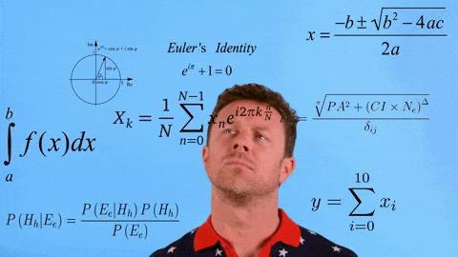
Logical Form and Logical Equivalence Conditional Statements Valid and Invalid Arguments
2. The Logic of Compound Statements
At the end of this lecture, you should be able to be expert in CSI…
There are four suspects in a murder mystery. Different testimonies have led to following observations.
  If Bob is innocent, then Cara is innocent.
  If Alice is innocent, then Dan is Guilty.
  If Alice is guilty, then Bob is innocent.
  Bob may or may not be guilty.
  Either Cara or Dan is guilty.
Who is guilty after all?
This Photo by Unknown Author is licensed under CC BY-SA-NC

Slide 4
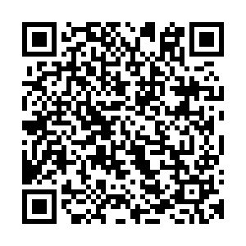

Logical Form and Logical Equivalence Conditional Statements Valid and Invalid Arguments
2. The Logic of Compound Statements
Another puzzle!
X is looking at Y,
and Y is looking at Z.
X is married, but Z is not.
PollEv.com/ashishdandekar
Is a married person looking at an unmarried person?
Yes.
No.
Cannot be determined.
Touted as the logic question that almost everyone gets wrong.
https://www.theguardian.com/science/2016/mar/28/did-you-solve-it-the-logic-question-almost-everyone-gets-wrong


Slide 5
Logical Form and Logical Equivalence Conditional Statements Valid and Invalid Arguments
2.1 Logical Form and Logical Equivalence

Slide 6


Logical Form and Logical Equivalence Conditional Statements Valid and Invalid Arguments
Example
If Jane is a math major or Jane is a computer science major, then Jane will take MA1101R.
Jane is a computer science major.
Therefore, Jane will take MA1101R.
If CS1231 is easy or ______________, then _____________________.
I study hard.
I study hard
Therefore, I will get A+ in this course.
I will get A+ in this course


Slide 7
Logical Form and Logical Equivalence Conditional Statements Valid and Invalid Arguments
Statements
2.1.1. Statements
If Jane is a math major or Jane is a computer science major, then Jane will take MA1101R.
Jane is a computer science major.
Statements
Therefore, Jane will take MA1101R.
Definition 2.1.1 (Statement)
A statement (or proposition) is a sentence that is true or false, but not both.

Slide 8
Logical Form and Logical Equivalence Conditional Statements Valid and Invalid Arguments
Statements
2.1.1. Statements
What is not a statement in logic?
Questions
Commands
Exclamations
Open sentences
Can you do it?
Do it.
Walao eh.. So difficult!
X student solved the question.

Slide 9

Logical Form and Logical Equivalence Conditional Statements Valid and Invalid Arguments
Statement variables
If Jane is a math major or Jane is a computer science major, then Jane will take MA1101R.
Jane is a computer science major.
Therefore, Jane will take MA1101R.
If p or q, then r.
q.
Therefore, r.
Statement variables
See Definition 2.1.5 Statement Form.

Slide 10
Logical Form and Logical Equivalence Conditional Statements Valid and Invalid Arguments
Compound Statements
2.1.2. Compound Statements
Logical connectives:
~
also ¬
∧
∨
Not/negation
and
or
Truth tables:
p | q | p ∧ q
T | T | T
T | F | F
F | T | F
F | F | F
p | q | p ∨ q
T | T | T
T | F | T
F | T | T
F | F | F
p | ~p
T | F
F | T

Slide 11
Logical Form and Logical Equivalence Conditional Statements Valid and Invalid Arguments
Compound Statements: Negation, Conjunction, and Disjunction
Definition 2.1.2 (Negation)
If p is a statement variable, the negation of p is “not p” or “it is not the case that p” and is denoted ~p.
Definition 2.1.3 (Conjunction)
If p and q are statement variables, the conjunction of p and q is “p and q”, denoted p ∧ q.
Definition 2.1.4 (Disjunction)
If p and q are statement variables, the disjunction of p and q is “p or q”, denoted p ∨ q.

Slide 12
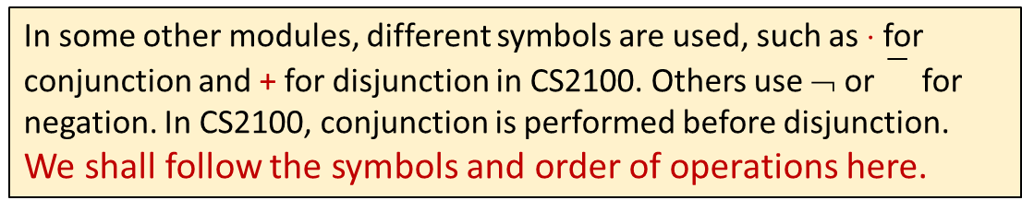
Logical Form and Logical Equivalence Conditional Statements Valid and Invalid Arguments
Compound Statements: Order of Operations
Order of operations:
  ~ is performed first
  ∧ and ∨ are coequal in order of operation
~p ∧ q ≡ (~p) ∧ q
p ∧ q ∨ r
Ambiguous
Use parentheses to override or disambiguate order of operations
~(p ∧ q)
(p ∧ q) ∨ r
p ∧ (q ∨ r)
Negation of p ∧ q
Unambiguous
In some other modules, different symbols are used, such as ⋅ for conjunction and + for disjunction in CS2100. Others use ¬ or for negation. In CS2100, conjunction is performed before disjunction.
We shall follow the symbols and order of operations here.

Slide 13

Logical Form and Logical Equivalence Conditional Statements Valid and Invalid Arguments
Compound Statements: Quick Quiz
Given:
  h = “It is hot”
  s = “It is sunny”
Write logical statements for the following:
  “It is not hot but it is sunny.”
  “It is neither hot nor sunny.”
~h ∧ s
~h ∧ ~s
or
~(h ∨ s)
(we will discuss this later)


Slide 14
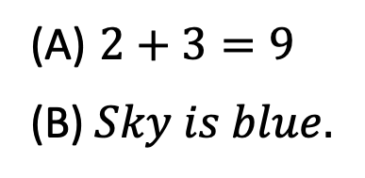
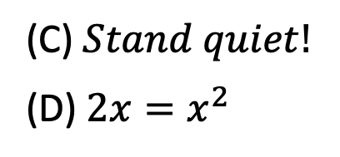
Logical Form and Logical Equivalence Conditional Statements Valid and Invalid Arguments
Statement Form
2.1.3. Statement Form (Propositional Form)
Examples:
~p ∨ q
(p ∨ q) ∧ ~(p ∧ q)
(p ∧ q) ∨ r
Definition 2.1.5 (Statement Form/Propositional Form)
A statement form (or propositional form) is an expression made up of statement variables and logical connectives that becomes a statement when actual statements are substituted for the component statement variables.
Which of the following are statements?


(A) $2+3=9$
(B) $Sky is blue.$
(C) $Stand quiet!$
(D) $2x=x^{2}$




Slide 15
Logical Form and Logical Equivalence Conditional Statements Valid and Invalid Arguments
Evaluating the Truth of Compound Statements
Construct the truth table for this statement form:
(p ∨ q) ∧ ~(p ∧ q)
p | q | p ∨ q | p ∧ q | ~(p ∧ q) | (p ∨ q) ∧ ~(p ∧ q)
T | T
T | F
F | T
F | F
T
T
T
F
T
F
F
F
F
T
T
T
F
T
T
F
(p ∨ q) ∧ ~(p ∧ q)
is also known as exclusive-or (why?)
p ⊕ q
(Sometimes denoted as or .
We would rarely these notations ⊕ and XOR in CS1231S.)
p XOR q


Slide 16
Logical Form and Logical Equivalence Conditional Statements Valid and Invalid Arguments
Logical Equivalence
2.1.4. Logical Equivalence
(1) Dogs bark and cats meow.
(2) Cats meow and dogs bark.
If (1) is true, it follows that (2) must also be true.
On the other hand, if (1) is false, it follows that (2) must also be false.
(1) and (2) are logically equivalent statements.

Slide 17
Logical Form and Logical Equivalence Conditional Statements Valid and Invalid Arguments
Logical Equivalence
Definition 2.1.6 (Logical Equivalence)
Two statement forms are called logically equivalent if, and only if, they have identical truth values for each possible substitution of statements for their statement variables.
The logical equivalence of statement forms P and Q is denoted by P ≡ Q.
Example:
a | b | a ∧ b | b ∧ a
T | T | T | T
T | F | F | F
F | T | F | F
F | F | F | F
(a ∧ b) and (b ∧ a) always have the same truth values, hence they are logically equivalent.

Slide 18
Logical Form and Logical Equivalence Conditional Statements Valid and Invalid Arguments
Logical Equivalence: Double Negative Property
Double negation:
~(~p) ≡ p
p | ~p | ~(~p)
T | F | T
F | T | F

Slide 19
Logical Form and Logical Equivalence Conditional Statements Valid and Invalid Arguments
Logical Equivalence: Showing Non-equivalence
To show that statement forms P and Q are not logically equivalent, there are 2 ways:
  Truth table – find at least one row where their truth values differ.
  Find a counter example – concrete statements for each of the two forms, one of which is true and the other of which is false.

Slide 20
Logical Form and Logical Equivalence Conditional Statements Valid and Invalid Arguments
Logical Equivalence: Showing Non-equivalence
Show that the following 2 statement forms are not logically equivalent.
~(p ∧ q)
~p ∧ ~q
Truth table method:
p | q | ~p | ~q | p ∧ q | ~(p ∧ q) | ~p ∧ ~q
T | T | F | F | T | F | F
T | F | F | T | F | T | F
F | T | T | F | F | T | F
F | F | T | T | F | T | T

Slide 21
Logical Form and Logical Equivalence Conditional Statements Valid and Invalid Arguments
Logical Equivalence: Showing Non-equivalence
Show that the following 2 statement forms are not logically equivalent.
~(p ∧ q)
~p ∧ ~q
Counter-example method:
Let p be the statement “0 < 1” and q the statement “1 < 0”.
~(p ∧ q)
“Not the case that both 0<1 and 1<0” which is TRUE.
~p ∧ ~q
“Not 0<1” and “not 1<0” which is FALSE.

Slide 22
Logical Form and Logical Equivalence Conditional Statements Valid and Invalid Arguments
Logical Equivalence: De Morgan’s Laws
De Morgan’s Laws:
~(p ∧ q) ≡ ~p ∨ ~q
Can be extended to more than two variables.
~(p ∨ q) ≡ ~p ∧ ~q
Write negations for each of the following:
  John is 6 feet tall and he weighs at least 200 pounds.
  The bus was late or Tom’s watch was slow.
John is not 6 feet tall or he weighs less than 200 pounds.
The bus was not late and Tom’s watch was not slow.
or
Neither was the bus late nor was Tom’s watch slow.

Slide 23
Logical Form and Logical Equivalence Conditional Statements Valid and Invalid Arguments
Tautologies and Contradictions
2.1.5. Tautologies and Contradictions
Definition 2.1.7 (Tautology)
A tautology is a statement form that is always true regardless of the truth values of the individual statements substituted for its statement variables. A statement whose form is a tautology is a tautological statement.
Definition 2.1.8 (Contradiction)
A contradiction is a statement form that is always false regardless of the truth values of the individual statements substituted for its statement variables. A statement whose form is a contradiction is a contradictory statement.

Slide 24
Logical Form and Logical Equivalence Conditional Statements Valid and Invalid Arguments
Tautologies and Contradictions
Logical equivalence involving tautologies and contradictions
Example: If t is a tautology and c is a contradiction, show that:
p ∧ t ≡ p
and
p ∧ c ≡ c
p | t | c | p ∧ t | p ∧ c
T | T | F | T | F
F | T | F | F | F
As t and c (used in the textbook) are hard to distinguished from statement variables, we will use true and false instead.

Slide 25
Logical Form and Logical Equivalence Conditional Statements Valid and Invalid Arguments
Summary of Logical Equivalences
2.1.6. Summary of Logical Equivalences
Theorem 2.1.1 Logical Equivalences
Given any statement variables p, q and r, a tautology true and a contradiction false:
1 | Commutative laws | p ∧ q ≡ q ∧ p | p ∨ q ≡ q ∨ p
2 | Associative laws | p ∧ q ∧ r ≡ (p ∧ q) ∧ r ≡ p ∧ (q ∧ r) | p ∨ q ∨ r ≡ (p ∨ q) ∨ r ≡ p ∨ (q ∨ r)
3 | Distributive laws | p ∧ (q ∨ r) ≡ (p ∧ q) ∨ (p ∧ r) | p ∨ (q ∧ r) ≡ (p ∨ q) ∧ (p ∨ r)
4 | Identity laws | p ∧ true ≡ p | p ∨ false ≡ p
5 | Negation laws | p ∨ ~p ≡ true | p ∧ ~p ≡ false
6 | Double negative law | ~(~p) ≡ p

Slide 26
Logical Form and Logical Equivalence Conditional Statements Valid and Invalid Arguments
Summary of Logical Equivalences
2.1.6. Summary of Logical Equivalences
Theorem 2.1.1 Logical Equivalences (continue)
Given any statement variables p, q and r, a tautology true and a contradiction false:
7 | Idempotent laws | p ∧ p ≡ p | p ∨ p ≡ p
8 | Universal bound laws | p ∨ true ≡ true | p ∧ false ≡ false
9 | De Morgan’s laws | ~(p ∧ q) ≡ ~p ∨ ~q | ~(p ∨ q) ≡ ~p ∧ ~q
10 | Absorption laws | p ∨ (p ∧ q) ≡ p | p ∧ (p ∨ q) ≡ p
11 | Negation of true and false | ~true ≡ false | ~false ≡ true

Slide 27
Logical Form and Logical Equivalence Conditional Statements Valid and Invalid Arguments
Simplifying Statement Forms: Quick Quiz
Use the laws in Theorem 2.1.1 to verify the following logical equivalence:
~(~p ∧ q) ∧ (p ∨ q) ≡ p
~(~p ∧ q) ∧ (p ∨ q) ≡
(~(~p) ∨ ~q) ∧ (p ∨ q)
(De Morgan’s)
≡ (p ∨ ~q) ∧ (p ∨ q)
(Double negative)
≡ p ∨ (~q ∧ q)
(Distributive)
Remember to cite the law in every step in your workings.
≡ p ∨ (q ∧ ~q)
(Commutative)
≡ p ∨ false
(Negation)
≡ p
(Identity)


Slide 28
You can apply the same law multiple times in a single step.
~(~p ∧ ~q)
~(~p ∧ ~q) ≡
(~(~p) ∨ ~(~q))
(De Morgan’s)
≡ (p ∨ q)
(Double negative) * 2
(p ∧ q) ∨ (r ∧ q)
You cannot use distributive law yet!
(p ∧ q) ∨ (r ∧ q) ≡
(q ∧ p) ∨ (q ∧ r)
(Commutative Law) * 2
≡ q ∧ (p ∨ q)
(Distributive Law)

Slide 29
Logical Form and Logical Equivalence Conditional Statements Valid and Invalid Arguments
Logical Equivalence
How to prove logical equivalence?
  Use the truth table
  Use algebraic laws
How to disprove logical equivalence?
  Find a counter-example!

Slide 30
Logical Form and Logical Equivalence Conditional Statements Valid and Invalid Arguments
2.2 Conditional Statements

Slide 31
Logical Form and Logical Equivalence Conditional Statements Valid and Invalid Arguments
Conditional Statements
2.2.1. Conditional Statements
If Jane is a math major or Jane
is a computer science major,
then Jane will take MA1101R.
hypothesis
conclusion
If 4,686 is divisible by 6,
then 4,686 is divisible by 3.
Conditional statement
If p then q
p → q

Slide 32
Logical Form and Logical Equivalence Conditional Statements Valid and Invalid Arguments
Conditional Statements
Logical connective:
Truth values:
p | q | p → q
T | T | T
T | F | F
F | T | T
F | F | T
→
if-then/implies
Definition 2.2.1 (Conditional)
If p and q are statement variables, the conditional of q by p is “if p then q” or “p implies q”, denoted p → q.
It is false when p is true and q is false; otherwise it is true.
We called p the hypothesis (or antecedent) of the conditional and q the conclusion (or consequent).

Slide 33
Logical Form and Logical Equivalence Conditional Statements Valid and Invalid Arguments
Conditional Statements
A conditional statement that is true by virtue of the fact that its hypothesis is false is often called vacuously true or true by default.
  “If you show up for work Monday morning, then you will get the job” is vacuously true if you do NOT show up for work Monday morning.
p | q | p → q
T | T | T
T | F | F
F | T | T
F | F | T
In general, when the “if” part of an if-then statement is false, the statement as a whole is said to be true, regardless of whether the conclusion is true or false.

Slide 34

Logical Form and Logical Equivalence Conditional Statements Valid and Invalid Arguments
Conditional Statements: Example #1
Example #1:
A Conditional Statement with a False Hypothesis
If 0 = 1, then 1 = 2
Strange as it may seem, the
statement as a whole is true!


Slide 35
Logical Form and Logical Equivalence Conditional Statements Valid and Invalid Arguments
Conditional Statements: Order of Operations
Order of operations:
~
∧
∨
→
not
and
or
if-then/implies
Coequal in order
Performed first
Performed last

Slide 36
Logical Form and Logical Equivalence Conditional Statements Valid and Invalid Arguments
Conditional Statements: Example #2
Example #2: Truth Table for p ∨ ~q → ~p
p ∨ ~q → ~p
≡
(p ∨ (~q)) → (~p)
conclusion
hypothesis
p | q | ~p | ~q | p ∨ ~q | p ∨ ~q → ~p
T | T
T | F
F | T
F | F
F
F
T
T
F
T
F
T
T
T
F
T
F
F
T
T


Slide 37
Logical Form and Logical Equivalence Conditional Statements Valid and Invalid Arguments
Conditional Statements: Example #3
Example #3: Show that
p ∨ q → r
≡
(p → r) ∧ (q → r)
p | q | r | p ∨ q | p → r | q → r | p ∨ q → r | (p → r) ∧ (q → r)
T | T | T
T | T | F
T | F | T
T | F | F
F | T | T
F | T | F
F | F | T
F | F | F
T
T
T
T
T
T
F
F
T
F
T
F
T
T
T
T
T
F
T
T
T
F
T
T
T
F
T
F
T
F
T
T
T
F
T
F
T
F
T
T


Slide 38
Logical Form and Logical Equivalence Conditional Statements Valid and Invalid Arguments
Representation of If-Then as Or: Implication Law
2.2.2. Representation of If-Then as Or: Implication Law
Rewrite the following statement in if-then form:
Either you get to work on time or you are fired.
Let ~p be “You get to work on time”
and q be “You are fired”.
~p ∨ q
Also, p is “You do not get to work on time”.
If you do not get to work on time, you are fired.
p → q

Slide 39
Logical Form and Logical Equivalence Conditional Statements Valid and Invalid Arguments
Representation of If-Then as Or: Implication Law
≡
p | q | p → q
T | T | T
T | F | F
F | T | T
F | F | T
p | q | ~p ∨ q
T | T | T
T | F | F
F | T | T
F | F | T
~p ∨ q
Implication law
p → q

Slide 40
Logical Form and Logical Equivalence Conditional Statements Valid and Invalid Arguments
Negation of a Conditional Statement
2.2.3. Negation of a Conditional Statement
In previous slide, we have shown the Implication Law
p → q
≡
~p ∨ q
Hence, negation of a conditional statement:
~(p → q) ≡ ~(~p v q) ≡ ~(~p) ∧ ~q ≡ p ∧ ~q
Implication law
De Morgan’s law
Double negation law
~(p → q)
≡
p ∧ ~q

Slide 41
Logical Form and Logical Equivalence Conditional Statements Valid and Invalid Arguments
Negation of a Conditional Statement: Quick Quiz
Write negation for each of the following statements:
  If my car is in the repair shop, then I cannot get to class.
  If Sara lives in Athens, then she lives in Greece.
My car is in the repair shop and I can get to class.
Sara lives in Athens and she does not live in Greece.


Slide 42
Logical Form and Logical Equivalence Conditional Statements Valid and Invalid Arguments
Contrapositive
2.2.4. Contrapositive of a Conditional Statement
Definition 2.2.2 (Contrapositive)
The contrapositive of a conditional statement of the form “if p then q” is
“if ~q then ~p”
Symbolically,
The contrapositive of p → q is ~q → ~p.
p → q
≡
~q → ~p
contrapositive

Slide 43
Logical Form and Logical Equivalence Conditional Statements Valid and Invalid Arguments
Contrapositive: Quick Quiz
Write each of the following statements in its equivalent contrapositive form:
  If Howard can swim across the lake, then Howard can swim to the island.
  If today is Easter, then tomorrow is Monday.
If Howard cannot swim to the island, then Howard cannot swim across the lake.
If tomorrow is not Monday, then today is not Easter.


Slide 44
Logical Form and Logical Equivalence Conditional Statements Valid and Invalid Arguments
Converse and Inverse
2.2.5. Converse and Inverse of a Conditional Statement
Definition 2.2.3 (Converse)
The converse of a conditional statement “if p then q” is
“if q then p”
Symbolically,
The converse of p → q is q → p.
Definition 2.2.4 (Inverse)
The inverse of a conditional statement “if p then q” is
“if ~p then ~q”
Symbolically,
The inverse of p → q is ~p → ~q.

Slide 45
Logical Form and Logical Equivalence Conditional Statements Valid and Invalid Arguments
Converse and Inverse
Conditional statement:
p → q
q → p
≡
~p → ~q
converse
inverse

Slide 46
Logical Form and Logical Equivalence Conditional Statements Valid and Invalid Arguments
Converse and Inverse: Quick Quiz
Write the converse and inverse of the following statements:
  If Howard can swim across the lake, then Howard can swim to the island.
  If today is Easter, then tomorrow is Monday.
Converse:
If Howard can swim to the island, then Howard can swim across the lake.
If Howard cannot swim across the lake, then Howard cannot swim to the island.
Inverse:
Converse:
If tomorrow is Monday, then today is Easter.
Inverse:
If today is not Easter, then tomorrow is not Monday.


Slide 47
2. The Logic of Compound Statements
Logical Form and Logical Equivalence Conditional Statements Valid and Invalid Arguments
Slides credits: Aaron Tan
2.2 The Logic of Compound Statements
(aka Propositional Logic)
Ashish Dandekar
AY2025/26 Semester 1
Notes:
Quizzes
Is a married person looking at an unmarried person?
Mother and son. “If you behave, then you will get ice-cream.”

Slide 48
Logical Form and Logical Equivalence Conditional Statements Valid and Invalid Arguments
Conditional statement and its Contrapositive, Converse and Inverse
p | q | p → q
T | T | T
T | F | F
F | T | T
F | F | T
p → q
≡
~q → ~p
conditional statement
contrapositive
q → p
≡
~p → ~q
converse
inverse
Note that:
p → q
≡
q → p

Slide 49
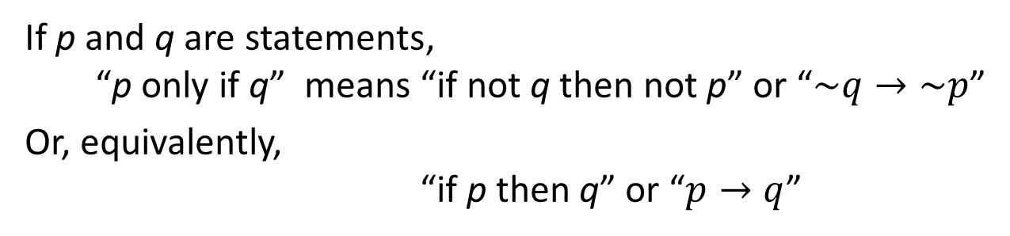
Logical Form and Logical Equivalence Conditional Statements Valid and Invalid Arguments
Only If and the Biconditional
2.2.6. Only If and the Biconditional
To say “p only if q” means that p can take place only if q takes place also. That is, if q does not take place, then p cannot take place.
Another way to say this is that if p occurs, then q must also occur (using contrapositive).
Definition 2.2.5 (Only If)
If p and q are statements,
“p only if q” means “if not q then not p” or “$\sim q→\sim p$”
Or, equivalently,
“if p then q” or “$p→q$”

Slide 50





Logical Form and Logical Equivalence Conditional Statements Valid and Invalid Arguments
Only If : Quick Quiz
Rewrite the following statement in if-then form in two ways, one of which is the contrapositive of the other.
  John will break the world’s record only if
  he runs the mile in under four minutes.
$$p$$
$$q$$
$$p→q$$
Version 1:
If John does not run the mile in under four minutes, then John will not break the world’s record.
$$\sim q→\sim p$$
Version 2:
If John breaks the world’s record, then John will have run the mile in under four minutes.
$$p→q$$


Slide 51
Logical Form and Logical Equivalence Conditional Statements Valid and Invalid Arguments
Only If and the Biconditional
Definition 2.2.6 (Biconditional)
Given statement variables p and q, the biconditional of p and q is “p if, and only if, q” and is denoted p ↔ q.
It is true if both p and q have the same truth values and is false if p and q have opposite truth values.
The words if and only if are sometimes abbreviated iff.
p ↔ q
p | q | p ↔ q
T | T | T
T | F | F
F | T | F
F | F | T

Slide 52
Logical Form and Logical Equivalence Conditional Statements Valid and Invalid Arguments
Only If and the Biconditional
p ↔ q
≡
(p → q) ∧ (q → p)
p | q | p → q | q → p | p ↔ q | (p → q) ∧ (q → p)
T | T | T | T | T | T
T | F | F | T | F | F
F | T | T | F | F | F
F | F | T | T | T | T

Slide 53
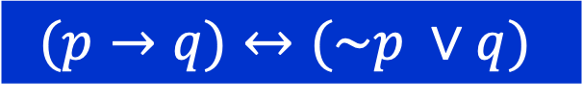
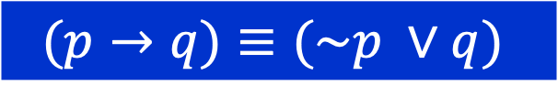
Logical Form and Logical Equivalence Conditional Statements Valid and Invalid Arguments
Only If and the Biconditional
What is the difference between in biconditional and logical equivalence?
Logical equivalence is not a new statement, rather it is an assertion between two statement forms.
Biconditional leads to a statement form.
$$(p→q)≡(\sim p ∨q)$$
Implication Law does not have a truth value.
It simply says that these two statements are
in agreement under all possible scenarios.
$$(p→q)↔(\sim p ∨q)$$
This is a statement form, which happens
to be a tautology.

Slide 54
Logical Form and Logical Equivalence Conditional Statements Valid and Invalid Arguments
Only If and the Biconditional
Order of operations:
~
∧
∨
→
↔
not
and
or
if-then/implies
if and only if
Coequal in order
Coequal in order
Performed first
Performed last

Slide 55
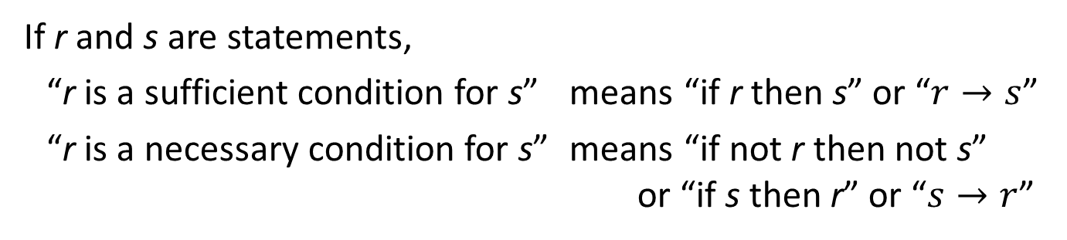
Logical Form and Logical Equivalence Conditional Statements Valid and Invalid Arguments
Necessary and Sufficient Conditions
2.2.7. Necessary and Sufficient Conditions
Definition 2.2.7 (Necessary and Sufficient Conditions)
If r and s are statements,
“r is a sufficient condition for s” means “if r then s” or “$r→s$”
“r is a necessary condition for s” means “if not r then not s”
or “if s then r” or “$s→r$”
To say “r is a sufficient condition for s” means that the occurrence of r is sufficient to guarantee the occurrence of s.
To say “r is a necessary condition for s” means that if r does not occur, then s cannot occur either: The occurrence of r is necessary to obtain the occurrence of s.

Slide 56
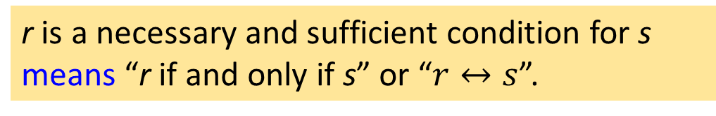
Logical Form and Logical Equivalence Conditional Statements Valid and Invalid Arguments
Necessary and Sufficient Conditions
Consequently,
r is a necessary and sufficient condition for s
means “r if and only if s” or “$r↔s$”.
Examples:
  An integer being divisible by 4 is sufficient for it to be even.
  Being at least 18 years old is necessary to buy alcoholic beverages in Singapore.
  For an integer larger than 2, being odd is necessary for it to be a prime.
  Being a mammal is necessary to being a human.
  Sam's being a father is both a necessary and a sufficient condition for his being a male parent.

Slide 57
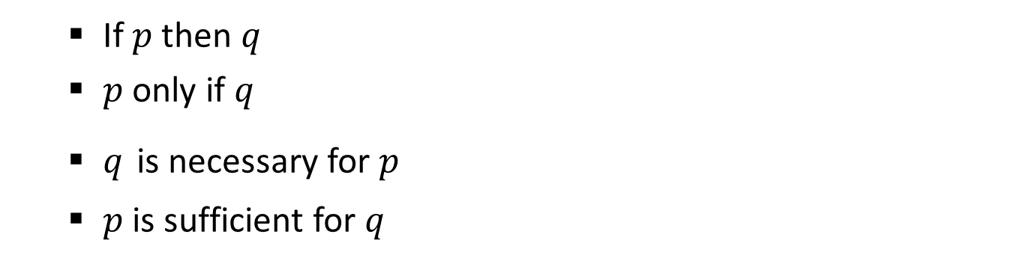
Logical Form and Logical Equivalence Conditional Statements Valid and Invalid Arguments
Necessary and Sufficient Conditions
In summary,
$$p→q$$
  If $p$ then $q$
  $p$only if $q$
  $q$ is necessary for $p$
  $p$ is sufficient for $q$
57

Slide 58
Logical Form and Logical Equivalence Conditional Statements Valid and Invalid Arguments
2.3 Valid and Invalid Arguments

Slide 59
Logical Form and Logical Equivalence Conditional Statements Valid and Invalid Arguments
Valid and Invalid Arguments
2.3.1. Valid and Invalid Arguments
Argument: a sequence of statements ending in a conclusion.
Abstract form
If Socrates is a man, then Socrates is mortal.
Socrates is a man.
• Socrates is mortal.
If p, then q
p
• q
An argument form is called valid if, and only if, whenever statements are substituted that make all the premises true, the conclusion is also true.

Slide 60

Logical Form and Logical Equivalence Conditional Statements Valid and Invalid Arguments
Valid and Invalid Arguments
Definition 2.3.1 (Argument)
An argument (argument form) is a sequence of statements (statement forms). All statements in an argument (argument form), except for the final one, are called premises (or assumptions or hypothesis).
The final statement (statement form) is called the conclusion. The symbol •, which is read “therefore”, is normally placed just before the conclusion.
To say that an argument form is valid means that no matter what particular statements are substituted for the statement variables in its premises, if the resulting premises are all true, then the conclusion is also true.
Example:
If p, then q
premises
$$p→q, p ⊢q$$
p
• q
conclusion

Slide 61
Logical Form and Logical Equivalence Conditional Statements Valid and Invalid Arguments
Determining Validity or Invalidity
2.3.2. Determining Validity or Invalidity
Testing an Argument Form for Validity
Identify the premises and conclusion of the argument form.
Construct a truth table showing the truth values of all the premises and the conclusion.
A row of the truth table in which all the premises are true is called a critical row.
  If there is a critical row in which the conclusion is false
  ⇒ the argument form is invalid.
  If the conclusion in every critical row is true
  ⇒ the argument form is valid.

Slide 62
Logical Form and Logical Equivalence Conditional Statements Valid and Invalid Arguments
Determining Validity or Invalidity: Example #1
p → q ∨ ~r
q → p ∧ r
Invalid argument
• p → r
premises
conclusion
p | q | r | ~r | q ∨ ~r | p ∧ r | p → q ∨ ~r | q → p ∧ r | p → r
T | T | T | F | T | T | T | T
T | T | F | T | T | F | T | F
T | F | T | F | F | T | F | T
T | F | F | T | T | F | T | T
F | T | T | F | T | F | T | F
F | T | F | T | T | F | T | F
F | F | T | F | F | F | T | T
F | F | F | T | T | F | T | T
Critical rows
T
F
T
T

Slide 63
Logical Form and Logical Equivalence Conditional Statements Valid and Invalid Arguments
Modus Ponens and Modus Tollens
2.3.3. Modus Ponens and Modus Tollens
Syllogism: An argument form consisting of two premises and a conclusion.
A famous form of syllogism is called modus ponens:
If p then q
p
• q

Slide 64
Logical Form and Logical Equivalence Conditional Statements Valid and Invalid Arguments
Modus Ponens and Modus Tollens
Modus ponens is a valid form of argument.
p → q
p
Affirming Hypothesis
p | q | p → q | p | q
T | T | T | T
T | F | F | T
F | T | T | F
F | F | T | F
• q
T

Slide 65
Logical Form and Logical Equivalence Conditional Statements Valid and Invalid Arguments
Modus Ponens and Modus Tollens
Modus tollens is another valid form of argument.
If p then q
Denying Consequence
~q
• ~p

Slide 66
Logical Form and Logical Equivalence Conditional Statements Valid and Invalid Arguments
Modus Ponens and Modus Tollens: Quick Quiz
Use modus ponens or modus tollens to fill in the blanks of the following arguments so that they become valid inferences.
  If there are more pigeons than there are pigeonholes, then at least two pigeons roost in the same hole.
  There are more pigeons than there are pigeonholes.
  • _____________________________________
  If 870,232 is divisible by 6, then it is divisible by 3. 870,232 is not divisible by 3.
  • _____________________________________
At least two pigeons roost in the same hole.
870,232 is not divisible by 6.


Slide 67
Logical Form and Logical Equivalence Conditional Statements Valid and Invalid Arguments
Additional Valid Argument Forms: Rules of Inference
2.3.4. Additional Valid Argument Forms: Rules of Inference
A rule of inference is a form of argument that is valid.
  Thus modus ponens and modus tollens are both rules of inference.
Other rules of inference:
  Generalization
  Specialization
  Elimination
  Transitivity
  Proof by Division into Cases

Slide 68
Logical Form and Logical Equivalence Conditional Statements Valid and Invalid Arguments
Rules of Inference: Generalization
2.3.4.1. Rules of Inference: Generalization
The following argument forms are valid.
p
q
• p ∨ q
• p ∨ q
Example:
Anton is a junior.
• (More generally) Anton is a junior or Anton is a senior.

Slide 69
Logical Form and Logical Equivalence Conditional Statements Valid and Invalid Arguments
Rules of Inference: Specialization
2.3.4.2. Rules of Inference: Specialization
The following argument forms are valid.
Allows you to discard extraneous information to concentrate on the particular property of interest.
p ∧ q
p ∧ q
• p
• q
Example:
Ana knows numerical analysis and Ana knows graph algorithms.
• (In particular) Ana knows graph algorithms.
So, if you are looking for someone who knows graph algorithms to work with you on a project, and you discover that Ana knows both numerical analysis and graph algorithms, would you invite her to work with you on your project?

Slide 70
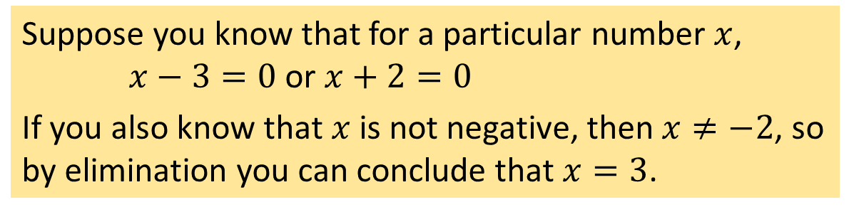
Logical Form and Logical Equivalence Conditional Statements Valid and Invalid Arguments
Rules of Inference: Elimination
2.3.4.3. Rules of Inference: Elimination
The following argument forms are valid.
p ∨ q
p ∨ q
When you have two possibilities and you can rule one out, the other must be the case.
~q
~p
• p
• q
Example:
Suppose you know that for a particular number $x$,
$x−3=0$or $x+2=0$
If you also know that $x$ is not negative, then $x≠−2$, so by elimination you can conclude that $x=3$.

Slide 71
Logical Form and Logical Equivalence Conditional Statements Valid and Invalid Arguments
Rules of Inference: Transitivity
2.3.4.4. Rules of Inference: Transitivity
The following argument form is valid.
p → q
Many arguments in mathematics contain chains of if-then statements.
From the fact that one statement implies a second and the second implies the third, you can conclude that the first statement implies the third.
q → r
• p → r
Example:
If 18,486 is divisible by 18, then 18,486 is divisible by 9.
If 18,486 is divisible by 9, then the sum of the digits of 18,486 is divisible by 9.
• If 18,486 is divisible by 18, then the sum of the digits of 18,486 is divisible by 9.

Slide 72
Logical Form and Logical Equivalence Conditional Statements Valid and Invalid Arguments
Rules of Inference: Proof by Division into Cases
2.3.4.5. Rules of Inference: Proof by Division into Cases
The following argument form is valid.
p ∨ q
It often happens that you know one thing or another is true. If you can show that in either case a certain conclusion follows, then this conclusion must also be true.
p → r
q → r
• r
Example:
Suppose you know that x is a nonzero real number.
The trichotomy property of the real numbers says that any number is positive, negative, or zero. Thus (by elimination) you know that x is positive or negative.
You can deduce that x² > 0 by arguing as follows:
x is positive or x is negative.
If x is positive, then x² > 0.
If x is negative, then x² > 0.
• x² > 0.

Slide 73

Logical Form and Logical Equivalence Conditional Statements Valid and Invalid Arguments
Rules of Inference: Example
2.3.4.6. Rules of Inference: Example
You are about to leave for school in the morning and discover that you don’t have your glasses. You know the following statements are true:
  If I was reading the newspaper in the kitchen, then my glasses are on the kitchen table.
  If my glasses are on the kitchen table, then I saw them at breakfast.
  I did not see my glasses at breakfast.
  I was reading the newspaper in the living room or I was reading the newspaper in the kitchen.
  If I was reading the newspaper in the living room then my glasses are on the coffee table.
So, where are your glasses?

Slide 74
Logical Form and Logical Equivalence Conditional Statements Valid and Invalid Arguments
Rules of Inference: Example
Let
  RK = I was reading the newspaper in the kitchen.
  GK = My glasses are on the kitchen table.
  SB = I saw my glasses at breakfast.
  RL = I was reading the newspaper in the living room.
  GC = My glasses are on the coffee table.
Here is a sequence of steps you might use to reach the answer, together with the rules of inference that allow you to draw the conclusion of each step:
1. RK → GK by (a)
GK → SB by (b)
• RK → SB by transitivity
3. RL ∨ RK by (d)
~RK by conclusion of (2)
• RL by elimination
2. RK → SB by conclusion of (1)
~SB by (c)
• ~RK by modus tollens
4. RL → GC by (e)
RL by conclusion of (3)
• GC by modus ponens
Thus the glasses are on the coffee table.


Slide 75
Logical Form and Logical Equivalence Conditional Statements Valid and Invalid Arguments
Fallacies
2.3.5. Fallacies
A fallacy is an error in reasoning that results in an invalid argument.
Three common fallacies:
  Using ambiguous premises and treating them as if they were unambiguous.
  Circular reasoning (assuming what is to be proved without having derived it from the premises)
  Jumping to a conclusion (without adequate grounds)

Slide 76


Logical Form and Logical Equivalence Conditional Statements Valid and Invalid Arguments
Fallacies: Converse Error
2.3.5.1. Fallacies: Converse Error
Example:
If Zeke is a cheater, then Zeke sits in the back row.
Zeke sits in the back row.
• Zeke is a cheater.
Note that this is just an example of a valid argument form. It is NOT related to the example above.
p → q
q → p
q
q
• p
• p
Converse error is also known as the fallacy of affirming the consequence.

Slide 77
Logical Form and Logical Equivalence Conditional Statements Valid and Invalid Arguments
Fallacies: Inverse Error
2.3.5.2. Fallacies: Inverse Error
Example:
If interest rates are going up, stock market prices will go down.
Interest rates are not going up.
• Stock market prices will not go down.
Note that this is just an example of a valid argument form. It is NOT related to the example above.
p → q
~p → ~q
~p
~p
• ~q
• ~q

Slide 78
Logical Form and Logical Equivalence Conditional Statements Valid and Invalid Arguments
Fallacies: A Valid Argument with a False Premise and a False Conclusion
2.3.5.3. Fallacies: A Valid Argument with a False Premise
The argument below is valid by modus ponens. But its major premise is false, and so is its conclusion.
If Joseph Schooling is a Singaporean, then Joseph Schooling is 2 metres tall.
Joseph Schooling is a Singaporean.
• Joseph Schooling is 2 metres tall.
This premise is false!

Slide 79
Logical Form and Logical Equivalence Conditional Statements Valid and Invalid Arguments
Fallacies: Sound and Unsound Arguments
2.3.5.5. Fallacies: Sound and Unsound Arguments
Definition 2.3.2 (Sound and Unsound Arguments)
An argument is called sound if, and only if, it is valid and all its premises are true.
An argument that is not sound is called unsound.

Slide 80
Logical Form and Logical Equivalence Conditional Statements Valid and Invalid Arguments
Contradictions and Valid Arguments
2.3.6. Contradictions and Valid Arguments
Contradiction Rule
If you can show that the supposition that statement p is false leads logically to a contradiction, then you can conclude that p is true.
premise
conclusion
~p → false
p | ~p | false | ~p → false | p
T | F | F | T | T
F | T | F | F
• p
Only one critical row, and in this row the conclusion is true.
Hence this form of argument is valid.
The contradiction rule is the heart of the method of proof by contradiction.
If an assumption leads to a contradiction, then that assumption must be false.

Slide 81
Logical Form and Logical Equivalence Conditional Statements Valid and Invalid Arguments
Summary of Rules of Inference
2.3.7. Summary of Rules of Inference
Table 2.3.1
Rule of inference
Modus Ponens | p → q p • q
Modus Tollens | p → q ~q • ~p
Generalization | p • p ∨ q | q • p ∨ q
Specialization | p ∧ q • p | p ∧ q • q
Conjunction | p q • p ∧ q

Slide 82
Logical Form and Logical Equivalence Conditional Statements Valid and Invalid Arguments
Summary of Rules of Inference
2.3.7. Summary of Rules of Inference
Table 2.3.1
(cont’d)
Rule of inference
Elimination | p ∨ q ~q • p | p ∨ q ~p • q
Transitivity | p → q q → r • p → r
Proof by Division Into Cases | p ∨ q p → r q → r • r
Contradiction Rule | ~p → false • p

Slide 83
Next week’s lectures
3. The Logic of Quantified Statements
∀
∃

Slide 84
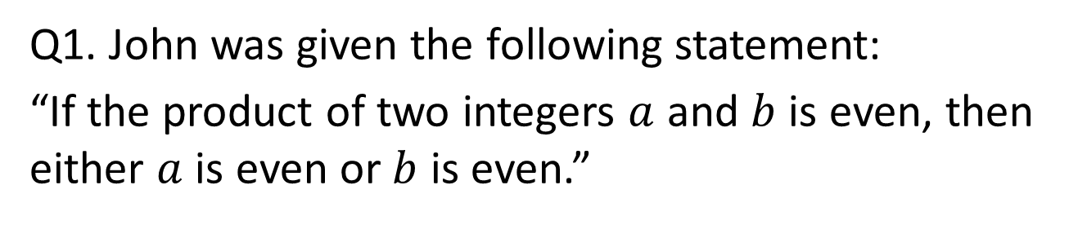
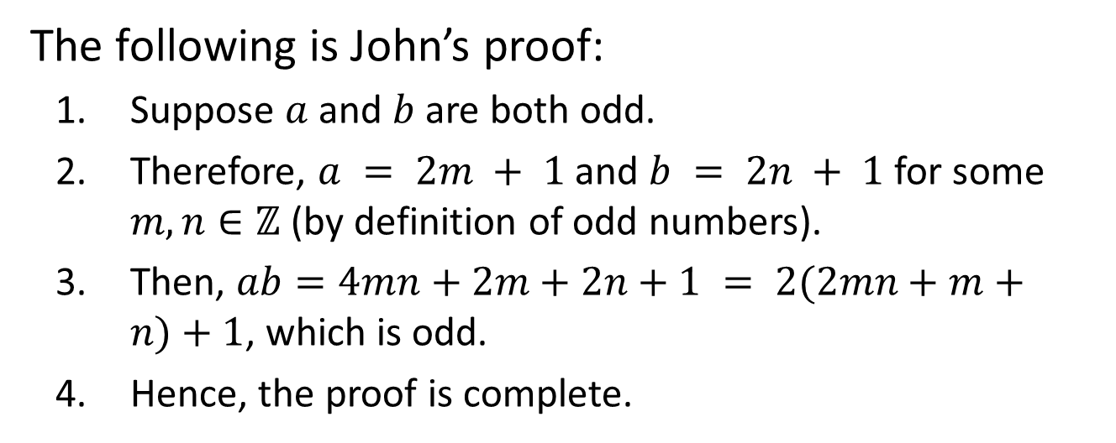
Past year’s midterm questions.
Q1. John was given the following statement:
“If the product of two integers $a$ and $b$ is even, then either $a$ is even or $b$ is even.”
The following is John’s proof:
Suppose $a$ and $b$ are both odd.
Therefore, $a = 2m + 1$and $b = 2n + 1$for some $m,n∈ℤ$ (by definition of odd numbers).
Then, $ab=4mn+2m+2n+1 = 2(2mn+m+n)+1$, which is odd.
Hence, the proof is complete.
What kind of proof did John use?
Proof by contraposition.


Slide 85
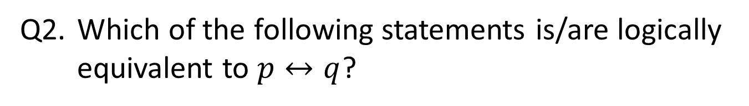
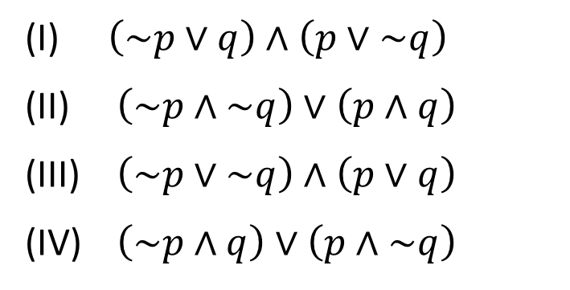
Past year’s midterm questions.
Q2. Which of the following statements is/are logically equivalent to $p↔q$?
(I) $\left(\sim p∨q\right)∧\left(p∨\sim q\right)$
(II) $\left(\sim p∧\sim q\right)∨\left(p∧q\right)$
(III) $\left(\sim p∨\sim q\right)∧\left(p∨q\right)$
(IV) $\left(\sim p∧q\right)∨\left(p∧\sim q\right)$


Slide 86
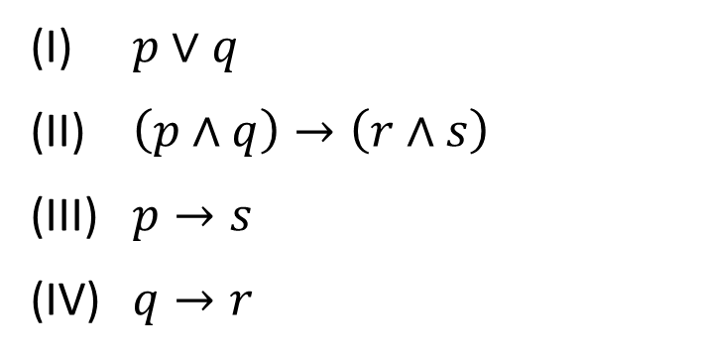
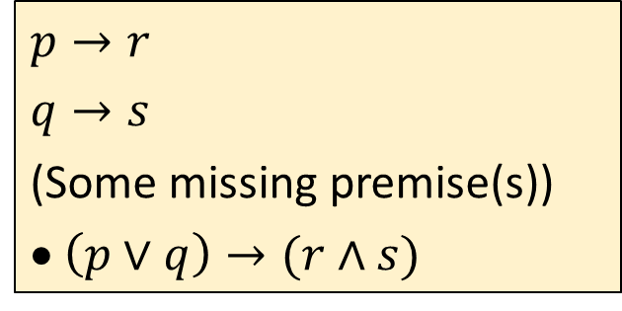
Past year’s midterm questions.
Q3. What is/are the missing premise(s) to make the following argument valid?
$$p→r$$
$$q→s$$
(Some missing premise(s))
• $\left(p∨q\right)→(r∧s)$
(I) $p∨q$
(II) $\left(p∧q\right)→\left(r∧s\right)$
(III) $p→s$
(IV) $q→r$


Slide 87
END OF FILE

