Slide 1
3. The Logic of Quantified Statements
Predicates & Quantified Statement I / II Statements with Multiple Quantifiers Arguments with Quantified Statements
Slides credits: Aaron Tan
3. The Logic of Quantified Statements
(aka Predicate Logic)
Ashish Dandekar
AY2026/27 Semester 1

Slide 2
Predicates & Quantified Statement I / II Statements with Multiple Quantifiers Arguments with Quantified Statements
3. The Logic of Quantified Statements
3.1 Predicates and Quantified Statements I
Predicate; domain; truth set
3.2 Predicates and Quantified Statements II
Negation of quantified statements; negation of universal conditional statements
Universal conditional statements; Implicit quantification
3.3 Statements with Multiple Quantifiers
Negations of multiply-quantified statements; order of quantifiers
Prolog
Universal quantifier ∀, existential quantifiers ∃ and ∃!
Vacuous truth of universal statements
Variants of universal conditional statements (contrapositive, converse, inverse)
Necessary and sufficient conditions, only if
3.4 Arguments with Quantified Statements
Universal instantiation; universal modus ponens; universal modus tollens
Reference: Epp’s Chapter 3 The Logic of Quantified Statements

Slide 3
Predicates & Quantified Statement I / II Statements with Multiple Quantifiers Arguments with Quantified Statements
3.1 Predicates and Quantified Statements I

Slide 4
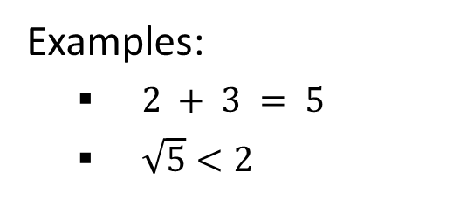
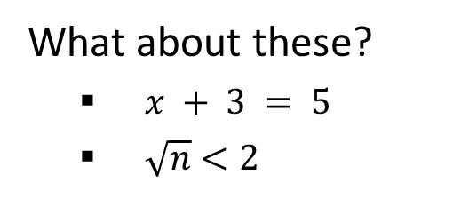
Predicates & Quantified Statement I / II Statements with Multiple Quantifiers Arguments with Quantified Statements
Proposition and Predicate
Proposition and Predicate
In the previous lecture, we introduced statements (or propositions). A statement (or proposition) can be true or false, but not both.
Examples:
$2 + 3 = 5$
$\sqrt{5}<2$
What about these?
$x + 3 = 5$
$\sqrt{n}<2$
A statement’s (or proposition’s) truth value does not depend on any variables. A predicate’s truth value depends on the variable(s) in it.

Slide 5
Predicates & Quantified Statement I / II Statements with Multiple Quantifiers Arguments with Quantified Statements
Predicates and Quantified Statements I
3.1.1. Predicates and Quantified Statements I
In logic, predicates can be obtained by removing some or all of the nouns from a statement. For instance, let P stand for “is a student at NUS” and let Q stand for “is a student at.” Then both P and Q are predicate symbols.
Predicate variables:
P(x) = “x is a student at NUS”
Q(x, y) = “x is a student at y”
When concrete values are substituted in place of predicate variables, a statement results.

Slide 6
Predicates & Quantified Statement I / II Statements with Multiple Quantifiers Arguments with Quantified Statements
Predicates and Quantified Statements I
For simplicity, we define a predicate to be a predicate symbol together with suitable predicate variables.
In some treatments of logic, such objects are referred to as propositional functions or open sentences.
Definition 3.1.1 (Predicate)
A predicate is a sentence that contains a finite number of variables and becomes a statement when specific values are substituted for the variables.
The domain of a predicate variable is the set of all values that may be substituted in place of the variable.
“Domain” may also be known as “domain of discourse”, “universe of discourse”, “universal set”, or simply “universe”. The last three terms are usually used in set theory.

Slide 7
Predicates & Quantified Statement I / II Statements with Multiple Quantifiers Arguments with Quantified Statements
Predicates and Quantified Statements I
When an element in the domain of the variable of a one-variable predicate is substituted for the variable, the resulting statement is either true or false. The set of all such elements that make the predicate true is called the truth set of the predicate.
Definition 3.1.2 (Truth set)
If P(x) is a predicate and x has domain D, the truth set is the set of all elements of D that make P(x) true when they are substituted for x.
The truth set of P(x) is denoted {x ∈ D | P(x)}.
In set theory, the symbol | is used to mean “such that”.

Slide 8
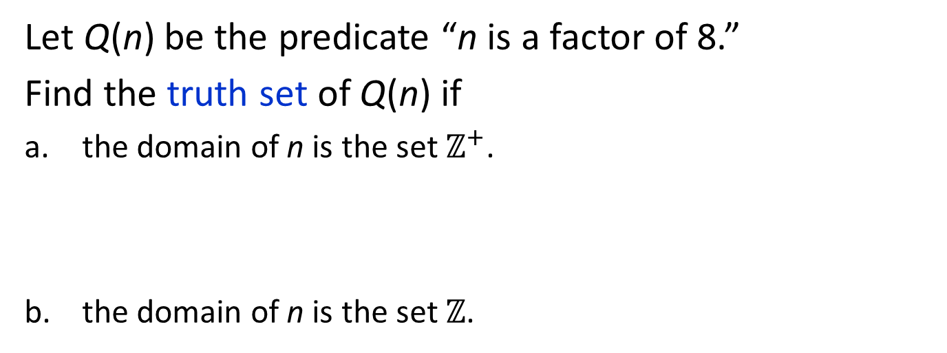
Predicates & Quantified Statement I / II Statements with Multiple Quantifiers Arguments with Quantified Statements
Predicates and Quantified Statements I: Finding the Truth Set of a Predicate
Let Q(n) be the predicate “n is a factor of 8.”
Find the truth set of Q(n) if
the domain of n is the set $ℤ^{+}$.
the domain of n is the set $ℤ$.
{1, 2, 4, 8} because these are exactly the positive integers that divide 8 evenly.
{1, 2, 4, 8, -1, -2, -4, -8}


Slide 9
Predicates & Quantified Statement I / II Statements with Multiple Quantifiers Arguments with Quantified Statements
The Universal Quantifier: ∀
3.1.2. The Universal Quantifier: ∀
One sure way to change predicates into statements is to assign specific values to all their variables.
Example:
If x represents the number 35, the sentence “x is divisible by 5” is a true statement.
Another way to obtain statements from predicates is to add quantifiers.

Slide 10
Predicates & Quantified Statement I / II Statements with Multiple Quantifiers Arguments with Quantified Statements
The Universal Quantifier: ∀
Quantifiers are words that refer to quantities such as “some” or “all” and tell for how many elements a given predicate is true.
The symbol ∀ denotes “for all” (or “for any”, “for every”, “for each”) and is called the universal quantifier.
Definition 3.1.3 (Universal Statement)
Let Q(x) be a predicate and D the domain of x. A universal statement is a statement of the form “∀x∈D, Q(x)”.
It is defined to be true iff Q(x) is true for every x in D.
It is defined to be false iff Q(x) is false for at least one x in D.
A value for x for which Q(x) is false is called a counterexample.

Slide 11
Predicates & Quantified Statement I / II Statements with Multiple Quantifiers Arguments with Quantified Statements
The Universal Quantifier: Truth and Falsity of Universal Statements
Truth and Falsity of Universal Statements
Let D = {1, 2, 3, 4, 5}, and consider the statement
∀x∈D (x² ≥ x).
Show that this statement is true.
Check that “x² ≥ x” is true for each x in D.
1² ≥ 1, 2² ≥ 2, 3² ≥ 3, 4² ≥ 4, 5² ≥ 5.
Hence “∀x∈D (x² ≥ x)” is true.
This method is called the method of exhaustion.

Slide 12
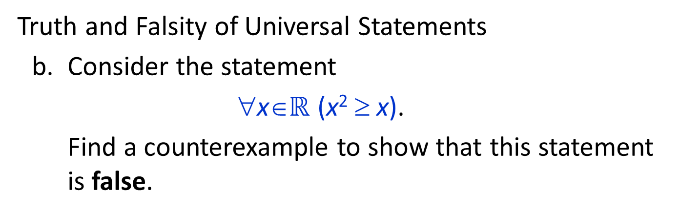
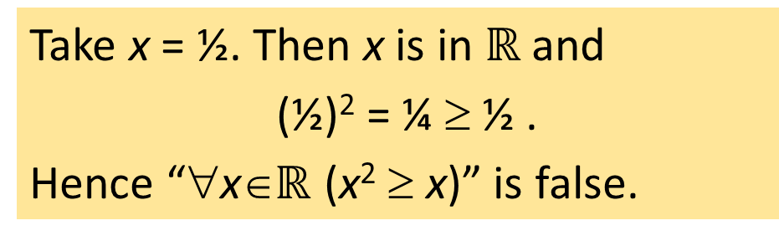
Predicates & Quantified Statement I / II Statements with Multiple Quantifiers Arguments with Quantified Statements
The Universal Quantifier: Truth and Falsity of Universal Statements
Truth and Falsity of Universal Statements
Consider the statement
∀x∈$ℝ$ (x² ≥ x).
Find a counterexample to show that this statement is false.
Take x = ½. Then x is in $ℝ$ and
(½)² = ¼ ≥ ½ .
Hence “∀x∈$ℝ$ (x² ≥ x)” is false.


Slide 13
Predicates & Quantified Statement I / II Statements with Multiple Quantifiers Arguments with Quantified Statements
The Existential Quantifiers: : ∃
3.1.3. The Existential Quantifier: ∃
Example: “There is a student in CS1231S” can be written as
∃ a person p such that p is a student in CS1231S.
Or, more formally,
∃p ∈P such that p is a student in CS1231S.
where P is the set of all people.
The words such that are inserted just before the predicate. If the context is clear, sometimes the abbreviation s.t. is used.
Some alternative expressions for “there exists” are “there is a”, “we can find a”, “there is at least one”, “for some”, and “for at least one”.

Slide 14
Predicates & Quantified Statement I / II Statements with Multiple Quantifiers Arguments with Quantified Statements
The Existential Quantifier: ∃
Sentences that are quantified existentially are defined as statements by giving them the truth values specified in the following definition.
Definition 3.1.4 (Existential Statement)
Let Q(x) be a predicate and D the domain of x. An existential statement is a statement of the form “∃x∈D such that Q(x)”.
It is defined to be true iff Q(x) is true for at least one x in D.
It is defined to be false iff Q(x) is false for all x in D.

Slide 15

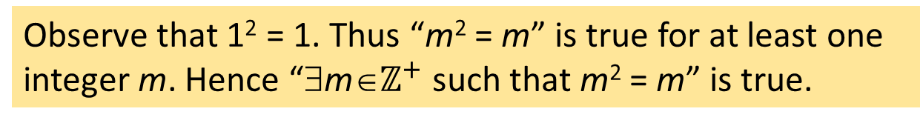
Predicates & Quantified Statement I / II Statements with Multiple Quantifiers Arguments with Quantified Statements
The Existential Quantifier: Truth and Falsity of Existential Statements
Truth and Falsity of Existential Statements
Show that the following statement is true.
∃m∈$ℤ^{+}$ such that m² = m.
Observe that 1² = 1. Thus “m² = m” is true for at least one integer m. Hence “∃m∈$ℤ^{+}$ such that m² = m” is true.
Let E = {5, 6, 7, 8}. Show that the following statement is false.
∃m∈E such that m² = m.
Note that m² = m is not true for any integer m from 5 through 8: 5² = 25 ≠ 5, 6² = 36 ≠ 6, 7² = 49 ≠ 7,
8² = 64 ≠ 8.
Hence “∃m∈E such that m² = m” is false.

Slide 16
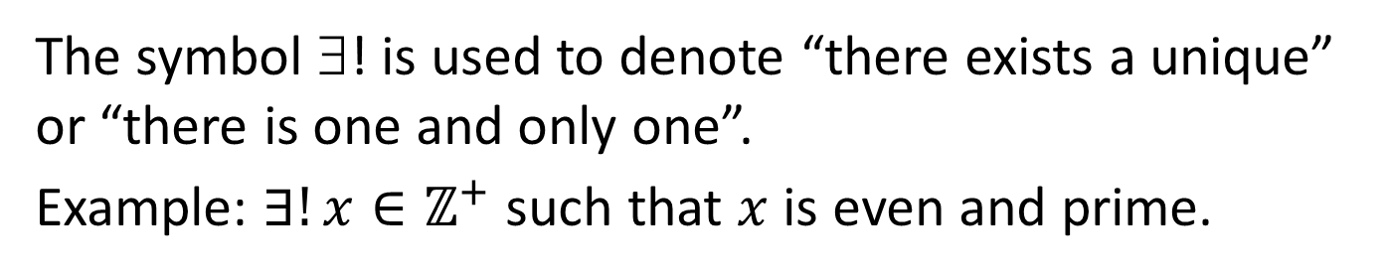
Predicates & Quantified Statement I / II Statements with Multiple Quantifiers Arguments with Quantified Statements
The Existential Quantifier: : ∃!
3.1.3. The Existential Quantifier: ∃!
The symbol ∃! is used to denote “there exists a unique” or “there is one and only one”.
Example: $∃!x∈ℤ^{+}$ such that $x$ is even and prime.
Can we re-write this using quantifiers and logical connectives?

Slide 17
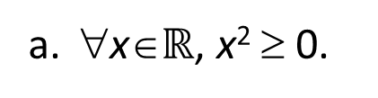
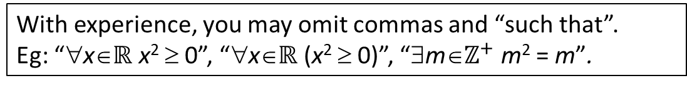
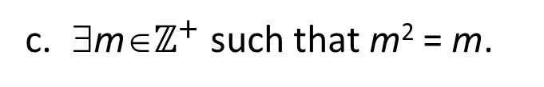
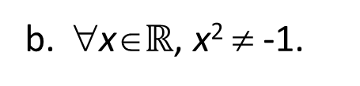
Predicates & Quantified Statement I / II Statements with Multiple Quantifiers Arguments with Quantified Statements
Formal Versus Informal Language
3.1.4. Formal Versus Informal Language
Rewrite the following formal statements in a variety of equivalent but more informal ways. Do not use the symbol ∀ or ∃.
All real numbers have non-negative squares.
Every/Any real number has a non-negative square.
∀x∈$ℝ$, x² ≥ 0.
∀x∈$ℝ$, x² ≠ -1.
All real numbers have squares that are not -1.
No real numbers have squares equal to -1.
∃m∈$ℤ^{+}$ such that m² = m.
There is a positive integer whose square is itself.
Some positive integer equals its own square.
With experience, you may omit commas and “such that”.
Eg: “∀x∈$ℝ$ x² ≥ 0”, “∀x∈$ℝ$ (x² ≥ 0)”, “∃m∈$ℤ^{+}$ m² = m”.

Slide 18

Predicates & Quantified Statement I / II Statements with Multiple Quantifiers Arguments with Quantified Statements
Universal Conditional Statements
3.1.5. Universal Conditional Statements
A reasonable argument can be made that the most important form of statement in mathematics is the universal conditional statement:
∀x (if P(x) then Q(x)).
or
∀x (P(x) $→$ Q(x)).
Familiarity with statements of this form is essential if you are to learn to speak mathematics.

Slide 19
Predicates & Quantified Statement I / II Statements with Multiple Quantifiers Arguments with Quantified Statements
Equivalent Forms of Universal and Existential Statements
3.1.6. Equivalent Forms of Universal and Existential Statements
Are these two statements the same?
∀ real numbers x, if x is an integer then x is rational.
∀ integers x, x is rational.
Yes, they have the same informal translation:
All integers are rational.


Slide 20

Predicates & Quantified Statement I / II Statements with Multiple Quantifiers Arguments with Quantified Statements
Equivalent Forms of Universal and Existential Statements
By narrowing U to be the domain D consisting of all values of the variable x that make P(x) true,
∀x∈U (P(x) $→$ Q(x))
∀x∈D, Q(x)
Rewrite the statement “All squares are rectangles” in the two forms:
∀x, (if then ).
∀ x, .
x is a square
x is a rectangle
squares
x is a rectangle


Slide 21
Predicates & Quantified Statement I / II Statements with Multiple Quantifiers Arguments with Quantified Statements
Equivalent Forms of Universal and Existential Statements
Similarly,
∃x∈U such that (P(x) and Q(x))
∃x∈D such that Q(x)
where D is the set of all x for which P(x) is true.

Slide 22
Predicates & Quantified Statement I / II Statements with Multiple Quantifiers Arguments with Quantified Statements
Equivalent Forms of Universal and Existential Statements
A prime number is an integer whose only positive integer factors are itself and 1. Consider the statement
“There is an integer that is both prime and even.”
Let Prime(n) be “n is prime” and Even(n) be “n is even”. Use the notation Prime(n) and Even(n) to rewrite this statement into the following two forms:
∃n such that ( ∧ ).
Prime(n)
Even(n)
∃ n such that .
an even number
Prime(n)


Slide 23
Predicates & Quantified Statement I / II Statements with Multiple Quantifiers Arguments with Quantified Statements
Implicit Quantification
3.1.7. Implicit Quantification
Mathematical writing contains many examples of implicitly quantified statements. Some occur, through the presence of the word a or an. Others occur in cases where the general context of a sentence supplies part of its meaning.
For example, in an algebra course in which the letter x is always used to indicate a real number, the predicate
If x > 2 then x² > 4
is interpreted to mean the same as the statement
∀ real numbers x, (if x > 2 then x² > 4).

Slide 24
Predicates & Quantified Statement I / II Statements with Multiple Quantifiers Arguments with Quantified Statements
Tarski’s World
3.1.8. Tarski’s World
Tarski’s World is a computer program developed by information scientists Jon Barwise and John Etchemendy to help teach the principles of logic.
It is described in their book The Language of First-Order Logic, which is accompanied by a CD-ROM containing the program Tarski’s World, named after the great logician Alfred Tarski.

Slide 25
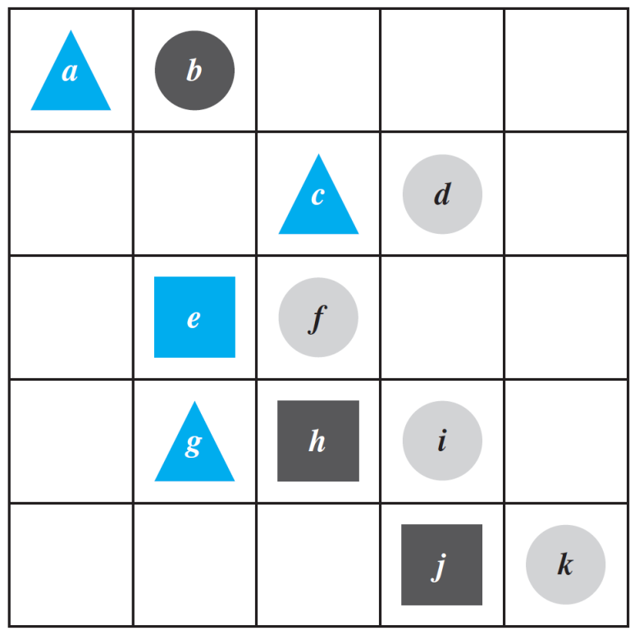
Predicates & Quantified Statement I / II Statements with Multiple Quantifiers Arguments with Quantified Statements
Tarski’s World
The program for Tarski’s World provides pictures of blocks of various sizes, shapes, and colors, which are located on a grid.
Shown in Figure 3.1.1 is a picture of an arrangement of objects in a two-dimensional Tarski world.
Figure 3.1.1

Slide 26
Predicates & Quantified Statement I / II Statements with Multiple Quantifiers Arguments with Quantified Statements
Tarski’s World
The configuration can be described using logical operators and — for the two-dimensional version —notation such as:
Triangle(x), meaning “x is a triangle,”
Blue(y), meaning “y is blue,” and
RightOf(x, y), meaning “x is to the right of y (but possibly in a different row).”
Individual objects can be given names such as a, b, or c.

Slide 27
Predicates & Quantified Statement I / II Statements with Multiple Quantifiers Arguments with Quantified Statements
Tarski’s World
Determine the truth or falsity of the following statements. The domain for all variables is the set of objects in the Tarski’s world shown on the right.
∀t (Triangle(t) → Blue(t)).
∀x (Blue(x) → Triangle(x)).
True
False
Figure 3.1.1
∃y such that (Square(y) ∧ RightOf(d, y)).
∃z such that (Square(z) ∧ Gray(z)).
True
False


Slide 28
Predicates & Quantified Statement I / II Statements with Multiple Quantifiers Arguments with Quantified Statements
3.2 Predicates and Quantified Statements II

Slide 29
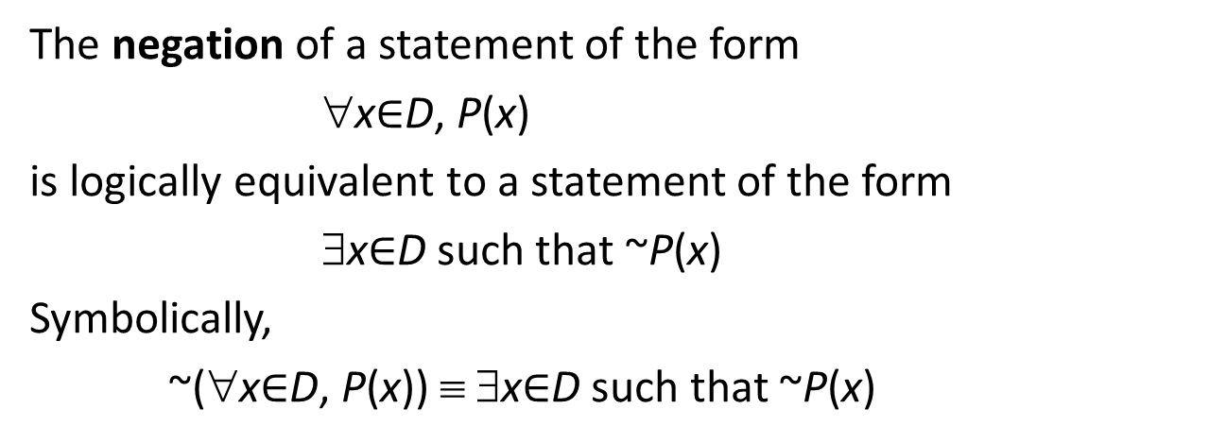
Predicates & Quantified Statement I / II Statements with Multiple Quantifiers Arguments with Quantified Statements
Negations of Quantified Statements: Negation of a Universal Statement
3.2.1. Negations of Quantified Statements
Theorem 3.2.1 Negation of a Universal Statement
The negation of a statement of the form
∀x$∈$D, P(x)
is logically equivalent to a statement of the form
∃x$∈$D such that ~P(x)
Symbolically,
~(∀x$∈$D, P(x)) ≡ ∃x$∈$D such that ~P(x)
That is, the negation of a universal statement (“all are”) is logically equivalent to an existential statement (“some are not” or “there is at least one that is not”).

Slide 30
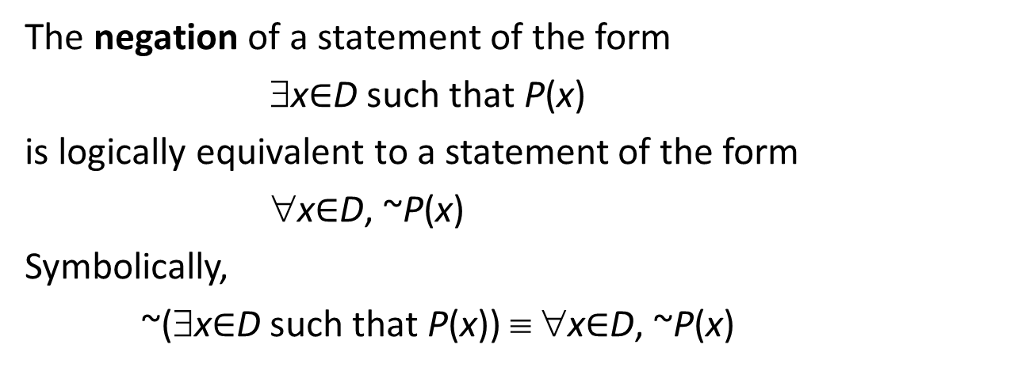
Predicates & Quantified Statement I / II Statements with Multiple Quantifiers Arguments with Quantified Statements
Negations of Quantified Statements: Negation of an Existential Statement
Theorem 3.2.2 Negation of an Existential Statement
The negation of a statement of the form
∃x$∈$D such that P(x)
is logically equivalent to a statement of the form
∀x$∈$D, ~P(x)
Symbolically,
~(∃x$∈$D such that P(x)) ≡ ∀x$∈$D, ~P(x)
That is, the negation of an existential statement (“some are”) is logically equivalent to a universal statement (“none are” or “all are not”).

Slide 31
Predicates & Quantified Statement I / II Statements with Multiple Quantifiers Arguments with Quantified Statements
Negations of Quantified Statements: Quick Quiz
Write formal negations for the following statements:
∀ primes p, p is odd.
∃ a triangle T such that the sum of the angles of T equals 200°.
∃a prime p such that p is not odd.
∀ triangles T, the sum of the angles of T does not equal 200°.


Slide 32



Predicates & Quantified Statement I / II Statements with Multiple Quantifiers Arguments with Quantified Statements
Negations of Universal Conditional Statements
3.2.2. Negations of Universal Conditional Statements
Of special importance in mathematics.
~(∀x (P(x) → Q(x)))
$$≡$$
∃x such that ~(P(x) → Q(x))
… (A)
~(P(x) → Q(x))
$$≡$$
P(x) ∧ ~Q(x)
… (B)
Substituting (B) into (A):
~(∀x (P(x) → Q(x)))
$$≡$$
∃x such that (P(x) ∧ ~Q(x))

Slide 33
Predicates & Quantified Statement I / II Statements with Multiple Quantifiers Arguments with Quantified Statements
Negations of Universal Conditional Statements: Quick Quiz
Write a formal negation for statement (a) and an informal negation for statement (b):
∀ people p, if p is blond then p has blue eyes.
If a computer program has more than 100,000 lines, then it contains a bug.
∃a person p such that p is blond and p does not have blue eyes.
There is at least one computer program that has more than 100,000 lines and does not contain a bug.


Slide 34


Predicates & Quantified Statement I / II Statements with Multiple Quantifiers Arguments with Quantified Statements
The Relation among ∀, ∃, ∧, and ∨
3.2.3. The Relation among ∀, ∃, ∧, and ∨
$$∀$$
$$∃$$
Negate
Analogous to De Morgan’s laws, which state that the negation of an and statement is an or statement and that the negation of an or statement is an and statement.
This similarity is not accidental. In a sense, universal statements are generalizations of and statements, and existential statements are generalizations of or statements.

Slide 35


Predicates & Quantified Statement I / II Statements with Multiple Quantifiers Arguments with Quantified Statements
The Relation among ∀, ∃, ∧, and ∨
If Q(x) is a predicate and the domain D of x is the set {x₁, x_{2 ,}…, x_{n}}, then
∀x∈D, Q(x)
$$≡$$
Q(x₁) ∧ Q(x₂) ∧ … ∧ Q(x_{n})
Similarly,
∃x∈D, Q(x)
$$≡$$
Q(x₁) ∨ Q(x₂) ∨ … ∨ Q(x_{n})

Slide 36
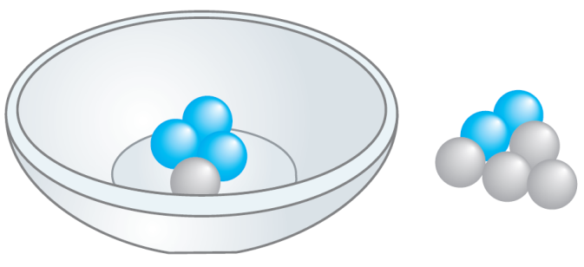
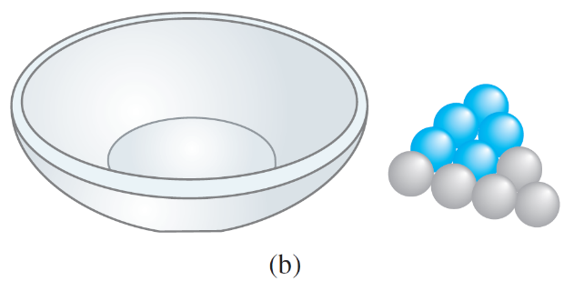
Predicates & Quantified Statement I / II Statements with Multiple Quantifiers Arguments with Quantified Statements
Vacuous Truth of Universal Statements
3.2.4. Vacuous Truth of Universal Statements
Suppose a bowl sits on a table and next to the bowl is a pile of five blue and five gray balls, any of which may be placed in the bowl.
If three blue balls and one gray ball are placed in the bowl, as shown in Figure 3.2.1(a), the statement “All the balls in the bowl are blue” would be false (since one of the balls in the bowl is gray).
Figure 3.2.1(a)
Now suppose that no balls at all are placed in the bowl, as shown in Figure 3.2.1(b).
Consider the statement:
All the balls in the bowl are blue.
Figure 3.2.1(b)

Slide 37
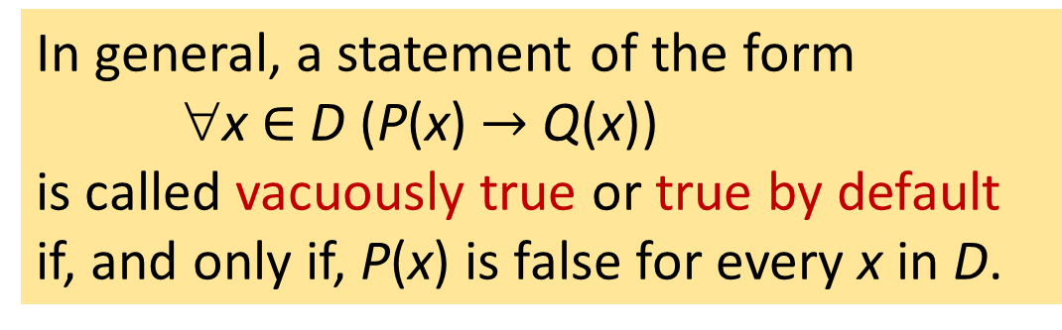
Predicates & Quantified Statement I / II Statements with Multiple Quantifiers Arguments with Quantified Statements
Vacuous Truth of Universal Statements
Now, is the statement “All the balls in the bowl are blue” true or false?
The statement is false if, and only if, its negation is true.
And its negation is: There exists a ball in the bowl that is not blue.
Figure 3.2.1(b)
But the only way this negation can be true is for there actually to be a non-blue ball in the bowl.
And there is not! Hence the negation is false, and so the statement is true “by default”.
In general, a statement of the form
∀x $∈$ D (P(x) $→$ Q(x))
is called vacuously true or true by default if, and only if, P(x) is false for every x in D.

Slide 38
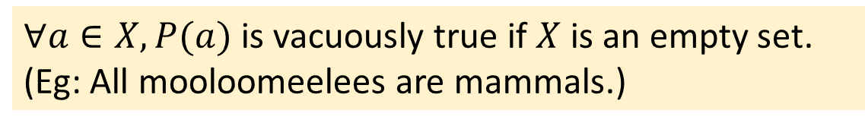
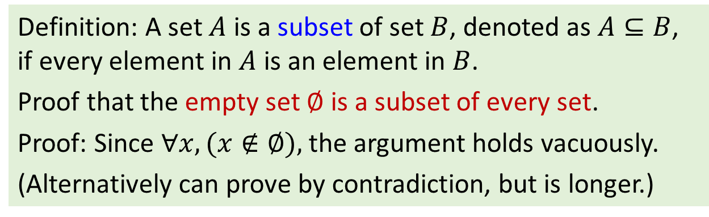
Predicates & Quantified Statement I / II Statements with Multiple Quantifiers Arguments with Quantified Statements
Vacuous Truth of Universal Statements
A vacuous truth is a conditional or universal statement that is only true because the hypothesis (antecedent) cannot be satisfied.
For this reason, sometimes we say a statement is vacuously true only because it does not really say anything.
$∀a∈X, P(a)$ is vacuously true if $X$ is an empty set. (Eg: All mooloomeelees are mammals.)
Definition: A set $A$ is a subset of set $B$, denoted as $A⊆B$, if every element in $A$ is an element in $B$.
Proof that the empty set $∅$ is a subset of every set.
Proof: Since $∀x,(x∉∅),$the argument holds vacuously.
(Alternatively can prove by contradiction, but is longer.)

Slide 39
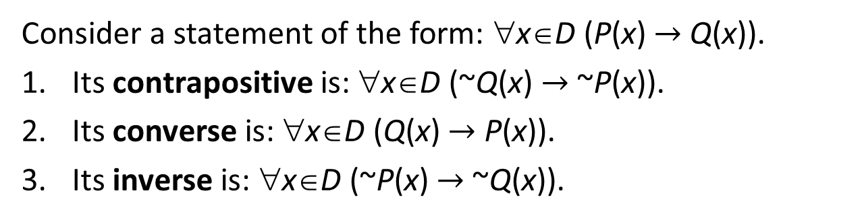
Predicates & Quantified Statement I / II Statements with Multiple Quantifiers Arguments with Quantified Statements
Variants of Universal Conditional Statements
3.2.5. Variants of Universal Conditional Statements
We have known that a conditional statement has a contrapositive, a converse, and an inverse.
The definitions of these terms can be extended to universal conditional statements.
Definition 3.2.1 (Contrapositive, converse, inverse)
Consider a statement of the form: ∀x∈D (P(x) $→$ Q(x)).
Its contrapositive is: ∀x∈D (~Q(x) $→$ ~P(x)).
Its converse is: ∀x∈D (Q(x) $→$ P(x)).
Its inverse is: ∀x∈D (~P(x) $→$ ~Q(x)).

Slide 40
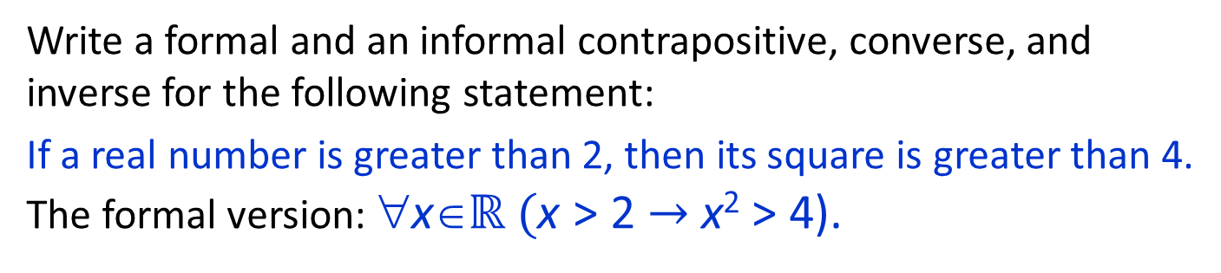
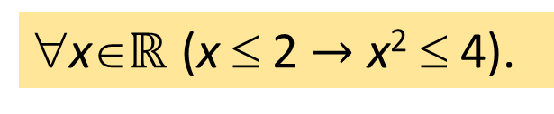
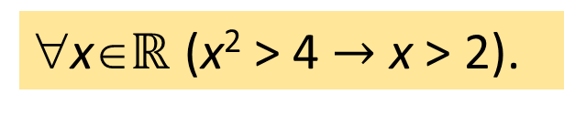
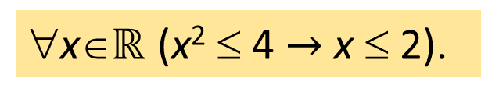
Predicates & Quantified Statement I / II Statements with Multiple Quantifiers Arguments with Quantified Statements
Variants of Universal Conditional Statements
Write a formal and an informal contrapositive, converse, and inverse for the following statement:
If a real number is greater than 2, then its square is greater than 4.
The formal version: ∀x∈$ℝ ($x > 2 $→$ x² > 4).
Contrapositive:
∀x∈$ℝ$ (x² ≤ 4 $→$ x ≤ 2).
If the square of a real number is less than or equal to 4, then the number is less than or equal to 2.
Converse:
∀x∈$ℝ$ (x² > 4 $→$ x > 2).
If the square of a real number is greater than 4, then the number is greater than 2.
Inverse:
∀x∈$ℝ$ (x ≤ 2 $→$ x² ≤ 4).
If a real number is less than or equal to 2, then the square of the number is less than or equal to 4.


Slide 41

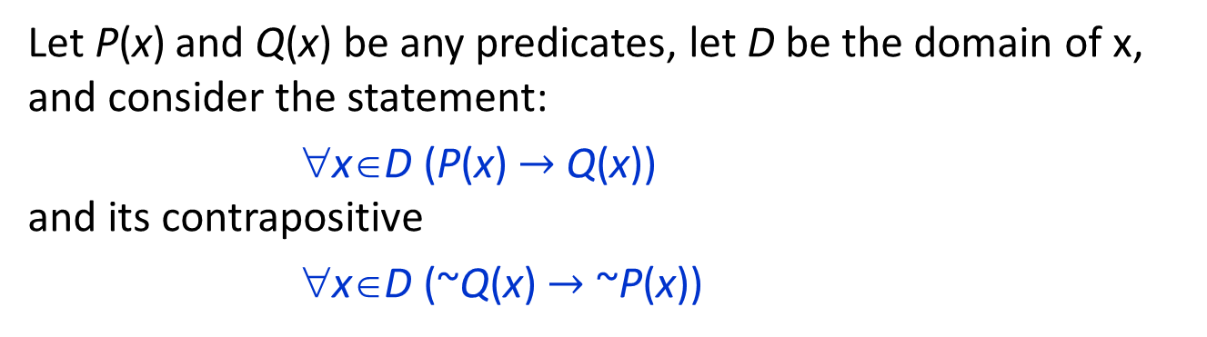
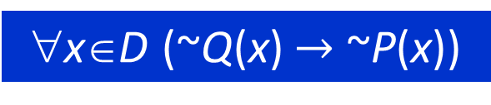
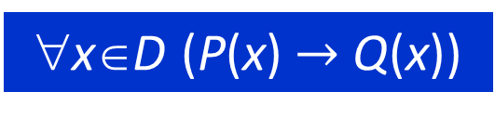
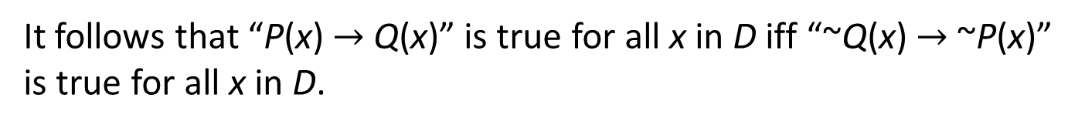
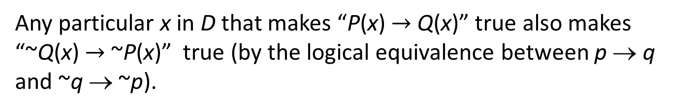
Predicates & Quantified Statement I / II Statements with Multiple Quantifiers Arguments with Quantified Statements
Variants of Universal Conditional Statements
Let P(x) and Q(x) be any predicates, let D be the domain of x, and consider the statement:
∀x∈D (P(x) $→$ Q(x))
and its contrapositive
∀x∈D (~Q(x) $→$ ~P(x))
Any particular x in D that makes “P(x) $→$ Q(x)” true also makes “~Q(x) $→$ ~P(x)” true (by the logical equivalence between p → q and ~q → ~p).
It follows that “P(x) $→$ Q(x)” is true for all x in D iff “~Q(x) $→$ ~P(x)” is true for all x in D.
∀x∈D (P(x) $→$ Q(x))
$$≡$$
∀x∈D (~Q(x) $→$ ~P(x))

Slide 42
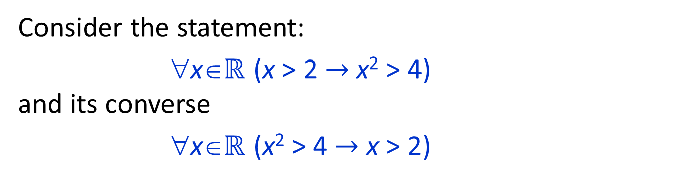
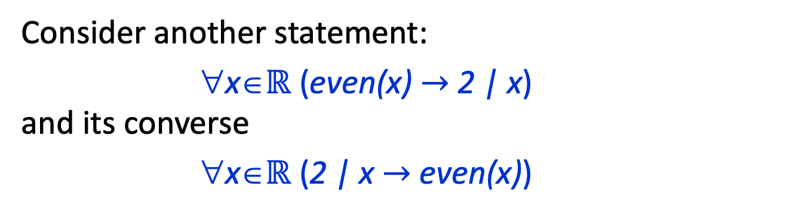

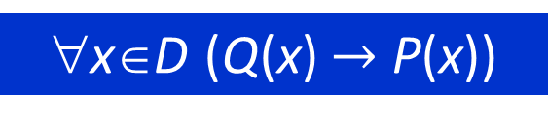
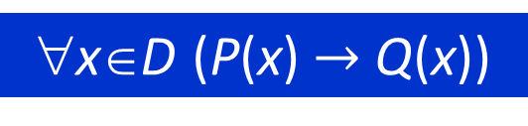
Predicates & Quantified Statement I / II Statements with Multiple Quantifiers Arguments with Quantified Statements
Variants of Universal Conditional Statements
Consider the statement:
∀x∈$ℝ$ (x > 2 $→$ x² > 4)
and its converse
∀x∈$ℝ$ (x² > 4 $→$ x > 2)
True
False
Consider another statement:
∀x∈$ℝ$ (even(x) $→$ 2 | x)
and its converse
∀x∈$ℝ$ (2 | x $→$ even(x))
True
True
A universal conditional statement is not logically equivalent to its converse.
∀x∈D (P(x) $→$ Q(x))
$$≢$$
∀x∈D (Q(x) $→$ P(x))

Slide 43
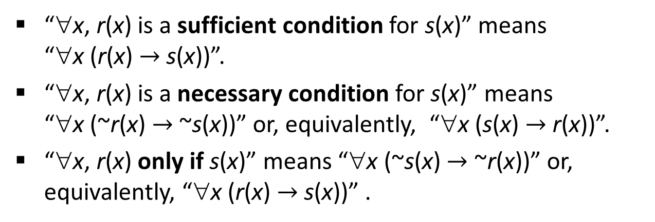
Predicates & Quantified Statement I / II Statements with Multiple Quantifiers Arguments with Quantified Statements
Necessary and Sufficient Conditions, Only if
3.2.6. Necessary and Sufficient Conditions, Only if
The definitions of necessary, sufficient, and only if can also be extended to apply to universal conditional statements.
Definition 3.2.2 (Necessary and Sufficient conditions, Only if)
“∀x, r(x) is a sufficient condition for s(x)” means
“∀x (r(x) $→$ s(x))”.
“∀x, r(x) is a necessary condition for s(x)” means
“∀x (~r(x) $→$ ~s(x))” or, equivalently, “∀x (s(x) $→$ r(x))”.
“∀x, r(x) only if s(x)” means “∀x (~s(x) $→$ ~r(x))” or, equivalently, “∀x (r(x) $→$ s(x))” .

Slide 44
Predicates & Quantified Statement I / II Statements with Multiple Quantifiers Arguments with Quantified Statements
Necessary and Sufficient Conditions, Only if
Rewrite the following statements as quantified conditional statements. Do not use the word necessary or sufficient:
Squareness is a sufficient condition for rectangularity.
Being at least 35 years old is a necessary condition for being President of the United States.
∀x, if x is a square, then x is a rectangle.
Informal: If a figure is a square, then it is a rectangle.
∀people x, if x is younger than 35, then x cannot be President of the United States.
or
∀people x, if x is President of the United States, then x is at least 35 years old.


Slide 45



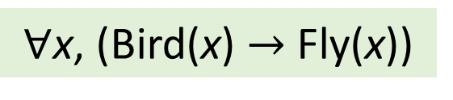
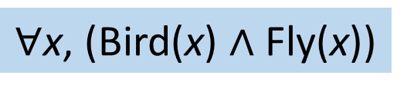
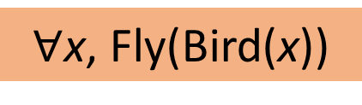
Common beginners’ mistakes
Given the following predicates:
Bird(x): x is a bird
Fly(x): x can fly
Write a quantified statement for the following sentence: All birds can fly.
Answer:
Why? Bird(x) is a predicate; it evaluates to true or false. This is like writing Fly(true) or Fly(false)!
$∀$x, Fly(Bird(x))
$∀$x, (Bird(x) $∧$ Fly(x))
Why? This is saying everything must be a bird and it flies!
$∀$x, (Bird(x) $→$ Fly(x))


Slide 46
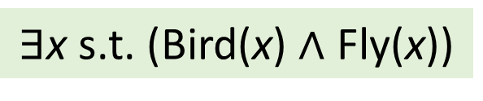
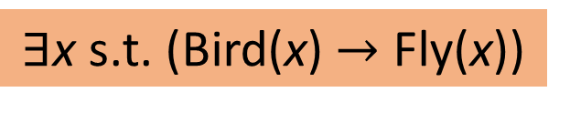
Common beginners’ mistakes
2. Write a quantified statement for the following sentence:
There is a bird that can fly.
Answer:
$∃$x s.t. (Bird(x)$→$ Fly(x))
What if there are no birds at all?
$∃$x s.t. (Bird(x)$∧$ Fly(x))


Slide 47
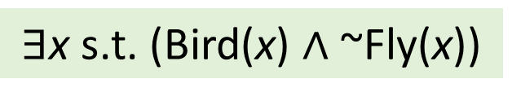
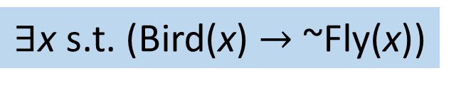
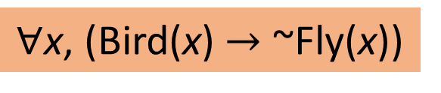
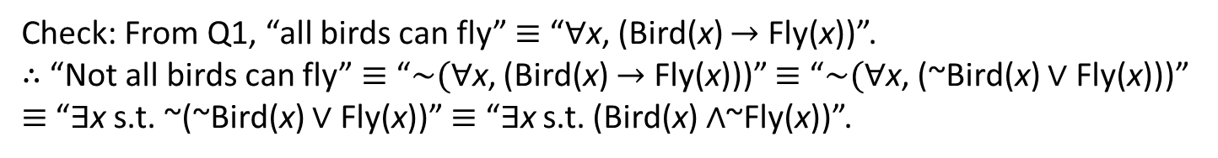
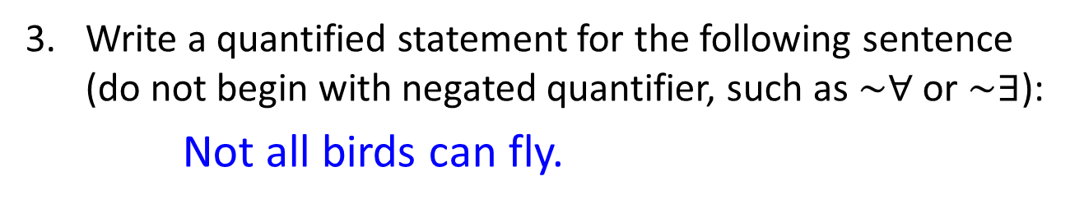
Common beginners’ mistakes
3. Write a quantified statement for the following sentence (do not begin with negated quantifier, such as $\sim ∀$ or $\sim ∃$):
Not all birds can fly.
Answer:
$∀$x, (Bird(x)$→$ ~Fly(x))
This means all birds can’t fly!
$∃$x s.t. (Bird(x) $→$ ~Fly(x))
Again, what if there are no birds?
$∃$x s.t. (Bird(x) $∧$ ~Fly(x))
Check: From Q1, “all birds can fly” $≡$ “$∀$x, (Bird(x) $→$ Fly(x))”.
$∴$ “Not all birds can fly” $≡$ “$\sim (∀$x, (Bird(x) $→$ Fly(x)))” $≡$ “$\sim (∀$x, (~Bird(x) $∨$ Fly(x)))” $≡$ “$∃$x s.t. ~(~Bird(x) $∨$ Fly(x))” $≡$ “$∃$x s.t. (Bird(x) $∧$~Fly(x))”.


Slide 48
Predicates & Quantified Statement I / II Statements with Multiple Quantifiers Arguments with Quantified Statements
3.3 Statements with Multiple Quantifiers

Slide 49
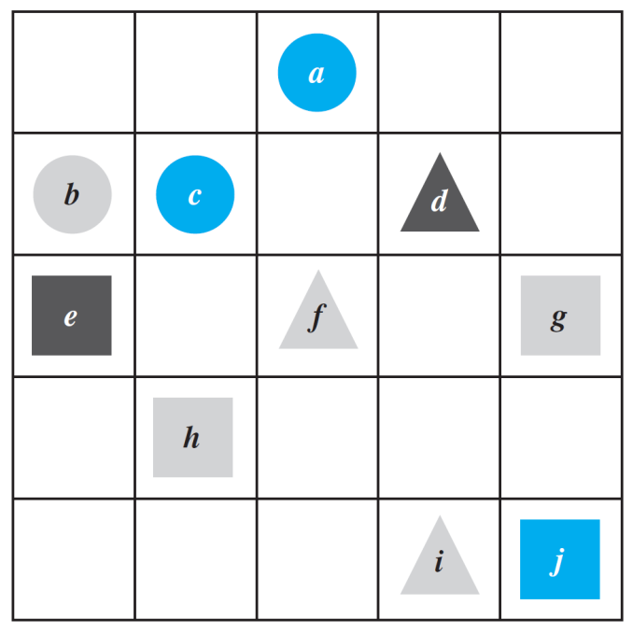
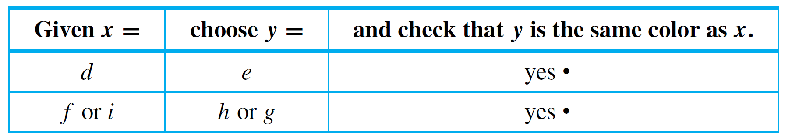
Predicates & Quantified Statement I / II Statements with Multiple Quantifiers Arguments with Quantified Statements
Statements with Multiple Quantifiers
Consider the Tarski’s world again.
Show that the following statement is true:
For all triangles x, there is a square y such that x and y have the same color.
The statement says that no matter which triangle someone gives you, you will be able to find a square of the same color.
There are only 3 triangles d, f, and i.
Figure 3.3.1

Slide 50
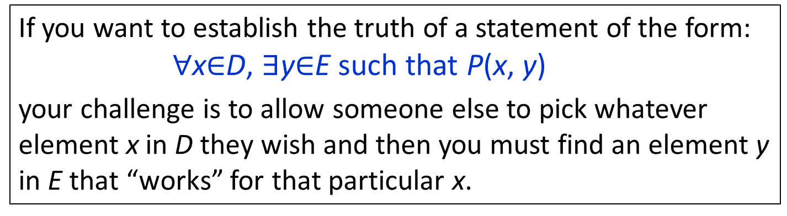
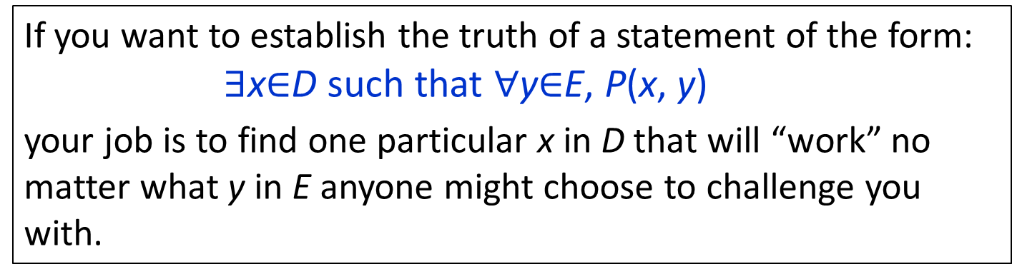
Predicates & Quantified Statement I / II Statements with Multiple Quantifiers Arguments with Quantified Statements
Statements with Multiple Quantifiers
3.3.1. Interpreting Multiply-Quantified Statements
If you want to establish the truth of a statement of the form:
∀x$∈$D, ∃y$∈$E such that P(x, y)
your challenge is to allow someone else to pick whatever element x in D they wish and then you must find an element y in E that “works” for that particular x.
If you want to establish the truth of a statement of the form:
∃x$∈$D such that ∀y$∈$E, P(x, y)
your job is to find one particular x in D that will “work” no matter what y in E anyone might choose to challenge you with.

Slide 51
Predicates & Quantified Statement I / II Statements with Multiple Quantifiers Arguments with Quantified Statements
Interpreting Multiply-Quantified Statements
A college cafeteria line has four stations: salads, main courses, desserts, and beverages.
The salad station offers a choice of green salad or fruit salad; the main course station offers spaghetti or fish; the dessert station offers pie or cake; and the beverage station offers milk, soda, or coffee. Three students, Uta, Tim, and Yuen, go through the line and make the following choices:
Uta: green salad, spaghetti, pie, milk
Tim: fruit salad, fish, pie, cake, milk, coffee
Yuen: spaghetti, fish, pie, soda

Slide 52
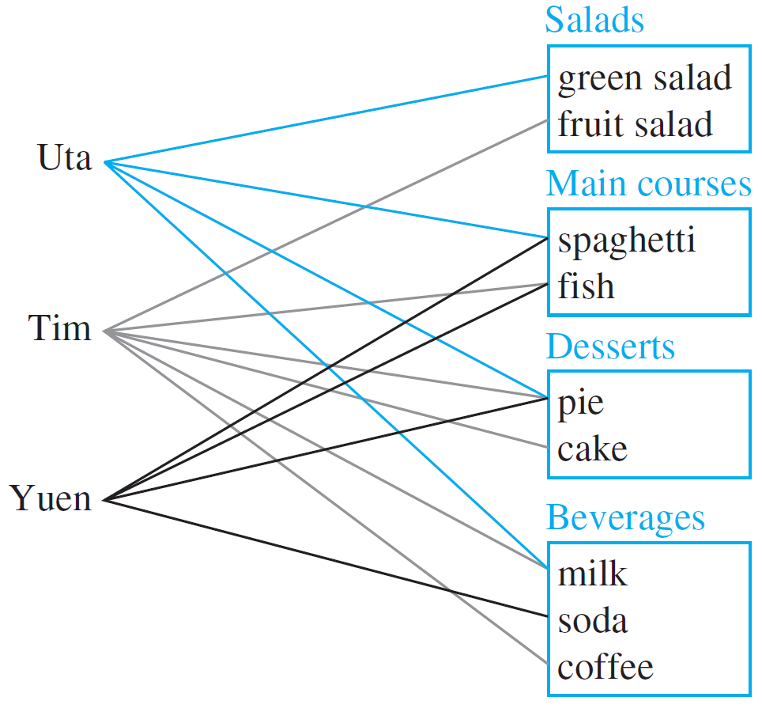
Predicates & Quantified Statement I / II Statements with Multiple Quantifiers Arguments with Quantified Statements
Interpreting Multiply-Quantified Statements
These choices are illustrated in Figure 3.3.2.
Figure 3.3.2

Slide 53
Predicates & Quantified Statement I / II Statements with Multiple Quantifiers Arguments with Quantified Statements
Interpreting Multiply-Quantified Statements
Write each of following statements informally and find its truth value.
∃ an item I such that ∀ students S, S chose I.
∃ a student S such that ∀ items I, S chose I.
∃ a student S such that ∀ stations Z, ∃ an item I in Z such that S chose I.
∀ students S and ∀ stations Z, ∃ an item I in Z such that S chose I.
There is an item that was chosen by every student.
True (pie).
There is a student who chose every available item.
False.
There is a student who chose at least one item from every station.
Figure 3.3.2
True (Uta and Tim).
For all students and stations, there is an item such that every student chose that item.

False.

Slide 54
Predicates & Quantified Statement I / II Statements with Multiple Quantifiers Arguments with Quantified Statements
Translating from Informal to Formal Language
3.3.2. Translating from Informal to Formal Language
Most problems are stated in informal language, but solving them often requires translating them into more formal terms.
Example: The reciprocal of a real number a is a real number b such that ab = 1. The following 2 statements are true. Rewrite them formally using quantifiers and variables:
Every nonzero real number has a reciprocal.
There is a real number with no reciprocal.
∀ nonzero real numbers u, ∃ a real number v such that uv = 1.
∃ a real numbers c such that ∀ real number d, cd ≠ 1.

Slide 55
Predicates & Quantified Statement I / II Statements with Multiple Quantifiers Arguments with Quantified Statements
Ambiguous Language
3.3.3. Ambiguous Language
You are visiting a computer microchips factory. The factory guide tells you:
There is a person supervising every detail of the production process.
“there is” – existential quantifier; “every” – universal quantifier.
Which of the following best describes its meaning?
There is one single person who supervises all the details of the production process.
For any particular production detail, there is a person who supervises the detail, but there might be different supervisors for different details.

Slide 56
Predicates & Quantified Statement I / II Statements with Multiple Quantifiers Arguments with Quantified Statements
Ambiguous Language
Once you interpreted the sentence in one way, it may have been hard for you to see that it could be understood in the other way.
Perhaps you had difficulty even though the two possible meanings were explained.
Although statements written informally may be open to multiple interpretations, we cannot determine their truth or falsity without interpreting them one way or another.
Therefore, we have to use context to try to ascertain their meaning as best we can.

Slide 57
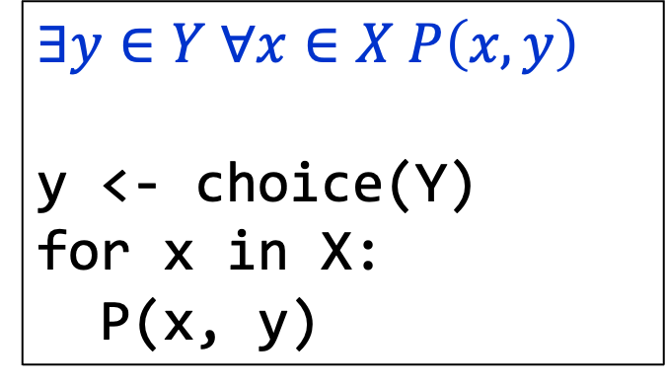

Predicates & Quantified Statement I / II Statements with Multiple Quantifiers Arguments with Quantified Statements
Order of Quantifiers
3.3.5. Order of Quantifiers
Context as the scope of variable!
$$∀x∈X ∃y∈Y P\left(x, y\right)$$
for x in X:
y <- choice(Y)
P(x, y)
$$∃y∈Y ∀x∈X P\left(x, y\right)$$
y <- choice(Y)
for x in X:
P(x, y)
They are not same!!!

Slide 58










Predicates & Quantified Statement I / II Statements with Multiple Quantifiers Arguments with Quantified Statements
Negations of Multiply-Quantified Statements
3.3.4. Negations of Multiply-Quantified Statements
Recall in 3.2.1:
~(∀x$∈$D, P(x)) ≡ ∃x$∈$D such that ~P(x)
~(∃x$∈$D such that P(x)) ≡ ∀x$∈$D, ~P(x)
(A) So, to find: ∼(∀x$∈$D, ∃y$∈$E such that P(x, y))
∃x$∈$D such that ∼(∃y$∈$E such that P(x, y))
∃x$∈$D such that ∀y$∈$E, ∼P(x, y).
∼(∀x $∈$ D, ∃y$∈$E such that P(x, y))
$$≡$$
∃x$∈$D such that ∀y$∈$E, ∼P(x, y)
(B) Similarly, to find: ∼(∃x$∈$D such that ∀y$∈$E, P(x, y))
∀x$∈$D, ∼(∀y$∈$E, P(x, y))
∀x$∈$D, ∃y$∈$E such that ∼P(x, y).
∼(∃x$∈$D such that ∀y$∈$ E, P(x, y))
$$≡$$
∀x$∈$D, ∃y$∈$E such that ∼P(x, y)

Slide 59
Predicates & Quantified Statement I / II Statements with Multiple Quantifiers Arguments with Quantified Statements
Negations of Multiply-Quantified Statements
Refer to the Tarski’s world of Figure 3.3.1 again.
Write a negation for each of the
following statements, and determine
which is true, the given statement or
its negation.
For all squares x, there is a circle y such that x and y have the same color.
Figure 3.3.1
Negation:
∃ a square x such that ~(∃ a circle y such that x and y have the same color)
∃ a square x such that ∀ circles y, x and y do not have the same color.
TRUE (Square e is black and no circle is black).

Slide 60
Predicates & Quantified Statement I / II Statements with Multiple Quantifiers Arguments with Quantified Statements
Negations of Multiply-Quantified Statements
Refer to the Tarski’s world of Figure 3.3.1 again.
Write a negation for each of the
following statements, and determine
which is true, the given statement or
its negation.
There is a triangle x such that for all
squares y, x is to the right of y.
Figure 3.3.1
Negation:
∀ triangles x, ~(∀ squares y, x is to the right of y)
∀ triangles x, ∃ a square y such that x is not to the right of y.
TRUE (No matter what triangle is chosen, it is not to the right of square g or square j).


Slide 61
Predicates & Quantified Statement I / II Statements with Multiple Quantifiers Arguments with Quantified Statements
Order of Quantifiers
3.3.5. Order of Quantifiers
∀ people x, ∃ a person y such that x loves y.
∃ a person y such that ∀ people x, x loves y.
Except for the order of the quantifiers, these statements are identical.
Given any person, it is possible to find someone whom that person loves.
They are not logically equivalent!
There is one amazing individual who is loved by all people!

Slide 62
Predicates & Quantified Statement I / II Statements with Multiple Quantifiers Arguments with Quantified Statements
Order of Quantifiers
In a statement containing both ∀ and ∃, changing the order of the quantifiers usually changes the meaning of the statement.
However, if one quantifier immediately follows another quantifier of the same type, then the order of the quantifiers does not affect the meaning.
Examples:
∀x ∀y is equivalent to ∀y ∀x (likewise for ∃)
∀x ∀y may be written as ∀x,y (likewise for ∃)

Slide 63
Predicates & Quantified Statement I / II Statements with Multiple Quantifiers Arguments with Quantified Statements
Order of Quantifiers
Refer to the Tarski’s world of Figure 3.3.1. What are the truth values of the following two statements?
For every square x, there is a triangle y such that x and y have different colors.
TRUE
There exists a triangle y such that for every square x, x and y have different colors.
Figure 3.3.1
FALSE


Slide 64




Predicates & Quantified Statement I / II Statements with Multiple Quantifiers Arguments with Quantified Statements
Formal Logical Notation
3.3.6. Formal Logical Notation
In some areas of computer science, logical statements are expressed in purely symbolic notation.
The notation involves using predicates to describe all properties of variables and omitting the words such as in existential statements.
“∀x $∈$ D, P(x)” written as
∀x (x $∈$ D → P(x))
“∃x $∈$ D such that P(x)” written as
∃x (x $∈$ D ∧ P(x))
We will follow this way of writing.

Slide 65
Predicates & Quantified Statement I / II Statements with Multiple Quantifiers Arguments with Quantified Statements
Formal Logical Notation: Formalizing Statements in a Tarski’s World
Example:
Tarski’s world.
Let the common domain D of all variables be the set of all the objects in the Tarski’s world.
Triangle(x): “x is a triangle”
Circle(x): “x is a circle”
Square(x): “x is a square”
Blue(x): “x is blue”
Gray(x): “x is gray”
Black(x): “x is black”
RightOf(x,y): “x is to the right of y”
Above(x,y): “x is above y”
SameColorAs(x,y): “x has the same color as y”
x = y: “x is equal to y”

Slide 66
Predicates & Quantified Statement I / II Statements with Multiple Quantifiers Arguments with Quantified Statements
Formal Logical Notation: Formalizing Statements in a Tarski’s World
Use formal, logical notation to write the following statements, and write a formal negation for each statement.
For all circles x, x is above f.
Statement:
∀x (Circle(x) → Above(x, f))
Negation:
~(∀x (Circle(x) → Above(x, f)))
≡
∃x ~(Circle(x) → Above(x, f))
≡
∃x (Circle(x) ∧ ~Above(x, f))
There is a square x such that x is black.
Statement:
∃x (Square(x) ∧ Black(x))
Negation:
~(∃x (Square(x) ∧ Black(x)))
≡
∀x ~(Square(x) ∧ Black(x))
≡
∀x (~Square(x) ∨ ~Black(x))

Slide 67
Predicates & Quantified Statement I / II Statements with Multiple Quantifiers Arguments with Quantified Statements
Formal Logical Notation: Formalizing Statements in a Tarski’s World
Use formal, logical notation to write the following statements, and write a formal negation for each statement.
For all circles x, there is a square y such that x and y have the same color.
Statement:
∀x(Circle(x) → ∃y(Square(y) ∧ SameColor(x, y)))
Negation:
~(∀x(Circle(x) → ∃y(Square(y) ∧ SameColor(x, y))))
≡
∃x ~(Circle(x) → ∃y(Square(y) ∧ SameColor(x, y)))
≡
∃x (Circle(x) ∧ ~(∃y (Square(y) ∧ SameColor(x, y))))
≡
∃x (Circle(x) ∧ ∀y (~(Square(y) ∧ SameColor(x, y))))
≡
∃x (Circle(x) ∧ ∀y (~Square(y) ∨ ~SameColor(x, y)))


Slide 68
Predicates & Quantified Statement I / II Statements with Multiple Quantifiers Arguments with Quantified Statements
Formal Logical Notation: Formalizing Statements in a Tarski’s World
Use formal, logical notation to write the following statements, and write a formal negation for each statement.
There is a square x such that for all triangles y, x is to right of y.
Statement:
∃x (Square(x) ∧ ∀y (Triangle(y) → RightOf(x, y)))
Negation:
~(∃x (Square(x) ∧ ∀y (Triangle(y) → RightOf(x, y))))
≡
∀x ~(Square(x) ∧ ∀y (Triangle(y) → RightOf(x, y)))
≡
∀x (~Square(x) ∨ ~(∀y (Triangle(y) → RightOf(x, y))))
≡
∀x (~Square(x) ∨ ∃y (~(Triangle(y) → RightOf(x, y))))
≡
∀x (~ Square(x) ∨ ∃y (Triangle(y) ∧ ~RightOf(x, y)))


Slide 69
Predicates & Quantified Statement I / II Statements with Multiple Quantifiers Arguments with Quantified Statements
Formal Logical Notation
Formal logical notation is used in branches of computer science such as artificial intelligence, program verification, and automata theory and formal languages.
Taken together, the symbols for quantifiers, variables, predicates, and logical connectives make up what is known as the language of first-order logic.
Even though this language is simpler in many respects than the language we use every day, learning it requires the same kind of practice needed to acquire any foreign language.

Slide 70
Predicates & Quantified Statement I / II Statements with Multiple Quantifiers Arguments with Quantified Statements
Prolog
3.3.7. Prolog (Only for your reading)
The programming language Prolog (short for programming in logic) was developed in France in the 1970s by A. Colmerauer and P. Roussel to help programmers working in the field of artificial intelligence.
A simple Prolog program consists of a set of statements describing some situation together with questions about the situation. Built into the language are search and inference techniques needed to answer the questions by deriving the answers from the given statements.
This frees the programmer from the necessity of having to write separate programs to answer each type of question.

Slide 71

Predicates & Quantified Statement I / II Statements with Multiple Quantifiers Arguments with Quantified Statements
Prolog: A Prolog Program
Consider the following picture, which shows colored blocks stacked on a table.
The following are statements in Prolog that describe this picture and ask two questions about it.

Slide 72

Predicates & Quantified Statement I / II Statements with Multiple Quantifiers Arguments with Quantified Statements
Prolog: A Prolog Program
isabove(g, b₁) color(g, gray) color(b₃, blue)
isabove(b₁, w₁) color(b₁, blue) color(w₁, white)
isabove(w₂, b₂) color(b₂, blue) color(w₂, white)
isabove(b₂, b₃) isabove(X, Z ) if isabove(X, Y ) and isabove(Y, Z)
?color(b₁, blue) ?isabove(X, w₁)
The statements “isabove(g, b₁)” and “color(g, gray)” are to be interpreted as “g is above b₁” and “g is colored gray”.
The statement “isabove(X, Z ) if isabove(X, Y ) and isabove(Y, Z )” is to be interpreted as “For all X, Y, and Z, if X is above Y and Y is above Z, then X is above Z.”

Slide 73
Predicates & Quantified Statement I / II Statements with Multiple Quantifiers Arguments with Quantified Statements
Prolog: A Prolog Program
The program statement
?color(b₁, blue)
is a question asking whether block b₁ is colored blue.
Prolog answers this by writing
Yes
The program statement
?isabove(X, w₁)
is a question asking for which blocks X the predicate “X is above w₁” is true..
Prolog answers this by giving a list of all such blocks. In this case, the answer is
X = b₁, X = g.
Infer the solution X = g from the following statements:
isabove(g, b₁)
isabove(b₁, w₁)
isabove(X, Z) if isabove(X, Y) and isabove(Y, Z)

Slide 74
Predicates & Quantified Statement I / II Statements with Multiple Quantifiers Arguments with Quantified Statements
Prolog: Quick Quiz
Write the answers Prolog would give if the following questions were added to the program above.
?isabove(b₂, w₁)
?color(w₁, X)
c. ?color(X, blue)
“No”
“X = white”
“X = b₁”, “X = b₂”, “X = b₃”
isabove(g, b₁) color(g, gray) color(b₃, blue)
isabove(b₁, w₁) color(b₁, blue) color(w₁, white)
isabove(w₂, b₂) color(b₂, blue) color(w₂, white)
isabove(b₂, b₃) isabove(X, Z ) if isabove(X, Y ) and isabove(Y, Z)

Slide 75
Predicates & Quantified Statement I / II Statements with Multiple Quantifiers Arguments with Quantified Statements
3.4 Arguments with Quantified Statements

Slide 76
Predicates & Quantified Statement I / II Statements with Multiple Quantifiers Arguments with Quantified Statements
Universal Instantiation
3.4.1. Universal Instantiation
The rule of universal instantiation:
If some property is true of everything in the set, then it is true of any particular thing in the set.
Universal instantiation is the fundamental tool of deductive reasoning.

Slide 77

Predicates & Quantified Statement I / II Statements with Multiple Quantifiers Arguments with Quantified Statements
Universal Modus Ponens
3.4.2. Universal Modus Ponens
The rule of universal instantiation can be combined with modus ponens to obtain the valid form of argument called universal modus ponens.
Universal Modus Ponens
Formal version Informal version
∀x (P(x) $→$ Q(x)). If x makes P(x) true, then x makes Q(x) true.
P(a) for a particular a. a makes P(x) true.
• Q(a). • a makes Q(x) true.

Slide 78

Predicates & Quantified Statement I / II Statements with Multiple Quantifiers Arguments with Quantified Statements
Recognizing Universal Modus Ponens
Rewrite the following argument using quantifiers, variables, and predicate symbols. Is this argument valid? Why?
If an integer is even, then its square is even.
k is a particular integer that is even.
• k² is even.
Solution:
Premise:
∀x, if x is an even integer then x² is even.
Let E(x) be “x is an even integer”, let S(x) be “x² is even”, and let k stand for a particular integer that is even.
∀x (E(x) $→$ S(x)).
E(k), for a particular k.
• S(k).
This argument has the form of universal modus ponens and is therefore valid.

Slide 79
Predicates & Quantified Statement I / II Statements with Multiple Quantifiers Arguments with Quantified Statements
Use of Universal Modus Ponens in a Proof
3.4.3. Use of Universal Modus Ponens in a Proof
Proof: The sum of any two even integers is even.
∀integers x, x is even iff ∃ an integer k such that x = 2k.
Suppose m and n are particular but arbitrarily chosen even integers, then m = 2r for some integer r⁽¹⁾, and n = 2s for some integer s⁽²⁾.
Hence
m + n = 2r + 2s = 2(r + s) ⁽³⁾
Now (r + s) is an integer⁽⁴⁾, and so 2(r + s) is even⁽⁵⁾.
Thus m + n is even.

Slide 80
Predicates & Quantified Statement I / II Statements with Multiple Quantifiers Arguments with Quantified Statements
Use of Universal Modus Ponens in a Proof
How universal modus ponens is used in the proof.
Suppose m and n are particular but arbitrarily chosen even integers, then m = 2r for some integer r⁽¹⁾, and n = 2s for some integer s⁽²⁾.
If an integer is even, then it equals twice some integer.
m is a particular even integer.
• m equals twice some integer r.
Similar to (1).

Slide 81
Predicates & Quantified Statement I / II Statements with Multiple Quantifiers Arguments with Quantified Statements
Use of Universal Modus Ponens in a Proof
How universal modus ponens is used in the proof.
Hence
m + n = 2r + 2s = 2(r + s) ⁽³⁾
If a quantity is an integer, then it is a real number.
r and s are particular integers.
• r and s are real numbers.
We want to show that if r and s are integers, then they are real numbers, so that we can apply distributive law below (Appendix A, F3), which are meant for real numbers.
For all a, b, and c, if a, b, and c are real numbers, then ab + ac = a(b + c).
2, r, and s are particular real numbers.
• 2r + 2s = 2(r + s).

Slide 82
Predicates & Quantified Statement I / II Statements with Multiple Quantifiers Arguments with Quantified Statements
Use of Universal Modus Ponens in a Proof
How universal modus ponens is used in the proof.
Now (r + s) is an integer⁽⁴⁾, and so 2(r + s) is even⁽⁵⁾.
Thus m + n is even.
For all u and v, if u and v are integers, then (u + v) is an integer.
r and s are two particular integers.
• (r + s) is an integer.
If a number equals twice some integer, then that number is even.
2(r + s) equals twice the integer (r + s).
• 2(r + s) is even.

Slide 83

Predicates & Quantified Statement I / II Statements with Multiple Quantifiers Arguments with Quantified Statements
Universal Modus Tollens
3.4.4. Universal Modus Tollens
Another crucially important rule of inference is universal modus tollens. Its validity results from combining universal instantiation with modus tollens.
Universal modus tollens is the heart of proof of contradiction.
Universal Modus Tollens
Formal version Informal version
∀x, (P(x) $→$ Q(x)). If x makes P(x) true, then x makes Q(x) true.
~Q(a) for a particular a. a does not make Q(x) true.
• ~P(a). • a does not makes P(x) true.

Slide 84

Predicates & Quantified Statement I / II Statements with Multiple Quantifiers Arguments with Quantified Statements
Recognizing Universal Modus Tollens
Rewrite the following argument using quantifiers, variables, and predicate symbols. Write the major premise in conditional form. Is this argument valid? Why?
All human beings are mortal.
Zeus is not mortal.
• Zeus is not human.
Solution:
Premise:
∀x, if x is human then x is mortal.
Let H(x) be “x is human”, let M(x) be “x is mortal”, and let Z stand for Zeus.
∀x (H(x) $→$ M(x)).
~M(Z).
• ~H(Z).
This argument has the form of universal modus tollens and is therefore valid.

Slide 85
Predicates & Quantified Statement I / II Statements with Multiple Quantifiers Arguments with Quantified Statements
Proving Validity of Arguments with Quantified Statements
3.4.5. Proving Validity of Arguments with Quantified Statements
The intuitive definition of validity for arguments with quantified statements is the same as for arguments with compound statements.
An argument is valid if, and only if, the truth of its conclusion follows necessarily from the truth of its premises.
Definition 3.4.1 (Valid Argument Form)
To say that an argument form is valid means the following: No matter what particular predicates are substituted for the predicate symbols in its premises, if the resulting premise statements are all true, then the conclusion is also true.
An argument is called valid if, and only if, its form is valid.

Slide 86

Predicates & Quantified Statement I / II Statements with Multiple Quantifiers Arguments with Quantified Statements
Using Diagrams to Test for Validity
3.4.6. Using Diagrams to Test for Validity
Consider the statement: All integers are rational numbers.
∀integers n, n is a rational number.
Figure 3.4.1

Slide 87

Predicates & Quantified Statement I / II Statements with Multiple Quantifiers Arguments with Quantified Statements
Using Diagrams to Show Invalidity
Use a diagram to show the invalidity of the following argument:
All human beings are mortal.
Felix is mortal.
• Felix is a human being.
Major premise
Minor premise
Figure 3.4.4

Slide 88

Predicates & Quantified Statement I / II Statements with Multiple Quantifiers Arguments with Quantified Statements
Using Diagrams to Show Invalidity
Use a diagram to show the invalidity of the following argument:
All human beings are mortal.
Felix is mortal.
• Felix is a human being.
Hence, argument is invalid.
Conclusion is true.
Conclusion is false.
Figure 3.4.5

Slide 89

Predicates & Quantified Statement I / II Statements with Multiple Quantifiers Arguments with Quantified Statements
Using Diagrams to Test for Validity
The argument of previous example would be valid if the major premise were replaced by its converse. But since a universal conditional statement is not logically equivalent to its converse, such a replacement cannot, in general, be made.
We say that this argument exhibit the converse error.
Converse Error (Quantified Form)
Formal version Informal version
∀x (P(x) $→$ Q(x)). If x makes P(x) true, then x makes Q(x) true.
Q(a) for a particular a. a makes Q(x) true.
• P(a). • a makes P(x) true.

Slide 90

Predicates & Quantified Statement I / II Statements with Multiple Quantifiers Arguments with Quantified Statements
Using Diagrams to Test for Validity
The following form of argument would be valid if a conditional statement were logically equivalent to its inverse. But it is not, and the argument form is invalid.
We say that this argument exhibit the inverse error.
Inverse Error (Quantified Form)
Formal version Informal version
∀x (P(x) $→$ Q(x)). If x makes P(x) true, then x makes Q(x) true.
~P(a) for a particular a. a does not make P(x) true.
• ~Q(a). • a does not make Q(x) true.

Slide 91

Predicates & Quantified Statement I / II Statements with Multiple Quantifiers Arguments with Quantified Statements
An Argument with “No”
Use diagrams to test the following argument for validity:
No polynomial functions have horizontal asymptotes.
This function has a horizontal asymptote.
• This function is not a polynomial function.
Hence argument is valid.
Figure 3.4.6

Slide 92

Predicates & Quantified Statement I / II Statements with Multiple Quantifiers Arguments with Quantified Statements
An Argument with “No”
No polynomial functions have horizontal asymptotes.
This function has a horizontal asymptote.
• This function is not a polynomial function.
Alternatively, transform the first statement into:
∀x, if x is a polynomial function, then x does not have a horizontal asymptote.
Then the argument has the form:
∀x (P(x) $→$ Q(x)).
~Q(a), for a particular a.
• ~P(a).
This is valid by universal modus tollens.

Slide 93
Predicates & Quantified Statement I / II Statements with Multiple Quantifiers Arguments with Quantified Statements
Creating Additional Forms of Argument
3.4.7. Creating Additional Forms of Argument
We have seen:
Universal instantiation
Universal modus ponens
Modus ponens
+
➔
Universal instantiation
Universal modus tollens
Modus tollens
+
➔
In the same way, additional forms of arguments involving universally quantified statements can be obtained by combining universal instantiation with other of the valid argument forms discussed earlier.

Slide 94
Predicates & Quantified Statement I / II Statements with Multiple Quantifiers Arguments with Quantified Statements
Creating Additional Forms of Argument
Consider the following argument:
  p → q
  q → r
  • p → r
This can be combined with universal instantiation to obtain a valid argument form.
Universal Transitivity
Formal version Informal version
∀x (P(x) → Q(x)). Any x that makes P(x) true makes Q(x) true.
∀x (Q(x) → R(x)). Any x that makes Q(x) true makes R(x) true.
• ∀x (P(x) → R(x)). • Any x that makes P(x) true makes R(x) true.

Slide 95
Predicates & Quantified Statement I / II Statements with Multiple Quantifiers Arguments with Quantified Statements
Evaluating an Argument for Tarski’s World
Consider the Tarski’s world:
Reorder and rewrite the premises to show that the conclusion follows as a valid consequence from the premises
All the triangles are blue.
If an object is to the right of all the squares, then it is above all the circles.
If an object is not to the right of all the squares, then it is not blue.
• All the triangles are above all the circles.
Figure 3.3.1

Slide 96
Predicates & Quantified Statement I / II Statements with Multiple Quantifiers Arguments with Quantified Statements
Evaluating an Argument for Tarski’s World
Consider the Tarski’s world:
Reorder and rewrite the premises to show that the conclusion follows as a valid consequence from the premises
Step 1:
∀x, if x is a triangle, then x is blue.
∀x, if x is to the right of all the squares, then x is above all the circles.
∀x, if x is not to the right of all the squares, then x is not blue.
• ∀x, if x is a triangle, then x is above all the circles.
Figure 3.3.1
Should be same as conclusion of the last premise.
Should be same as hypothesis of the first premise.

Slide 97
Predicates & Quantified Statement I / II Statements with Multiple Quantifiers Arguments with Quantified Statements
Evaluating an Argument for Tarski’s World
Consider the Tarski’s world:
Reorder and rewrite the premises to show that the conclusion follows as a valid consequence from the premises
Step 2:
∀x, if x is a triangle, then x is blue.
∀x, if x is not to the right of all the squares, then x is not blue.
∀x, if x is to the right of all the squares, then x is above all the circles.
• ∀x, if x is a triangle, then x is above all the circles.
Figure 3.3.1
Rewrite it in contrapositive form.

Slide 98

Predicates & Quantified Statement I / II Statements with Multiple Quantifiers Arguments with Quantified Statements
Evaluating an Argument for Tarski’s World
Consider the Tarski’s world:
Reorder and rewrite the premises to show that the conclusion follows as a valid consequence from the premises
Step 3:
∀x, if x is a triangle, then x is blue.
∀x, if x is blue, then x is to the right of all the squares.
∀x, if x is to the right of all the squares, then x is above all the circles.
• ∀x, if x is a triangle, then x is above all the circles.
Figure 3.3.1

Slide 99

Predicates & Quantified Statement I / II Statements with Multiple Quantifiers Arguments with Quantified Statements
Remark on the Converser and Inverse Errors
3.4.8. Rules of Inference for Quantified Statements
Rule of Inference | Name
$$∀x∈D P\left(x\right)$$ $∴P(a)$ if $a∈D$ | Universal instantiation
$P\left(a\right)$ for every $a∈D$ $$∴∀x∈D P\left(x\right)$$ | Universal generalization
$$∃x∈D P\left(x\right)$$ $∴P(a)$ for some $a∈D$ | Existential instantiation
$P\left(a\right)$ for some $a∈D$ $$∴∃x∈D P\left(x\right)$$ | Existential generalization

Slide 100
Predicates & Quantified Statement I / II Statements with Multiple Quantifiers Arguments with Quantified Statements
Remark on the Converser and Inverse Errors
Only for reading.
3.4.9. Remark on the Converse and Inverse Errors
A variation of the converse error is a very useful reasoning tool, provided that it is used with caution.
It is the type of reasoning that is used by doctors to make medical diagnoses and by auto mechanics to repair cars.
It is the type of reasoning used to generate explanations for phenomena. It goes like this: If a statement of the form
For all x (P (x) → Q (x))
is true, and if
Q (a) is true, for a particular a,
then check out the statement P (a); it just might be true.

Slide 101
Predicates & Quantified Statement I / II Statements with Multiple Quantifiers Arguments with Quantified Statements
Remark on the Converser and Inverse Errors
Only for reading.
For instance, suppose a doctor knows that
For all x, if x has pneumonia, then x has a fever and
chills, coughs deeply, and feels exceptionally tired
and miserable.
And suppose the doctor also knows that
John has a fever and chills, coughs deeply,
and feels exceptionally tired and miserable.
On the basis of these data, the doctor concludes that a diagnosis of pneumonia is a strong possibility, though not a certainty.
This form of reasoning has been named abduction by researchers working in artificial intelligence.

Slide 102
END OF FILE

