Slide 1
3. The Logic of Quantified Statements
Direct Proof and Counterexample Rational Numbers Divisibility Indirect Proof
4. Methods of Proof
Aaron Tan
AY2026/27 Semester 1

Slide 2
Direct Proof and Counterexample Rational Numbers Divisibility Indirect Proof
4. Methods of Proof
4.1 Direct Proof and Counterexample
Definitions: even and odd numbers; prime and composite.
4.2 Proofs on Rational Numbers
Every integer is a rational number.
Disproving universal statements by counterexample.
4.3 Proofs on Divisibility
Positive divisor of a positive integer; divisors of 1; transitivity of divisibility.
Proving existential statements by constructive proof.
Sum of any two rational numbers is rational.
4.4 Indirect Proof
Proof by contradiction; proof by contraposition.
Proving universal statements by exhaustion.
Proving universal statements by generalizing from the generic particular.
Reference: Epp’s Chapter 4 Elementary Number Theory and Methods of Proof

Slide 3
Direct Proof and Counterexample Rational Numbers Divisibility Indirect Proof
4.1 Definitions

Slide 4
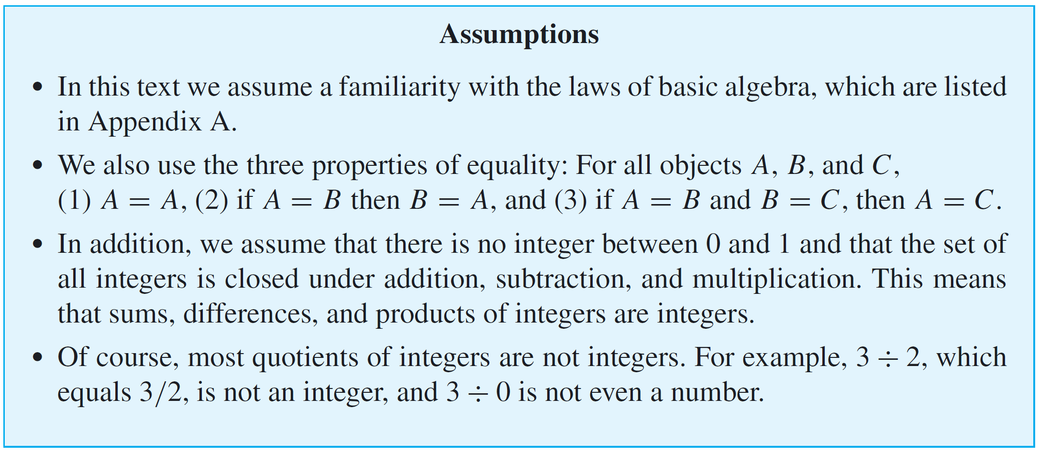
Direct Proof and Counterexample Rational Numbers Divisibility Indirect Proof
Definitions
4.1.1. Definitions
Appendix A has been uploaded onto “LumiNUS > Files > Lecture slides and notes” and the CS1231S website.

Slide 5
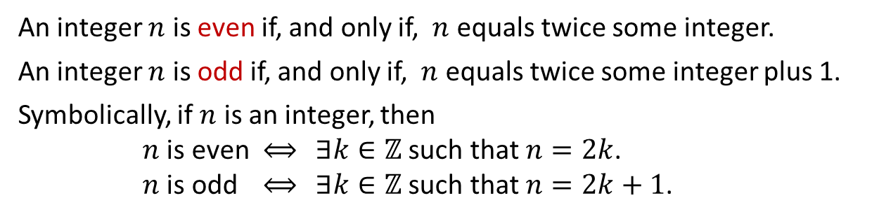
Direct Proof and Counterexample Rational Numbers Divisibility Indirect Proof
Definitions: Even and Odd Integers
Recall from Lecture #2:
Definitions: Even and Odd Integers
An integer $n$ is even if, and only if, $n$ equals twice some integer.
An integer $n$ is odd if, and only if, $n$ equals twice some integer plus 1.
Symbolically, if $n$ is an integer, then
$n$ is even $⟺$ $∃k∈ℤ$ such that $n=2k$.
$n$ is odd $⟺$ $∃k∈ℤ$ such that $n=2k+1$.

Slide 6
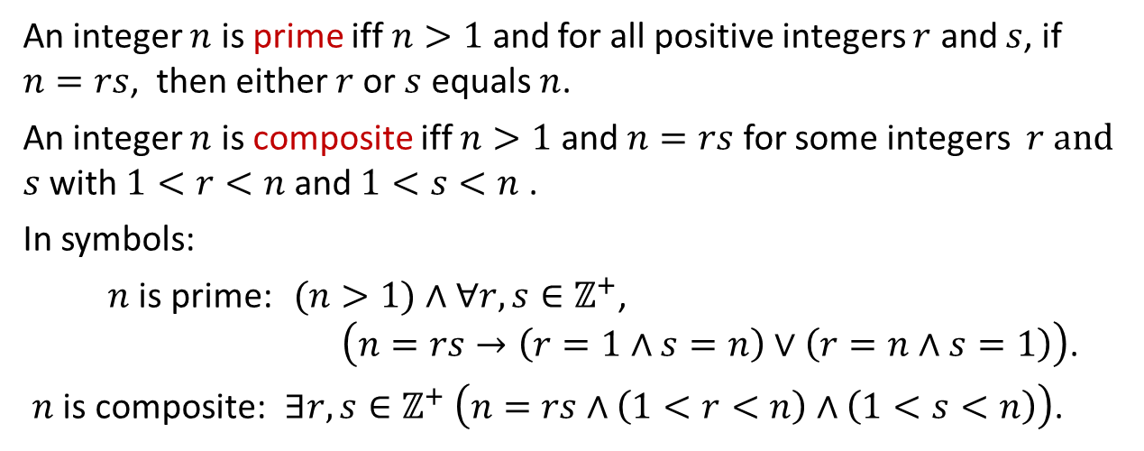
Direct Proof and Counterexample Rational Numbers Divisibility Indirect Proof
Definitions: Prime and Composite
Definitions: Prime and Composite
An integer $n$ is prime iff $n>1$ and for all positive integers $r$ and $s$, if $n=rs$, then either $r$or $s$ equals $n$.
An integer $n$ is composite iff $n>1$ and $n=rs$ for some integers $r and$ $s$ with $1<r<n$ and $1<s<n$ .
In symbols:
$n$ is prime: $(n>1)∧∀r,s∈ℤ^{+}$,
$\left(n=rs→\left(r=1∧s=n\right)∨\left(r=n∧s=1\right)\right)$.
$n$ is composite: $∃r,s∈ℤ^{+}$ $\left(n=rs∧\left(1<r<n\right)∧\left(1<s<n\right)\right)$.
There are other ways of defining prime. For example:
$n$ is prime: $\left(n>1\right)∧\left(∀r,s∈ℤ \left(\left(r>1\right)∧\left(s>1\right)→rs≠n\right)\right)$.

Slide 7

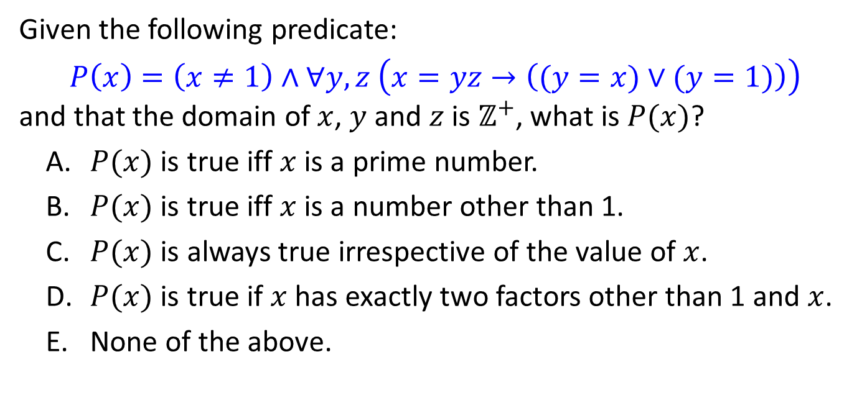
Direct Proof and Counterexample Rational Numbers Divisibility Indirect Proof
CS1231S Midterm Test (AY2019/20 Sem1)
Given the following predicate:
$$P\left(x\right)=\left(x≠1\right)∧∀y,z \left(x=yz→\left((y=x)∨(y=1)\right)\right)$$
and that the domain of $x$, $y$ and $z$ is $ℤ^{+}$, what is $P(x)$?
$P(x)$ is true iff $x$ is a prime number.
$P(x)$ is true iff $x$ is a number other than 1.
$P(x)$ is always true irrespective of the value of $x$.
$P(x)$ is true if $x$ has exactly two factors other than 1 and $x$.
None of the above.


Slide 8
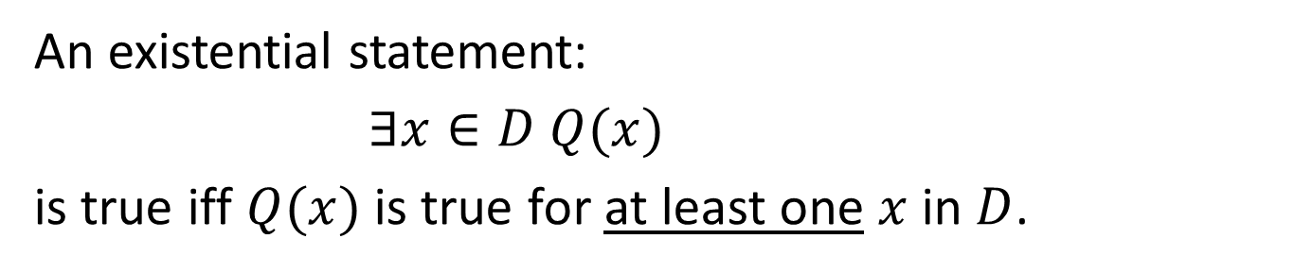
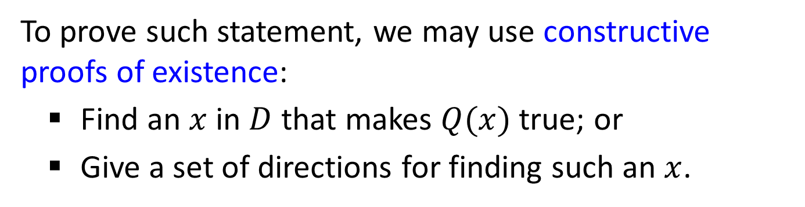
Direct Proof and Counterexample Rational Numbers Divisibility Indirect Proof
Proving Existential Statements: Constructive Proof
4.1.2. Proving Existential Statements by Constructive Proof
An existential statement:
$∃x∈D Q(x)$
is true iff $Q(x)$is true for at least one $x$ in $D$.
To prove such statement, we may use constructive proofs of existence:
Find an $x$ in $D$ that makes $Q(x)$true; or
Give a set of directions for finding such an $x$.

Slide 9
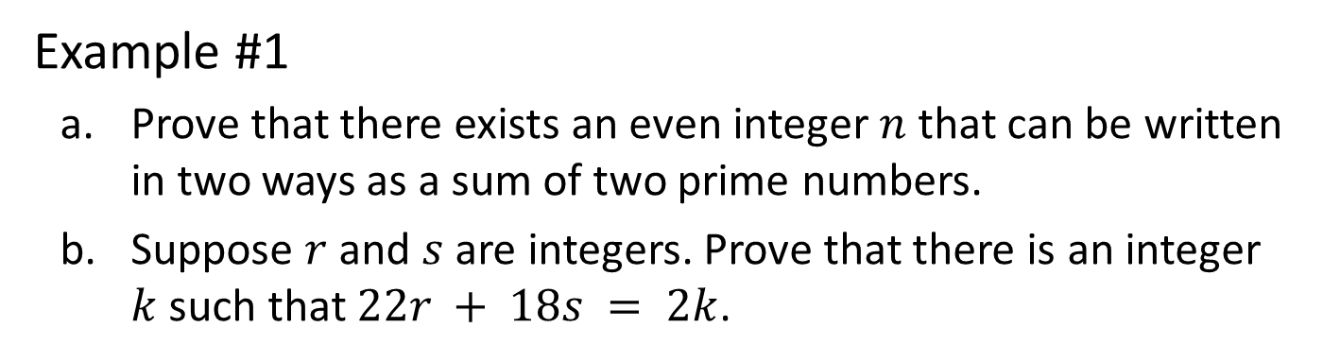
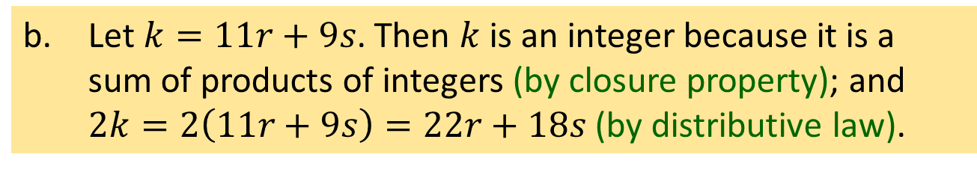
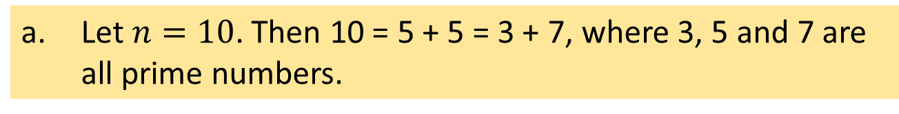
Direct Proof and Counterexample Rational Numbers Divisibility Indirect Proof
Proving Existential Statements: Constructive Proof
Example #1
Prove that there exists an even integer $n$ that can be written in two ways as a sum of two prime numbers.
Suppose $r$ and $s$ are integers. Prove that there is an integer $k$ such that $22r + 18s = 2k$.
a. Let $n=10$. Then 10 = 5 + 5 = 3 + 7, where 3, 5 and 7 are all prime numbers.
Note that the question does not say that the two prime numbers must be distinct.
b. Let $k=11r+9s$. Then $k$ is an integer because it is a sum of products of integers (by closure property); and $2k=2\left(11r+9s\right)=22r+18s$ (by distributive law).

Slide 10
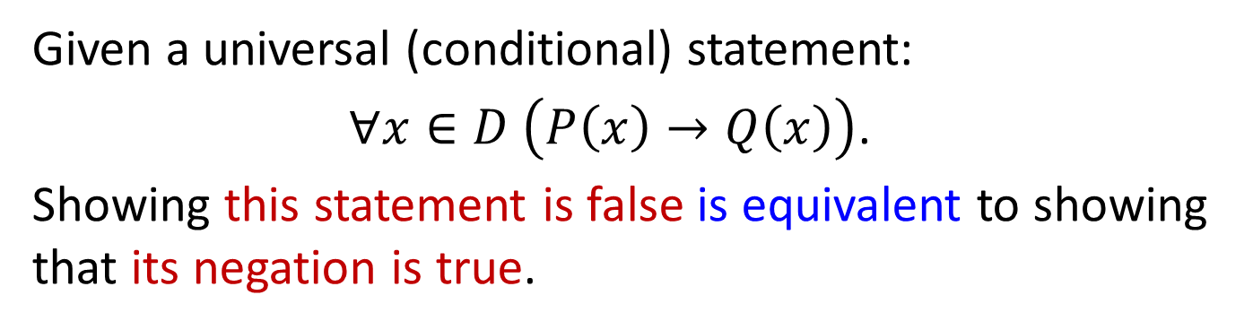
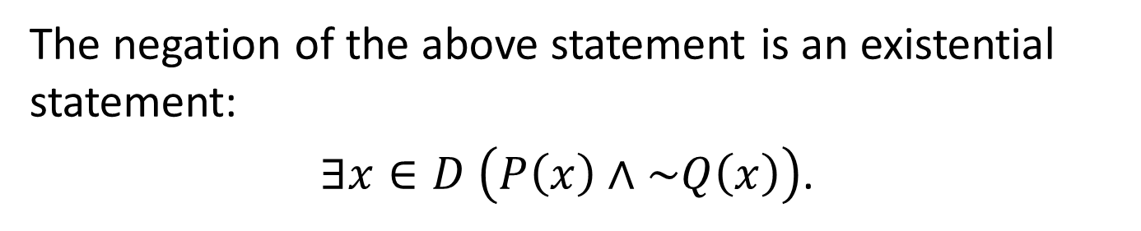
Direct Proof and Counterexample Rational Numbers Divisibility Indirect Proof
Disproving Universal Statements: Counterexample
4.1.3. Disproving Universal Statements by Counterexample
Given a universal (conditional) statement:
$∀x∈D$ $\left(P\left(x\right)→Q\left(x\right)\right)$.
Showing this statement is false is equivalent to showing that its negation is true.
The negation of the above statement is an existential statement:
$∃x∈D$ $\left(P\left(x\right)∧\sim Q\left(x\right)\right)$.

Slide 11
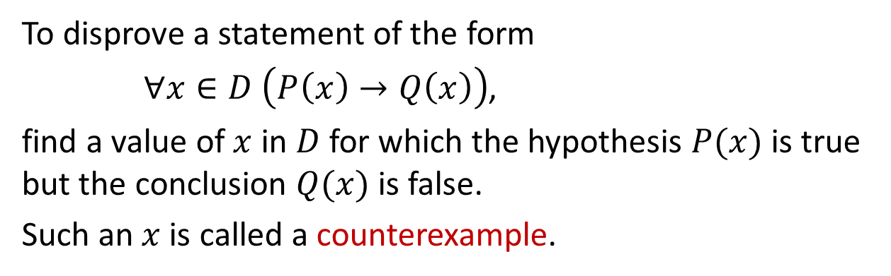
Direct Proof and Counterexample Rational Numbers Divisibility Indirect Proof
Disproving Universal Statements: Counterexample
To prove that an existential statement is true, we use an example (constructive proof), which is called the counterexample for the original universal conditional statement.
Disproof by Counterexample
To disprove a statement of the form
$∀x∈D \left(P\left(x\right)→Q\left(x\right)\right)$,
find a value of $x$ in $D$ for which the hypothesis $P(x)$ is true but the conclusion $Q(x)$ is false.
Such an $x$ is called a counterexample.

Slide 12
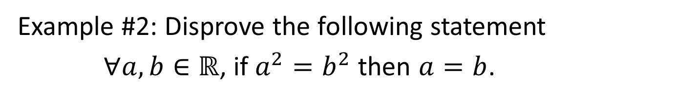
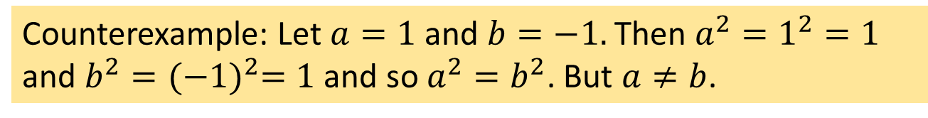
Direct Proof and Counterexample Rational Numbers Divisibility Indirect Proof
Disproving Universal Statements: Counterexample
Example #2: Disprove the following statement
$∀a,b∈ℝ$, if $a^{2}=b^{2}$ then $a=b$.
Counterexample: Let $a=1$ and $b=−1.$ Then $a^{2}=1^{2}=1$ and $b^{2}={(−1)}^{2}=1$ and so $a^{2}=b^{2}$. But $a≠b$.

Slide 13
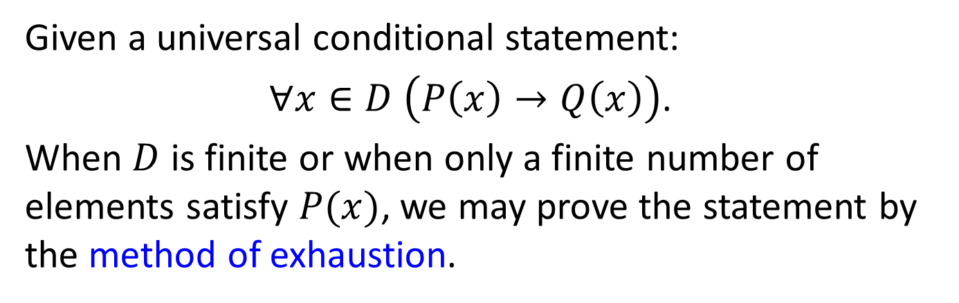
Direct Proof and Counterexample Rational Numbers Divisibility Indirect Proof
Proving Universal Statements: Exhaustion
4.1.4. Proving Universal Statements by Exhaustion
Given a universal conditional statement:
$∀x∈D \left(P\left(x\right)→Q\left(x\right)\right)$.
When $D$ is finite or when only a finite number of elements satisfy $P(x)$, we may prove the statement by the method of exhaustion.

Slide 14
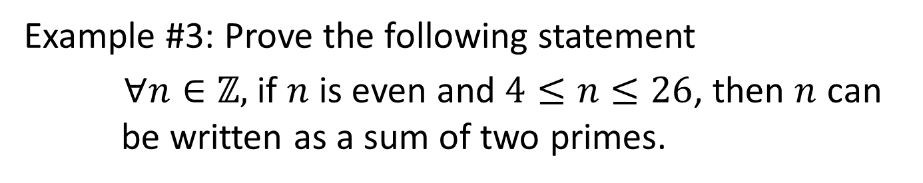
Direct Proof and Counterexample Rational Numbers Divisibility Indirect Proof
Proving Universal Statements: Exhaustion
Example #3: Prove the following statement
$∀n∈ℤ,$ if $n$ is even and $4≤n≤26$, then $n$ can be written as a sum of two primes.
Proof (by method of exhaustion):
4 = 2 + 2
6 = 3 + 3
8 = 3 + 5
10 = 5 + 5
12 = 5 + 7
14 = 11 + 3
16 = 5 + 11
18 = 7 + 11
20 = 7 + 13
22 = 5 + 17
24 = 5 + 19
26 = 7 + 19

Slide 15
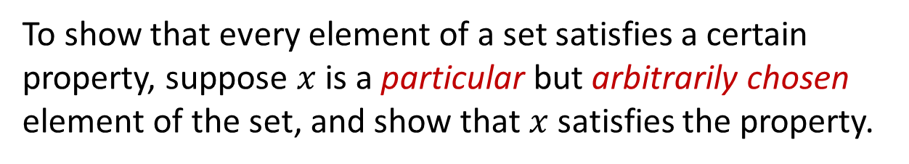
Direct Proof and Counterexample Rational Numbers Divisibility Indirect Proof
Proving Universal Statements: Generalizing from the Generic Particular
4.1.5. Proving Universal Statements by
Generalizing from the Generic Particular
The most powerful technique for proving a universal statement s one that works regardless of the size of the domain (possibly infinite) over which the statement is quantified.
Generalizing from the Generic Particular
To show that every element of a set satisfies a certain property, suppose $x$ is a particular but arbitrarily chosen element of the set, and show that $x$satisfies the property.

Slide 16
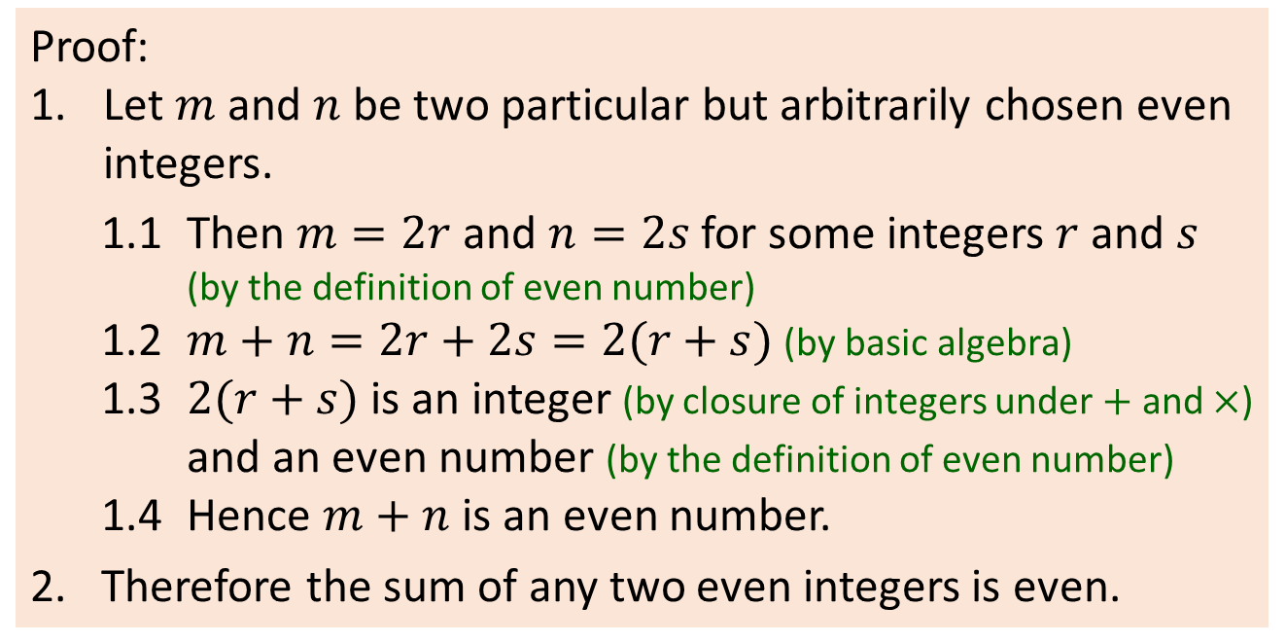
Direct Proof and Counterexample Rational Numbers Divisibility Indirect Proof
Proving Universal Statements: Generalizing from the Generic Particular
Example #4: Prove that the sum of any two even integers is even.
Proof:
Let $m$ and $n$ be two particular but arbitrarily chosen even integers.
1.1 Then $m=2r$and $n=2s$for some integers $r$ and $s$ (by the definition of even number)
1.2 $m+n=2r+2s=2(r+s)$(by basic algebra)
1.3 $2(r+s)$ is an integer (by closure of integers under $+$ and$×$) and an even number (by the definition of even number)
1.4 Hence $m+n$ is an even number.
2. Therefore the sum of any two even integers is even.

Slide 17
Direct Proof and Counterexample Rational Numbers Divisibility Indirect Proof
4.2 Proofs on Rational Numbers

Slide 18
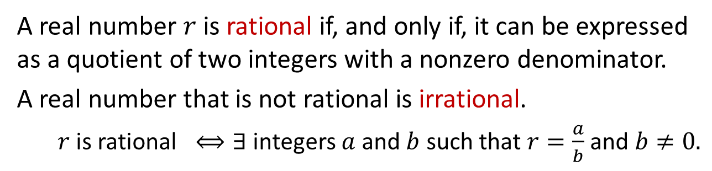
Direct Proof and Counterexample Rational Numbers Divisibility Indirect Proof
Definition
4.2.1. Definition
In this section, we will apply proof techniques we have learned on rational numbers.
Definition: Rational Numbers
A real number $r$ is rational if, and only if, it can be expressed as a quotient of two integers with a nonzero denominator.
A real number that is not rational is irrational.
$r$ is rational $⟺∃$ integers $a$ and $b$ such that $r=\frac{a}{b}$ and $b≠0.$

Slide 19
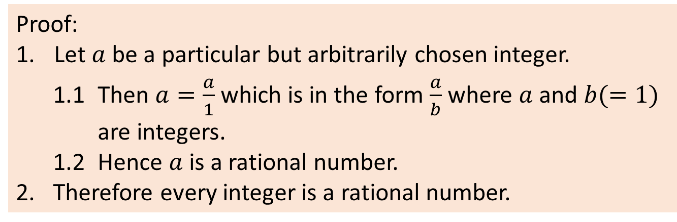
Direct Proof and Counterexample Rational Numbers Divisibility Indirect Proof
Every Integer is a Rational Number
4.2.2. Every Integer is a Rational Number
Theorem 4.2.1 (5th: 4.3.1)
Every integer is a rational number.
Proof:
Let $a$ be a particular but arbitrarily chosen integer.
1.1 Then $a=\frac{a}{1}$which is in the form $\frac{a}{b}$where $a$ and $b(=1)$ are integers.
1.2 Hence $a$ is a rational number.
2. Therefore every integer is a rational number.

Slide 20
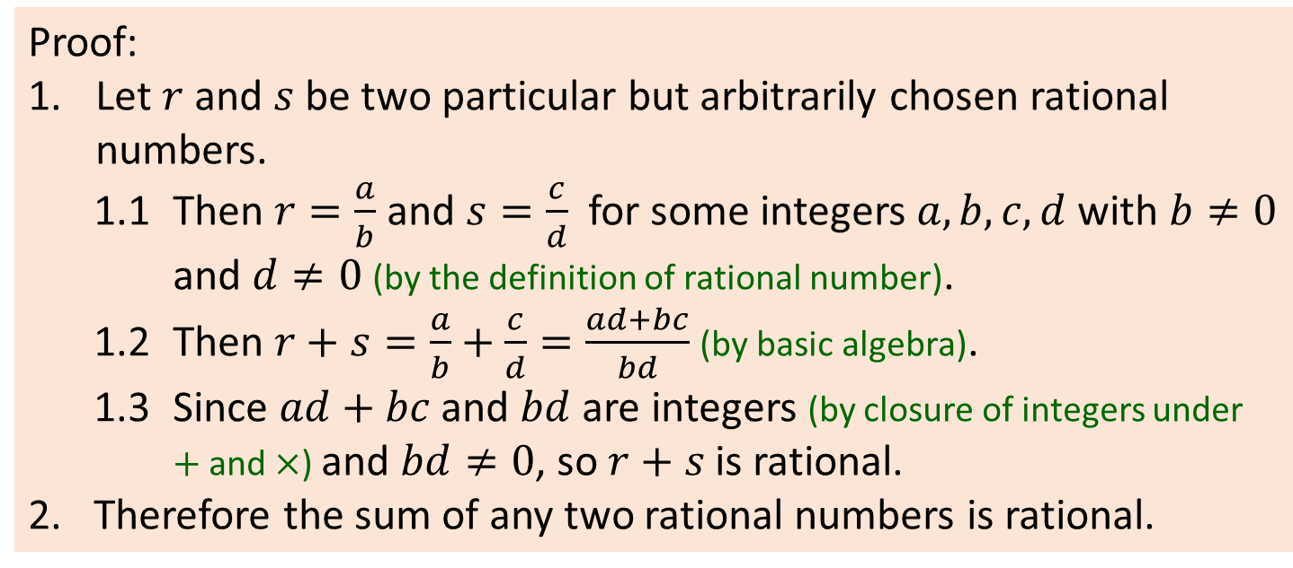
Direct Proof and Counterexample Rational Numbers Divisibility Indirect Proof
The Sum of Any Two Rational Numbers is Rational
4.2.3. The Sum of Any Two Rational Numbers is Rational
Theorem 4.2.2 (5th: 4.3.2)
The sum of any two rational numbers is rational.
Proof:
Let $r$ and $s$ be two particular but arbitrarily chosen rational numbers.
1.1 Then $r=\frac{a}{b}$and $s=\frac{c}{d}$ for some integers $a,b,c,d$ with $b≠0$ and $d≠0$ (by the definition of rational number).
1.2 Then $r+s=\frac{a}{b}+\frac{c}{d}=\frac{ad+bc}{bd}$ (by basic algebra).
1.3 Since $ad+bc$ and $bd$ are integers (by closure of integers under $+$ and$×$) and $bd≠0$, so $r+s$ is rational.
2. Therefore the sum of any two rational numbers is rational.

Slide 21
Direct Proof and Counterexample Rational Numbers Divisibility Indirect Proof
Corollary; The Double of a Rational Number is Rational
Recall from Lecture #2:
Corollary
A result that is a simple deduction from a theorem.
Example:
(Chapter 4)
Theorem 4.2.2 (5th: 4.3.2) The sum of any two rational numbers is rational
Corollary 4.2.3 (5th: 4.3.3) The double of a rational number is rational.
Theorem 4.2.2 (5th: 4.3.2)
The sum of any two rational numbers is rational.
Corollary 4.2.3 (5th: 4.2.3)
The double of a rational number is rational.

Slide 22
Direct Proof and Counterexample Rational Numbers Divisibility Indirect Proof
4.3 Proofs on Divisibility

Slide 23
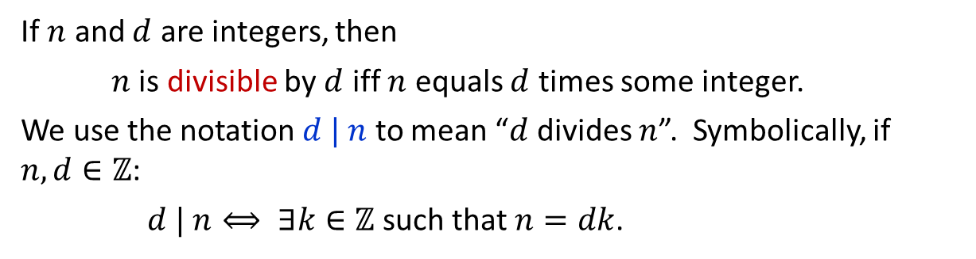
Direct Proof and Counterexample Rational Numbers Divisibility Indirect Proof
Definition
4.3.1. Definition
Recall from Lecture #2:
Definition: Divisibility
If $n$ and $d$ are integers, then
$n$ is divisible by $d$ iff $n$ equals $d$ times some integer.
We use the notation $d | n$ to mean “$d$ divides $n$”. Symbolically, if $n, d∈ℤ$:
$d | n⟺ ∃k∈ℤ$ such that $n=dk$.

Slide 24
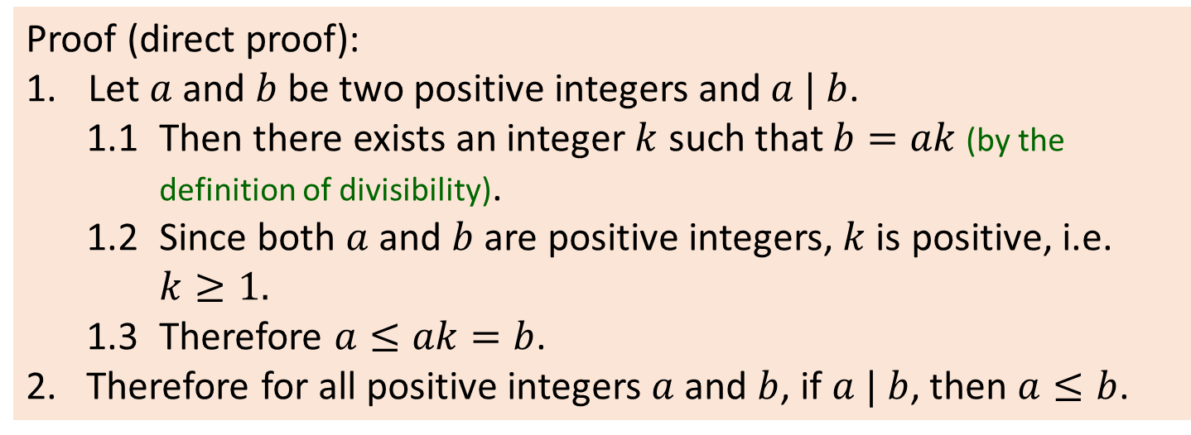
Direct Proof and Counterexample Rational Numbers Divisibility Indirect Proof
Theorems: A Positive Divisor of a Positive Integer
4.3.2. Theorems
Theorem 4.3.1 (5th: 4.4.1) A Positive Divisor of a Positive Integer
For all positive integers $a$ and $b$, if $a | b$, then $a≤b.$
Proof (direct proof):
Let $a$ and $b$ be two positive integers and $a | b$.
1.1 Then there exists an integer $k$ such that $b=ak$(by the definition of divisibility).
1.2 Since both $a$ and $b$ are positive integers, $k$ is positive, i.e. $k≥1.$
1.3 Therefore $a≤ak=b$.
2. Therefore for all positive integers $a$ and $b$, if $a | b$, then $a≤b$.

Slide 25
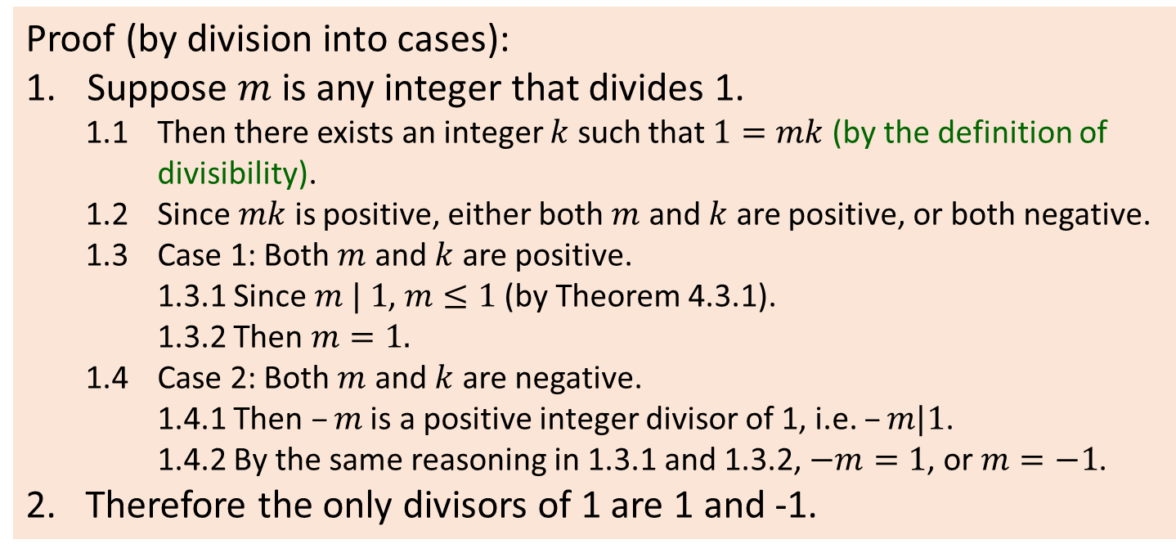
Direct Proof and Counterexample Rational Numbers Divisibility Indirect Proof
Theorems: Divisors of 1
Theorem 4.3.2 (5th: 4.4.2) Divisors of 1
The only divisors of 1 are 1 and -1.
Proof (by division into cases):
Suppose $m$ is any integer that divides 1.
1.1 Then there exists an integer $k$ such that $1=mk$(by the definition of divisibility).
1.2 Since $mk$ is positive, either both $m$ and $k$ are positive, or both negative.
1.3 Case 1: Both $m$ and $k$ are positive.
1.3.1 Since $m | 1$, $m≤1$ (by Theorem 4.3.1).
1.3.2 Then $m=1.$
1.4 Case 2: Both $m$ and $k$ are negative.
1.4.1 Then $–m$ is a positive integer divisor of 1, i.e. $–m|1$.
1.4.2 By the same reasoning in 1.3.1 and 1.3.2, $−m=1$, or $m=−1$.
2. Therefore the only divisors of 1 are 1 and -1.

Slide 26
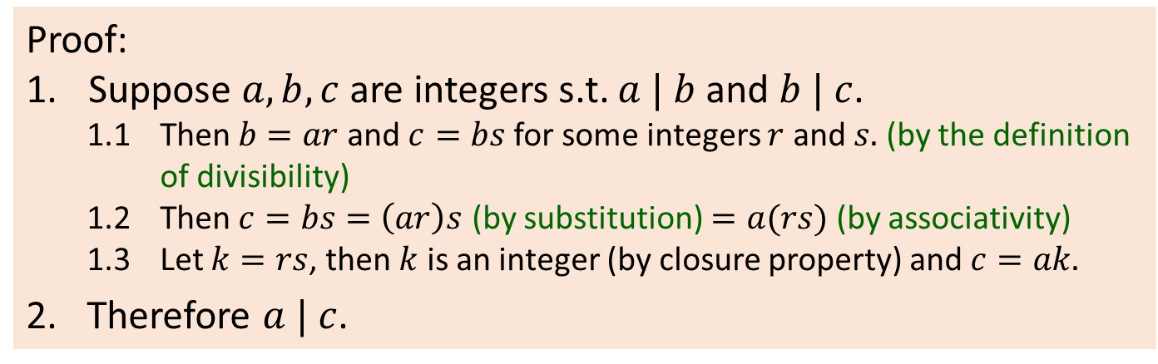
Direct Proof and Counterexample Rational Numbers Divisibility Indirect Proof
Theorems: Transitivity of Divisibility
Theorem 4.3.3 (5th: 4.4.3) Transitivity of Divisibility
For all integers $a$, $b$ and $c$, if $a | b$and $b | c$, then $a | c$.
Proof:
Suppose $a,b,c$ are integers s.t. $a | b$and $b | c$.
1.1 Then $b=ar$and $c=bs$for some integers $r$ and $s.$ (by the definition of divisibility)
1.2 Then $c=bs=\left(ar\right)s$ (by substitution) $=a(rs)$ (by associativity)
1.3 Let $k=rs$, then $k$ is an integer (by closure property) and $c=ak.$
2. Therefore $a | c$.

Slide 27
Direct Proof and Counterexample Rational Numbers Divisibility Indirect Proof
4.4 Indirect Proof

Slide 28
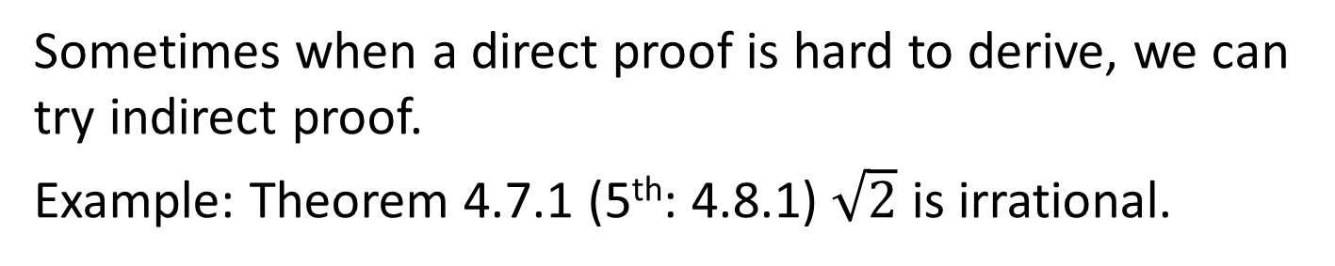
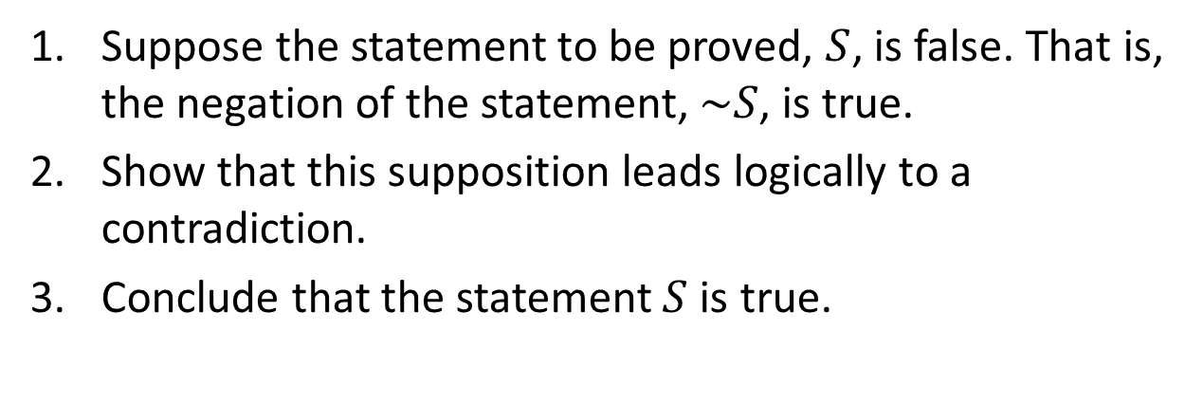
Direct Proof and Counterexample Rational Numbers Divisibility Indirect Proof
Indirect Proof: Proof by Contradiction
4.4.1. Indirect Proof: Proof by Contradiction
Sometimes when a direct proof is hard to derive, we can try indirect proof.
Example: Theorem 4.7.1 (5th: 4.8.1) $\sqrt{2}$ is irrational.
Proof by Contradiction
Suppose the statement to be proved, $S$, is false. That is, the negation of the statement, $\sim S$, is true.
Show that this supposition leads logically to a contradiction.
Conclude that the statement $S$ is true.

Slide 29
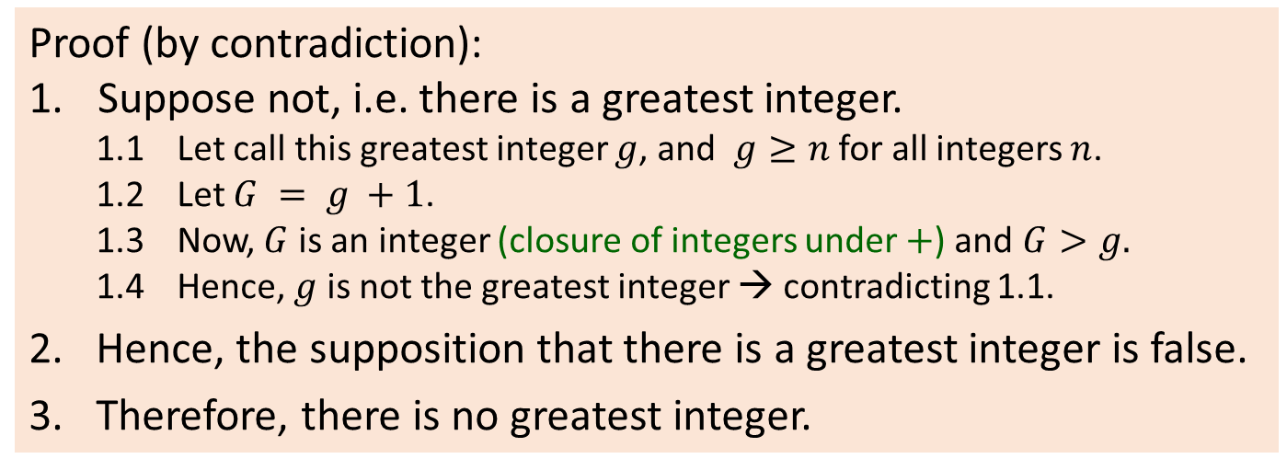
Direct Proof and Counterexample Rational Numbers Divisibility Indirect Proof
Indirect Proof: Proof by Contradiction
Theorem 4.6.1 (5th: 4.7.1)
There is no greatest integer.
Proof (by contradiction):
Suppose not, i.e. there is a greatest integer.
1.1 Let call this greatest integer $g$, and $g≥n$ for all integers $n$.
1.2 Let $G = g +1$.
1.3 Now, $G$ is an integer (closure of integers under $+$) and $G>g.$
1.4 Hence, $g$ is not the greatest integer → contradicting 1.1.
2. Hence, the supposition that there is a greatest integer is false.
3. Therefore, there is no greatest integer.

Slide 30
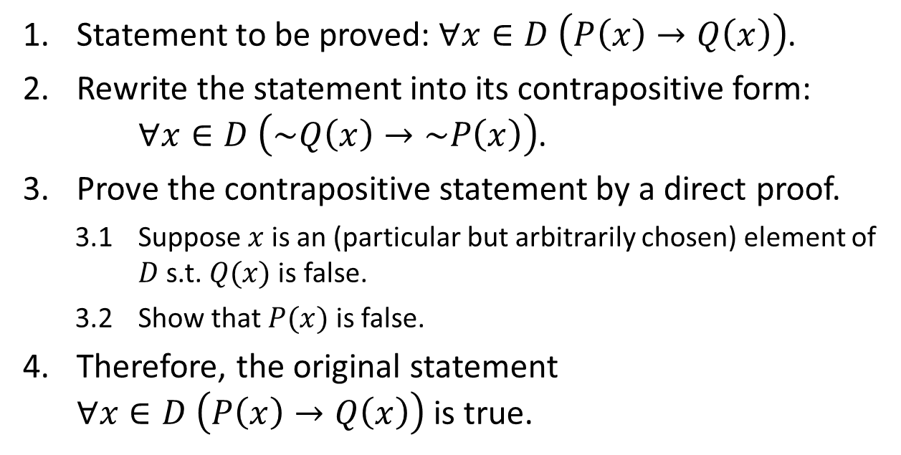
Direct Proof and Counterexample Rational Numbers Divisibility Indirect Proof
Indirect Proof: Proof by Contraposition
4.4.2. Indirect Proof: Proof by Contraposition
Recall: Contrapositive of $p→q$ is $\sim q→\sim p$.
Proof by Contraposition
Statement to be proved: $∀x∈D \left(P\left(x\right)→Q\left(x\right)\right)$.
Rewrite the statement into its contrapositive form:
$∀x∈D \left(\sim Q\left(x\right)→\sim P\left(x\right)\right)$.
Prove the contrapositive statement by a direct proof.
3.1 Suppose $x$ is an (particular but arbitrarily chosen) element of $D$ s.t. $Q(x)$is false.
3.2 Show that $P(x)$ is false.
Therefore, the original statement
$∀x∈D \left(P\left(x\right)→Q\left(x\right)\right)$ is true.

Slide 31
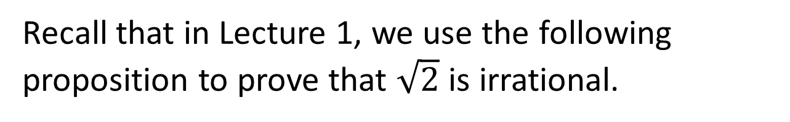
Direct Proof and Counterexample Rational Numbers Divisibility Indirect Proof
Indirect Proof: Proof by Contraposition
Recall that in Lecture 1, we use the following proposition to prove that $\sqrt{2}$ is irrational.
Proposition 4.6.4 (5th: 4.7.4)
For all integers $n$, if $n^{2}$ is even than $n$ is even.
We shall now prove this proposition.

Slide 32
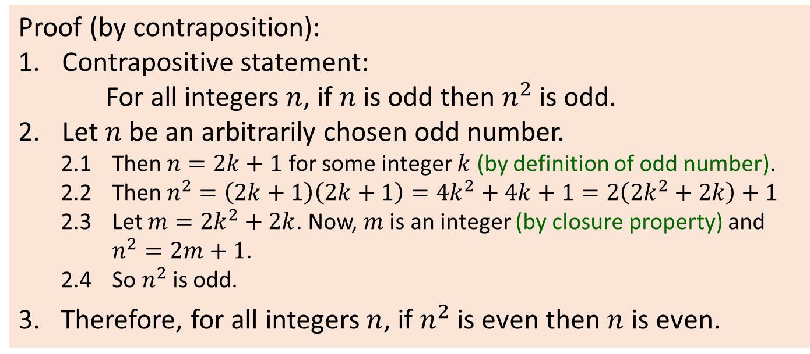
Direct Proof and Counterexample Rational Numbers Divisibility Indirect Proof
Indirect Proof: Proof by Contraposition
Proposition 4.6.4 (5th: 4.7.4)
For all integers $n$, if $n^{2}$ is even then $n$ is even.
Proof (by contraposition):
Contrapositive statement:
For all integers $n$, if $n$ is odd then $n^{2}$ is odd.
Let $n$ be an arbitrarily chosen odd number.
2.1 Then $n=2k+1$ for some integer $k$ (by definition of odd number).
2.2 Then $n^{2}=\left(2k+1\right)\left(2k+1\right)=4k^{2}+4k+1=2\left({2k}^{2}+2k\right)+1$
2.3 Let $m={2k}^{2}+2k$. Now, $m$ is an integer (by closure property) and $n^{2}=2m+1$.
2.4 So $n^{2}$ is odd.
3. Therefore, for all integers $n$, if $n^{2}$ is even then $n$ is even.


Slide 33
END OF FILE

