Slide 1
Lecture 5: Set Theory
Definitions Properties of Sets
Slides credits: Aaron Tan
Ashish Dandekar
AY2026/27 Semester 1

Slide 2
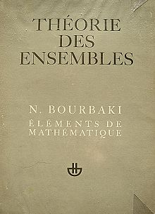
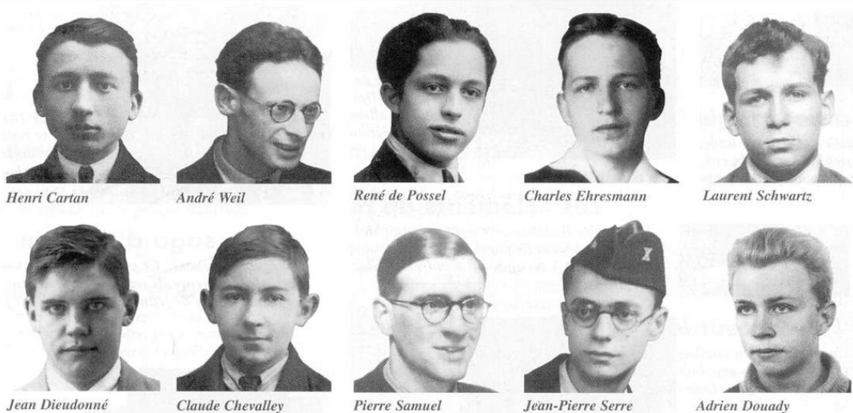
Lecture 5: Set Theory
“For whereas in the past it was thought that every branch of mathematics depended on its own particular intuition which provided its concepts and prime truths, nowadays it is known to be possible, logically speaking, to derive practically the whole of known mathematics from a single source – the Theory of Sets.”
~Nicolas Bourbaki
Elements of Mathematics: Theory of Sets

Slide 3
Lecture 5: Set Theory
Why is Set Theory important for Computer Science?
It is a useful tool for formalizing and reasoning about computation and the objects of computation.
It is indivisible from logic where Computer Science has its roots.
Applications
  Data structures
  Database theory – databases as relations over sets
  Formal language theory
  Machine learning
  etc.

Slide 4
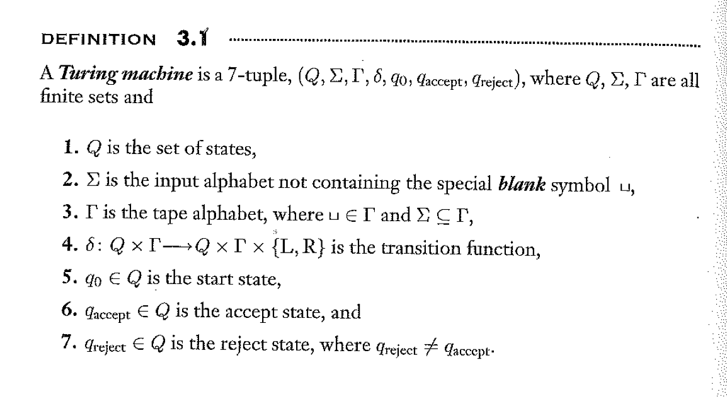
Ref: Introduction to the Theory of Computation by Michael Sipser

Slide 5
Definitions Properties of Sets
5. Set Theory
5.1 Definitions
Set-roster notation; set-builder notation; replacement notation.
5.2 Properties of Sets
Some subset relations
Set equality; Venn diagrams; operations on sets (union, intersection, difference, complement).
Subsets; proper subsets; empty set; singleton.
Procedural versions of set definitions
Set identities
Partitions of sets; power sets.
Membership; cardinality.
Ordered pairs; Cartesian products.
Reference: Epp’s Chapter 6 Set Theory

Slide 6
Definitions Properties of Sets
5.1 Definitions

Slide 7


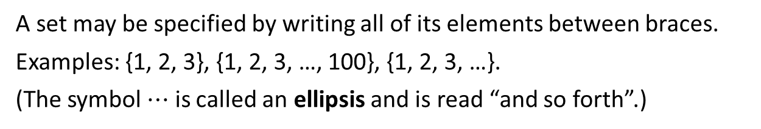
Definitions Properties of Sets
Definitions: Set-roster Notation
5.1.1. Definitions
A set is a unordered collection of objects.
The objects are called members or elements of the set.
S = { 3, a, $\sqrt{5}$ }
Days = { Sunday, Monday, Tuesday, Wednesday, Thursday, Friday, Saturday }
Set-Roster Notation
A set may be specified by writing all of its elements between braces.
Examples: {1, 2, 3}, {1, 2, 3, …, 100}, {1, 2, 3, …}.
(The symbol $⋯$ is called an ellipsis and is read “and so forth”.)
Order and duplicates do not matter.
{ 9, 8, 7 } = { 7, 9, 8 } = { 7, 8, 7, 9, 9, 7, 7 }
We distinguish between set and multiset. Eg: {a, b, c} and {a, b, b, c} are two different multisets. Multisets are not in the scope of this lecture.

Slide 8
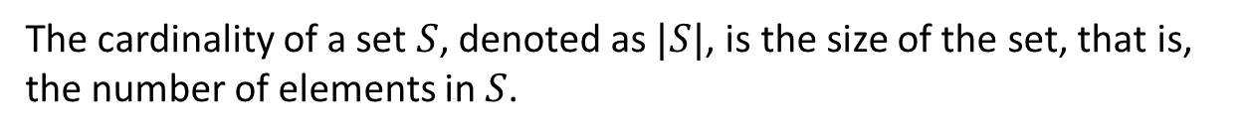

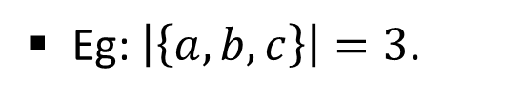
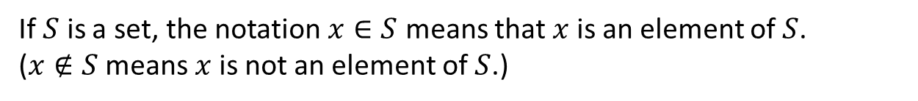
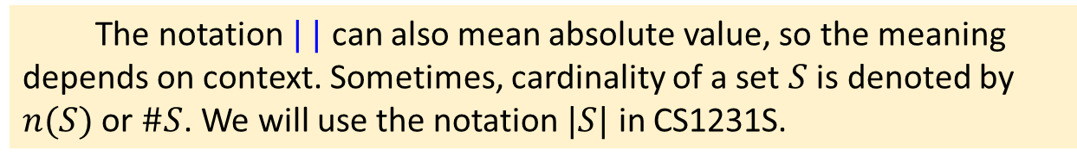
Definitions Properties of Sets
Definitions: Membership and Cardinality of a Set
Definition: Membership of a Set (Notation: $∈$)
If $S$ is a set, the notation $x∈S$ means that $x$ is an element of $S$.
($x∉S$ means $x$ is not an element of $S$.)
  Eg: $b∈\left\{a, b, c\right\};$ $456 ∈\left\{1, 2, 3, …, 999\right\};$ $f∉\{a, b, c\}$.
Definition: Cardinality of a Set (Notation: $|S|$)
The cardinality of a set $S$, denoted as $|S|$, is the size of the set, that is, the number of elements in $S$.
  Eg: $\left|\left\{a, b, c\right\}\right|=3$.
The notation $| |$ can also mean absolute value, so the meaning depends on context. Sometimes, cardinality of a set $S$ is denoted by $n(S)$ or $\#S$. We will use the notation $|S|$ in CS1231S.

Slide 9

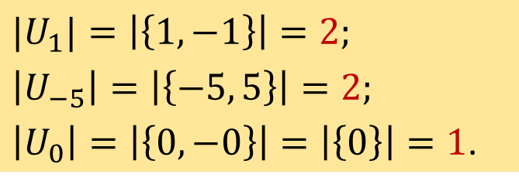
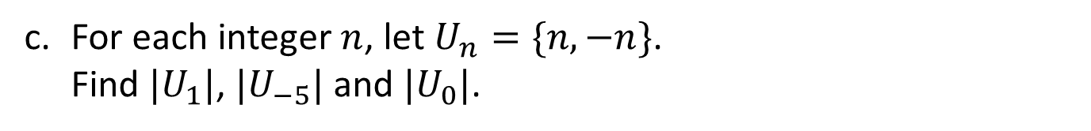
Definitions Properties of Sets
Definitions : Membership and Cardinality of a Set
a. Is $\left\{a\right\}∈\left\{a,\left\{a,b\right\},c\right\}$?
No. The 3 members of $\left\{a,\left\{a,b\right\},c\right\}$ are $a$, $\{a,b\}$and $c$.
b. What is the cardinality of the set $\left\{1,\left\{1,2\right\},\left\{3,\left\{4,5\right\},6\right\},\left\{2,3\right\}\right\}$?
4
c. For each integer $n$, let $U_{n}=\{n,−n\}$.
Find ${|U}_{1}|$, $|U_{−5}|$ and $|U_{0}|$.
$${|U}_{1}|=\left|\left\{1, −1\right\}\right|=2;$$
$$\left|U_{−5}\right|=\left|\left\{−5, 5\right\}\right|=2;$$
$\left|U_{0}\right|=\left|\left\{0, −0\right\}\right|=\left|\left\{0\right\}\right|=1$.


Slide 10
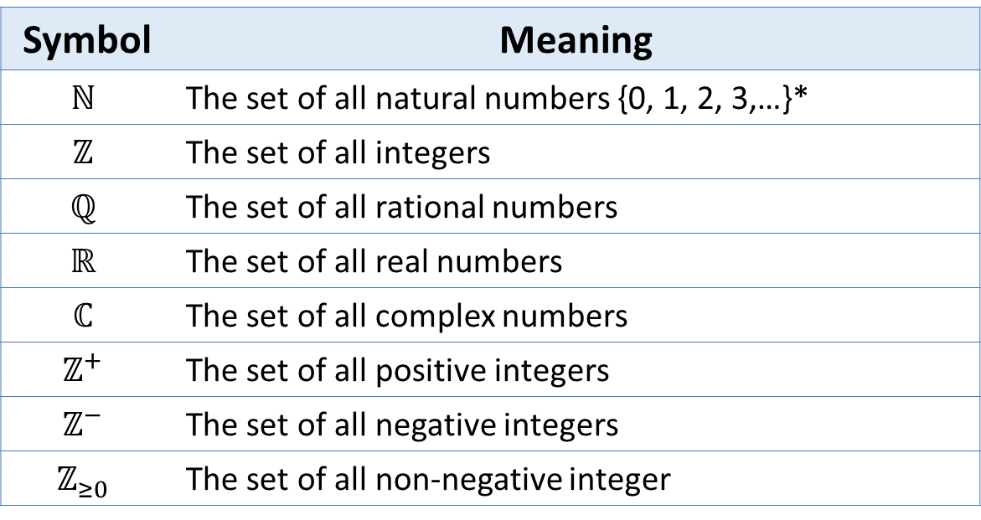
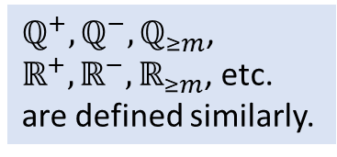
Definitions Properties of Sets
Commonly used sets
Table 5.1. Common Sets
Symbol | Meaning
$$ℕ$$ | The set of all natural numbers {0, 1, 2, 3,…}*
$$ℤ$$ | The set of all integers
$$ℚ$$ | The set of all rational numbers
$$ℝ$$ | The set of all real numbers
$$ℂ$$ | The set of all complex numbers
$$ℤ^{+}$$ | The set of all positive integers
$$ℤ^{−}$$ | The set of all negative integers
$$ℤ_{≥0}$$ | The set of all non-negative integer
$ℚ^{+},ℚ^{−},ℚ_{≥m}$, $ℝ^{+},ℝ^{−},ℝ_{≥m}$, etc. are defined similarly.
*: In this module we define the set $ℕ$ to include zero.
Zero is neither positive nor negative.

Slide 11
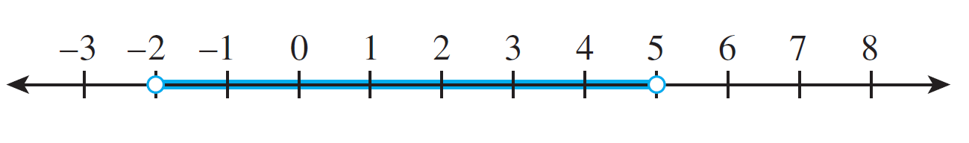
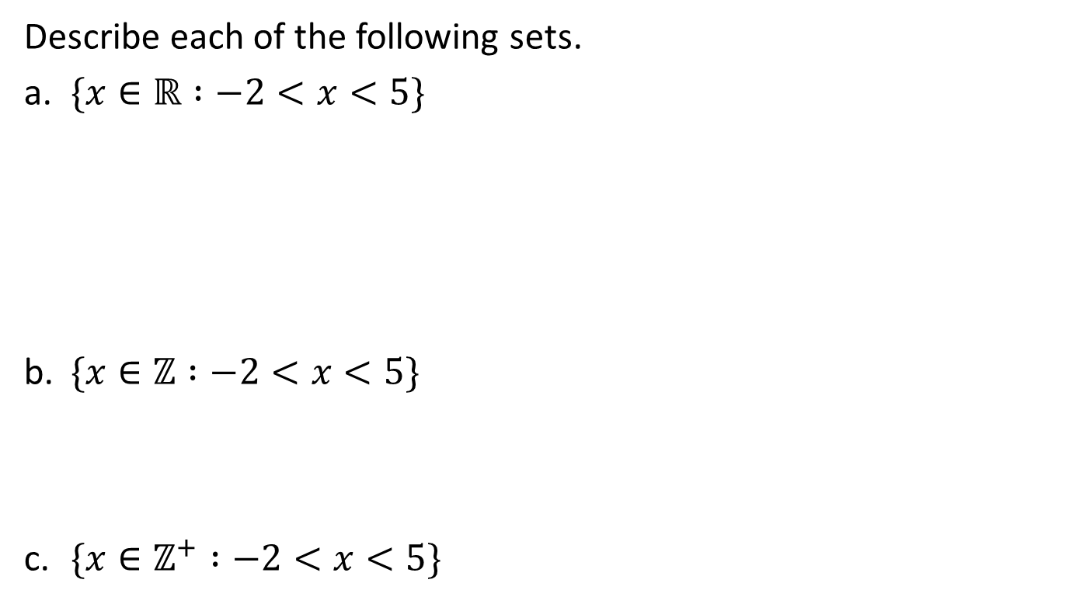
Definitions Properties of Sets
Using the set-builder notation
Describe each of the following sets.
a. $\{x∈ℝ :−2<x<5\}$
b. $\{x∈ℤ :−2<x<5\}$
c. $\{x∈ℤ^{+} :−2<x<5\}$
The open interval of real numbers (strictly) between -2 and 5, pictured as follows:
The set of all integers (strictly) between -2 and 5, that is,
{ -1, 0, 1, 2, 3, 4}.
The set { 1, 2, 3, 4}.

Slide 12


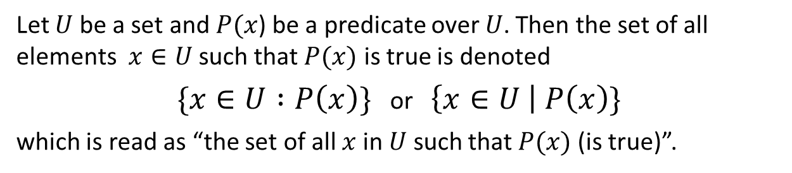
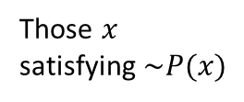
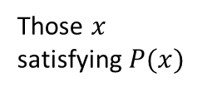
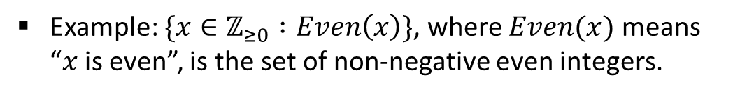
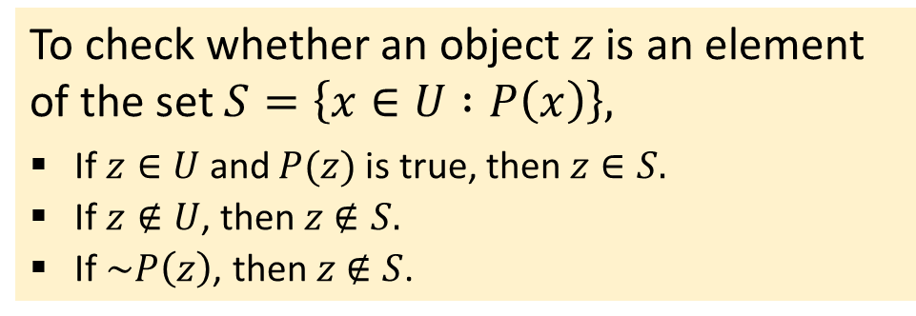
Definitions Properties of Sets
Set-builder notation
Another way to specify a set is to describe its elements. This is called the set-builder notation.
Set-Builder Notation
Let $U$ be a set and $P(x$) be a predicate over $U$. Then the set of all elements $x∈U$ such that $P(x)$ is true is denoted
$\{x∈U :P\left(x\right)\}$ or $\left\{x∈U \right| P\left(x\right)\}$
which is read as “the set of all $x$ in $U$ such that $P(x)$(is true)”.
Example: $\{x∈ℤ_{≥0} :Even\left(x\right)\}$, where $Even(x)$ means “$x$ is even”, is the set of non-negative even integers.
$$U$$
To check whether an object $z$ is an element of the set $S=\left\{x∈U :P\left(x\right)\right\},$
If $z∈U$ and $P(z)$is true, then $z∈S.$
If $z∉U\text{, }\text{then} z∉S.$
If $\sim P\left(z\right)\text{, }\text{then} z∉S$.
Those $x$ satisfying $P(x)$
Those $x$ satisfying $\sim P(x)$

Slide 13

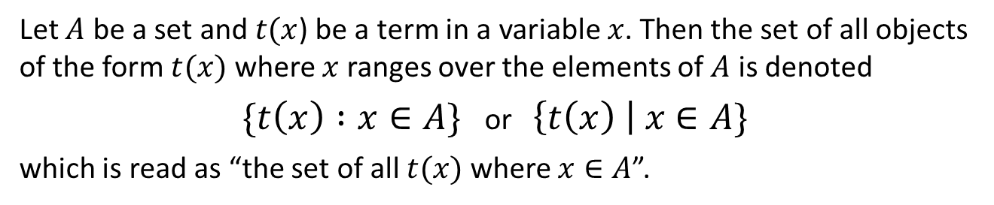

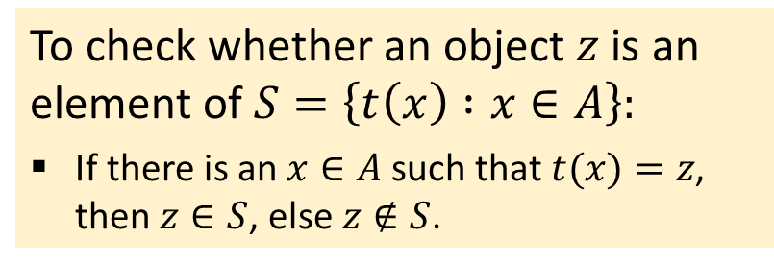
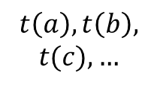

Definitions Properties of Sets
Replacement notation
Yet another way to specify a set uses the replacement notation.
Replacement Notation
Let $A$ be a set and $t(x$) be a term in a variable $x$. Then the set of all objects of the form $t(x)$ where $x$ ranges over the elements of $A$ is denoted
$\{t\left(x\right) :x∈A\}$ or $\left\{t\left(x\right) \right| x∈A\}$
which is read as “the set of all $t(x)$ where $x∈A$”.
Eg: The elements of $S=\{x+1 : x∈ℤ_{≥0}\}$ are precisely those $x+1$where $x∈ℤ_{≥0}$, i.e., the positive integers. So, $1=0+1∈S$ but $0∉S$.
To check whether an object $z$ is an element of $S=\left\{t\left(x\right) :x∈A\right\}:$
If there is an $x∈A$ such that $t(x)=z$, then $z∈S$, else $z∉S$.
$$t\left(a\right),t\left(b\right),$$
$$t(c),…$$
$$a,b,c,…$$
$$A$$
$$\{t\left(x\right) :x∈A\}$$

Slide 14
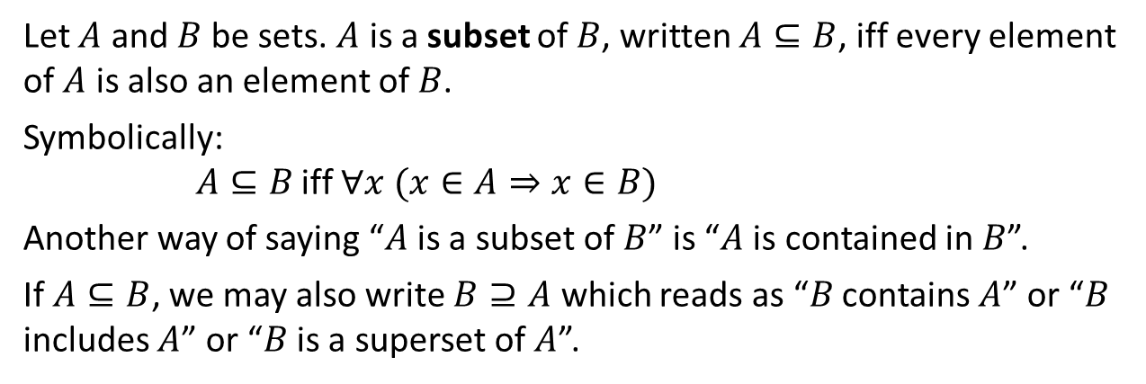
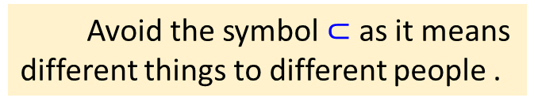
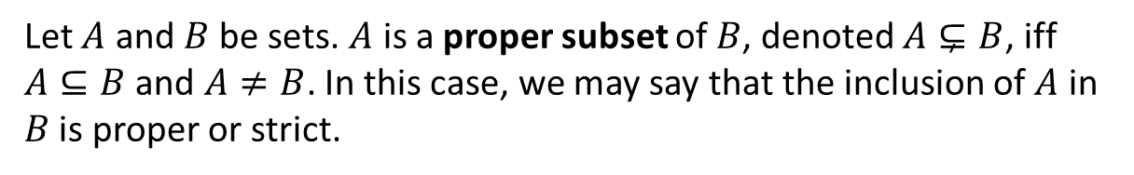
Definitions Properties of Sets
Subsets, Proper Subsets, Empty Set and Singleton
5.1.2. Subsets, Proper Subsets, Empty Set and Singleton
Definitions: Subset and superset
Let $A$ and $B$ be sets. $A$ is a subset of $B$, written $A⊆B$, iff every element of $A$ is also an element of $B$.
Symbolically:
$A⊆B$ iff $∀x (x∈A⇒x∈B)$
Another way of saying “$A$ is a subset of $B$” is “$A$ is contained in $B$”.
If $A⊆B$, we may also write $B⊇A$ which reads as “$B$ contains $A$” or “$B$ includes $A$” or “$B$ is a superset of $A$”.
Avoid the symbol $⊂$ as it means different things to different people .
Definition: Proper Subset
Let $A$ and $B$ be sets. $A$ is a proper subset of $B$, denoted $A⊊B$, iff $A⊆B$ and $A≠B$. In this case, we may say that the inclusion of $A$ in $B$ is proper or strict.

Slide 15
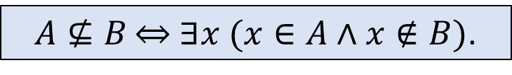



Definitions Properties of Sets
Subsets, Proper Subsets, Empty Set and Singleton
It follows from the definition of subset that for a set A not to be a subset of a set B means that there is at least one element of A that is not an element of B.
Symbolically:
$A⊈B$ $⇔$ $∃x$ $(x∈A∧x∉B)$.
$$⊆$$
$$⊊$$
$$⊈$$
Subset
Proper subset
Not subset
A set with no element, {}, is an empty set, denoted as $∅$.
Theorem 6.2.4
An empty set is a subset of every set, i.e. $∅⊆A$ for all sets $A$.
A set with exactly one element is called a singleton.

Slide 16
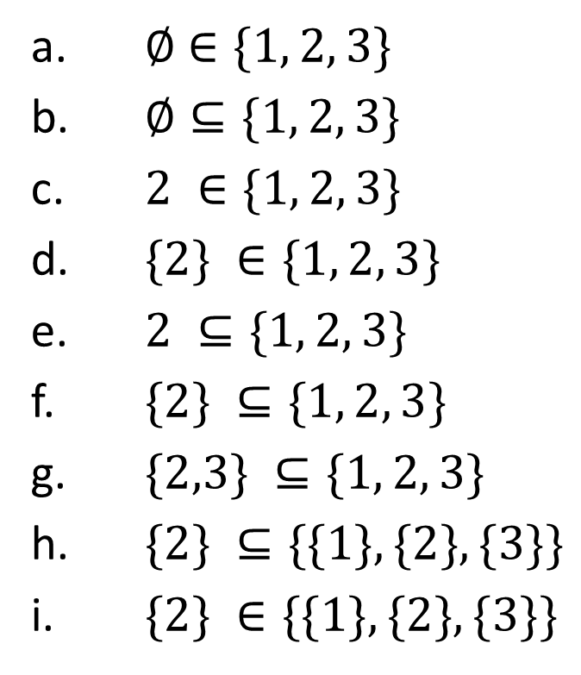
Definitions Properties of Sets
Distinction between $∈$ and $⊆$
Which of the following are true?
×
a. $∅$ $∈\{1, 2, 3\}$
b. $∅⊆\{1, 2, 3\}$
c. $2 ∈\{1, 2, 3\}$
d. $\{2\} ∈\{1, 2, 3\}$
e. $2 ⊆\{1, 2, 3\}$
f. $\{2\} ⊆\{1, 2, 3\}$
g. $\{2,3\} ⊆\{1, 2, 3\}$
h. $\{2\} ⊆\{\{1\}, \{2\}, \{3\}\}$
i. $\{2\} ∈\{\{1\}, \{2\}, \{3\}\}$
✓
✓
×
×
✓
✓
×
✓


Slide 17
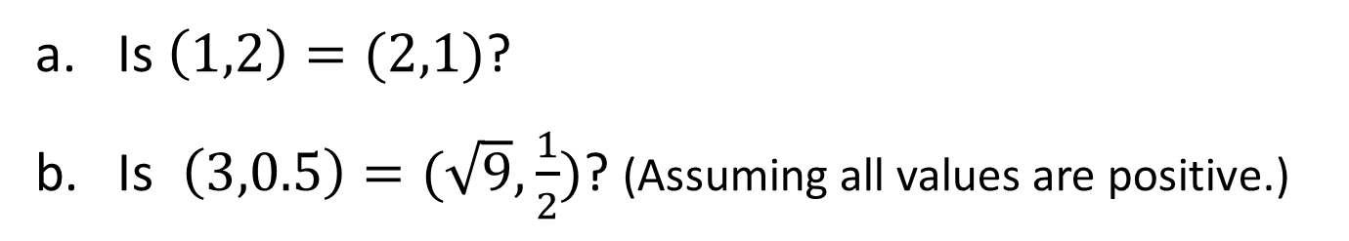
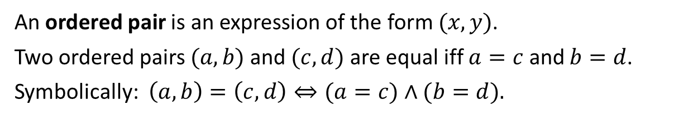
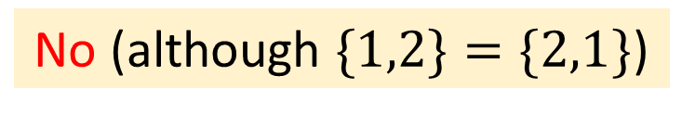
Definitions Properties of Sets
Ordered Pairs
5.1.3. Ordered Pairs
Definition: Ordered Pair
An ordered pair is an expression of the form $(x,y)$.
Two ordered pairs $(a,b)$and $(c,d)$ are equal iff $a=c$ and $b=d$.
Symbolically: $\left(a,b\right)=\left(c,d\right)⇔(a=c)∧(b=d).$
Is $\left(1,2\right)=(2,1)$?
Is $\left(3,0.5\right)=(\sqrt{9},\frac{1}{2})$? (Assuming all values are positive.)
No (although $\{1,2\}=\{2,1\}$)
Yes


Slide 18

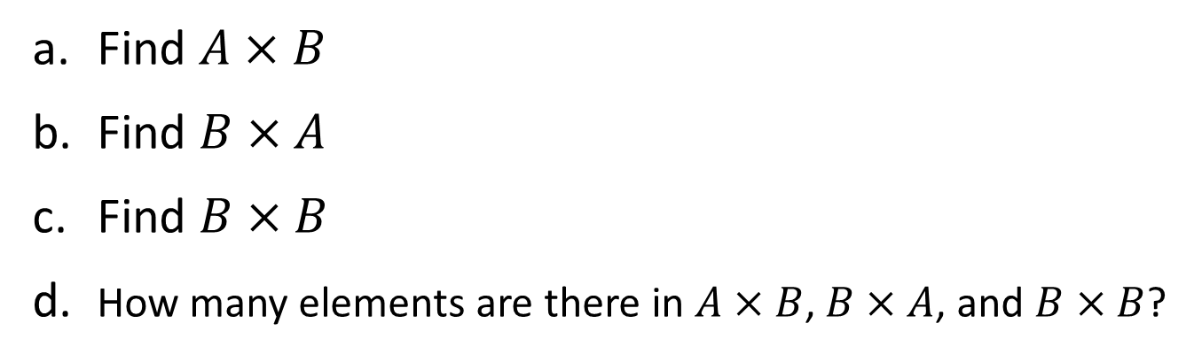
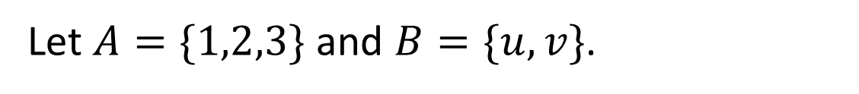
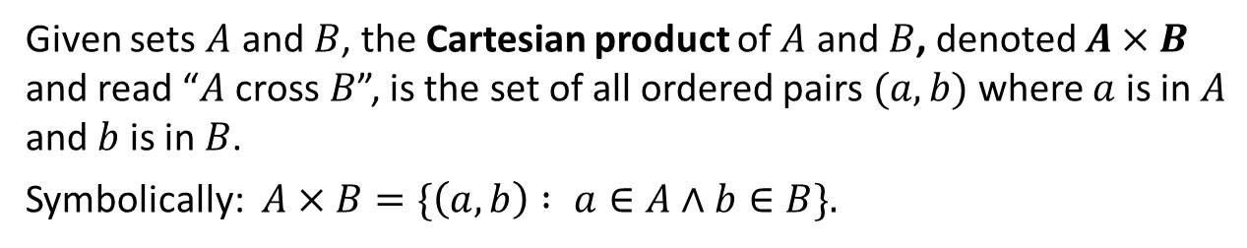
Definitions Properties of Sets
Cartesian Products
5.1.4. Cartesian Products
Definition: Cartesian Product
Given sets $A$ and $B$, the Cartesian product of $A$ and $B$, denoted $A×B$ and read “$A$ cross $B$”, is the set of all ordered pairs $(a,b)$where $a$ is in $A$ and $b$ is in $B$.
Symbolically: $A×B=\{\left(a,b\right) : a∈A∧b∈B\}.$
Let $A=\{1,2,3\}$ and $B=\{u,v\}$.
a. Find $A×B$
b. Find $B×A$
Find $B×B$
d. How many elements are there in $A×B$, $B×A$, and $B×B$?
$$A×B=\{\left(1,u\right),\left(2,u\right),\left(3,u\right),\left(1,v\right),\left(2,v\right),\left(3,v\right)\}$$
$$B×A=\{\left(u,1\right),\left(u,2\right),\left(u,3\right),\left(v,1\right),\left(v,2\right),\left(v,3\right)\}$$
$$B×B=\{\left(u,u\right),\left(u,v\right),\left(v,u\right),(v,v)\}$$
6, 6, and 4


Slide 19
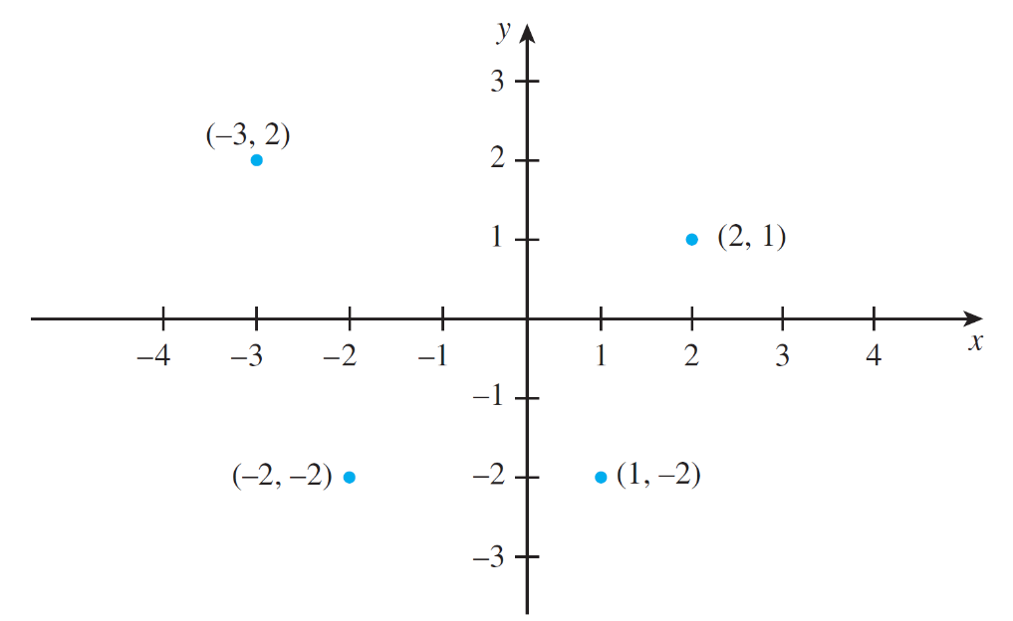
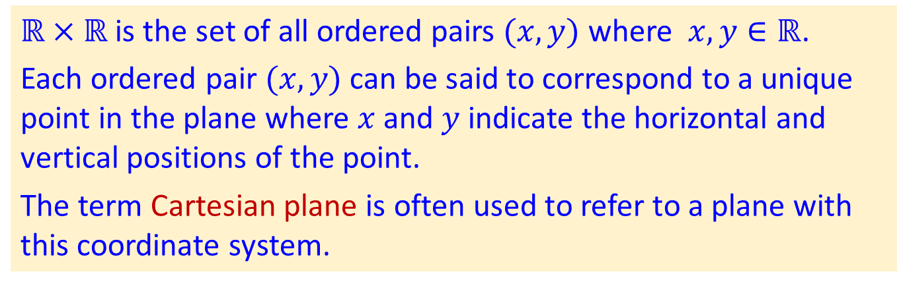
Definitions Properties of Sets
Cartesian Products
Let $ℝ$denote the set of all real numbers. Describe $ℝ×ℝ$.
$ℝ×ℝ$ is the set of all ordered pairs $(x,y)$ where $x,y∈ℝ$.
Each ordered pair $(x,y)$ can be said to correspond to a unique point in the plane where $x$ and $y$ indicate the horizontal and vertical positions of the point.
The term Cartesian plane is often used to refer to a plane with this coordinate system.
Figure 1.2.1 A Cartesian Plane

Slide 20
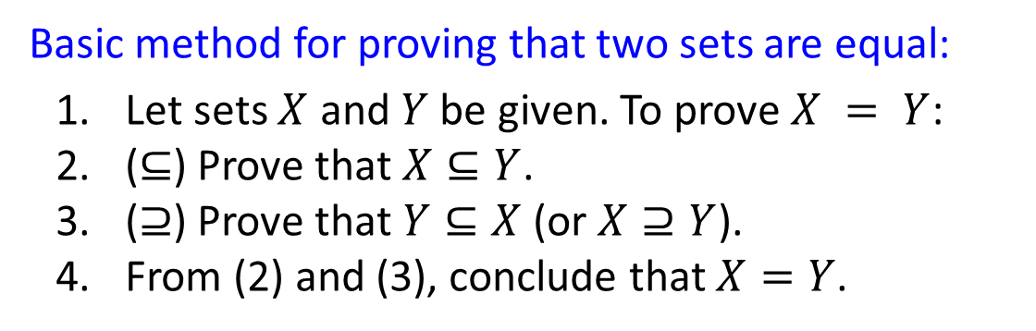
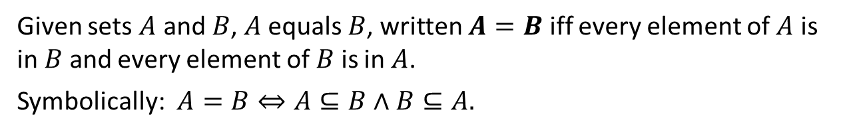
Definitions Properties of Sets
Set Equality
5.1.5. Definition: Set Equality
Sets A and B are equal if, and only if, they have exactly the same elements.
Definition: Set equality
Given sets $A$ and $B$, $A$ equals $B$, written $A=B$ iff every element of $A$ is in $B$ and every element of $B$ is in $A$.
Symbolically: $A=B⇔A⊆B∧B⊆A.$
Basic method for proving that two sets are equal:
Let sets $X$ and $Y$ be given. To prove $X = Y$:
($⊆$) Prove that $X⊆Y$.
($⊇$) Prove that $Y⊆X$ (or $X⊇Y$).
From (2) and (3), conclude that $X=Y$.

Slide 21
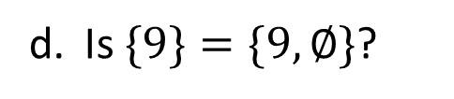
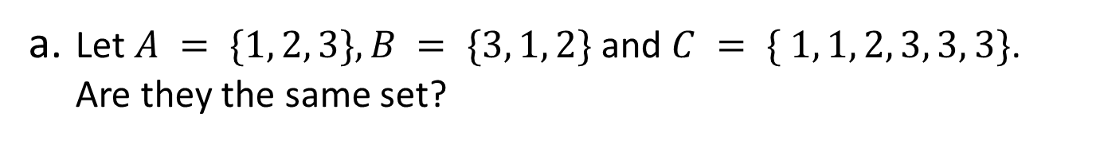
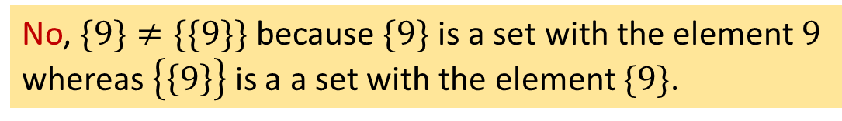
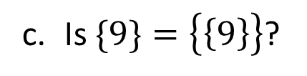

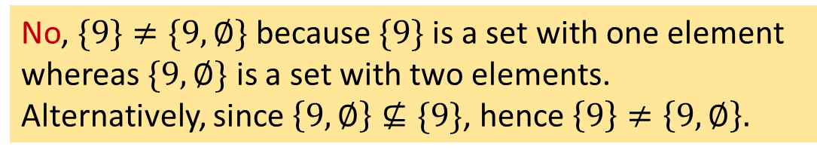
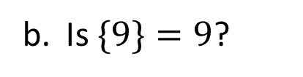
Definitions Properties of Sets
Set Equality
a. Let $A = \{1, 2, 3\}, B = \{3, 1, 2\}$ and $C = \{ 1, 1, 2, 3, 3, 3\}$.
Are they the same set?
Yes, they are the same set, each containing three elements: 1, 2 and 3.
b. Is $\{9\}=9$?
No, $\{9\} ≠ 9$because $\{9\}$is a set but $9$ is not.
c. Is $\{9\}=\left\{\left\{9\right\}\right\}$?
No, $\{9\}≠\{\{9\}\}$because $\{9\}$ is a set with the element $9$ whereas $\left\{\left\{9\right\}\right\}$ is a a set with the element $\{9\}$.
d. Is $\{9\}=\{9,∅\}$?
No, $\{9\}≠\{9, ∅\}$ because $\{9\}$is a set with one element whereas $\{9, ∅\}$ is a set with two elements.
Alternatively, since $\left\{9, ∅\right\}⊈\{9\}$, hence $\left\{9\right\}≠\left\{9, ∅\right\}.$


Slide 22
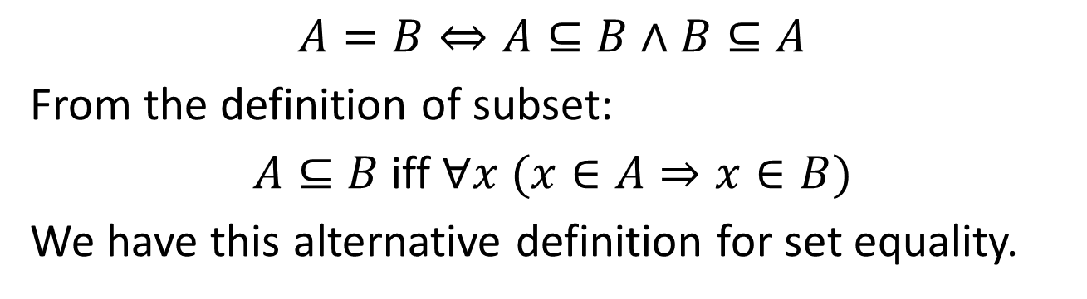
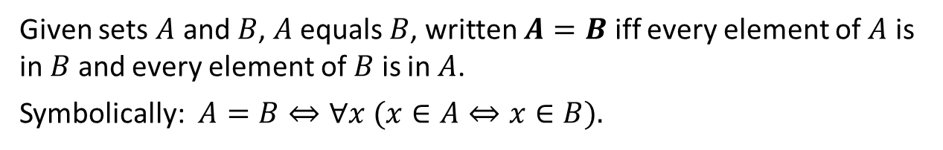
Definitions Properties of Sets
Set Equality
$$A=B⇔A⊆B∧B⊆A$$
From the definition of subset:
$A⊆B$iff $∀x (x∈A⇒x∈B)$
We have this alternative definition for set equality.
Definition: Set equality
Given sets $A$ and $B$, $A$ equals $B$, written $A=B$ iff every element of $A$ is in $B$ and every element of $B$ is in $A$.
Symbolically: $A=B⇔∀x (x∈A⇔x∈B).$

Slide 23
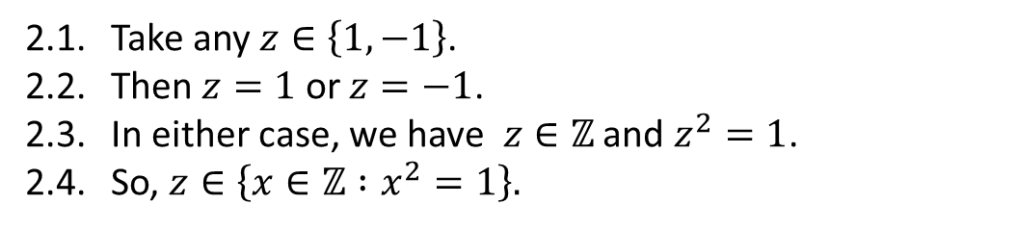
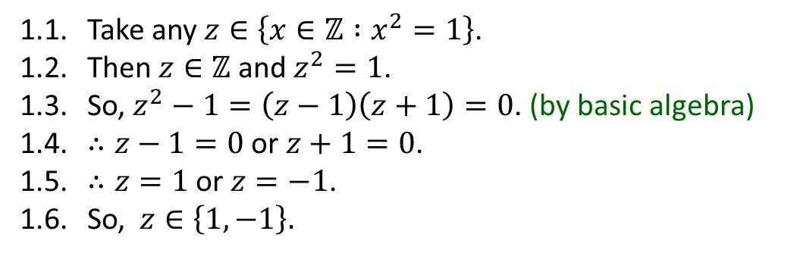
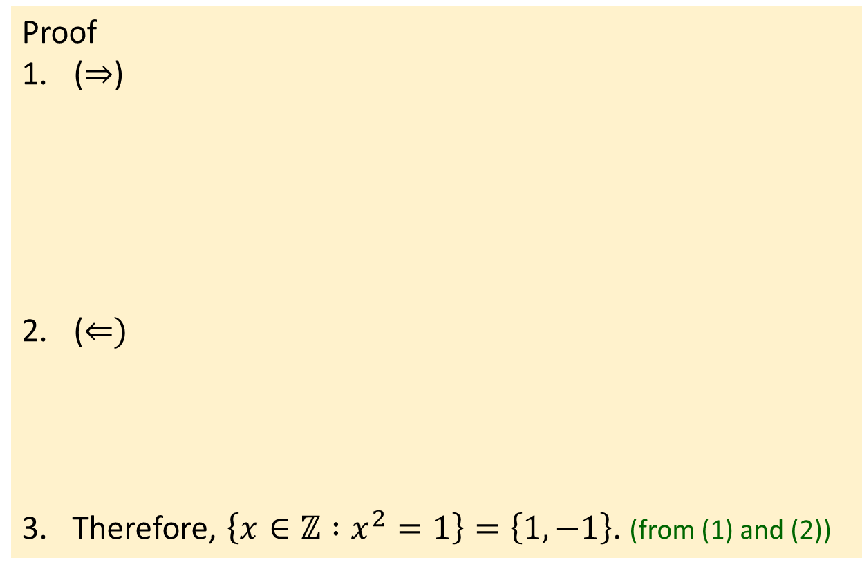
Definitions Properties of Sets
Set Equality
Example: Prove that $\left\{x∈ℤ :x^{2}=1\right\}=\left\{1,−1\right\}.$
Proof
($⇒$)
($⇐)$
Therefore, $\left\{x∈ℤ :x^{2}=1\right\}=\left\{1,−1\right\}$. (from (1) and (2))
1.1. Take any $z∈\left\{x∈ℤ :x^{2}=1\right\}$.
1.2. Then $z∈ℤ$ and $z^{2}=1$.
1.3. So, $z^{2}−1=\left(z−1\right)\left(z+1\right)=0$. (by basic algebra)
1.4. $∴z−1=0$ or $z+1=0$.
1.5. $∴z=1$ or $z=−1$.
1.6. So, $z∈\left\{1,−1\right\}.$
2.1. Take any $z∈\left\{1,−1\right\}$.
2.2. Then $z=1$ or $z=−1$.
2.3. In either case, we have $z∈ℤ$ and $z^{2}=1$.
2.4. So, $z∈\left\{x∈ℤ :x^{2}=1\right\}.$


Slide 24
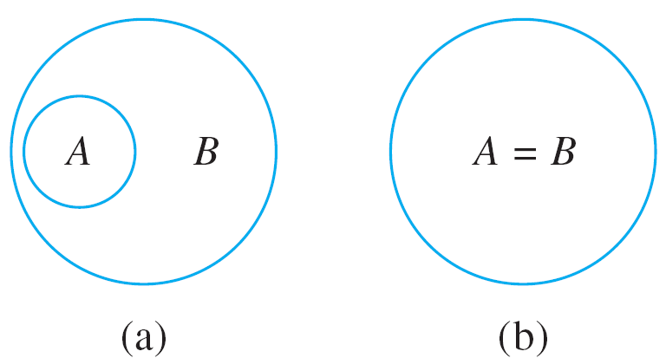
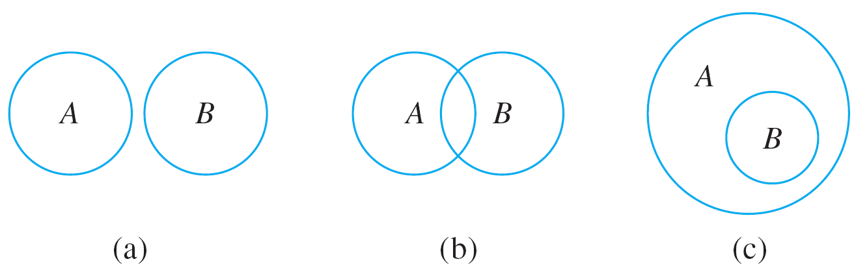


Definitions Properties of Sets
Venn Diagrams
5.1.6. Venn Diagrams
If sets A and B are represented as regions in the plane, relationships between A and B can be represented by pictures, called Venn diagrams, introduced by the British mathematician John Venn in 1881.
$$A⊆B$$
Figure 6.1.1
$$A ⊈B$$
Figure 6.1.2

Slide 25
Definitions Properties of Sets
Operations on Sets
5.1.7. Operations on Sets
Universal set:
Most mathematical discussions are carried on within some context. For example, in a certain situation all sets being considered might be sets of real numbers.
In such a situation, the set of real numbers would be called a universal set or a universe of discourse for the discussion.

Slide 26

Definitions Properties of Sets
Operations on Sets
Union, intersection, difference and complement.
Definitions
Let $A$ and $B$ be subsets of a universal set $U$.
The union of $A$ and $B$, denoted $A∪B$, is the set of all elements that are in at least one of $A$ or $B$.
The intersection of $A$ and $B$, denoted $A∩B$, is the set of all elements that are common to both $A$ and $B$.
The difference of $B$ minus $A$ (or relative complement of $A$ in $B$), denoted $B−A$, or $B \backslash A$, is the set of all elements that are in $B$ and not $A$.
The complement of $A$, denoted $\overline{A}$, is the set of all elements in $U$ that are not in $A$. (Note: Epp uses the notation $A^{c}$.)
Symbolically: $A∪B=\{x∈U:x∈A∨x∈B\},$
$A∩B=\{x∈U:x∈A∧x∈B\},$
$B \backslash A=\{x∈U:x∈B∧x∉A\},$
$\overline{A}=\left\{x∈U \right| x∉A\}.$

Slide 27







Definitions Properties of Sets
Operations on Sets
Union, intersection, difference and complement.
Shaded region
represents A ∪ B.
Shaded region
represents A ∩ B.
Shaded region
represents B – A.
Shaded region
represents A^{c}.
Figure 6.1.4
Let the universal set be $U=\{a,b,c,d,e,f,g\}$and
let $A=\{a,c,e,g\}$ and $B=\{d,e,f,g\}$ . Find
a. $A∪B$
b. $A∩B$
c. $B \backslash A$
d. $\overline{A}$
$$\{a,c,d,e,f,g\}$$
$$\{e,g\}$$
Note: In a context where $U$ is the universal set (so that implicitly means $U⊇X$), the complement of $X$, denoted $\overline{X}$ or $X^{c}$, is defined by $\overline{X}=U \backslash X$.
$$\{d,f\}$$
$$\{b,d,f\}$$


Slide 28

Definitions Properties of Sets
Operations on Sets
Intervals of real numbers:
There is a convenient notation for subsets of real numbers that are intervals.
Interval notation
Given real numbers $a$ and $b$ with $a≤b:$
$\left(a,b\right)=\{x∈ℝ :a<x<b\},$ $[a,b]=\{x∈ℝ :a≤x≤b\},$
$(a,b]=\{x∈ℝ :a<x≤b\},$ $\left[a,b\right)=\{x∈ℝ :a≤x<b\}.$
The symbols $∞$ and $−∞$ are used to indicate intervals that are unbounded either on the right or on the left:
$\left(a,∞\right)=\{x∈ℝ :x>a\},$ $[a,∞)=\{x∈ℝ :x≥a\},$
$(−∞,b)=\{x∈ℝ :x<b\},$ $(−∞,b]=\{x∈ℝ :x≤b\}.$
Note: Observe that the notation for the interval (a, b) is identical to the notation for the ordered pair (a, b). However, context makes it unlikely that the two will be confused.

Slide 29


Definitions Properties of Sets
Operations on Sets
The definitions of unions and intersections for more than two sets are very similar to the definitions for two sets.
$\bigcup_{i=0}^{n}{A_{i}}=A_{0}∪A_{1}∪⋯∪A_{n}$
$\bigcap_{i=0}^{n}{A_{i}}=A_{0}∩A_{1}∩⋯∩A_{n}$

Slide 30


Definitions Properties of Sets
Partition of Sets
5.1.8. Partitions of Sets
In many applications of set theory, sets are divided up into nonoverlapping (or disjoint) pieces. Such a division is called a partition.
Definition
Two sets are disjoint iff they have no elements in common.
Symbolically: $A$ and $B$ are disjoint iff $A∩B=∅$.
Definition
Sets $A_{1},A_{2}$, $A_{3},⋯$ are mutually disjoint (or pairwise disjoint or nonoverlapping) iff no two sets $A_{i}$ and $A_{j}$ with distinct subscripts have any elements in common, i.e. for all $i,j=1,2,3,⋯$
$A_{i}∩A_{j}=∅$ whenever $i≠j$.

Slide 31


Definitions Properties of Sets
Partition of Sets
Suppose A, A₁, A₂, A₃, and A₄ are the sets of points represented by the regions shown in Figure 6.1.5.
Then A₁, A₂, A₃, and A₄ are subsets of A, and A = A₁ $∪$ A₂ $∪$ A₃ $∪$ A₄.
A Partition of a Set
Figure 6.1.5
Suppose further that boundaries are assigned to the regions representing A₁, A₂, A₃, and A₄ in such a way that these sets are mutually disjoint.
Then A is called a union of mutually disjoint subsets, and the collection of sets {A₁, A₂, A₃, A₄} is said to be a
partition of A.

Slide 32


Definitions Properties of Sets
Partition of Sets
Theorem 4.4.1 The Quotient-Remainder Theorem
Given any integer $n$ and positive integer $d$, there exist unique integers $q$ and $r$such that
$n=dq+r$ and $0≤r<d.$
Examples:
$n=54,d=4$
$54=4∙13+2;$ hence $q=13$and $r=2$.
$n=−27,d=5$
$−27=5∙(−6)+3;$ hence $q=−6$and $r=3.$

Slide 33



Definitions Properties of Sets
Partition of Sets
a. Let A = {1, 2, 3, 4, 5, 6}, A₁ = {1, 2}, A₂ = {3, 4}, and A₃ = {5, 6}. Is {A₁, A₂, A₃} a partition of A?
Yes. A = A₁ $∪$ A₂ $∪$ A₃ and the sets A₁, A₂, and A₃ are mutually disjoint.
b. Let $ℤ$ be the set of all integers and let
Is {T₀, T₁, T₂} a partition of $ℤ$?
$T_{0}=\{n∈ℤ :n=3k$, for some integer $k\}$,
$T_{1}=\{n∈ℤ :n=3k+1$, for some integer $k\}$, and
$T_{2}=\{n∈ℤ :n=3k+2$, for some integer $k\}.$
Yes. By the quotient-remainder theorem, every integer n can be written in exactly one of the three forms: n = 3k, or n = 3k+1, or n = 3k + 2 for some integer k. This implies that T₀, T₁ and T₂ are mutually disjoint and $ℤ$ = T₀ $∪$ T₁ $∪$ T₂.


Slide 34


Definitions Properties of Sets
Power Sets
5.1.9. Power Sets
There are various situations in which it is useful to consider the set of all subsets of a particular set.
The power set axiom guarantees that this is a set.
Definition
Given a set $A$, the power set of $A$, denoted $𝒫(A)$, is the set of all subsets of $A$.
Let $A=\{x,y\}$. Find the power set of $A$, i.e. $𝒫(A)$.
$𝒫$(𝐴) is the set of all subsets of $A$. Therefore
$$𝒫\left(A\right)=\left\{∅, \left\{x\right\}, \left\{y\right\}, \left\{x,y\right\}\right\}$$

Slide 35

Definitions Properties of Sets
Power Sets
The number of subsets of a set is the number of elements of its power set. Assume that set A is a finite set.
Theorem: Cardinality of Power Set of a Finite Set
Let $A$ be a finite set where $\left|A\right|=n$, then $\left|𝒫\left(A\right)\right|=2^{n}.$
The proof uses mathematical induction (to be covered in lecture 8) and is based on the following observations. Suppose $A$ is a set and $z∈A$.
The subsets of $A$ can be split into two groups: those that do not contain $z$ and those that contain $z$.
The subsets of $A$ that do not contain $z$ are the same as the subset of $A−\{z\}$.
The subsets of $A$ that do not contain $z$ can be matched up one for one with the subsets of $A$ that do contain $z$ by matching each subset that does not contain $z$ to the subset that contains $z$.
Thus, there are as many subsets of $A$ that contains $z$ as there are subsets of $A$ that do not contain $z$.

Slide 36



Definitions Properties of Sets
Power Sets
For instance, if $A = \{x, y, z\}$, the following table shows the correspondence between subsets of $A$ that do not contain $z$ and subsets of $A$ that contain $z$.
Subsets of A that do not contain z
Subsets of A that contain z
$∅$ $⟷$ $∅∪\left\{z\right\}=\left\{z\right\}$
$\{x\}$ $⟷$ $\{x\}∪\left\{z\right\}=\left\{x,z\right\}$
$\{y\}$ $⟷$ $\left\{y\right\}∪\left\{z\right\}=\left\{y,z\right\}$
$\{x,y\}$ $⟷$ $\{x,y\}∪\left\{z\right\}=\left\{x,y,z\right\}$
Theorem 6.3.1
Suppose $A$ is a finite set with $n$ elements, then $𝒫(A)$ has $2^{n}$ elements. In other words, $\left|𝒫\left(A\right)\right|=2^{|A|}.$

Slide 37



Definitions Properties of Sets
Ordered $n$-tuples and Cartesian Products (Revisit)
5.1.10. Ordered $n$-tuples and Cartesian Products (Revisit)
Definition
Let $n∈ℤ^{+}$ and let $x_{1},x_{2},⋯,x_{n}$ be (not necessarily distinct) elements. An ordered $n$-tuple is an expression of the form $\left(x_{1},x_{2},⋯,x_{n}\right)$.
An ordered pair is an ordered 2-tuple; an ordered triple is an ordered 3-tuple.
Equality of two ordered $n$-tuples:
$\left(x_{1},x_{2},⋯,x_{n}\right)=\left(y_{1},y_{2},⋯,y_{n}\right)⇔x_{1}=y_{1}$, $x_{2}=y_{2},⋯,$ $x_{n}=y_{n}$.
Definition
Given sets ${A_{1},A}_{2},⋯,A_{n}$, the Cartesian product of ${A_{1},A}_{2},⋯,A_{n}$, denoted ${A_{1}×A}_{2}×⋯×A_{n}$, is the set of all ordered $n$-tuples $\left(a_{1},a_{2},⋯,a_{n}\right)$ where $a_{1}∈A_{1}, a_{2}∈A_{2},⋯,a_{n}∈A_{n}$.
${A_{1}×A}_{2}×⋯×A_{n}=\{\left(a_{1},a_{2},⋯,a_{n}\right) :a_{1}∈A_{1}∧a_{2}∈A_{2}∧⋯∧a_{n}∈A_{n}\}$.
If $A$ is a set, then $A^{n}=A×A×⋯×A$.
n many $A$’s

Slide 38





Definitions Properties of Sets
Ordered $n$-tuples and Cartesian Products (Revisit)
Let $A_{1}=\{x,y\}$, $A_{2}=\{1,2,3\}$ and $A_{3}=\{a,b\}$.
a. Find $A_{1}×A_{2}$.
$$A_{1}×A_{2}=\{\left(x,1\right),\left(x,2\right),\left(x,3\right), \left(y,1\right),\left(y,2\right),(y,3)\}$$
b. Find ${(A}_{1}×A_{2})×A_{3}$.
$${(A}_{1}×A_{2})×A_{3}=\{\left(u,v\right) : u∈A_{1}×A_{2} and v∈A_{3}\}$$
$$=\{\left(\left(x,1\right),a\right),\left(\left(x,2\right),a\right),\left(\left(x,3\right),a\right),\left(\left(y,1\right),a\right),\left(\left(y,2\right),a\right),\left(\left(y,3\right),a\right),$$
$\left(\left(x,1\right),b\right),\left(\left(x,2\right),b\right),\left(\left(x,3\right),b\right),\left(\left(y,1\right),b\right),\left(\left(y,2\right),b\right),\left(\left(y,3\right),b\right)\}$
c. Find $A_{1}×A_{2}×A_{3}$.
$$A_{1}×A_{2}×A_{3}=\{\left(u,v,w\right): u∈A_{1},v∈A_{2} and w∈A_{3}\}$$
$$=\{\left(x,1,a\right),\left(x,1,b\right),\left(x,2,a\right),\left(x,2,b\right),\left(x,3,a\right),\left(x,3,b\right),$$
$\left(y,1,a\right),\left(y,1,b\right),\left(y,2,a\right),\left(y,2,b\right),\left(y,3,a\right),\left(y,3,b\right)\}$


Slide 39
Definitions Properties of Sets
5.2 Properties of Sets

Slide 40

Definitions Properties of Sets
Properties of Sets
5.2.1 Properties of Sets
We begin by listing some set properties that involve subset relations.
Theorem 6.2.1 Some Subset Relations
1. Inclusion of Intersection: For all sets $A$ and $B$,
  (a) $A∩B⊆A$ (b) $A∩B⊆B$
2. Inclusion in Union: For all sets $A$ and $B$,
  (a) $A⊆A∪B$ (b) $B⊆A∪B$
3. Transitive Property of Subsets: For all sets $A$, $B$ and $C$,
  $A⊆B∧$ $B⊆C→A⊆C$.

Slide 41


Definitions Properties of Sets
Properties of Sets
Procedural versions of the definitions of the other set operations are derived similarly and are summarized below.
Procedural Versions of Set Definitions
Let $X$ and $Y$ be subsets of a universal set $U$ and suppose $a$ and $b$ are elements of $U$.
1. $a∈X∪Y⇔a∈X∨a∈Y$
2. $a∈X∩Y⇔a∈X∧a∈Y$
3. $a∈X−Y⇔a∈X∧a∉Y$
4. $a∈\overline{X}⇔a∉X$
5. $(a,b)∈X×Y⇔a∈X∧b∈Y$
Note: In a context where $U$ is the universal set (so that implicitly means $U⊇X$), the complement of $X$, denoted $\overline{X}$ or $X^{c}$, is defined by $\overline{X}=U \backslash X$.

Slide 42

Definitions Properties of Sets
Set Identities
5.2.2 Set Identities
Theorem 6.2.2 Set Identities
Let all sets referred to below be subsets of a universal set $U$.
1. Commutative Laws: For all sets $A$ and $B$,
(a) $A∪B=B∪A$ and (b) $A∩B=B∩A$.
2. Associative Laws: For all sets $A,B$ and $C$,
(a) $(A∪B)∪C=A∪(B∪C)$ and (b) $(A∩B)∩C=A∩(B∩C)$.
3. Distributive Laws: For all sets $A,B$ and $C$,
(a) $A∪(B∩C)=(A∪B)∩(A∪C)$ and
(b) $A∩(B∪C)=(A∩B)∪(A∩C)$.
4. Identity Laws: For all sets $A$,
(a) $A∪∅=A$ and (b) $A∩U=A$.
5. Complement Laws: For all sets $A$,
(a) $A∪\overline{A}=U$ and (b) $A∩\overline{A}=∅$.
6. Double Complement Law: For all sets $A$,
$\overset{̿}{A}=A$.

Slide 43

Definitions Properties of Sets
Set Identities
Theorem 6.2.2 Set Identities
7. Idempotent Laws: For all sets $A$,
(a) $A∪A=A$ and (b) $A∩A=A$.
8. Universal Bound Laws: For all sets $A$,
(a) $A∪U=U$ and (b) $A∩∅=∅$.
9. De Morgan’s Laws: For all sets $A$ and $B$,
(a) $\overline{A∪B}=\overline{A}∩\overline{B}$ and (b) $\overline{A∩B}=\overline{A}∪\overline{B}$.
10. Absorption Laws: For all sets $A$ and $B$,
(a) $A∪(A∩B)=A$ and (b) $A∩(A∪B)=A$.
11. Complements of $U$ and $∅$:
(a) $\overline{U}=∅$ and (b) $\overline{∅}=U$.
12. Set Difference Law: For all sets $A$ and $B$,
$A \backslash B=A∩\overline{B}$.

Slide 44

Definitions Properties of Sets
Properties of Sets
Table 6.4.1 summarizes the main features of the logical equivalences from Theorem 2.1.1. and the set properties from Theorem 6.2.2. Notice how similar they are.
In fact, both are special cases of the same general structure, known as a Boolean algebra.
=
=
=
=
Table 6.4.1

Slide 45

Definitions Properties of Sets
Properties of Sets
=
=
Table 6.4.1 (continued)

Slide 46



Definitions Properties of Sets
Examples
5.2.3 Examples of Proofs involving Sets
Example #1: Prove the De Morgan’s law below by working in the universal set $U$ and using definition of set operations and laws for propositional logic.
$\overline{A∪B}=\overline{A}∩\overline{B}$ (De Morgan’s law)
Proof:
1. Let $z∈U$.
2.1. Then $z∈\overline{A∪B}$
2.2 $⇔$ $\sim (z∈A∪B)$ by the definition of
2.3 $⇔$ $\sim \left(\left(z∈A\right)∨\left(z∈B\right)\right)$ by the definition of $∪$
2.4 $⇔$ $\left(z∉A\right)∧\left(z∉B\right)$ by De Morgan’s Law for
propositional logic
2.5 $⇔$ $\left(z∈\overline{A}\right)∧\left(z∈\overline{B}\right)$ by the definition of
2.6 $⇔$ $z∈\overline{A}∩\overline{B}$ by the definition of $∩$

Slide 47



Definitions Properties of Sets
Examples
5.2.3 Examples of Proofs involving Sets
Example #2: Using set identities (Theorem 6.2.2), prove the following: Under the universal set $U$, show that
$\left(A∩B\right)∪\left(A \backslash B\right)=A$ for all sets $A,B$.
Proof:
1. $\left(A∩B\right)∪\left(A \backslash B\right)=(A∩B)∪(A∩\overline{B})$ by the Set Difference Law
2. $=A∩(B∪\overline{B})$ by the Distributive Law
3. $=A∩U$ by the Complement Law
4. $=A$ by the Identity Law


Slide 48
Definitions Properties of Sets Paradoxes and Axiomatisation
5.3 Paradoxes and Axiomatisation
Only for reading!

Slide 49

Definitions Properties of Sets Paradoxes and Axiomatisation
So far, we described the sets like this $\{x∈ℝ :−2<x<5\}$
(Unrestricted) Comprehension Principle
5.3 Paradoxes
If $P$ is property (a predicate) , then there exists a set $\left\{x :P\left(x\right)\right\}.$
Hmm… where does $x$ come from?
Let $𝒟$ be a set that contains “everything”!
$x$ comes from $𝒟$!
49

Slide 50

Definitions Properties of Sets Paradoxes and Axiomatisation
Russell’s Paradox (Paraphrased).
5.3 Paradoxes
(Unrestricted) Comprehension Principle leads to a contradiction.
Proof:
Let $𝒟$ be the set of all possible sets in the world.
Consider a predicate over $𝒟$, $P\left(x\right)=x∉x$. This predicate evaluates to true if the set $x$ does not contain itself.
Using comprehension principle, let us construct
  $$A=\left\{ x∈𝒟 \right| P\left(x\right)\}$$
  ($A$ represents a set that contains all those sets that do not contain themselves.)
50

Slide 51


Definitions Properties of Sets Paradoxes and Axiomatisation
Russell’s Paradox (Paraphrased).
5.3 Paradoxes
(Unrestricted) Comprehension Principle leads to a contradiction.
Proof:
4. S$uppose that A∈A$:
4.1 Then by definition of the set A, $P(A)$ is true.
4.2 By definition of the predicate, $A∉A$.
4.3 Contradiction
5. S$uppose that A∉A$:
5.1 Then by definition of the set A, $P(A)$ is not true.
5.2 By definition of the predicate, $A∈A$.
5.3 Contradiction
6. *********
51

Slide 52

Definitions Properties of Sets Paradoxes and Axiomatisation
Cantor’s Paradox (Paraphrased).
5.3 Paradoxes
Existence of $𝒟$ leads to contradiction.
Proof:
Let $𝒟$ be a set that contains “everything” (all possible sets).
Then, $𝒫(𝒟)$ denotes the power set of $𝒟$.
Cardinality of $𝒫(𝒟)$ is strictly larger than the cardinality of $𝒟$.
Contradiction ($𝒟$ should contain everything including $𝒫(𝒟)$ )
Existential Crisis!
Wait for Lecture 9

Slide 53
Definitions Properties of Sets Paradoxes and Axiomatisation
Where have we gone wrong?
We allowed existence/creation of the universal set.
We allowed unrestricted creation of the new sets.
We allowed possibility of set that may contain itself.
5.3 Paradoxes
Premises are false!
53
53

Slide 54
Definitions Properties of Sets Paradoxes and Axiomatisation
Axiomatisation
1890s - Cantor’s Paradox
1901 - Russell’s Paradox
cure
5.3 Paradoxes
In 1908, Zermelo gave the initial set of axioms to the set theory.
These were later modified by Skolem and Frankel in 1922.
They are known as ZF Axioms.

Slide 55
Definitions Properties of Sets Paradoxes and Axiomatisation
Zermelo-Frankel Axioms
1. Extensionality Axiom
Two sets are equal if and only if they have the same elements.
5.3 Paradoxes
2. Null Set Axiom
There exists a set with no elements.
3. Pairing Axiom
Given any sets $x$ and $y$, there is a set whose elements are $x$ and $y.$

Slide 56


Definitions Properties of Sets Paradoxes and Axiomatisation
Zermelo-Frankel Axioms
4. Union Axiom
Given any set $x$ (whose elements are sets), there is a set which has its elements all elements of elements of $x$.
5.3 Paradoxes
5. Power Set Axiom
Given any set $x$, there is a set which has its elements all subsets of $x$.
6. Separation Axiom
Given a well-formed property $P$and any set $x$, there is a set $\left\{y∈x \right| P(y)\}.$

Slide 57


Definitions Properties of Sets Paradoxes and Axiomatisation
Zermelo-Frankel Axioms
7. Replacement Axiom
Given any well-formed formula $𝒻\left(x, y\right)$, which determines a function and any set$u$, there is a set $v$ consisting all objects $y$ for which there is $x∈u$ such that $𝒻\left(x, y\right)$ holds.
5.3 Paradoxes
8. Infinity Axiom
There is a set $x$ such that $φ∈x$ and such that for every set $u∈x$ we have $u∪\left\{u\right\}∈x$.
9. Foundation Axiom
Every non-empty set $x$ contains an element which is disjoint from $x.$

Slide 58
END OF FILE

