Slide 1
Relations on Sets Reflexivity, Symmetry and Transitivity Equivalence Relations Partial Order Relations
Slides credits: Aaron Tan
Lecture 6: Relations
Ashish Dandekar
Part of the contents here is taken from Dr Wong Tin Lok’s lecture notes.
AY2026/27 Semester 1

Slide 2
Relations on Sets Reflexivity, Symmetry and Transitivity Equivalence Relations Partial Order Relations
6. Relations
6.1 Relations on Sets
Definition of relation; arrow diagram, inverse of a relation.
6.2 Reflexivity, Symmetry and Transitivity
Definitions of reflexivity, symmetry and transitivity.
Relation on a set; directed graph of a relation.
Transitive closure of a relation.
6.3 Equivalence Relations
Partition of a set; the relation induced by a partition.
Equivalence relation; equivalence classes.
N-ary relations and relational databases.
Composition of relations.
Congruence.
Dividing a set by an equivalence relation.
Summary
Reference: Epp’s Chapter 8 Properties of Relations

Slide 3
Relations on Sets Reflexivity, Symmetry and Transitivity Equivalence Relations Partial Order Relations
6. Relations
6.4 Partial Order Relations
Antisymmetry.
Hasse diagrams.
Comparability.
Total order relations; well ordered sets.
Maximal/minimal/largest/smallest element.
Linearization.
Partial order relations.
Reference: Epp’s Chapter 8 Properties of Relations

Slide 4
Relations on Sets Reflexivity, Symmetry and Transitivity Equivalence Relations Partial Order Relations
6.1 Relations on Sets

Slide 5
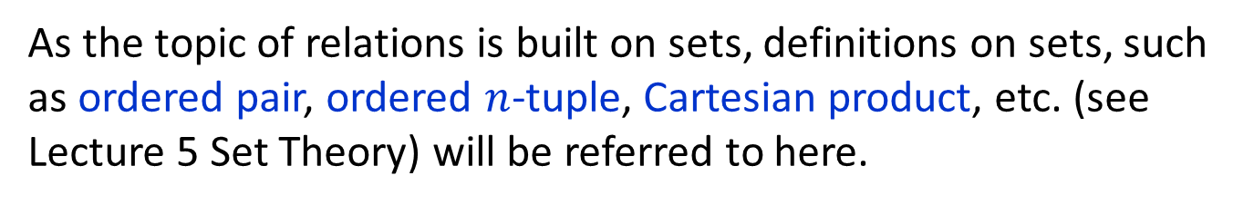
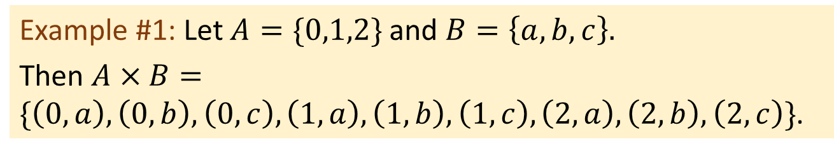
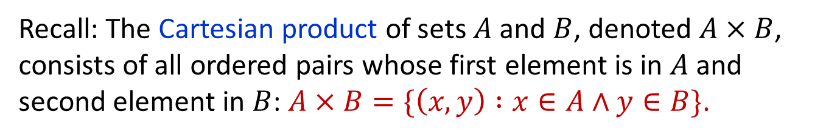
Relations on Sets Reflexivity, Symmetry and Transitivity Equivalence Relations Partial Order Relations
Definitions
6.1.1 Definitions
As the topic of relations is built on sets, definitions on sets, such as ordered pair, ordered $n$-tuple, Cartesian product, etc. (see Lecture 5 Set Theory) will be referred to here.
Recall: The Cartesian product of sets $A$ and $B$, denoted $A×B$, consists of all ordered pairs whose first element is in $A$ and second element in $B$: $A×B=\{\left(x,y\right) :x∈A∧y∈B\}$.
Example #1: Let $A=\{0,1,2\}$and $B=\left\{a,b,c\right\}.$
Then $A×B=\{\left(0,a\right),\left(0,b\right),\left(0,c\right),\left(1,a\right),\left(1,b\right),\left(1,c\right),\left(2,a\right),\left(2,b\right),\left(2,c\right)\}$.

Slide 6
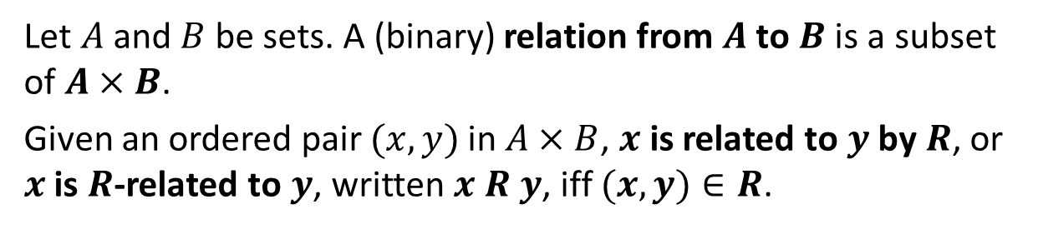


Relations on Sets Reflexivity, Symmetry and Transitivity Equivalence Relations Partial Order Relations
Definitions
Definition: Relation
Let $A$ and $B$ be sets. A (binary) relation from $A$ to $B$ is a subset of $A×B$.
Given an ordered pair $(x,y)$in $A×B$, $x$ is related to $y$ by $R$, or $x$ is $R$-related to $y$, written $x R y$, iff $(x,y)∈R$.
Symbolically, $x R y$ means $(x,y)∈R$
$x R y$ means $(x,y)∉R$
We read $x R y$ as “$x$ is $R$-related to $y$” or, if there is no risk of confusion, simply “$x$ is related to $y$”.

Slide 7
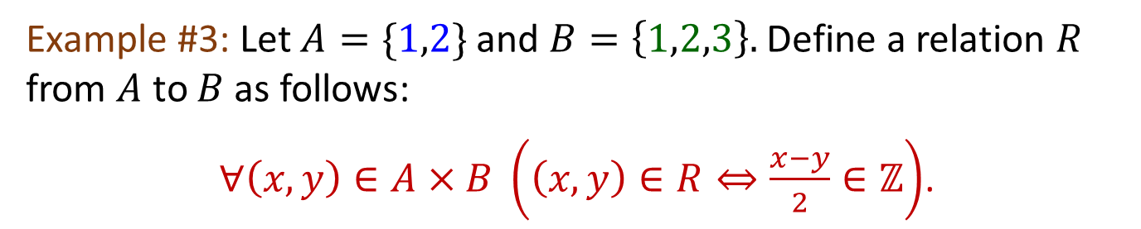
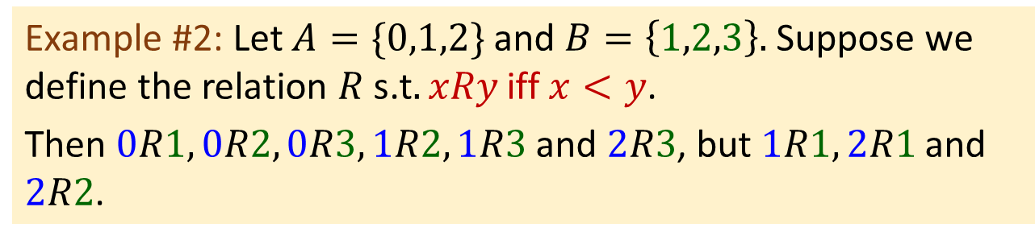
Relations on Sets Reflexivity, Symmetry and Transitivity Equivalence Relations Partial Order Relations
Definitions
Example #2: Let $A=\{0,1,2\}$and $B=\left\{1,2,3\right\}.$ Suppose we define the relation $R$ s.t$. xRy$iff $x<y$.
Then $0R1, 0R2, 0R3, 1R2, 1R3$ and $2R3$, but $1R1, 2R1$and $2R2$.
Example #3: Let $A=\{1,2\}$and $B=\left\{1,2,3\right\}.$ Define a relation $R$ from $A$ to $B$ as follows:
$∀\left(x,y\right)∈A×B \left(\left(x,y\right)∈R⇔\frac{x−y}{2}∈ℤ\right)$.
State explicitly which ordered pairs are in $A×B$ and which are in $R$.
$$A×B=\left\{\left(1,1\right),\left(1,2\right),\left(1,3\right),\left(2,1\right),\left(2,2\right),\left(2,3\right)\right\}.$$
$$R=\{\left(1,1\right),\left(1,3\right),\left(2,2\right)\}.$$

Slide 8
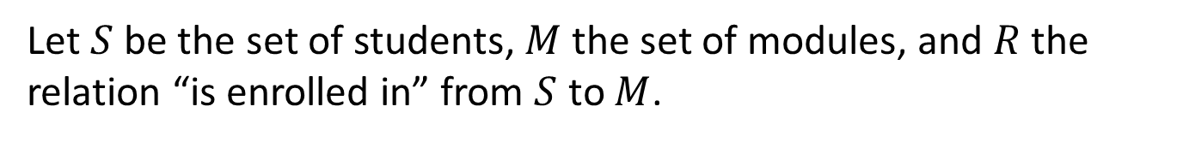
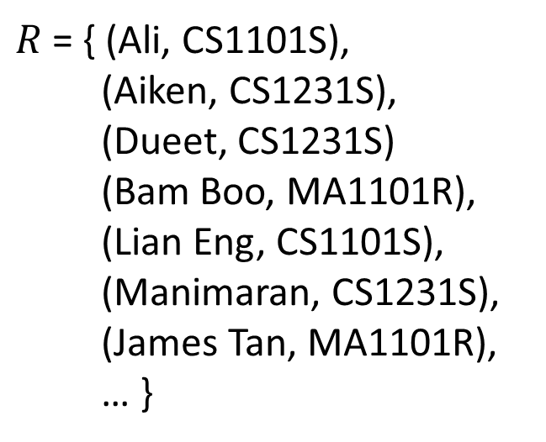
Relations on Sets Reflexivity, Symmetry and Transitivity Equivalence Relations Partial Order Relations
Application of Relations
An application: A simple database
Let $S$ be the set of students, $M$ the set of modules, and $R$ the relation “is enrolled in” from $S$ to $M$.
Student | Module
Ali | CS1101S
Aiken | CS1231S
Dueet | CS1231S
Bam Boo | MA1101R
Lian Eng | CS1101S
Manimaran | CS1231S
James Tan | MA1101R
: | :
$R$ = { (Ali, CS1101S),
(Aiken, CS1231S),
(Dueet, CS1231S)
(Bam Boo, MA1101R),
(Lian Eng, CS1101S),
(Manimaran, CS1231S),
(James Tan, MA1101R),
… }

Slide 9
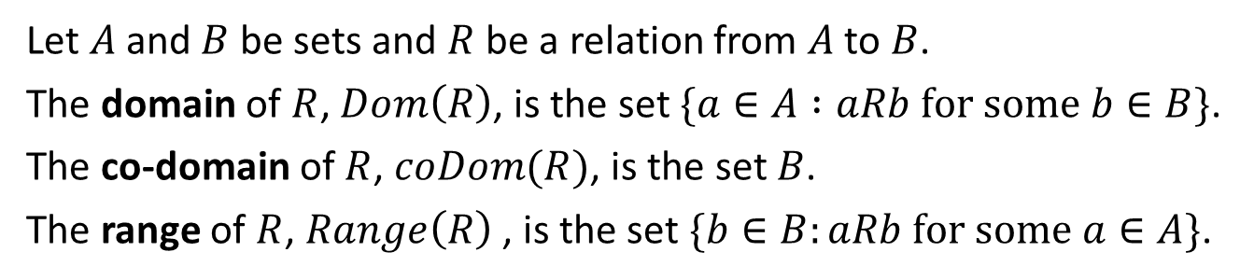
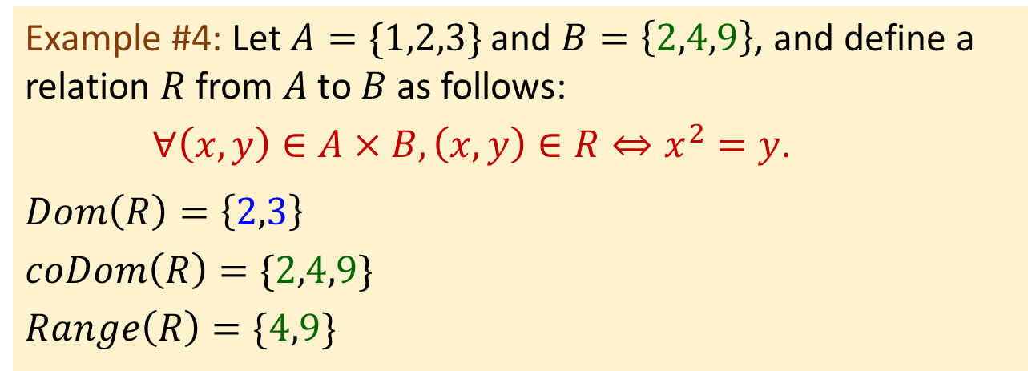
Relations on Sets Reflexivity, Symmetry and Transitivity Equivalence Relations Partial Order Relations
Definitions
Definitions: Domain, Co-domain, Range
Let $A$ and $B$ be sets and $R$ be a relation from $A$ to $B$.
The domain of $R$, $Dom\left(R\right)$, is the set $\{a∈A :aRb for some b∈B\}$.
The co-domain of $R$, $coDom(R)$, is the set $B$.
The range of $R$, $Range\left(R\right)$ , is the set $\{b∈B:aRb for some a∈A\}$.
Example #4: Let $A=\{1,2,3\}$and $B=\left\{2,4,9\right\}$, and define a relation $R$ from $A$ to $B$ as follows:
$∀\left(x,y\right)∈A×B, \left(x,y\right)∈R⇔x^{2}=y$.
$$Dom\left(R\right)=\left\{2,3\right\}$$
$$coDom\left(R\right)=\{2,4,9\}$$
$$Range\left(R\right)=\{4,9\}$$

Slide 10
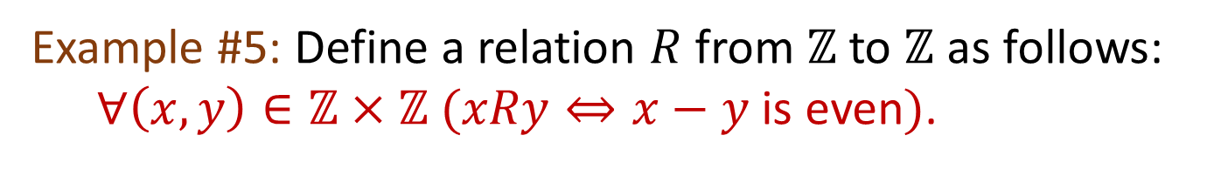
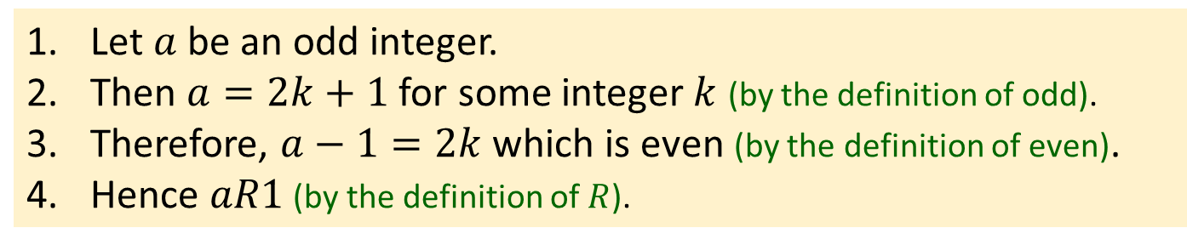
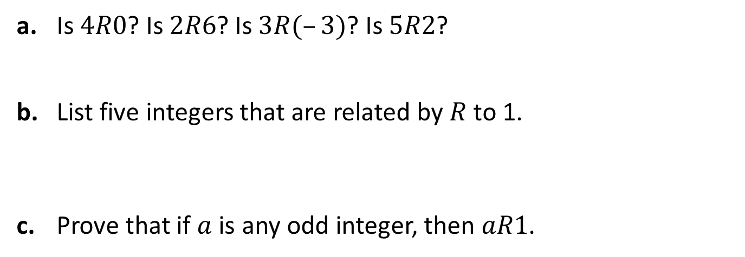
Relations on Sets Reflexivity, Symmetry and Transitivity Equivalence Relations Partial Order Relations
Definitions
Example #5: Define a relation $R$ from $ℤ$ to $ℤ$ as follows:
$∀\left(x,y\right)∈ℤ×ℤ (xRy⇔x−y$ is even$)$.
a. Is $4R0$? Is $2R6$? Is $3R(–3)$? Is $5R2$?
b. List five integers that are related by $R$ to 1.
c. Prove that if $a$ is any odd integer, then $aR1$.
Yes
Yes
Yes
No
Infinitely many possible answers.
One answer: 1, 57, 12345, -203, -999.
Let $a$ be an odd integer.
Then $a=2k+1$for some integer $k$ (by the definition of odd).
Therefore, $a−1=2k$which is even (by the definition of even).
Hence $aR1$ (by the definition of $R$).


Slide 11
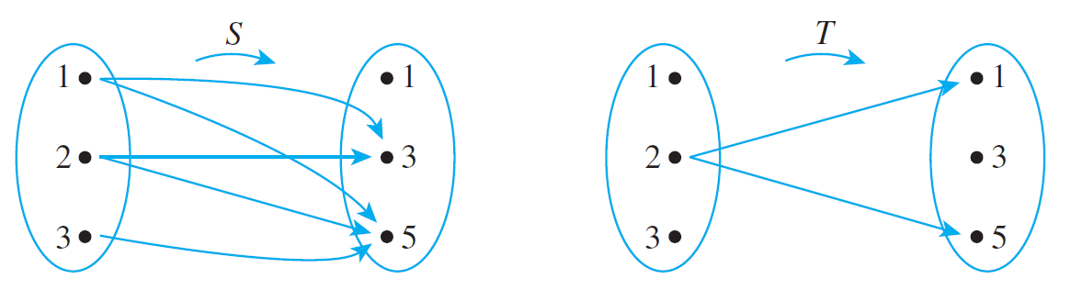
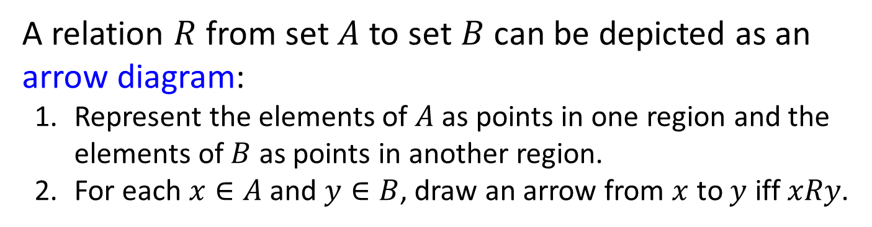
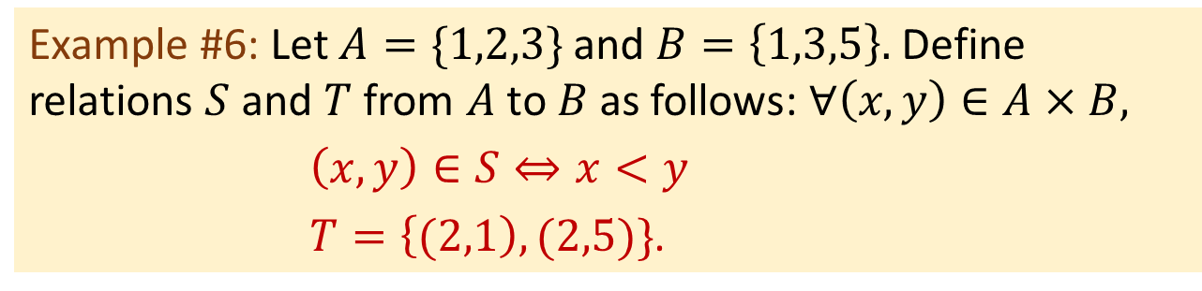
Relations on Sets Reflexivity, Symmetry and Transitivity Equivalence Relations Partial Order Relations
Arrow Diagram
A relation $R$ from set $A$ to set $B$ can be depicted as an arrow diagram:
Represent the elements of $A$ as points in one region and the elements of $B$ as points in another region.
For each $x∈A$ and $y∈B$, draw an arrow from $x$ to $y$ iff $xRy$.
Example #6: Let $A=\{1,2,3\}$and $B=\left\{1,3,5\right\}.$ Define relations $S$ and $T$ from $A$ to $B$ as follows: $∀\left(x,y\right)∈A×B,$
$\left(x,y\right)∈S⇔x<y$
$T=\left\{(2,1\right),(2,5)\}$.

Slide 12
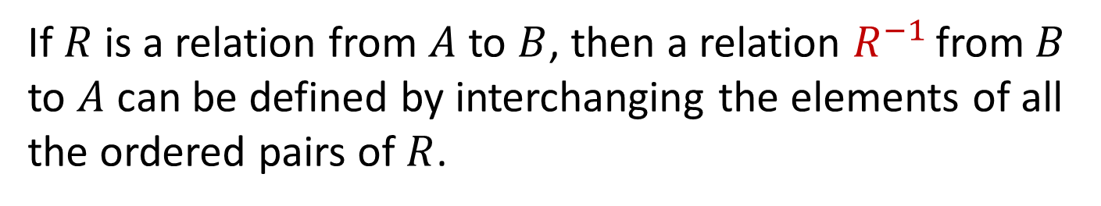
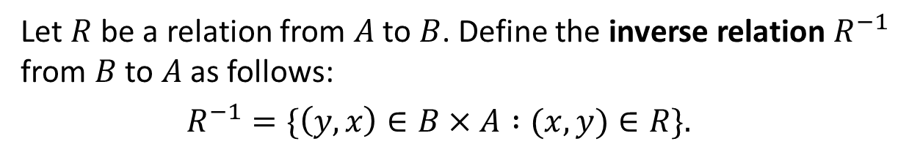
Relations on Sets Reflexivity, Symmetry and Transitivity Equivalence Relations Partial Order Relations
The Inverse of a Relation
6.1.2 The Inverse of a Relation
If $R$ is a relation from $A$ to $B$, then a relation $R^{−1}$ from $B$ to $A$ can be defined by interchanging the elements of all the ordered pairs of $R$.
Definition: Inverse of a Relation
Let $R$ be a relation from $A$ to $B$. Define the inverse relation $R^{−1}$ from $B$ to $A$ as follows:
$R^{−1}=\{\left(y,x\right)∈B×A :(x,y)∈R\}.$
This definition can be written operationally as follows:
$$∀x∈A,∀y∈B \left(\left(y,x\right)∈R^{−1}⇔\left(x,y\right)∈R\right).$$

Slide 13
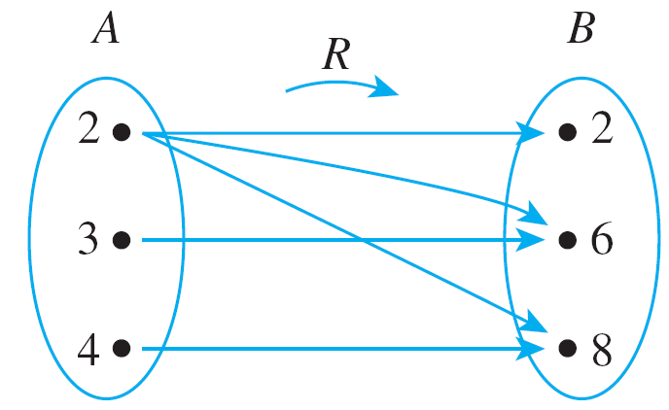
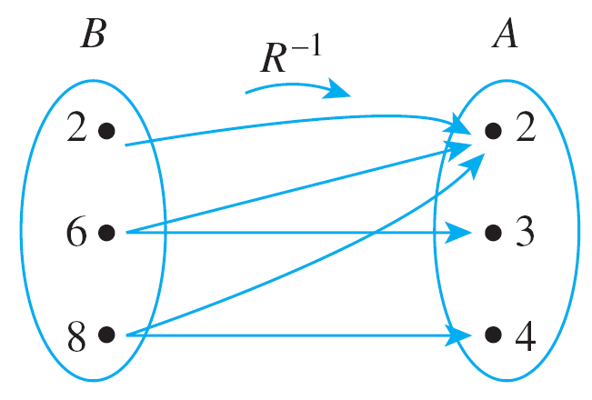
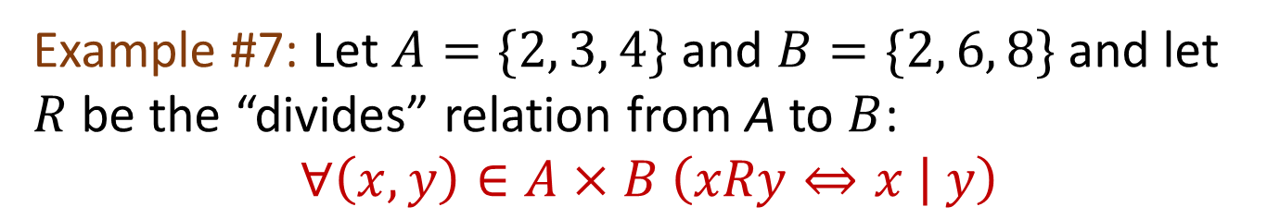

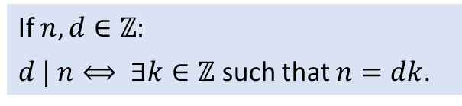

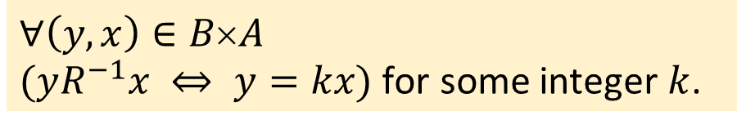
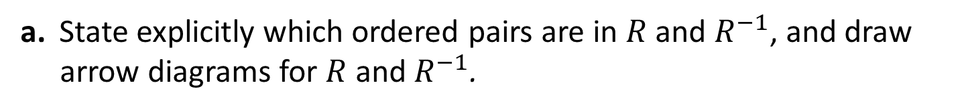
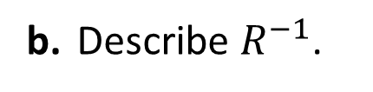
Relations on Sets Reflexivity, Symmetry and Transitivity Equivalence Relations Partial Order Relations
The Inverse of a Relation
If $n, d∈ℤ$:
$d | n⟺ ∃k∈ℤ$ such that $n=dk$.
Example #7: Let $A=\{2, 3, 4\}$and $B=\{2, 6, 8\}$and let $R$ be the “divides” relation from A to $B$:
$$∀\left(x,y\right)∈A×B \left(xRy⇔x | y\right)$$
a. State explicitly which ordered pairs are in $R$ and $R^{−1}$, and draw arrow diagrams for $R$ and $R^{−1}$.
$$R=\{(2,2), (2,6), (2,8), (3,6), (4,8)\}$$
$$R^{−1}=\{(2,2), (6,2), (8,2), (6,3), (8,4)\}$$
b. Describe $R^{−1}$.
$$∀\left(y, x\right)∈B×A$$
$(yR^{−1}x ⇔ y=kx)$ for some integer $k$.


Slide 14
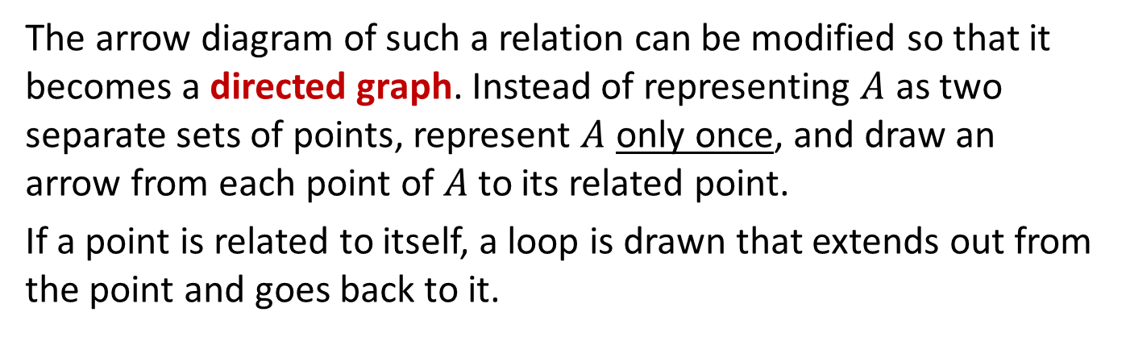
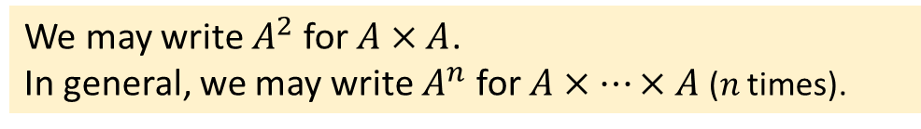
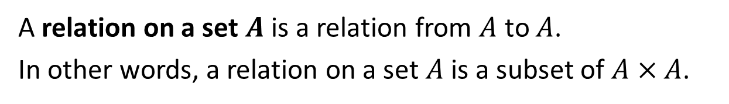
Relations on Sets Reflexivity, Symmetry and Transitivity Equivalence Relations Partial Order Relations
Directed Graph of a Relation
6.1.3 Directed Graph of a Relation
Definition: Relation on a Set
A relation on a set $A$ is a relation from $A$ to $A$.
In other words, a relation on a set $A$ is a subset of $A×A$.
We may write $A^{2}$ for $A×A$.
In general, we may write $A^{n}$ for $A×…×A$ ($n$ times).
The arrow diagram of such a relation can be modified so that it becomes a directed graph. Instead of representing $A$ as two separate sets of points, represent $A$ only once, and draw an arrow from each point of $A$ to its related point.
If a point is related to itself, a loop is drawn that extends out from the point and goes back to it.

Slide 15
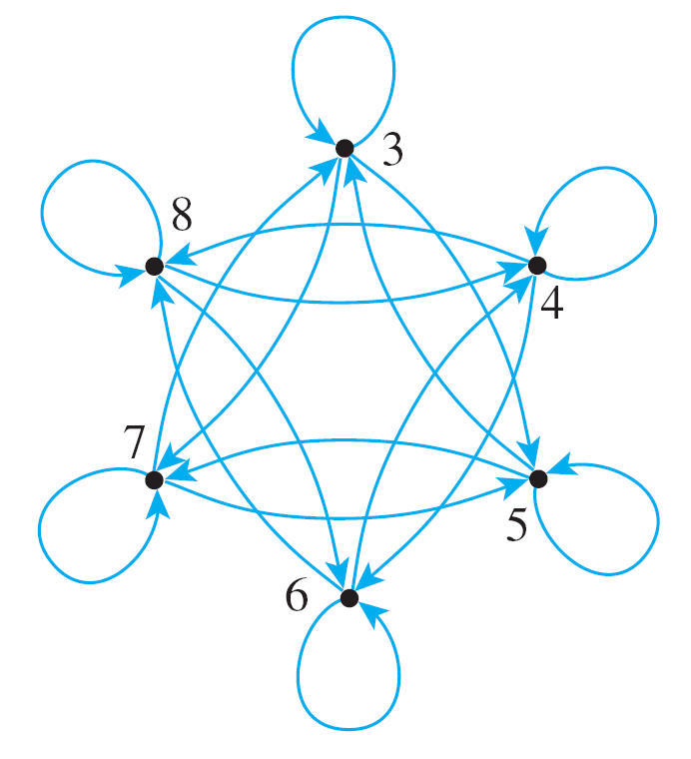
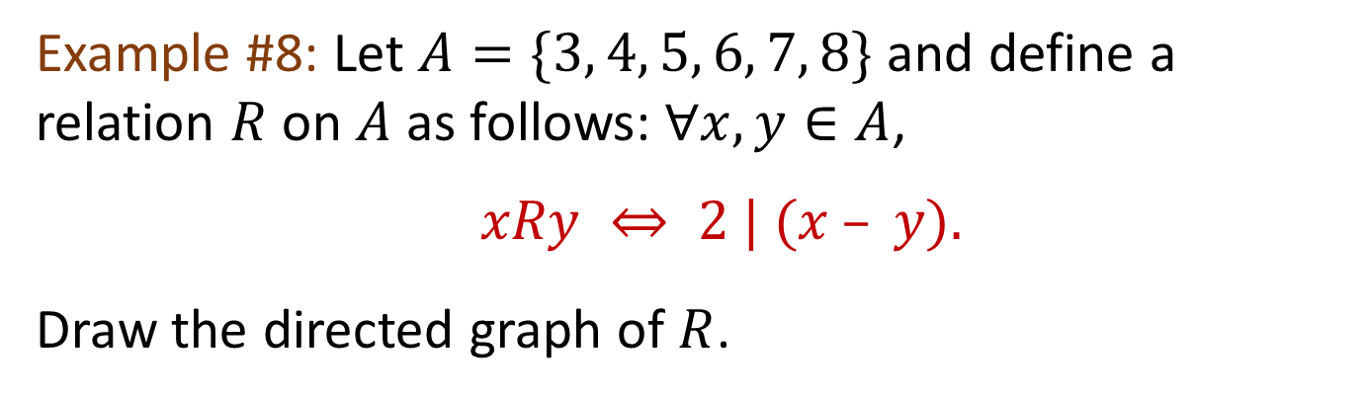
Relations on Sets Reflexivity, Symmetry and Transitivity Equivalence Relations Partial Order Relations
Directed Graph of a Relation
Example #8: Let $A=\{3, 4, 5, 6, 7, 8\}$and define a relation $R$ on $A$ as follows: $∀x, y∈A$,
$xRy ⇔ 2 | (x – y).$
Draw the directed graph of $R$.

Slide 16
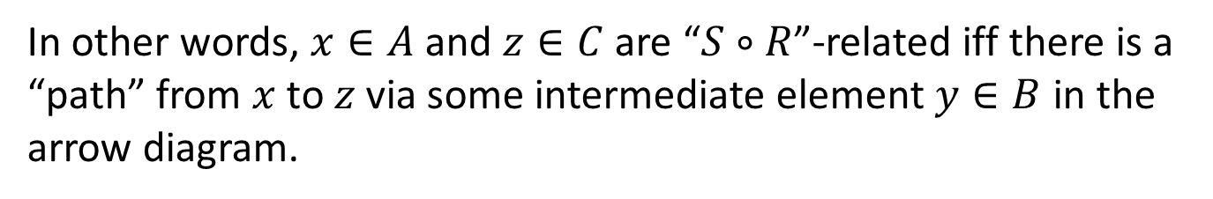
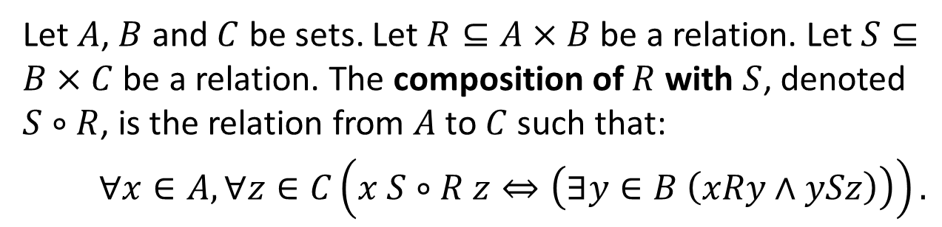
Relations on Sets Reflexivity, Symmetry and Transitivity Equivalence Relations Partial Order Relations
Composition of Relations
6.1.4 Composition of Relations
Definition: Composition of Relations
Let $A$, $B$ and $C$ be sets. Let $R⊆A×B$ be a relation. Let $S⊆B×C$ be a relation. The composition of $R$ with $S$, denoted $S∘R$, is the relation from $A$ to $C$ such that:
$∀x∈A,∀z∈C\left(x S∘R z⇔\left(∃y∈B \left(xRy∧ySz\right)\right)\right).$
In other words, $x∈A$ and $z∈C$ are “$S∘R$”-related iff there is a “path” from $x$ to $z$ via some intermediate element $y∈B$ in the arrow diagram.

Slide 17

Relations on Sets Reflexivity, Symmetry and Transitivity Equivalence Relations Partial Order Relations
Composition of Relations
Students
Module
Venue
takes
held in
Ann
CS1010
LT15
Bryan
CS1231
ICube
Candy
IS1103
MA1101
SR1
Danny
CS2100
Students
Venue
Ann
“held in$∘$ takes” = “go to”
LT15
Bryan
ICube
Candy
Danny
SR1

Slide 18
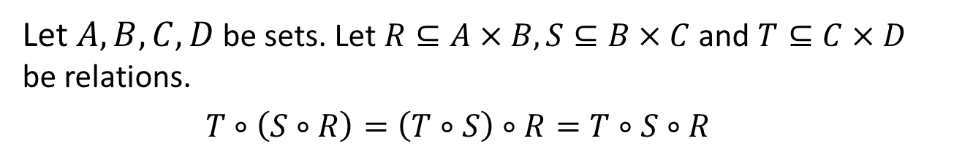
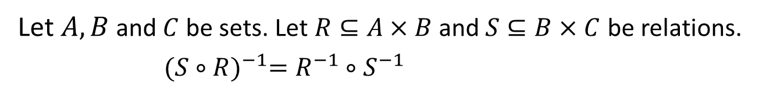
Relations on Sets Reflexivity, Symmetry and Transitivity Equivalence Relations Partial Order Relations
Composition of Relations
Proposition: Composition is Associative
Let $A,B,C,D$ be sets. Let $R⊆A×B, S⊆B×C$ and $T⊆C×D$ be relations.
$T∘\left(S∘R\right)=\left(T∘S\right)∘R=T∘S∘R$
Proposition: Inverse of Composition
Let $A,B$ and $C$ be sets. Let $R⊆A×B$ and $S⊆B×C$ be relations.
${(S∘R)}^{−1}=R^{−1}∘S^{−1}$

Slide 19

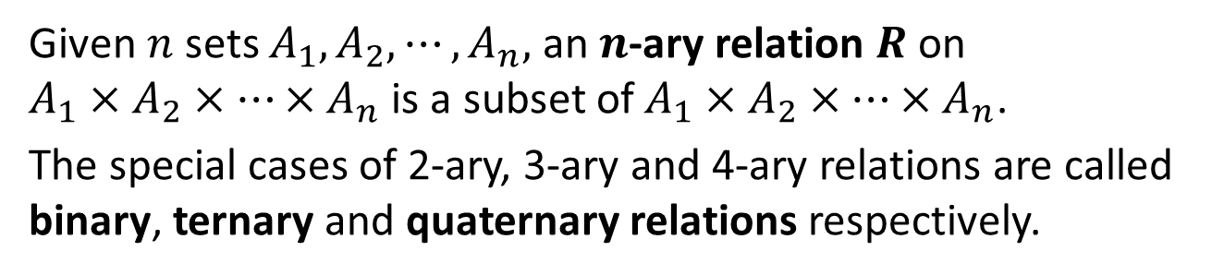
Relations on Sets Reflexivity, Symmetry and Transitivity Equivalence Relations Partial Order Relations
N-ary Relations and Relational Databases
6.1.5 N-ary Relations and Relational Databases
A relation involving two sets is called binary relation. We can generalize a relation to involve more than two sets.
Definition: $n$-ary Relation
Given $n$ sets $A_{1},A_{2},⋯,A_{n},$ an $n$-ary relation $R$ on
$A_{1}×A_{2}×⋯{×A}_{n}$ is a subset of $A_{1}×A_{2}×⋯{×A}_{n}$.
The special cases of 2-ary, 3-ary and 4-ary relations are called binary, ternary and quaternary relations respectively.

Slide 20
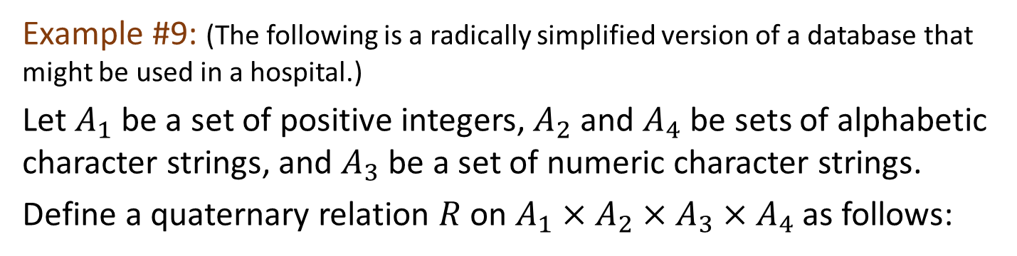
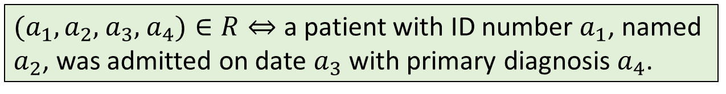
Relations on Sets Reflexivity, Symmetry and Transitivity Equivalence Relations Partial Order Relations
N-ary Relations and Relational Databases
Example #9: (The following is a radically simplified version of a database that might be used in a hospital.)
Let $A_{1}$ be a set of positive integers, $A_{2}$ and $A_{4}$ be sets of alphabetic character strings, and $A_{3}$ be a set of numeric character strings.
Define a quaternary relation $R$ on $A_{1}×A_{2}×A_{3}{×A}_{4}$ as follows:
$(a_{1},a_{2},$ $a_{3},$ $a_{4})∈R⇔$ a patient with ID number $a_{1}$, named $a_{2}$, was admitted on date $a_{3}$ with primary diagnosis $a_{4}$.
At a particular hospital, this relation might contain these 4-tuples:
(011985, John Schmidt, 020710, asthma)
(574329, Tak Kurosawa, 011410, pneumonia)
(466581, Mary Lazars, 010310, appendicitis)
(008352, Joan Kaplan, 112409, gastritis)
(011985, John Schmidt, 021710, pneumonia)
(244388, Sarah Wu, 010310, broken leg)
(778400, Jamal Baskers, 122709, appendicitis)

Slide 21
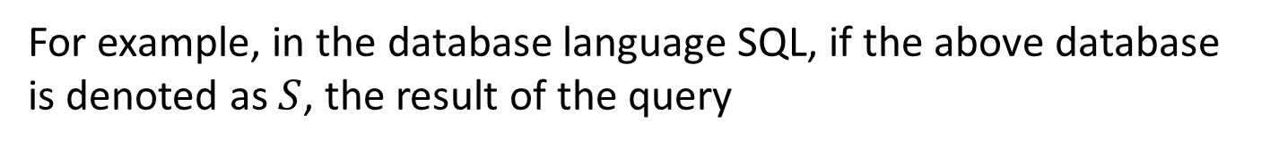
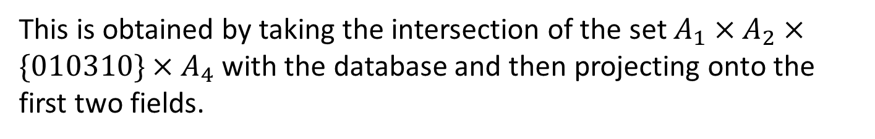
Relations on Sets Reflexivity, Symmetry and Transitivity Equivalence Relations Partial Order Relations
N-ary Relations and Relational Databases
For example, in the database language SQL, if the above database is denoted as $S$, the result of the query
SELECT Patient_ID#, Name FROM $S$ WHERE Admission_Date=010310
would yield a list of the ID numbers and names of all patients admitted on 01-03-10:
466581 Mary Lazars
244388 Sarah Wu
This is obtained by taking the intersection of the set $A_{1}×A_{2}×\{010310\}{×A}_{4}$ with the database and then projecting onto the first two fields.

Slide 22
Relations on Sets Reflexivity, Symmetry and Transitivity Equivalence Relations Partial Order Relations
6.2 Reflexivity, Symmetry
and Transitivity

Slide 23
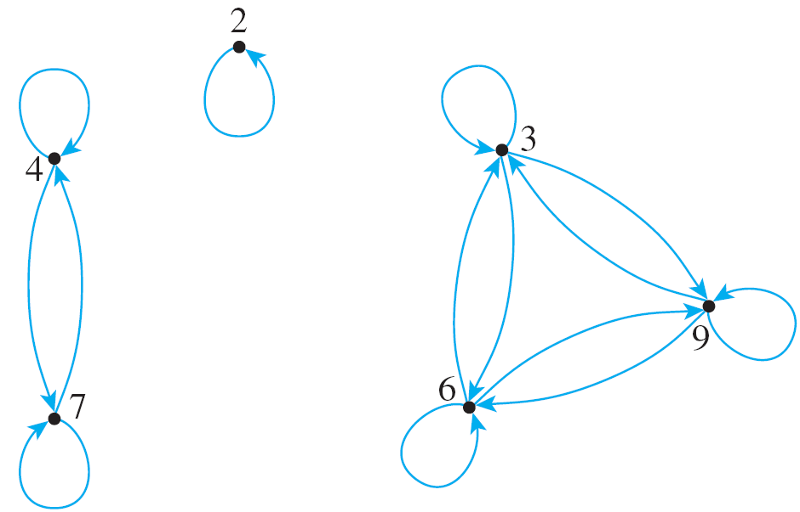
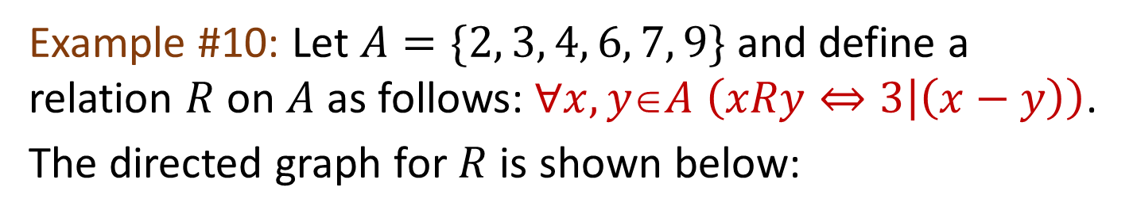
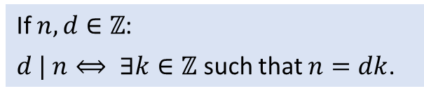
Relations on Sets Reflexivity, Symmetry and Transitivity Equivalence Relations Partial Order Relations
Definitions of Reflexivity, Symmetry and Transitivity
6.2.1 Definitions of Reflexivity, Symmetry and Transitivity
Example #10: Let $A=\{2, 3, 4, 6, 7, 9\}$and define a relation $R$ on $A$ as follows: $∀x, yA \left(xRy⇔3 | \left(x−y\right)\right)$.
The directed graph for $R$ is shown below:
Each point of the graph has an arrow looping around from it back to itself.
Wherever there is an arrow going from one point to another, there is also an arrow going from the second point back to the first.
Wherever there is an arrow going from one point to a second and from the second point to a third, there is also an arrow going from the first point to the third.
If $n, d∈ℤ$:
$d | n⟺ ∃k∈ℤ$ such that $n=dk$.

Slide 24

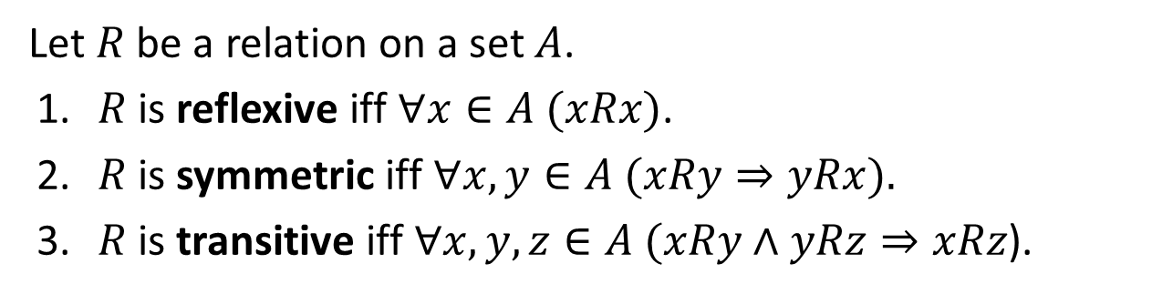






Relations on Sets Reflexivity, Symmetry and Transitivity Equivalence Relations Partial Order Relations
Definitions of Reflexivity, Symmetry and Transitivity
Properties (1), (2), and (3) correspond to properties of general relations called reflexivity, symmetry, and transitivity.
Definitions: Reflexivity, Symmetry, Transitivity
Let $R$ be a relation on a set $A$.
1. $R$ is reflexive iff $∀x∈A (xRx)$.
2. $R$ is symmetric iff $∀x,y∈A (xRy⇒yRx).$
3. $R$ is transitive iff $∀x,y,z∈A (xRy∧yRz⇒xRz$).
Reflexive
Symmetric
Transitive
$$∀$$
$$∀$$
$$∀$$
$$∀$$
$$∃$$
$$∃$$
$$∃$$

Slide 25
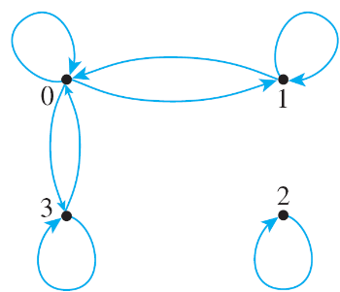
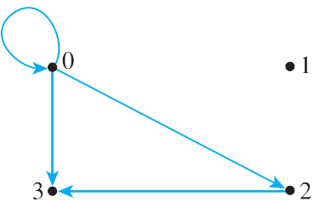


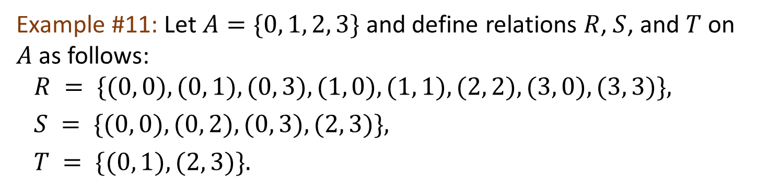
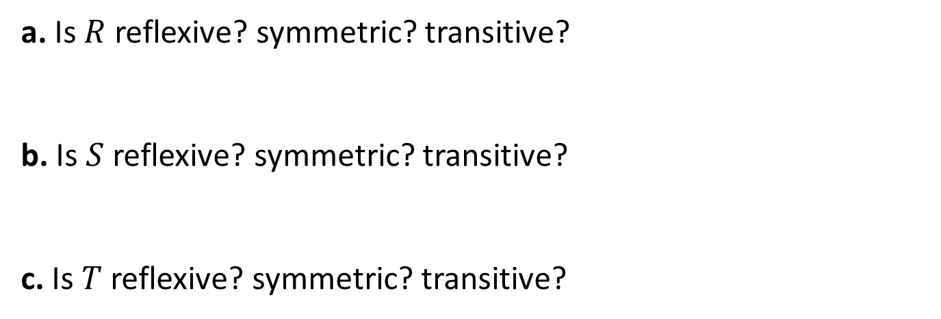
Relations on Sets Reflexivity, Symmetry and Transitivity Equivalence Relations Partial Order Relations
Definitions of Reflexivity, Symmetry and Transitivity
Example #11: Let $A=\{0, 1, 2, 3\}$and define relations $R$, $S$, and $T$ on $A$ as follows:
$R = \{(0, 0), (0, 1), (0, 3), (1, 0), (1, 1), (2, 2), (3, 0), (3, 3)\},$
$S = \{(0, 0), (0, 2), (0, 3), (2, 3)\},$
$T = \{(0, 1), (2, 3)\}.$
a. Is $R$ reflexive? symmetric? transitive?
b. Is $S$ reflexive? symmetric? transitive?
c. Is $T$ reflexive? symmetric? transitive?
Yes
Yes
No
No
No
Yes
No
No
Yes


Slide 26



Relations on Sets Reflexivity, Symmetry and Transitivity Equivalence Relations Partial Order Relations
Definitions of Reflexivity, Symmetry and Transitivity
Common mistake: Talking about reflexivity.
“The element 0 is reflexive.”
“The element 0 is related to itself.”
“The element 1 is not reflexive.”
“The element 1 is not related to itself.”
“The element 2 is not reflexive.”
“The element 2 is not related to itself.”
Reflexivity, symmetry and transitivity are properties of a relation, not properties of members of the set.
We say a relation is reflexive or not reflexive.

Slide 27
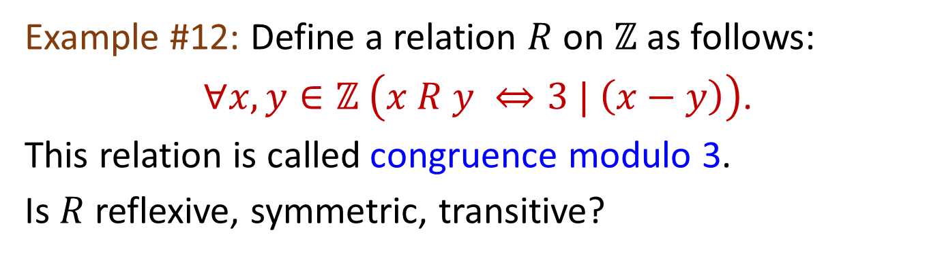
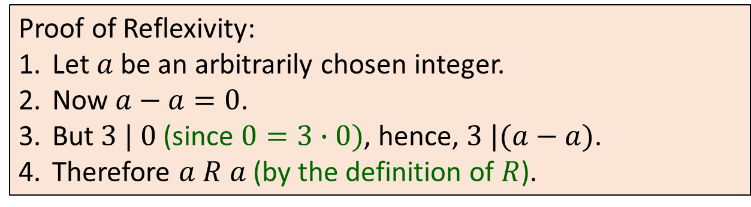
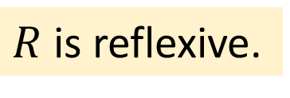
Relations on Sets Reflexivity, Symmetry and Transitivity Equivalence Relations Partial Order Relations
Definitions of Reflexivity, Symmetry and Transitivity
Example #12: Define a relation $R$ on $ℤ$ as follows:
$∀x,y∈ℤ \left(x R y ⇔3 | \left(x−y\right)\right)$.
This relation is called congruence modulo 3.
Is $R$ reflexive, symmetric, transitive?
$R$is reflexive.
Proof of Reflexivity:
Let $a$ be an arbitrarily chosen integer.
Now $a−a=0$.
But $3 | 0$ (since $0=3∙0)$, hence, $3 |(a−a)$.
4. Therefore $a R a$ (by the definition of $R$).

Slide 28


Relations on Sets Reflexivity, Symmetry and Transitivity Equivalence Relations Partial Order Relations
Definitions of Reflexivity, Symmetry and Transitivity
Example #12: Define a relation $R$ on $ℤ$ as follows:
$∀x,y∈ℤ \left(x R y ⇔3 | \left(x−y\right)\right)$.
This relation is called congruence modulo 3.
Is $R$ reflexive, symmetric, transitive?
$R$ is symmetric.
Proof of Symmetry:
Let $a$ and $b$ be arbitrarily chosen integers that satisfy $a R b$.
Then $3|(a−b)$(by the definition of $R$), hence $a−b=3k$ for some integer $k$ (by the definition of divisibility).
Multiplying both sides by $−1$ gives $b−a=3\left(−k\right).$
Since $–k$ is an integer, $3|(b−a$) (by definition of divisibility).
5. Therefore $b R a$ (by the definition of $R$).

Slide 29


Relations on Sets Reflexivity, Symmetry and Transitivity Equivalence Relations Partial Order Relations
Definitions of Reflexivity, Symmetry and Transitivity
Example #12: Define a relation $R$ on $ℤ$ as follows:
$∀x,y∈ℤ \left(x R y ⇔3 | \left(x−y\right)\right)$.
This relation is called congruence modulo 3.
Is $R$ reflexive, symmetric, transitive?
$R$ is transitive.
Proof of Transitivity:
Let $a,b$ and $c$ be arbitrarily chosen integers that satisfy $a R b$ and $b R c$.
Then $3|(a−b)$ and $3|(b−c)$ (by the definition of $R$), hence $a−b=3r$ and $b−c=3s$for some integers $r$ and $s$ (by the definition of divisibility).
Adding both equations gives $a−c=3\left(r+s\right).$
Since $r+s$ is an integer, $3|(a−c)$ (by definition of divisibility).
5. Therefore $a R c$ (by the definition of $R$).

Slide 30
Relations on Sets Reflexivity, Symmetry and Transitivity Equivalence Relations Partial Order Relations
The Transitive Closure of a Relation
6.2.2 The Transitive Closure of a Relation
Generally speaking, a relation fails to be transitive because it fails to contain certain ordered pairs.
For example, if (1, 3) and (3, 4) are in a relation R, then the pair (1, 4) must be in R for R to be transitive.
To obtain a transitive relation from one that is not transitive, it is necessary to add ordered pairs.
Roughly speaking, the relation obtained by adding the least number of ordered pairs to ensure transitivity is called the transitive closure of the relation.

Slide 31

Relations on Sets Reflexivity, Symmetry and Transitivity Equivalence Relations Partial Order Relations
The Transitive Closure of a Relation
In a sense made precise by the formal definition, the transitive closure of a relation is the smallest transitive relation that contains the relation.
Definition: Transitive Closure
Let $A$ be a set and $R$ a relation on $A$. The transitive closure of $R$ is the relation $R^{t}$ on $A$ that satisfies the following three properties:
1. $R^{t}$ is transitive.
2. $R⊆R^{t}$.
3. If $S$ is any other transitive relation that contains $R$, then $R^{t}⊆S$.

Slide 32





Relations on Sets Reflexivity, Symmetry and Transitivity Equivalence Relations Partial Order Relations
The Transitive Closure of a Relation
Example #13: Let $A=\{0, 1, 2, 3\}$ and consider the relation $R$ defined on $A$ as follows: $R=\{(0, 1), (1, 2), (2, 3)\}.$
Find the transitive closure of $R$.
Since there are arrows from 0 to 1 and from 1 to 2, $R^{t}$ must have an arrow from 0 to 2. Hence $(0,2)∈R^{t}$.
Then $(0,2)∈R^{t}$ and $(2,3)∈R^{t}$, so $(0,3)∈R^{t}$.
Also, since $(1,2)∈R^{t}$ and $(2,3)∈R^{t}$, so $(1,3)∈R^{t}$.
Directed graph of $R^{t}$:

Slide 33
Relations on Sets Reflexivity, Symmetry and Transitivity Equivalence Relations Partial Order Relations
6.3 Equivalence Relations

Slide 34

















Relations on Sets Reflexivity, Symmetry and Transitivity Equivalence Relations Partial Order Relations
The Relation Induced by a Partition
6.3.1 The Relation Induced by a Partition
A partition of a set $A$ is a finite or infinite collection of nonempty, mutually disjoint subsets whose union is $A$.
The diagram below illustrates a partition of a set
$A=\{b,e,f,k,m,p\}$ by subsets $\left\{b,p\right\},\left\{f,m\right\},\left\{k\right\},\{e\}$.
$$b$$
$$b$$
$$k$$
$$p$$
$$p$$
$$k$$
$$f$$
$$m$$
$$e$$
$$f$$
$$m$$
$$e$$

Slide 35

















Relations on Sets Reflexivity, Symmetry and Transitivity Equivalence Relations Partial Order Relations
The Relation Induced by a Partition
Definition: Partition
C is a partition of a set $A$ if the following hold:
(1) C is a set of which all elements are non-empty subsets of $A$, i.e., $∅≠S⊆A$ for all $S∈$C.
(2) Every element of $A$ is in exactly one element of C, i.e.,
$∀x∈A ∃S∈\text{C} (x∈S)$ and
$∀x∈A ∀S_{1},S_{2}∈\text{C} (x∈S_{1}∧x∈S_{2}⇒S_{1}=S_{2})$.
Elements of a partition are called components of the partition.
$$b$$
$$b$$
$$k$$
$$p$$
$$p$$
$$k$$
$$f$$
$$m$$
$$e$$
$$f$$
$$m$$
$$e$$
$$A=\{b,e,f,k,m,p\}$$
$$\text{C}=\left\{\left\{b,p\right\},\left\{f,m\right\},\left\{k\right\},\left\{e\right\}\right\}$$

Slide 36

Relations on Sets Reflexivity, Symmetry and Transitivity Equivalence Relations Partial Order Relations
The Relation Induced by a Partition
Definition: Partition
C is a partition of a set $A$ if the following hold:
(1) C is a set of which all elements are non-empty subsets of $A$, i.e., $∅≠S⊆A$ for all $S∈$C.
(2) Every element of $A$ is in exactly one element of C, i.e.,
$∀x∈A ∃S∈\text{C} (x∈S)$ and
$∀x∈A ∀S_{1},S_{2}∈\text{C} (x∈S_{1}∧x∈S_{2}⇒S_{1}=S_{2})$.
Elements of a partition are called components of the partition.
Definition (shorter): Partition
A partition of set $A$ is a set C of non-empty subsets of $A$ such that
$$∀x∈A ∃!S∈\text{C} \left(x∈S\right).$$
(Recall: $∃!$ means “there exists a unique”.)

Slide 37

















Relations on Sets Reflexivity, Symmetry and Transitivity Equivalence Relations Partial Order Relations
The Relation Induced by a Partition
Partitions as relations
We may view a partition as a “is in the same component as” relation.
Let $R$ be “in the same component as” relation.
$$b$$
$$p$$
$$b R b$$
$$p R p$$
$$b R p$$
$$p R b$$
$$f R f$$
$$m R m$$
$$f R m$$
$$m R f$$
$$b$$
$$f$$
$$m$$
$$p$$
$$k$$
$$m$$
$$k R k$$
$$e R e$$
$$f$$
$$k$$
$$e$$
$$e$$

Slide 38


Relations on Sets Reflexivity, Symmetry and Transitivity Equivalence Relations Partial Order Relations
The Relation Induced by a Partition
Definition: Relation Induced by a Partition
Given a partition C of a set $A$, the relation $R$ induced by the partition is defined on $A$ as follows: $∀x,y∈A,$
$xRy⇔∃$ a component $S$ of C s.t. $x,y∈S$.
Example #14: Let $A=\{0, 1, 2, 3, 4\}$and consider this partition of $A$: $\left\{\left\{0, 3, 4\right\}, \left\{1\right\}, \left\{2\right\}\right\}.$
Find the relation $R$ induced by this partition.
{0,3,4} is a component of the partition → 0R0, 0R3, 0R4, 3R0, 3R3, 3R4, 4R0, 4R3 and 4R4.
{1} is a component of the partition → 1R1.
{2} is a component of the partition → 2R2.
Therefore, R = {(0,0), (0,3), (0,4), (1,1), (2,2), (3,0), (3,3), (3,4), (4,0), (4,3), (4,4)}.

Slide 39




Relations on Sets Reflexivity, Symmetry and Transitivity Equivalence Relations Partial Order Relations
The Relation Induced by a Partition
The fact is that a relation induced by a partition of a set satisfies all three properties: reflexivity, symmetry, and transitivity.
Theorem 8.3.1 Relation Induced by a Partition
Let $A$ be a set with a partition and let $R$ be the relation induced by the partition. Then $R$ is reflexive, symmetric, and transitive.

Slide 40

Relations on Sets Reflexivity, Symmetry and Transitivity Equivalence Relations Partial Order Relations
Definition of an Equivalence Relation
6.3.2 Definition of an Equivalence Relation
A relation on a set that satisfies the three properties of reflexivity, symmetry, and transitivity is called an equivalence relation.
Definition: Equivalence Relation
Let $A$ be a set and $R$ a relation on $A$. $R$ is an equivalence relation iff $R$ is reflexive, symmetric and transitive.
Note: The symbol $\sim$ is commonly used to denote an equivalence relation.

Slide 41



Relations on Sets Reflexivity, Symmetry and Transitivity Equivalence Relations Partial Order Relations
Definition of an Equivalence Relation
Example #15: Let $X$ be the set of all nonempty subsets of $\{1, 2, 3\}.$
Then $X=\{\{1\}, \{2\}, \{3\}, \{1, 2\}, \{1, 3\}, \{2, 3\}, \{1, 2, 3\}\}.$
Define a relation R on $X$ as follows: For all $A,B∈X$,
$A$ R $B$ ⇔ the least element of $A$ equals the least element of $B$.
Prove that R is an equivalence relation on $X$.
R is reflexive:
Suppose $A$ is a nonempty subset of {1, 2, 3}. It is true to say that the least element of $A$ equals the least element of $A$. Thus, $A$ R $A$.
R is symmetric:
Suppose $A$ and $B$ are nonempty subsets of {1, 2, 3} and $A$ R $B$.
Since $A$ R $B$, the least element of $A$ equals the least element of $B$.
But this means that the least element of $B$ equals the least element of $A$, and so by definition of R, $B$ R $A$.

Slide 42


Relations on Sets Reflexivity, Symmetry and Transitivity Equivalence Relations Partial Order Relations
Definition of an Equivalence Relation
Example #15: Let $X$ be the set of all nonempty subsets of $\{1, 2, 3\}.$
Then $X=\{\{1\}, \{2\}, \{3\}, \{1, 2\}, \{1, 3\}, \{2, 3\}, \{1, 2, 3\}\}.$
Define a relation R on $X$ as follows: For all $A,B∈X$,
$A$ R $B$ ⇔ the least element of $A$ equals the least element of $B$.
Prove that R is an equivalence relation on $X$.
R is transitive:
Suppose $A$, $B$ and $C$ are nonempty subsets of {1, 2, 3}, $A$ R $B$ and $B$ R $C$.
Since $A$ R $B$, the least element of $A$ equals the least element of $B$ and since $B$ R $C$, the least element of $B$ equals the least element of $C$.
Thus the least element of $A$ equals the least element of $C$, and so, by definition of R, $A$ R $C$.

Slide 43


Relations on Sets Reflexivity, Symmetry and Transitivity Equivalence Relations Partial Order Relations
Equivalence Classes of an Equivalence Relation
6.3.3 Equivalence Classes of an Equivalence Relation
Suppose there is an equivalence relation on a certain set.
If $a$ is any particular element of the set, then one can ask, “What are the elements that are related to $a$?” This set of elements is called the equivalence class of $a$.
Definition: Equivalence Class
Suppose $A$ is a set and $\sim$ is an equivalence relation on $A$. For each $a∈A$, the equivalence class of $a$, denoted $[a]$ and called the class of $a$ for short, is the set of all elements $x∈A$ s.t. $a$ is $\sim$-related to $x$.
Symbolically,
${[a]}_{\sim }=\{x∈A :a\sim x \}$

Slide 44




Relations on Sets Reflexivity, Symmetry and Transitivity Equivalence Relations Partial Order Relations
Equivalence Classes of an Equivalence Relation
The procedural version of this definition is
$$∀x∈A \left(x∈{[a]}_{\sim }⇔a\sim x\right).$$
$$a$$
$${[a]}_{\sim }$$
(When there is no risk of confusion, we may drop the subscript $\sim$ and write $[a]$.)

Slide 45


Relations on Sets Reflexivity, Symmetry and Transitivity Equivalence Relations Partial Order Relations
Equivalence Classes of an Equivalence Relation
Example #16: Let $A=\{0, 1, 2, 3, 4\}$and define a relation $R$ on $A$ as follows:
$R=\{(0, 0), (0, 4), (1, 1), (1, 3), (2, 2), (3, 1), (3, 3), (4, 0), (4, 4)\}.$
The directed graph for $R$ is as shown below. As can be seen by inspection, $R$ is an equivalence relation on $A$. Find the distinct equivalence classes of $R$.

Slide 46



Relations on Sets Reflexivity, Symmetry and Transitivity Equivalence Relations Partial Order Relations
Equivalence Classes of an Equivalence Relation
First find the equivalence class of every element of $A$.
$$\left[0\right]=\{x∈A :0 R x\}=\left\{0,4\right\}$$
$$\left[1\right]=\{x∈A :1 R x\}=\{1,3\}$$
$$\left[2\right]=\{x∈A :2 R x\}=\{2\}$$
$$\left[3\right]=\{x∈A :3 R x\}=\{1,3\}$$
$$\left[4\right]=\{x∈A :4 R x\}=\{0,4\}$$
Note that [0] = [4] and [1] = [3]. Thus the distinct equivalence classes of the relation are {0, 4}, {1, 3}, and {2}.

Slide 47






Relations on Sets Reflexivity, Symmetry and Transitivity Equivalence Relations Partial Order Relations
Equivalence Classes of an Equivalence Relation
Lemma Rel.1 Equivalence Classes
We prove this by proving:
Let $\sim$ be an equivalence relation on a set $A$. The following are equivalent for all $x,y∈A$.
(i) $x\sim y$. (ii) $\left[x\right]=\left[y\right].$ (iii) $\left[x\right]∩[y]≠∅$.
(i)
$$⇒$$
$$⇒$$
(iii)
$$⇐$$
(ii)
Proof
1. ((i) $⇒$ (ii))
1.1. Suppose $x\sim y$.
1.2. Then $y\sim x$ by symmetry.
1.3. For every $z∈[x]$,
1.3.1. $x\sim z$ by the definition of $[x]$;
1.3.2. $∴y\sim z$ by transitivity, as $y\sim x$;
1.3.3. $∴z∈[y]$ by the definition of $[y]$.
1.4. This shows $\left[x\right]⊆\left[y\right].$
1.5. Switching the roles of $x$ and $y$, we see also that $\left[y\right]⊆\left[x\right].$
1.6. Therefore, $[x]=[y].$
Definition:
$${[a]}_{\sim }=\{x∈A :a\sim x \}$$

Slide 48

Relations on Sets Reflexivity, Symmetry and Transitivity Equivalence Relations Partial Order Relations
Equivalence Classes of an Equivalence Relation
Lemma Rel.1 Equivalence Classes
We prove this by proving:
Let $\sim$ be an equivalence relation on a set $A$. The following are equivalent for all $x,y∈A$.
(i) $x\sim y$. (ii) $\left[x\right]=\left[y\right].$ (iii) $\left[x\right]∩[y]≠∅$.
(i)
$$⇒$$
$$⇒$$
(iii)
$$⇐$$
(ii)
Proof
2. ((ii) $⇒$ (iii))
2.1. Suppose $[x]=[y]$.
2.2. Then $\left[x\right]∩\left[y\right]=[x]$ by the Idempotent Law for $∩$.
2.3. However, we know $x\sim x$ by the reflexivity of ~.
2.4. This shows $x∈\left[x\right]=\left[x\right]∩\left[y\right]$ by the definition of [x] and line 2.2.
2.5. Therefore, $\left[x\right]∩[y]≠∅.$
Definition:
$${[a]}_{\sim }=\{x∈A :a\sim x \}$$

Slide 49

Relations on Sets Reflexivity, Symmetry and Transitivity Equivalence Relations Partial Order Relations
Equivalence Classes of an Equivalence Relation
Lemma Rel.1 Equivalence Classes
We prove this by proving:
Let $\sim$ be an equivalence relation on a set $A$. The following are equivalent for all $x,y∈A$.
(i) $x\sim y$. (ii) $\left[x\right]=\left[y\right].$ (iii) $\left[x\right]∩[y]≠∅$.
(i)
$$⇒$$
$$⇒$$
(iii)
$$⇐$$
(ii)
Proof
3. ((iii) $⇒$ (i))
3.1. Suppose $\left[x\right]∩[y]≠∅$.
3.2. Take $z∈\left[x\right]∩\left[y\right].$
3.3. Then $z∈\left[x\right]$ and $z∈\left[y\right]$ by the definition of $∩$.
3.4. Then $x\sim z$ and $y\sim z$. by the definition of $[x]$and $[y]$.
3.5. $y\sim z$ implies $z\sim y$ by symmetry.
3.6. Therefore, $x\sim y$ by transitivity.
Definition:
$${[a]}_{\sim }=\{x∈A :a\sim x \}$$

Slide 50

Relations on Sets Reflexivity, Symmetry and Transitivity Equivalence Relations Partial Order Relations
Equivalence Classes of an Equivalence Relation
Theorem 8.3.4 The Partition Induced by an Equivalence Relation
If $A$ is a set and $R$ is an equivalence relation on $A$, then the distinct equivalence classes of $R$ form a partition of $A$; that is, the union of the equivalence classes is all of $A$, and the intersection of any two distinct classes is empty.

Slide 51



Relations on Sets Reflexivity, Symmetry and Transitivity Equivalence Relations Partial Order Relations
Equivalence Classes of an Equivalence Relation
Revisit Example #12:
Define a relation $R$ on $ℤ$ as follows:
$∀x,y∈ℤ \left(x R y ⇔3 | \left(x−y\right)\right)$.
This relation is called congruence modulo 3.
It has been shown that $R$ is an equivalence relation.
What are the distinct equivalence classes of $R$?
The distinct equivalent classes of $R$ are:
$\{3k :k∈ℤ\}$,
$\{3k+1 :k∈ℤ\}$, and
$\left\{3k+2 :k∈ℤ\right\}.$
{…,-9,-6,-3,0,3,6,9,…}
{…,-8,-5,-2,1,4,7,10,…}
{…,-7,-4,-1,2,5,8,11,…}
Observe that {{…,-9,-6,-3,0,3,6,9,…}, {…,-8,-5,-2,1,4,7,10,…}, {…,-7,-4,-1,2,5,8,11,…}} is a partition of $ℤ.$

Slide 52







Relations on Sets Reflexivity, Symmetry and Transitivity Equivalence Relations Partial Order Relations
Equivalence Classes of an Equivalence Relation
Congruence modulo $n$ (congruence-mod-$n$) relation:
$∀x,y∈ℤ \left(x R y ⇔n | \left(x−y\right)\right)$.
Congruence modulo 2
Congruence modulo 3
Congruence modulo 4
:
-4
-2
0
2
4
:
:
-3
-1
1
3
5
:
$$ℤ$$
:
-6
-3
0
3
6
:
:
-5
-2
1
4
7
:
:
-4
-1
2
5
8
:
$$ℤ$$
:
-8
-4
0
4
8
:
:
-7
-3
1
5
9
:
:
-6
-2
2
6
10
:
:
-5
-1
3
7
11
:
$$ℤ$$
Partition of $ℤ$:
$$\left\{\begin{aligned}\left\{2k :k∈ℤ\right\}, \\ \left\{2k+1 :k∈ℤ\right\}\end{aligned}\right\}$$
Partition of $ℤ$:
$$\left\{\begin{aligned}\left\{3k :k∈ℤ\right\}, \\ \left\{3k+1 :k∈ℤ\right\}, \\ \left\{3k+2 :k∈ℤ\right\}\end{aligned}\right\}$$
Partition of $ℤ$:
$$\left\{\begin{aligned}\left\{4k :k∈ℤ\right\}, \\ \left\{4k+1 :k∈ℤ\right\}, \\ \begin{aligned}\left\{4k+2 :k∈ℤ\right\}, \\ \left\{4k+3 :k∈ℤ\right\}\end{aligned}\end{aligned}\right\}$$

Slide 53




Relations on Sets Reflexivity, Symmetry and Transitivity Equivalence Relations Partial Order Relations
Congruence
6.3.4 Congruence
Definition: Divisibility
Let $n,d∈ℤ$. Then $d | n⇔n=dk$ for some $k∈ℤ.$
Definition: Congruence
Let $a,b∈ℤ$ and $n∈ℤ^{+}$. Then $a$ is congruent to $b$ modulo $n$ iff $a−b=nk$ for some $k∈ℤ.$ In other words, $n | \left(a−b\right).$
In this case, we write $a≡b (mod n)$.
Example #17: Are the following true?
(a) $7≡1 (mod 2)$
(b) $−3≡12 (mod 5)$
(c) $−4≡5 (mod 7)$
Yes, because $7−1=6=2×3$. $k=3$.
Yes, because $−3−12=−15=5×(−3)$. $k=−3$.
No, because $−4−5=−9≠7k$ for any $k∈ℤ$.


Slide 54







Relations on Sets Reflexivity, Symmetry and Transitivity Equivalence Relations Partial Order Relations
Congruence
Proposition
Congruence-mod $n$ is an equivalence relation on $ℤ$ for every $n∈ℤ^{+}$.
Proof:
A relation $R$ on a set $A$ is
reflexive: $∀x∈A (x R x)$;
1. (Reflexivity) For all $a∈ℤ$,
1.1. $a−a=0=n×0$.
1.2. So $a≡a (mod n)$ by the defn of congruence.
symmetric:
$∀x,y∈A (x R y⇒y R x)$;
transitive:
$∀x,y,z∈A$
$\left(x R y∧y R z⇒x R z\right).$
2. (Symmetry)
2.1. Let $a,b∈ℤ$ such that $a≡b (mod n)$ .
2.2. Then there is a $k∈ℤ$ such that $a−b=nk$.
2.3. Then $b−a=−\left(a−b\right)=−nk=n(−k)$.
2.4. $−k$ $∈ℤ$ (by closure of integers under $×$),
so $b≡a (mod n)$ by the definition of congruence.
3. (Transitivity)
3.1. Let $a,b,c∈ℤ$ such that $a≡b (mod n)$ and $b≡c (mod n)$ .
3.2. Then there are $k,l∈ℤ$ such that $a−b=nk$ and $b−c=nl.$
3.3. Then $a−c=\left(a−b\right)+\left(b−c\right)=nk+nl=n(k+l)$.
3.4. $k+l$ $∈ℤ$ (by closure of integers under $+$),
so $a≡c (mod n)$ by the definition of congruence.

Slide 55





Relations on Sets Reflexivity, Symmetry and Transitivity Equivalence Relations Partial Order Relations
Congruence
Definition: Equivalence Class
Suppose $A$ is a set and $\sim$ is an equivalence relation on $A$. The equivalence class of $a∈A$, is ${[a]}_{\sim }=\{x∈A :a\sim x \}$.
Congruence: Equivalence classes
Congruence modulo 4
:
-8
-4
0
4
8
:
:
-7
-3
1
5
9
:
:
-6
-2
2
6
10
:
:
-5
-1
3
7
11
:
$$ℤ$$
Let $n∈ℤ^{+}$. The equivalence classes w.r.t. the congruence-mod-$n$ relation on are of the form:
$$\left[x\right]=\left\{y∈ℤ :x≡y \left(mod n\right)\right\}$$
$=\{y∈ℤ :x−y=nk$ for some $k∈ℤ\}$
$=\left\{x+nk :k∈ℤ\right\}$
$=\left\{…,x−2n,x−n,x,x+n,x+2n,…\right\}$ where $x∈ℤ$.
Note that for all $x∈ℤ, \left[x+n\right]=\left\{…,x−n,x,x+n,x+2n,x+3n,…\right\}=\left[x\right].$
For example, if $n=4$, then
$⋯=\left[−8\right]=\left[−4\right]=\left[0\right]=\left[4\right]=…$ and $⋯=\left[−7\right]=\left[−3\right]=\left[1\right]=\left[5\right]=…$
and so on.

Slide 56


Relations on Sets Reflexivity, Symmetry and Transitivity Equivalence Relations Partial Order Relations
Dividing a Set by an Equivalence Relation
6.3.5 Dividing a Set by an Equivalence Relation
Definition: Set of equivalence classes
Let $A$ be a set and $\sim$ be an equivalence relation on $A$. Denote by $A/\sim$ the set of all equivalence classes with respect to $\sim$, i.e.,
$A/\sim$ $=\left\{{\left[x\right]}_{\sim } :x∈A\right\}.$
We may read $A/\sim$ as “the quotient of $A$ by $\sim$”.
Example #18: Let $n∈ℤ^{+}$. If $\sim _{n}$ denotes the congruence-mod-$n$ relation on $ℤ$, then
$ℤ/\sim _{n}$ $=\{\left[x\right] :x∈ℤ\}$
$=\left\{\left\{nk :k∈ℤ\right\},\left\{nk+1 :k∈ℤ\right\},⋯,\left\{nk+\left(n−1\right) :k∈ℤ\right\}\right\}.$

Slide 57





Relations on Sets Reflexivity, Symmetry and Transitivity Equivalence Relations Partial Order Relations
Dividing a Set by an Equivalence Relation
Theorem Rel.2 Equivalence classes form a partition
$A/\sim$ $=\left\{{\left[x\right]}_{\sim } :x∈A\right\}.$
Let $\sim$ be an equivalence relation on a set $A$. Then $A/\sim$ is a partition of $A$.
C is a partition of a set $A$ if:
(1) C is a set of which all elements are nonempty subsets of $A$.
(2) Every element of $A$ is in exactly one element of C.
Proof:
1. $A/\sim$ is by definition a set.
2. We show that every element of $A/\sim$ is a nonempty subset of $A$.
2.1. Let $S∈A/\sim$.
2.2. Use the definition of $A/\sim$ to find $x∈A$ such that $S=[x].$
2.3. Then $S=[x]⊆A$ in view of the definition of equivalence classes.
2.4. $x\sim x$ by the reflexivity of $\sim$.
2.5. Hence $x∈\left[x\right]=S$ by the definition of [x].
2.6. In particular, we know $S$ is nonempty.
3. We show that every element of $A$ is in at least one element of $A/\sim$.
4. We show that every element of $A$ is in at most one element of $A/\sim$.

Slide 58

Relations on Sets Reflexivity, Symmetry and Transitivity Equivalence Relations Partial Order Relations
Dividing a Set by an Equivalence Relation
Theorem Rel.2 Equivalence classes form a partition
$A/\sim$ $=\left\{{\left[x\right]}_{\sim } :x∈A\right\}.$
Let $\sim$ be an equivalence relation on a set $A$. Then $A/\sim$ is a partition of $A$.
C is a partition of a set $A$ if:
(1) C is a set of which all elements are nonempty subsets of $A$.
(2) Every element of $A$ is in exactly one element of C.
Proof:
1. $A/\sim$ is by definition a set.
2. We show that every element of $A/\sim$ is a nonempty subset of $A$.
3. We show that every element of $A$ is in at least one element of $A/\sim$.
3.1. Let $x∈A$.
3.2. $x\sim x$ by the reflexivity of $\sim$.
3.3. So $x∈\left[x\right]∈A/\sim$.
4. We show that every element of $A$ is in at most one element of $A/\sim$.

Slide 59


Relations on Sets Reflexivity, Symmetry and Transitivity Equivalence Relations Partial Order Relations
Dividing a Set by an Equivalence Relation
Theorem Rel.2 Equivalence classes form a partition
$A/\sim$ $=\left\{{\left[x\right]}_{\sim } :x∈A\right\}.$
Let $\sim$ be an equivalence relation on a set $A$. Then $A/\sim$ is a partition of $A$.
C is a partition of a set $A$ if:
(1) C is a set of which all elements are nonempty subsets of $A$.
(2) Every element of $A$ is in exactly one element of C.
Proof:
1. $A/\sim$ is by definition a set.
2. We show that every element of $A/\sim$ is a nonempty subset of $A$.
3. We show that every element of $A$ is in at least one element of $A/\sim$.
4. We show that every element of $A$ is in at most one element of $A/\sim$.
4.1. Let $x∈A$ that is in two elements of $A/\sim$, say $S_{1}$ and $S_{2}$.
4.2. Use the definition of $A/\sim$ to find $y_{1},y_{2}∈A$ such that $S_{1}=[y_{1}]$ and $S_{2}=[y_{2}]$.
4.3. $x∈[y_{1}]∩[y_{2}]$ by lines 4.1 and 4.2.
4.4. So $[y_{1}]∩[y_{2}]≠∅$.
4.5. Therefore $S_{1}=\left[y_{1}\right]=\left[y_{2}\right]=S_{2}$ by lemma: equivalence classes.
Lemma Rel.1 Equivalence Classes
Let $\sim$ be an equivalence relation on a set $A$. The following are equivalent for all $x,y∈A$. (i) $x\sim y;$(ii) $\left[x\right]=\left[y\right];$ (iii) $\left[x\right]∩[y]≠∅$.

Slide 60

Relations on Sets Reflexivity, Symmetry and Transitivity Equivalence Relations Partial Order Relations
Summary
6.3.6 Summary
Definition: A relation on set $A$ is a subset of $A^{2}.$
Definition: If $R$ is a relation on a set $A$, then we write $x R y$for $(x,y)∈R$.
Definition: A partition of a set $A$ is a set C of non-empty subsets of $A$ such that
$∀x∈A ∃!S∈\text{C} \left(x∈S\right).$
Definition: A relation $R$ on $A$ is an equivalence relation if
(reflexivity) $∀x∈A (x R x)$;
(symmetry) $∀x,y∈A (x R y⇒y R x)$; and
(transitivity) $∀x,y,z∈A (x R y∧yRz⇒y R z)$.
Definition: Let $\sim$ be an equivalence relation on $A$. Then the set of equivalence classes is denoted by $A/\sim$ $=\left\{{\left[x\right]}_{\sim } :x∈A\right\}$, where ${\left[x\right]}_{\sim }=\{y∈A :x\sim y\}$.
Proposition: The same-component relation w.r.t. a partition is an equivalence relation.
Theorem Rel.2: If $\sim$ is an equivalence relation on $A$, then $A/\sim$ is a partition of $A$.

Slide 61


















Relations on Sets Reflexivity, Symmetry and Transitivity Equivalence Relations Partial Order Relations
Summary
Informal descriptions of the terms
$$b$$
$$p$$
$$k$$
$$f$$
1. underlying set $A$ the set to be “partitioned”
2. components $S$ subsets of $A$, mutually disjoint,
together union to $A$
3. partition $\text{C}$ the set of all components
4. same-component relation $\sim$ equivalence relation
$$m$$
$$e$$
$$A=\{b,e,f,k,m,p\}$$
$$b$$
$$p$$
1. underlying set $A$ the set of all vertices
2. relation $R$ the set of all arrows
equivalence relation $\sim$ if ignoring directions of arrows
one can walk from $x$ to $y$, then
there is an arrow from $x$ to $y$
4. equivalence classes $[x]$ connected components
5. quotient $A/\sim$ the set of all connected components
$$k$$
$$f$$
$$m$$
$$e$$
$$\text{C}=\left\{\left\{b,p\right\},\left\{f,m\right\},\left\{k\right\},\left\{e\right\}\right\}$$
$$b$$
$$p$$
$$f$$
$$m$$
$$k$$
$$e$$

Slide 62
Relations on Sets Reflexivity, Symmetry and Transitivity Equivalence Relations Partial Order Relations
6.4 Partial Order Relations

Slide 63



Relations on Sets Reflexivity, Symmetry and Transitivity Equivalence Relations Partial Order Relations
Antisymmetry
6.4.1 Antisymmetry
Definition: Antisymmetry
Let $R$ be a relation on a set $A$. $R$ is antisymmetric iff
$∀x,y∈A (x R y∧y R x⇒x=y)$.

$$∀$$
or
$$∀$$
By taking the negation of the definition, you can see that a relation $R$ is not antisymmetric iff
$∃x,y∈A (x R y∧y R x∧x≠y)$.

Slide 64







Relations on Sets Reflexivity, Symmetry and Transitivity Equivalence Relations Partial Order Relations
Antisymmetry
The big question: Is antisymmetry $≡\sim ($symmetry)?
Let$R$ be a relation on a set $A$.
$R$ is symmetric
iff $∀x,y∈A (xRy⇒yRx).$

$R$ is not symmetric
iff $∃x,y∈A \left(xRy∧yRx\right)$.
$$≡$$
$R$ is antisymmetric
iff $∀x,y∈A (xRy∧yRx⇒x=y).$
$$?$$


Slide 65



Relations on Sets Reflexivity, Symmetry and Transitivity Equivalence Relations Partial Order Relations
Antisymmetry
Example #19: Let $R_{1}$ be the “divides” relation on the set of all positive integers, and let $R_{2}$ be the “divides” relation on the set of all integers.
$$∀a,b∈ℤ^{+}, aR_{1}b⇔a|b.$$
$$∀a,b∈ℤ, aR_{2}b⇔a|b.$$
a. Is $R_{1}$ antisymmetric? Prove or give a counterexample.
$R_{1}$ is antisymmetric:
1. Suppose $a,b∈ℤ^{+}$ such that $aR_{1}b$ and $bR_{1}a$.
2. Then $b=ra$ and $a=sb$ for some integers $r$ and $s$ (by definition of “divides”). It follows that $b=ra=r\left(sb\right).$
3. Dividing both sides by $b$ gives $1=rs.$
4. The only product of two positive integers that equals 1 is $1∙1$.
5. Thus $r=s=1$, and so $a=sb=1∙b=b.$

Slide 66



Relations on Sets Reflexivity, Symmetry and Transitivity Equivalence Relations Partial Order Relations
Antisymmetry
Example #19: Let $R_{1}$ be the “divides” relation on the set of all positive integers, and let $R_{2}$ be the “divides” relation on the set of all integers.
$$∀a,b∈ℤ^{+}, aR_{1}b⇔a|b.$$
$$∀a,b∈ℤ, aR_{2}b⇔a|b.$$
a. Is $R_{1}$ antisymmetric? Prove or give a counterexample.
Alternatively, we may use Theorem 4.3.1 (see lecture #4):
For all $a,b∈ℤ^{+}$, if $a | b$then $a≤b$.
$R_{1}$ is antisymmetric:
1. Suppose $a,b∈ℤ^{+}$ such that $aR_{1}b$ and $bR_{1}a$.
2. Then $a≤b$ and $b≤a$ by Theorem 4.3.1.
3. So $a=b.$

Slide 67

Relations on Sets Reflexivity, Symmetry and Transitivity Equivalence Relations Partial Order Relations
Antisymmetry
Example #19: Let $R_{1}$ be the “divides” relation on the set of all positive integers, and let $R_{2}$ be the “divides” relation on the set of all integers.
$$∀a,b∈ℤ^{+}, aR_{1}b⇔a|b.$$
$$∀a,b∈ℤ, aR_{2}b⇔a|b.$$
b. Is $R_{2}$ antisymmetric? Prove or give a counterexample.
$R_{2}$ is not antisymmetric.
Counterexample:
Let $a=2$and $b=−2$. Then $a|b$ and $b|a$.
Hence $aR_{2}b$ and $bR_{2}a$but $a≠b$.


Slide 68



Relations on Sets Reflexivity, Symmetry and Transitivity Equivalence Relations Partial Order Relations
Partial Order Relations
6.4.2 Partial Order Relations
Definition: Partial Order Relation
Let $R$ be a relation on a set $A$. Then $R$ is a partial order relation (or simply partial order) iff $R$ is reflexive, antisymmetric and transitive.
Two fundamental partial order relations are the “less than or equal to ($≤$)” relation on a set of real numbers and the “subset ($⊆$)” relation on a set of sets.
Definition: Partially Ordered Set
A set $A$ is called a partially ordered set (or poset) with respect to a partial order relation $R$ on $A$, denoted by $(A,R)$.

Slide 69





Relations on Sets Reflexivity, Symmetry and Transitivity Equivalence Relations Partial Order Relations
Partial Order Relations
Example #20: Let | be the “divides” relation on a set $A$ of positive integers. That is, $∀a,b∈A,$
$a|b⇔b=ka$ for some integer $k$.
Prove that | is a partial order relation on $A$.
| is reflexive: Suppose $a∈A$. Then $a=1a$, so $a|a$ (by the definition of divisibility).
| is antisymmetric: To show that $∀a,b∈A, a\left|b ∧b\right|a→a=b$. Proof identical to Exercise #19a.
| is transitive: To show that for $∀a,b,c∈A, a\left|b ∧b\right|c→a|c$. This is Theorem 4.3.3 (5th: 4.4.3).
Theorem 4.3.3 (5th: 4.4.3) Transitivity of Divisibility
For all integers $a$, $b$ and $c$, if $a | b$and $b | c$, then $a | c$.

Slide 70

Relations on Sets Reflexivity, Symmetry and Transitivity Equivalence Relations Partial Order Relations
Partial Order Relations
Theorem 4.3.3 (5th: 4.4.3) Transitivity of Divisibility
For all integers $a$, $b$ and $c$, if $a | b$and $b | c$, then $a | c$.
Proof:
1. Suppose $a,b,c$ are integers such that $a | b$and $b | c$.
2. Then $b=ar$and $c=bs$for some integers $r$ and $s$ by the definition of divisibility.
3. $c=bs=(ar)s=a(rs)$ by basic algebra.
4. Therefore $a | c$since $rs$ is an integer (by closure of integers under $×$).

Slide 71






Relations on Sets Reflexivity, Symmetry and Transitivity Equivalence Relations Partial Order Relations
Partial Order Relations
Exercise: Let $≤$ be the “less than or equal to” relation on $ℚ$. Show that $≤$ is a partial order.
Notation
Because of the special paradigmatic role played by the $≤$ relation in the study of partial order relations, the symbol $≼$ is often used to refer to a general partial order, and the notation $x≼y$ is read “$x$ is curly less than or equal to $y$”.
Question: The “less than” relation on $ℚ$ is denoted as $<$. Is $<$ a partial order? Why?
No. $<$ is not reflexive.
Question: Fix an $n{∈ℤ}^{+}$. Let $R$ denote the congruence-mod-$n$ relation on $ℤ$. Is $R$ a partial order? Why?
No. $R$ is not antisymmetric.


Slide 72

Relations on Sets Reflexivity, Symmetry and Transitivity Equivalence Relations Partial Order Relations
Partial Order Relations
One way of viewing partial orders.
We may view the set $A$ as a set of tasks.
Suppose $x,y∈A$. We write $x≼y$ iff task $x$ must be done before or at the same time as task $y$.
For some elements $x$ and $y$, it could be that neither $x≼y$ nor $y≼x$ (that is, $x$ and $y$ are not “comparable” – to be defined later).
Hence, the order is “partial”, that is, there may not be an order between certain elements.
This is clearer when we get to the Hasse Diagram.

Slide 73



Relations on Sets Reflexivity, Symmetry and Transitivity Equivalence Relations Partial Order Relations
Hasse Diagrams
6.4.3 Hasse Diagrams
Example #21: Let $A=\{1, 2, 3, 9, 18\}$and consider the “divides” relation on $A$: $∀a,b∈A$,
$a | b⇔b=ka$ for some integer $k$.
The directed graph of this relation, which is a partial order, is as follows:

Slide 74

Relations on Sets Reflexivity, Symmetry and Transitivity Equivalence Relations Partial Order Relations
Hasse Diagrams
Note that there is a loop at every vertex, all other arrows point in the same direction (upward), and any time there is an arrow from one point to a second and from the second point to a third, there is an arrow from the first point to the third.
Given any partial order relation defined on a finite set, it is possible to draw the directed graph in such a way that all of these properties are satisfied.
This makes it possible to associate a somewhat simpler graph, called a Hasse diagram (after Helmut Hasse, a twentieth-century German number theorist), with a partial order relation defined on a finite set.

Slide 75

Relations on Sets Reflexivity, Symmetry and Transitivity Equivalence Relations Partial Order Relations
Hasse Diagrams
To obtain a Hasse diagram, proceed as follows:
Start with a directed graph of the relation, placing vertices on the page so that all arrows point upward. Then eliminate
1. the loops at all the vertices,
2. all arrows whose existence is implied by the transitive property,
3. the direction indicators on the arrows.
Directed graph of the “divides” relation on {1,2,3,9,18}
Hasse diagram of the “divides” relation on {1,2,3,9,18}

Slide 76


Relations on Sets Reflexivity, Symmetry and Transitivity Equivalence Relations Partial Order Relations
Hasse Diagrams
Definition: Hasse Diagram
Let $≼$ be a partial order on a set $A$. A Hasse diagram of $≼$ satisfies the following condition for all distinct $x,y,m∈A$:
If $x≼y$ and no $m∈A$ is such that $x≼m≼y$, then $x$ is placed below $y$ with a line joining them, else no line joins $x$ and $y$.
Directed graph of the “divide” relation on {1,2,3,9,18}
Hasse diagram of the “divide” relation on {1,2,3,9,18}

Slide 77











Relations on Sets Reflexivity, Symmetry and Transitivity Equivalence Relations Partial Order Relations
Hasse Diagrams
Example #22: Consider $𝒫(\left\{1,2,3\right\})$ partially ordered by the subset relation $⊆$. Draw its Hasse diagram.
(The directed graph would be too complex.
The Hasse diagram carries the same information.)
Recall that $𝒫(A)$ denotes the power set of $A$.
$$\{1,2,3\}$$
Note that certain elements, say $x$ and $y$, of $𝒫(\left\{1,2,3\right\}$ are not comparable, that is, neither $x≼y$ nor $y≼x$.
$\{1,2\}$and $\{1,3\}$are two such elements, as neither $\left\{1,2\right\}⊆\{1,3\}$ nor
$\left\{1,3\right\}⊆\{1,2\}$.
$$\{1,2\}$$
$$\{1,3\}$$
$$\{2,3\}$$
$$\{1\}$$
$$\{2\}$$
$$\{3\}$$
$$\{\}$$

Slide 78

Relations on Sets Reflexivity, Symmetry and Transitivity Equivalence Relations Partial Order Relations
Comparability
6.4.4 Comparability
Given any two real numbers $x$ and $y$, either $x≤y$ or
$y≤x$. In a situation like this, the elements $x$ and $y$ are said to be comparable.
On the other hand, given two subsets $A$ and $B$ of $\{a, b, c\}$, it may be the case that neither $A⊆B$ nor
$$B⊆A.$$
For instance, let $A=\{a, b\}$and $B=\{b, c\}.$Then $A⊈B$ and $B⊈A.$
In such a case, $A$ and $B$ are said to be noncomparable.

Slide 79











Relations on Sets Reflexivity, Symmetry and Transitivity Equivalence Relations Partial Order Relations
Comparability
Definition: Comparability
Suppose $≼$ is a partial order relation on a set $A$. Elements $a$ and $b$ of $A$ are said to be comparable iff either $a≼b$ or $b≼a$. Otherwise, $a$ and $b$ are noncomparable.
$⊆$ on $𝒫(\left\{1,2,3\right\})$
Which of the following pairs of elements are comparable?
(a) $\{1\}$ and $\{1,3\}$
(b) $\{2,3\}$and $\{2\}$
(c) $\{1\}$ and $\{3\}$
(d) $\{1,2\}$and $\{3\}$
(e) $\{3\}$ and $\{1,2,3\}$
$$\{1,2,3\}$$
Yes
$$\{1,2\}$$
$$\{1,3\}$$
$$\{2,3\}$$
Yes
No
$$\{1\}$$
$$\{2\}$$
$$\{3\}$$
No
$$\{\}$$
Yes


Slide 80

Relations on Sets Reflexivity, Symmetry and Transitivity Equivalence Relations Partial Order Relations
Maximal/Minimal/Largest/Smallest Element
6.4.5 Maximal/Minimal/Largest/Smallest Element
Definitions
Let a set $A$ be partially ordered with respect to a relation $≼$ and $c∈A$.
1. $c$ is a maximal element of $A$ iff $∀x∈A$, either $x≼c$, or $x$ and $c$ are not comparable. Alternatively, $c$ is a maximal element of $A$ iff
$∀x∈A (c≼x⇒c=x.)$
2. $c$ is a minimal element of $A$ iff $∀x∈A$, either $c≼x$, or $x$ and $c$ are not comparable. Alternatively, $c$ is a minimal element of $A$ iff
$∀x∈A (x≼c⇒c=x).$
3. $c$ is the largest element of $A$ iff $∀x∈A (x≼c)$.
4. $c$ is the smallest element of $A$ iff $∀x∈A (c≼x)$.
Note: Alternative terms
largest element = greatest element = maximum;
smallest element = least element = minimum.

Slide 81




Relations on Sets Reflexivity, Symmetry and Transitivity Equivalence Relations Partial Order Relations
Maximal/Minimal/Largest/Smallest Element
Example #23: Let $A=\{a, b, c, d, e, f, g, h, i\}$ have the partial ordering defined by the following Hasse diagram. Find all maximal, minimal, largest, and smallest elements of $A$.
There is just one maximal element, $g$, which is also the largest element. The minimal elements are $c, d,$and $i$, and there is no smallest element.
Let a set $A$ be partially ordered with respect to a relation $≼$ and $c∈A$.
1. $c$ is a maximal element of $A$ iff $∀x∈A (c≼x⇒c=x.)$
2. $c$ is a minimal element of $A$ iff $∀x∈A (x≼c⇒c=x).$
3. $c$ is the largest element of $A$ iff $∀x∈A (x≼c)$.
4. $c$ is the smallest element of $A$ iff $∀x∈A (c≼x)$.

Slide 82












Relations on Sets Reflexivity, Symmetry and Transitivity Equivalence Relations Partial Order Relations
Maximal/Minimal/Largest/Smallest Element
Example #24: The divisibility relation $|$ on $A=\{1, 2, ⋯, 10\}$ is has the following Hasse diagram. Find all maximal, minimal, largest, and smallest elements of $A$.
$$8$$
Maximal:
Minimal:
Largest:
Smallest:
$$6,7,8,9,10$$
$$4$$
$$6$$
$$10$$
$$9$$
1
$$2$$
$$3$$
$$5$$
$$7$$
No largest element
1
$$1$$
Let a set $A$ be partially ordered with respect to a relation $≼$ and $c∈A$.
1. $c$ is a maximal element of $A$ iff $∀x∈A (c≼x⇒c=x.)$
2. $c$ is a minimal element of $A$ iff $∀x∈A (x≼c⇒c=x).$
3. $c$ is the largest element of $A$ iff $∀x∈A (x≼c)$.
4. $c$ is the smallest element of $A$ iff $∀x∈A (c≼x)$.


Slide 83







Relations on Sets Reflexivity, Symmetry and Transitivity Equivalence Relations Partial Order Relations
Maximal/Minimal/Largest/Smallest Element
Proposition: A smallest element is minimal.
Consider a partial order $≼$ on a set $A$. Any smallest element is minimal.
(Likewise, any largest element is maximal.)
smallest $⇔$ everything is above
Being above and below implies equality by antisymmetry
$$⇓$$
minimal $⇔$ nothing is below
$$∀x,y∈A$$
$$\left(xRy∧yRx⇒x=y\right)$$
Proof:
1. Let $c$ be a smallest element.
2. Take any $x∈A$ such that $x≼c$.
3. By smallestness, we know $c≼x$ too.
4. So $c=x$by antisymmetry.
Let a set $A$ be partially ordered with respect to a relation $≼$ and $c∈A$.
2. $c$ is a minimal element of $A$ iff $∀x∈A (x≼c⇒c=x).$
4. $c$ is the smallest element of $A$ iff $∀x∈A (c≼x)$.

Slide 84

















Relations on Sets Reflexivity, Symmetry and Transitivity Equivalence Relations Partial Order Relations
Linearization
6.4.6 Linearization
Let $≼$be a partial order relation on a set $A$. Suppose we view $A$ as a set of tasks and $x≼y$ to mean $x$ must be performed before or at the same time as $y$. How can we “line up” the tasks in $A$ assuming that we cannot perform two tasks simultaneously?
Possible “line-ups”:
A “line-up” is called a linearization of $≼$.
Such a “line-up” (linearization) happens to be a total order (to be defined later).
$$18$$
$$18$$
$$18$$
$$9$$
$$9$$
$$2$$
or
or
or …
$$3$$
$$2$$
$$9$$
Hasse diagram of the “divides” relation on {1,2,3,9,18}
$$2$$
$$3$$
$$3$$
$$1$$
$$1$$
$$1$$

Slide 85



























Relations on Sets Reflexivity, Symmetry and Transitivity Equivalence Relations Partial Order Relations
Linearization
Example #25: Consider the subset relation $⊆$on $𝒫(\left\{1,2,3\right\})$. The Hasse Diagram is shown below.
Which of the following is a linearization of $\left(𝒫\left(\left\{1,2,3\right\}\right)\text{,}⊆\right)?$
$$\{1,2,3\}$$
$$\{1,2,3\}$$
$$\{1,2,3\}$$
$⊆$ on $𝒫(\left\{1,2,3\right\})$
$$\{2,3\}$$
$$\{2,3\}$$
$$\{2,3\}$$
$$\{1,2,3\}$$
$$\{1,2\}$$
$$\{1\}$$
$$\{1,2\}$$
$$\{1,2\}$$
$$\{1,3\}$$
$$\{2,3\}$$
$$\{1,3\}$$
$$\{1,2\}$$
$$\{1\}$$
$$\{2\}$$
$$\{2\}$$
$$\{2\}$$
$$\{1\}$$
$$\{2\}$$
$$\{3\}$$
$$\{1\}$$
$$\{1,3\}$$
$$\{1,3\}$$
$$\{\}$$
$$\{3\}$$
$$\{3\}$$
$$\{3\}$$

$$\{\}$$
$$\{\}$$
$$\{\}$$

Slide 86



Relations on Sets Reflexivity, Symmetry and Transitivity Equivalence Relations Partial Order Relations
Total Order Relations
6.4.7 Total Order Relations
When all the elements of the set in a partial order relation are comparable, the relation is called a total order. (Some call it a linear order.)
Definition: Total Order Relations
If $R$ is a partial order relation on a set $A$, and for any two elements $x$ and $y$ in $A$, either $x R y$ or $y R x$, then $R$ is a total order relation (or simply total order) on $A$.
In other words, $R$ is a total order iff
$R$ is a partial order and $∀x,y∈A \left(x R y ∨y R x\right)$.
Example #25: The divisibility relation $|$ on $ℤ^{+}$ is a partial order but not a total order because 3 and 5 are not comparable (i.e., $3∤5$ and $5∤3$).
Example #26: The $≤$ relation on $ℚ$ is a total order because for every $x,y∈ℚ \left(x≤y∨y≤x\right).$

Slide 87

Relations on Sets Reflexivity, Symmetry and Transitivity Equivalence Relations Partial Order Relations
Total Order Relations
It follows that the Hasse diagram of a total order is one single line (chain). Hence, the linearization of a total order is the total order itself.
A linearization of a partial order can be seen as deriving one total order (among many possible total orders) from that partial order.
Definition: Linearization of a partial order
Let $≼$ be a partial order on a set $A$. A linearization of $≼$ is a total order $≼^{∗}$ on $A$ such that
$∀x,y∈A \left(x≼y⇒x≼^{∗}y\right).$

Slide 88

Relations on Sets Reflexivity, Symmetry and Transitivity Equivalence Relations Partial Order Relations
Linearization of Partial Orders
Example #25 (revisit): Consider the subset relation $⊆$on $𝒫(\left\{1,2,3\right\})$.
Which of the following is a linearization of $\left(𝒫\left(\left\{1,2,3\right\}\right)\text{,}⊆\right)?$
$$\{1,2,3\}$$
$$\{1,2,3\}$$
$$\{1,2,3\}$$
$⊆$ on $𝒫(\left\{1,2,3\right\})$
$$\{2,3\}$$
$$\{2,3\}$$
$$\{2,3\}$$
$$\{1,2,3\}$$
$$\{1,2\}$$
$$\{1\}$$
$$\{1,2\}$$
$$\{1,2\}$$
$$\{1,3\}$$
$$\{2,3\}$$
$$\{1,3\}$$
$$\{1,2\}$$
$$\{1\}$$
$$\{2\}$$
$$\{2\}$$
$$\{2\}$$
$$\{1\}$$
$$\{2\}$$
$$\{3\}$$
$$\{1\}$$
$$\{1,3\}$$
$$\{1,3\}$$
$\left\{1\right\}≼\{1,3\}$ but $\left\{1\right\}≼^{∗}\{1,3\}$
$$\{\}$$
$$\{3\}$$
$$\{3\}$$
$$\{3\}$$

$$\{\}$$
$$\{\}$$
$$\{\}$$

Slide 89


Relations on Sets Reflexivity, Symmetry and Transitivity Equivalence Relations Partial Order Relations
Khan’s Algorithm
Kahn’s Algorithm (1962)
Input: A finite set $A$ and a partial order $≼$ on $A$.
1. Set $A_{0}≔A$ and $i≔0$.
2. Repeat until $A_{i}=∅$
2.1. find a minimal element $c_{i}$ of $A_{i}$ wrt $≼$
2.2. set $A_{i+1}=A_{i} \backslash \{c_{i}\}$
2.3. set $i≔i+1$
Output: A linearization $≼^{∗}$ of $≼$ defined by setting, for all indices $i,j,$
$$c_{i}≼^{∗}c_{j}⇔i≤j.$$

Slide 90



































Relations on Sets Reflexivity, Symmetry and Transitivity Equivalence Relations Partial Order Relations
Khan’s Algorithm
$$30$$
Example #26: A run of the Kahn’s algorithm on the set $\left\{d∈ℤ^{+} :d | 30\right\}$ partially ordered by the divisibility relation $|$.
$$30$$
$$6$$
$$10$$
$$15$$
$$10$$
$$2$$
$$3$$
$$5$$
 Set $A_{0}≔\left\{d∈ℤ^{+} :d | 30\right\}$.
$$15$$
$$1$$
 1 is the only minimal element of $A_{0}$.
Set $c_{0}≔1$ and $A_{1}≔A_{0}$ $\backslash \{1\}$.
$$5$$
 2,3,5 are the minimal elements of $A_{1}$.
Set $c_{1}≔3$ and $A_{2}≔A_{1}$ $\backslash \{3\}$.
 2,5 are the minimal elements of $A_{2}$.
$$6$$
Set $c_{2}≔2$ and $A_{3}≔A_{2}$ $\backslash \{2\}$.
 5,6 are the minimal elements of $A_{3}$.
Set $c_{3}≔6$ and $A_{4}≔A_{3}$ $\backslash \{6\}$.
$$2$$
 5 is the only minimal element of $A_{4}$.
Set $c_{4}≔5$ and $A_{5}≔A_{4}$ $\backslash \{5\}$.
 10,15 are the minimal elements of$A_{5}$.
$$3$$
Set $c_{5}≔15$ and $A_{6}≔A_{5}$ $\backslash \{15\}$.
 10 is the only minimal element of $A_{6}$.
Set $c_{6}≔10$ and $A_{7}≔A_{6}$ $\backslash \{10\}$.
$$1$$
 30 is the only minimal element of $A_{7}$.
Set $c_{7}≔30$ and $A_{8}≔A_{7}$ $\backslash \{30\}$.
 $A_{8}=∅$ and so we stop.
 A linearization is obtained: $1≼^{∗}3≼^{∗}2≼^{∗}6≼^{∗}5≼^{∗}15≼^{∗}10≼^{∗}30.$

Slide 91


Relations on Sets Reflexivity, Symmetry and Transitivity Equivalence Relations Partial Order Relations
Well-Ordered Set
Definition: Well-Ordered Set
Let $≼$be a total order on a set $A$. $A$ is well-ordered iff every non-empty subset of $A$ contains a smallest element. Symbolically,
$∀S∈𝒫\left(A\right), S≠∅⇒\left(∃x∈S ∀y∈S \left(x≼y\right)\right).$
Example #27:
$(ℕ,≤)$ is well-ordered.
$(ℤ,≤)$ is not well-ordered.

Slide 92
Relations on Sets Reflexivity, Symmetry and Transitivity Equivalence Relations Partial Order Relations
Summary
Summary
Relations allow us to model and study many real-world relationships.
Relations may be inverted and composited.
Important properties are: reflexivity, symmetry, transitivity, anti-symmetry.
An Equivalent Relation is the generalization of the notion of “equality”.
A partition of a set and an equivalence relation are two sides of the same coin.
A Partial Order is the generalization of the notion of “less than or equal to”.
Maximal and minimal elements are generalizations of upper and lower bounds.

Slide 93
END OF FILE

Slide 94

Recap: Concepts in Sets that are needed in Relations
Sets (membership $∈$, subset $⊆$, power set $𝒫(A)$, union $∪$, intersection $∩$, difference $\backslash$)
Cartesian Products ($A×B$) and ordered pairs
Partition of a set

Slide 95

Today’s focus:
Definition of Relations
Common properties of Relations
Equivalence Relation

Slide 96


































REFLEXIVITY
Let $A$ be a set and $R$ a relation on $A$.
$R$ is reflexive: $∀x∈A \left(xRx\right).$
Given a set $A=\{a,b,c\}$and a binary relation defined on $A$ as follows.
Which of the relations below are REFLEXIVE?
$$R_{1}$$
$$R_{2}$$
$$R_{3}$$
$$R_{4}$$
$$a$$
$$b$$
$$a$$
$$b$$
$$a$$
$$b$$
$$a$$
$$b$$
$$c$$
$$c$$
$$c$$
$$c$$
$$a$$
$$b$$
$$a$$
$$b$$
$$a$$
$$b$$
$$a$$
$$b$$
$$c$$
$$c$$
$$c$$
$$c$$
$$R_{5}$$
$$R_{6}$$
$$R_{7}$$
$$R_{8}$$

Slide 97


































REFLEXIVITY
Let $A$ be a set and $R$ a relation on $A$.
$R$ is reflexive: $∀x∈A \left(xRx\right).$
Given a set $A=\{a,b,c\}$and a binary relation defined on $A$ as follows.
Which of the relations below are REFLEXIVE?
$$R_{1}$$
$$R_{2}$$
$$R_{3}$$
$$R_{4}$$
$$a$$
$$b$$
$$a$$
$$b$$
$$a$$
$$b$$
$$a$$
$$b$$
$$c$$
$$c$$
$$c$$
$$c$$
$$a$$
$$b$$
$$a$$
$$b$$
$$a$$
$$b$$
$$a$$
$$b$$
$$c$$
$$c$$
$$c$$
$$c$$
$$R_{5}$$
$$R_{6}$$
$$R_{7}$$
$$R_{8}$$

Slide 98

































SYMMETRY
Let $A$ be a set and $R$ a relation on $A$.
$R$ is symmetric: $∀x,y∈A \left(xRy⇒yRx\right).$
Given a set $A=\{a,b,c\}$and a binary relation defined on $A$ as follows.
Which of the relations below are SYMMETRIC?
$$R_{1}$$
$$R_{2}$$
$$R_{3}$$
$$R_{4}$$
$$a$$
$$b$$
$$a$$
$$b$$
$$a$$
$$b$$
$$a$$
$$b$$
$$c$$
$$c$$
$$c$$
$$c$$
$$a$$
$$b$$
$$a$$
$$b$$
$$a$$
$$b$$
$$a$$
$$b$$
$$c$$
$$c$$
$$c$$
$$c$$
$$R_{5}$$
$$R_{6}$$
$$R_{7}$$
$$R_{8}$$

Slide 99
SYMMETRY
Let $A$ be a set and $R$ a relation on $A$.
$R$ is symmetric: $∀x,y∈A \left(xRy⇒yRx\right).$
Given a set $A=\{a,b,c\}$and a binary relation defined on $A$ as follows.
Which of the relations below are SYMMETRIC?
$$R_{1}$$
$$R_{2}$$
$$R_{3}$$
$$R_{4}$$
$$a$$
$$b$$
$$a$$
$$b$$
$$a$$
$$b$$
$$a$$
$$b$$
$$c$$
$$c$$
$$c$$
$$c$$
$$a$$
$$b$$
$$a$$
$$b$$
$$a$$
$$b$$
$$a$$
$$b$$
$$c$$
$$c$$
$$c$$
$$c$$
$$R_{5}$$
$$R_{6}$$
$$R_{7}$$
$$R_{8}$$

Slide 100

TRANSITIVITY
Let $A$ be a set and $R$ a relation on $A$.
$R$ is transitive: $∀x,y,z∈A \left(xRy∧yRz⇒xRz\right)$.
Given a set $A=\{a,b,c\}$and a binary relation defined on $A$ as follows.
Which of the relations below are TRANSITIVE?
$$R_{1}$$
$$R_{2}$$
$$R_{3}$$
$$R_{4}$$
$$a$$
$$b$$
$$a$$
$$b$$
$$a$$
$$b$$
$$a$$
$$b$$
$$c$$
$$c$$
$$c$$
$$c$$
$$a$$
$$b$$
$$a$$
$$b$$
$$a$$
$$b$$
$$a$$
$$b$$
$$c$$
$$c$$
$$c$$
$$c$$
$$R_{5}$$
$$R_{6}$$
$$R_{7}$$
$$R_{8}$$

Slide 101
TRANSITIVITY
Let $A$ be a set and $R$ a relation on $A$.
$R$ is transitive: $∀x,y,z∈A \left(xRy∧yRz⇒xRz\right)$.
Given a set $A=\{a,b,c\}$and a binary relation defined on $A$ as follows.
Which of the relations below are TRANSITIVE?
$$R_{1}$$
$$R_{2}$$
$$R_{3}$$
$$R_{4}$$
$$a$$
$$b$$
$$a$$
$$b$$
$$a$$
$$b$$
$$a$$
$$b$$
$$c$$
$$c$$
$$c$$
$$c$$
$$a$$
$$b$$
$$a$$
$$b$$
$$a$$
$$b$$
$$a$$
$$b$$
$$c$$
$$c$$
$$c$$
$$c$$
$$R_{5}$$
$$R_{6}$$
$$R_{7}$$
$$R_{8}$$

Slide 102


































Partitions of a set
1. $𝒞=\left\{\left\{x\right\},\left\{y\right\},\left\{z\right\}\right\}$
2. $𝒞=\left\{\left\{x,z\right\},\left\{y\right\}\right\}$
3. $𝒞=\left\{\left\{y\right\},\left\{z\right\}\right\}$
$$x$$
$$y$$
$$z$$
$$x$$
$$x$$
$$z$$
$$y$$
$$y$$
$$z$$
$$y$$
$$z$$
$$A=\{x,y,z\}$$
4. $𝒞=\left\{x,y,z \right\}$
5. $𝒞=\left\{\left\{x,y,z\right\}\right\}$
6. $𝒞=\left\{\left\{x,y\right\},\{y,z\}\right\}$
7. $𝒞=\left\{\left\{x,y\right\},\left\{z\right\},\{\}\right\}$
$$x$$
$$z$$
$$x$$
$$x$$
$$y$$
$$x$$
$$y$$
$$y$$
$$z$$
$$z$$
$$y$$
$$z$$
$$y$$

Slide 103








Partial order

