Slide 1
Cs1231S tutorial #6
Functions
Q9 and Q10
(AY2026/27 Semester 1)
Aaron Tan

Slide 2

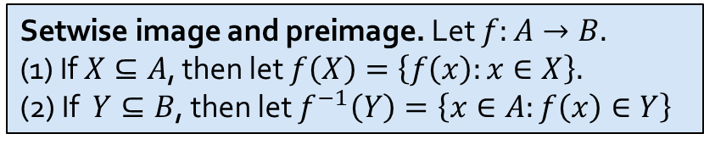
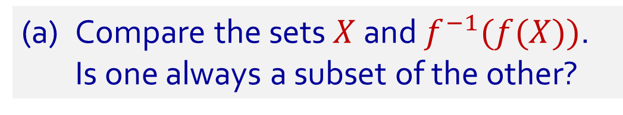
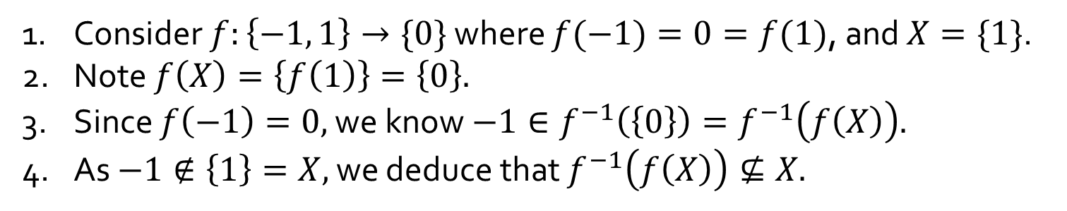




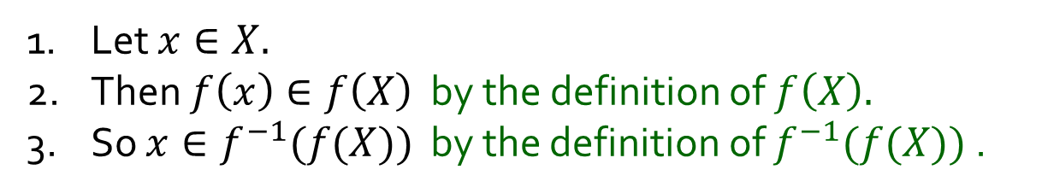



Q9.
Let $f:A→B$ be a function. Let $X⊆A$ and $Y⊆B$.
(a) Compare the sets $X$ and $f^{−1}(f(X))$.
Is one always a subset of the other?
$$A$$
$$f$$
$$B$$
$$f^{−1}\left(f\left(X\right)\right)$$
Is $X⊆f^{−1}(f(X))$ always true?
Yes
$$f(X)$$
1. Let $x∈X.$
2. Then $f\left(x\right)∈f\left(X\right)$ by the definition of $f\left(X\right).$
3. So $x∈f^{−1}(f(X))$ by the definition of $f^{−1}(f(X))$ .
$$X$$
Is$f^{−1}(f(X))⊆X$ always true?
No
1. Consider $f:\left\{−1, 1\right\}→\{0\}$ where $f(−1)=0=f(1)$, and $X=\{1\}$.
2. Note $f\left(X\right)=\left\{f\left(1\right)\right\}=\left\{0\right\}.$
3. Since $f\left(−1\right)=0,$ we know $−1∈f^{−1}\left(\left\{0\right\}\right)=f^{−1}\left(f\left(X\right)\right).$
4. As $−1∉\left\{1\right\}=X,$ we deduce that $f^{−1}\left(f\left(X\right)\right)⊈X.$
Setwise image and preimage. Let $f:A→B.$
(1) If $X⊆A$, then let $f\left(X\right)=\left\{f\left(x\right):x∈X\right\}.$
(2) If $Y⊆B$, then let $f^{−1}\left(Y\right)=\left\{x∈A:f\left(x\right)∈Y\right\}$
2

Slide 3

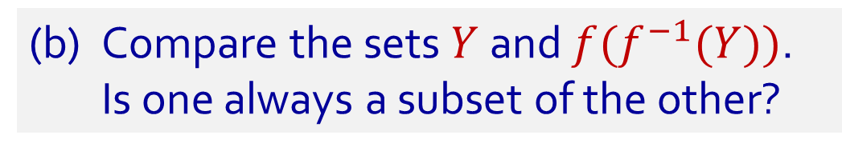
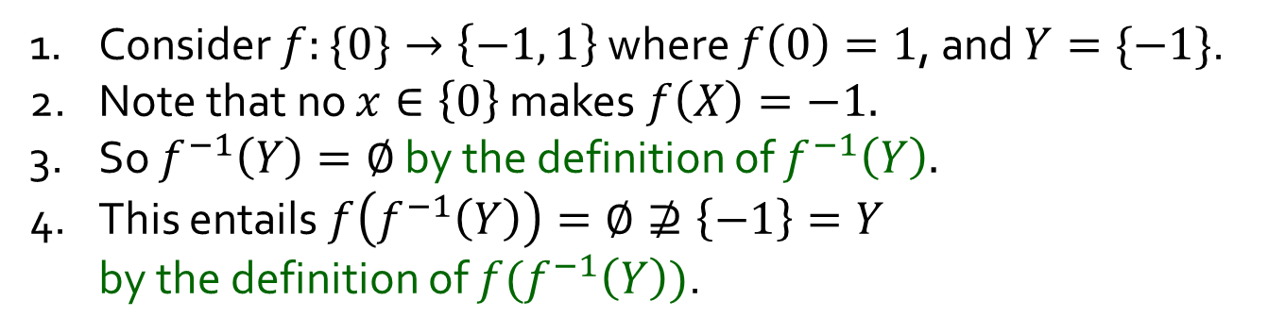

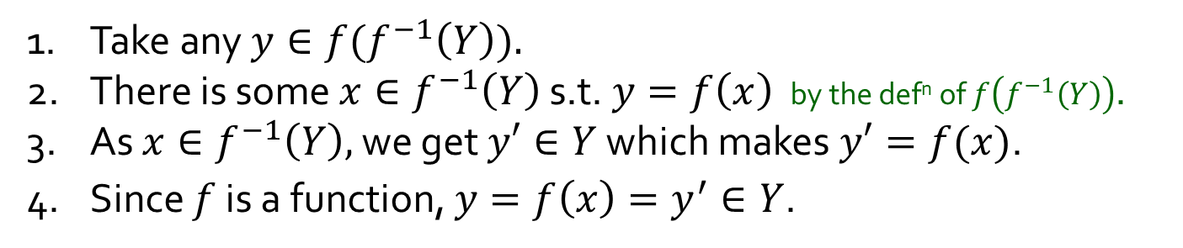




Q9.
Let $f:A→B$ be a function. Let $X⊆A$ and $Y⊆B$.
(b) Compare the sets $Y$ and $f(f^{−1}(Y))$.
Is one always a subset of the other?
$$A$$
$$f$$
$$B$$
Is $f(f^{−1}(Y))⊆Y$ always true?
Yes
$f^{−1}(Y$)
$$f\left(f^{−1}\left(Y\right)\right)$$
Take any $y∈f(f^{−1}\left(Y\right)).$
2. There is some $x∈f^{−1}\left(Y\right)$ s.t. $y=f\left(x\right)$ by the def^{n} of $f\left(f^{−1}\left(Y\right)\right)$.
3. As $x∈f^{−1}\left(Y\right),$ we get $y′∈Y$ which makes $y′=f(x)$.
4. Since $f$ is a function, $y=f\left(x\right)=y^{′}∈Y$.
$$Y$$
Is $Y⊆f(f^{−1}(Y))$ always true?
No
1. Consider $f:\{0\}→\left\{−1, 1\right\}$ where $f\left(0\right)=1$, and $Y=\{−1\}$.
2. Note that no $x∈\left\{0\right\}$ makes $f\left(X\right)=−1.$
3. So $f^{−1}\left(Y\right)=∅$ by the definition of $f^{−1}\left(Y\right).$
4. This entails $f\left(f^{−1}\left(Y\right)\right)=∅⊉\left\{−1\right\}=Y$
by the definition of $f(f^{−1}\left(Y\right))$.
Setwise image and preimage. Let $f:A→B.$
(1) If $X⊆A$, then let $f\left(X\right)=\left\{f\left(x\right):x∈X\right\}.$
(2) If $Y⊆B$, then let $f^{−1}\left(Y\right)=\left\{x∈A:f\left(x\right)∈Y\right\}$
3

Slide 4
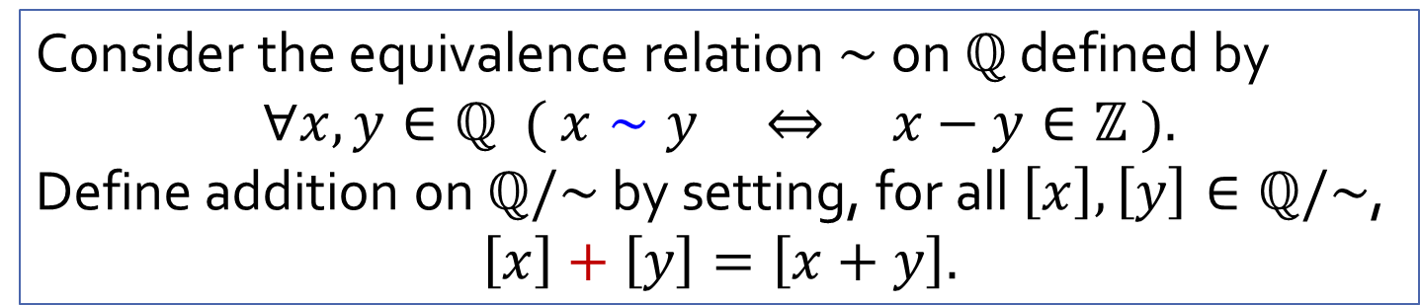
Q10(+)
Consider the equivalence relation $∼$ on $ℚ$ defined by
$$∀x,y∈ℚ ( x∼y ⇔ x−y∈ℤ ).$$
Define addition on $ℚ/\sim$ by setting, for all $\left[x\right],\left[y\right]∈ℚ/\sim$,
$$\left[x\right]+\left[y\right]=\left[x+y\right].$$
Is $+$ well defined on $ℚ/\sim$?
In other words, is it true that, according to this definition, for all $\left[x_{1}\right],\left[y_{1}\right],\left[x_{2}\right],\left[y_{2}\right]∈ℚ/\sim$,
$$\left[x_{1}\right]=\left[x_{2}\right]∧\left[y_{1}\right]=\left[y_{2}\right] ⇒ \left[x_{1}\right]+\left[y_{1}\right]=\left[x_{2}\right]+\left[y_{2}\right]?$$
Consider $A=\left\{…,−\frac{8}{3},−\frac{5}{3},−\frac{2}{3},\frac{1}{3},\frac{4}{3},\frac{7}{3},\frac{10}{3},…\right\}$ and $B=\left\{…,−\frac{13}{5},−\frac{8}{5},−\frac{3}{5},\frac{2}{5},\frac{7}{5},\frac{12}{5},\frac{17}{5},…\right\}$.
Note $A,B∈ℚ/\sim$. What is $A+B$?
Since $A=\left[\frac{1}{3}\right]$ and $B=\left[\frac{2}{5}\right]$, the definition above tells us $A+B=\left[\frac{1}{3}\right]+\left[\frac{2}{5}\right]=\left[\frac{1}{3}+\frac{2}{5}\right]=\left[\frac{11}{15}\right].$
$$=$$
Since $A=\left[\frac{4}{3}\right]$ and $B=\left[\frac{7}{5}\right]$, the definition above tells us $A+B=\left[\frac{4}{3}\right]+\left[\frac{7}{5}\right]=\left[\frac{4}{3}+\frac{7}{5}\right]=\left[\frac{41}{15}\right].$
4

Slide 5
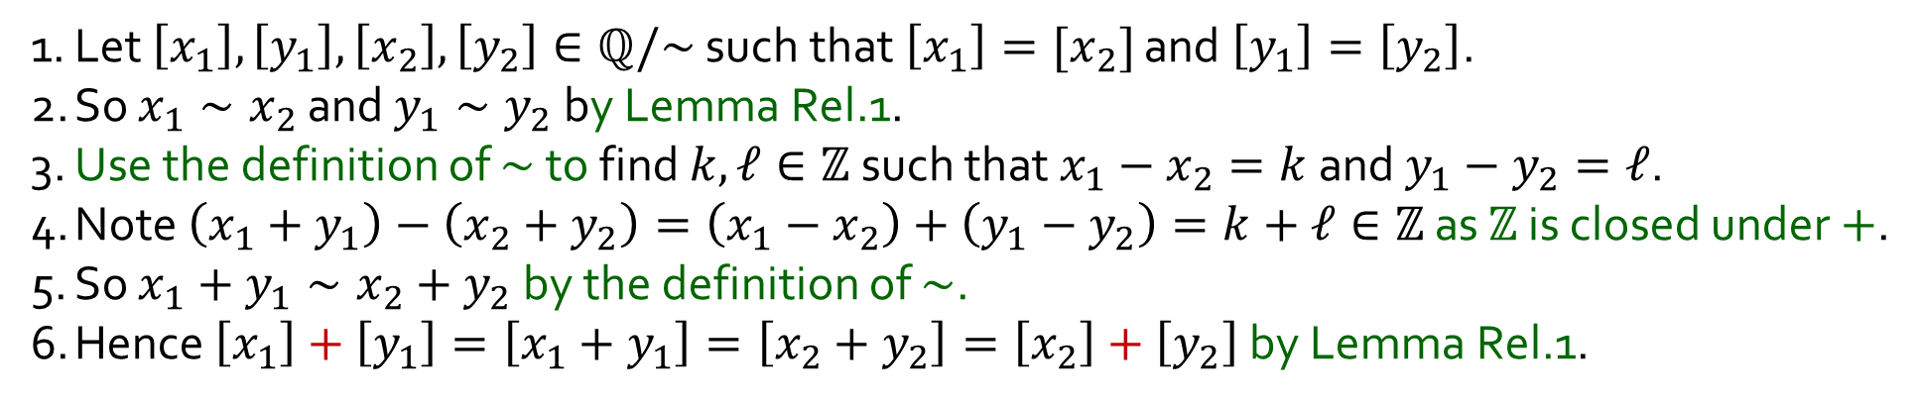
Q10(+)
Consider the equivalence relation $∼$ on $ℚ$ defined by
$$∀x,y∈ℚ ( x∼y ⇔ x−y∈ℤ ).$$
Define addition on $ℚ/\sim$ by setting, for all $\left[x\right],\left[y\right]∈ℚ/\sim$,
$$\left[x\right]+\left[y\right]=\left[x+y\right].$$
Yes!
Is $+$ well defined on $ℚ/\sim$?
In other words, is it true that, according to this definition, for all $\left[x_{1}\right],\left[y_{1}\right],\left[x_{2}\right],\left[y_{2}\right]∈ℚ/\sim$,
$$\left[x_{1}\right]=\left[x_{2}\right]∧\left[y_{1}\right]=\left[y_{2}\right] ⇒ \left[x_{1}\right]+\left[y_{1}\right]=\left[x_{2}\right]+\left[y_{2}\right]?$$
1. Let $\left[x_{1}\right],\left[y_{1}\right],\left[x_{2}\right],\left[y_{2}\right]∈ℚ/\sim$ such that $\left[x_{1}\right]=[x_{2}]$ and $\left[y_{1}\right]=\left[y_{2}\right]$.
2. So $x_{1}∼x_{2}$ and $y_{1}∼y_{2}$ by Lemma Rel.1.
3. Use the definition of $∼$ to find $k,ℓ∈ℤ$ such that $x_{1}−x_{2}=k$ and $y_{1}−y_{2}=ℓ$.
4. Note $\left(x_{1}+y_{1}\right)−\left(x_{2}+y_{2}\right)=\left(x_{1}−x_{2}\right)+\left(y_{1}−y_{2}\right)=k+ℓ∈ℤ$ as $ℤ$ is closed under $+$.
5. So $x_{1}+y_{1}∼x_{2}+y_{2}$ by the definition of $\sim$.
6. Hence $\left[x_{1}\right]+\left[y_{1}\right]=\left[x_{1}+y_{1}\right]=\left[x_{2}+y_{2}\right]=\left[x_{2}\right]+\left[y_{2}\right]$ by Lemma Rel.1.
Lemma Rel.1. The following are equivalent: (i) $x∼y$; (ii) $\left[x\right]=\left[y\right]$; (iii) $\left[x\right]∩\left[y\right]≠∅$.
5

Slide 6
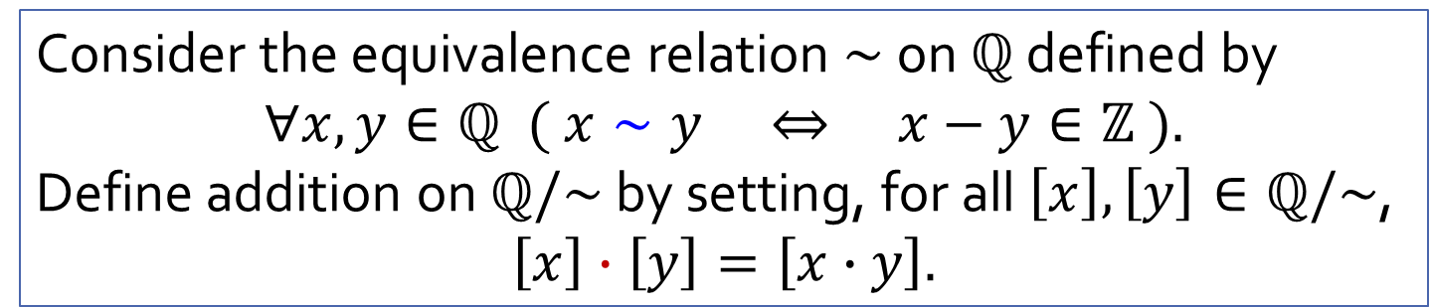
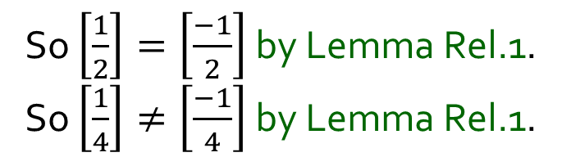
Q10(⋅)
Consider the equivalence relation $∼$ on $ℚ$ defined by
$$∀x,y∈ℚ ( x∼y ⇔ x−y∈ℤ ).$$
Define addition on $ℚ/\sim$ by setting, for all $\left[x\right],\left[y\right]∈ℚ/\sim$,
$$\left[x\right]∙\left[y\right]=\left[x∙y\right].$$
No!
Is $⋅$ well defined on $ℚ/\sim$?
In other words, is it true that, according to this definition, for all $\left[x_{1}\right],\left[y_{1}\right],\left[x_{2}\right],\left[y_{2}\right]∈ℚ/\sim$,
$$\left[x_{1}\right]=\left[x_{2}\right]∧\left[y_{1}\right]=\left[y_{2}\right] ⇒ \left[x_{1}\right]⋅\left[y_{1}\right]=\left[x_{2}\right]⋅\left[y_{2}\right]?$$
So $\left[\frac{1}{2}\right]=\left[\frac{−1}{2}\right]$ by Lemma Rel.1.
So $\left[\frac{1}{4}\right]≠\left[\frac{−1}{4}\right]$ by Lemma Rel.1.
1. Note that $\frac{1}{2}−\frac{−1}{2}=1∈ℤ$. This implies $\frac{1}{2}∼\frac{−1}{2}$. So $\left[\frac{1}{2}\right]=\left[\frac{−1}{2}\right]$ by Lemma 6.3.4.
2. Note also $\frac{1}{4}−\frac{−1}{4}=\frac{1}{2}∉ℤ$. This implies $\frac{1}{4}≁\frac{−1}{4}$. So $\left[\frac{1}{4}\right]≠\left[\frac{−1}{4}\right]$ by Lemma 6.3.4.
3. Therefore, according to the definition of $⋅$ on $ℚ/\sim$ above,
$$\left[\frac{1}{2}\right]⋅\left[\frac{1}{2}\right]=\left[\frac{1}{2}⋅\frac{1}{2}\right]=\left[\frac{1}{4}\right]≠\left[\frac{−1}{4}\right]=\left[\frac{1}{2}⋅\frac{−1}{2}\right]=\left[\frac{1}{2}\right]⋅\left[\frac{−1}{2}\right].$$
This implies $\frac{1}{2}∼\frac{−1}{2}$. $\left[\frac{1}{2}\right]$
This implies $\frac{1}{4}≁\frac{−1}{4}$. $\left[\frac{1}{2}\right]$
$$\left[\frac{1}{2}⋅\frac{1}{2}\right]$$
$$=\left[\frac{1}{4}\right]$$
$$\left[\frac{−1}{4}\right]=$$
$$\left[\frac{1}{2}⋅\frac{−1}{2}\right]$$
$$≠$$
Lemma Rel.1. The following are equivalent: (i) $x∼y$; (ii) $\left[x\right]=\left[y\right]$; (iii) $\left[x\right]∩\left[y\right]≠∅$.
6

Slide 7
END OF FILE

