Slide 1

Lecture #1
Introduction
From High-Level Languages to Computer Organisation
(AY2025/26 Semester 2)

Slide 2

Blended Learning Format
Lecture slides and videos will be uploaded in advance.
We have recitations every Monday face-to-face Monday, 10am – 12nn.
    Venue: UTown Auditorium 2
You may post questions on SeTsify QnA https://setsify.com/space/6951ea2dd27e3dae4bbc0c4c

Slide 3
Lecture #1: Introduction
Programming Languages
C Programming Language
Abstraction
So, What is a Computer?
Why Study Computer Organisation?

Slide 4
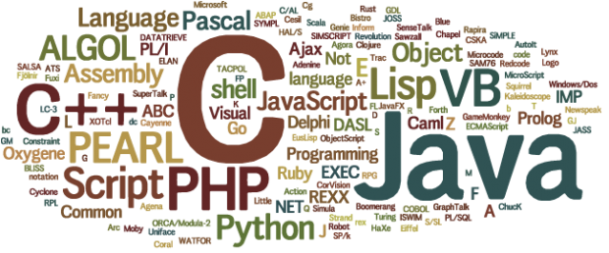
1. Programming Languages
Programming language: a formal language that specifies a set of instructions for a computer to implement specific algorithms to solve problems.

Slide 5
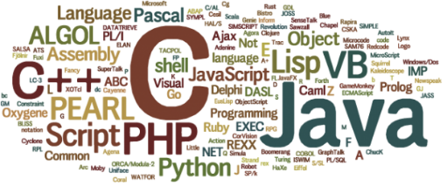
1. Programming Languages
High-level program
Eg: C (CS1010), Java (CS1010J), Python (CS1010S), ECMAScript (CS1101S)
int i, a = 0;
for (i=1; i<=10; i++) {
a = a + i*i;
}
a = 0
for i in range(1,11):
a = a + i*i
addi $t1, $zero, 10
add $t1, $t1, $t1
addi $t2, $zero, 10
Loop: addi $t2, $t2, 10
addi $t1, $t1, -1
beq $t1, $zero, Loop
Low-level program
Eg: MIPS (CS2100)
Machine code
00100000000010010000000000001010
00000001001010010100100000100000
. . .
Computers can execute only machine code directly.

Slide 6
1. Programming Languages (3/5)
1st Generation Languages
2nd Generation Languages
3rd Generation Languages
4th Generation Languages
5th Generation Languages
Machine language.
Directly executable by machine.
Machine dependent.
Efficient code but difficult to write.
Assembly language.
Need to be translated (assembled) into machine code for execution.
Efficient code, easier to write than machine code.
Closer to English.
Need to be translated (compiled or interpreted) into machine code for execution.
Eg: FORTRAN, COBOL, C, BASIC
Require fewer instructions than 3GL.
Used with databases (query languages, report generators, forms designers)
Eg: SQL, PostScript, Mathematica
Used mainly in A.I. research.
Declarative languages
Functional languages (eg: Lisp, Scheme, SML)
Logic programming (eg: Prolog)

Slide 7
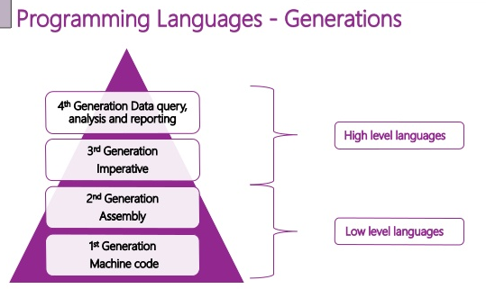
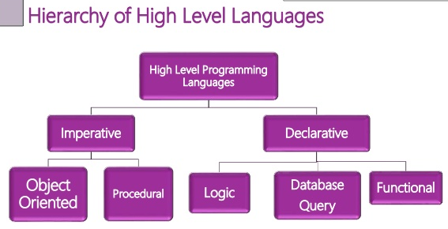
1. Programming Languages (4/5)
“Generational” classification of high level languages (3GL and later) was never fully precise.
A different classification is based on paradigm.

Slide 8
1. Programming Languages (5/5)
Difference between scripting languages and programming languages
Scripting languages | Programming languages
Eg: JavaScript, PHP, Python | Eg: C, C++, Java
Interpreted; do not require compilation | Compiled
Generally slower | Generally faster
However, the environment is more important than the language in the classification.
  We can write a C interpreter and use it as a scripting language
  We can compile JavaScript to machine code
The distinction is getting blurred due to improved hardware capabilities and coding practices
  Eg: Python is widely used without compilation, but the main implementation (CPython) does that by compiling to bytecode on-the-fly and then running the bytecode in a VM (virtual machine)
  Eg: Java is compiled to bytecode, which is then interpreted/recompiled at runtime

Slide 9

2. C Programming Language (1/4)
Created by Dennis Ritchie (1941 – 2011) at Bell Laboratories in the early 1970s.
C is an imperative procedural language.
C provides constructs that map efficiently to typical machine instructions.
C is a high-level language very close to the machine level, hence sometimes it is called “mid-level”.
UNIX is written in C.
HelloWorld.c
#include <stdio.h>
int main(void) {
printf("Hello, world\n");
return 0;
}
HelloWorld.py
print("Hello, world")
(Note: All C programs in the lectures are available on LumiNUS as well as the CS2100 website. Python versions are also available.)
Notes:
An imperative language uses a sequence of statements to determine how to reach a certain goal. These statements are said to change the state of the program as each one is executed in turn.
A procedural language is a type of computer programming language that specifies a series of well-structured steps and procedures within its programming context to compose a program. It contains a systematic order of statements, functions and commands to complete a computational task or program.

Slide 10
2. C Programming Language (2/4)
Creating a C program
Editor
Source code
Compiler
Object code
Other object codes
Function libraries
Linker
Executable code

Slide 11
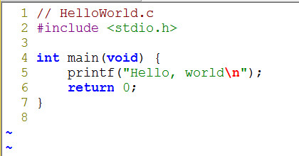
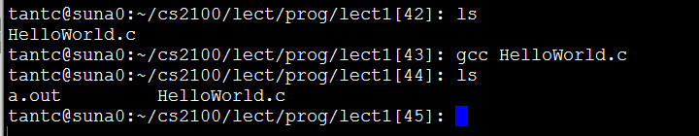

2. C Programming Language (3/4)
Edit
Illustration on SoC UNIX server
Compile and link
Execute

Slide 12
2. C Programming Language (4/4)
Compile and link
The command gcc hides all the details
Using gcc –v HelloWorld.c will display all the details
The process goes through the following steps to generate machine code:
  Preprocessing
  Compilation
  Assembler
  Linker

Slide 13
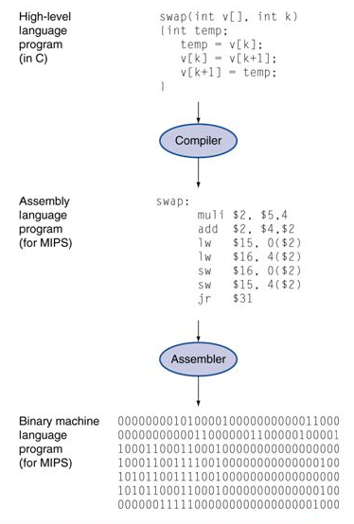
3. Abstraction (1/3)
High-level language
  Level of abstraction closer to problem domain
  Provides productivity and portability
Assembly language
  Textual and symbolic representation of instructions
Machine code (object code or binary)
  Binary bits of instructions and data

Slide 14
3. Abstraction Layers (2/3)
Hardware/Software Stack in Computer
CS4212
Application software
CS2106
Compiler
Software
Assembler
Operating System
Linker
Loader
Scheduler
Device Drivers
Instruction Set Architecture (ISA)
Processor
Memory
I/O System
Datapath & Control Design
Hardware
Digital Logic Design
CS2100
Circuit Design
Transistors

Slide 15
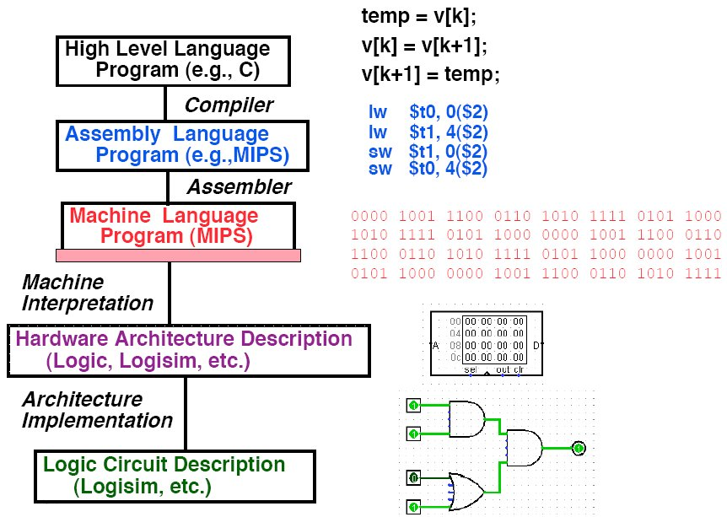
3. Abstraction (3/3)
Level of Representation

Slide 16
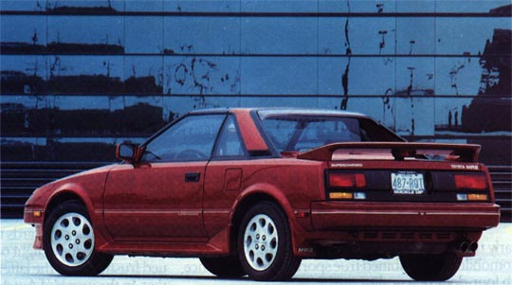

4. So, What is a Computer? (1/6)
Driver
Example: An automobile augments our power of locomotion.
A computer is a device capable of solving problems according to designed programs. It simply augments our power of storage and speed of calculation.
Programmer

Slide 17
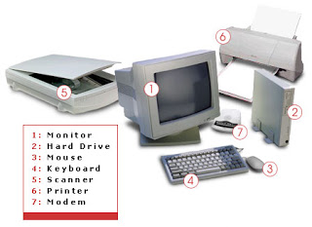
4. So, What is a Computer? (2/6)
From computer organisation perspective, we study the components and how they work together
  Processor, memory, input/output devices, networks, …
Credit: http://tech4abc.blogspot.sg/2010/08/latest-technology-in-computer-hardwares.html

Slide 18

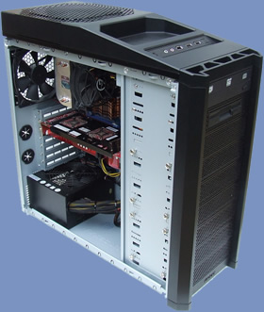
4. So, What is a Computer? (3/6)
Power supply
Motherboard
Central Processing Unit (CPU)
Random Access Memory (RAM)
Hard drive
Cooling fan
I/O devices
Credit: http://www.overclock3d.net/reviews/cpu_mainboard/the_computer_council_-_clocked_gamer_quad/1
Credit: http://tech3news.com/most-recent-computer-technology/

Slide 19
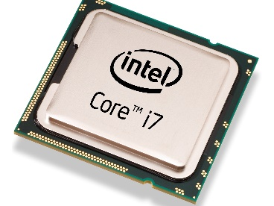
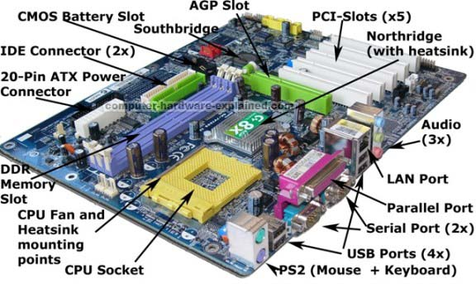
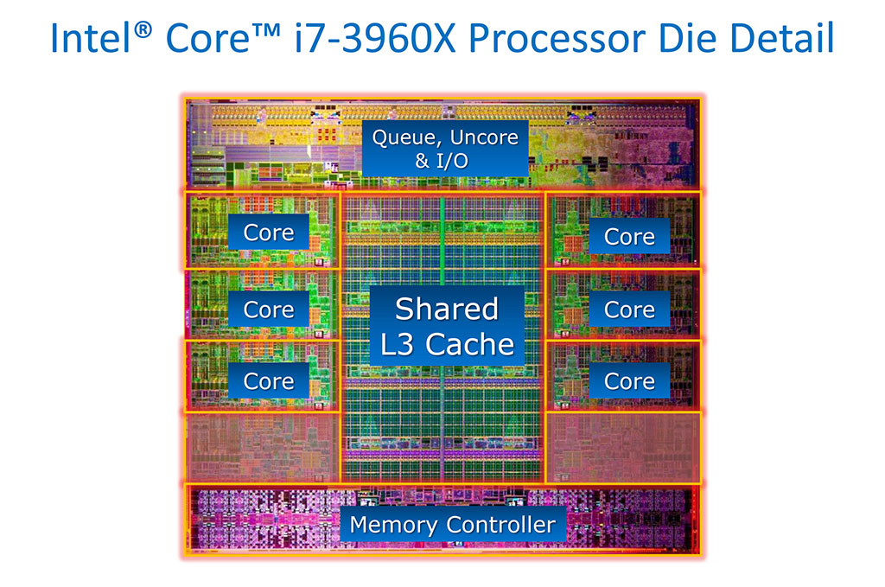
4. So, What is a Computer? (4/6)
PC motherboard
Intel i7 Processor
Credit: http://www.computer-hardware-explained.com/what-is-a-motherboard.html

Slide 20
4. So, What is a Computer? (5/6)
Central Processing Unit
(CPU)
Control Unit
Input Device
Output Device
ALU
Memory Unit
ALU: Arithmetic/Logic Unit

Slide 21



4. So, What is a Computer? (6/6)
Next generation…
Credit: http://www.custom-build-computers.com/Latest-Computer-Hardware.html
Credit:
http://www.prabhanjamindiaits.com/blogdetailedpage.aspx?id=66
Credit: http://new-techpc.blogspot.sg/2012/10/latest-in-computer-technology.html

Slide 22

6th January 2014
http://www.theverge.com/2014/1/6/5282472/intel-announces-edison-a-computer-the-size-of-an-sd-card

Slide 23
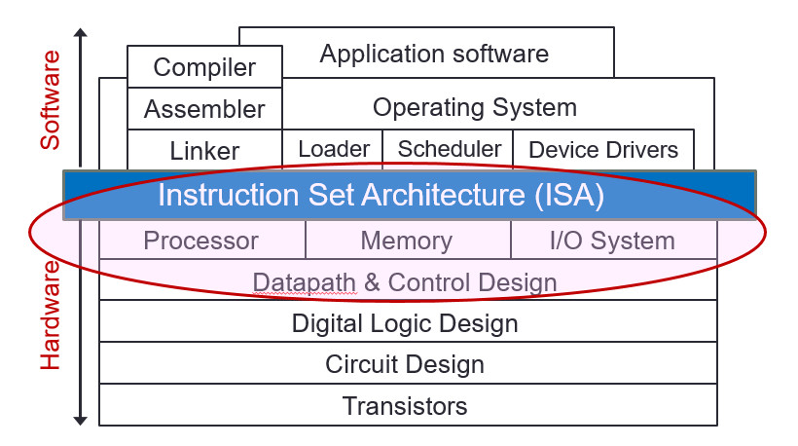
5. Why Study Computer Organisation?
Computer organisation is the study of internal working, structuring and implementation of a computer system.
It refers to the level of abstraction above the digital logic level, but below the operating system level.
CS2100

Slide 24
5. Why Study Computer Organisation?
(From user to builder)
You want to call yourself a computer scientist/specialist.
You want to build software people use.
You need to make purchasing decisions.
You need to offer “expert” advice.
Hardware and software affect performance
  Algorithm determines number of source-level statements
  (eg: CS1010, CS2030, CS2040, CS3230)
  Language, compiler, and architecture determine machine instructions (COD chapters 2 and 3)
  Processor and memory determine how fast instructions are executed (COD chapters 5, 6 and 7)
Understanding performance (COD chapter 4)

Slide 25
End of File

