Slide 1


https://www.comp.nus.edu.sg/~cs2100/
Lecture #3d
Data Representation and Number Systems

Slide 2
11. Real Numbers
Many applications involve computations not only on integers but also on real numbers.
How are real numbers represented in a computer system?
Due to the finite number of bits, real number are often represented in their approximate values.

Slide 3
11.1 Fixed-Point Representation
In fixed-point representation, the number of bits allocated for the whole number part and fractional part are fixed.
For example, given an 8-bit representation, 6 bits are for whole number part and 2 bits for fractional parts.
integer part
fraction part
assumed binary point
If 2s complement is used, we can represent values like:
011010.11_{2s} = 26.75₁₀
111110.11_{2s} = -000001.01₂ = -1.25₁₀

Slide 4
11.2 Floating-Point Representation (1/4)
Fixed-point representation has limited range.
Alternative: Floating point numbers allow us to represent very large or very small numbers.
Examples:
0.23 × 10²³ (very large positive number)
0.5 × 10⁻³⁷ (very small positive number)
-0.2397 × 10⁻¹⁸ (very small negative number)

Slide 5
11.2 IEEE 754 Floating-Point Rep. (2/4)
3 components: sign, exponent and mantissa (fraction)
sign
exponent
mantissa
The base (radix) is assumed to be 2.
Two formats:
Single-precision (32 bits): 1-bit sign, 8-bit exponent with bias 127 (excess-127), 23-bit mantissa
Double-precision (64 bits): 1-bit sign, 11-bit exponent with bias 1023 (excess-1023), and 52-bit mantissa
We will focus on the single-precision format
Reading
DLD pages 32 - 33
IEEE standard 754 floating point numbers: http://steve.hollasch.net/cgindex/coding/ieeefloat.html

Slide 6
11.2 IEEE 754 Floating-Point Rep. (3/4)
3 components: sign, exponent and mantissa (fraction)
sign
exponent
mantissa
Sign bit: 0 for positive, 1 for negative.
Mantissa is normalised with an implicit leading bit 1
110.1₂ → normalised → 1.101₂ × 2² → only 101 is stored in the mantissa field
0.00101101₂ → normalised → 1.01101₂ × 2^{–3} → only 01101 is stored in the mantissa field

Slide 7
11.2 IEEE 754 Floating-Point Rep. (4/4)
Example: How is –6.5₁₀ represented in IEEE 754 single-precision floating-point format?
-6.5₁₀ = -110.1₂ = -1.101₂ × 2²
Exponent = 2 + 127 = 129 = 10000001₂
1
10000001
10100000000000000000000
sign
exponent
(excess-127)
mantissa
We may write the 32-bit representation in hexadecimal:
1 10000001 10100000000000000000000₂ = C0D00000₁₆
(Slide 4)
11000000110100000000000000000000
As an ‘int’, it is -1060110336
As an ‘float’, it is -6.5

Slide 8
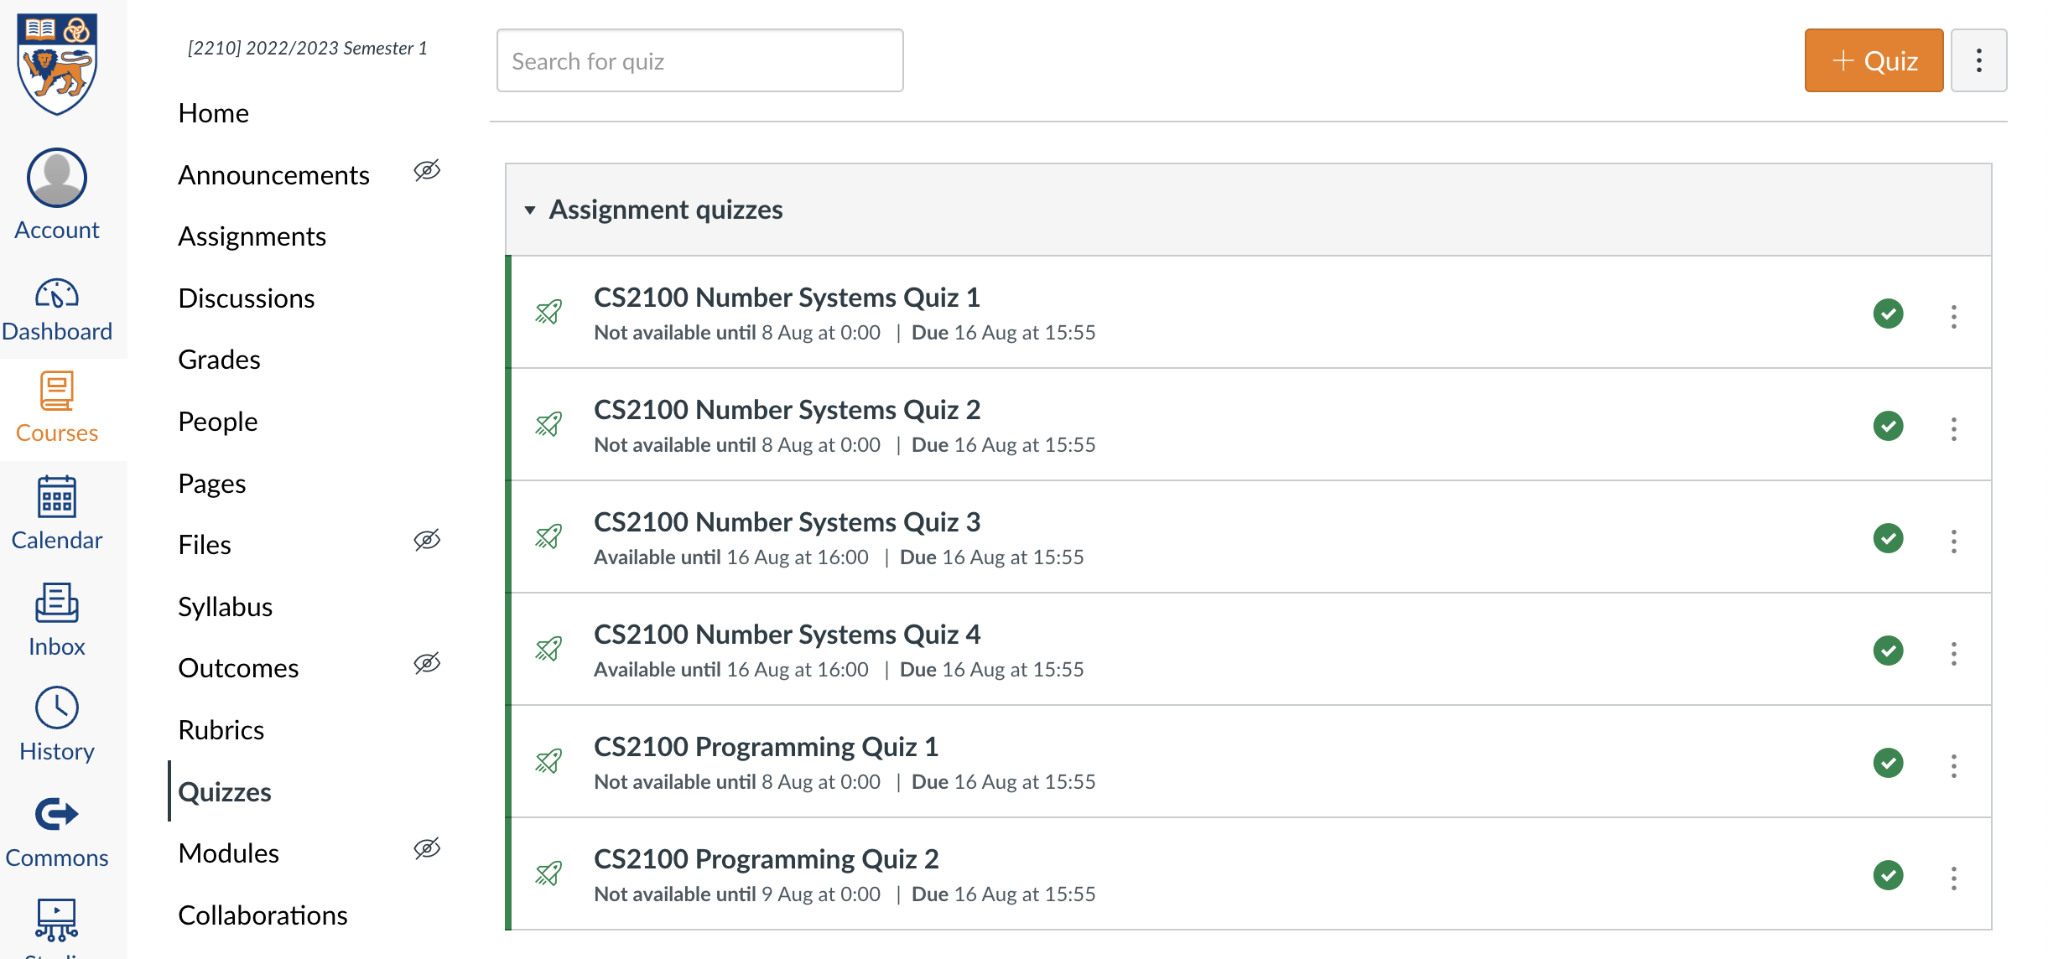
Quiz
Please complete the “CS2100 C Number Systems Quiz 4” in Canvas.
Access via the “Quizzes” tool in the left toolbar and select the quiz on the right side of the screen.

Slide 9
End of File

