Slide 1

https://www.comp.nus.edu.sg/~cs2100/
Recitation 0
Introduction
From High-Level Languages to Computer Organisation
(AY2025/26 Semester 2)

Slide 2

Blended Learning Format
Lecture slides and videos will be uploaded in advance.
We have recitations every Monday face-to-face Monday, 10am – 12nn.
    Venue: UTown Auditorium 2
You may post questions on SeTsify QnA https://setsify.com/space/6951ea2dd27e3dae4bbc0c4c

Slide 3
Lecture #1: Introduction
Programming Languages
C Programming Language
Abstraction
So, What is a Computer?
Why Study Computer Organisation?
Here, we extracted some parts of Lecture #1. For the full lecture slides, please refer to Canvas > Files > Lecture Slides.

Slide 4
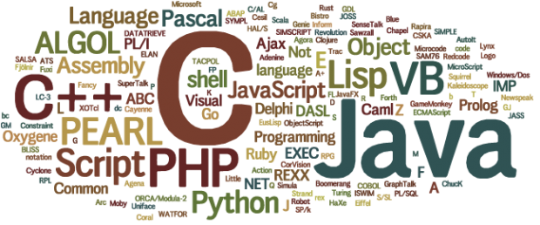
1. Programming Languages
Programming language: a formal language that specifies a set of instructions for a computer to implement specific algorithms to solve problems.

Slide 5
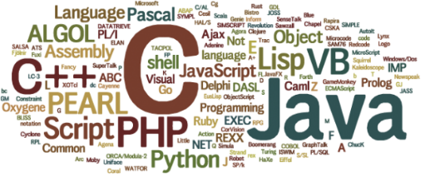
1. Programming Languages
High-level program
Eg: C (CS1010), Java (CS1010J), Python (CS1010S), ECMAScript (CS1101S)
int i, a = 0;
for (i=1; i<=10; i++) {
a = a + i*i;
}
a = 0
for i in range(1,11):
a = a + i*i
addi $t1, $zero, 10
add $t1, $t1, $t1
addi $t2, $zero, 10
Loop: addi $t2, $t2, 10
addi $t1, $t1, -1
beq $t1, $zero, Loop
Low-level program
Eg: MIPS (CS2100)
Machine code
00100000000010010000000000001010
00000001001010010100100000100000
. . .
Computers can execute only machine code directly.

Slide 6
1. Programming Languages
1st Generation Languages
2nd Generation Languages
3rd Generation Languages
4th Generation Languages
5th Generation Languages
Machine language.
Directly executable by machine.
Machine dependent.
Efficient code but difficult to write.
Assembly language.
Need to be translated (assembled) into machine code for execution.
Efficient code, easier to write than machine code.
Closer to English.
Need to be translated (compiled or interpreted) into machine code for execution.
Eg: FORTRAN, COBOL, C, BASIC
Require fewer instructions than 3GL.
Used with databases (query languages, report generators, forms designers)
Eg: SQL, PostScript, Mathematica
Used mainly in A.I. research.
Declarative languages
Functional languages (eg: Lisp, Scheme, SML)
Logic programming (eg: Prolog)

Slide 7
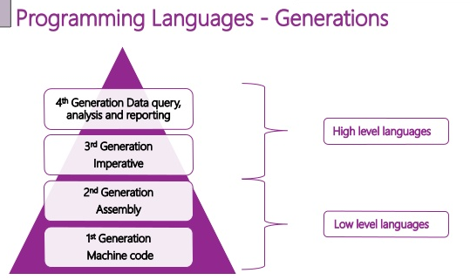
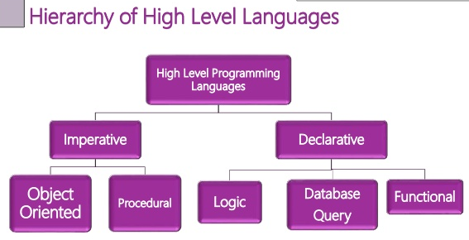
1. Programming Languages
“Generational” classification of high level languages (3GL and later) was never fully precise.
A different classification is based on paradigm.

Slide 8

2. C Programming Language
Created by Dennis Ritchie (1941 – 2011) at Bell Laboratories in the early 1970s.
C is an imperative procedural language.
C provides constructs that map efficiently to typical machine instructions.
C is a high-level language very close to the machine level, hence sometimes it is called “mid-level”.
UNIX is written in C.
HelloWorld.c
#include <stdio.h>
int main(void) {
printf("Hello, world\n");
return 0;
}
HelloWorld.py
print("Hello, world")
(Note: All C programs in the lectures are available on Canvas as well as the CS2100 website. Python versions are also available.)
Notes:
An imperative language uses a sequence of statements to determine how to reach a certain goal. These statements are said to change the state of the program as each one is executed in turn.
A procedural language is a type of computer programming language that specifies a series of well-structured steps and procedures within its programming context to compose a program. It contains a systematic order of statements, functions and commands to complete a computational task or program.

Slide 9
2. C Programming Language
Creating a C program
Editor
Source code
Compiler
Object code
Other object codes
Function libraries
Linker
Executable code

Slide 10
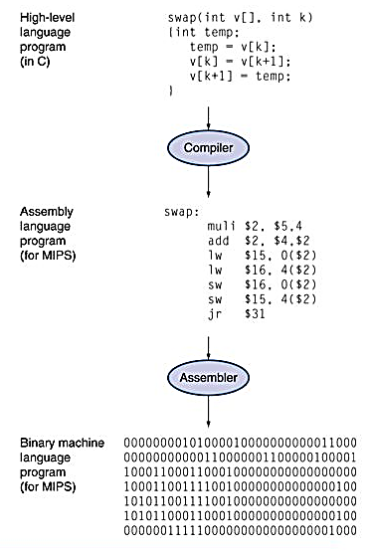
3. Abstraction
High-level language
  Level of abstraction closer to problem domain
  Provides productivity and portability
Assembly language
  Textual and symbolic representation of instructions
Machine code (object code or binary)
  Binary bits of instructions and data

Slide 11
3. Abstraction Layers
Hardware/Software Stack in Computer
CS4212
Application software
CS2106
Compiler
Software
Assembler
Operating System
Linker
Loader
Scheduler
Device Drivers
Instruction Set Architecture (ISA)
Processor
Memory
I/O System
Datapath & Control Design
Hardware
Digital Logic Design
CS2100
Circuit Design
Transistors

Slide 12
4. So, What is a Computer?
Central Processing Unit
(CPU)
Control Unit
Input Device
Output Device
ALU
Memory Unit
ALU: Arithmetic/Logic Unit

Slide 13
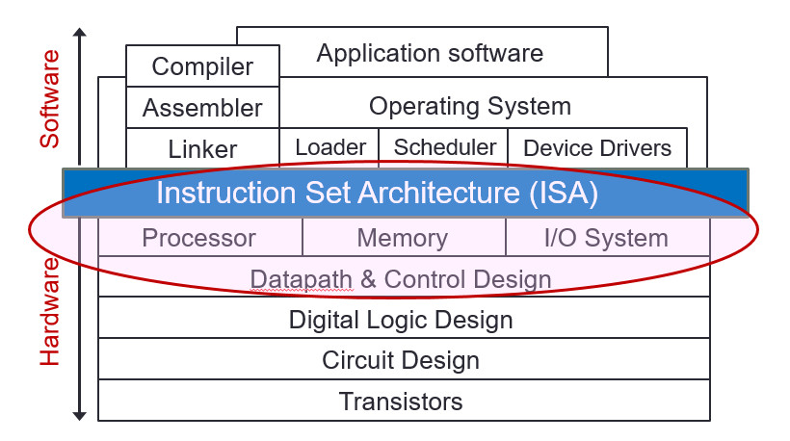
5. Why Study Computer Organisation?
Computer organisation is the study of internal working, structuring and implementation of a computer system.
It refers to the level of abstraction above the digital logic level, but below the operating system level.
CS2100

Slide 14
5. Why Study Computer Organisation?
(From user to builder)
You want to call yourself a computer scientist/specialist.
You want to build software people use.
You need to make purchasing decisions.
You need to offer “expert” advice.
Hardware and software affect performance
  Algorithm determines number of source-level statements
  (eg: CS1101S, CS2030S, CS2040S, CS3230)
  Language, compiler, and architecture determine machine instructions (COD chapters 2 and 3)
  Processor and memory determine how fast instructions are executed (COD chapters 5, 6 and 7)
Understanding performance (COD chapter 4)

Slide 15
End of File

