Slide 1


http://www.comp.nus.edu.sg/~cs2100/
Recitation-1
C Programming and Number Systems
L1 and L2 videos
Prabhu NATARAJAN

Slide 2

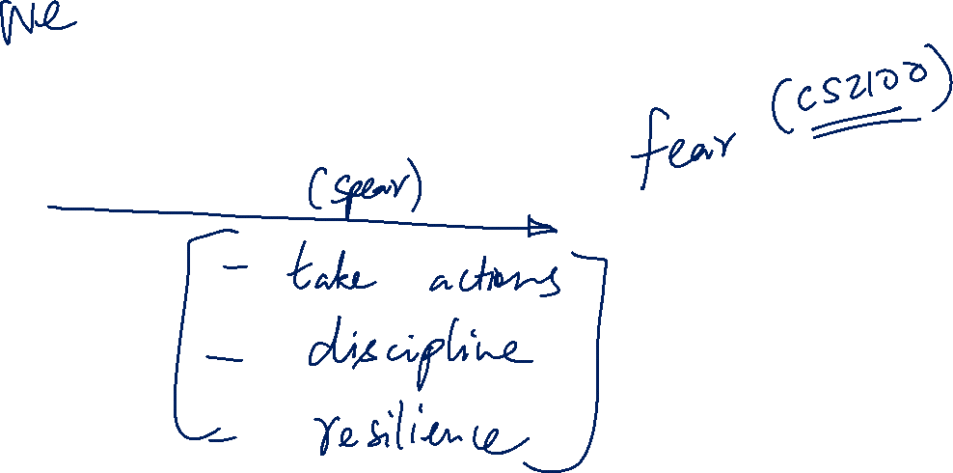
Notes:
Pi shares a lifeboat with a tiger.
Once he reaches shore, the tiger runs away.
Regular study sessions, active participation in labs, and diligent problem-solving are your tools to keep the 'tiger' of CS2100 under control.

Slide 3
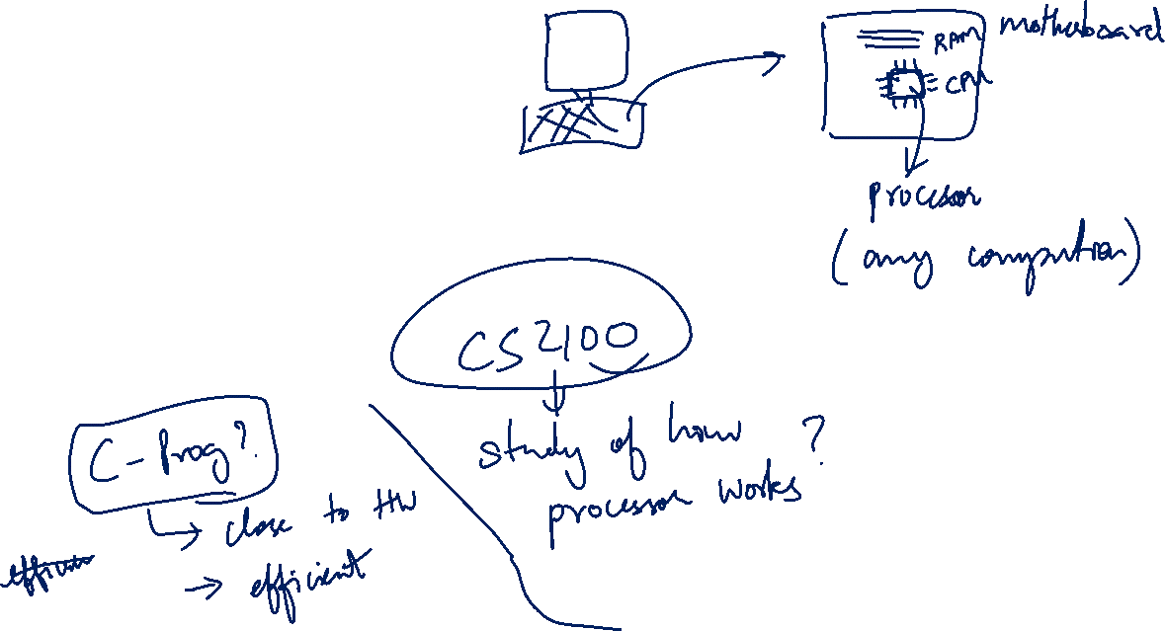
Agenda
Summary
Quiz Questions
Extra Exercises
Announcement
Notes:
“Even when you write Python, it’s ultimately running on C code under the hood — and that C code gets compiled to assembly, which is what the processor actually executes. So learning C helps you understand what’s really happening when you run high-level programs.”

Slide 4
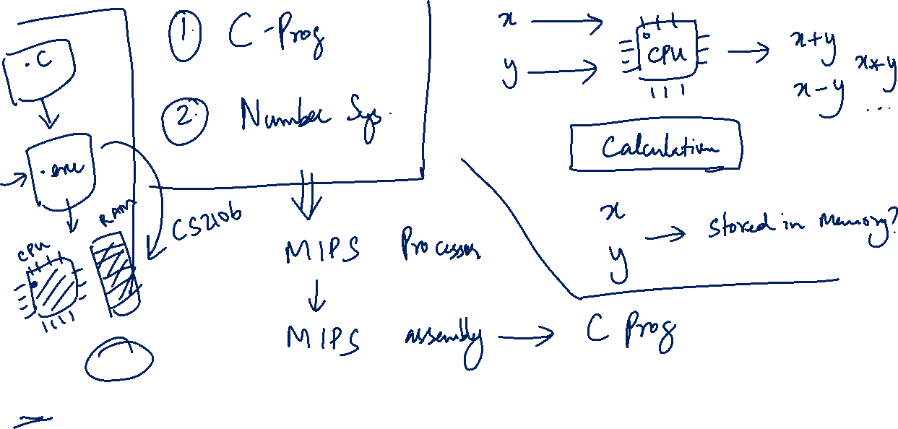
Python (Tesla): Easy, high-level, safe, does a lot for you automatically (garbage collection, memory).
C (Manual Car): You control the memory, manage variables, optimize performance — more power, but more responsibility.
Notes:
“Python is clean and beginner-friendly — but C gives you full control. You manage memory, work close to the hardware, and understand how things like pointers, arrays, and registers really work.”
“If Python is driving an automatic car, C is driving manual — harder at first, but it teaches you how the engine works.”

Slide 5
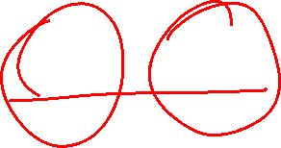
Summary of L1 and L2

Slide 6
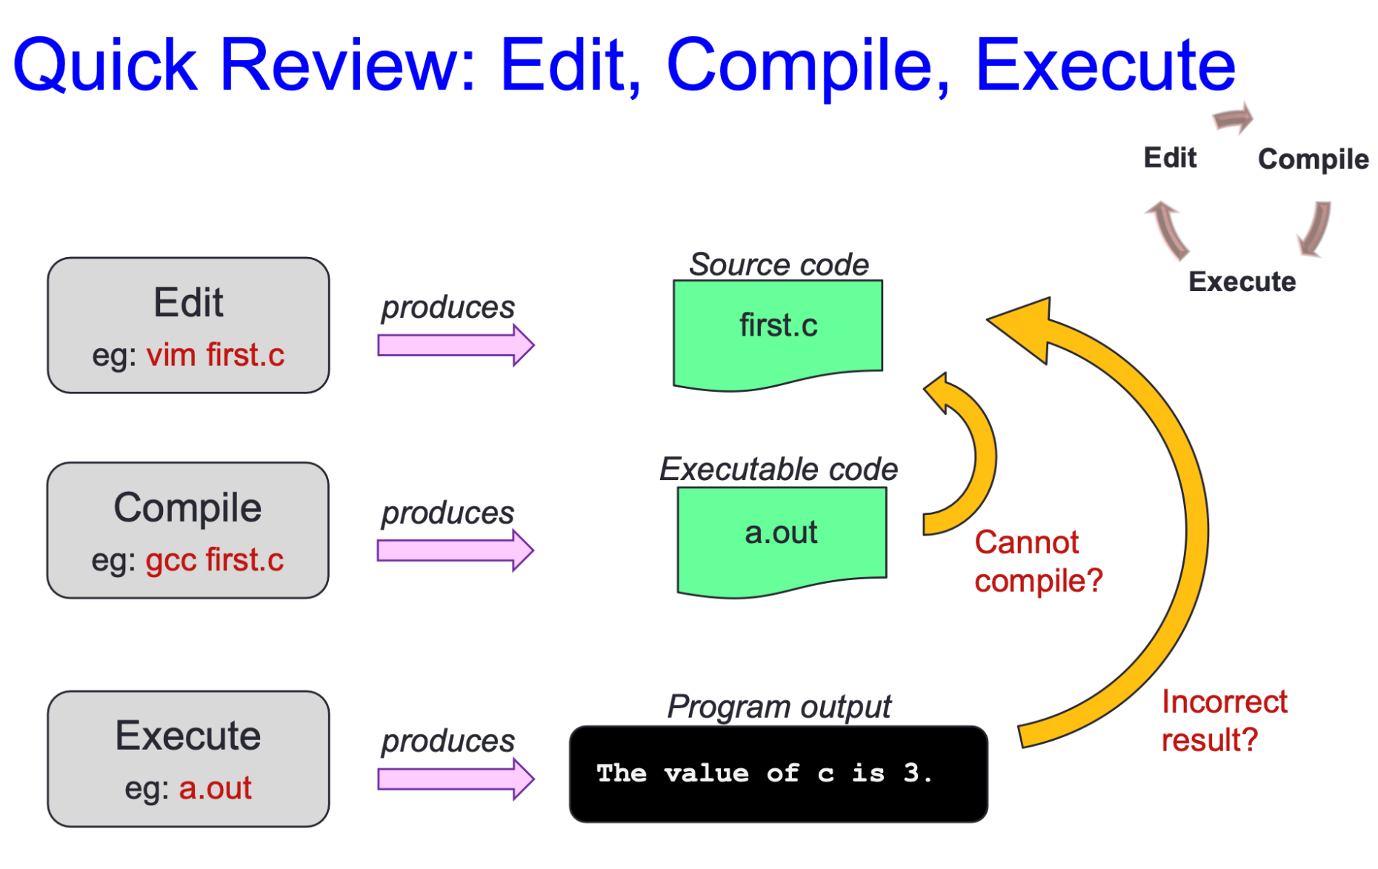

L1 - Overview of C Programming

Slide 7
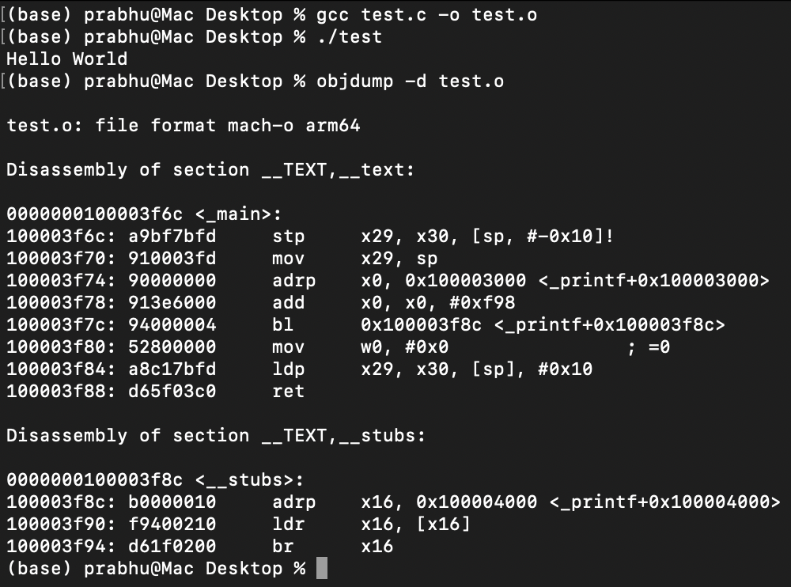
C Program to Object Codes – objdump Command
Notes:
objdump - display information from object files.
-d Display the assembler mnemonics for the machine instructions from objfile
My macbook runs on Apple Silicon Mac (M3), which uses the ARM64 instruction set architecture, not x86-64.

Slide 8
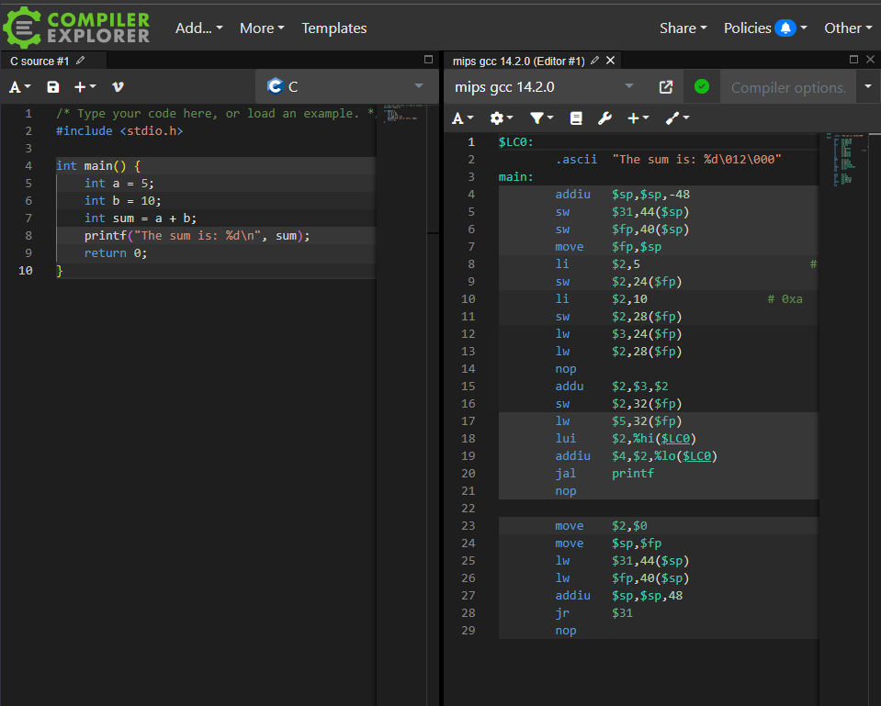
Online tools: www.godbolt.org
Notes:
Compiler Explorer is an online tool that lets you see the assembly code generated from your C code by various compilers in real-time.
Input Code: Enter your C code into the left-hand pane of the Compiler Explorer interface.
Select Compiler and Options: Choose the compiler (e.g., GCC, Clang) and the compilation options you want to use. You can specify optimization levels and other compiler flags.
View Assembly: The middle pane will automatically update to show the generated assembly code corresponding to your C code. This provides a clear view of how the high-level constructs in your C code translate to lower-level assembly instructions.

Slide 9
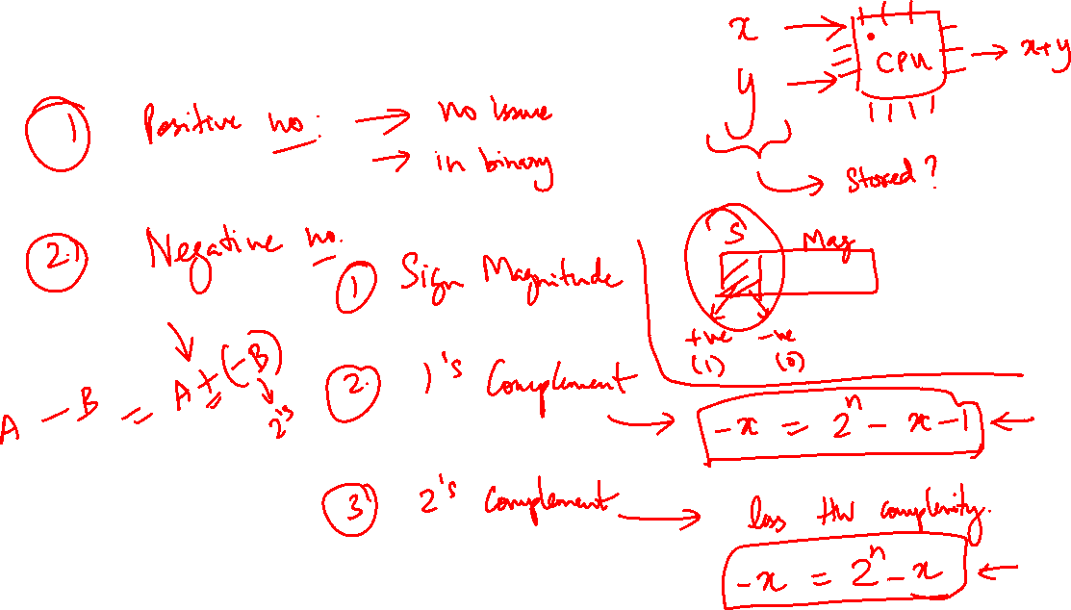
L2 – Number Systems
Notes:
The two's complement system is particularly advantageous because it simplifies binary arithmetic operations:
Addition and subtraction can be performed uniformly without needing to differentiate between positive and negative numbers.
There's no need for separate subtraction hardware in computers—subtraction can be handled via addition of two's complements.
It naturally handles overflow (when operations result in numbers beyond the designated bit range) by discarding the carry out of the most significant bit, ensuring results wrap around within the correct range.

Slide 10
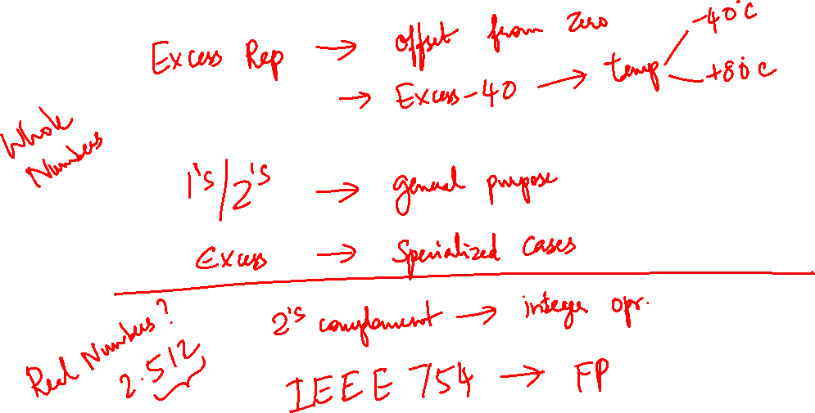
L2 – Number Systems

Slide 11
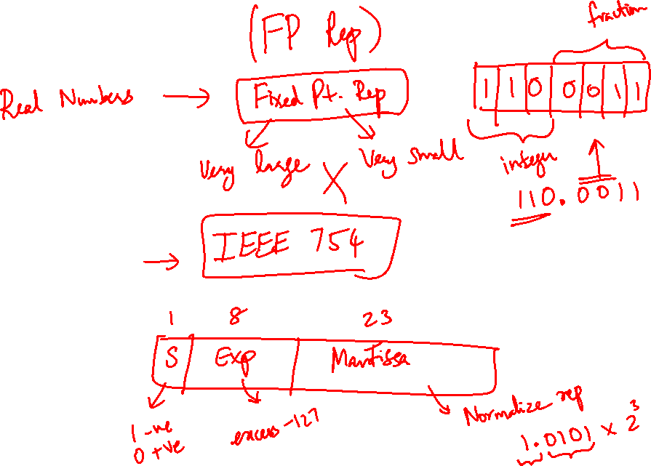
L2 – Number Systems
Notes:
Using a biased exponent, like excess-127 in IEEE 754, simplifies floating-point operations by unifying arithmetic processing and allowing direct integer comparisons.
we want to represent exponents like: 2^{-5}, 2^{0}, 2^{+20}, \dots
It extends the exponent range, efficiently represents zero, and simplifies handling of special values like infinities and NaNs, enhancing computational reliability and hardware design simplicity.
This is design choice.

Slide 12
Quiz Questions

Slide 13
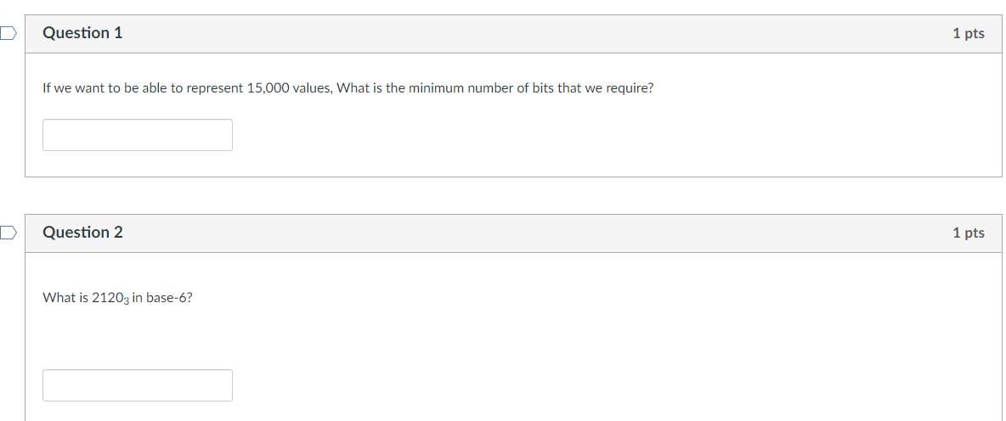
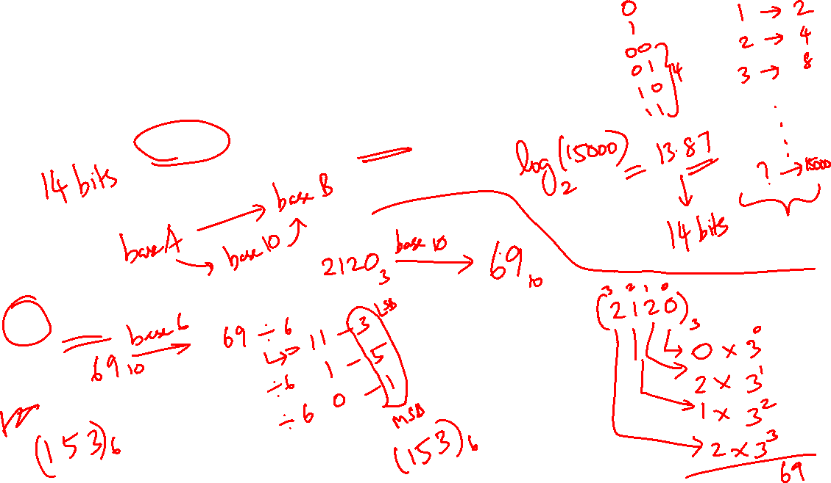
Week-1: 03. Number Systems Quiz 1/4
Notes:
03. Number Systems Quiz ¼
Q1 – if ternary numbers are used, then we need 9 ternary bits (trits) – log (15000) base 3 – 8.38 trits.
Q2 - Convert from base A → decimal → base B

Slide 14
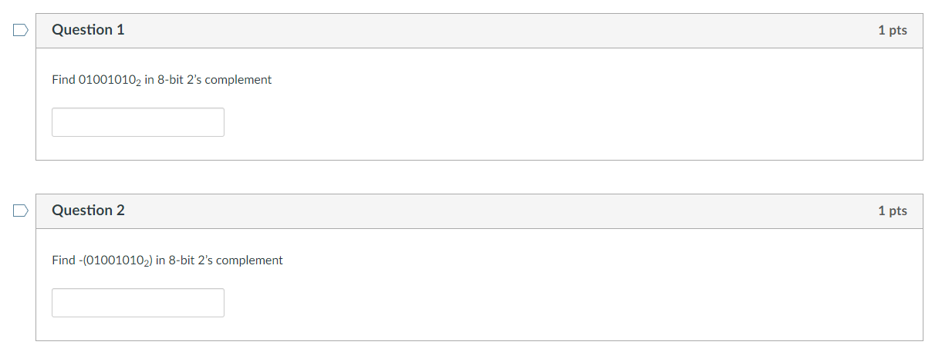
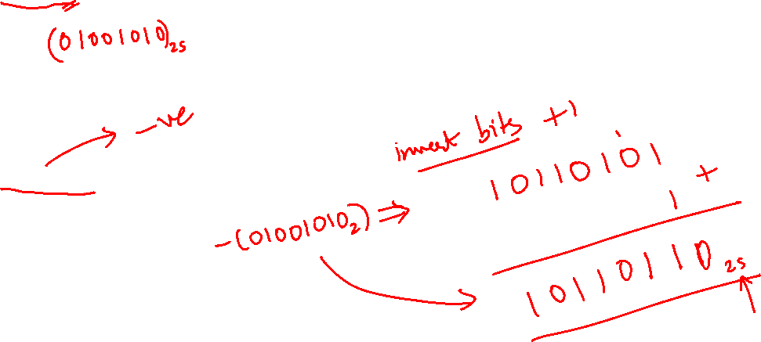
Week-1: 04. Number Systems Quiz 2/4
Notes:
03. Number Systems Quiz 2/4
Range of 2’s complement 8-bit number: -128 to +127
Why -128 and not +128?
0 → 00000000, -1 → 11111111, -2 → 11111110
SM or 1s comp range is -127 to +127. For 2s comp range is -127 to +128 because there is only one rep for 0.

Slide 15
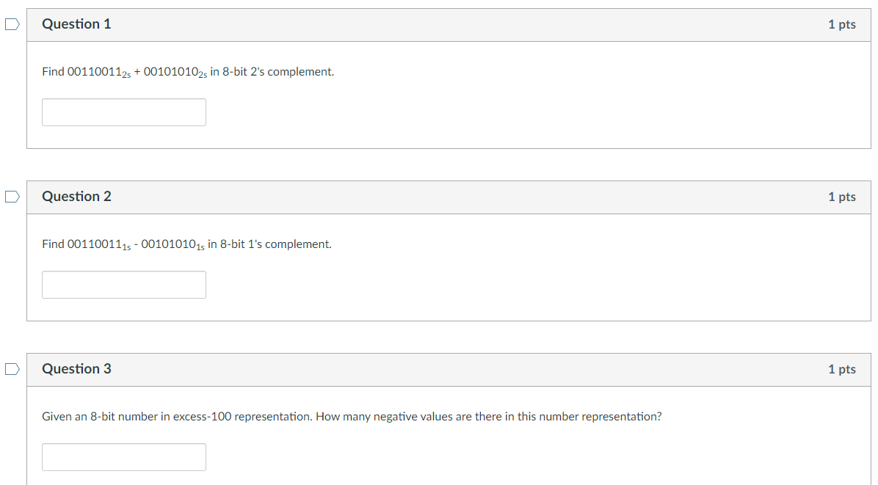
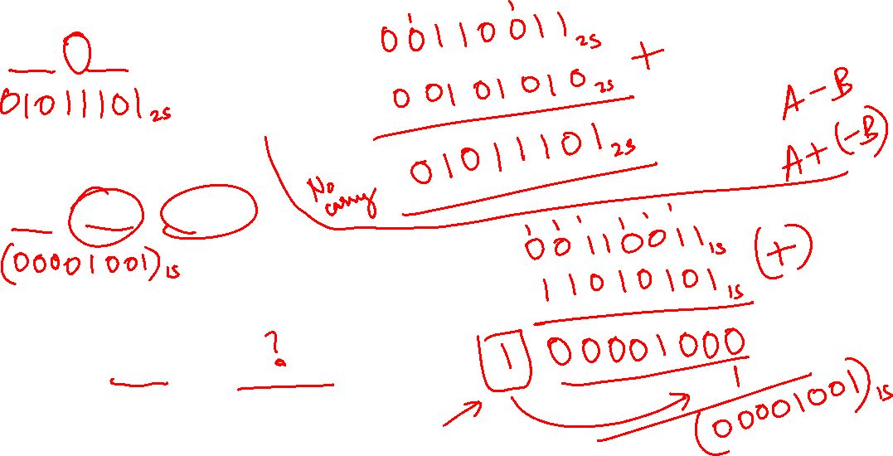
Week-1: 05. Number Systems Quiz 3/4
Notes:
03. Number Systems Quiz 3/4

Slide 16
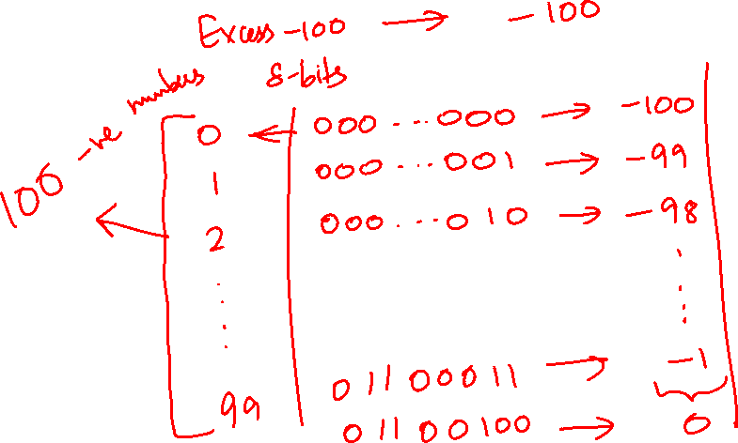

Slide 17
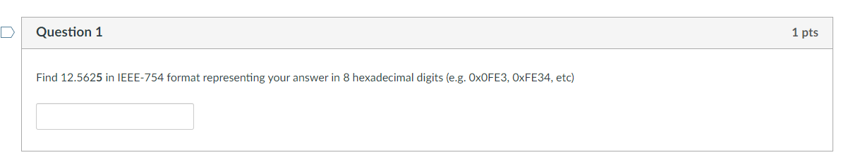
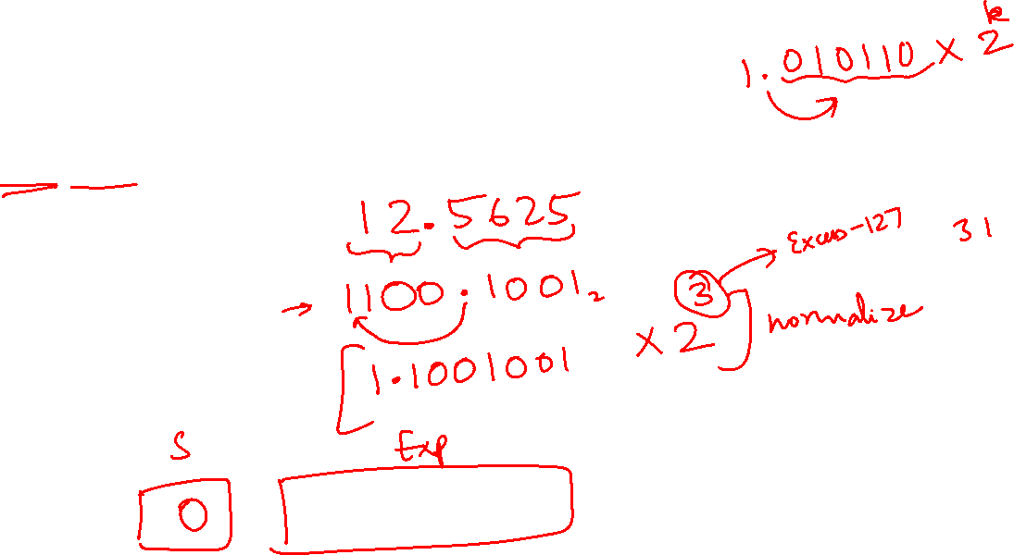
Week-1: 06. Number Systems Quiz 4/4
Notes:
03. Number Systems Quiz 4/4
Why using an excess-127 representation for exponents in floating-point formats is preferred over using the exponent directly?
Unified Arithmetic and Comparisons: Applying a bias to the exponent simplifies floating-point arithmetic operations and comparisons, allowing for straightforward integer-like handling without special processing for positive and negative exponents.
Efficient Handling of Special Values: The excess-127 format facilitates the distinct representation of zero, subnormal numbers, infinities, and Not-a-Number (NaN) values by reserving specific exponent codes, enhancing system reliability and computational integrity.
Extended Exponent Range: Biasing the exponent extends the usable range, allowing for a balanced and efficient encoding of both large and small magnitudes, which optimizes the storage and processing of floating-point numbers in digital systems.

Slide 18
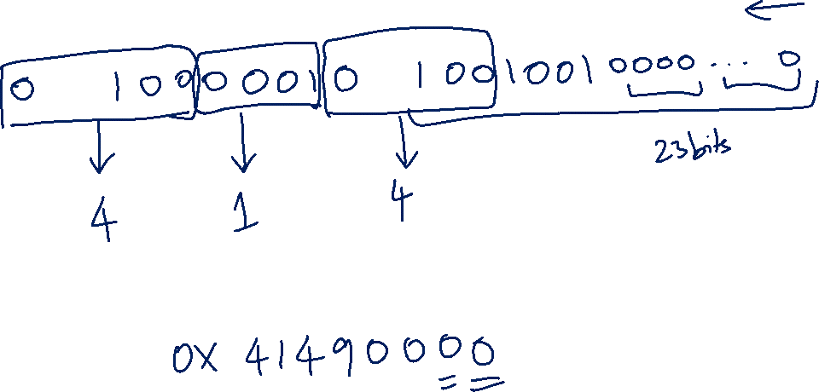

Slide 19
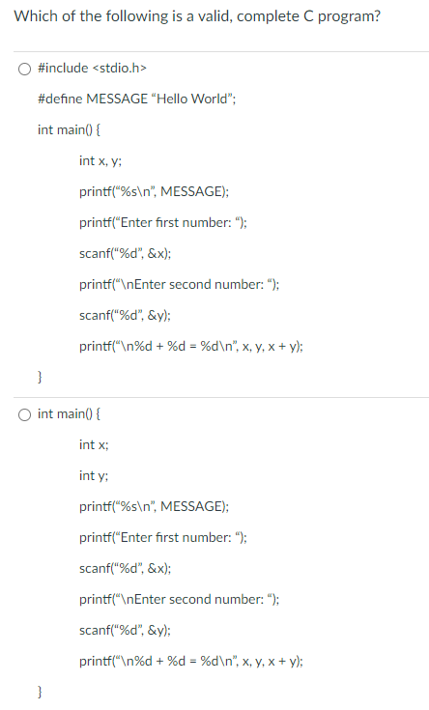
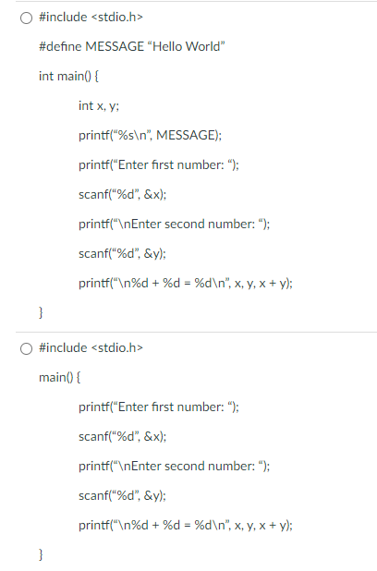
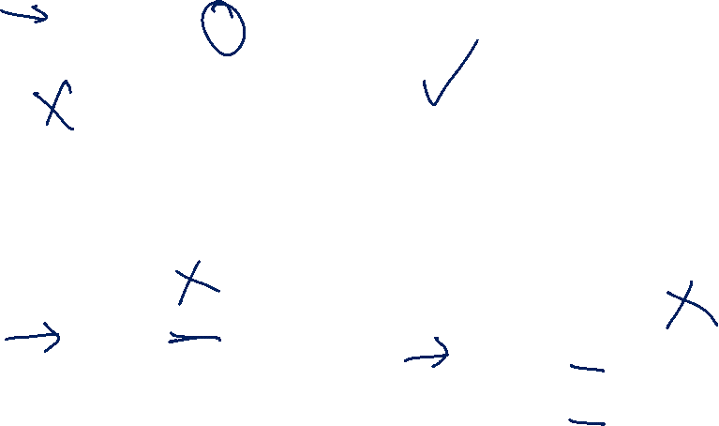
Week-1: 01. Programming Quiz 1/2
Notes:
🔵 Top-left: ❌ Invalid
Adding semicolon after #define MESSAGE "Hello World” (macro) — causes a compiler error.
🔵 Top-right: ✅ Valid
Correct syntax, all variables declared, header included, and macro used properly.
🔵 Bottom-left: ❌ Invalid
MESSAGE is used but not defined — leads to an “undeclared identifier” error.
🔵 Bottom-right: ❌ Invalid
Variables x and y used in scanf without being declared — causes “undeclared variable” error.

Slide 20
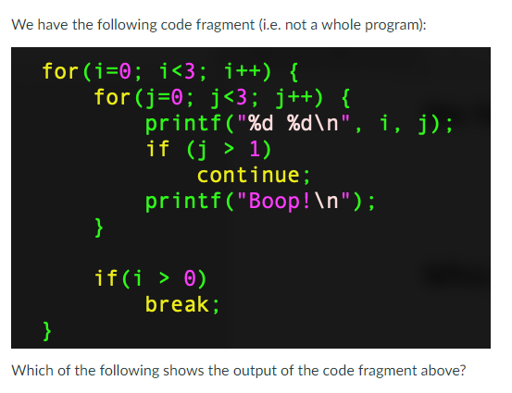
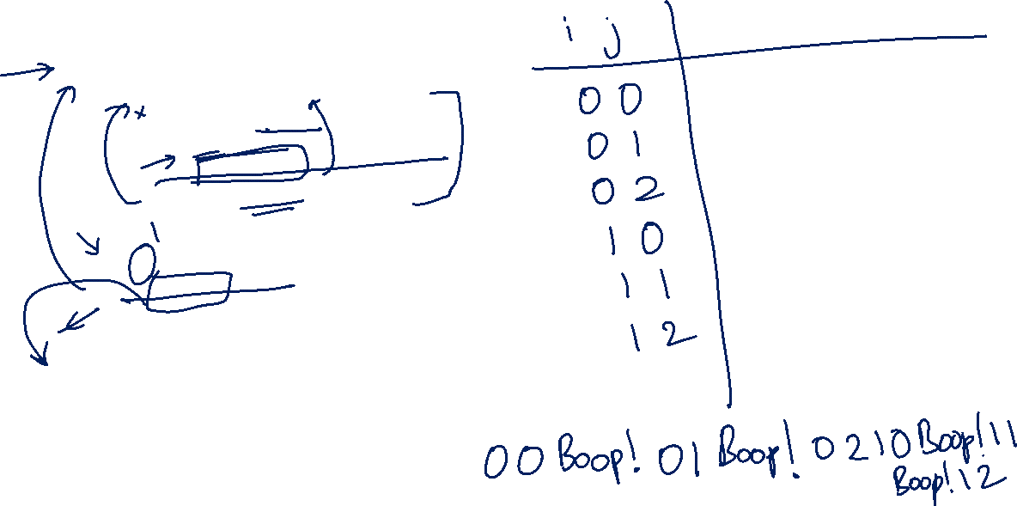
Week-1: 02. Programming Quiz 2/2
Notes:
02. Programming Quiz 1/2

Slide 21
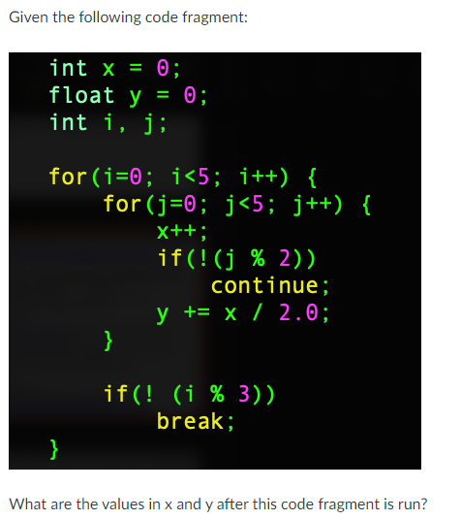
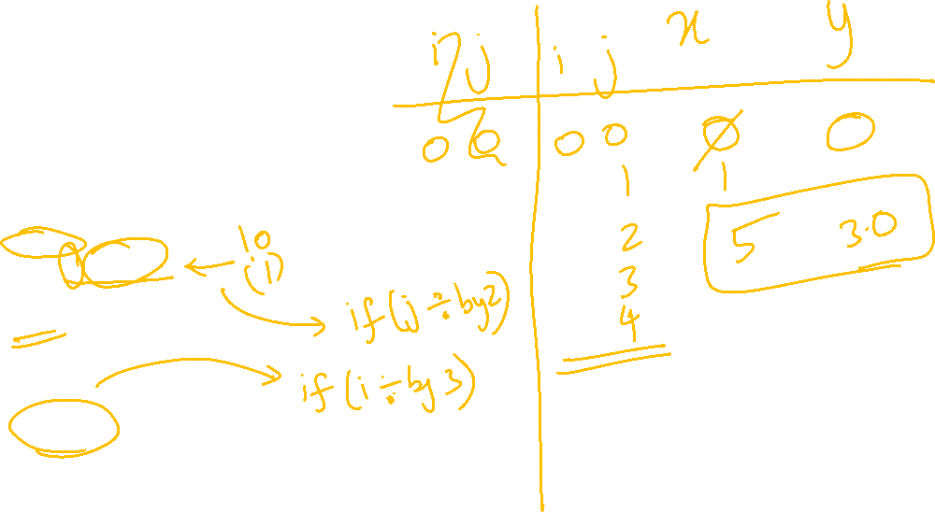
Week-1: 02. Programming Quiz 2/2
Notes:
02. Programming Quiz 2/2
If(!(j%2)) - checks if j is divisible by 2?
If(!(i%3)) – if i is divisible by 3 then do something

Slide 22
Extra Exercises

Slide 23

Extra Exercises Exercise 1 – Simple Calculator
Write a program that:
Asks for an operator (+, -, *, / or q).
If the operator is +, -, * or /, ask for two floating point numbers.
Prints “Unrecognized operation” if the operator entered is not +, -, *, / or q.
If the person enters ”q” the program says “Bye!” and exits. If the user enters +, -, *, /, the program performs the operation on the two numbers entered and prints the result in two decimal places.
If the user did not enter “q”, go to 1.
The next slide shows some sample runs.

Slide 24
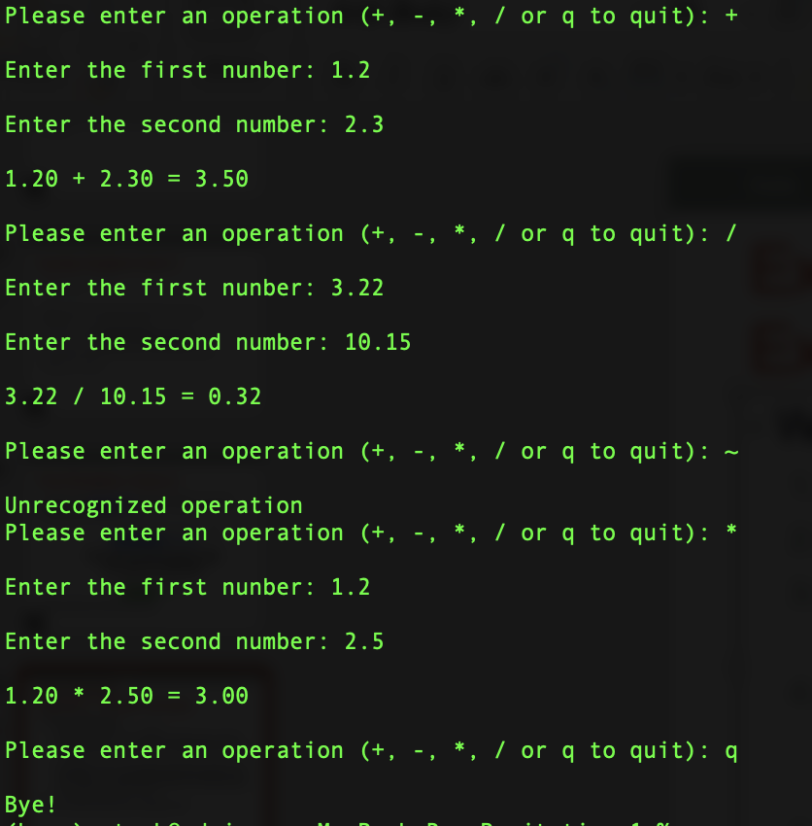
Extra Exercises Exercise 1 – Simple Calculator
Notes:
The space before %c skips any whitespace characters.

Slide 25
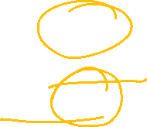
Extra Exercises Exercise 2 – Number Systems
Using what you know about number systems and C, show why this while loop may never end: float x = 0.0; while(x != 1.0) x += 0.1;

Slide 26
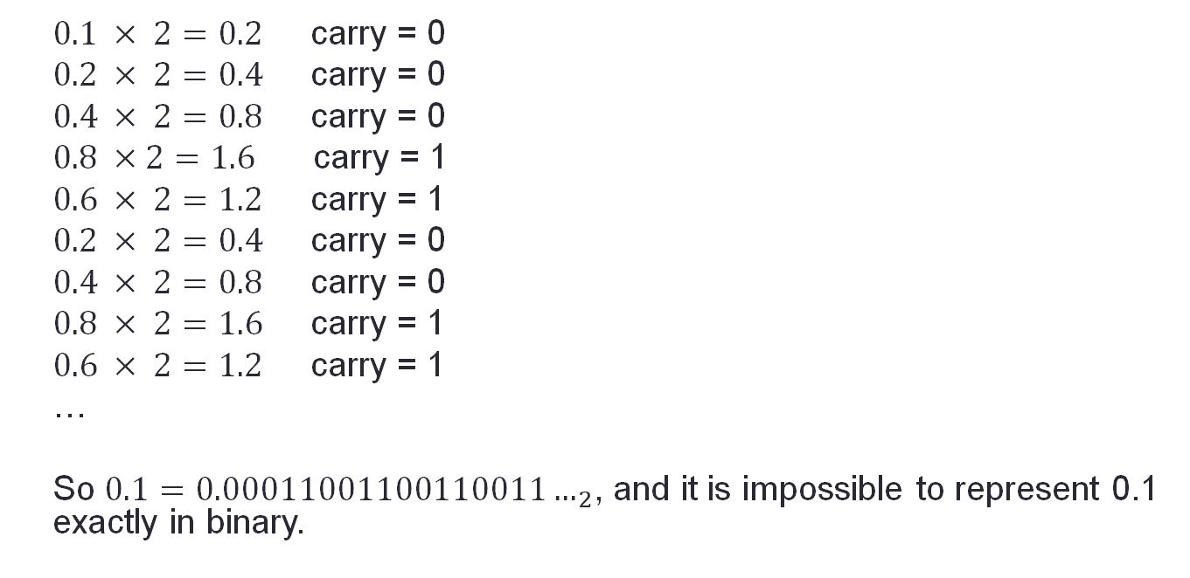

Extra Exercises Exercise 2 – Number Systems
Let’s convert 0.1 to binary:
$0.1 × 2=0.2$ carry = 0
$0.2 × 2=0.4$ carry = 0
$0.4 × 2=0.8$ carry = 0
$0.8 ×2=1.6$ carry = 1
$0.6 × 2=1.2$ carry = 1
$0.2 × 2=0.4$ carry = 0
$0.4 × 2=0.8$ carry = 0
$0.8 × 2=1.6$ carry = 1
$0.6 × 2=1.2$ carry = 1
…
So $0.1=0.00011001100110011…_{2}$, and it is impossible to represent 0.1 exactly in binary.

Slide 27
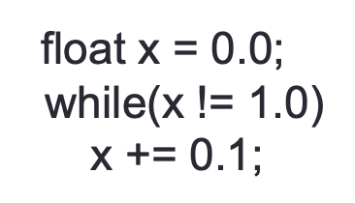
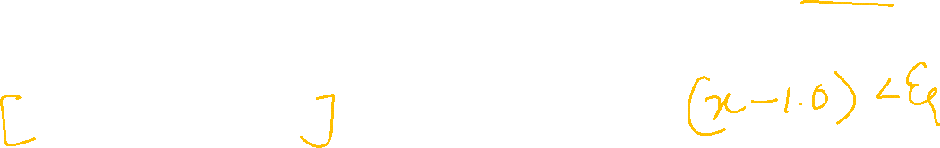
Extra Exercises Exercise 2 – Number Systems
If we used 32 bits to represent 0.1, the closest we would get is 0.0999999998603016.
After adding 10 of these, would get 0.99999999860316.
After adding again, we would get 1.09999999846332. i.e., x will never become 1 and the loop will never terminate.
Note: IEEE-754 format uses only 23 bits for the mantissa and would be even less accurate.

Slide 28
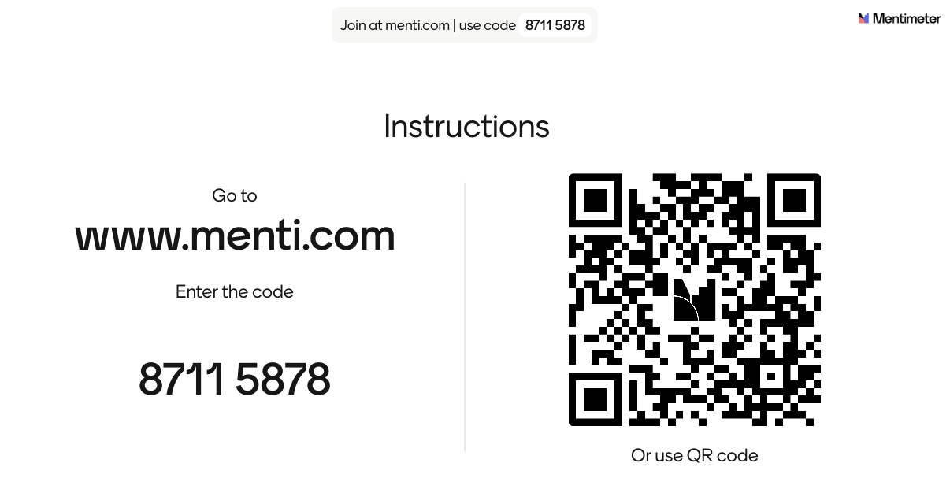
Fun Interactive Quiz

Slide 29
Q1
If a number is divisible by 3 in base-10, is it guaranteed to be divisible by 3 in any other base?
Options:
A) Yes, because divisibility rules are universal. B) No, because divisibility depends on the base-specific representation. C) Yes, but only for bases that are multiples of 3. D) No, because changes in the base automatically alter the numerical values, making all previously applicable rules invalid.

Slide 30
Q2
In various number systems (decimal, signed-magnitude binary and hexadecimal), how is the value '0' typically classified and represented?
Options:
A) As a positive number in decimal, signed-magnitude binary, and hexadecimal.
B) As a negative number in decimal, signed-magnitude binary, and hexadecimal.
C) Neither positive nor negative in decimal, signed-magnitude binary, and hexadecimal.
D) Positive in decimal and hexadecimal, but negative in signed-magnitude binary.

Slide 31
Q3
In 1’s complement representation using 4 bits, how many distinct values can be represented, and what is unique about zero representation?
Options:
A) 16 values, with only one representation for zero
B) 15 values, with one representation for zero and one unused pattern
C) 16 values, with two different representations for zero
D) 15 values, with two different representations for zero and one unused value
Notes:
💡 Explanation:
In 1’s complement, negative numbers are represented by bitwise inversion of their positive counterparts.
This causes:
0000 = +0
1111 = −0
Both represent zero, but they are stored differently → two representations of zero
Total 4-bit combinations = 2⁴ = 16 → all used

Slide 32
Q4
Why is the C programming language often used to teach MIPS architecture in computer organization courses?
A) Because C operates at a high level of abstraction, similar to Java or Python, making it easier for students to understand complex concepts without focusing on hardware details.
B) Because C provides low-level access to memory through pointers and direct manipulation of bits and bytes, closely resembling how machine instructions manipulate hardware.
C) Because C is the only language that can be compiled to MIPS machine code, making it essential for any MIPS-based system.
D) Because C supports object-oriented programming, which is necessary for understanding MIPS architecture.

Slide 33
Q5
Why can the size of basic data types like int and char in C programming vary across different computer systems?
Options:
A) Because the C standard allows flexibility in size to optimize programs for different computer architectures.
B) Because different computer systems use different compilers.
C) Because C is a high-level programming language and does not interact with the hardware directly.
D) Because all computer systems process data types differently, and C must adapt to each system individually.

Slide 34
Announcement
Next week Tutorial begins – 5% for attendance
Week 3 Lab-0 handout is ready
For CNY Holidays – we will do one mass online tutorial for affected sessions:
16th Feb, Mon afternoon session – no classes
17th Tue & 18th Feb Wed – no classes
Rest of the sessions in that week – business as usual

Slide 35
Thank You

Slide 36
End of File

