Slide 1
WARNING
15 min
These slides are not optimized for printing or exam preparation. These are for lecture delivery only.
These slides are made for PowerPoint 2010. They may not show up well on other PowerPoint versions. You can download PowerPoint 2010 viewer from here.
These slides contain a lot of animations. For optimal results, watch in slideshow mode.

Slide 2
Create an OO domain model for the following problem description.
A person can have many tasks to do. These tasks can be of different nature. Some examples: tasks ‘to be done some day’, tasks to be done in a specific time period (e.g. a meeting), some needs to be done before a specific deadline, and so on.
Sometimes, tasks are tentatively scheduled on a number of alternative time slots until one time slot is confirmed.
Some tasks recur periodically. E.g. weekly meetings
Some tasks are completed successfully while some may not be completed as planned.

Slide 3
1
<<Enumeration>>
Frequency
FloatingTask
DAILY, WEEKLY, MONTHLY, YEARLY
0..1
ListPro
Recurrence
0..1
*
deadline
Person
Task
DeadlineTask
1
DateTime
Description
start
1
end 1
1
ScheduleTask
<<Enumeration>> status
scheduled on
0..1
Duration
TENTATIVE, PENDING, OVERDUE, DONE
alternatives *
1
An analysis pattern!
What?
Why?
OODM
Everything?
Correct?

Slide 4
Which of these patterns is least likely to be in this design?
ListAccesoriesUI
UIController
ListAllUI
1
SIS
*
SISObserver
StockItemList
*
StockItemType
*
StockItem
Based on a worked example in the handout
Appliance
< is for
*
Accessory
(a) Abstraction Occurrence (b) Singleton (c) Command (d) MVC (e) Observer
missing {a|b|c|d|e} e.g. missing a
77577 OR tinyurl.com/answerpost

Slide 5
ListAccesoriesUI
UIController
ListAllUI
1
SIS
*
SISObserver
StockItemList
*
StockItemType
*
StockItem
Appliance
< is for
*
Accessory
(a) Abstraction Occurrence (b) Singleton (c) Command (d) MVC (e) Observer

Slide 6
ListAccesoriesUI
UIController
ListAllUI
1
SIS
*
SISObserver
StockItemList
*
StockItemType
*
StockItem
Appliance
< is for
*
Accessory
(a) Abstraction Occurrence (b) Singleton (c) Command (d) MVC (e) Observer

Slide 7
ListAccesoriesUI
UIController
ListAllUI
1
SIS
*
SISObserver
StockItemList
*
StockItemType
*
StockItem
Appliance
< is for
*
Accessory
(a) Abstraction Occurrence (b) Singleton (c) Command (d) MVC (e) Observer

Slide 8
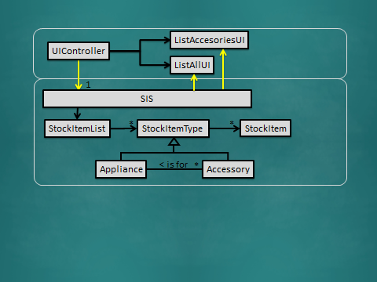
GUI
ListAccesoriesUI
UIController
Logic
ListAllUI
Logic UI
1
SIS
*
SISObserver
StockItemList
*
StockItemType
*
StockItem
GUI
Appliance
< is for
*
Accessory
Logic
(a) Abstraction Occurrence (b) Singleton (c) Command (d) MVC (e) Observer

Slide 9
ListAccesoriesUI
UIController
ListAllUI
1
SIS
StockItemList
*
StockItemType
*
StockItem
Appliance
< is for
*
Accessory

Slide 10
ListAccesoriesUI
UIController
ListAllUI
1
SIS
*
SISObserver
StockItemList
*
StockItemType
*
StockItem
Appliance
< is for
*
Accessory
(a) Abstraction Occurrence (b) Singleton (c) Command (d) MVC (e) Observer

Slide 11
ListAccesoriesUI
UIController
ListAllUI
1
SIS
*
SISObserver
StockItemList
*
StockItemType
*
StockItem
Appliance
< is for
*
Accessory
(a) Abstraction Occurrence (b) Singleton (c) Command (d) MVC (e) Observer

Slide 12
ListAccesoriesUI
UIController
ListAllUI
1
SIS
*
SISObserver
StockItemList
*
StockItemType
*
StockItem
Appliance
< is for
*
Accessory
(a) Abstraction Occurrence (b) Singleton (c) Command (d) MVC (e) Observer

Slide 13
ListAccesoriesUI
UIController
ListAllUI
SIS
*
SISObserver
StockItemList
*
StockItemType
*
StockItem
Appliance
< is for
*
Accessory
What principles could be in place here?
Notes:
Answer: Single responsibility, separation of concerns, law of Demeter, open-closed, liskov substitution

