Slide 1
WARNING
These slides are not optimized for printing or exam preparation. These are for lecture delivery only.
These slides are made for PowerPoint 2010. They may not show up well on other PowerPoint versions. You can download PowerPoint 2010 viewer from here.
These slides contain a lot of animations. For optimal results, watch in slideshow mode.

Slide 2
Comment on logging, assertions, exceptions, defensiveness, coupling, and cohesion of this code (possible exam question).
/* Sets user as ‘active’ on the server.
* @throws CannotActivateException if the user does not exist
* on the server
*/
void activateUserOnServer(String userName)
throws CannotActivateException{
  log("trying to activate");
  assert isUsernameAcceptable(userName);
  ServerConnection.activate(userName);
  if(!ServerConnection.isActivated(userName)) {
  throw new CannotActivateException(userName + " not activated");
  }
  Account account = AccountManager.getAccount(userName);
  account.toggleActivatedStatus(); //mark as activated
}
1
2
3
4
5
6
7
8
What will happen in run time if name is invalid and assertions are enabled?
Is it right to use assertions here? Does the behavior match the header comment?
---
Is this a correct use of exceptions? Does it match the header comment?
How does this affect coupling and cohesion?
Is this defensive enough?
Is this a good log message?
Notes:
---
[afterclick] What will happen in run time if name is invalid and assertions are enabled?
Is it right to use assertions here? Does the behavior match the header comment?
[afterclick] Is this a correct use of exceptions? Does it match the header comment?
[afterclick] How does this affect coupling and cohesion?
[afterclick] Is this defensive enough?
[afterclick] Is this a good log message?

Slide 3
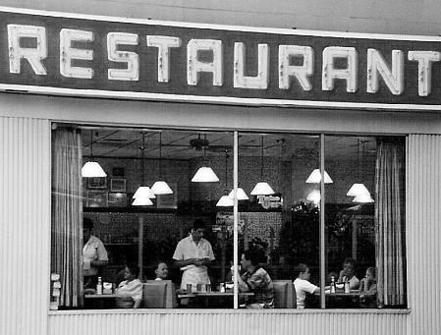
Procedural
Boil water
Put tea leaves in strainer
Add hot water
Steep for a while
Remove strainer
Add milk and sugar
OOP
1 chef
2 waiters
1 cashier
1 part time accountant
1 manager
1 cash register
1 stove
Serve tea
Clean table
Toast bread
Cut bread
Accept payment
Give change
Issue receipt
Wash utensils
Pay bills
Order supplies
…… … …

Slide 4
OOP
Architecture
1 chef
2 waiters
1 cashier
1 part time accountant
1 manager
1 cash register
1 stove
Divisions/Departments
Kitchen
Accounting
Customer Services
Purchasing

Slide 5
OOP
Architecture

Slide 6

OOP
Architecture

Slide 7

Architecture
A
B
D
Achievement Unlocked!
Multi-level design
C
:A
:B
:D
OOP Component design
Component A design
Component C design
A
C
*
B
*
D
C
Component B design
Component D design
Notes:
Mental hurdle: design top down, design at multiple levels

Slide 8
