Slide 1
WARNING
20 min
These slides are not optimized for printing or exam preparation. These are for lecture delivery only.
These slides are made for PowerPoint 2010. They may not show up well on other PowerPoint versions. You can download PowerPoint 2010 viewer from here.
These slides contain a lot of animations. For optimal results, watch in slideshow mode.

Slide 2
What is an Equivalence Partition?
How does it help to improve E&E of testing?
What are the EPs for name in the method below?
/**
* Adds the name to the course list.
* @param name must be between 5 to 50 chars (both inclusive)
* and not already in the course list
*/
void addName(String name) { … }
5..50
Case sensitivity?
Leading/trailing spaces?
< 5
in the list
not in the list
> 50
null
Empty string

Slide 3
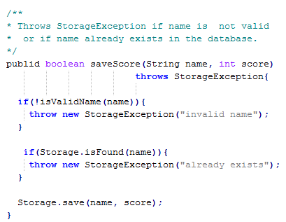
Estimate the statement coverage of this method for these three test cases.
Test input | Expected
“new guy”, 0 | success
null , -3 | Name invalid -> exception
“”, 5 | Name invalid -> exception
1
2
3
a) about 50%
b) about 80%
c) 100%
4
5
cover {a|b|c} e.g. cover c
77577 OR tinyurl.com/answerpost

