Slide 1
Rate Adaptations

Slide 2
You are Here
Encoder
Decoder
Middlebox
Sender
Receiver
Network

Slide 3
Sender’s Algorithm
open UDP socket
foreach video frame
chop into packets
add RTP header
send to network

Slide 4
Sender’s Algorithm
open UDP socket
foreach video frame
chop into packets
add RTP header
send to network
wait for 1/fps seconds

Slide 5
Sender’s Algorithm
open UDP socket
foreach video frame
chop into packets
add RTP header
send to network
wait for 1/fps seconds
Send frames at equal time distance.

Slide 6
Sender’s Algorithm
open UDP socket
foreach video frame
chop into packets
foreach packet
add RTP header
send to network
wait for size/bps seconds
Send data at constant bandwidth.

Slide 7
Rules
Transmission rate should match encoding rate
Transmission should not be too bursty

Slide 8
Two Approaches
Just send at a fix rate
  or “I hope the network can handle it” approach

Slide 9
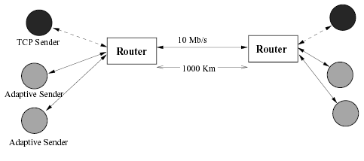
Effects on TCP: Simulation
From Sisalem, Emanuel and Schulzrinne paper on
“Direct Adjustment Algorithm.”

Slide 10
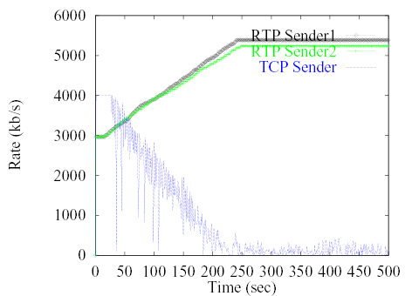
Effects on TCP

Slide 11
DAA Parameters
Adaptive RTP flows
  Additive increase/multiplicative decrease
    50 kb and factor 0.875
  RTCP: min 5 sec inter-report time
  Loss thresholds: 5% and 10%
TCP
  Immediate loss notification
  Transmission window is halved

Slide 12
Demo
Effects of UDP on TCP without congestion control

Slide 13
Two Approaches
Just send at a fixed rate
  or “I hope the network can handle it” approach
Adapt transmission/encoding rate to network condition

Slide 14
How to Adapt?
if network condition is bad
reduce rate
else if network condition is so-so
do nothing
else if network condition is good
increase rate

Slide 15
How to ..
Know “network condition is bad”?
Increase/decrease rate?

Slide 16
Adapting Output Rate
if network condition is bad
else if network condition is so-so
do nothing
else if network condition is good

Slide 17
Adapting Output Rate
Multiplicative
decrease
if network condition is bad
else if network condition is so-so
do nothing
else if network condition is good
Additive
increase

Slide 18
Question:
What should μ and ν be?

Slide 19
Observation 1
Should never change your rate more than an equivalent TCP stream.

Slide 20
Observation 2
μ and ν should depend on network conditions and current rate.
Notes:
current rate high,

Slide 21
Goal: Fair Share of Bottleneck
let r : current rate
b : bottleneck bandwidth S : current share
Notes:
current rate high,

Slide 22
S vs ν
ν
S
1

Slide 23
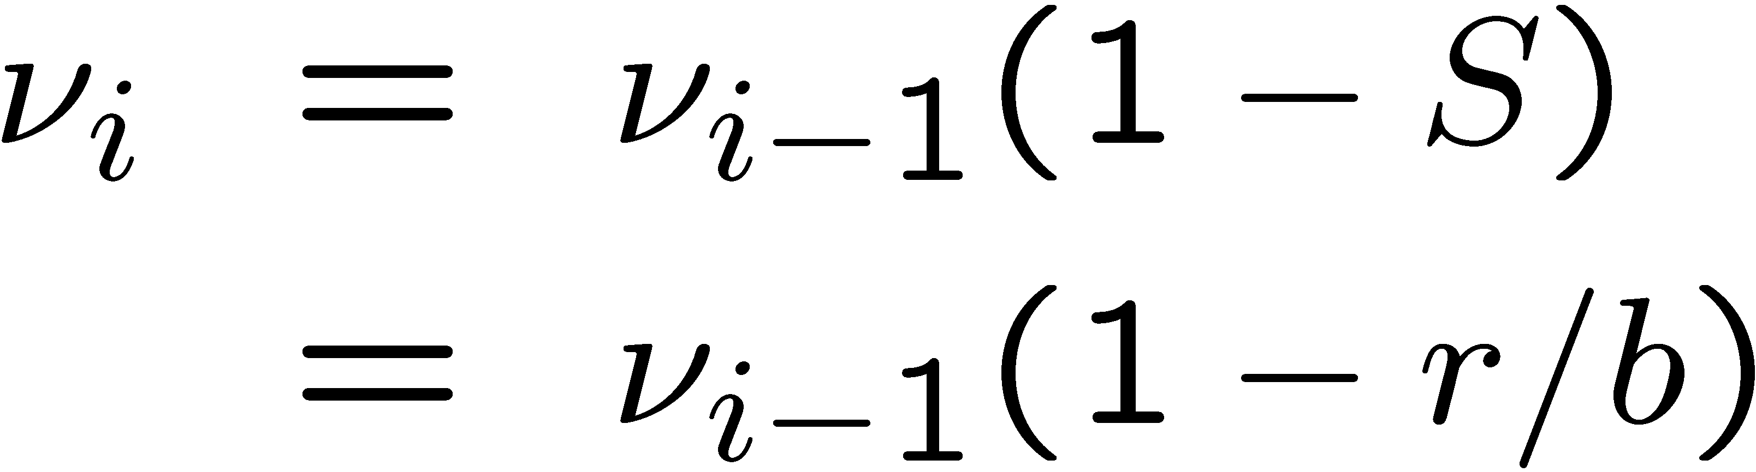
Value of ν
(Assuming one receiver)

Slide 24
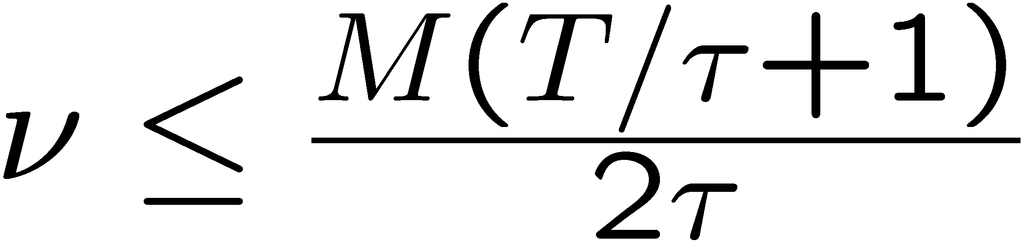
Limit of ν
M : packet size
τ : round trip time
T : period between evaluation of ν

Slide 25
Limit of ν
M : packet size
τ : round trip time
T : period between evaluation of ν

Slide 26
Loss rate vs μ
μ
1
1
loss rate

Slide 27
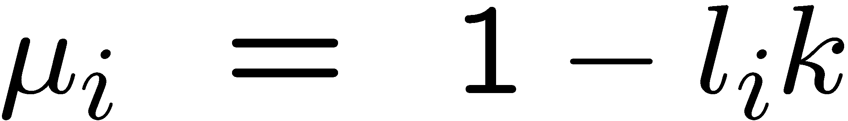

Value of μ
where
is the loss rate
k is a constant
(Assuming one receiver)

Slide 28
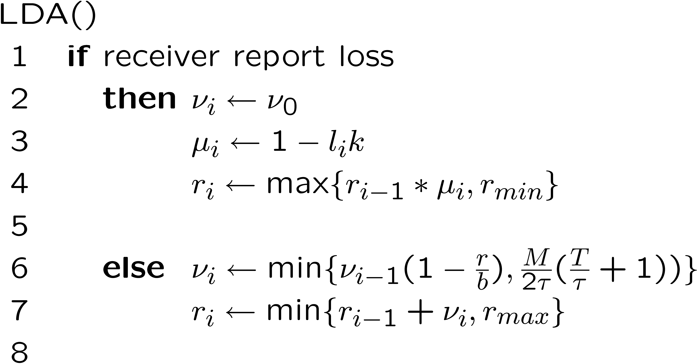

Slide 29
What is Needed?

Slide 30
Estimating b : Packet Pair

Slide 31
Estimating b : Packet Pair

Slide 32
Estimating b : Packet Pair

Slide 33
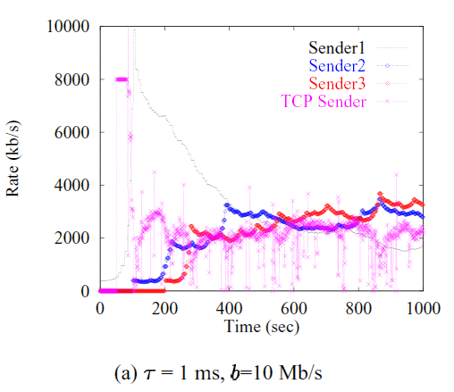
Evaluation

Slide 34
More TCP-Friendly Rate Control

Slide 35
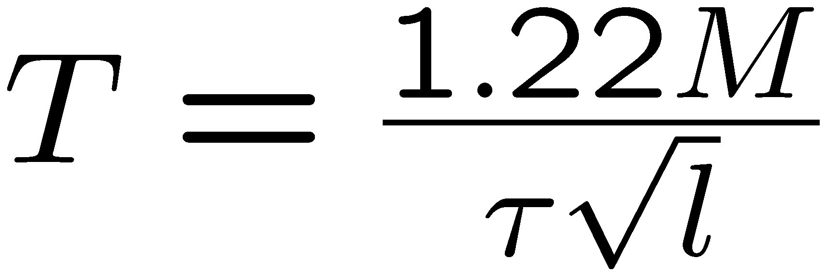
TCP-Equation
Window size behavior in TCP/IP with constant loss probability
T. Ott, J. Kemperman, and M. Mathis
June 1997, HPCS 1997

Slide 36
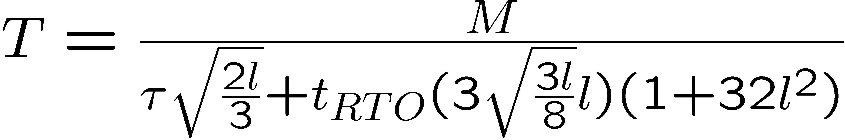
TCP-Equation
Equation-Based Congestion Control for Unicast Applications
Sally Floyd, Mark Handley, Jitendra Padhye, and Joerg Widmer.
August 2000. SIGCOMM 2000

Slide 37
Another Transport Protocol
Datagram Congestion Control Protocol (DCCP)
Implements congestion control but not reliability

Slide 38
Rules
Transmission rate should match encoding rate
Transmission should not be too bursty

Slide 39
Rate Control
Given a rate, how to encode the video with the given rate?

Slide 40
Reduce Frame Rate
Live Video
Stored Video

Slide 41
Reduce Frame Resolution
Live Video
Stored Video

Slide 42
Increase Quantization
Live Video
Stored Video

Slide 43
Drop AC components
Live Video
Stored Video

Slide 44
Trouble with Stored Video
Reducing rate requires partial decoding and re-encoding
Solution: Layered Video

Slide 45
Layered Video
or “Scalable Video”

Slide 46



Layered Video
Layer 1
Layer 2
Layer 3
Notes:
One of the better proposed solution is called RLM or receiver driven layered multicast. The idea is to divide a stream into multiple layers. The base layer encodes the video stream at a low bitrate, and each additional layer on top enhances its quality. The layers are sent onto different multicast channels, and receivers can choose the number of layers to receive based on their available bandwidth.

Slide 47
Layering Scheme
Temporal (Frame Rate) Layering

Slide 48
Layering Scheme
Spatial (Resolution) Layering

Slide 49
Layering Scheme
DCT Layering; SNR (Quality) Layering
30
30
8
2
30
8
2
0
-6
-1
-6
-1
0
0
1
1
0
0
0
0
0
0
0

Slide 50
Layering Scheme
Fine Granularity Scalability (FGS): e.g., MPEG-4
1 1 0 0 0 0 0 0
1 1 1 0 0 0 1 0
1 0 0 1 0 1 0 1
1 0 0 0 0 1 0 0

Slide 51
Layered Video
SVC: Scalable Video Coding
  Base-layer plus enhancement layers
  Each received layer improves the quality
  Layer n+1 depends on layer n
MDC: Multiple Description Coding
  Layers are independent
  Each received layer improves the quality

Slide 52
Layered Video
BUT: Layered video codecs are less bandwidth-efficient than single-layer codecs.

Slide 53
Rate Adaptation
To increase rate, send more layers
To decrease rate, drop some layers

Slide 54
MS Windows Streaming Media

Slide 55
Intelligent Streaming
Multiple-Bit-Rate Encoding
Intelligent Bandwidth Control
  bit rate selection
  thinning
Intelligent Image Processing

Slide 56
Intelligent Streaming
How exactly does it work?
Sorry, it’s proprietary

Slide 57
Is WSM TCP friendly?
Measurements of the Congestion Responsiveness of Windows Streaming Media
J. Nichols et. al., NOSSDAV 2004
All figures taken from the original NOSSDAV presentation

Slide 58
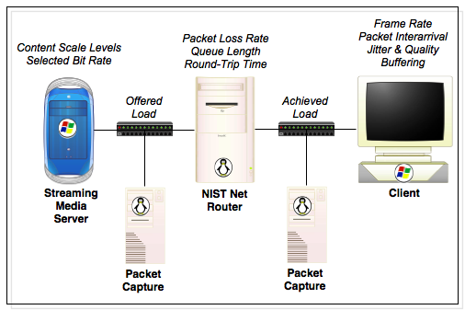

Slide 59
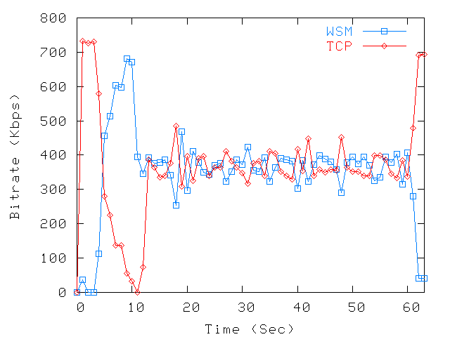
340kbps clip, 725kbps bottleneck

Slide 60
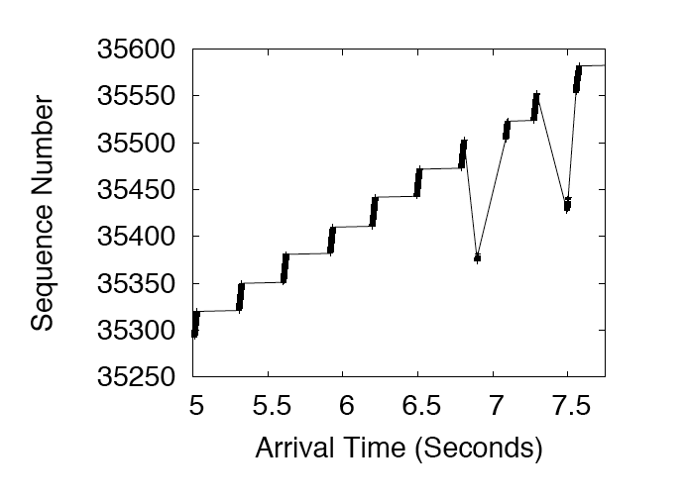
Transmission is Bursty

Slide 61
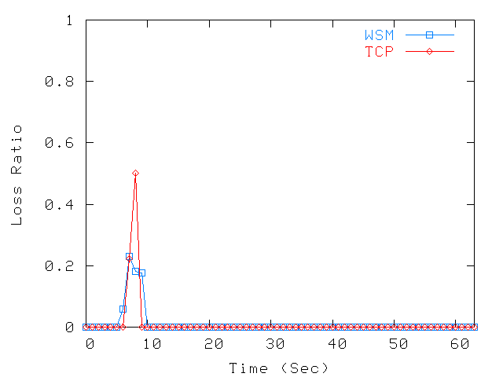
340kbps clip, 725kbps bottleneck

Slide 62
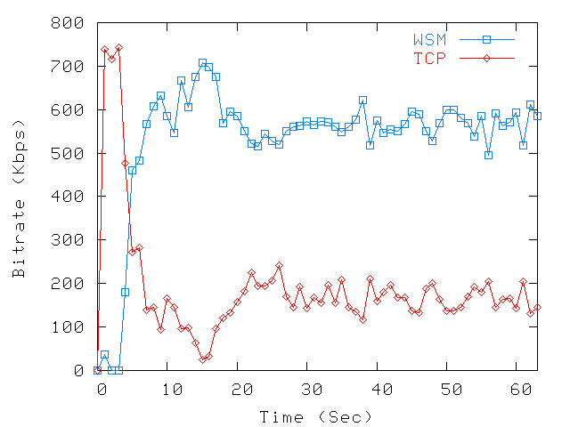
548kbps Clip - 725kbps Bottleneck

Slide 63
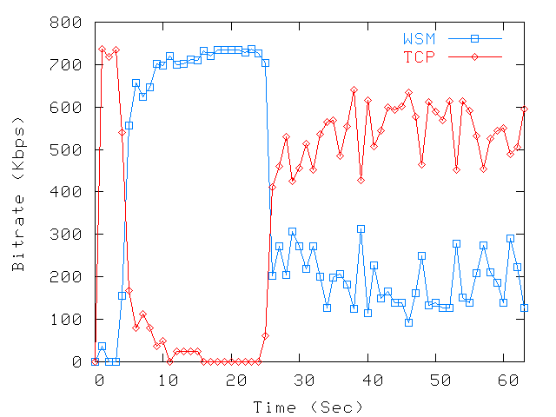
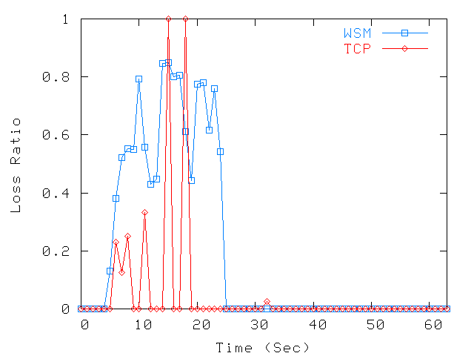
1128kbps Clip - 725kbps Bottleneck

Slide 64
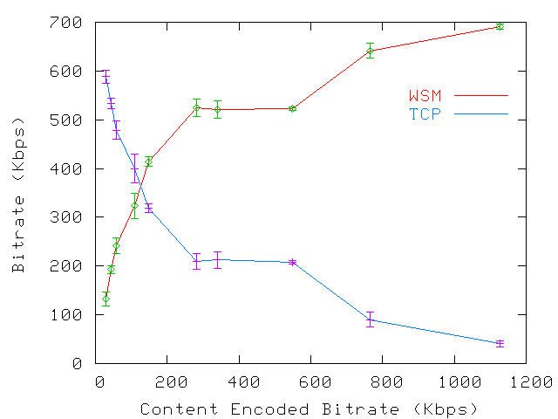
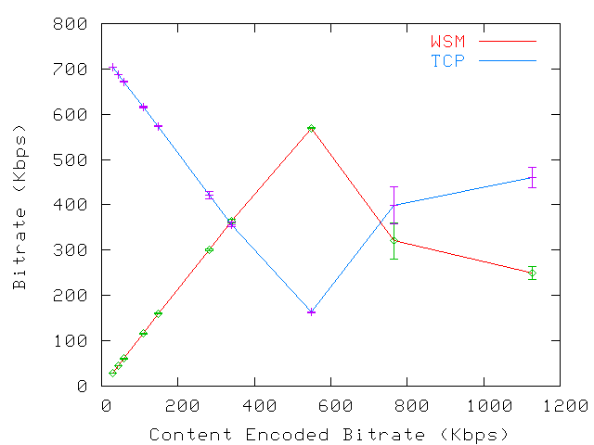
725kbps Bottleneck
Buffering
Playout
Single Encoded Bit Rate

Slide 65
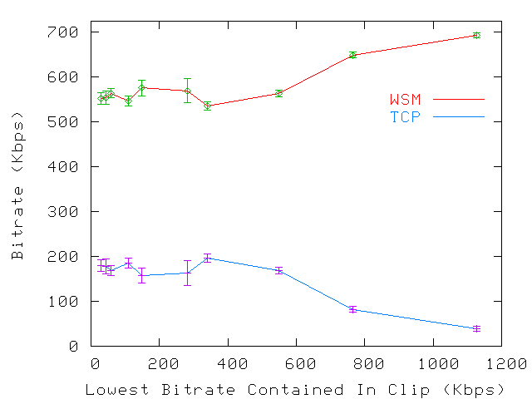
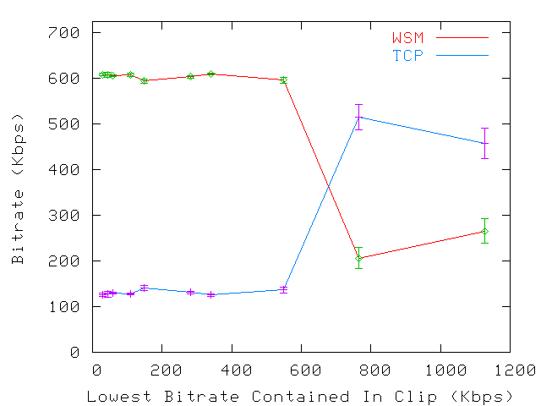
725kbps Bottleneck
Multiple Encoded Bit Rate
Buffering
Playout

Slide 66
Conclusion
Two phases: buffering + playout
Not always TCP-friendly

