Slide 1
Project
Create a DASH-compliant (Dynamic Adaptive Streaming over HTTP) streaming system

Slide 2

Goals (1)
Capture a video on an ASUS Transformer tablet computer and store it as an MP4 file.
Split the MP4 file into streamlets, i.e., 3 second long video files.
Upload the streamlets to a web server.
Transcode the streamlets into 3 different streamlets (e.g., low, medium, high quality).
Create a playlist on the web server.

Slide 3
Goals (2)
ASUS Transformer runs the Android 4.0 Ice Cream Sandwich OS.
Programming on Android is done in Java with the Eclipse IDE.
On the web server, create scripts in the PHP language.
Implement a simple Android DASH media player.

Slide 4
Project Homepage
Descriptions and web links
Some utilities and some library source codes
Documentation (RFCs, etc.)
IVLE Forums
TA: Wang Guanfeng

Slide 5
Advice and Actions (1)
Form a team (3 persons).
Note: You will need to read and learn a lot. Your program code will be quite small.
  HTTP POST command structure
  MP4Parser usage to create streamlets
  FFmpeg transcoder usage
  Playlist .m3u8 format in XML
Start early (i.e., this week)!

Slide 6
Actions (2): Get your Tablet
Check out your loan ASUS Transformer for the project from SoC Technical Services (on the first floor of COM1).
There is one tablet per team (3 students).
Please make an appointment with Mr. Chow Chin Ming to get your tablet.
Email: chowcm@comp.nus.edu.sg.
Tell Mr. Chow the 3 team member names.

Slide 7
Introduction to DASH
Dynamic Adaptive Streaming over HTTP

Slide 8
DASH (1)
RTP/RTSP/RTCP streaming faces several challenges
  Special-purpose server for media (complex)
  Protocols use TCP and UDP transmissions (firewalls)
  Difficult to cache data (no “web caching”)
Advantage
  Short end-to-end latency

Slide 9
DASH (2)
Main idea of DASH
  Use HTTP protocol to “stream” media
  Divide media into small chunks, i.e., streamlets
Advantages
  Server is simple, i.e., regular web server
  No firewall problems (use port 80 for HTTP)
  Standard (image) web caching works

Slide 10

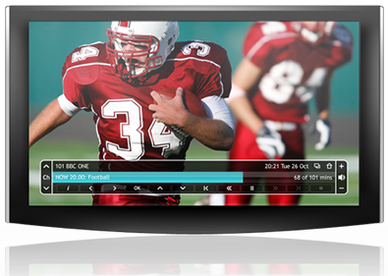
DASH (3)
Original DASH implementation by Move Networks
  Introduced concept of streamlets
  Additional idea: make playback adaptive
    Encode media into
    multiple different
    streamlet files, e.g.,
    a low, medium, and
    high quality version
    (different bandwidth)

Slide 11
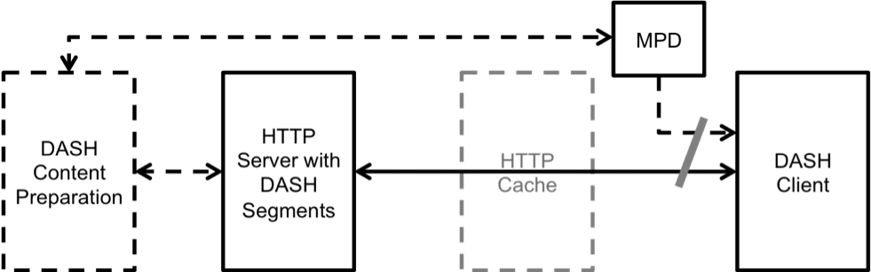
DASH (4)
MPD: Media Presentation Description
ISO/IEC Standard:
  “Information technology — MPEG systems technologies — Part 6: Dynamic adaptive streaming over HTTP (DASH)”
  JTC 1/SC 29; FCD 23001-6

Slide 12
DASH (5)
Web server provides a playlist
  The playlist is a file in a specific format that lists all the available qualities and all the streamlets for each quality
  Playlist file extension is .m3u8
  Content preparation:
    Original media file needs to be split into streamlets
    Streamlets need to be transcoded into different qualities

Slide 13
DASH (6)
HTTP protocol is stateless!
  Server remembers “nothing” about session
Scheduling logic, etc., is in media player!

Slide 14
DASH (7)
DASH media player
  Loads .m3u8 file and then starts to download streamlets
  All the scheduling logic is in the player
    Render current streamlet while downloading the next streamlet before playback is done
    Measure bandwidth and switch between different qualities (i.e., adapt)
    Switch servers ⇒ can be done easily

Slide 15
DASH (8)
Many media players now understand DASH streaming format
Many companies use HTTP streaming:
  Move Networks, Apple, Microsoft, Netflix, …
CDNs like this approach
  No need to run QuickTime, Windows Media, RealNetworks, and Flash streaming servers
    Just use web server for everything!

Slide 16
Continuous Media Servers
Introduction
Continuous Media
Magnetic Disk Drives
Display of CM (single disk, multi-disks )
Optimization Techniques
Additional Issues
Case Study (Yima)

Slide 17
What is a CM Server?
Network
Storage Manager
Memory
Multiple streams of audio and video should be delivered to many users simultaneously.

Slide 18
Some Applications
Video-on-demand
News-on-demand
News-editing
Movie-editing
Interactive TV
Digital libraries
Distance Learning
Medical databases
NASA databases

Slide 19
Challenge: Continuous Media
CM object consists of a sequence of media quanta (e.g., audio samples or video frames), which convey meaning only when presented in time.
S torage & Retrieval
  Continuous display
  Retrieval may require a specific bandwidth for a long period of time
  Data types are large (megabytes and gigabytes)
Communications
End-user (display and interface)
Content-based querying for pictures, audio and video streams

Slide 20
Multimedia Database Issues
Challenges:
  Store non-textual, non-numerical data: audio, video, multi-dimensional data, pictures
  Data types are large (megabytes and gigabytes)
  Retrieval may require a specific bandwidth for a long period of time
  Data may not be very well structured -- querying becomes more difficult
    Content-based querying for pictures, audio and video streams

Slide 21
Continuous Display
Data should be transferred from the storage device to the memory (or display) at a pre-specified rate.
Otherwise: frequent disruptions & delays, termed hiccups.
NTSC quality: 270 Mb/s uncompressed; 3-8 Mb/s compressed (MPEG-2).
Memory
Disk

Slide 22
Challenge: Real-Time Media
Bandwidth requirements for different media types:
100 Mb/s
50 Mb/s
31 Mb/s
20 Mb/s
4-6 Mb/s
1 Mb/s

Slide 23
High Bandwidth & Large Size
HDTV quality ~ 1.4 Gb/s
Uncompressed!
Standard: SMPTE 292M
2-hr HDTV ~ 1260 GB

Slide 24
Streaming Media Servers
Streaming media servers require a different “engine” than traditional databases because of:
  Real-time retrieval and storage
  Large media objects
The performance metrics for streaming media servers are:
  The number of simultaneous displays: throughput N
  The amount of time that elapses until a display starts: startup latency L
  The overall cost of the system: cost per stream, C

Slide 25
Media Types
Examples of continuous media are:
  Audio
  Video
  Haptics
Continuous media are often compressed. There are many different compression algorithms, for example:
  Motion Picture Experts Group: MPEG-1, MPEG-2, MPEG-4
  Joint Photographic Expert Group: Motion-JPEG
  Digital Video: DV, MiniDV
  Microsoft Video 9, DivX, …
  MP3: MPEG-1 layer 3 audio
  Above codecs are based on
  discrete cosine transform (DCT)
  Others:
  Wavelet-based codecs
  Lossless compression

Slide 26
Compression
MPEG-1 180:1 reduction in both size and bandwidth requirement (SMPTE 259M, NTSC 270 Mb/s is reduced to 1.5 Mb/s).
MPEG-2 30:1 to 60:1 reduction.
(NTSC ~ 4, DVD ~ 8, HDTV ~ 20 Mb/s)
Problem: loose information
(cannot be tolerated by some applications: medical, NASA)

Slide 27
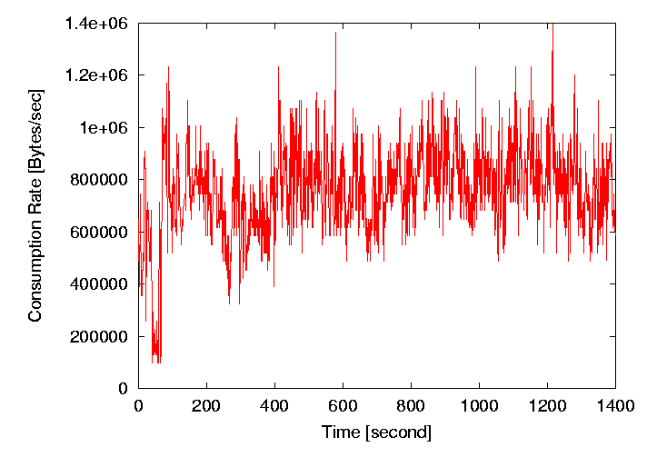
Media Characteristics
Data requires a specific bandwidth:
  Constant bitrate (CBR) CM
  Variable bitrate (VBR) CM
Easier case: CBR
  Data is partitioned into equi-sized blocks which represent a certain display time of the media
  E.g.: 176,400 bytes represent 1 second of playtime for CD audio (44,100 samples per second, stereo, 16-bits per sample)

Slide 28
Assumed Hardware Platform
Multiple magnetic disk drives:
  Not too expensive
  (as compared to RAM)
  Not too slow
  (as compared to tape)
  Not too small
  (as compared to CD-ROM)
  And it’s already everywhere!
Memory

Slide 29
Magnetic Disk Drives
An electro-mechanical random access storage device
Magnetic head(s) read and write data from/to the disk
Disk Drive Internals

Slide 30
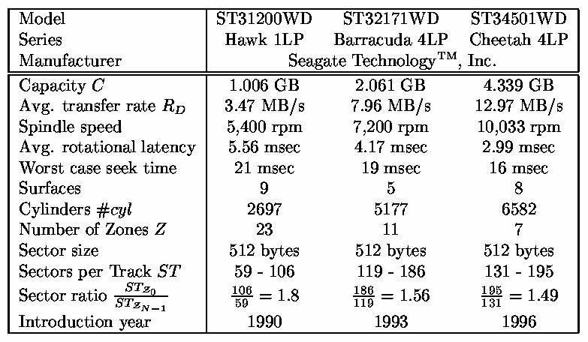
Disk Device Comparison

Slide 31
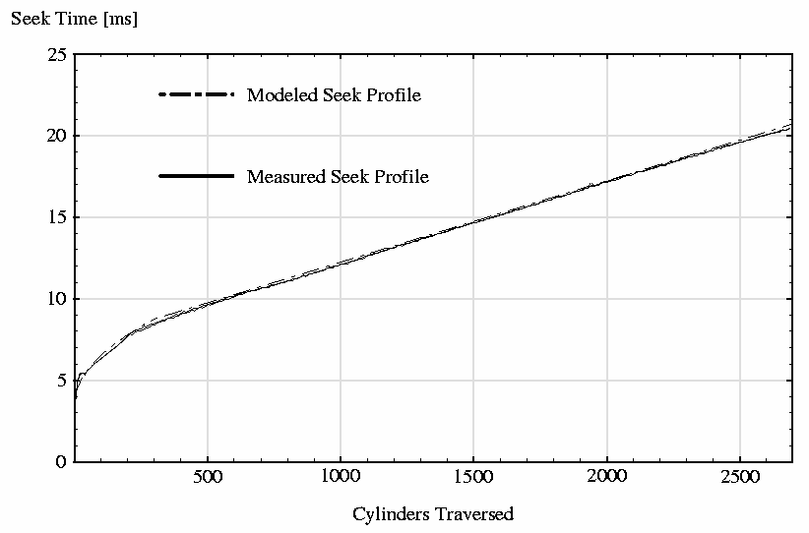
Disk Seek Characteristic

Slide 32
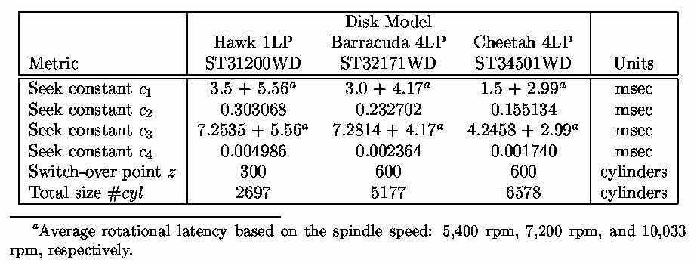
Disk Seek Time Model
If d < z cylinders
If d >= z cylinders

Slide 33
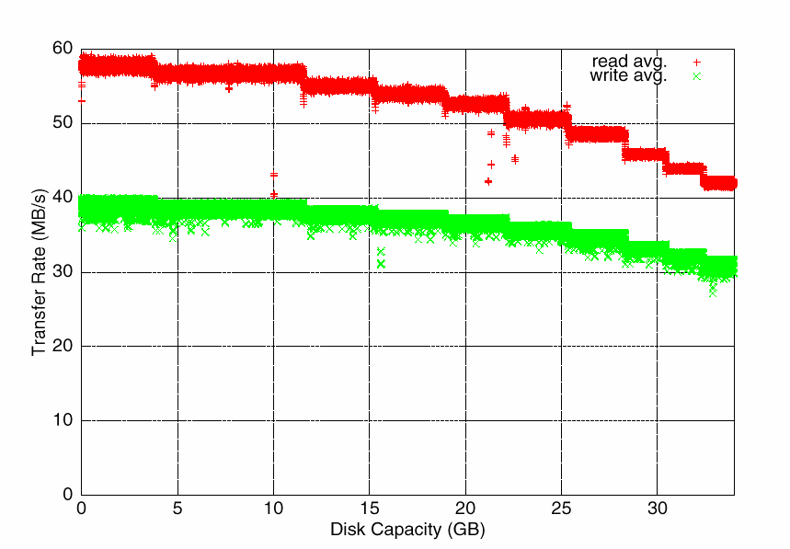
Disk Service Time
The disk service time is dependent on several factors:
Seek time
  Platter diameter (e.g., 3.5”, 2.5”, 1”)
Rotational latency
  Spindle speed
Data transfer time
  Zone-bit recording
  Read versus write bandwidth

Slide 34
Disk Service Time Model
  T_{Transfer}: data transfer time [s]
  T_{AvgRotLatency}: average rotational latency [s]
  T_{Service}: service time [s]
  B: block size [MB]
  BW_{Effective}: effective bandwidth [MB/s]

Slide 35
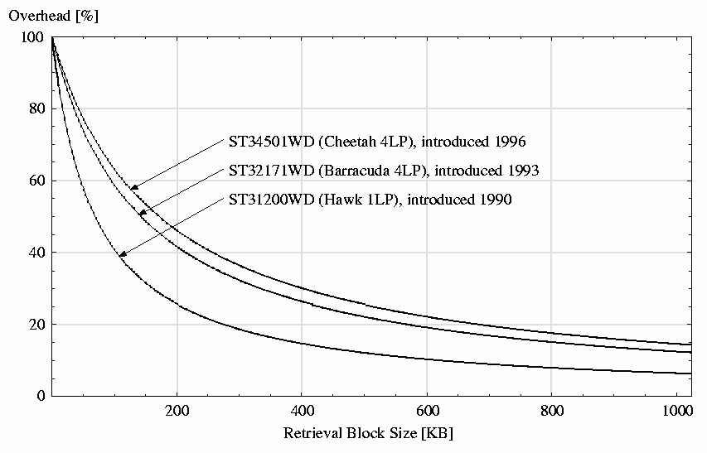
Data Retrieval Overhead

Slide 36
Sample Calculations
Assumptions:
  T_{Seek} = 10 ms
  BW_{Max} = 20 MB/s
  Spindle speed: 10,000 rpm

Slide 37
Summary
Average rotational latency depends on the spindle speed of the disk platters (rpm).
Seek time is a non-linear function of the number of cylinders traversed.
Average rotational latency + seek time = overhead (wasteful).
Average rotational latency and seek time reduce the maximum bandwidth of a disk drive to the effective bandwidth

Slide 38
Continuous Display (1 disk)
Retrieve
from disk
X2
X3
X1
Display
from
memory
Display X1
Display X2
Display X3
Time
Traditional production/consumption problem
RC = Consumption Rate, e.g., MPEG-1: 1.5 Mb/s.
RD = Production Rate, Seagate Cheetah X15: 40-55 MB/s.
For now: RC < RD
Partition video X into n blocks: X1, X2, ..., Xn
(to reduce the buffer requirement)

Slide 39
Round-robin Display
Retrieve
from Disk
X2
X3
X1
Y3
Y4
Y5
Seek Time
Display
from
Memory
Display X1
Display X2
Display X3
Display Y3
Display Y4
Display Y5
Time
Time period: time to display a block (is fixed).
System Throughput (N): number of streams.
Assuming random assignment of the blocks:
  Maximum seek time between block retrievals
  Waste of disk bandwidth ==> lower throughput
  Tp=?, N=?, Memory=?, max-latency=?

Slide 40
Cycle-based Display
Retrieve
from Disk
Z5
Z6
X2
X3
Z7
X1
Y3
Y4
Y5
Display
from
Memory
Display X1, Y3, Z5
Display X2, Y4, Z6
Time
Using disk scheduling techniques
  Less seek time ==> Less disk bandwidth waste ==> Higher throughput
  Larger buffer requirement
  Tp=?, N=?, Memory=?, max-latency=?

Slide 41
Group Sweeping Schema (GSS)
Group 1
Group 2
W1
X1
Y3
Z5
X2
W2
Z6
Y4
W3
X3
Z7
Y5
Subcycle 1
Subcycle 2
Display X1, W1
Display X2, W2
Can shuffle order of blocks retrievals within a group
Cannot shuffle the order of groups
GSS when g=1 is cycle-based
GSS when g=N is round-robin
Optimal value of g can be determined to minimize memory buffer requirements
  Tp=?, N=?, Memory=?, max-latency=?

Slide 42
System Issues
Movie is cut into equi-sized blocks: X0, X1, …, Xn-1.
Time required to display one block is called time period Tp.
Note: Tp is usually longer than the disk retrieval time of a block; this allows multiplexing of a disk among different displays.
Server
Retrieval
Time
X0
X1
X2
Network
X0
X1
X2
Buffer
X0
X1
Buffer empty
Display
X0
X1
X2
Time period
Hiccup

Slide 43
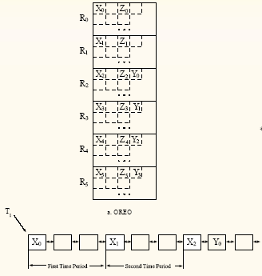
Constrained Data Placement
Partition the disk into R regions.
During each time period only blocks reside in the same region are retrieved.
Maximum seek time is reduced almost by a factor of R.
Introduce startup latency time
  Tp=?, N=?, Memory=?, max-latency=?

Slide 44
Hybrid
For the blocks retrieved within a region, use GSS schema.
This is the most general approach;
  Tp=?, N=?, Memory=?, max-latency=?
By varying R and g all the possible display techniques can be achieved.
Round-robin (R=1, g=N).
Cycle-based (R=1, g=1).
Constrained placement (R>0, g=1), ...
A configuration planner calculates the optimal values of R & g for certain application.

Slide 45
Display of Mix of Media
Retrieve
from Disk
Z5
Z6
X2
X3
Z7
X1
Y3
Y4
Y5
Display
from
Memory
Display X1, Y3, Z5
Display X2, Y4, Z6
Time
Mix of media types: different RC’s: audio, video;
e.g.: Rc(Y) < Rc(X) < Rc(Z)
Different block sizes: Rc(X)/B(X)=Rc(Y)/B(Y)= ...
Display time of a block (time period) is still fixed.

Slide 46
Multiple-disks
Single disk: even in the best case with 0 seek time, 240/1.5 = 160 MPEG-1 streams.
Typical applications (MOD): 1000’s of streams.
Solution: aggregate bandwidth and storage space of multiple disk drives.
How to place a video?
Memory

Slide 47
RAID Striping
All disks take part in the transmission of a block.
Can be conceptualized as a single disk.
Even distribution of display load.
Efficient admission.
Is not scalable in throughput.
X1
d1
d2
d3
X1.1
X1.2
X1.3
X2.1
X2.2
X2.3

Slide 48
Round-robin Retrieval
d1
d2
d3
Only a single disk takes part in the transmission of each block.
Retrieval schedule
  Round-robin retrieval of the blocks.
Even distribution of display load.
Efficient admission.
Not scalable in latency.
X1
X2
X3
Y1
Y2
Y3
W1
W2
Z1
W3
Z2
Z3
Retrieval Schedule
d1
d2
d3
Display
Time
X1,Y1,W1,Z1
X2,Y2,W2,Z2
X3,Y3,W3,Z3

Slide 49
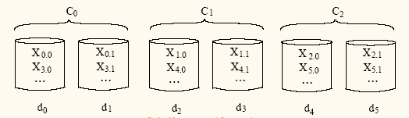
Hybrid Striping
Partition D disks into clusters of d disks.
Each block is declustered across the d disks that constitute a cluster (each cluster is a logical disk drive).
RAID striping within a cluster.
Round-robin retrieval across the clusters.
RAID striping (d=D), Round-robin retrieval (d=1).

Slide 50
Introduction to Yima PE
Personal Edition Streaming Media System

Slide 51
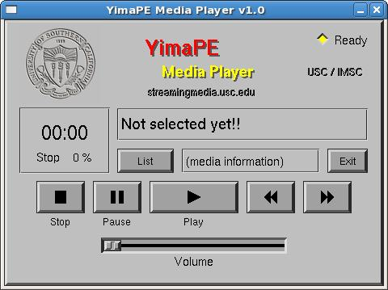
Overview
Command line server
GUI client
“Split” utility to prepare media files
RTSP communication (port 5xxxx)
# ./yimaserver
<YimaPE 1.0> begin scheduler
<YimaPE 1.0> begin rtsps

Slide 52
Software Source
Directories
  Server Server code
  Client Client code and GUI library
  Splitter Media preparation utility
  Streams Sample media (WAV file)
Remove all object files (*.o) before building the executables

Slide 53
Yima PE Server
RTSP front and backend (one process)
Scheduler + FLIB (one process)
Qpthread v1.3.1 library for multi-threading
Must set LP_LIBRARY_PATH to include Qpthread
Server configuration file: config
  Where are the media files located
  Name, size [bytes] and duration [sec]

Slide 54
Splitter
Input: yimaintro.wav (for example)
Output: BLOCKS sub-directory
  Data block files: yimaintro.wav_1, yimaintro.wav_2, …
  Each block is 256,000 bytes and contains 500 RTP packets (of 512 bytes each)
  A sample config file is created; must copy contents to the main config file

Slide 55
Server + Splitter
Server does not care about block contents, i.e., it does not know what kind of media data is stored (MPEG-1/2, WAVE, …)
Server sends RTP packets based on config info:
  BW = size / duration
  Packet-level scheduling
Need only modify splitter for MP3 media!

Slide 56
Linux Client
Operation:
  [List] button: reads media
  entries from local Yima.cfg file
  [Play], [Pause], [Stop] buttons execute RTSP commands to server
GUI was built with XForms library; it is message-driven, with callback functions for buttons, etc. Plays uncompressed audio (PCM).

Slide 57
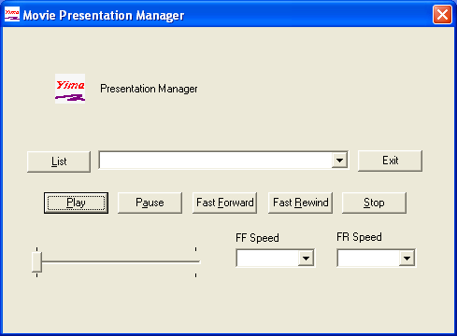
Windows Client
Operation:
  [List] button: reads media
  entries from local Yima.cfg file
  [Play], [Pause], [Stop] buttons execute RTSP commands to server
GUI was built with Visual Studio C/C++ (MFC library); it is message-driven, with callback functions for buttons. Includes MP3 decoder.

Slide 58

Client Structure
Player
“P”
3 threads
State
machine
GUI
“C”
/dev/dsp
Buffer
Network
“N”
RTP
Command
Message
Queues, e.g.,
put_cmd(CtoN, …);
RTSP

