Slide 1
Application-Level Multicast

Slide 2
You are Here
Encoder
Decoder
Middlebox
Sender
Receiver
Network

Slide 3
Application-Level Multicast
S
A
A
Router
B
Router
Router
Router
C

Slide 4
Application-Level Multicast
S
B
C
A
Router
B
Router
Router
Router
C

Slide 5
Overlay Network
S
A
B
C

Slide 6
Penalty: Delay
S
A
Router
B
Router
Router
Router
C
S
A
B
C

Slide 7
Penalty: Network Resource
S
A
Router
B
Router
Router
Router
C
S
A
B
C

Slide 8
Link Stress
S
A
Router
B
Router
Router
Router
C

Slide 9
Questions
How to construct overlay multicast tree?
How to maintain overlay multicast tree?

Slide 10
A Case for End-System Multicast
Y. Chu, S. Rao, S. Seshan, H. Zhang
JSAC 2002

Slide 11
Narada’s Idea
Build a mesh, then build a tree
S
S
A
A
B
C
B
C
Notes:
source-based tree

Slide 12
Why Build Mesh?

Slide 13
Desirable Property of Mesh
Path between any two nodes must be “good”
Cannot be too sparse or too dense

Slide 14
How to build Mesh?
Node join
  Randomly choose some existing members as neighbor
S
A
B
C

Slide 15
How to maintain Mesh?
Everybody knows everybody
Each node maintains a table
Address | Last Seq No | Last Update
1 | 512 | 10:00am
2 | 603 | 10:03am
3 | 341 | 10:02am
4 | 704 | 09:59am

Slide 16
How to update table?
Refresh message to neigbours
  receive message 604 from node 2
Address | Last Seq No | Last Update
1 | 512 | 10:00am
2 | 604 | 10:16am
3 | 341 | 10:02am
4 | 704 | 09:59am

Slide 17
How to update table?
Exchange Table
Address | Last Seq No | Last Update
1 | 513 | 10:07am
2 | 604 | 10:19am
3 | 343 | 10:10am
4 | 702 | 9:51am
Address | Last Seq No | Last Update
1 | 512 | 10:00am
2 | 604 | 10:16am
3 | 341 | 10:02am
4 | 704 | 09:59am

Slide 18
How to maintain Mesh?
Neighbor failure
  Probes if no refresh messages for a while
S
A
B
C

Slide 19
How to maintain Mesh?
Mesh Partition
  Probes if no updates for a while, add random edges if alive
S
A
B
C

Slide 20
How to Optimize Mesh?
Mesh needs to periodically updated because:
  nodes join and leave
  network condition changes
  partition repair add unneeded edges
  initial constructions are random

Slide 21
Adding a Link
Node i periodically probe randomly selected members j
Ask “what if I add (i,j)?”

Slide 22
Adding a Link (i,j)
for each node m
d_{curr}(i,m) = current latency from i to m
d_{new}(i,m) = new latency from i to m
if d_{new}(i,m) < d_{curr}(i,m)
utility += 1 - d_{new}(i,m)/d_{curr}(i,m)
add (i,j) if utility is high

Slide 23
Adding a Link
S
S
A
A
B
C
B
C

Slide 24
Removing a Link
Harder to ask “what if I remove link (i,j)?”
compute cost(i,j) instead: number of nodes for which i uses j as next hop

Slide 25
cost(i,j)
S
cost(S,A) = 2
A
B
C

Slide 26
cost(i,j)
cost(S,A) = 3
cost(A,S) = 1
E
S
A
D
B
C

Slide 27
Removing a link
if max(cost(i,j), cost(j,i)) < Threshold
drop link (i,j)
(Threshold should depend on group size)

Slide 28
Narada’s Idea
Build a mesh, then build a tree
S
S
A
A
B
C
B
C
Notes:
source-based tree

Slide 29
How to build tree?
Modify DVMRP
Cost definition
  Pick widest path
  Break ties by latency

Slide 30
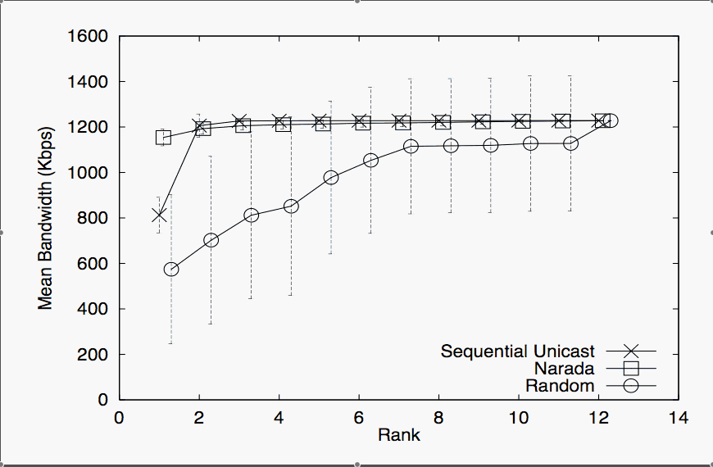
Evaluation: Bandwidth

Slide 31
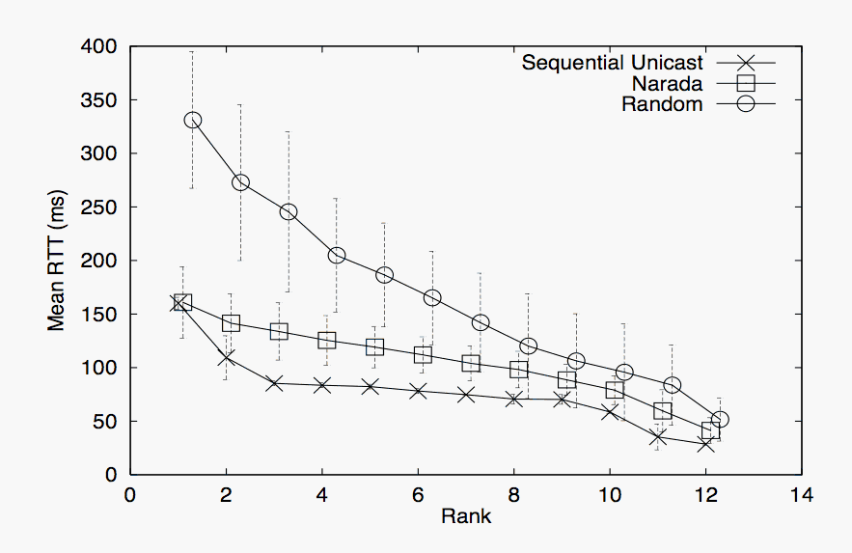
Evaluation: RTT

Slide 32
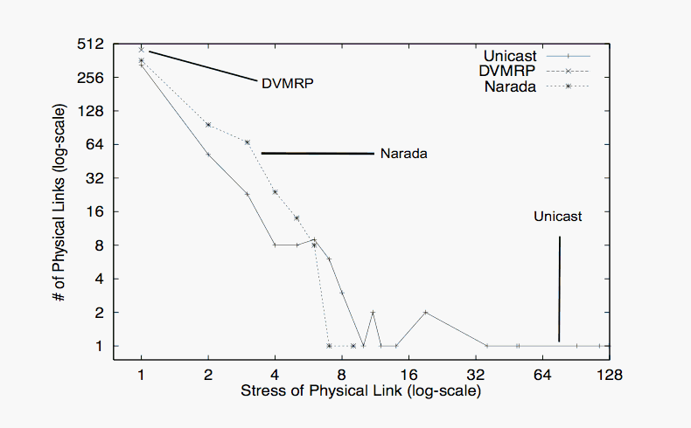
Evaluation: Link Stress

Slide 33
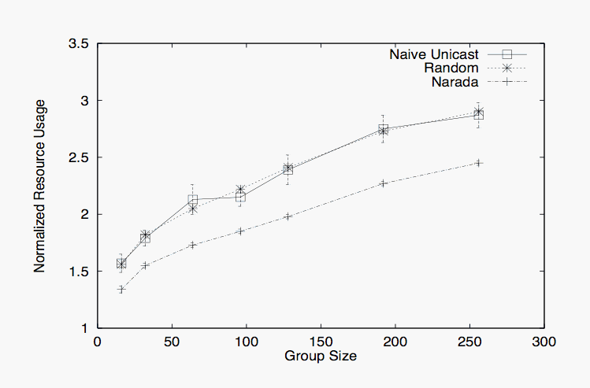
SUM(Delay x Stress)

Slide 34
Problem
Narada does not scale
  State maintenance
  Message overhead

Slide 35
Scalable Application Layer Multicast
S. Banerjee, B. Bhattacharjee, and C. Kommareddy
SIGCOMM 2002

Slide 36
NICE
NICE is scalable
  State maintenance
  Message overhead

Slide 37
Members

Slide 38
Clusters

Slide 39
Leader

Slide 40
Layer

Slide 41
Nodes per Cluster
[k, 3k-1]

Slide 42
Control Topology

Slide 43
Multicast Tree

Slide 44
Analysis
height =

Slide 45
Analysis
Let L_{i} be the highest layer of a node
Number of neighbours =
Number of nodes at layer L_{i} =

Slide 46
Analysis
Worst Case Control Message Overhead =
Average Case Control Message Overhead =

Slide 47
Analysis
Number of hops between 2 nodes =

Slide 48
Analysis
Maximum Degree of a Node =

Slide 49
Multicast Tree (Improved)

Slide 50
Node Join
RP

Slide 51
Other operations
Node leave
Node failure
Cluster merge/split

Slide 52
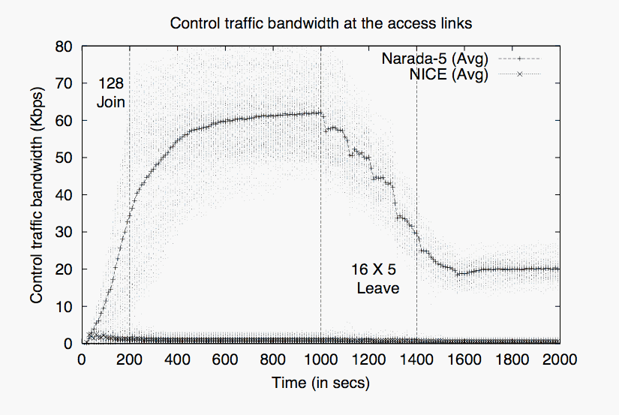
Evaluation: Control Overhead

Slide 53
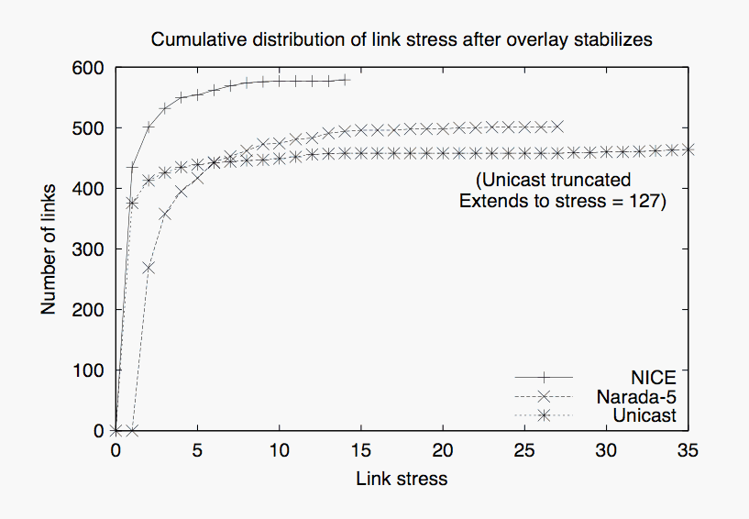
Evaluation: Link Stress

Slide 54
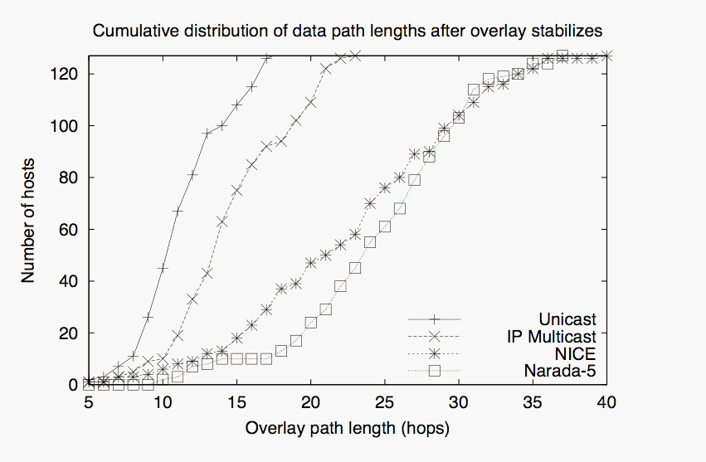
Evaluation: Path Length

