Slide 1
Peer-to-Peer Streaming

Slide 2
Peer-to-Peer Streaming
A type of application-level multicast
But packets are forwarded by end-host (not proxies)

Slide 3
Peer-to-Peer Streaming
ALM with end-hosts as forwarders
End Host
Video Server
S
Overlay Links

Slide 4
Issues with P2P Streaming
Depends on peers to forward packets, but peers can fail/leave anytime
S
Notes:
Bad for tree-based scheme like NICE/Narada

Slide 5
CoopNet
Resilient Peer-to-Peer Streaming, V. Padmanabhan et. al.
ICNP 2003

Slide 6
Idea
Split video into k “parts”, send one part along one tree

Slide 7
“Smart” Splitting
A node may be able to reconstruct partial data with a subset of the parts
More parts, better quality
“Multiple Description Coding”

Slide 8
Simple Example (Video)
Divide into two descriptions
  1. Even frames
  2. Odd frames
“Multiple State Encoding”
Does not scale to a large number of descriptions

Slide 9



Layered Coding
Layer 1
Layer 2
Layer 3

Slide 10
Layered Coding
One layer one description?
But there are dependencies between the descriptions

Slide 11
Multiple Description Coding
L1
L2.1
L3.1
D1
L1
L2.2
L3.2
D2
L1
L2.1
XOR
L2.2
L3.3
D3

Slide 12
Multiple Description Coding
D1
L1
L2.1
L2.2
L2.3
L3.1
D2
L1
L2.3
L2.4
L2.1
L3.2
D3
L1
L2.1
L2.2
L2.4
L3.3
D4
L1
L2.3
L2.4
L2.2
XOR

Slide 13
How to Build Tree?
Send one description along one tree only
A node is internal node in at most one tree, and is leaf node in the rest of the trees

Slide 14
Example
R
R
1
3
2
4
2
4
5
6
1
3
5
6

Slide 15
Tree Maintenance
The source of video maintains all states.
Isn’t this a centralized design that is not robust?

Slide 16
Node Join
Becomes internal node in a tree with least number of internal nodes.
Becomes leaf node in the rest of the trees.

Slide 17
To join as internal node
Pick highest internal node with enough bandwidth as parent.
If cannot find, pick internal node with leaf node as child, preempt the leaf node.

Slide 18
To join as leaf node
Pick highest internal node with enough bandwidth as parent.
If cannot find, migrate an internal node from another tree.

Slide 19
Network Efficiency
When choosing parents, breaks ties by choosing closer node as parents.

Slide 20
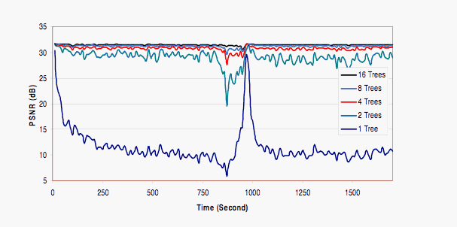
Effects of Number of Trees

Slide 21
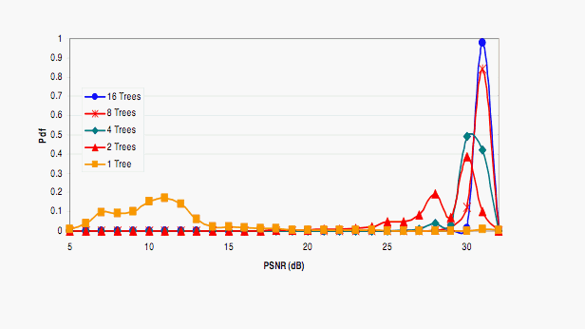
Effects of Number of Trees

Slide 22
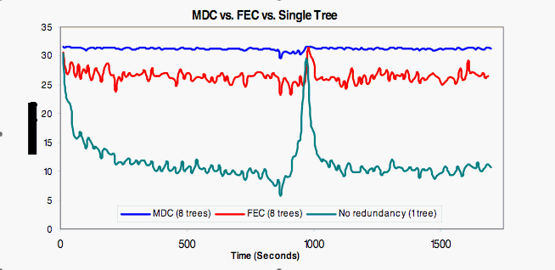
MDC versus FEC

Slide 23
Summary of CoopNet
Robustness through redundancy in
  coding
  network paths

Slide 24
Issues with P2P Streaming
Not all peers are happy to contribute resources — selfish peers exist.
S

Slide 25
Deter Selfish Peers
Add a constraint:
  A peer can only receive at most as much as it is willing to send
  S/R >= 1
Notes:
S:R

Slide 26
Practical Issues
Asymmetric Links
Different
downlink
capacity

Slide 27
Dagster
Contributor Aware P2P Streaming in Heterogeneous Environment
MMCN 2005

Slide 28
Goals
Robustness wrt transient peers
Deter selfish users without restricting S:R ratio
Heterogeneous receivers

Slide 29
Issue 1
Heterogeneous receivers
  Solution: Transcoding

Slide 30
Transcoding
D
A
C
E
S
F
B
Notes:
CPU is fast

Slide 31
Issue 2
Improve Robustness
  Solution: Distributed Streaming

Slide 32
Distributed Streaming
D
A
C
E
S
F
B
Notes:
Improve robustness
It’s a DAG

Slide 33
Multiple State Encoding
D
A
1,3,5..
C
E
1,2,3,4..
S
2,4,6..
F
1,2,3,4..
B
2,4,6..

Slide 34
Issue 3
Provide incentives without constraining S:R ratio?
  Solution: give peers that pledge more contributions some benefits
  “contributor-aware”

Slide 35
Providing Incentives
Idea: allow a peer to preempt another peer with smaller contributions
Benefits
  Lower rejection rate
  Closer to source

Slide 36
DAG Construction

Slide 37
Example
15:5
A
0:30
S
15:5
B

Slide 38
Example
15:5
A
0:30
S
15:5
B

Slide 39
Example
15:5
A
0:30
S
15:5
15:15
B
C

Slide 40
Example: Preemption
15:5
A
0:30
S
15:15
15:5
C
B
Notes:
Abandon
Adopt

Slide 41
Example: Rejection
15:5
A
0:30
S
15:5
15:6
B
D
Notes:
reject

Slide 42
Preemption Rules
A can preempt B if
  A is willing to donate more than B
  B can find new parents after preemption

Slide 43
Example
15:5
A
0:30
S
15:5
10:5
B
E

Slide 44
Example
15:5
A
0:30
10:5
S
E
15:5
B

Slide 45
Example
15:5
2:1
A
F
0:30
S
15:5
2:1
10:5
B
H
G

Slide 46
Example: 2 Preemptions
15:5
2:1
A
F
0:30
10:5
S
G
15:5
2:1
B
H

Slide 47
Details
Centralized control at the server to prevent illegal preemption

Slide 48
Details
Minimize number of descendents affected when preempting peers
Find a subset of children to preempt, such that number of descendents affected is minimized, and preempted bandwidth is enough for the new node.
KNAPSACK problem!

Slide 49
Details
Prefer parents who are closer to the source and have large contributions

Slide 50
Details
Peers can cheat by pledging more contributions than they are capable of.
We can only do our best to detect such cheaters :-(

Slide 51
Evaluations

Slide 52
Simulation Setup
Host characteristics based on study of Gnutella and Napster by Saroiu et. al.

Slide 53
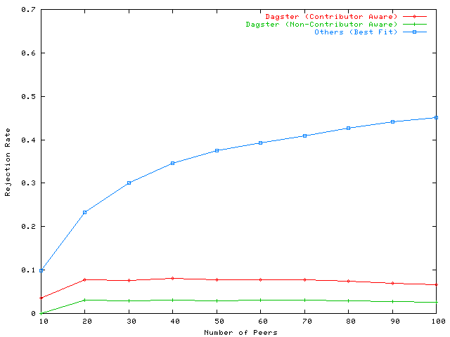
Best Fit (no Preemption)
Rejection Rate
Contributor-Aware (with Preemption)
Non Contributor Aware (with Preemption)
Number of Peers

Slide 54
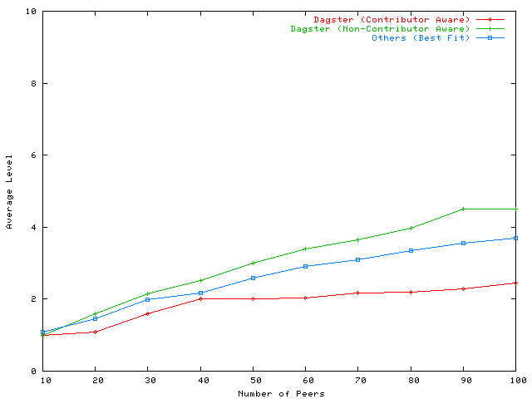
Average Level
Non-Contributor Aware
Contributor Aware
Number of Peers

Slide 55
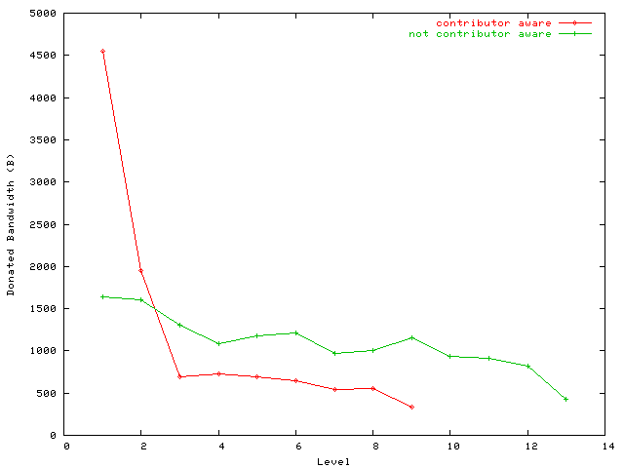
Contributor Aware
Average Donated Bandwidth
Non-contributor Aware
Level

Slide 56
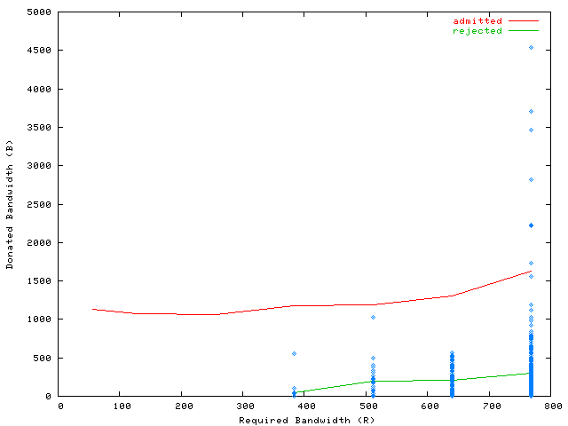
Donated Bandwidth
Admitted
Rejected
Requested Bandwidth

Slide 57
Number of Parents
Dagster limits maximum number of parents a node can have.
How many is ideal?

Slide 58
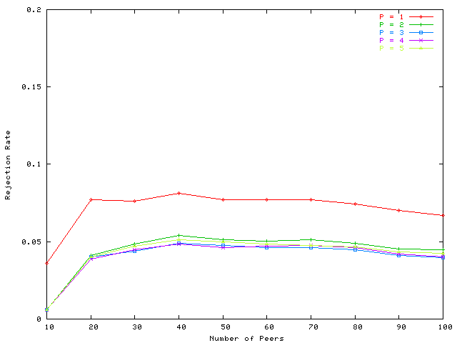
Rejection Rate
P = 1
P > 1
Number of Peers

Slide 59
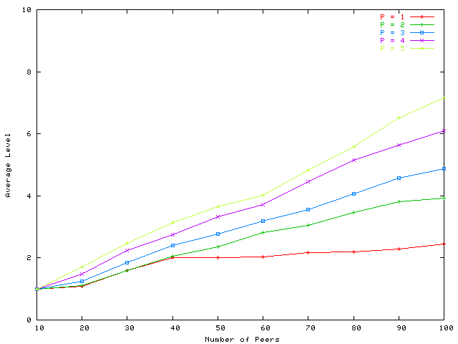
Average Level
P = 2
P = 1
Number of Peers

Slide 60
Robustness with P
Typical frame-rate 24-30 fps.
If P = 3, and one parent fails, then clients can expect to receive 16-20 fps.

Slide 61
Remaining Tasks
11 April 2011: Project reports and software due
  In-class presentation
28 April 2011: Final exam (evening)
  Open book
  Style: a few MCQ and essay questions

