Slide 1
Project
Create a DASH-compliant (Dynamic Adaptive Streaming over HTTP) streaming system

Slide 2
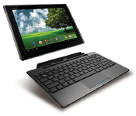
Goals (1)
Capture a video on an ASUS Transformer/ Samsung Galaxy Note Pro tablet computer and store it as an MP4 file.
Split the MP4 file into streamlets, i.e., 10 second long video files.
Upload the streamlets to a web server.
Transcode the streamlets into 3 different streamlets (e.g., low, medium, high quality).
Create a playlist on the web server.

Slide 3
Goals (2)
ASUS Transformer/Samsung Galaxy Note Pro runs the Android 4.2 Jelly Bean or 4.4 KitKat OS.
Programming on Android is done in Java with the Eclipse IDE.
On the web server, create scripts in the PHP language.
Implement a simple Android DASH media player.

Slide 4
Project Homepage
Descriptions and web links
Some utilities and some library source codes
Documentation (RFCs, etc.)
IVLE Forums
TA: Rajiv Ratn Shah (rajiv@comp.nus.edu.sg)

Slide 5

Advice and Actions (1)
Form a team (3 persons).
Note: You will need to read and learn a lot. Your program code will be quite small.
  HTTP POST command structure
  MP4Parser usage to create streamlets
  FFmpeg transcoder usage
  Playlist .m3u8 format in XML
Start early (i.e., this week)!

Slide 6
Actions (2): Get your Tablet
Check out your loan ASUS Transformer for the project from Mr. Chow from SoC Technical Services (on the 4th floor of AS6).
There is one tablet per team (3 students).
Please loan your tablet on 10/9 or 12/9, 2:00-5:30 pm, AS6-04-27.
Email: chowcm@comp.nus.edu.sg.
Tell Mr. Chow the 3 team member names.

Slide 7
Introduction to DASH
Dynamic Adaptive Streaming over HTTP

Slide 8
DASH (1)
RTP/RTSP/RTCP streaming faces several challenges
  Special-purpose server for media (complex)
  Protocols use TCP and UDP transmissions (firewalls)
  Difficult to cache data (no “web caching”)
Advantage
  Short end-to-end latency

Slide 9
DASH (2)
Main idea of DASH
  Use HTTP protocol to “stream” media
  Divide media into small chunks, i.e., streamlets
Advantages
  Server is simple, i.e., regular web server
  No firewall problems (use port 80 for HTTP)
  Standard (image) web caching works

Slide 10

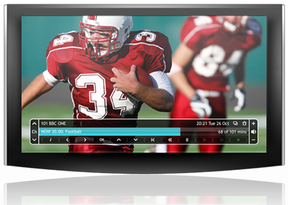
DASH (3)
Original DASH implementation by Move Networks
  Introduced concept of streamlets
  Additional idea: make playback adaptive
    Encode media into
    multiple different
    streamlet files, e.g.,
    a low, medium, and
    high quality version
    (different bandwidth)

Slide 11
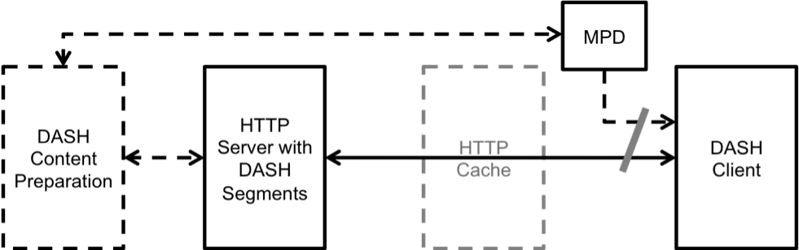
DASH (4)
MPD: Media Presentation Description
ISO/IEC Standard:
  “Information technology — MPEG systems technologies — Part 6: Dynamic adaptive streaming over HTTP (DASH)”
  JTC 1/SC 29; FCD 23001-6

Slide 12
DASH (5)
Web server provides a playlist
  The playlist is a file in a specific format that lists all the available qualities and all the streamlets for each quality
  Playlist file extension is .m3u8
  Content preparation:
    Original media file needs to be split into streamlets
    Streamlets need to be transcoded into different qualities

Slide 13
DASH (6)
HTTP protocol is stateless!
  Server remembers “nothing” about session
Scheduling logic, etc., is in media player!

Slide 14
DASH (7)
DASH media player
  Loads .m3u8 file and then starts to download streamlets
  All the scheduling logic is in the player
    Render current streamlet while downloading the next streamlet before playback is done
    Measure bandwidth and switch between different qualities (i.e., adapt)
    Switch servers ⇒ can be done easily

Slide 15
DASH (8)
Many media players now understand DASH streaming format
Many companies use HTTP streaming:
  Apple, Microsoft, Adobe, Netflix, …
CDNs like this approach
  No need to run QuickTime, Windows Media, RealNetworks, and Flash streaming servers
    Just use web server for everything!

