Slide 1
Adaptive Playout

Slide 2
You are Here
Encoder
Decoder
Middlebox
Sender
Receiver
Network

Slide 3
How to recv and play?
open socket
while not done
if socket is readable
read packet from socket
remove RTP header
decode
play back

Slide 4
What’s Wrong?
packet ordering
packet loss
next packet arrive in-time?
Especially bad for audio applications

Slide 5
Overview
Decode
RTP
Classifier
Network

Slide 6
Implementation
Single Thread
  using select()
Multi-Threads

Slide 7
Packet Buffer
Sorted by sequence number
When ADU is complete, send to decoder
RTP
Classifier

Slide 8
Playout Buffer
Stored decoded data in playout order
Post-processing/Mixing may happen
Decode

Slide 9
Why Buffer?

Slide 10
Sending Packets
Packet
Time

Slide 11
Receiving Packets
Packet
t₀
t₁
Time

Slide 12
With Jitter
Packet
Time

Slide 13
With Jitter
Packet
t₀
t₂
Time

Slide 14
What causes Jitter?
Network delay =
Transmission Delay (fixed) +
Propagation Delay (fixed) +
Queuing Delay (variable)
Delay jitter is caused by variable queuing delay

Slide 15
Delay Jitter
Transit
Time
small jitter
large jitter
Time

Slide 16
Spike
Transit
Time
Time

Slide 17
Today’s Question
How big is the playout buffer?
When to play back?

Slide 18
Types of Applications
Non-interactive
  Buffer can be large
Interactive
  As small as possible

Slide 19
Types of Applications
Video
  Frames are discrete (easier problem)
Audio
  Samples are “continuous”

Slide 20
Naive Answer
How big is a buffer?
  Fixed at a small value, to reduce latency
When to playback?
  Playback as soon as possible, to reduce latency

Slide 21
Client Buffer Management
Bandwidth Smoothing for Non-interactive Applications

Slide 22
Multi-Threshold Flow Control
R. Zimmermann, K. Fu, M. Jahangiri, C. Shahabi
MTAP 2006

Slide 23
Video-on-Demand (VoD)
High-quality playback required
Buffer can be large
Encoding may be VBR for high visual quality
Playback time may be very long (2+ hours)

Slide 24
Two Approaches (1)
Server-controlled
  Pre-compute transmission schedule
  Piece-wise linear approximation: compute a number of constant-rate segments
  Different optimization criteria
    Minimize: # of rate changes, # utilization of client buffer, peak rate, etc.

Slide 25
Two Approaches (2)
Client-controlled
  Client adaptively informs server
  Advantages:
    No rate history necessary (VBR)
    Can adjust to network conditions
    Works easily with interactive commands such as FF, FR, Pause

Slide 26
Robust Stream Delivery
Smoothing of VBR media traffic has the following quality benefits:
  Better resource utilization (less bursty)
  More streams with the same network capacity

Slide 27
Objectives
Multi-Threshold Flow Control
(MTFC) algorithm objectives:
  Online operation
  Content independence
  Minimizing feedback
  control signaling
  Rate smoothing

Slide 28
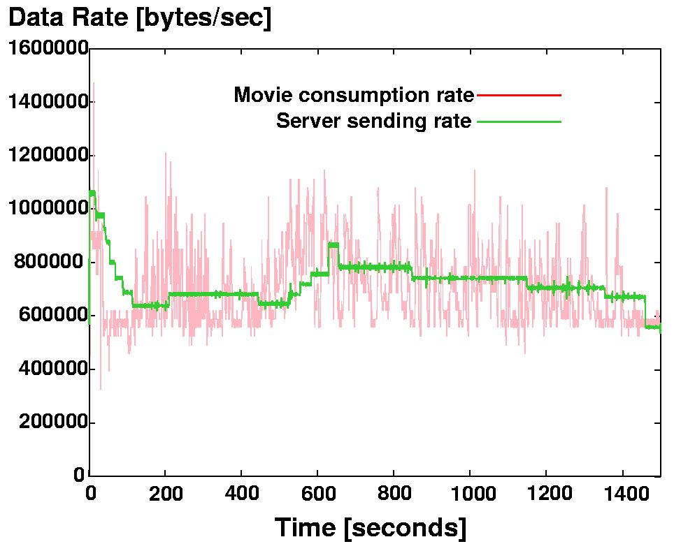
Example

Slide 29
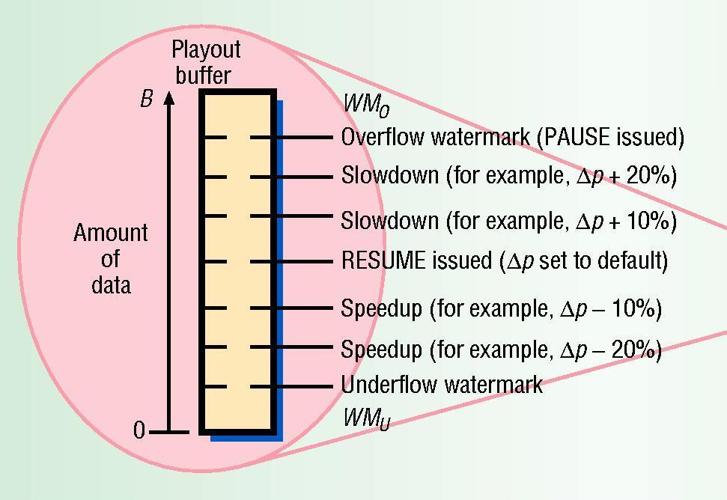
MTFC Buffer Management
Multiple Thresholds: goal is middle of buffer
Send rate
adjust
command
to server
whenever
threshold
is crossed

Slide 30
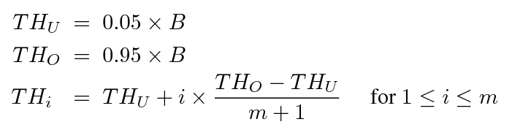
How to Set Thresholds?
Simple: equi-distant
  m: number of thresholds
  Overflow and underflow thresholds

Slide 31
How to Calculate Sending Rate?

Slide 32
Threshold Spacing Strategies
Linear vs. arithmetic vs. geometric

Slide 33
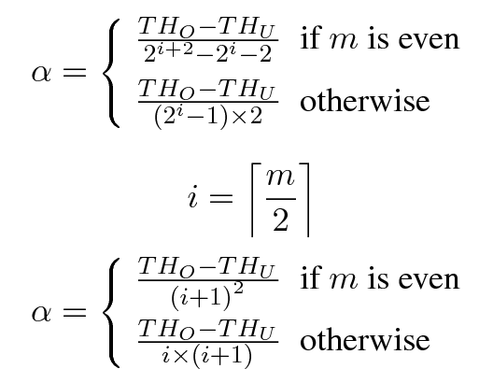
Threshold Spacing Strategies
Geometric and arithmetic spacing:

Slide 34
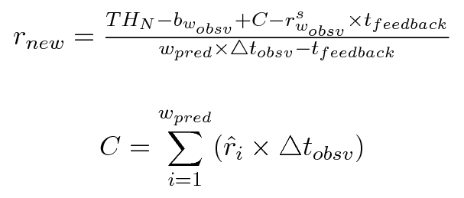
Sending Rate Computation
Relevant factors:
  Target buffer level (i.e., 50%): TH_{N}
  Current buffer level: b_{wobsv}
  Predicted duration to reach target level
  Data consumed during predicted duration

Slide 35
MTFC Results

Slide 36
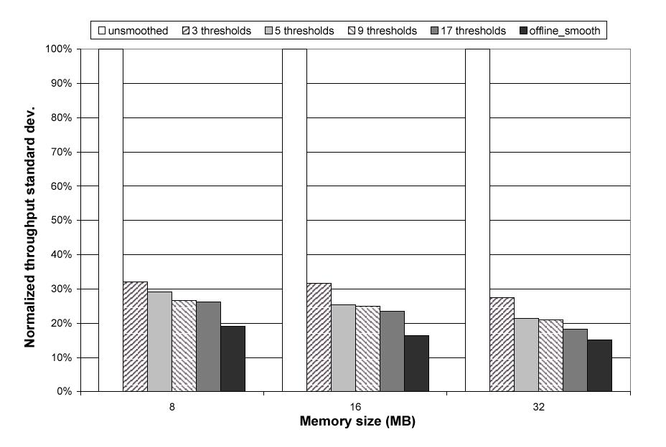
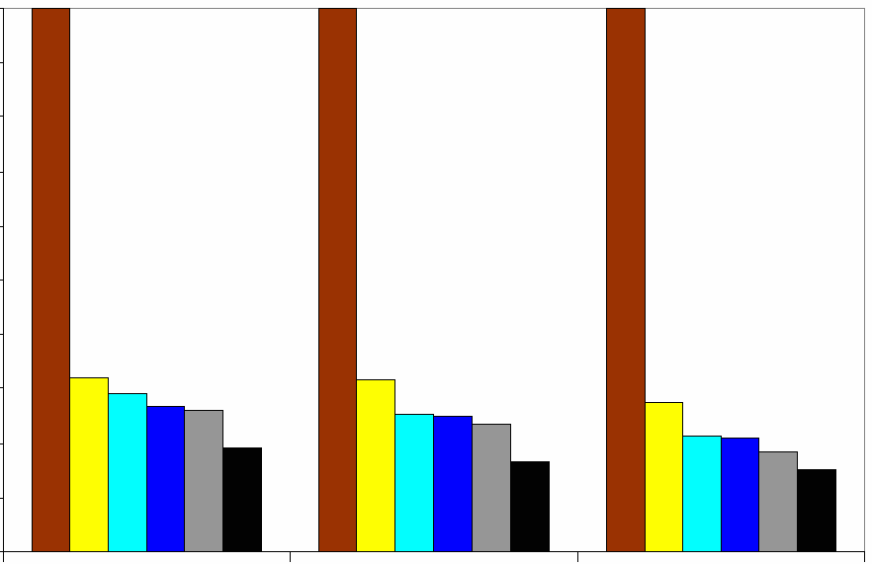
MTFC Results: # of Thresholds

Slide 37
MTFC Results: # of Thresholds
Number of Thresholds
3
5
9
17
Number
Of
Rate
Changes
100
90
80
70
60
50
40
30
20
10
0
8MB
16MB
32MB

Slide 38
A Brief Introduction to Audio Conferencing

Slide 39
Audio Conferencing
Live, interactive application
  Latency is important
Typically each packet contains
20-30ms of audio

Slide 40
Silence Suppression
Silence Detection
  If no sound, no need to send
Talkspurt
  Consecutive audio packets (between silence)
  Hundreds of ms

Slide 41
Recall: RTP Header
marker bit:
  depends on payload
  e.g. beginning of frame

Slide 42
RTP and Talkspurt
First packet of a talkspurt will have marker bit set to 1

Slide 43
RTP and Talkspurt
Deduce talkspurt from sequence number and timestamp
1
20
2
40
3
60
5
190
SeqNo
TimeStamp

Slide 44
Consequences of Talkspurt
Opportunity to adjust playout delay
  if jitter is large, increase delay
  if jitter is small, decrease delay

Slide 45
Fixed Playout Delay
Talkspurt 2
Talkspurt 1
SEND
RECV
PLAY
Time

Slide 46
Adaptive Playout Delay
SEND
RECV
PLAY

Slide 47
Adaptive Playout Delay
SEND
RECV
PLAY

Slide 48
Trade-Off
Latency vs. Packet Loss

Slide 49
Latency vs Loss-Rate
Loss
Rate
Latency

Slide 50
Latency vs Loss-Rate
Loss
Rate
Note: Late packets
are considered lost
Latency

Slide 51
Adaptive Playout Mechanisms for Packetized Audio Applications in WAN
R. Ramjee, J. Kurose, D. Towsley, H. Schulzrinne
INFOCOM 1994

Slide 52
Variables and Notations

Slide 53
Variables and Notations
T_{net}(i)
T_{buf}(i)
T_{arrive}(i)
T_{play}(i)
T_{delay}(i)
T_{send}(i)

Slide 54
1st Packet in Talkspurt
We can estimate as
Mean and variation of the end-to-end delay.

Slide 55
How to estimate V_{net}(i)

Slide 56
How to estimate E_{net}(i)
Method 1: Jacobson’s Method
(Delay estimate as in RFC 793, TCP
re-transmit timer.)

Slide 57
Spike
T_{net}
Arrival Time

Slide 58
Problems
Described algorithm does not react to spike fast enough.

Slide 59
How to estimate E_{net}(i)
Ramjee’s Method:
SPIKE
NORMAL

Slide 60
Ramjee’s Idea
if T_{net}(i) suddenly increases
SPIKE
NORMAL
if “slope” is small enough

Slide 61
In Spike Mode
SPIKE
T_{net}
i

Slide 62
In Normal Mode
NORMAL
T_{net}
i

Slide 63
Evaluations
Loss
Rate
Delay

Slide 64
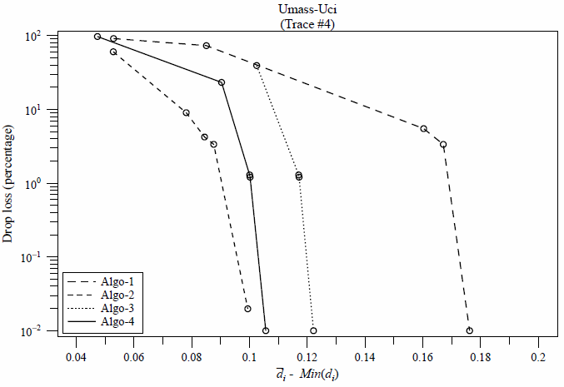
Evaluations
Loss
Rate
Delay

Slide 65
Problems with Ramjee’s Method
Transit
Time
Time

Slide 66
Packet Audio Playout Delay Adjustment: Performance Bounds and Algorithms
S. Moon, J. Kurose, D. Towsley
Multimedia Systems 1998

Slide 67
Recall Previous Methods

Slide 68
How to Set T_{delay}(i)
Moon’s Method
Collect statistics on packets that have arrived.
Find t such that q% of last w packets have T_{net}(i) < t.

Slide 69
Example (w =50, q = 90%)
num of
packets
1 2 3 4 5 6 7 8 9 10 11 12
delay

Slide 70
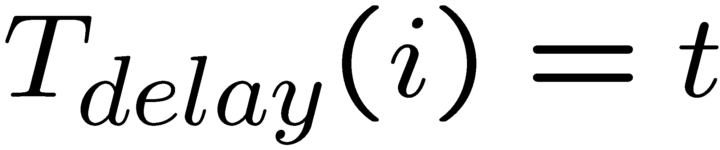
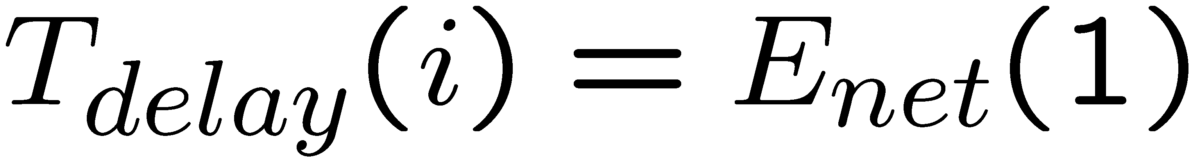
Setting T_{delay}(i)
NORMAL
SPIKE

Slide 71
Setting T_{delay}(i)
Transit
Time
Time

Slide 72
Performance Bound
Given a trace of packets, and a loss rate, find the minimum average playout delay.
Use Dynamic Programming

Slide 73
A Packet Trace
k
M talkspurts
1,k
2,k
3,k
j,k
n_{k},k
T_{net}
13
15
10
…

Slide 74
More Notations
M:
  Number of Talkspurt
N_{packet}(k) or n_{k}
  Number of packets in talkspurt k
N_{total}
  Total number of packets

Slide 75
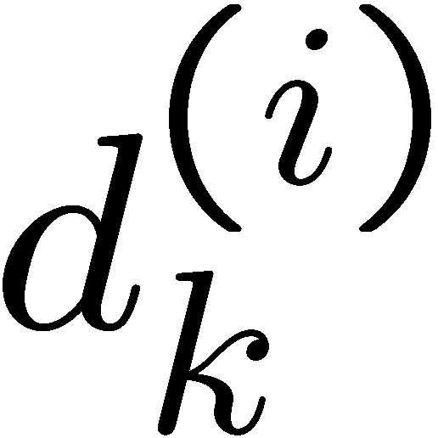
Definition
minimum average playout delay for choosing i packets to be played out from k-th talkspurt
k
M talkspurts

Slide 76
How to find

Slide 77
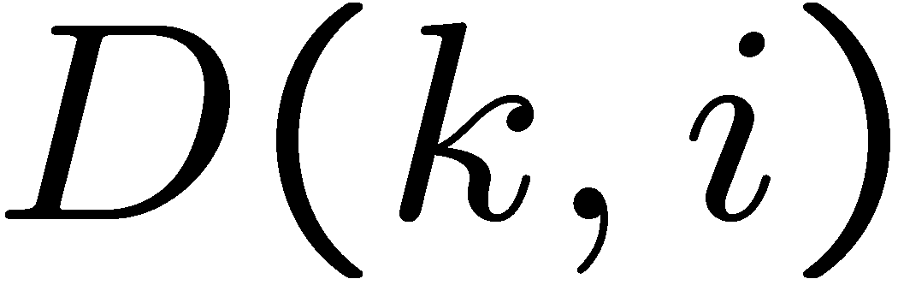
Definition
minimum average playout delay for choosing i packets to be played out from k-th to M-th talkspurt
k
..
M
M talkspurts

Slide 78
Base Case
D(k, 0) =
D(M, i) =
minimum average playout delay for
choosing i packets to be played out
from k-th to M-th talkspurt

Slide 79
Recursive Case
..
k
..
M
1,k
2,k
3,k
..
n_{k},k
j

Slide 80
Performance Bound
Given a trace of M talkspurts and n packets, and a loss rate e, find the minimum average playout delay.
Answer: Minimum possible average playout delay is D(1, (1-e)n)
minimum average playout delay for
choosing i packets to be played out
from k-th to M-th talkspurt

Slide 81
Evaluations
Loss
Rate
Delay

Slide 82
Summary
Playout Adjustment for Audio Conferencing
Weighted Average Methods vs. Statistical Methods
An Analysis of Minimum Playout Delay

Slide 83
Practical Complications
Clock Drifts
Route Change

Slide 84
Advanced Techniques
Speed-up Playback

