Slide 1
Introduction to DASH
Dynamic Adaptive Streaming over HTTP

Slide 2
Dynamic Adaptive Streaming over HTTP (DASH)
Christian Timmerer and Christopher Müller
Alpen-Adria Universität Klagenfurt (AAU)  Faculty of Technical Sciences (TEWI)
Institute of Information Technology (ITEC)  Multimedia Communication (MMC)
http://research.timmerer.com  http://blog.timmerer.com  mailto:christian.timmerer@itec.uni-klu.ac.at
02 May 2011
Acknowledgment: Thomas Stockhammer (QUALCOMM), Mark Watson (Netflix) – reused their presentations from MMSys’11 accessible via http://www.mmsys.org/

Slide 3
User Frustration in Internet Video
Video not accessible
Behind a firewall
Plugin not available
Bandwidth not sufficient
Wrong/non-trusted device
Wrong format
Fragmentation
Devices
Content Formats
DRMs
Low Quality of Experience
Long start-up delay
Frequent Re-buffering
Low playback quality
No lip-sync
No DVD quality (language, subtitle)
Expensive
Sucks my bandwidth
Need a dedicated devices
Other costs…
One way to build confidence ➪ Open Standards
Ack & ©: Thomas Stockhammer

Slide 4
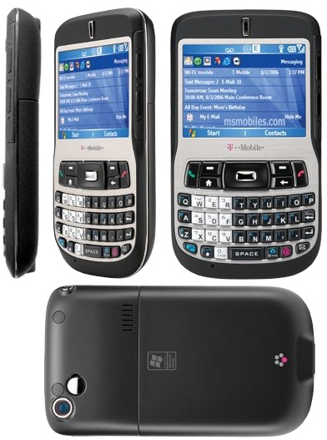
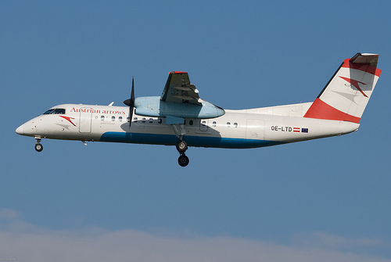
What is DASH?
http://en.wikipedia.org/wiki/Dash_(disambiguation)

Slide 5
HTTP Streaming of Media
Server
Client
1
MF
MF
DF
2
DF
ISOBMFF
ISOBMFF
easy conversion
easy conversion
M2TS
M2TS
ISOBMFF … ISO Base Media File Format (e.g., mp4 – others: avi)
M2TS … MPEG-2 Transport Stream (e.g., DVB, DMB)
MF … Manifest Format (e.g., MPD, FMF)
DF … Delivery Format (e.g., F4F, 3gs)

Slide 6
Adaptive Streaming in Practice
Ack & ©: Mark Watson

Slide 7
Dynamic Adaptive Streaming over HTTP (DASH)
Proprietary Solutions
Int’l Standard Solutions V1
Int’l Standard Solutions V2
Apple HTTP Live Streaming
3GPP Rel.9 Adaptive HTTP Streaming
3GPP Rel.10 DASH
Adobe HTTP Dynamic Streaming
Microsoft Smooth Streaming
OIPF HTTP Adaptive Streaming
MPEG DASH
Netflix
Akamai
Movenetworks’ Movestreaming
Amazon
. . .
time
http://multimediacommunication.blogspot.com/2010/05/http-streaming-of-mpeg-media.html

Slide 8
Outline
Introduction
DASH Design Principles
Scope: What is specified – and what is not!
DASH Data Model
Media Presentation Description
Segment Indexing
Dynamic & Adaptive
Video on Demand vs. Live
The Adaptation Problem
Conclusions & Future Work

Slide 9
DASH Design Principles
DASH is not
system, protocol, presentation, codec, interactivity, client specification
DASH is an enabler
It provides formats to enable efficient and high-quality delivery of streaming services over the Internet
It is considered as one component in an end-to-end service
System definition left to other organizations (SDOs, Fora, Companies, etc.)
Design choices
Enable reuse of existing technologies (containers, codecs, DRM etc.)
Enable deployment on top of HTTP-CDNs (Web Infrastructures, caching)
Enable very high user-experience (low start-up, no rebuffering, trick modes)
Enable selection based on network and device capability, user preferences
Enable seamless switching
Enable live and DVD-kind of experiences
Move intelligence from network to client, enable client differentiation
Enable deployment flexibility (e. g., live, on-demand, time-shift viewing)
Provide simple interoperability points (profiles)
Ack & ©: Thomas Stockhammer

Slide 10
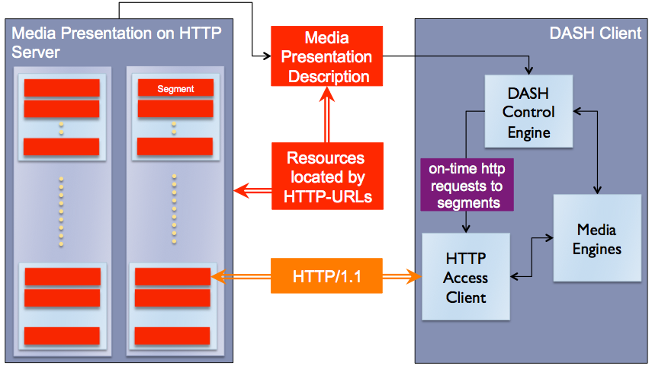
What is specified – and what is not?
Ack & ©: Thomas Stockhammer

Slide 11
DASH Data Model
Segment Info
Initialization Segment
http://www.e.com/ahs-5.3gp
Media Presentation
Media Segment 1
start=0s
http://www.e.com/ahs-5-1.3gs
Period,
start=100
baseURL=http://www.e.com/
Period, start=0s
…
Representation 1
bandwidth=500kbit/s
width 640, height 480
…
…
Media Segment 2
start=10s
http://www.e.com/ahs-5-2.3gs
Representation 1
500kbit/s
Period, start=100s
…
Segment Info
duration=10s
Template: ./ahs-5-$Index$.3gs
Media Segment 3
start=20s
http://www.e.com/ahs-5-3.3gh
Representation 2
100kbit/s
Period, start=295s
…
…
…
Media Segment 20
start=190s
http://www.e.com/ahs-5-20.3gs
Ack & ©: Thomas Stockhammer

Slide 12
Media Presentation Description
Redundant information of Media Streams for the purpose to initially select or reject Groups or Representations
Examples: Codec, DRM, language, resolution, bandwidth
Access and Timing Information
HTTP-URL(s) and byte range for each accessible Segment
Earliest next update of the MPD on the server
Segment availability start and end time in wall-clock time
Approximated media start time and duration of a Media Segment in the media presentation timeline
For live service, instructions on starting playout such that media segments will be available in time for smooth playout in the future
Switching and splicing relationships across Representations
Relatively little other information
Ack & ©: Thomas Stockhammer

Slide 13
DASH Groups & Subsets
Group id="grp-1"
Group by codec, language, resolution, bandwidth, views, etc. – very flexible (in combination with xlink)!
Ranges for the @bandwidth, @width, @height and @frameRate
Representation id="rep-1"
Representation id="rep-2"
. . .
Representation id="rep-n"
Subset id="ss-1"
Contains group="grp-1"
Group id="grp-2"
Contains group="grp-4"
Representation id="rep-1"
Contains group="grp-7"
Representation id="rep-2"
. . .
Representation id="rep-n"
Subsets
Mechanism to restrict the combination of active Groups
Expresses the intention of the creator of the Media Presentation
. . .
Group id="grp-m"
Representation id="rep-1"
Representation id="rep-2"
. . .
Representation id="rep-n"

Slide 14
Segment Indexing
Provides binary information in ISO box structure on
Accessible units of data in a media segment
Each unit is described by
Byte range in the segments (easy access through HTTP partial GET)
Accurate presentation duration (seamless switching)
Presence of representation access positions, e.g. IDR frames
Provides a compact bitrate-over-time profile to client
Can be used for intelligent request scheduling
Generic Data Structure usable for any media segment format, e.g. ISO BMFF, MPEG-2 TS, etc.
Hierarchical structuring for efficient access
May be combined with media segment or may be separate
Ack & ©: Thomas Stockhammer

Slide 15
Segment Indexing
Segment Index in MPD only
seg1.mp4
<MPD>
...
<URL sourceURL="seg1.mp4"/>
<URL sourceURL="seg2.mp4"/>
</MPD>
seg2.mp4
...
<MPD>
...
<URL sourceURL="seg.mp4" range="0-499"/>
<URL sourceURL="seg.mp4" range="500-999"/>
</MPD>
seg.mp4
Segment Index in MPD + Segment
<MPD>
...
<Index sourceURL="idx.mp4"/>
<URL sourceURL="seg.mp4"/>
</MPD>
idx.mp4
seg.mp4
Segment Index in Segment only
<MPD>
...
<BaseURL>seg.mp4</BaseURL>
</MPD>
seg.mp4
idx

Slide 16
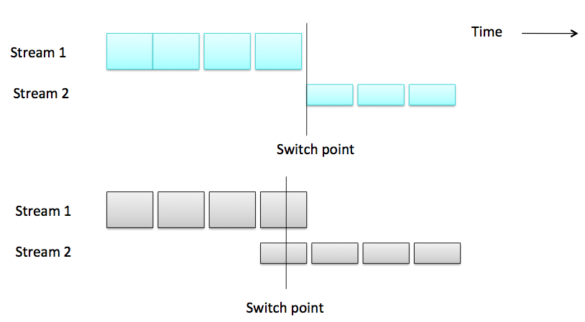
Switch Point Alignment
Ack & ©: Mark Watson

Slide 17
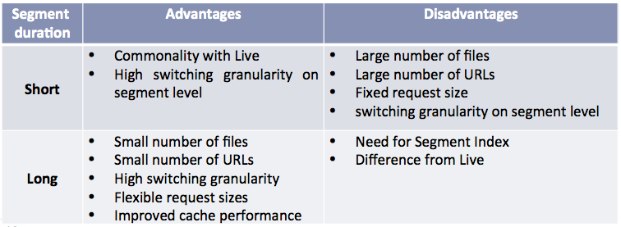
Adaptive Streaming Summary
For on demand
Chunks are unnecessary and costly
Byte range requests have caching and flexibility advantages
Separate audio/video essential for language support
For live
Chunks are unavoidable
Still value in decoupling request size from chunk size
Multiple language audio tracks are rare
May need manifest updates
For both
Switch point alignment required for most CE decoding pipelines
Ack & ©: Mark Watson and Thomas Stockhammer

Slide 18
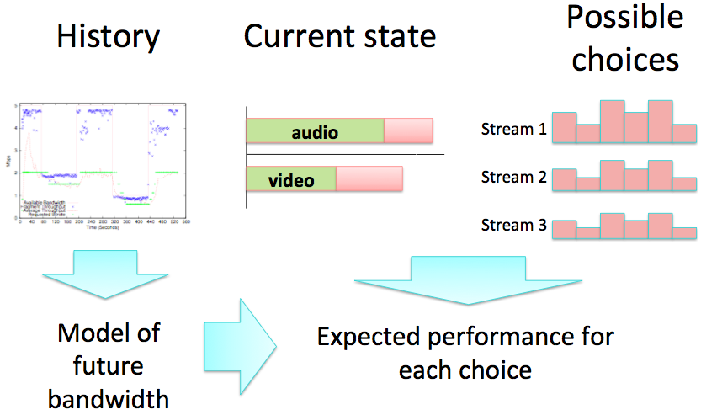
Adaptation Problem
Choose sequence and timing of requests to minimize probability of re-buffers and maximize quality
Ack & ©: Mark Watson

Slide 19
Conclusions
Asynchronous delivery of the same content to many users is a first-class network service
HTTP CDNs may not be the “perfect” architecture, but it’s working pretty well at scale
Many variations on HTTP Adaptive Streaming theme in deployed systems and emerging standards
DASH provides sufficient flexibility here
DASH is rich and simple at the same time
Understand more detailed market needs
Create profiles as considered necessary
Collaborate with system creators on how to integrate DASH
Ack & ©: Mark Watson and Thomas Stockhammer

Slide 20
Potential Future Work Items
MMSys’11 Keynote
HTTP Adaptive Streaming in Practice by Mark Watson (Netflix)
Future work
Good models for future bandwidth
Tractable representations of future choices - how to efficiently search the 'choice space’
What are the quality goals?
Call for adaptation logics
Efficient implementations of the actual adaptation logic which is responsible for the dynamic and adaptive part of DASH
Get it deployed and adopted (e.g. W3C, DVB – what is necessary?)
Join this activity, everyone is invited – get involved in and exited about DASH!
http://multimediacommunication.blogspot.com/2011/02/beta-version-of-vlc-dash-plugin.html

Slide 21
Implementations
Reference Software
Open Source, ISO Copyright
Currently not publicly available
GPAC Implementation
GNU Lesser General Public License
http://gpac.wp.institut-telecom.fr/
VLC Plugin
GNU Lesser General Public License
http://www-itec.uni-klu.ac.at/dash/

Slide 22
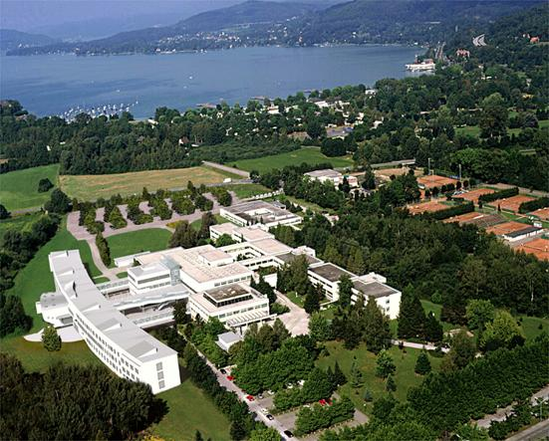
Thank you for your attention
... questions, comments, etc. are welcome …
Ass.-Prof. Dipl.-Ing. Dr. Christian Timmerer
Klagenfurt University, Department of Information Technology (ITEC)
Universitätsstrasse 65-67, A-9020 Klagenfurt, AUSTRIA
christian.timmerer@itec.uni-klu.ac.at
http://research.timmerer.com/
Tel: +43/463/2700 3621 Fax: +43/463/2700 3699
© Copyright: Christian Timmerer

