Slide 1
Rate Adaptations

Slide 2
You are Here
Encoder
Decoder
Middlebox
Sender
Receiver
Network

Slide 3
Sender’s Algorithm
open UDP socket
foreach video frame
chop into packets
add RTP header
send to network

Slide 4
Sender’s Algorithm
open UDP socket
foreach video frame
chop into packets
add RTP header
send to network
wait for 1/fps seconds

Slide 5
Sender’s Algorithm
open UDP socket
foreach video frame
chop into packets
add RTP header
send to network
wait for 1/fps seconds
Send frames at equal time distance.

Slide 6
Sender’s Algorithm
open UDP socket
foreach video frame
chop into packets
foreach packet
add RTP header
send to network
wait for size/bps seconds
Send data at constant bandwidth.

Slide 7
Rules
Transmission rate should match encoding rate
Transmission should not be too bursty

Slide 8
Two Approaches
Just send at a fix rate
or “I hope the network can handle it” approach

Slide 9
Effects on TCP: Simulation
From Sisalem, Emanuel and Schulzrinne paper on
“Direct Adjustment Algorithm.”

Slide 10
Effects on TCP

Slide 11
DAA Parameters
Adaptive RTP flows
Additive increase/multiplicative decrease
50 kb and factor 0.875
RTCP: min 5 sec inter-report time
Loss thresholds: 5% and 10%
TCP
Immediate loss notification
Transmission window is halved

Slide 12
DAA Parameters
Adaptive RTP flows
Additive increase/multiplicative decrease
50 kb and factor 0.875
RTCP: min 5 sec inter-report time
Loss thresholds: 5% and 10%
TCP
Immediate loss notification
Transmission window is halfed

Slide 13
Demo
Effects of UDP on TCP without congestion control

Slide 14
Two Approaches
Just send at a fixed rate
or “I hope the network can handle it” approach
Adapt transmission/encoding rate to network condition

Slide 15
How to Adapt?
if network condition is bad
reduce rate
else if network condition is so-so
do nothing
else if network condition is good
increase rate

Slide 16
How to ..
Know “network condition is bad”?
Increase/decrease rate?

Slide 17
Adapting Output Rate
if network condition is bad
else if network condition is so-so
do nothing
else if network condition is good

Slide 18
Adapting Output Rate
Multiplicative
decrease
if network condition is bad
else if network condition is so-so
do nothing
else if network condition is good
Additive
increase

Slide 19
Adapting Output Rate
r_{i}
Additive increase
Multiplicative decrease

Slide 20
Question:
What should μ and ν be?

Slide 21
Observation 1
Should never change your rate more than an equivalent TCP stream.

Slide 22
Observation 2
μ and ν should depend on network conditions and current rate.
Notes:
current rate high,

Slide 23
Goal: Fair Share of Bottleneck
let r : current rate b : bottleneck bandwidth S : current share
Notes:
current rate high,

Slide 24
Goal: Fair Share of Bottleneck
let r : current rate b : bottleneck bandwidth S : current share
Notes:
current rate high,

Slide 25
S versus ν
ν
S
1

Slide 26
S versus ν
ν
S
1

Slide 27
Value of ν
(Assuming one receiver)

Slide 28
Limit of ν
M : packet size
τ : round trip time
T : period between evaluation of ν
⇒ Limited to the average rate increase a TCP connection
would utilize during periods without losses.

Slide 29
Limit of ν
M : packet size
τ : round trip time
T : period between evaluation of ν

Slide 30
Loss rate versus μ
μ
1
1
loss rate

Slide 31
Loss rate versus μ
μ
1
1
loss rate

Slide 32
Value of μ
where
is the loss rate
k is a constant
(Assuming one receiver)

Slide 33
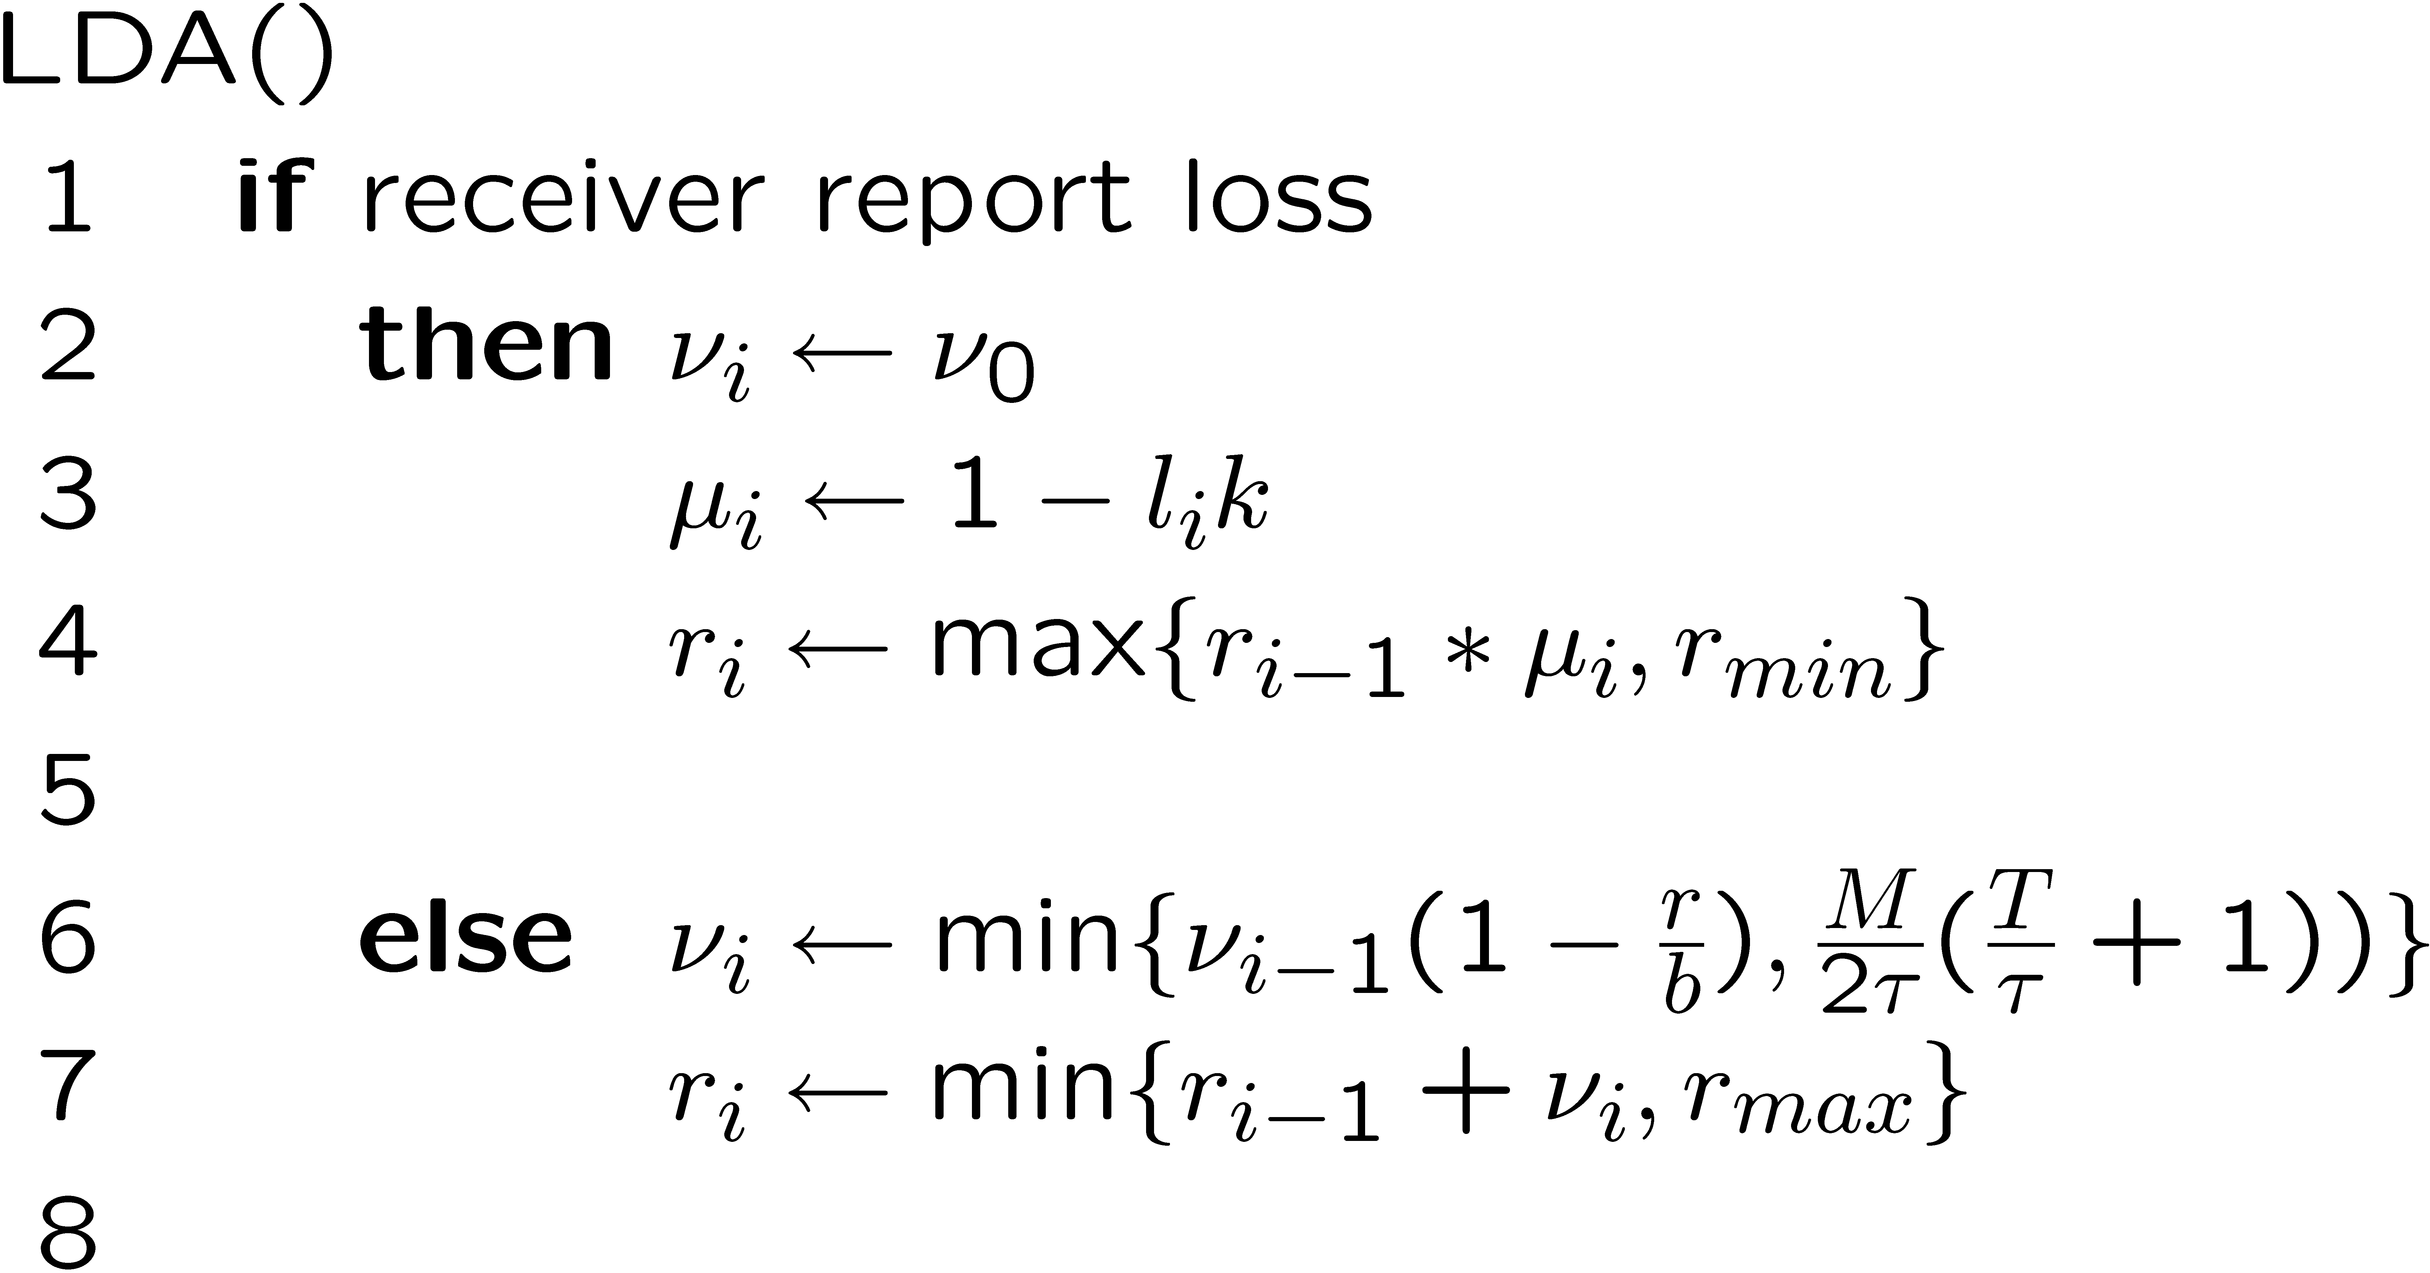
LDA Algorithm

Slide 34
What is Needed?

Slide 35
What is Needed?
We know
v_{i}, r, M, T, τ
But not
b

Slide 36
Estimating b : Packet Pair

Slide 37
Estimating b : Packet Pair

Slide 38
Estimating b : Packet Pair

Slide 39
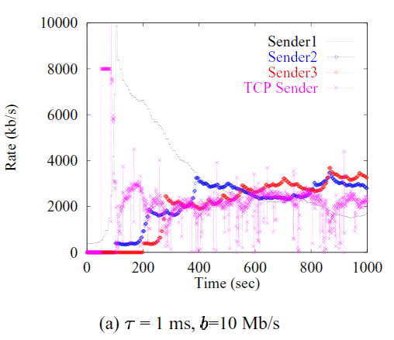
Evaluation

Slide 40
More TCP-Friendly Rate Control

Slide 41
TCP-Equation
Window size behavior in TCP/IP with constant loss probability
T. Ott, J. Kemperman, and M. Mathis
June 1997, HPCS 1997

Slide 42
TCP-Equation
Equation-Based Congestion Control for Unicast Applications
Sally Floyd, Mark Handley, Jitendra Padhye, and Joerg Widmer. August 2000. SIGCOMM 2000

Slide 43
Another Transport Protocol
Datagram Congestion Control Protocol (DCCP)
Implements congestion control but not reliability

Slide 44
Rules
Transmission rate should match encoding rate
Transmission should not be too bursty

Slide 45
Rate Control
Given a rate, how to encode the video with the given rate?

Slide 46
Reduce Frame Rate
Live Video
Stored Video

Slide 47
Reduce Frame Rate
Live Video
Easy (uncompressed input)
Stored Video
Difficult (frame dependencies)

Slide 48
Reduce Frame Resolution
Live Video
Stored Video

Slide 49
Reduce Frame Resolution
Live Video
Easy
Stored Video
Difficult

Slide 50
Increase Quantization
Live Video
Stored Video

Slide 51
Increase Quantization
Live Video
Easy
Stored Video
Difficult

Slide 52
Drop AC components
Live Video
Stored Video

Slide 53
Drop AC components
Live Video
Easy
Stored Video
Easy

Slide 54
Trouble with Stored Video
Reducing rate requires partial decoding and re-encoding
Solution: Layered Video

Slide 55
Layered Video
or “Scalable Video”

Slide 56
Layered Video
Layer 1
Layer 2
Layer 3
Notes:
One of the better proposed solution is called RLM or receiver driven layered multicast. The idea is to divide a stream into multiple layers. The base layer encodes the video stream at a low bitrate, and each additional layer on top enhances its quality. The layers are sent onto different multicast channels, and receivers can choose the number of layers to receive based on their available bandwidth.

Slide 57
Layering Scheme
Temporal (Frame Rate) Layering

Slide 58
Layering Scheme
Spatial (Resolution) Layering

Slide 59
Layering Scheme
DCT Layering; SNR (Quality) Layering
30
30
8
2
30
8
2
0
-6
-1
-6
-1
0
0
1
1
0
0
0
0
0
0
0

Slide 60
Layering Scheme
Fine Granularity Scalability (FGS): e.g., MPEG-4
1 1 0 0 0 0 0 0
1 1 1 0 0 0 1 0
1 0 0 1 0 1 0 1
1 0 0 0 0 1 0 0

Slide 61
Layering Scheme
Fine Granularity Scalability (FGS): e.g., MPEG-4
© Mihaela van der Schaar

Slide 62
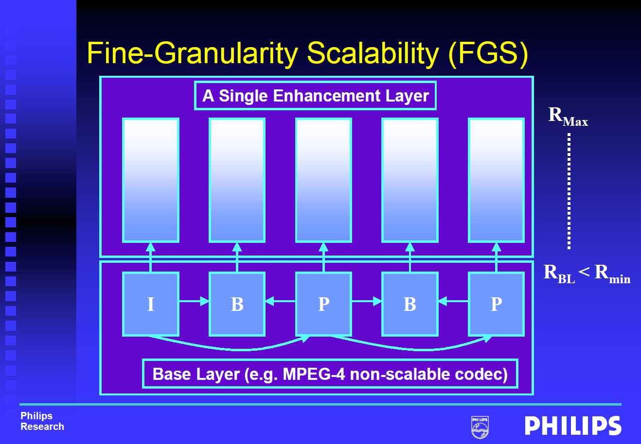
Layering Scheme
Fine Granularity Scalability (FGS): e.g., MPEG-4
© Mihaela van der Schaar

Slide 63
Layering Scheme
Fine Granularity Scalability (FGS): e.g., MPEG-4
© Mihaela van der Schaar

Slide 64
Layered Video
SVC: Scalable Video Coding
Base-layer plus enhancement layers
Each received layer improves the quality
Layer n+1 depends on layer n
MDC: Multiple Description Coding
Layers are independent
Each received layer improves the quality

Slide 65
Layered Video
BUT: Layered video codecs are less bandwidth-efficient than single-layer codecs.

Slide 66
Rate Adaptation
To increase rate, send more layers
To decrease rate, drop some layers

Slide 67
MS Windows Streaming Media

Slide 68
Intelligent Streaming
Multiple-Bit-Rate Encoding
Intelligent Bandwidth Control
bit rate selection
thinning
Intelligent Image Processing

Slide 69
Intelligent Streaming
How exactly does it work?
Sorry, it’s proprietary

Slide 70
Is WSM TCP friendly?
Measurements of the Congestion Responsiveness of Windows Streaming Media
J. Nichols et. al., NOSSDAV 2004
All figures taken from the original NOSSDAV presentation

Slide 71
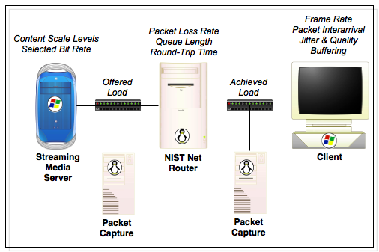

Slide 72
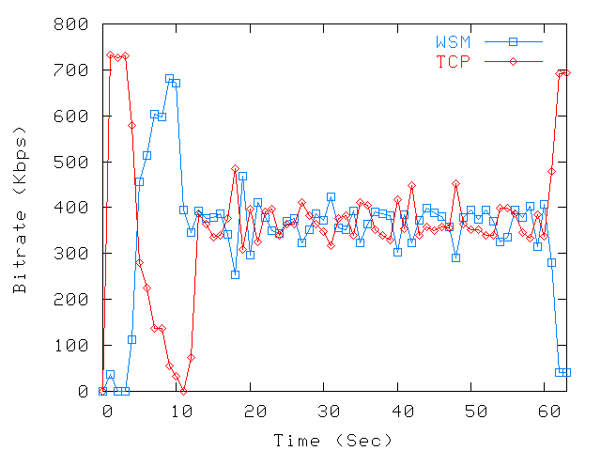
340kbps clip, 725kbps bottleneck

Slide 73
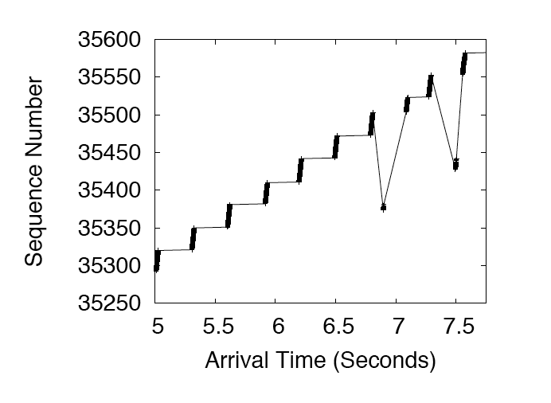
Transmission is Bursty

Slide 74
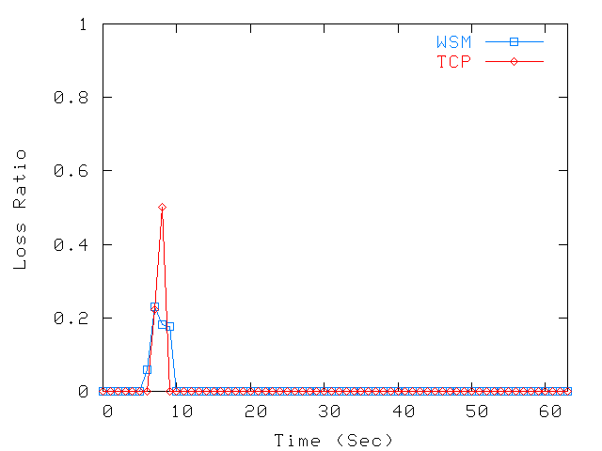
340kbps clip, 725kbps bottleneck

Slide 75
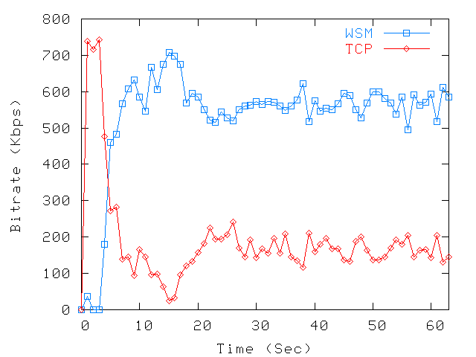
548kbps Clip - 725kbps Bottleneck

Slide 76
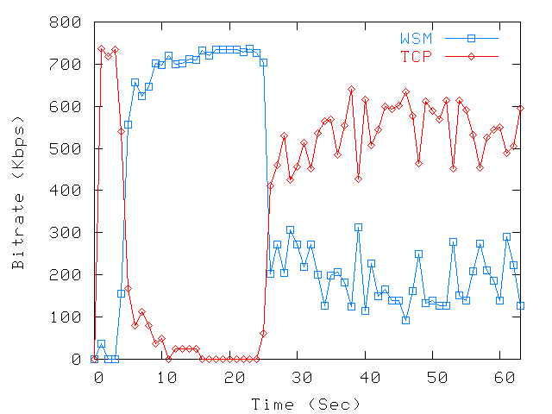
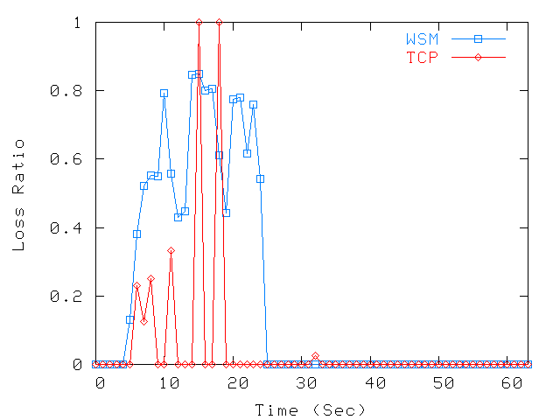
1128kbps Clip - 725kbps Bottleneck

Slide 77
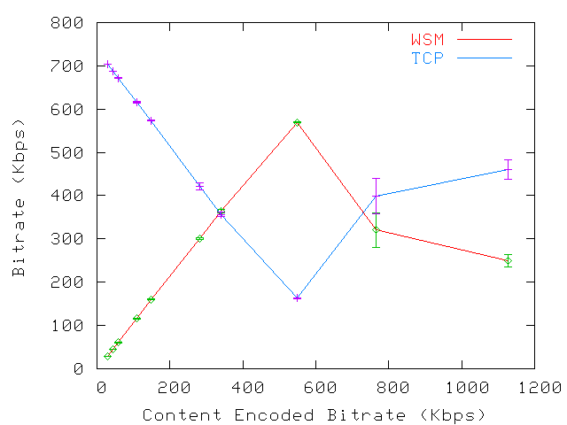
725kbps Bottleneck
Buffering
Playout
Single Encoded Bit Rate

Slide 78
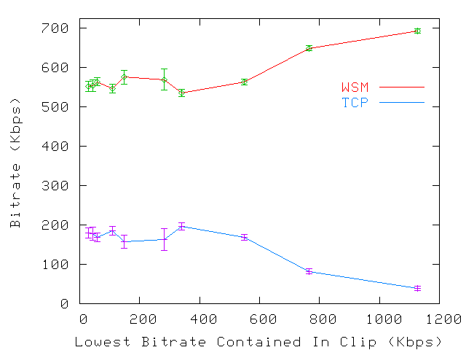
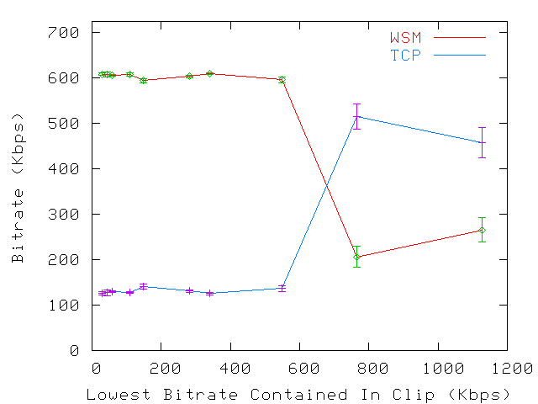
725kbps Bottleneck
Multiple Encoded Bit Rate
Buffering
Playout

Slide 79
Conclusion
Two phases: buffering + playout
Not always TCP-friendly

