Slide 1
Error Recovery

Slide 2
Problems with Internet
Limited Bandwidth
Varying Conditions
Delay Jitter
Packet Loss
Delay
Heterogeneity
:

Slide 3
You Are Here
Encoder
Decoder
Middlebox
Sender
Receiver
Network

Slide 4
Overview
Characteristics of the Internet
General techniques
Error recovery for audio
Effect of loss on MPEG
Error recovery for MPEG

Slide 5
Loss Characteristics of The Internet

Slide 6
Characteristics of Internet
60-70% of paths do not show any loss
Those with loss have an average of 4.5 – 6% packet loss
[Paxson97] End-to-end Internet packet dynamics

Slide 7
Packet Loss Pattern
Number of
Occurrences
1000
Burst
Length
30

Slide 8
Packet Loss Pattern
Number of
Occurrences
1000
Burst
Length
30

Slide 9
Characteristics of Internet
Bursts of loss are typically short (2-3 consecutively loss packets)
Long bursts do occur
Bursts may occur periodically

Slide 10
Wireless Link
Loss rate measured in various environments (e.g., office) 10 ~ 20%
Up to 50% reported!

Slide 11
Gilbert Model
This model is used to simulate packet losses that may include packet trains.
GOOD
BAD

Slide 12
Gilbert Model
p
GOOD
BAD
1-p
1-q
q

Slide 13
A Survey of Packet-Loss Recovery Techniques for Streaming Audio
Perkins, Hodson and Hardman
IEEE Network Magazine 1998

Slide 14
Three Fundamental Techniques
Retransmission
Redundant data
Error concealment
Note: The optimal error recovery technique may be different for frame-based protocols (RTP) and chunk-based protocols (DASH).

Slide 15
1. Retransmission
1
2
3
4
3
X
1
2
4
3

Slide 16
2. Redundant Data
1
2
2
3
3
4
4
5
1
2
2
3
3
4
5

Slide 17
3. Error Concealment
1
2
3
4
1
2
4

Slide 18
Retransmission
for audio

Slide 19
Pros/Cons of Retransmissions
Pros
Low bandwidth overhead
Cons
Additional delay
2-way channel needed with RTP (1-way channel with DASH)

Slide 20
Scalable Retransmission
On packet loss
T = random(0, RTT)
wait for T
multicast NACK
On receiving NACK from others
suppress own NACK

Slide 21
Retransmit when
Group size is small, or with DASH
Loss rate is low
Large latency acceptable

Slide 22
Selective Retransmission
Retransmission based on priority of packets
Important/urgent packets are retransmitted first
Packets are only retransmitted when there is enough time [Papadopoulos and Parulkar, NOSSDAV 1996]

Slide 23
Redundant Data
for audio

Slide 24
Parity Forward Error Correction
1011001
XOR
1000010
0010010
0001001

Slide 25
Parity Forward Error Correction
1011001
1000010
0001001
0010010

Slide 26
Parity FEC Ordering

Slide 27
Parity FEC Ordering

Slide 28
Parity FEC Ordering

Slide 29
Parity FEC Ordering

Slide 30
Parity FEC Ordering

Slide 31
Reed-Solomon Code
RS(n,k)
Data symbols
Parity symbols
RS
n
k
(popular: n = 223)
(popular: k = 32)

Slide 32
Reed-Solomon Code
Data block (length n+k, e.g., 255)
Can correct up to 16 corrupted
symbols per block (32/2)

Slide 33
Media Specific FEC
Transmit low quality chunk i+1 and high quality chunk i together.
1
2
2
3
3
4
4
5
1
2
2
3
3
4
5

Slide 34
Pros/Cons of Redundant Data
Pros
Small additional delay
Only 1-way channel needed
Cons
Computational complexity
Limited correction ability
Additional bandwidth overhead

Slide 35
Interleaving

Slide 36
Pros/Cons of Interleaving
Pros
No bandwidth overhead
“Several small errors vs. one large error”
Cons
Additional delay

Slide 37
Error Concealment

Slide 38
Recreate Lost Information

Slide 39
Effect of Loss on Audio
Speech
Human ears can interpolate
Loss up to length of phoneme can still be tolerable

Slide 40
Insertion-based Repair
Splice
Silence Substitution
Noise Substitution
Repetition

Slide 41
Other Repair Methods
Interpolation
Regeneration

Slide 42
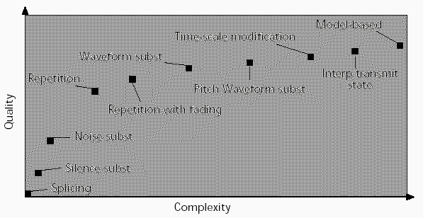
Error Concealment
More complex error concealment algorithms provide better performance (i.e., playback quality)

Slide 43
Pros/Cons of Error Concealment
Pros
No bandwidth overhead
No (small) additional delay
Cons
Computational complexity
May result in visual artifacts
May result in propagation errors

Slide 44
Pros/Cons of Error Concealment
Note:
Error concealment only works for very short amounts of time, i.e., 1 or 2 frames of video or a few milliseconds of audio. Larger interpolations will become very noticeable.
Thus: Does not work for DASH (2 to 5 second streamlets).

Slide 45
Colin’s Recommendations

Slide 46
Non-Interactive Apps
Interleaving
FEC
Retransmission for unicast only

Slide 47
Interactive Applications
Media Specific FEC

Slide 48
Error Concealment
Repeat

Slide 49
Packet Loss Effects on MPEG Video Sent over the Public Internet
Jill Boyce and Robert Gaglianello
ACM Multimedia 1998

Slide 50
Measurement-based Study
Need to understand the problem before proposing solution

Slide 51
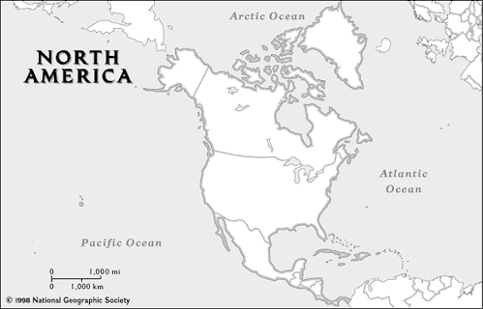
Data Gathering Method
From: NYC¹³ , Austin²¹, London¹⁸
To: Holmdel, NJ

Slide 52
Data Gathering Method
Video:
Two 5-mins MPEG
30 fps
384 kbps and 1 Mbps
GOP: IBBPBBPBBPBBPBB
QSIF 176x112 and SIF 352x240
One row per slice

Slide 53
Average Packet Loss

Slide 54
Frames Affected by Errors (1)
% Frames in Error
Packet Loss Rate

Slide 55
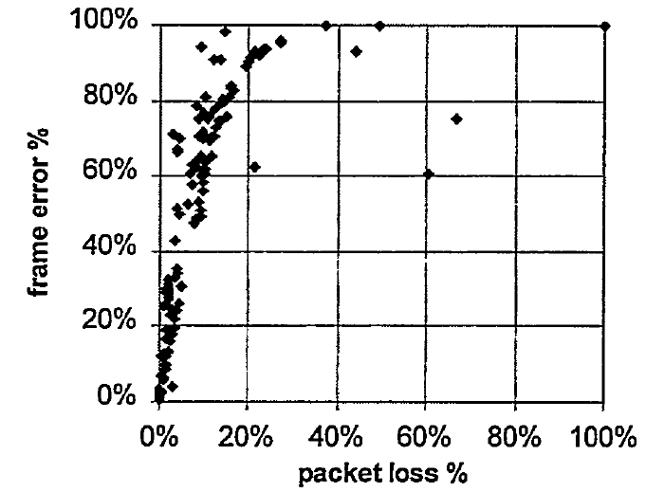
Frames Affected by Errors (2)

Slide 56
Overview of Error Recovery for Video

Slide 57
Methods
Retransmission
Interleaving
Error Concealment
FEC
Limiting Error Propagation
Reference Frame Selection

Slide 58
Reference Frame Selection
I P B B P
I
X

Slide 59
Methods
Retransmission
Interleaving
Error Concealment
FEC
Limiting Error Propagation
Reference Frame Selection
Changing Temporal Pattern

Slide 60
Summary (1)
How to recover packet loss
Retransmission
FEC
Error Concealment

Slide 61
Summary (2)
How to limit the damage of errors
Interleaving
Key frame selection
Change reference frame

