Slide 1
Error Recovery
Supplemental Slides

Slide 2
Case Study: HD video conferencing
Korean Air, Inha University (Seoul), University of Southern California, Pratt & Whitney

Slide 3
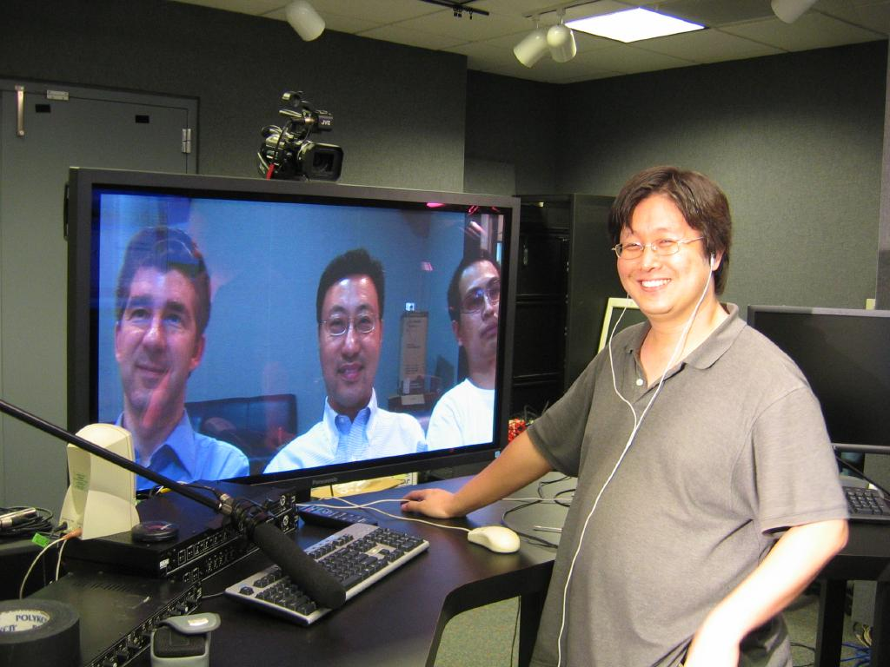
July 2005
USC-Inha Two-way Experiments
USC (Powell Hall of Engineering)

Slide 4
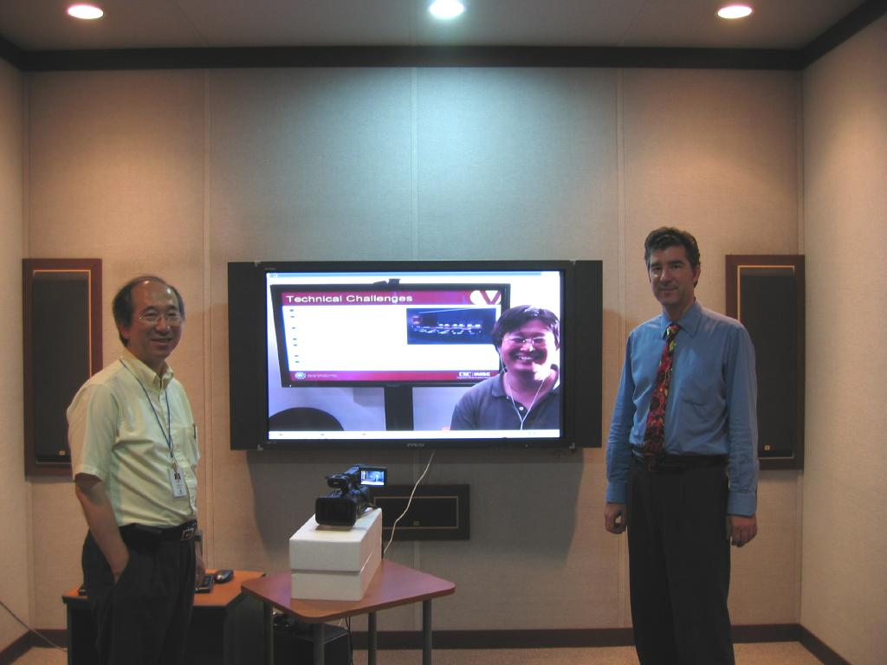
July 2005
USC-Inha Two-way Experiments
Inha University (Memorial Library)

Slide 5
KAL Network Infrastructure
December 2005
Korean Air network infrastructure between Incheon, Kimpo, and Pusan
KAL network &
external ISP (KT)
1 Gbps:
ICN-GMP
50 Mbps:
GMP-PUS

Slide 6
Network Measurements
November 2005
End-to-end packet loss rates of the network path between Kimpo (GMP) and Incheon (ICN) observed during November 15-16, 2005
Network is shared with other business traffic
Loss rates are quite low

Slide 7
Hardware Preparation
December 2005
3 computers purchased in Korea
Computers sent to USC with KAL
Software setup in the IMSC laboratories
  Linux installation
  RCS software installation
  Retransmission configuration
  End-to-end equipment test with local JVC cameras and displays
Computers sent back to KAL HQ

Slide 8
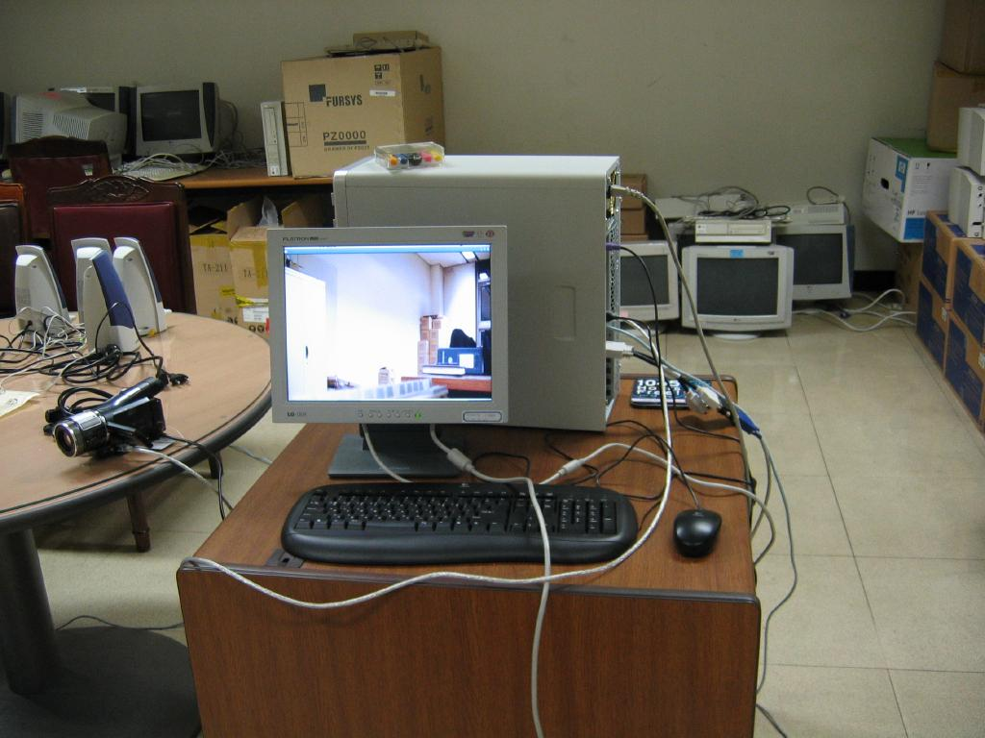
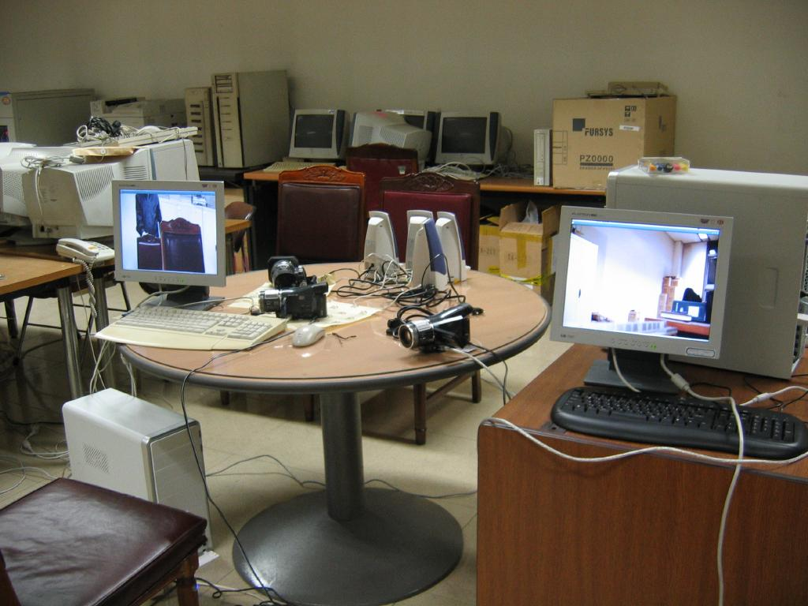
Hardware Test at KAL
December 2005
Re-configuration for Sony HDR-HC1 cameras
Local area network tests

Slide 9
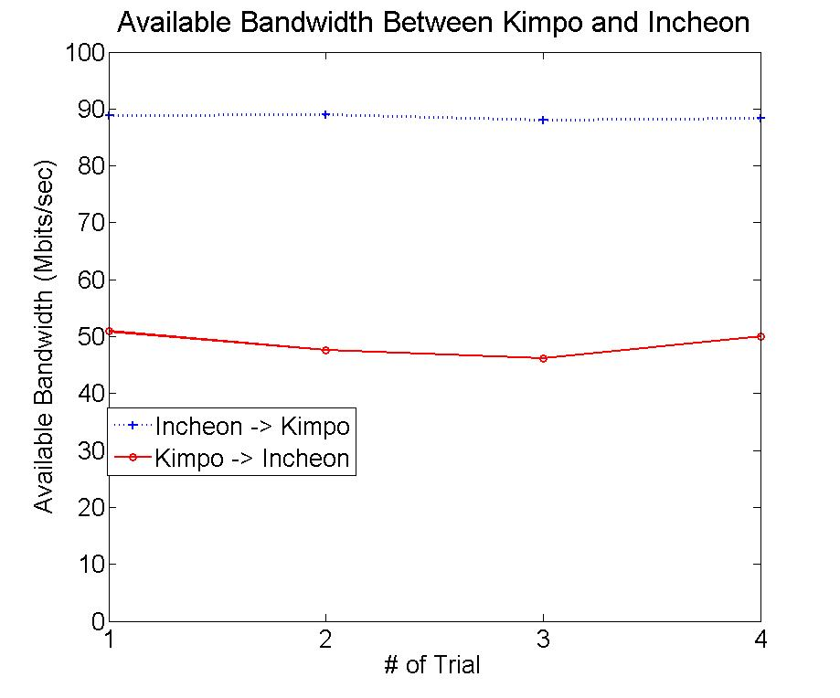
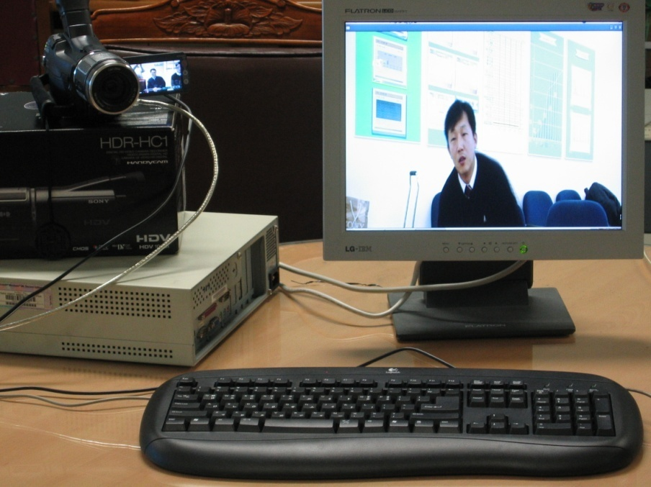
Experiments: ICN ◄▬► GMP
December 2005
Asymmetric environment: 88 Mb/s & 50 Mb/s
Conclusion: ICN - GMP: sufficient BW for HD video
Sufficient headroom for data applications
Bandwidth measurements
Visual quality
Required by RCS

Slide 10
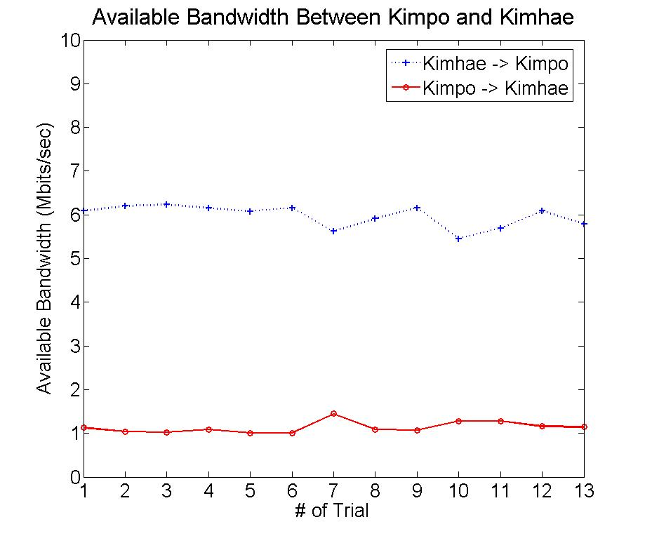
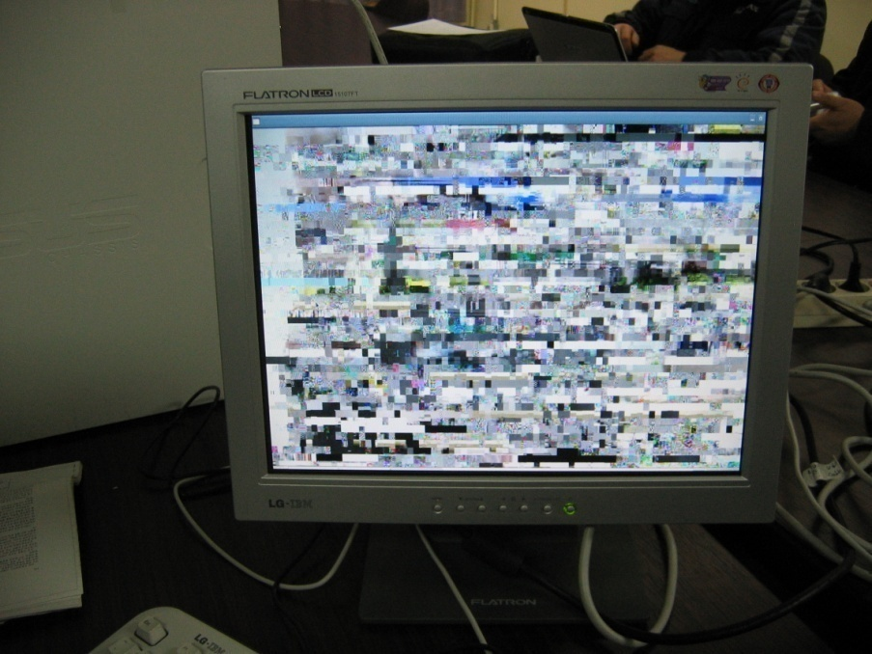
Experiments: ICN ◄▬► PUS
December 2005
Asymmetric environment: 6 Mb/s & 1 Mb/s
GMP - PUS: initially insufficient BW for HD video
Investigated network routers with KAL IT help
Conclusion: replaced router to improve throughput; to be re-tested
Bandwidth measurements
Visual quality

Slide 11
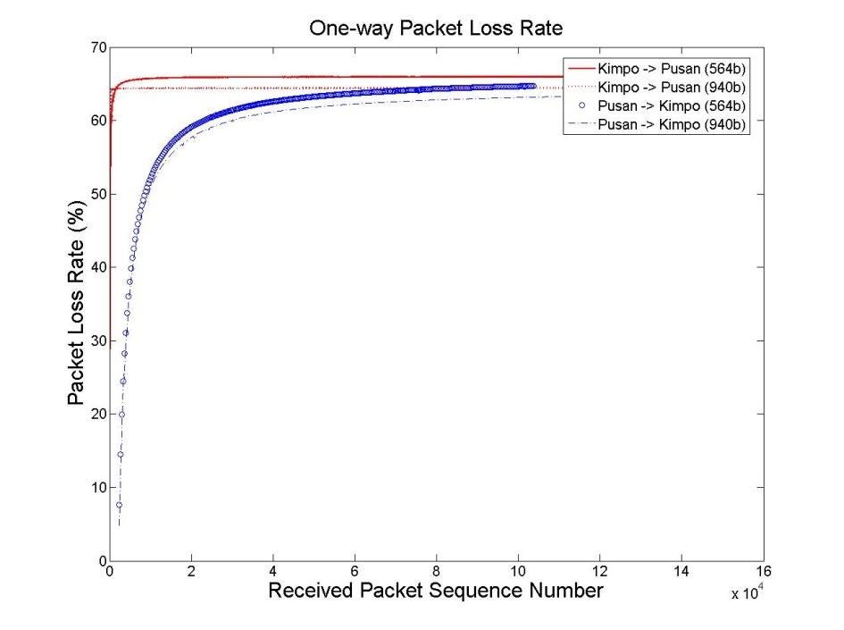
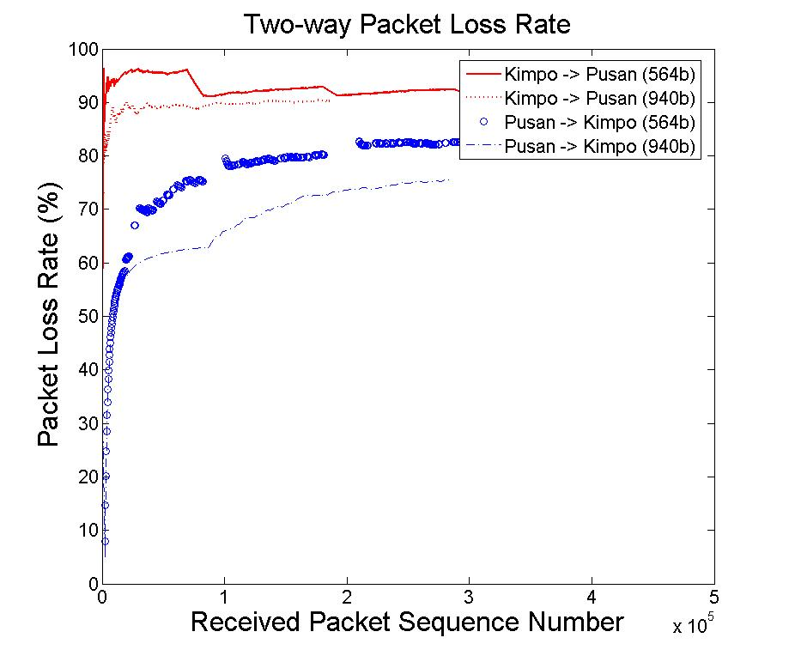
Measurements: Packet Loss Rate
December 2005
Path: ICN - PUS
Two packet sizes: 564 bytes and 940 bytes
Conclusion: GMP - PUS loss rate very high
One-way packet loss rate
Two-way packet loss rate

Slide 12
Packet Loss Error Recovery
Selective retransmission protocol is used to recover
from lost data
Effectiveness of protocol is tested in lab environment
Gilbert Model is used to induce losses into transmission
Transmission delay is chosen to be 10 ms
(expected latency in
Korea)

Slide 13
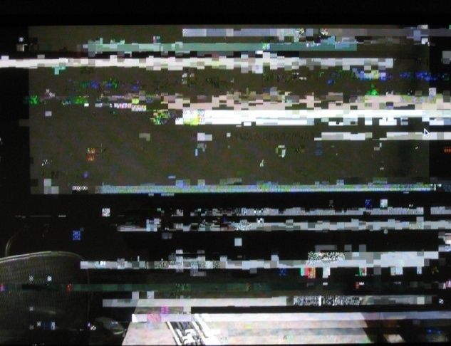
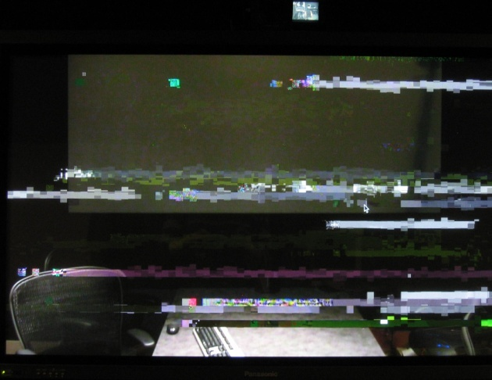
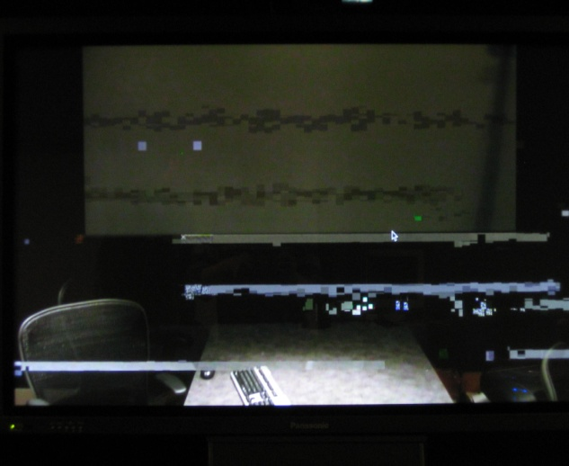
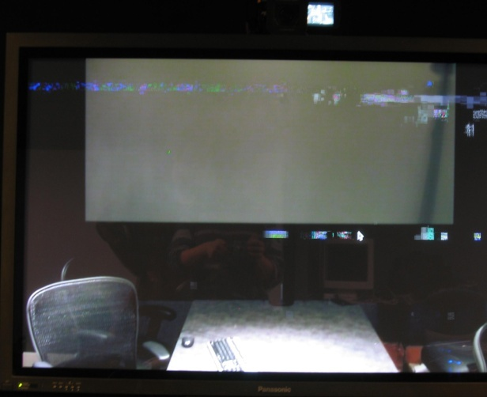
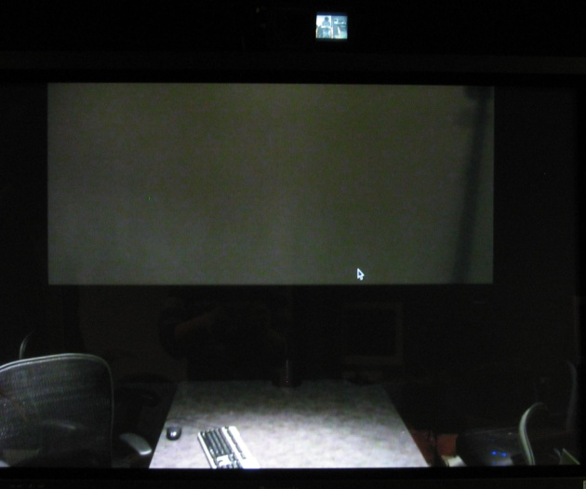
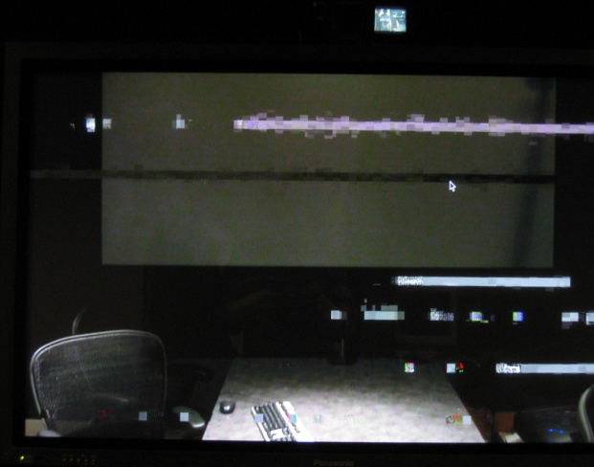
Packet Loss Error Recovery
Sept. - Dec. 2005
Selective retransmission protocol
(ICN-GMP Link)
10% Loss Rate
5% Loss Rate
1% Loss Rate
With Retransmissions
With Retransmissions
With Retransmissions

Slide 14
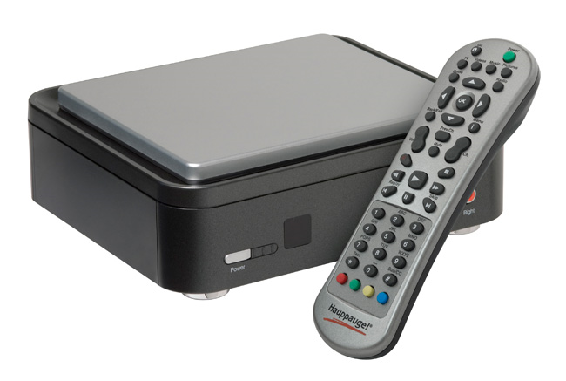
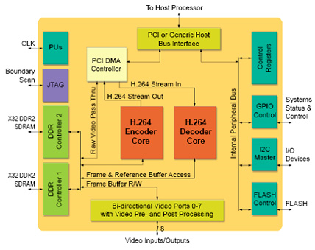

Current Hardware Codecs
Hauppauge HD-PVR
Cavium PureVu™ CNW31XX

Slide 15

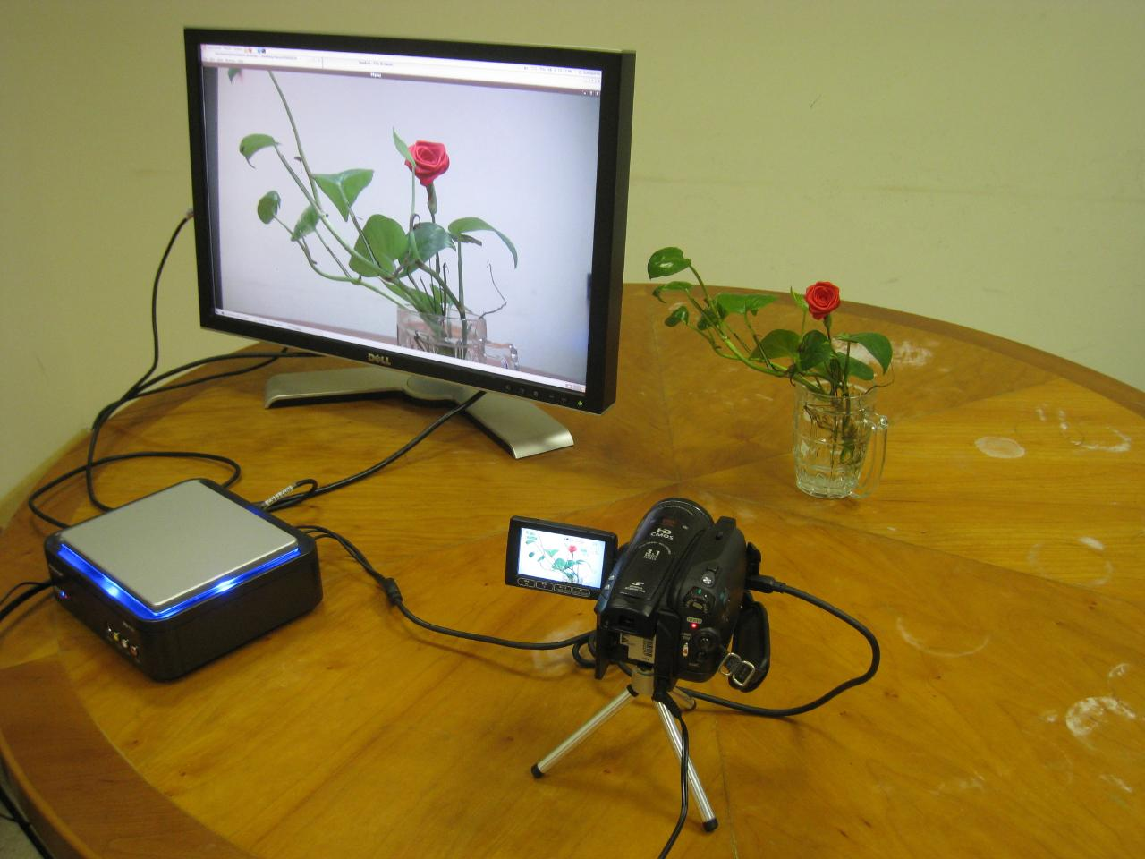
HD-PVR H.264 Encoder

Slide 16
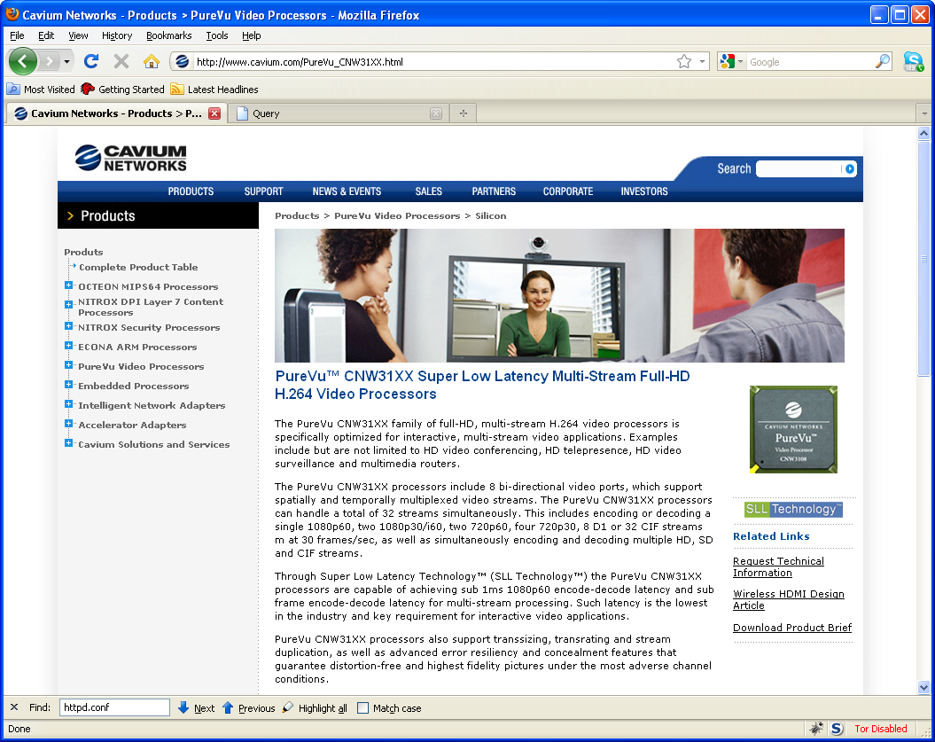

Slide 17
Error Control Techniques for Interactive Low Bitrate Video Transmission over The Internet
Injong Rhee
SIGCOMM ‘98

Slide 18
Basic Idea
“Better Late Than Never!”, or
Late packet is still useful

Slide 19
MPEG Frame Pattern
I
B
B
P
B
B
P
I
P
B
B
P
B
B

Slide 20
H.261 Error Propagation
I
P
P
P
P
P
P
X
X
X
X
X
X
loss
I
P
P
P
P
P
P
X
X
X
X
retransmission

Slide 21
H.261 Frame Pattern
I
P
P
P
P
P
P
X
loss

Slide 22
H.261 Frame Pattern
I
P
P
P
P
P
P
X
X
X
retransmission
loss

Slide 23
PTDD
Periodic Temporal Dependency Distance
Large PTDD
  Higher Chance of Repair
  Longer Error Propagations
  Less Temporal Redundancy

Slide 24
QAL
I
P
P
P
Enhancement
Layer
I
P
P
P
Base Layer

Slide 25
QAL
I
P
P
P
X
Enhancement
Layer
I
P
P
P
Base Layer
+ FEC

Slide 26
QAL + PTDD
I
P
P
P
Enhancement
Layer
I
P
P
P
Base Layer

Slide 27
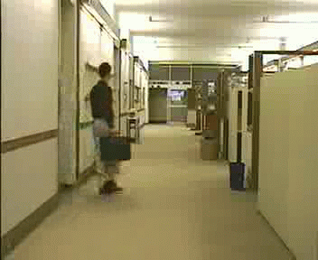
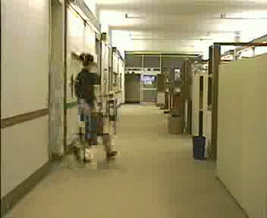
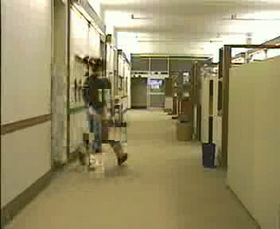
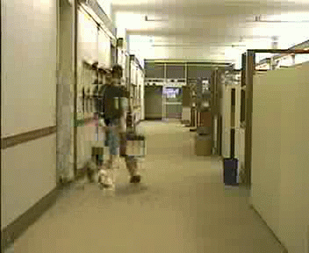
Error Propagation

Slide 28
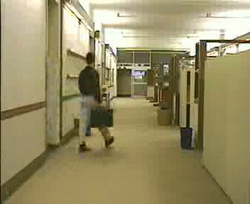
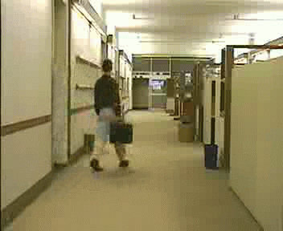
Recovery from Error Propagation

Slide 29

Frame “quality”
PSNR =

Slide 30
PSNR vs. Loss Rate
PSNR
Packet Loss Rate

Slide 31
Today’s Summary

Slide 32
How to recover packet loss
Retransmission
FEC
Error Concealment

Slide 33
Limit the damage of error
Interleaving
Key frame selection
Change reference frame

