Slide 1
Error Recovery

Slide 2
Problems with Internet
Limited Bandwidth
Varying Conditions
Delay Jitter
Packet Loss
Delay
Heterogeneity
:

Slide 3
You Are Here
Encoder
Decoder
Middlebox
Sender
Receiver
Network

Slide 4
Overview
Characteristics of the Internet
General techniques
Error recovery for audio
Effect of loss on MPEG
Error recovery for MPEG

Slide 5
Loss Characteristics of The Internet

Slide 6
Characteristics of Internet
60-70% of paths do not show any loss
Those with loss have an average of 4.5 – 6% packet loss
[Paxson97] End-to-end Internet packet dynamics

Slide 7
Packet Loss Pattern
Number of
Occurrences
1000
Burst
Length
30

Slide 8
Characteristics of Internet
Bursts of loss are typically short (2-3 consecutively loss packets)
Long bursts do occur
Bursts may occur periodically

Slide 9
Wireless Link
Loss rate measured in my office 10 ~ 20%
Up to 50% reported!

Slide 10
Gilbert Model
This model is used to simulate packet losses that may include packet trains.
GOOD
BAD

Slide 11
A Survey of Packet-Loss Recovery Techniques for Streaming Audio
Perkins, Hodson and Hardman
IEEE Network Magazine 1998

Slide 12
Three Fundamental Techniques
Retransmission
Redundant data
Error concealment
Note: The optimal error recovery technique may be different for frame-based protocols (RTP) and chunk-based protocols (DASH).

Slide 13
Retransmission
1
2
3
4
3
X
1
2
4
3

Slide 14
Redundant Data
1
2
2
3
3
4
4
5
1
2
2
3
3
4
5

Slide 15
Error Concealment
1
2
3
4
1
2
4

Slide 16
Retransmission
for audio

Slide 17
Pros/Cons of Retransmissions

Slide 18
Scalable Retransmission
On packet loss
  T = random(0, RTT)
  wait for T
  multicast NACK
On receiving NACK from others
  suppress own NACK

Slide 19
Retransmit when
Group size is small, or with DASH
Loss rate is low
Large latency acceptable

Slide 20
Selective Retransmission
Retransmission based on priority of packets
Important/urgent packets are retransmitted first
Packets are only retransmitted when there is enough time [Papadopoulos and Parulkar, NOSSDAV 1996]

Slide 21
Redundant Data
for audio

Slide 22
Parity Forward Error Correction
1011001
XOR
1000010
0010010
0001001

Slide 23
Parity Forward Error Correction
1011001
1000010
0001001
0010010

Slide 24
Parity FEC Ordering

Slide 25
Parity FEC Ordering

Slide 26
Parity FEC Ordering

Slide 27
Parity FEC Ordering

Slide 28
Parity FEC Ordering

Slide 29
Reed-Solomon Code
RS(n,k)
Data symbols
Parity symbols
RS
n
k
(popular: n = 223)
(popular: k = 32)

Slide 30
Reed-Solomon Code
Data block (length n+k, e.g., 255)
Can correct up to 16 corrupted
symbols per block (32/2)

Slide 31
Media Specific FEC
Transmit low quality chunk i+1 and high quality chunk i together.
1
2
2
3
3
4
4
5
1
2
2
3
3
4
5

Slide 32
Pros/Cons of Redundant Data

Slide 33
Interleaving

Slide 34
Pros/Cons of Interleaving

Slide 35
Error Concealment

Slide 36


Recreate Lost Information

Slide 37
Effect of Loss on Audio
Speech
  Human ears can interpolate
  Loss up to length of phoneme can still be tolerable

Slide 38
Insertion-based Repair
Splice
Silence Substitution
Noise Substitution
Repetition

Slide 39
Other Repair Methods
Interpolation
Regeneration

Slide 40
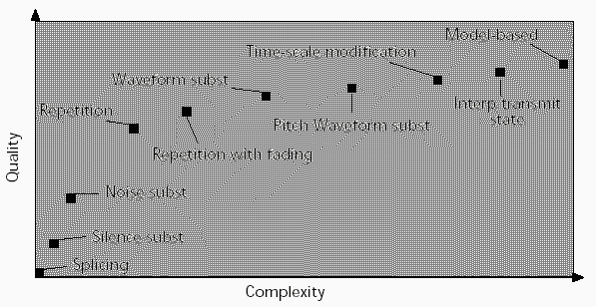
Error Concealment
More complex error concealment algorithms provide better performance (i.e., playback quality)

Slide 41
Colin’s Recommendations

Slide 42
Non-Interactive Apps
Interleaving
FEC
Retransmission for unicast only

Slide 43
Interactive Applications
Media Specific FEC

Slide 44
Error Concealment
Repeat

Slide 45
Packet Loss Effects on MPEG Video Sent over the Public Internet
Jill Boyce and Robert Gaglianello
ACM Multimedia 1998

Slide 46
Measurement-based Study
Need to understand the problem before proposing solution

Slide 47
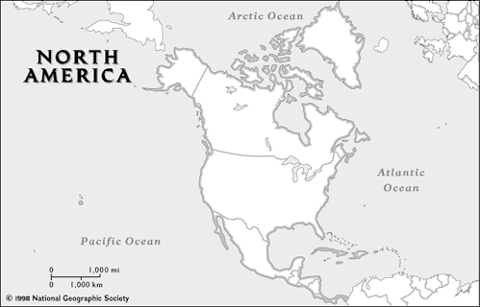
Data Gathering Method
From: NYC¹³ , Austin²¹, London¹⁸
To: Holmdel, NJ

Slide 48
Data Gathering Method
Video:
  Two 5-mins MPEG
  30 fps
  384 kbps and 1 Mbps
  GOP: IBBPBBPBBPBBPBB
  QSIF 176x112 and SIF 352x240
  One row per slice

Slide 49
Average Packet Loss

Slide 50
Frames Affected by Errors (1)
% Frames in Error
Packet Loss Rate

Slide 51
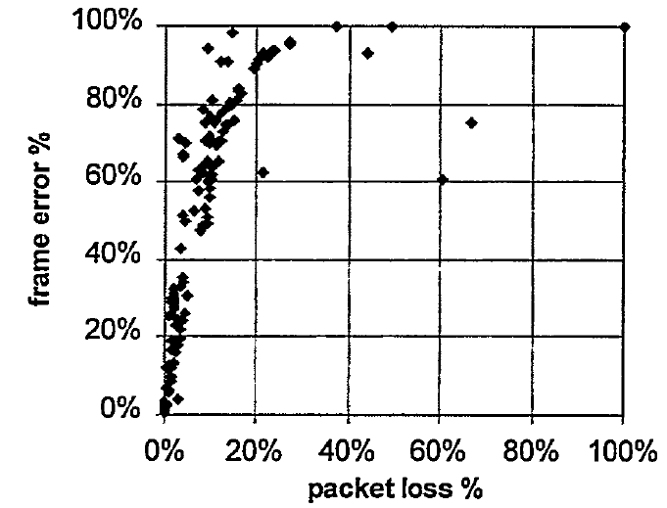
Frames Affected by Errors (2)

Slide 52
Overview of Error Recovery for Video

Slide 53
Methods
Retransmission
Interleaving
Error Concealment
FEC
Limiting Error Propagation
  Reference Frame Selection

Slide 54
Reference Frame Selection
I P B B P
I
X

Slide 55
Methods
Retransmission
Interleaving
Error Concealment
FEC
Limiting Error Propagation
  Reference Frame Selection
  Changing Temporal Pattern

Slide 56
Summary (1)
How to recover packet loss
  Retransmission
  FEC
  Error Concealment

Slide 57
Summary (2)
How to limit the damage of errors
  Interleaving
  Key frame selection
  Change reference frame

