Slide 1
Proxy Caching for Streaming Media

Slide 2
You Are Here
Encoder
Decoder
Middlebox
Sender
Receiver
Network

Slide 3
Types of Caches
Browser cache
  For one user
Proxy cache
  Shared cache between clients and server
Gateway cache
  Content Delivery Networks (CDN)
  “Scale” server

Slide 4
Gateway Caches
Deployed (or hired) by web site owners
Makes sites more scalable and reliable
Content is pushed out to caching nodes around the world
Use DNS redirection to find closest cache
Commercial CDNs:
  Akamai, Amazon CloudFront, …

Slide 5
Cache Proxies for Web
A

Slide 6
Hierarchical Caching
B
A

Slide 7
Cooperative Caching
A
B

Slide 8
Distributed Caching
A
B

Slide 9
Streaming Media vs. Webpage

Slide 10
Video Access Pattern
by S. Acharya and B. Smith in 1999
  Study at Lulea University, Sweden
  55% complete, 45% stop very early
  High temporal locality

Slide 11
Prefix Access Distribution

Slide 12

Video Popularity
For modeling of video popularity
(Note: this is not a measurement)
Curve fitting to Zipf “Law”
Probability of access to i-th most popular video can be approximated as:
Usually: 0.8 ≤ γ ≤ 1.2

Slide 13
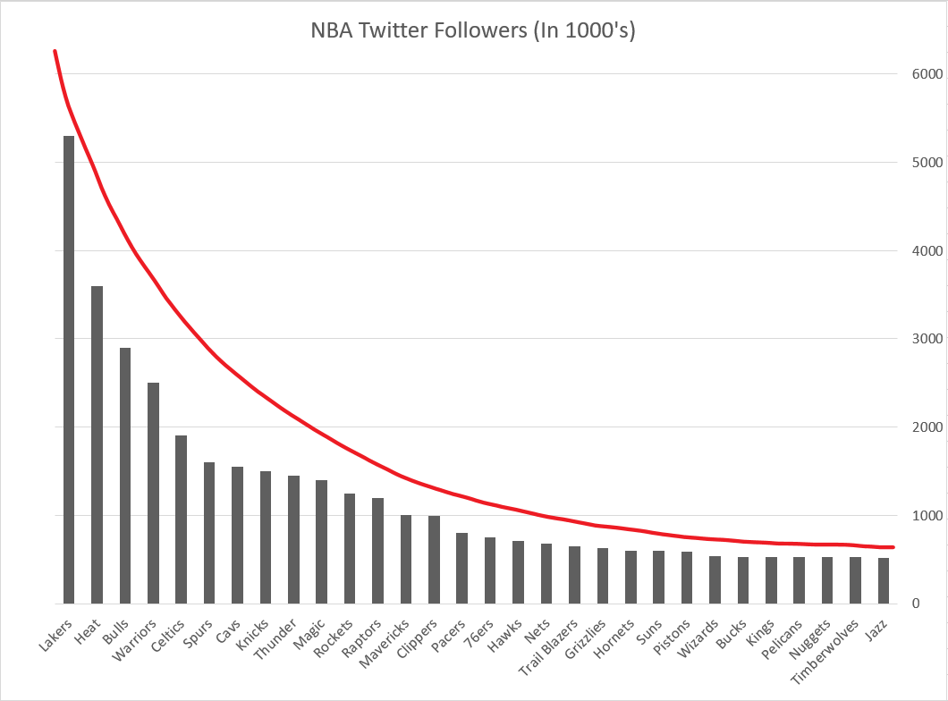
Video Popularity: Zipf’s Law

Slide 14
Benefits of Caching

Slide 15
Reduce Access Latency
:)
:(

Slide 16
Reduce Server Load

Slide 17
Reduce Start-up Latency

Slide 18
Hide Network Congestion

Slide 19
Other Issues
What to cache?
Who to fetch from?
When cache is full, what to kick out?
How to measure popularity?
Can cache adapt to popularity?

Slide 20
What to Cache?

Slide 21
Segmentation
Cache “all or none” is bad
Divide media file into segments S and consider each segment individually

Slide 22
Effects of Segment Size S
Large S : Low utilization
Small S : Lots of gaps
(fragmentation)

Slide 23
Prefix Caching Policy
1 Chunk = k segments

Slide 24
Caching Policy
Basic unit of caching: segment
Cache prefix in chunk
Replace suffix in chunk
Never replace segments in currently accessed chunk

Slide 25
Where To Fetch From?

Slide 26
Cooperative Caching
A
B

Slide 27
Fetch from Server
Server
B
A
Client 1
Client 2
Notes:
server unicast to client 2

Slide 28
Fetch from Fellow Proxy
Server
B
A
Client 1
Client 2
Notes:
server unicast to client 2

Slide 29
Issues
How to advertise?
How to choose “helper”?

Slide 30
How to Advertise?
Balance between
  network load
  freshness of information

Slide 31
Scalable Advertisement
Expanding Ring Advertisement
TTL PERIOD
16 1
32 2
64 4
128 8

Slide 32
How to Choose Helper?
Consideration for Static Cache
  network distance (1,2,3,4)
  number of streams being served
  avoid frequent switches
Build a cost function, integrating the metrics

Slide 33

Cost Function
Cost for retrieving a segment from node X to node Y =

Slide 34
Algorithm
Consider the next gap in local caches.
Find the next helper with minimum cost, which can fill in at least k segments in gaps.

Slide 35
Distributed Caching
Y. Chae et al.
JSAC 2002

Slide 36
Cooperative vs. Distributed
With both types, the caching nodes work together and are aware of each others content (global segment map). However:
  Cooperative caching caches independently, while
  Distributed caching caches as a team.

Slide 37
Cold Start
Server
B
A
new clip!

Slide 38
Segment Map
Local segment map
  Which segment should I cache?
Global segment map
  Who is supposed to cache what?

Slide 39
Cache Hit
Server
B
A

Slide 40
Cache Miss
Server
B
A

Slide 41
Distributed Caching
Server
B
A

Slide 42
Problems
Who should cache what?
Which segment to kick out?
How to adapt segment distribution?

Slide 43
Who Should Cache What?
RCache scheme
  Segment video into equal size segments
  A proxy will cache each segment with some probability

Slide 44
RCache
N_{p} proxies
video of length L_{v}
divide into N_{s} equal segments
Each proxy caches each segment with a/N_{p} probability

Slide 45
Analysis
Probability that whole video is cached is
N_{s:}: num of segments
N_{p:} num of proxies
a/N_{p:} prob of caching 1 segment

Slide 46
RCache’s Segmentation
Video is divided into segments of equal length
Can we do better?

Slide 47
Bimodal Distribution

Slide 48
Silo
segment size
probability
of storage

Slide 49
Further Improvement
segment size
probability
of storage

Slide 50
Problems
Who should cache what?
Which segment to kick out?
How to redistribute data?

Slide 51
Segment “Popularity”
For each video i
For each segment j
F(i,j) = Prob(i is accessed)*Prob(j is accessed)

Slide 52
Rainbow Algorithm
Videos
less popular
Segment Number

Slide 53
Rainbow Algorithm
Problem:
  Many large videos – too many segments
  computationally expensive to sort
Solution:
  Just approximate by quantizing popularity

Slide 54
Rainbow Algorithm
Videos
less popular
Segment Number

Slide 55
Problems
Who should cache what?
Which segment to kick out?
How to redistribute data?

Slide 56
Data Redistribution
When popularity changes, need to redistribute.
Redistribute “on-demand” (lazy)

Slide 57
Cache Token
Each segment have two bits
  (T,C)
T: I am suppose to have the segment
C: I have the segment

Slide 58
Data Redistribution
(T=1,C=1)
(T=0,C=0)
(T=1,C=0)
(T=0,C=1)

Slide 59
Example
T=0,C=1
T=0,C=1
old
I
J
new
A
B
C
D
T=1,C=0
T=1,C=0
T=1,C=0
T=1,C=0

Slide 60
Example
T=1,C=1
T=0,C=1
old
I
J
new
A
B
C
D
T=0,C=0
T=1,C=0
T=1,C=0
T=1,C=0

Slide 61
Example
T=1,C=1
T=1,C=1
old
I
J
new
A
B
C
D
T=0,C=0
T=1,C=0
T=1,C=0
T=0,C=0

Slide 62
Example
T=1,C=1
T=1,C=1
old
I
J
new
A
B
C
D
T=0,C=0
T=1,C=1
T=1,C=0
T=0,C=0

Slide 63
Quality Adaptive Caching
Reza Rajaie et al.
INFOCOM 2000

Slide 64
Objective
Quality adaptive streaming
  Use Scalable Video Coding (SVC)
How to integrate with proxy caching?
See Additional Reading and Supplemental Slides

Slide 65
Rules of Thumb
Simple rules that should be considered in the design of caching architectures
  Cache must be large enough to hold “working set”, otherwise thrashing will happen
  Unified caches perform better than partitioned caches

Slide 66
Summary (1)
Streaming media caching
  Is essential for large-scale, high performance
  Consider popularity of:
    Videos
    Segments in videos
  Cooperative and distributed caching

Slide 67
Summary (2)
Streaming media caching issues:
  What to cache?
  Who to fetch from?
  When cache is full, what to kick out?
  How to measure popularity?
  Can cache adapt to popularity?
Complexity vs. practicality

