Slide 1

Achieving Sublinear Complexity under Constant 𝑇 in 𝑇-interval Dynamic Networks
Ruomu Hou Irvan Jahja Yucheng Sun Jiyan Wu Haifeng Yu
National University of Singapore

Slide 2
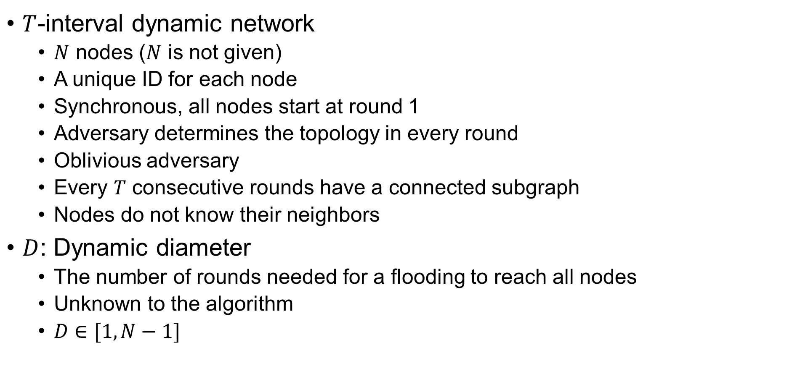
Our Settings – Nodes and Topology
$T$-interval dynamic network
  $N$ nodes ($N$ is not given)
  A unique ID for each node
  Synchronous, all nodes start at round 1
  Adversary determines the topology in every round
  Oblivious adversary
  Every $T$ consecutive rounds have a connected subgraph
  Nodes do not know their neighbors
$D$: Dynamic diameter
  The number of rounds needed for a flooding to reach all nodes
  Unknown to the algorithm
  $D∈[1,N−1]$

Slide 3
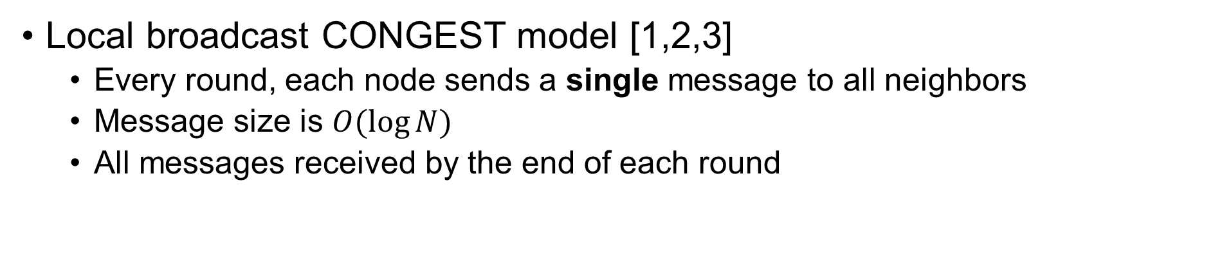
Our Settings – Communication
Local broadcast CONGEST model [1,2,3]
  Every round, each node sends a single message to all neighbors
  Message size is $O(\log{N})$
  All messages received by the end of each round
[1] Ahmadi and Kuhn. 2017. In ALGOSENSORS.
[2] Haeupler and Karger. 2011. In PODC.
[3] Peleg. 1987. Society for Industrial and Applied Mathematics.

Slide 4
Problems We Consider
We consider the following fundamental problems:
Count
LeaderElection
Consensus
Max/Sum
ConfirmedFlood
Time Complexity as the measure of goodness: expected number of rounds needed for all nodes to output and terminate, under worst-case input and worst-case oblivious adversary
In the following, we will focus on Count

Slide 5
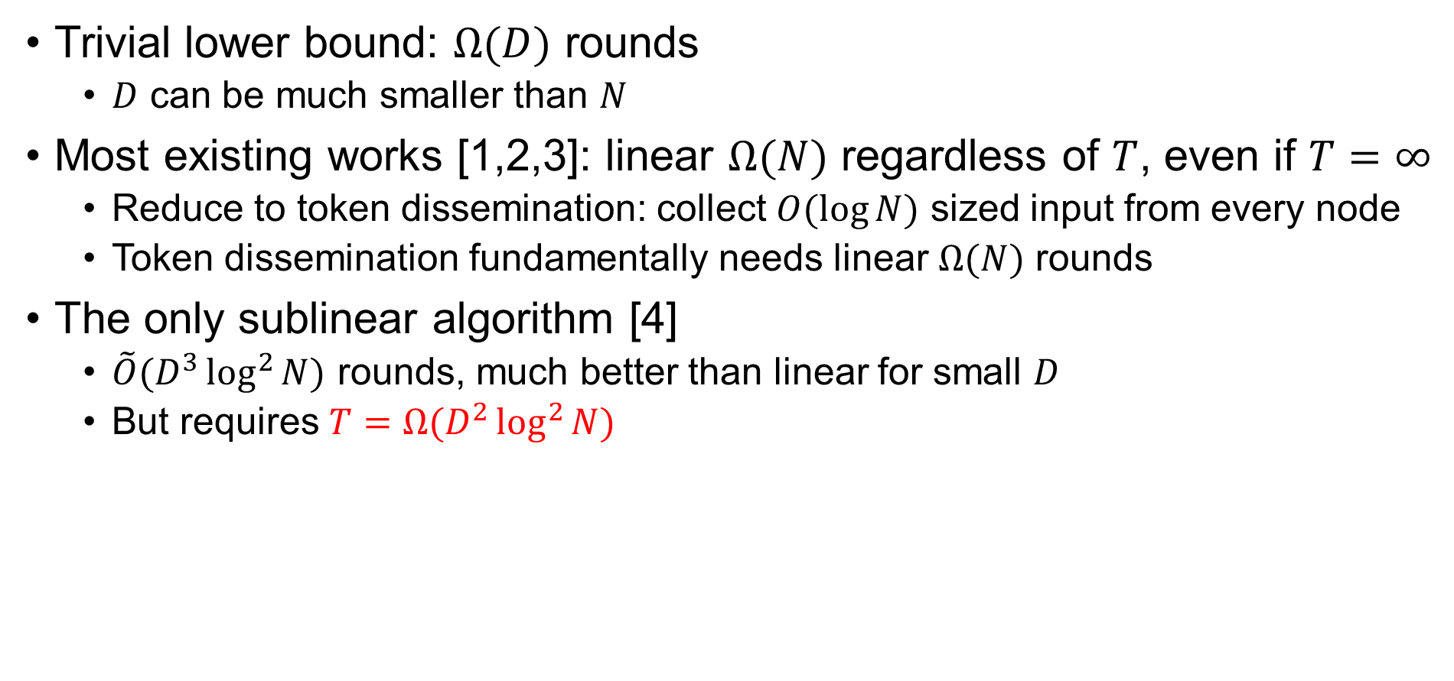
Existing Results
Trivial lower bound: $Ω(D)$ rounds
  $D$ can be much smaller than $N$
Most existing works [1,2,3]: linear $Ω(N)$ regardless of $T$, even if $T=∞$
  Reduce to token dissemination: collect $O(\log{N})$ sized input from every node
  Token dissemination fundamentally needs linear $Ω(N)$ rounds
The only sublinear algorithm [4]
  $\tilde{O}(D^{3}\log^{2}{N})$ rounds, much better than linear for small $D$
  But requires $T=Ω(D^{2}\log^{2}{N})$
[1] Das Sarma, Molla, and Pandurangan. 2012. In DISC.
[2] Haeupler and Karger. 2011. In PODC.
[3] Kuhn, Lynch, and Oshman. 2010. In STOC.
[4] Jahja and Yu. 2020. In SPAA.

Slide 6
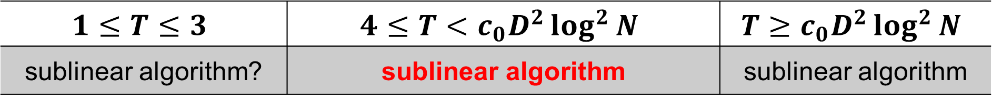
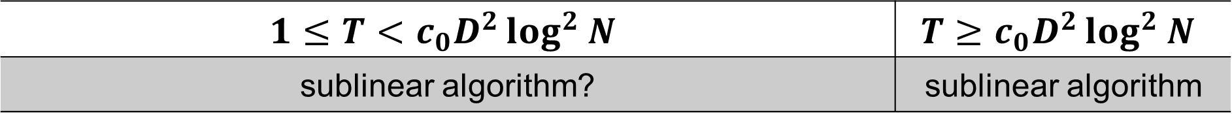

Our Results
The only sublinear algorithm [1] requires $T=Ω(D^{2}\log^{2}{N})$
Sublinear complexity for smaller $T$?
Our main result: sublinear algorithm for constant $T$
  $\tilde{O}(DN^{6/7})$ rounds for all previous problems, under $T≥4$
$$1≤T<c_{0}D^{2}\log^{2}{N}$$ | $$T≥c_{0}D^{2}\log^{2}{N}$$
sublinear algorithm? | sublinear algorithm
$$1≤T≤3$$ | $$4≤T<c_{0}D^{2}\log^{2}{N}$$ | $$T≥c_{0}D^{2}\log^{2}{N}$$
sublinear algorithm? | sublinear algorithm | sublinear algorithm
[1] Jahja and Yu. 2020. In SPAA.

Slide 7
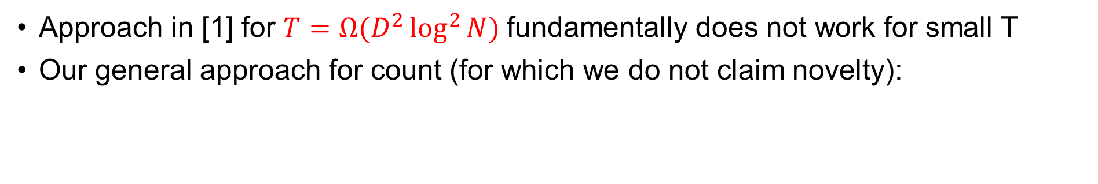
Our General Approach
Approach in [1] for $T=Ω(D^{2}\log^{2}{N})$fundamentally does not work for small T
Our general approach for count (for which we do not claim novelty):
Challenges
1
Challenges in random walk
  Existing ones are slow
  Hard to implement with unknown neighbors
Some values are not collected
  Too many/few sinks
  Random walk too short
  Sink flooding for too many/too few rounds
1
5
5
5
5
5
5
5
5
1
3
3
3
3
3
3
3
1
3
sink
1
sink
2
1
1
1
1
1
[1] Jahja and Yu. 2020. In SPAA.

Slide 8
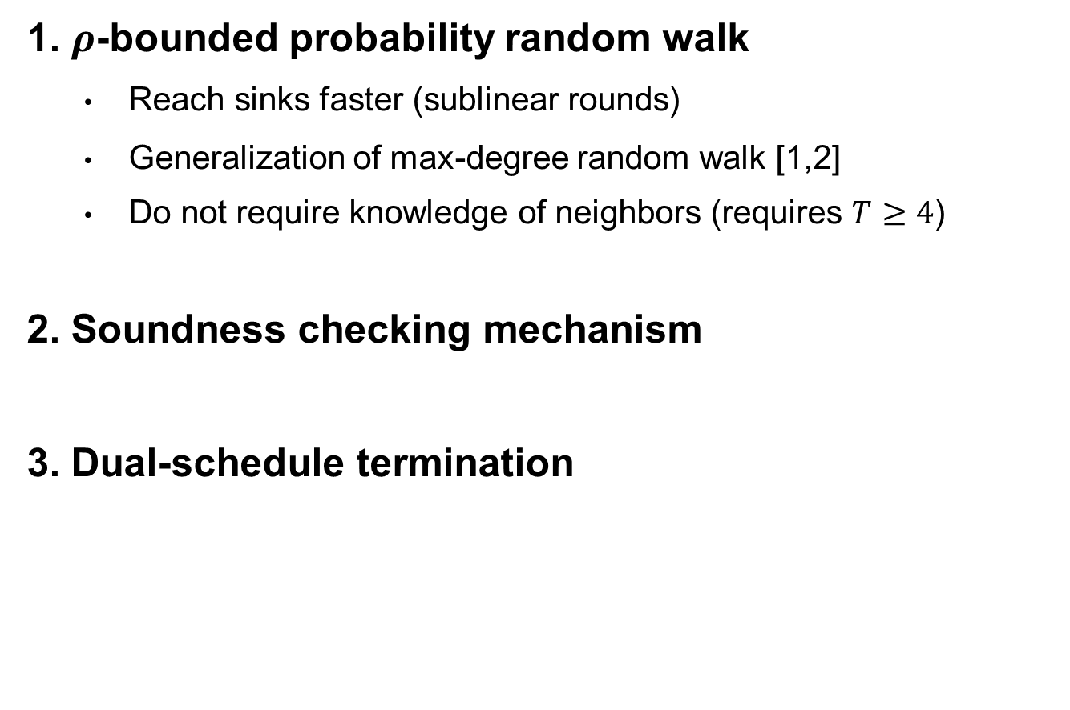
Our Novel Techniques to Overcome the Challenges
Challenges
1. $ρ$-bounded probability random walk
  Reach sinks faster (sublinear rounds)
  Generalization of max-degree random walk [1,2]
  Do not require knowledge of neighbors (requires $T≥4$)
2. Soundness checking mechanism
3. Dual-schedule termination
Challenges in random walk
  Existing ones are slow
  Hard to implement with unknown neighbors
Some values are not collected
  Too many/few sinks
  Random walk too short
  Sink flooding for too many/too few rounds
[1] Denysyuk and Rodrigues. 2014. In DISC.
[2] Ahmadi, Kuhn, Kutten, Molla, and Pandurangan. 2019.. In ICDCS.

Slide 9

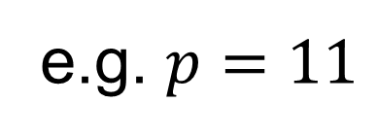
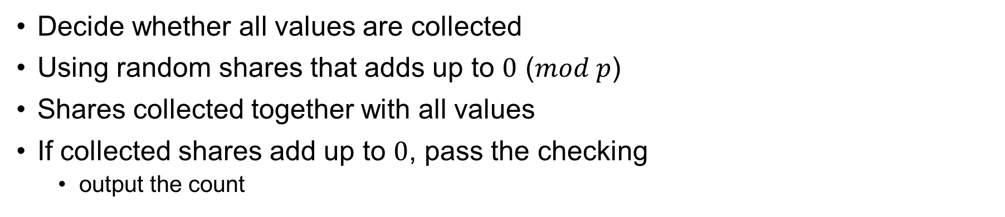
Soundness Checking
Challenges
Some values are not collected
  Too many/few sinks
  Random walk too short
  Sink flooding for too many/too few rounds
How to get the shares?
Nodes do not pass soundness checking at the same time!
Decide whether all values are collected
Using random shares that adds up to $0$ ($mod p$)
Shares collected together with all values
If collected shares add up to $0$, pass the checking
  output the count
1
1
3
3
1
6
e.g. $p=11$
1
1
1
9
1
4
1
5
missing value
The other shares do not add up to 0
Soundness checking will not pass
1
3
1
2

Slide 10

Soundness Checking – how to generate shares
Easy in centralized setting
  $N−1$ random numbers and $1$ node takes the complement
  This is what n-n secret sharing is doing
In distributed setting
  Every node distribute random sub-shares
  Keep a complement sub-share
  Random share = sum of all sub-shares
4
7
2
2
7
C
A
1
1
1
B

Slide 11
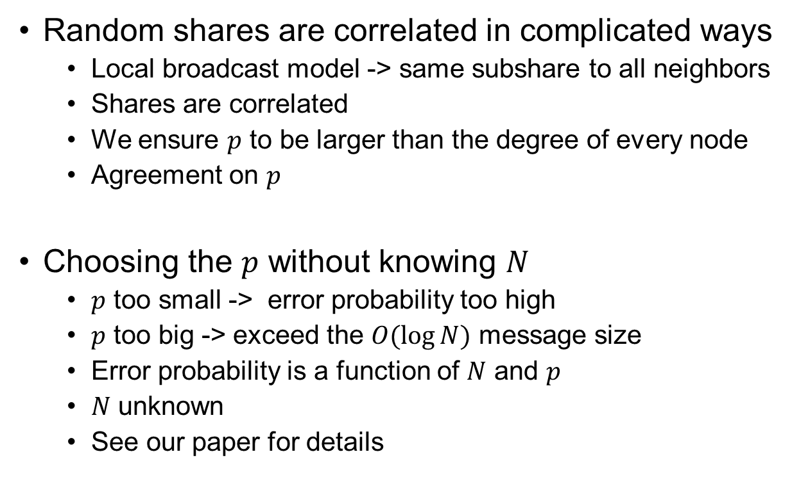


Soundness Checking – caveats
nodes whose values are collected
Random shares are correlated in complicated ways
  Local broadcast model -> same subshare to all neighbors
  Shares are correlated
  We ensure $p$ to be larger than the degree of every node
  Agreement on $p$
Choosing the $p$ without knowing $N$
  $p$ too small -> error probability too high
  $p$ too big -> exceed the $O(\log{N})$ message size
  Error probability is a function of $N$ and $p$
  $N$ unknown
  See our paper for details
B
C
A
$$x_{A}$$
$$x_{A}$$
$$x_{A}$$
We want:
$$deg⁡(A)x_{A}+f\left(x_{B},x_{C}…\right)≠0(mod p)$$

Slide 12
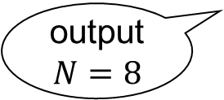
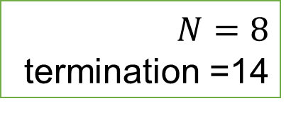

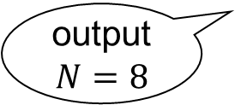


Dual-Schedule Termination
Nodes may not pass soundness checking at the same time
  If node $A$ terminate immediately, node $B$ will not be able to count correctly any more
Simplified case: $D$ is known
  Flood $N$ and terminate in $D=4$ rounds
round: 10
round: 11
round: 13
round: 14
terminate in round 14
output $N=8$
$$N=8$$
termination =14
$$A$$
terminate in round 10+$D$=14
output $N=8$

Slide 13
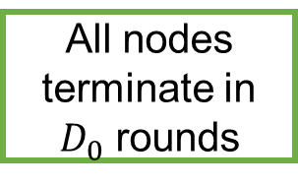
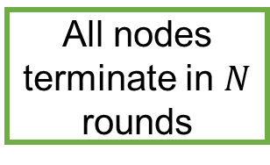


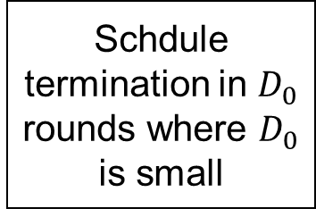
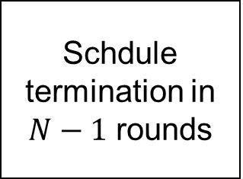
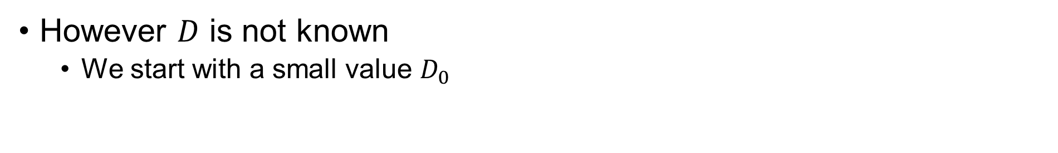
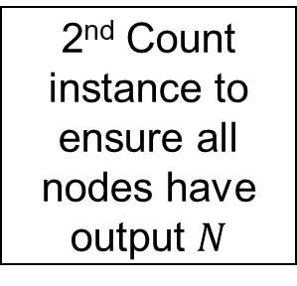
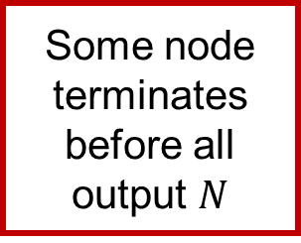

Dual-Schedule Termination
However $D$ is not known
  We start with a small value $D_{0}$
Soundness checking passed, output $N$
All nodes terminate in $D_{0}$ rounds
$$D≤D_{0}$$
Schdule termination in $N−1$ rounds
2nd Count instance to ensure all nodes have output $N$
Schdule termination in $D_{0}$ rounds where $D_{0}$ is small
Some node terminates before all output $N$
Some node may not schedule to terminate
Slow termination
Fast termination
$$D>D_{0}$$
All nodes terminate in $N$ rounds

Slide 14

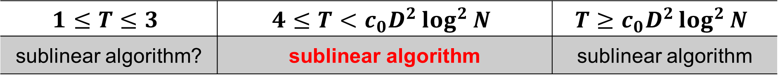
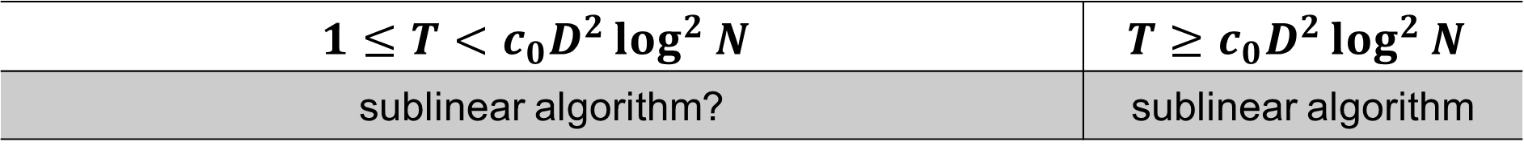
Conclusion
We consider synchronous $T$-interval dynamic networks with local broadcast CONGEST model for communication
We investigate the time complexity needed to solve a number of fundamental problems:
  Count, LeaderElection, Consensus, Max/Sum, ConfirmedFlood
Future work: $1≤T≤3$
$$1≤T<c_{0}D^{2}\log^{2}{N}$$ | $$T≥c_{0}D^{2}\log^{2}{N}$$
sublinear algorithm? | sublinear algorithm
$$1≤T≤3$$ | $$4≤T<c_{0}D^{2}\log^{2}{N}$$ | $$T≥c_{0}D^{2}\log^{2}{N}$$
sublinear algorithm? | sublinear algorithm | sublinear algorithm

