Slide 1

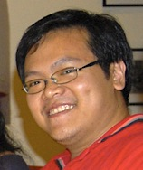
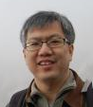
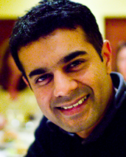
Constructing an Anonymous Dataset From the Personal Digital Photo Libraries of Mac App Store Users
Slides Available: http://bit.ly/1aIC3S6
JCDL 2013
Jesse P. Gozali, Min-Yen Kan, Hari Sundaram
National University of Singapore, Arizona State University
1
Notes:
- My name is...
- On behalf of...
- Present our work on automatically segmenting event photo streams.
- This work is supported by the NExT Research Center
- and funded by Media Development Authority of Singapore

Slide 2
COLLECTING PERSONAL DATA FOR RESEARCH
Slides Available: http://bit.ly/1aIC3S6
Research on personal digital photo libraries need access to real data.
The personal nature, especially since photos are involved, makes accessing large datasets difficult, yet alone creating a publicly available one.
Past research that requires such data have resorted to photos from the researchers themselves or soliciting volunteers with monetary remuneration.
2

Slide 3
CROWDSOURCING?
Slides Available: http://bit.ly/1aIC3S6
How can we reach out to a large number of potential volunteers?
Crowd-sourcing platforms (e.g. Amazon Mechanical Turk) are useful for gathering human judgements, as long as precautions are taken (qualification task, verification questions, fake data filtering)
However:
  Annotations on the data must be done by photo owners, not third-party evaluators due to the semantic gap between the photos and the event they represent.
  Motivation is monetary; MTurk participants may not be target users.
3

Slide 4
APP STORES
Slides Available: http://bit.ly/1aIC3S6
A solution: Application Stores
  Widely used for mobile applications (e.g. Android Marketplace, Apple’s App Store), but also for
  desktop applications (Valve’s Steam, Apple’s Mac App Store, Microsoft’s Windows Store).
  Large user base with high download rates.
  Helps application developers to manage the purchase, distribution, updating, and publicity of their applications.
4

Slide 5
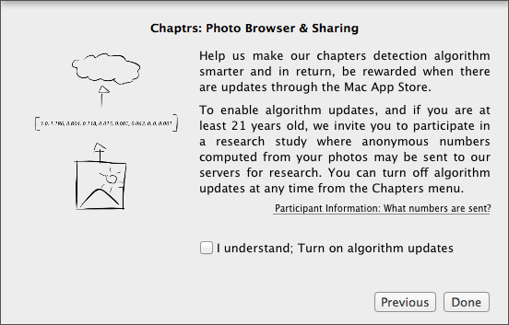
DATASET CONSTRUCTION
We did a study to use Mac App Store (MAS) to alleviate issues with cost and reaching potential participants for constructing a dataset.
We published a photo browser application Chaptrs ver. 2 on MAS and invited users to participate in the study (opt-in), expanding on our work presented in JCDL 2012.
5

Slide 6
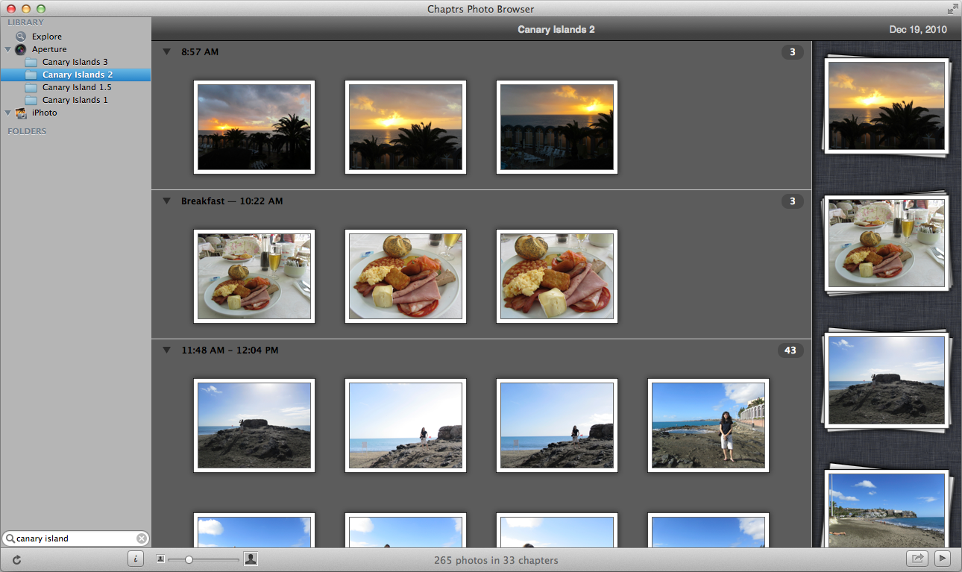
CHAPTRS Photo Browser (ver. 2)
6

Slide 7
CONS IN USING MAS
Application needs to have a “useful purpose” for the user. Its main purpose cannot be for collecting data; for us, the main purpose is a chapter-based photo browser.
A necessary overhead just like qualification tasks and verification questions in MTurk.
Application needs to undergo a review process; usually 1-2 weeks, but will be longer if complications arise (resubmission, appeals to review board).
7

Slide 8
PROS IN USING MAS
Cost doesn’t scale with number of participants or amount of data collected. Cost only attributed to the 99 USD / year fee.
Cost is lower than reported by previous work with MTurk
  If we consider the 20,778 photo sets (473,772 photos) we collected in 60 days, cost is 0.0002 USD per photo
  If we consider the 60 photo sets (8,107 photos) with chapter boundary annotations, cost is 0.012 USD per annotation
Visibility is high: total number of downloads in 60 days of study is 2,549 (42 per day)
8

Slide 9
CHAPTRS DATASET
The dataset we constructed has anonymous photo features, corresponding to those used in our event photo stream segmentation algorithm: time gap, aperture diameter, log light (scene brightness), 8-bin color histogram.
20,778 photo sets (473,772 photos), including 60 photo sets (8,107 photos) with author-annotated chapter boundary annotations.
The dataset can be expanded to include other anonymous photo features.
Released as a publicly available dataset to further research in personal digital photo libraries.
http://bit.ly/113ZQsY
http://wing.comp.nus.edu.sg/~jeprab/chaptrs_dataset/
9

Slide 10
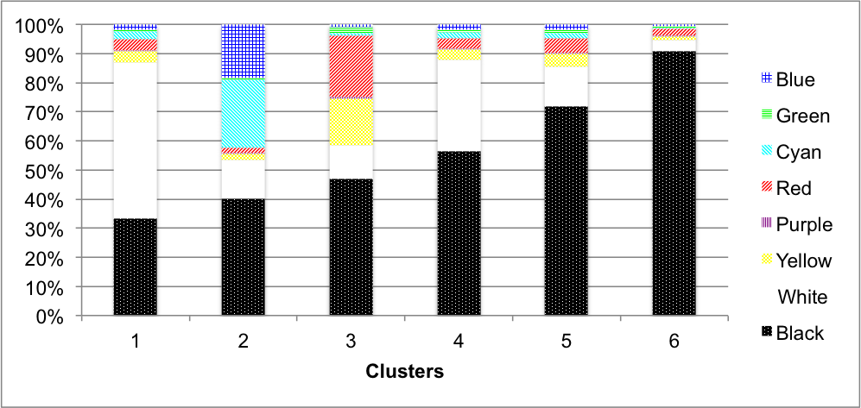
COLOR DISTRIBUTION
http://bit.ly/113ZQsY
The dataset has an 8-bin color distribution for each photo.
We clustered these distributions with k-means for up to k=9 and found k=6 to have an optimal BIC score.
  Clusters 1, 4, 5, and 6 show different ratios of white to black while the ratios of the remaining 6 colors remain fairly constant.
  Cluster 2 shows the representative color distribution for blue/cyan -colored photos.
  Cluster 3 shows the representative color distribution for the red/yellow -colored photos.
10

Slide 11
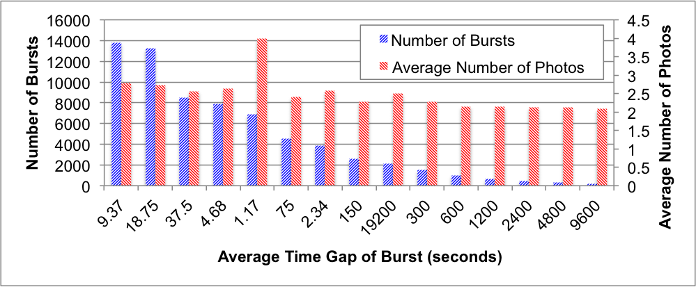
PHOTO TAKING BURSTS
http://bit.ly/113ZQsY
A photo taking burst is a sequence of photos (> 1 photo) taken in succession with an average time gap of t seconds.
To be reasonably referred to as a burst, t should be a small value. However, just to be thorough, we identified bursts for t from 1.1 seconds to 96,000 seconds (26 hours).
Most bursts had an average time gap of 9.3 seconds with ~3 photos on average.
The largest average number of photos per burst is 4 photos with an average time gap of 1.1 seconds.
11

Slide 12
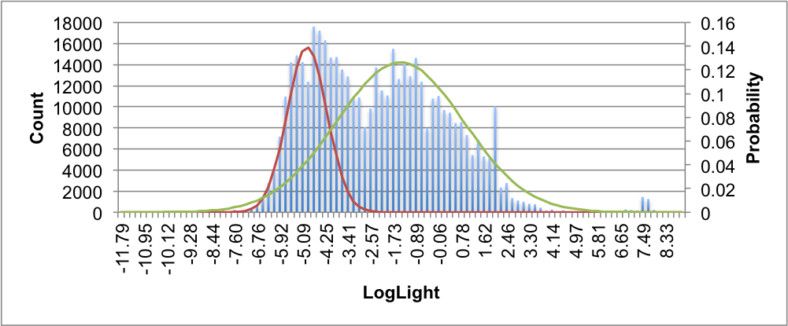
LOG LIGHT (BRIGHTNESS)
http://bit.ly/113ZQsY
The histogram of log light values (a measure of scene brightness) has two peaks and fits a 2-mixture Gaussian distribution
While we do not have access to the absolute timestamps of the photos, these may be peaks corresponding to day (left) and night time (right mixture) photos.
12

Slide 13
CONCLUSION
Dataset Available:
http://bit.ly/113ZQsY
First study on chapter-based photo organization
Unsupervised method for event photo stream segmentation, embedded into ...
Released a freely-available chapter-based photo browser
Released publicly available dataset for photo organization research
Outlined data collection method to reach personal digital photo libraries using the Mac App Store (MAS) as a distribution platform and released the dataset to the research community
13

