Slide 1
CS1010: Programming Methodology http://www.comp.nus.edu.sg/~cs1010/ www.comp.nus.edu.sg/~khoosc/1010/11

Slide 2
Week 11: Recursion
Objectives:
Understand the nature of recursion
Learn to write recursive functions
Comparing recursive codes with iterative codes
Reference:
Chapter 8, Lesson 8.6

Slide 3
Week 11: Outline (1/2)
0. Week 10 Exercise #3: Module Sorting
Introduction
Two Simple Classic Examples
2.1 Demo #1: Factorial
2.2 Demo #2: Fibonacci
Think Recursively
3.1 ~ 3.6 Demo and Exercises
Gist of Coding Recursion
Gist of Executing Recursion
Exercises #1 – 3

Slide 4
Week 11: Outline (2/2)
Auxiliary Function
Types of Recursion
Tracing Recursive Codes
Recursion versus Iteration
Towers of Hanoi

Slide 5
Exercise #3: Module Sorting (take-home) (1/2)
Week10_SortModules.c: Given two arrays: one containing the module codes, and the other containing the number of students enrolled in the modules. Sort the modules in ascending order of student enrolment, using Selection Sort, Bubble Sort, or Insertion Sort (if you happen to know it).
You may assume that there are at most 10 modules and a module code is at most 7 characters long.
This is a take-home exercise.
This exercise is mounted on CodeCrunch.
Notes:
CS1010 Programming Methodology

Slide 6
Exercise #3: Module Sorting (take-home) (2/2)
Sample run:
Input
Enter number of modules: 10
Enter module codes and student enrolment:
CS1010 292
CS1234 178
CS1010E 358
CS2102 260
IS1103 215
IS2104 93
IS1112 100
GEK1511 83
IT2002 51
MA1101S 123
Sorted by student enrolment:
IT2002 51
GEK1511 83
IS2104 93
IS1112 100
MA1101S 123
CS1234 178
IS1103 215
CS2102 260
CS1010 292
CS1010E 358
See input file modules.in
Output
Notes:
CS1010 Programming Methodology

Slide 7
void sortByEnrolment(char mod[][MODULE_LENGTH+1], int enrol[], int size) {
int i, j;
char this_mod[MODULE_LENGTH];
int this_enrol;
for (i=1; i<size; i++) {
strcpy(this_mod, mod[i]);
this_enrol = enrol[i];
j = i-1;
while ((j >= 0) && (this_enrol < enrol[j])) {
// shift elements to make space for mod[i] and enrol[i]
strcpy(mod[j+1], mod[j]);
enrol[j+1] = enrol[j];
j--;
}
strcpy(mod[j+1], this_mod);
enrol[j+1] = this_enrol;
}
}
this_enrol:
23
i
10 | 21 | 32 | 32 | 23 | 60 | 13 | 25
j
Notes:
CS1010 Programming Methodology

Slide 8
void sortByEnrolment(char mod[][MODULE_LENGTH+1], int enrol[], int size) {
int i, j;
char this_mod[MODULE_LENGTH];
int this_enrol;
for (i=1; i<size; i++) {
strcpy(this_mod, mod[i]);
this_enrol = enrol[i];
j = i-1;
while ((j >= 0) && (this_enrol < enrol[j])) {
// shift elements to make space for mod[i] and enrol[i]
strcpy(mod[j+1], mod[j]);
enrol[j+1] = enrol[j];
j--;
}
strcpy(mod[j+1], this_mod);
enrol[j+1] = this_enrol;
}
}
this_enrol:
23
i
10 | 21 | 32 | 32 | 32 | 60 | 13 | 25
j
Notes:
CS1010 Programming Methodology

Slide 9
void sortByEnrolment(char mod[][MODULE_LENGTH+1], int enrol[], int size) {
int i, j;
char this_mod[MODULE_LENGTH];
int this_enrol;
for (i=1; i<size; i++) {
strcpy(this_mod, mod[i]);
this_enrol = enrol[i];
j = i-1;
while ((j >= 0) && (this_enrol < enrol[j])) {
// shift elements to make space for mod[i] and enrol[i]
strcpy(mod[j+1], mod[j]);
enrol[j+1] = enrol[j];
j--;
}
strcpy(mod[j+1], this_mod);
enrol[j+1] = this_enrol;
}
}
this_enrol:
23
i
10 | 21 | 32 | 32 | 32 | 60 | 13 | 25
j
Notes:
CS1010 Programming Methodology

Slide 10
void sortByEnrolment(char mod[][MODULE_LENGTH+1], int enrol[], int size) {
int i, j;
char this_mod[MODULE_LENGTH];
int this_enrol;
for (i=1; i<size; i++) {
strcpy(this_mod, mod[i]);
this_enrol = enrol[i];
j = i-1;
while ((j >= 0) && (this_enrol < enrol[j])) {
// shift elements to make space for mod[i] and enrol[i]
strcpy(mod[j+1], mod[j]);
enrol[j+1] = enrol[j];
j--;
}
strcpy(mod[j+1], this_mod);
enrol[j+1] = this_enrol;
}
}
this_enrol:
23
i
10 | 21 | 23 | 32 | 32 | 60 | 13 | 25
j
Notes:
CS1010 Programming Methodology

Slide 11
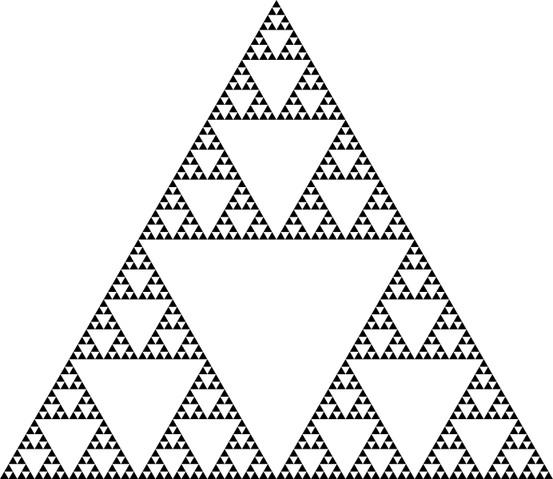
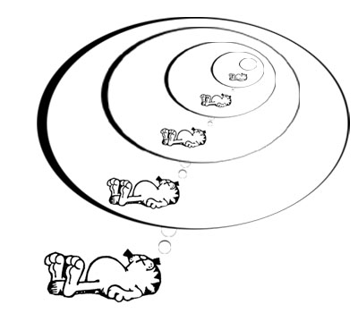
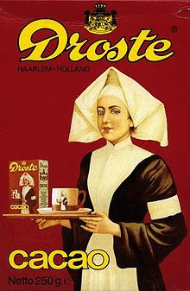
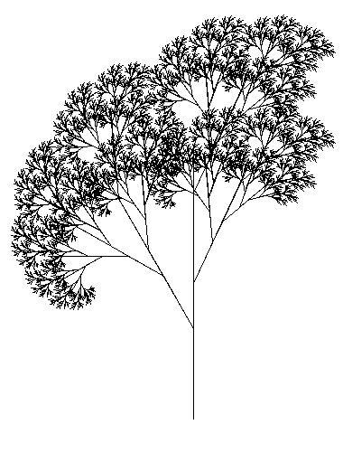
1. Introduction (1/3)
Recursion
A central idea in CS.
Some examples of recursion (inside and outside CS):
Garfield dreaming recursively.
Sierpinksi triangle
Droste effect
Recursive tree

Slide 12
1. Introduction (2/3)
Recursion
A central idea in CS.
Definitions based on recursion:
Dictionary entry:
Recursion: See recursion.
Recursive definitions:
A person is a descendant of another if
the former is the latter’s child, or
the former is one of the descendants of the latter’s child.
A list of numbers is
a number, or
a number followed by a list of numbers.
To understand recursion, you must first understand recursion.
Recursive acronyms:
GNU = GNU’s Not Unix
PHP = PHP: Hypertext Preprocessor

Slide 13
1. Introduction (3/3)
There is NO new syntax needed for recursion.
Recursion is a form of (algorithm) design; it is a problem-solving technique for divide-and-conquer paradigm
Very important paradigm – many CS problems solved using it
Recursion is:
A method where the solution to a problem depends on solutions to smaller instances of the same problem.
Notes:
Reference of quote: Graham, Ronald; Donald Knuth, Oren Patashnik (1990). Concrete Mathematics. Chapter 1: Recurrent Problems. http://www-cs-faculty.stanford.edu/~knuth/gkp.html

Slide 14
2.1 Demo #1: Factorial (1/3)
n! = n × (n – 1) × (n – 2) × … × 2 × 1
Thinking Factorial
Recursively
(n – 1) !
n ! = n × (n – 1) !
0 ! = 1
Note: All these versions work only for n < 13, due to the range of values permissible for type int. This is the limitation of the data type, not a limitation of the problem-solving model.

Slide 15
2.1 Demo #1: Factorial (2/3)
Thinking Factorial Recursively
Base/Degenerate Case
1 if n = 0
factorial (n) =
n* factorial (n-1) otherwise
Recursive/Inductive Case
// Pre-cond: n >= 0
int factorial(int n)
{
if (n == 0)
return 1;
else
return n * factorial(n-1);
}
Calling itself (recursively) achieves repetitive computation.
Week11_factorial.c

Slide 16
2.1 Demo #1: Factorial (3/3)
int f(int n) {
if (n == 0)
return 1;
else
return n * f(n-1);
}
Trace the calls made starting from factorial(3). For simplicity, we write f(3).
Trace tree:
Winding:
f(3)
6
f(3): Since 3 ≠ 0, call 3 * f(2)
f(2): Since 2 ≠ 0, call 2 * f(1)
f(1): Since 1 ≠ 0, call 1 * f(0)
f(0): Since 0 == 0, …
3 *
f(2)
2
2 *
f(1)
1
Unwinding:
f(0): Return 1
f(1): Return 1 * f(0) = 1 * 1 = 1
f(2): Return 2 * f(1) = 2 * 1 = 2
f(3): Return 3 * f(2) = 3 * 2 = 6
1 *
f(0)
1

Slide 17
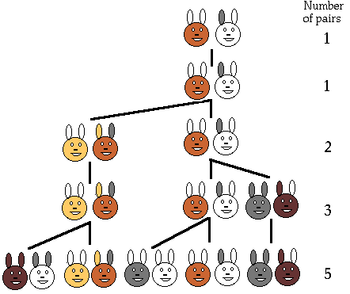
2.2 Demo #2: Fibonacci (1/5)
Suppose a newborn pair of rabbits, one male and one female, is put in the wild. The rabbits mate at the age of one month and at the end of its second month a female can produce another pair of rabbits. Suppose that the rabbits never die and that each female always produces one new pair, with one male and one female, every month from the second month on. How many pairs will there be in one year?
from Leonardo Fibonacci, 1202.

Slide 18
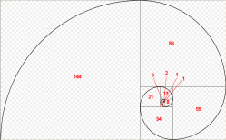
2.2 Demo #2: Fibonacci (2/5)
The Fibonacci series models the rabbit population each time they mate:
1, 1, 2, 3, 5, 8, 13, 21, …
The modern version is:
0, 1, 1, 2, 3, 5, 8, 13, 21, …
Fibonacci numbers are found in nature (sea-shells, sunflowers, etc)
http://www.maths.surrey.ac.uk/hosted-sites/R.Knott/Fibonacci/fibnat.html
Notes:
12.45PM
Population growth is related to the Fibonacci series. It was the question of how fast rabbits could breed under ideal circumstances that Leonardo Fibonacci originally investigated in the year 1202. Here was the question he posed:
Suppose a newborn pair of rabbits, one male and one female, is put in the wild. The rabbits mate at the age of one month and at the end of its second month a female can produce another pair of rabbits. Suppose that the rabbits never die and that each female always produces one new pair, with one male and one female, every month from the second month on. How many pairs will there be in one year?
The sequence is 1 1 2 3 5 8 13 21 ….

Slide 19
2.2 Demo #2: Fibonacci (3/5)
At first two months, there are only 1 pair of rabbits.
In month n, for n > 2, the number of pairs of rabbits are:
Those alive in month n-1, continue to live in month n
Those alive in month n-2, will each produce a new pair of rabbits in month n.
fib(n) = fib(n-1) + fib(n-2)
Notes:
12.45PM
Population growth is related to the Fibonacci series. It was the question of how fast rabbits could breed under ideal circumstances that Leonardo Fibonacci originally investigated in the year 1202. Here was the question he posed:
Suppose a newborn pair of rabbits, one male and one female, is put in the wild. The rabbits mate at the age of one month and at the end of its second month a female can produce another pair of rabbits. Suppose that the rabbits never die and that each female always produces one new pair, with one male and one female, every month from the second month on. How many pairs will there be in one year?
The sequence is 1 1 2 3 5 8 13 21 ….

Slide 20
2.2 Demo #2: Fibonacci (4/5)
0, 1, 1, 2, 3, 5, 8, 13, 21, …
Recurrent relation:
0 if n = 0
Fib (n) = 1 if n = 1
Fib (n-1) + Fib (n-2) otherwise
Recursive code:
// Pre-cond: n >= 0
int fib(int n)
{
if (n < 2)
return n;
else
return fib(n-1) + fib(n-2);
}
Week11_fibonacci.c

Slide 21
2.2 Fibonacci (5/5)
int fib(int n) {
if (n < 2)
return n;
else
return fib(n-1)
+ fib(n-2);
}
Trace tree (or call tree) for fib(5)
Trace the calls made!
5
fib(5)
3
2
Winding
fib(4)
fib(3)
Unwinding
2
1
1
1
fib(3)
fib(2)
fib(2)
fib(1)
1
1
1
0
1
0
fib(2)
fib(1)
fib(1)
fib(0)
fib(1)
fib(0)
1
0
fib(1)
fib(0)

Slide 22
3. Thinking Recursively
It is apparent that to do recursion you need to think “recursively”:
Breaking a problem into simpler problems that have identical form
Is there only one way of breaking a problem into simpler problems?

Slide 23
3. Gist of Recursion Thinking (1/3)
Iteration vs Recursion: How to compute factorial(3)?
You, do f(2) for me. I’ll return 3 * your answer to my boss.
Recursion man
You, do f(1) for me. I’ll return 2 * your answer to my boss.
Iteration man
I do f(3) all by myself…return 6 to my boss.
You, do f(0) for me. I’ll return 1 * your answer to my boss.
f(3)
f(2)
I will do f(0) all by myself, and return 1 to my boss.
f(3)
f(1)
f(0)

Slide 24
3. Gist of Recursion Thinking (2/3)
What should the middle manager do?
What smaller problem must I pass down to my subordinate?
What result must I expect from my subordinate?
How should I combine the results from my subordinate with what I have to obtain a result for my boss?
You, do f(1) for me. I’ll return 2 * your answer to my boss.
f(3)
f(2)
f(1)
f(0)

Slide 25
3.1 Think: Sum of Squares (1/5)
Given 2 positive integers x and y, where x ≤ y, compute
sumSq(x,y) = x² + (x+1) ² + … + (y-1) ² + y²
For example
sumSq(5,10) = 5² + 6² + 7² + 8² + 9² + 10² = 355
How do you break this problem into smaller problems?
How many ways can it be done?
We are going to show 3 versions

Slide 26
3.1 Think: Sum of Squares (2/5)
Version 1: ‘going up’
y * y if x = y
ssq (x,y) =
x * x + ssq(x+1, y) if x < y
int sumSq1(int x, int y) {
if (x == y) return y * y;
else return x * x + sumSq1(x+1, y);
}


Slide 27
3.1 Think: Sum of Squares (3/5)
Version 2: ‘going down’
x * x if x = y
ssq (x,y) =
ssq(x, y-1) + y * y if x < y
int sumSq2(int x, int y) {
if (x == y) return x * x;
else return y * y + sumSq2(x, y-1);
}


Slide 28
3.1 Think: Sum of Squares (4/5)
Version 3: ‘divide and conquer’
x * x if x = y
ssq (x,y) =
ssq(x, m) + ssq(m+1, y) if x < y
where m = (x + y) / 2

int sumSq3(int x, int y) {
int mid; // middle value
if (x == y)
return x * x;
else {
mid = (x + y)/2;
return sumSq3(x, mid) + sumSq3(mid+1, y);
}
}


Slide 29
3.1 Think: Sum of Squares (5/5)
Version 1a: ‘going up with accumulator’
ssq (x,y) = ssq_Rec (x, y, 0)
acc if x > y
ssq_Rec (x, y, acc) =
ssq_Rec(x+1, y, acc+x*x) if x ≤ y
int sumSq (int x, int y) {
return sumSqRec(x, y, 0);
}
int sumSqRec(int x, int y, int acc) {
if (x > y)
return acc ;
else return sumSqRec(x+1, y, acc + x*x );
}


Slide 30
3. Gist of Recursion Thinking (3/3)
The One-Layer Thinking Maxim
Don’t try to think recursively about a recursive process
Illustration: Compute n² recursively.
Moment of inspiration:
(n-1)² = n² - 2n + 1
Thus, 0 if n = 0
n² =
(n-1)² + 2n - 1 otherwise
There is no need to think about how (n-1)² computes

Slide 31
3.2 Thinking Exercise
On the first day of Christmas
My true love gave to me
A partridge in a pear tree.
On the second day of Christmas
My true love gave to me
Two turtle doves
And a partridge in a pear tree.
On the third day of Christmas
My true love gave to me
Three French hens,
Two turtle doves,
And a partridge in a pear tree.
How many presents do I receive on n^{th} day of Christmas?


Slide 32
3.2 Thinking Exercise
How many presents do I receive on n^{th} day of Christmas?
1 if n = 1
Present_on_day (n) =
otherwise
n + Present_on_day(n-1)
How many presents do I receive total over n day of
Christmas?
1 if n = 1
Present_on_day(n) + otherwise
Present_thru_day (n-1)
Present_thru_day (n) =


Slide 33
3.3 Demo #3: Counting Occurrences (1/3)
Given an array
int list[] = { 9, -2, 1, 7, 3, 9, -5, 7, 2, 1, 7, -2, 0, 8, -3 }
We want
countValue(7, list, 15)
to return 3 (the number of times 7 appears in the 15 elements of list.
0 if n = 0
cV (x,[a₁,..,a_{n}]) =
check(x,a_{n}) + cV(x,[a₁,…,a_{n-1}]) otherwise
where check(x,a) = if (x ≠ a) then 0 else 1

Slide 34
3.3 Demo #3: Counting Occurrences (2/3)
Recursive code Version 1:
Week11_countValue.c
int countValue(int value, int arr[], int size) {
if (size == 0)
return 0;
else
return (value == arr[size-1]) +
countValue(value, arr, size-1);
}

Slide 35
3.3 Demo #3: Counting Occurrences (3/3)
Recursive code Version 2 (with accumulator) :
int countValue(int value, int arr[], int size) {
return countValueRec(value, arr, size, 0) ;
}
int countValueRec(int value, int arr[],
int size, int acc) {
if (size == 0)
return acc;
else
return countValueRec(value, arr, size-1,
(value == arr[size-1]) + acc);
}

Slide 36
3.4. Ex #4 (take home) : Recursive operations on Array
Write a program to include a recursive function
To sum up all values in an integer array Week11_sumArray.c
To find the largest element in a non-empty integer array.
To turn [a₁, … , a_{n}] into [a₁², …, a_{n}²]
♠ ♠ To find the maximum difference between any two elements in a non-empty integer array (do it in one pass of the array)

Slide 37
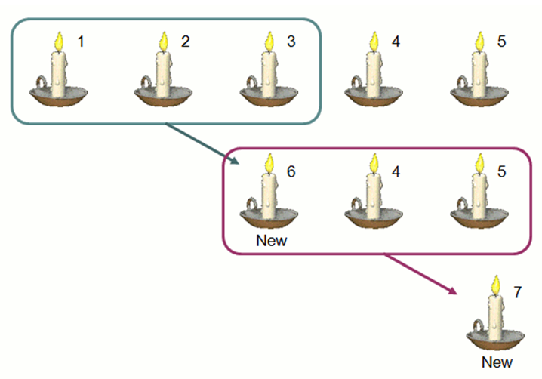
3.5 Ex #5 (take home) : Candles
int candle(int n, int k)
Base case:
Recursive case:

Slide 38
3.6 Ex #6 (take-home): Counting Change
How many different ways can we make change to $1.00, given 50¢, 20¢, 10¢, 5¢ and 1¢ coins?
Possible ways:
50¢, 20¢, 20¢, 5¢, 1¢, 1¢, 1¢, 1¢, 1¢
50¢, 50¢
20¢, 20¢, 20¢, 10¢, 10¢, 5¢, 5¢
…
Ex: Write cc(amount) to return the different number of ways we can make change to amount

Slide 39
3.6 Counting Change: Think recursively
How many different ways can we make change to $1.00, given 50¢, 20¢, 10¢, 5¢ and 1¢ coins?
Recursive case
Number of ways to change amount a using n kinds of coins =
Number of ways to change amount a – d using all n kinds of coins, where d is the denomination of the first kind of coin
+ Number of ways to change amount a using all but the first kind of coin

Slide 40
3.6 Counting Change: Think recursively
How many different ways can we make change to $1.00, given 50¢, 20¢, 10¢, 5¢ and 1¢ coins?
Degenerate cases:
If the amount a is exactly 0, count that as 1 way to make change
If a is less than 0, count that as 0 way
If the kind of coins n is 0, count that as 0 way

Slide 41
3.6 Counting Change: Think recursively
1 if a = 0
cc(a, n) = 0 if a < 0 or n = 0
cc(a-d(n), n) + cc(a, n-1) otherwise
where d(n) = denominator for the n^{th} kind of coins
1 if n = 1
5 if n = 2
d(n) = 10 if n = 3
20 if n = 4
50 if n = 5

Slide 42
4. Gist of Coding Recursion (1/3)
To write a recursive function:
Identify the base case(s) of the relation
Identify the recursive/inductive case of the relation that reduces the problem size
Ensure that the recursion/induction can reduce the problem size to the base cases
sSq_faster(a,b) =
pre: a <= b
If (a < b) then
return a*a +
sSq_faster(a+1,b-1) + b*b
else return a*a
sSq1(a,b) =
pre: a <= b
If (a < b) then
return sSq1(a,b-1) + b*b
else return a*a

Slide 43
4. Gist of Coding Recursion (2/3)
Identifying sub-problem:
Sum up all digits:
sUp(1) → 1
sUp(12345) → 1 + 2 + 3 + 4 + 5
Any differences in these sub-problems?
→ sUp(1234) + 5 ?
→ 1 + sUp(2345) ?
→ 1 + sUp(234) + 5 ?
sUp(n) =
pre: n >= 0
If (n > 0) then
r ← remainder of n / 10
n ← quotient of n / 10
return sUp(n) + r
2. Return 0.

Slide 44
4. Gist of Coding Recursion (3/3)
Testing Recursive programs:
Check that it runs on base cases
Check that it runs on slightly more complicated (than base) recursive cases
Check the correctness of recursive cases via tracing

Slide 45
5. Gist of Executing Recursion (1/2)
When a function is called, an activation record (or frame) is created by the system.
Each activation record stores the local parameters and variables of the function and its return address.
Such records reside in the memory called stack.
Stack is also known as LIFO (last-in-first-out) structure
A recursive function can potentially create many activation records
Winding: each recursive call creates a separate record
Unwinding: each return to the caller erases its associated record

Slide 46
5. Gist of Executing Recursion (2/2)
Example: factorial(3)
n
0
n
n
1
n
1
1
1
n
n
n
n
1
2
2
2
2
n
n
n
n
n
3
3
3
3
3
f(3)
f(2)
f(1)
f(0)
n
2
int f(int n) {
if (n == 0) return 1;
else return n * f(n-1);
}
n
n
2
3
3
6

Slide 47
6. Exercises #1 – 3 (1/2)
Given the following 2 recursive functions, trace mystery1(3902) and mystery2(3902) using the trace tree method
void mystery1(int n)
{
if (n>0) {
printf("%d", n%10);
mystery1(n/10);
}
}
void mystery2(int n)
{
if (n>0) {
mystery2(n/10);
printf("%d", n%10);
}
}
The order of statements does matter!

Slide 48
6. Exercises #1 – 3 (2/2)
The recurrence relation for Greatest Common Divisor (GCD) of two non-negative integers a and b, not both zero, is given below:
Write a function int gcd(int a, int b) to compute the GCD of a and b. Skeleton program Week11_gcd.c given.
The math function double pow(double x, double y) computes x^{y}. Write your own, simpler function double mypow(double x, int n) to compute x^{n}, where n is a non-negative integer. Skeleton program Week11_pow.c given.
The recurrence relation is not given, can you derive it before writing the function?

Slide 49
7. Auxiliary Function (1/3)
Sometimes, auxiliary functions are needed to implement recursion. Eg: Refer to Demo #3 Counting Occurrences.
If the function handles the first element instead of the last, it could be re-written as follows:
int countValue(int value, int arr[],
int start, int size) {
if (start == size)
return 0;
else
return (value == arr[start]) +
countValue(val, arr, , start+1, size);
}

Slide 50
7. Auxiliary Function (2/3)
However, doing so means that the calling function has to change the call from:
countValue(value, list, ARRAY_SIZE)
to:
countValue(value, list, 0, ARRAY_SIZE)
The additional parameter 0 seems like a redundant data from caller’s point of view.

Slide 51
7. Auxiliary Function (3/3)
Solution: Keep the calling part as:
countValue(value, list, ARRAY_SIZE)
Rename the original countValue() function to countValue_recur(). The recursive call inside should also be similarly renamed.
Add a new function countValue() to act as a driver function, as follows:
int countValue(int value, int arr[], int size)
{
return countValue_recur(value, arr, 0, size);
}
See program Week11_countValue_auxiliary.c
Notes:
Program is Week11_countValue_auxiliary.c

Slide 52
8. Types of Recursion (1/3)
Besides direct recursion (function A calls itself), there could be mutual or indirect recursion (we will not cover these in CS1010)
Examples: Function A calls function B, which calls function A; or function X calls function Y, which calls function Z, which calls function X.
Note that it is not typical to write a recursive main() function.
One type of recursion is known as tail recursion.
Not covered in CS1010

Slide 53
8. Types of Recursion (2/3) (Optional)
Tail recursion is one in which the recursive call is the last operation in the code.
Which of the following are tail recursion and which are not?
factorial(n)

mypow(x, n)

fibonacci(n)

sumSq(x, y)

gcd(a, b)



Slide 54
8. Types of Recursion (3/3) (Optional)
Rewriting factorial() into a tail-recursive function.
Original (non-tail-recursive):
int factorial(int n)
{
if (n == 0) return 1;
else return n * factorial(n-1);
}
Tail-recursive:
int factorial(int n)
{
return f_tail_recur(n, 1);
}
int f_tail_recur(int n, int accumulator)
{
if (n == 0) return accumulator;
else return f_tail_recur(n-1, n*accumulator);
}


Slide 55
9. Tracing Recursive Codes
Beginners usually rely on tracing to understand the sequence of recursive calls and the passing back of results.
However, tracing a recursive code is tedious, especially for non-tail-recursive codes. The trace tree could be huge (example: fibonacci.)
If you find that tracing is needed to aid your understanding, start tracing with small problem sizes, then gradually see the relationship between the successive calls.
Students should grow out of tracing habit and understand recursion by examining the relationship between the problem and its immediate subproblem(s).

Slide 56
10. Recursion versus Iteration (1/2)
Iteration can be more efficient
Replaces function calls with looping
Less memory is used (no activation record for each call)
Some good compilers are able to transform a tail-recursion code into an iterative code.
If a problem can be done easily with iteration, then do it with iteration.
For example, Fibonacci can be coded with iteration or recursion, but the recursive version is very inefficient (large call tree due to duplicate computations), so use iteration instead.

Slide 57
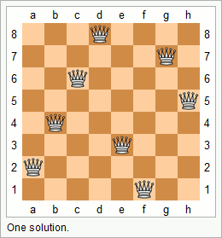
10. Recursion versus Iteration (2/2)
Many problems are more naturally solved with recursion, which can provide elegant solution.
Towers of Hanoi
Mergesort (to be covered in CS1020)
The N Queens problem
Conclusion: choice depends on problem and the solution context. In general, use recursion if
A recursive solution is natural and easy to understand.
A recursive solution does not result in excessive duplicate computation.
The equivalent iterative solution is too complex.

Slide 58
11. Towers of Hanoi (1/16)
This classical “Towers of Hanoi” puzzle has attracted the attention of computer scientists more than any other puzzles.
Invented by Edouard Lucas, a French mathematician, in1883.
There are 3 pegs (A, B and C) and a tower of n disks on the first peg A, with the smallest disk on the top and the biggest at the bottom. The purpose of the puzzle is to move the whole tower from peg A to peg C, with the following simple rules:
Only one disk (the one at the top) can be moved at a time.
A bigger disk must not rest on a smaller disk.

Slide 59
11. Towers of Hanoi (2/16)
Demo: Tower of Hanoi
We attempt to write a program to produce instructions on how to move the disks from peg A to peg C to complete the puzzle.
Example: A tower with 3 disks.
Output produced by program:
Move disk from A to C
Move disk from A to B
Move disk from C to B
Move disk from A to C
Move disk from B to A
Move disk from B to C
Move disk from A to C

Slide 60
11. Towers of Hanoi (3/16)
Example: A tower with 3 disks.
Move disk from A to C
Move disk from A to B
Move disk from C to B
Move disk from A to C
Move disk from B to A
Move disk from B to C
Move disk from A to C
A
B
C

Slide 61
11. Towers of Hanoi (4/16)
Example: A tower with 3 disks.
Move disk from A to C
Move disk from A to B
Move disk from C to B
Move disk from A to C
Move disk from B to A
Move disk from B to C
Move disk from A to C
A
B
C

Slide 62
11. Towers of Hanoi (5/16)
Example: A tower with 3 disks.
Move disk from A to C
Move disk from A to B
Move disk from C to B
Move disk from A to C
Move disk from B to A
Move disk from B to C
Move disk from A to C
A
B
C

Slide 63
11. Towers of Hanoi (6/16)
Example: A tower with 3 disks.
Move disk from A to C
Move disk from A to B
Move disk from C to B
Move disk from A to C
Move disk from B to A
Move disk from B to C
Move disk from A to C
A
B
C

Slide 64
11. Towers of Hanoi (7/16)
Example: A tower with 3 disks.
Move disk from A to C
Move disk from A to B
Move disk from C to B
Move disk from A to C
Move disk from B to A
Move disk from B to C
Move disk from A to C
A
B
C

Slide 65
11. Towers of Hanoi (8/16)
Example: A tower with 3 disks.
Move disk from A to C
Move disk from A to B
Move disk from C to B
Move disk from A to C
Move disk from B to A
Move disk from B to C
Move disk from A to C
A
B
C

Slide 66
11. Towers of Hanoi (9/16)
Example: A tower with 3 disks.
Move disk from A to C
Move disk from A to B
Move disk from C to B
Move disk from A to C
Move disk from B to A
Move disk from B to C
Move disk from A to C
A
B
C

Slide 67
11. Towers of Hanoi (10/16)
Example: A tower with 3 disks.
Move disk from A to C
Move disk from A to B
Move disk from C to B
Move disk from A to C
Move disk from B to A
Move disk from B to C
Move disk from A to C
VIOLA!
A
B
C

Slide 68
11. Towers of Hanoi (11/16)
Can be interpreted as:
1. move four disks from peg A to peg B
2. move disk 5 from peg A to peg C
3. move four disks from peg B to peg C

Slide 69
11. Towers of Hanoi (12/16)
Towers after steps 1 and 2:
But how do we execute step 1? Or step 3?
Step 3 can be interpreted as:
3.1 move three disks from peg B to peg A
3.2 move disk 4 from peg B to peg C
3.3 move three disks from peg A to peg C

Slide 70
11. Towers of Hanoi (13/16)
Towers after steps 1, 2, 3.1 and 3.2:
Can you start to visualise how to solve this using recursion?

Slide 71
11. Towers of Hanoi (14/16)
Algorithm:
if (n > 0)
move n – 1 disks from the source peg to the temp peg using the dest peg
move disk n from the source peg to the dest peg
move n – 1 disks from the temp peg to the dest peg using the source peg

Slide 72
11. Towers of Hanoi (15/16)
Week9_TowersOfHanoi.c
#include <stdio.h>
void tower(char, char, char, int);
int main(void)
{
int disks;
printf("Number of disks: ");
scanf("%d", &disks);
tower('A','B','C', disks);
return 0;
}
// Display instructions for moving n disk from source to dest
// using temp as an auxiliary. Disks are numbered 1 to n
// (smallest to largest).
void tower(char source, char temp, char dest, int n)
{
if (n > 0) {d
tower(source, dest, temp, n-1);
printf("Move disk %d from peg %c to peg %c\n",
n, source, dest);
tower(temp, source, dest, n-1);
}
}

Slide 73
11. Towers of Hanoi (16/16)
Output generated by tower('A', 'B', 'C', 3);
Move disk 1 from peg A to peg C
Move disk 2 from peg A to peg B
Move disk 1 from peg C to peg B
Move disk 3 from peg A to peg C
Move disk 1 from peg B to peg A
Move disk 2 from peg B to peg C
Move disk 1 from peg A to peg C

Slide 74
Summary for Today
In this lecture we looked at:
Recursion as a design
The components of a recursive code
Difference between Recursion and Iteration

Slide 75
Announcements/Things-to-do
Revise:
Lesson 8.6 Functions with One Recursive Call
Exercises: many of them
Next week’s lecture:
Structures: Lessons 8.1 – 8.5
File Processing: Lessons 3.3 – 3.4

Slide 76
End of File

