Slide 1
LR PARSERS
CS3230R

Slide 2
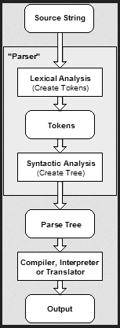
What is a parser?
Notes:
Program text represented as a string
Much easier to think of programs in terms of tokens rather than chars
Builds a tree. Why a tree? Express hierarchical structure of programs
Compiler/interpreter takes that tree and translates it or executes it

Slide 3
What is an LR parser?
A bottom-up parser that efficiently handles deterministic context-free languages in guaranteed linear time
Notes:
Reads text in one input direction without backing up
Bottom up
Lookahead
I’ll get into that in a minute

Slide 4
Deterministic context-free what?
Class of context-free languages that can be accepted by a deterministic pushdown automaton

Slide 5
Deterministic context-free what?
Unambiguous
Of great practical use

Slide 6
Context-sensitive grammars
int x;
typedef int x;

Slide 7
Context-sensitive grammars
MyObject object;
MyObject object(parameters);
MyObject object(); // ?
Notes:
Ironically these come from C++, which is a really context-sensitive language, but its parser is written by hand

Slide 8
What is an LR parser?
Left-to-right, Rightmost derivation
Deterministic – single correct parse without guesswork or backtracking
Lookahead to avoid guessing or backtracking

Slide 9
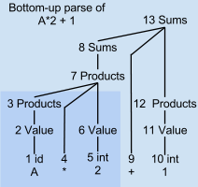
What is an LR parser?
Bottom-up construction of syntax tree
Notes:
First token id
Create singleton tree node
Encounters multiplication sign, does a reduce and promotes previous token into a product

Slide 10
What is an LR parser?
Unsuited for human languages, which require more flexible but slower methods
Shift-reduce parser

Slide 11
Shift-reduce
Shift
Advances the input stream by one symbol
That symbol becomes a new single-node parse tree
Reduce
Applies a grammar rule to some of the recent parse trees
Joins them into one with a new root symbol

Slide 12
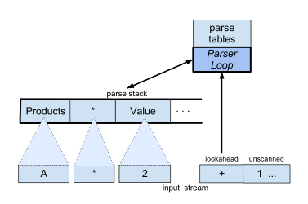
Shift-reduce
Shifts and reduces until all input has been consumed, or until a syntax error is encountered
Differs from other parsers in when to reduce and breaking ties between rules

Slide 13
Decisions, decisions…
When to shift, when to reduce?
Notes:
Since shifts and reductions are all the parser can do

Slide 14
Decisions, decisions…
Naïve approach:
Compare current parse trees against rules
Reduce if any matches
Shift if no matches
Check all rules every time
Parser gets slower and slower for large input programs

Slide 15
Decisions, decisions…
Observation:
CFGs are unambiguous
Finite number of states
Notes:
At any one time the parser can be in a finite number of states

Slide 16
Decisions, decisions…
Preprocessing
Encode each state the parser may be in with a number
Goal → Sums EOF
Sums → Sums + Products
Sums → Products
Products → Products * Value
Products → Value
Value → int
Value → id

Slide 17
Decisions, decisions…
Preprocessing
Encode each state the parser may be in with a number
Sums → ●Sums + Products
Sums → Sums ● + Products
Sums → Sums + ● Products
Sums → Sums + Products ●

Slide 18
Decisions, decisions…
Preprocessing
Decide in advance whether to shift or reduce
Note what state the parser will be in afterwards
Build a static parse table with this information

Slide 19
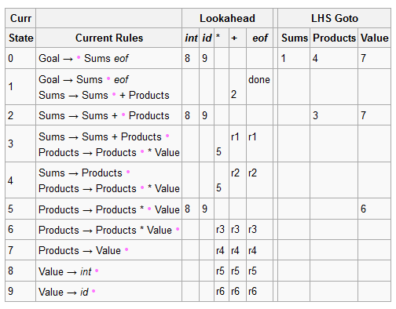
Decisions, decisions…
Parse table
Notes:
Lookahead defines actions for terminals
Goto defines actions for nonterminals, same thing

Slide 20
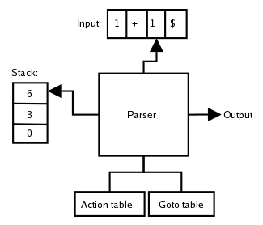
Decisions, decisions…
LR parsers are table-driven FSMs

Slide 21
Decisions, decisions…
LR parsers are table-driven FSMs
Tables are large and difficult to compute by hand
LR parsers are generated from grammars written in DSLs

Slide 22
Example
<expression> ::=
<number>
| <string>
| <boolean>
| <pair>
| fun (<id>, ...) -> <expression>
| <id>
| (<expression>)
| <unary-op> <expression>
| <expression> <binary-op> <expression>

Slide 23
Example
<expression> ::=
| if <expression> then <expression> else <expression>
| let <id> = <expression> in <expression>
| <id>(<expression>, ...)
Notes:
GO TO CODE

Slide 24
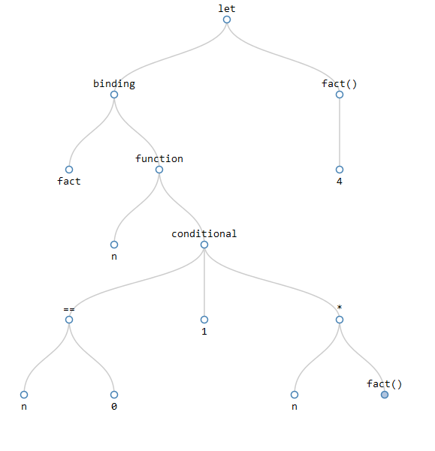
Example

Slide 25
Thanks!

