Slide 1
Algorithms (Introduction)
Readings: [SG] Ch. 1, Ch. 2
Chapter Outline:
  Chapter Goals
  What are Algorithms [SG] Ch. 2.1
  Pseudo-Code to Express Algorithms [SG] Ch. 2.2
  Some Simple Algorithms
  Examples of Algorithmic Problem Solving
Last Revised: September 2013.

Slide 2
1. Goals of Algorithm Study
To develop framework for instructing computer to perform tasks (solve problems)
Algorithm as a
“means of specifying how to solve a problem”
To introduce the idea of decomposing complex tasks into simpler tasks;

Slide 3
Algorithms to solve problems
Computing devices are dumb
  How to instruct a dumb mechanical / computing device to solve a problem
Express instructions using
  “a small, basic set of primitive instructions”
Example: Working with a pet dog
  Primitive oral instructions:
  “sit”, “heel”, “fetch”, “roll”…
  Primitive visual instructions:
  sign language

Slide 4

Dog obedience training…
Source: http://lacetoleather.com/obedience.html

Slide 5
Chapter Outline:
  Chapter Goals
  What are Algorithms [SG] Ch. 2.1
    Real Life Examples (origami, recipes)
    Simple Example: Calculating Mile-per-Gallon
    Definition of Algorithm
    A = B + C (self-study, [SG]-C1.2, 2.1)
  Pseudo-Code to Express Algorithms
  Some Simple Algorithms
  Examples of Algorithmic Problem Solving

Slide 6
2. Computer Science and Algorithms…
Computer Science is…
  the study of algorithms, including
  their formal and mathematical properties
  Their hardware,
  Their linguistic (software) realisations
  Their applications (to diverse areas)
(Read carefully Ch-1.2 of [SG])

Slide 7
Algorithm
al go rithm [SG3]: A well-ordered collection of
unambiguous and effectively computable operations
that, when executed, produces a result and
halts in a finite amount of time.
Unambiguous,
Effectively computable operation,
produces a result,
Halts in a finite amount of time.

Slide 8
Algorithms: Real Life Examples
Many Real-Life Analogies
  Directions: How to go to Changi Airport
  Origami: The Art of Paper Folding
  Cooking: Recipe for preparing a dish
Keep in Mind:
Framework: “Input, output, hardware, software ”
2. Algorithm: “The actual step-by-step instructions”
3. Abstraction: “Decomposing / Simplifying”

Slide 9

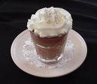
A Recipe Analogy for Algorithm
Recipe for a chocolate mousse
    Ingredients:
      8 ounces of semi-sweet chocolate pieces,
      2 tablespoon of water, 1/4 cup of powdered suger,
      6 separated eggs, … ...
  “Melt chocolate and 2 tablespoons water in double boiler.
  When melted, stir in powdered sugar; add butter bit by bit. Set aside.
  Beat egg yolks until thick and lemon-colored, about 5 minutes.
  Gently fold in chocolate. Reheat slightly to melt chocolate, if necessary. Stir in rum and vanilla.
  Beat egg white until foamy. Beat in 2 tablespoons sugar; beat until stiff peaks form. Gently fold egg whites into chocolate-yolk mixture. Pour into individual serving dishes.
  Chill at least 4 hours.
  Serve with whipped cream, if desired. Makes 6 to 8 servings.”

Slide 10
Framework (for the Recipe Example)
Sample Problem: Making chocolate mousse
Algorithms | Framework for Cooking
Input | Ingredients
Hardware | Utensils, oven, pots, pens, chef
Software | Recipe
Output | Chocolate mousse
Ingredients
Primitive (Basic) Operations:
(software)
(hardware)
pour, mix, stir, drip, stir-fry
bake, boil, melt,
open-oven-door, remove-pan
measure time, volume, weight
recipe
Utensils, oven, baker
Chocolate mousse

Slide 11
Multiple Levels of Abstraction (1)
The level of abstraction
  (level of detail of the instructions) should vary with the sophistication of the hardware / software tools
Hierarchy of abstraction levels…
L0: Prepare Chocolate mousse for 5 people
L1: Prepare chocolate mixture;
Prepare chocolate-yoke mixture;
Prepare egg-white batter; …

Slide 12
Multiple Levels of Abstraction (2)
The level of abstraction
  (level of detail of the instructions) should vary with the sophistication of the hardware / software tools
Hierarchy of abstraction levels…
L0: Prepare Chocolate mousse for 5 people
L1: Prepare chocolate mixture;
Prepare chocolate-yoke mixture;
Prepare egg white batter; …
L2: Melt chocolate and 2 tablespoons water …
…stir in powdered sugar; add butter bit-by-bit
L3: …take a little powdered sugar,
pour it into the melted chocolate, stir it in,
take a little more sugar, pour…, stir…,

Slide 13
Multiple Levels of Abstraction (3)
Hierarchy of abstraction levels…
L0: Prepare Chocolate mousse for 5 people
L1: Prepare chocolate mixture;
Prepare chocolate-yoke mixture;
Prepare egg white batter; …
L2: Melt chocolate and 2 tablespoons water …
…stir in powdered sugar; add butter bit-by-bit
L3: …take a little powdered sugar,
pour it into the melted chocolate, stir it in,
take a little more sugar, pour…, stir…,
L4: …take 2365 grains of powdered sugar, pour them into the
melted chocolate, pick up a spoon and
use circular motion to stir it in, …
L5: …move your arm towards the ingredients at an angle of 14º,
at a velocity of 0.5m per second, …

Slide 14
Multiple Levels of Abstraction (4)
Recall Recurring Principle:
Multiple Levels of Abstraction
Why have some many levels of abstraction?
  L0: Good for “bosses”
  L1: Good for experienced chefs
  L2: Good for inexperienced chefs
  L3: Good for newbie chefs
  L4: Good for an “automated” process
  L5: Good for people who needs to
  program the automated process
Question: What is the appropriate level?

Slide 15
Summary: Cooking Analogy
Framework:
  “Cooking or Recipe mini-language”
Algorithm:
  “Recipe for Chocolate Mousse”
    (step-by-step instructions)
Problem Decomposition
  L0 task is decomposed into L1 tasks
    Prepare the Chocolate Mixture;
    Prepare Chocolate-Yoke Mixture;
    Prepare Egg-White Batter;
  Each L1 task is further decomposed into L2 tasks
  And so on…

Slide 16
An Origami Analogy for Algorithm
Framework:
  “Origami or Paper-Folding language”
Algorithm:
  “Sequence of Paper-Folding Instructions”
    (step-by-step instructions for each fold)
Problem Decomposition
  Start with a Bird Base; … …
  Finish the Head;
  Finish the Legs; Finish the Tail;
http://www.origami-instructions.com/origami-bird-base.html

Slide 17
Primitives in Origami
Primitive folds in Origami
  Valley fold, Mountain fold, Triangle fold
  Squash fold, Petal fold
  Inside and Outside Reverse folds
Patterns of Often-used Folds:
  Kite base → Diamond base,
  Square base → Bird base,
  Blintz base, Boat base, Helmet base,
  Organ base, Pig base,
  Water bomb base (Balloon base)

Slide 18
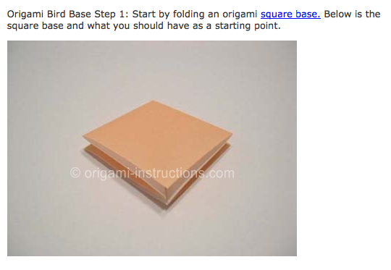
Folding a Bird Base: Step 1

Slide 19
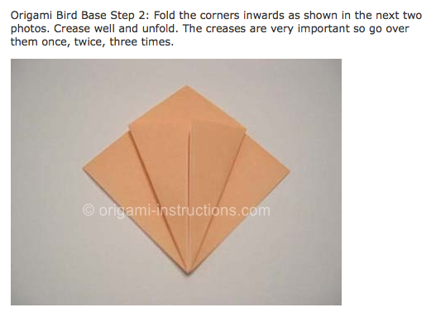
Folding a Bird Base: Step 2
many more steps . . . .

Slide 20
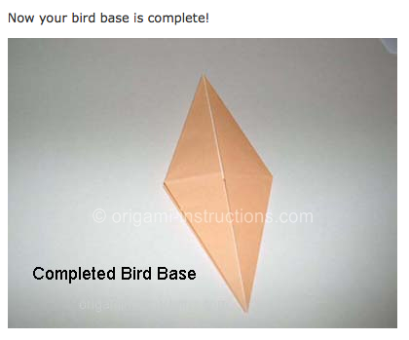
Folding a Bird Base: last step

Slide 21
Problem Decompostion in Origami
Making an Origami Crane:
Problem Decomposition
  Start with a Bird Base;
  Fold the outside corners inside… …
  Using reverse fold, make neck and tail
  Finish the Head;
  Finish the Wings;
Modular Origami
  http://www.origami-instructions.com/modular-origami-instructions.html
http://www.origami-instructions.com/origami-crane.html

Slide 22
Example of
Simple Algorithm
for Problem Solving

Slide 23
Simple Example: Computing miles-per-gallon
Problem:
  Given: Starting mileage, ending mileage,
  amount of gas used for a trip;
  Calculate average “miles per gallon” for the trip
An Instance of the Problem:
  StartMiles = 12345; EndMiles = 12745; GasUsed = 20 (gallons)
The Calculations:
  Distance = (12745 – 12345) = 400 (miles);
  Average = 400/20 = 20 (miles/gallon)

Slide 24
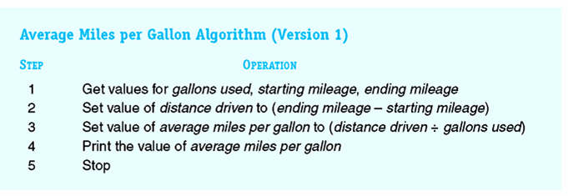
Simple Miles-per-gallon Algorithm:
Call this “GasUsed”
Call this “StartMiles”
Call this “EndMiles”
Call this “Average”
Call this “Distance”
Figure 2.3
Algorithm for Computing Average Miles per Gallon

Slide 25
Simple Miles-per-gallon Algorithm:
Problem:
  Given: Starting mileage, ending mileage,
  amount of gas used for a trip;
  Calculate average “miles per gallon” for the trip
A More Concise Version:
ALGORITHM Avg-MPG
1. Get values for GasUsed, StartMiles, EndMiles;
2. Let Distance be (EndMiles – StartMiles);
3. Let Average be Distance / GasUsed;
4. Print the value of Average
5. Stop

Slide 26
Tracing the “State of the Algorithm”
ALGORITHM Avg-MPG
1. Get values for GasUsed, StartMiles, EndMiles;
2. Let Distance be (EndMiles – StartMiles);
3. Let Average be Distance / GasUsed;
4. Print the value of Average
5. Stop
Input to Algorithm:
Output of Algorithm:
Algorithm
30, 2201, 2861
???
GasUsed
???
Step ???.
StartMiles
???
Our abstract
model of
the computer
EndMiles
???
Distance
???
CPU
Average
???

Slide 27
Tracing the “State of the Algorithm”
ALGORITHM Avg-MPG
1. Get values for GasUsed, StartMiles, EndMiles;
2. Let Distance be (EndMiles – StartMiles);
3. Let Average be Distance / GasUsed;
4. Print the value of Average
5. Stop
Input to Algorithm:
Output of Algorithm:
Algorithm
30, 2201, 2861
???
GasUsed
30
Step 1.
StartMiles
2201
Our abstract
model of
the computer
EndMiles
2861
Distance
???
CPU
Average
???

Slide 28
Tracing the “State of the Algorithm”
ALGORITHM Ave-MPG
1. Get values for GasUsed, StartMiles, EndMiles;
2. Let Distance be (EndMiles – StartMiles);
3. Let Average be Distance / GasUsed;
4. Print the value of Average
5. Stop
Input to Algorithm:
Output of Algorithm:
Algorithm
30, 2201, 2861
???
GasUsed
30
Step 2.
(2861 – 2201)
= 660
StartMiles
2201
Our abstract
model of
the computer
EndMiles
2861
Distance
660
CPU
Average
???

Slide 29
Tracing the “State of the Algorithm”
ALGORITHM Avg-MPG
1. Get values for GasUsed, StartMiles, EndMiles;
2. Let Distance be (EndMiles – StartMiles);
3. Let Average be Distance / GasUsed;
4. Print the value of Average
5. Stop
Input to Algorithm:
Output of Algorithm:
Algorithm
30, 2201, 2861
???
GasUsed
30
Step 3.
(660 / 30)
= 22
StartMiles
2201
Our abstract
model of
the computer
EndMiles
2861
Distance
660
CPU
Average
22

Slide 30
Tracing the “State of the Algorithm”
ALGORITHM Avg-MPG
1. Get values for GasUsed, StartMiles, EndMiles;
2. Let Distance be (EndMiles – StartMiles);
3. Let Average be Distance / GasUsed;
4. Print the value of Average
5. Stop
Input to Algorithm:
Output of Algorithm:
Algorithm
30, 2201, 2861
22
GasUsed
30
Step 4.
StartMiles
2201
Our abstract
model of
the computer
EndMiles
2861
Distance
660
CPU
Average
22

Slide 31
Scratch version…
Go check out the
Scratch version yourself

Slide 32
Example: Adding two (m-digit) numbers
Input:
  Two positive m-digit decimal numbers (A and B)
A = ( a_{m-1}, a_{m-2}, …., a₀ )
B = ( b_{m-1}, b_{m-2}, …., b₀ )
Output:
  The sum C = A + B
C = ( c_{m}, c_{m-1}, c_{m-2}, …., c₀ )
Self Study:
Read [SG] Ch 1.2, 2.1
Make sure you
understand how the
algorithm work;
An instance of the Problem:
  a = 5 9 8 2 m = 4
  b = 7 6 6 5
  c = 1 3 6 4 7

Slide 33
How to “derive” the algorithm
Adding is something we all know
  done it a thousand times, know it “by heart”
How do we give the algorithm?
  A step-by-step instruction
  to a dumb machine
Try an example:
  3 4 9 2
  8 1 5 7
“Imagine you looking at yourself solving it”

Slide 34
Algorithm: Finding sum of A & B
Addition Algorithm for C = A + B
Skip this for now
Cover during tutorials.
Step 1: Set the value of carry to 0
Step 2: Set the value of i to 0.
Step 3: While the value of i is less than or equal to (m – 1), repeat steps 4 through 6
  Step 4: Add a_{i} and b_{i} to the current value of carry, to get x
  Step 5: If x < 10 then
  Let c_{i} = x, and reset carry to 0.
  else (* namely, in this case x ≥ 10 *)
  Let c_{i} = x – 10 and reset carry to 1.
  Step 6: Increase the value of i by 1.
Step 7: Set c_{m} to the value of carry.
Step 8: Print the final answer c_{m}, c_{m-1}, …., c₀
Step 9: Stop.
Self Study:
Read [SG] Ch 1.2, 2.1
Make sure you
understand how this
algorithm work;

Slide 35
Chapter Outline:
  Chapter Goals
  What are Algorithms
  Pseudo-Code to Express Algorithms [SG]-Ch 2.2
    Communicating algorithm to computer
    Pseudo-Code for expressing Algorithms
    Model of a Computer, Variables and Arrays
    Primitive Operations and examples
  Some Simple Algorithms
  Examples of Algorithmic Problem Solving

Slide 36
Expressing Algorithms: Issues
Problems/Difficulties with using English
  Imprecise instructions; ambiguity
  Human often can do the job anyway, even if instructions are not followed precisely
  Modifications are made by the person following the instructions;
NOT suitable for instructing a Computer
  Computer needs to told PRECISELY what to do;
    Instructions must be PRECISE;
    Cannot be vague or ambiguous

Slide 37
3. Expressing Algorithms for a Computer
To communicate algorithm to computer
  Need way to “represent” the algorithm
  Cannot use English
Can use computer language
  machine language and
  programming languages (Java, Pascal, C)
But, these are too tedious (&technical)
Use Pseudo-Code and Scratch instead…

Slide 38
Pseudo-Code to express Algorithms
Pseudo-Code
  Mixture of computer language and English
    Somewhere in between
    precise enough to describe what is meant
    without being too tedious
  Examples:
    Let c be 0;
    c ← 0;
    Sort the list of numbers in increasing order;
Need to know both syntax and semantics
  syntax – representation
  semantics – meaning

Slide 39
Definition of Algorithm:
An algorithm for solving a problem
  “a finite sequence of unambiguous, executable steps or instructions, which, if followed would ultimately terminate and give the solution of the problem”.
  Note the keywords:
    Finite sequence of steps;
    Unambiguous;
    Executable;
    Terminates;
(Read more in [SG]-Ch 1)

Slide 40
Are these Algorithm?
Problem 1: What is the largest integer
  INPUT: All the integers { … -2, -1, 0, 1, 2, … }
  OUTPUT: The largest integer
  Algorithm:
    Arrange all the integers in a list in decreasing order;
    MAX = first number in the list;
    Print out MAX;
  WHY is the above NOT an Algorithm?
    (Hint: How many integers are there?)
Problem 2: Who is the tallest women in the world?
  Algorithm: To be discuss during Tutorial

Slide 41
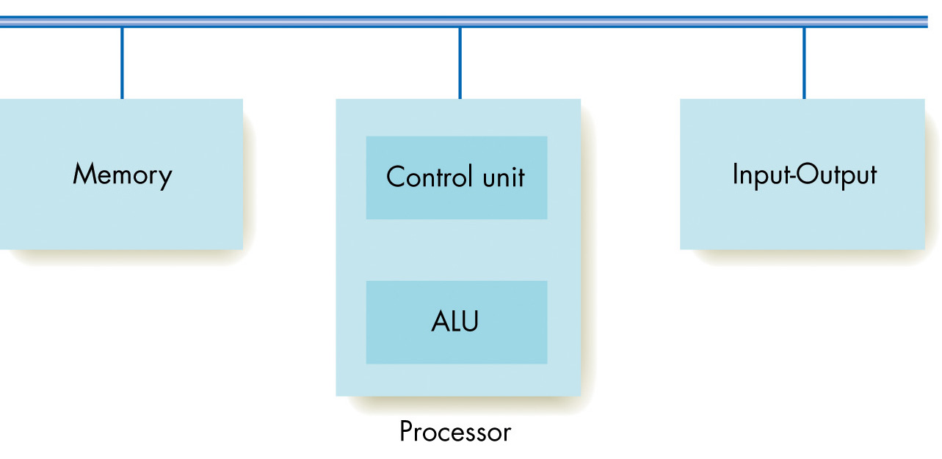
Our Current Model of a Computer
CPU
Major Components of a Computer
(from Figure 5.2 of [SG])

Slide 42
Our Current Model of a Computer
Memory: Large Number of “Storage Boxes”:
  Each memory (or storage box) can store information;
  Can give name to these memory boxes (variable names)
  Can only store one number at a time
  (old value are overwritten, and gone!)
CPU (Central Processing Unit):
  Can read data from memory (variables) into CPU
  Can do complex calculations (+, - , *, /, etc) in CPU
  Can store answers back to memory (variables)
Input / Output Devices:
  Monitor, Keyboard, Mouse, Speakers, Microphone, etc
  Can read data from Input Devices into the CPU,
  Can print data from CPU to Output Devices

Slide 43
Memory Model: Variables
Variables (or Storage Boxes)
  Computers work with data (numbers, words, etc)
  Data must be stored (in storage boxes)
    Each storage box can store one number at any time
  Each storage box is given a name, called a variable
    Examples: Distance, Average, j
Operations of a Variable (storage box)
  Read: read the content of (value stored in) the box
  Write: store a new value into the box
  IMPT: When a new value is written to a variable,
  the old value is lost forever.
30
Distance
660

Slide 44
Arrays (contiguous storage boxes)
Often deal with many numbers (of same type)
  Eg: Quiz score for all students in the class
    One storage box for each score (need 25 boxes)
  Have 25 different variables
    QuizScore1, QuizScore2, … , QuizScore25
Give them a common variable name, say, A
  Such as A₁, A₂, A₃, … , A₂₅
  Store as an “array” A[1], A[2], … , A[100]
  They are stored in contiguous storage boxes
  One box for each A[k]
    we treat each of them as a variable,
    each is assigned a storage “box”
30

Slide 45
Primitive Operations
To “tell” a computer what to do, we need
  “a basic set of instructions”
  That is understood and executable by computer
  Here, we call them “primitive operations”
  Most primitive operations are very low level
Will express algorithms using these primitive
operations

Slide 46
Primitive Operations of a Computer
Three types of primitive operations:
  Sequential operation:
    assignment statement, read/print statements
  Conditional operation:
    if statement
    case statement
  Looping (iterative) operation:
    while loop,
    for loop,
Operations/statements are executed sequentially (from top to bottom), one-by-one

Slide 47
Type 1: Simple Operations/Statements
Assignment statements (examples)
  Set Count to 5;
  Assign X the value of (C+B)/2;
  Let Interest be Rate*Principle*Duration;
  Let A[3] be 8;
  Let Smallest be A[i+3];
Another (more concise) way to express these…
  Count ← 5;
  X ← (C+B)/2;
  Interest ← Rate*Principle*Duration;
  A[3] ← 8;
  Smallest ← A[i+3];
Note: These statements are executed one-by-one
Semantics:
1. Compute value of expression on the RHS of the assignment statement.
2. Store the compute value as the new value of the variable on LHS.
(Note: Old value of variable is lost.)

Slide 48
Execution of some Sequential Statements
Try it out yourself!
Count
143
Count ← 5;
X ← (C+B)/2;
A[3] ← 8;
Smallest ← A[i+3];
B
10
C
30
X
205
A[1]
20
A[2]
15
CPU
A[3]
??
Assume this is the initial
state of the computation…

Slide 49
Tracing (or exercising) an algorithm…
Sample Algorithm
1. J ← 3;
2. X ← 14;
3. J ← X + 2*J;
J X
? ?
3 ?
3 14
20 14
Given an algorithm (above left), to exercise it means
  to “trace” the algorithm step-by-step; and
  observe the value of each variable after each step;
  Good to organize as a “table” as shown above (right)

Slide 50
More Simple Operations/Statements
Some Input / Output Statements;
  Get the value of N;
  Read in the value of A[1], A[2], A[3], A[4];
  Print the string “Welcome to my Intelligent Agent”;
  Print “Your IQ is”, A, “ but your EQ is”, A/3;
Another way of expressing them…
  Read ( N );
  Read ( A[1], A[2], A[3], A[4] );
  Print “Welcome to my Intelligent Agent”;
  Print “Your IQ is”, A, “ but your EQ is”, A/3;
Note: These statements are executed one-by-one
(Can assume each takes constant unit of time to execute)

Slide 51
Miles-per-gallon (revisited)
To obtain a better report, use more print statements;
  Print out details in nice report format;
ALGORITHM
1. Read ( StartMiles, EndMiles, GasUsed );
2. Distance ← (EndMiles – StartMiles);
3. Average ← Distance / GasUsed;
4. Print “Trip Report”
5. Print “ Your StartMiles =“, StartMiles;
6. Print “ Your EndMiles =“, EndMiles;
7. Print “ Gas Used =“, GasUsed;
8. Print “ Average km/litre=“, Average;
9. Print “End of Trip Report”;
5. Stop
…

Slide 52
More Example: To swap two variables
Given two values stored in A and B;
Wanted: An algorithm to exchange the values stored;
Example:
  Input: A = 15; B = 24;
  Required Output: A = 24; B = 15;
Two Incorrect Algorithms
ALG 1:
1. A ← B;
2. B ← A;
A B
15 24
ALG 2:
1. B ← A;
2. A ← B;
A B
15 24
Error: One of the values was over-written;
HW: What is a correct algorithm to swap A & B?

Slide 53
Type 2: Conditional Statements
if statement
  to take different actions based on condition
Syntax
  if (condition)
  then (Step A)
  else (Step B)
  endif
  if (condition)
  then (Step A)
  endif
Semantics
true
false
condition?
Step A
Step B
Either Step A or Step B
is executed, but never both.

Slide 54
Example 1 of Conditional Statement (1)
Syntax
  if (Average >= 25)
  then Print “Good..”;
  else Print “Bad..”;
  endif
Semantics
true
false
Average >= 25
Print “Good..”
Print “Bad..”

Slide 55
Example 1 of Conditional Statement (2)
Miles-per-Gallon Problem (revisited)
  Suppose we consider good petrol consumption to be Average that is >= 25.0 miles / gallon
  Determine if petrol consumption for trip is Good!
Example:
  Average = 15.0, then “Not good petrol consumption”
  Average = 30.6, then “Good petrol consumption”
ALGORITHM
1. ... (* Steps to compute Average ... *)
2. if (Average >= 25)
3. then Print “Good Petrol Consumption”;
4. else Print “Not good petrol comsumption”;
5. endif
6. Stop
…

Slide 56
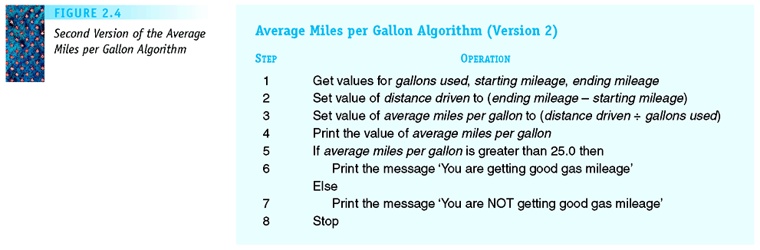
Version 2 of Miles-per-Gallon Algorithm
Average mile per gallon version 2
Figure 2.4
Second Version of the Average Miles per Gallon Algorithm

Slide 57
Version 2 of Miles-per-Gallon Algorithm
Combine the two parts into one longer algorithm
  With printout on good /bad petrol consumption
ALGORITHM Miles-per-Gallon; version 2)
1. Read ( StartMiles, EndMiles, GasUsed );
2. Distance ← (EndMiles – StartMiles);
3. Average ← Distance / GasUsed;
4. Print “Average Mileage is”, Average;
5. if (Average >= 25)
6. then Print “Good Petrol Consumption”;
7. else Print “Not good petrol comsumption”;
8. endif
9. Stop
…
Homework:
Modify the Scratch program to incorporate this.

Slide 58
Example 2 of Conditional Statement
Alg. to read in a mark and print out if student pass.
  Let’s say that the passing mark is 40;
Examples:
  mark = 25; Expected Output is “Student fail”
  mark = 45; Expected Output is “Student pass”
  mark = 99; Expected Output is “Student pass”
Solution: Use an if-then-else statement

Slide 59
Example 2 of Conditional Statement
The Algorithm:
Algorithm:
1. Read (mark); (*get value of mark*)
2. if (mark < 40)
3. then (print “Student fail”)
4. else (print “Student pass”)
5. endif
…
Try executing algorithm with some cases:
  When mark = 30; Output is “Student fail”
  When mark = 42; Output is “Student pass”
  When mark = 95; Output is “Student pass”
Note: in the above,
  either 3 or 4 is executed; never both
Q: What about the different grades of passes?

Slide 60
Two if Statements (one after another)…
Suppose grade “D” is defined as 40-49 marks
1. Read (mark); (* Get value of mark *)
2. if (mark < 40)
then (print “Student fail”)
endif;
5. if (mark >= 40) and (mark < 50)
6. then (print “Grade D”)
7. endif;
…
Try some cases:
  When mark = 30; Output is “Student fail”
  When mark = 42; Output is “Grade D”
  When mark = 95; What is output?
Where is the “error”?

Slide 61
“Nested” if Statements (one inside another)…
1. Read (mark); (* Get value of mark *)
2. if (mark < 40)
then (print “Student fail”)
else if (mark < 50)
5. then (print “Grade D”)
6. else (print “Grade C or better”)
7. endif
7. endif;
…
Try some cases:
  When mark = 30; Output is “Student fail”
  When mark = 42; Output is “Grade D”
  When mark = 95; Output is “Grade C or better”

Slide 62
A Complicated if Statement
read in mark (*from the terminal*)
if (mark < 40) then (Grade ← “F”)
else if (mark < 50) then (Grade ← “D”) endif
else if (mark < 60) then (Grade ← “C”) endif
else if (mark < 70) then (Grade ← “B”) endif
else if (mark < 80) then (Grade ← “A”) endif
else (Grade ← “A+”)
endif
print “Student grade is”, Grade
This is a complicated if statement;
  Study it carefully to make sure you understand it;
  Can you come up with this algorithm yourself?

Slide 63
Type 3: Iterative (looping) operations
Recall Recurring Principle:
The Power of Iterations
Iterative statement:
  Tells computer to do “something” multiple times
  Tells computer to “loop” multiple times
  Loop condition: (also called terminating condition)
  a condition (true/false) to tell when to stop looping!
Pre- and Post-loop iterative statements
  Pre-test: Test loop condition before looping
  Post-test: Test loop condition after looping
Question: What if the loop condition is never satisfied?
  Infinite loop!

Slide 64
Type 3: Iterative (looping) operations
Recall the underlying principles:
“The power of iterations”
Iterative statement:
  Tells computer to do “something” multiple times
  Tells computer to “loop” multiple times
  Loop condition: (also called terminating condition)
  a condition (true/false) to tell when to stop looping!
Pre- and Post-loop iterative statements
  Pre-test: Test loop condition before looping
  Post-test: Test loop condition after looping
Question: What if the loop condition is never satisfied?
  Infinite loop!

Slide 65
Iterative operation: while-loop
the while-loop
  loop multiple times
  while condition is true
Syntax
  while (condition) do
  (some sequence
  of statements)
  endwhile
Semantics…
false
condition?
true
Some sequence
of statements;
Execute this group of statements
repeatedly as long the condition is true.
Exits only if condition is false.
If condition is never false, infinite loop!

Slide 66
Exercising a while-loop
j ← 1;
while (j <= 3) do
print j;
j ← j + 1;
endwhile
print “--- Done ---”
(* General Loop *)
Read(n);
j ← 1;
while (j <= n) do
print j;
j ← j + 1;
endwhile
print “--- Done ---”
Output:
1
2
3
--- Done ---

Slide 67
Danger with using a while-loop
j ← 1;
while (j <= 3) do
print j;
j ← j + 1;
endwhile
print “--- Done ---”
j ← 1;
while (j >= 0) do
print j;
j ← j + 1;
endwhile
print “--- Done ---”
Output:
1
2
3
--- Done ---
Output:
1
2
3
4
5
...
Infinite loop!
To err is human,
To forgive, divine!
To err is human,
To really foul things up,
you need a computer.

Slide 68
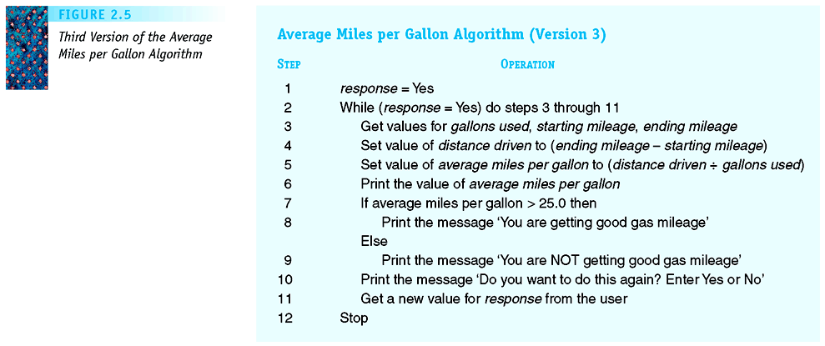
Miles-per-Gallon (with while loop)
Average mile per gallon version 2
Figure 2.5
Third Version of the Average Miles per Gallon Algorithm

Slide 69
Conditional and Iterative Operations
Pretest loop
  Loop condition tested at the beginning of each pass through the loop
  It is possible for the loop body to never be executed
  While loop

Slide 70
Algorithms Problem Solving
Readings: [SG] Ch. 2
Chapter Outline:
  Chapter Goals
  What are Algorithms
  Pseudo-Code to Express Algorithms
  Some Simple Algorithms
    Computing Sum
    Structure of Basic Iterative Algorithm
  Examples of Algorithmic Problem Solving
(Continued in next ppt file)

Slide 71

Thank you!

Slide 72
Additional Slides…
The next few slides are for your info only.
They are on the for-loop
  a special iterative statement
for loops will not be tested in UIT2201.
If you don’t know it, and don’t want to,
  You can do perfectly fine with the while-loop.
But if you already know it, you can use it

Slide 73
Looping Primitive – for-loop
First, the for-loop
  loop a “fixed” or
  (pre-determined)
  number of times
Syntax
  for j ← a to b do
  (some sequence
  of statements)
  endfor
Semantics…
j ← a;
false
(j <= b)?
true
Some sequence
of statements;
j ← j+1;

Slide 74
“Exercising the alg”: for and while
for j ← 1 to 4 do
print 2*j;
endfor
print “--- Done ---”
j ← 1;
while (j <= 4) do
print 2*j;
j ← j + 1;
endwhile
print “--- Done ---”
Output:
2
4
6
8
--- Done ---
Output:
2
4
6
8
--- Done ---

Slide 75
Recall: Algorithm for summing A & B
Addition Algorithm for C = A + B
Step 1: Set the value of carry to 0
Step 2: Set the value of i to 0.
Step 3: While the value of i is less than or equal to (m – 1), repeat steps 4 through 6
  Step 4: Add a_{i} and b_{i} to the current value of carry, to get x
  Step 5: If x < 10 then
  Let c_{i} = x, and reset carry to 0.
  else (* namely, in this case x ≥ 10 *)
  Let c_{i} = x – 10 and reset carry to 1.
  Step 6: Increase the value of i by 1.
Step 7: Set c_{m} to the value of carry.
Step 8: Print the final answer c_{m}, c_{m-1}, …., c₀
Step 9: Stop.

Slide 76
Algorithm: A = B + C (in pseudo-code)
Can re-write the C=A+B algorithm concisely as follows:
Alg. to Compute C = A + B;
(* sum two m-bit integers *)
1. carry ← 0;
2. i ← 0;
3. while (i < m) do
4. x ← a[i] + b[i] + carry;
5. if (x < 10)
6. then { c[i] ← x; carry ← 0; }
7. else { c[i] ← x - 10; carry ← 1; }
8. endif
9. i ← i + 1;
10. endwhile;
11. c[m] ← carry;
12. print c[m], c[m-1], …., c[0]

Slide 77
Algorithm: A = B + C (in pseudo-code)
Can re-write the C=A+B algorithm concisely as follows:
Alg. to Compute C = A + B:
(*sum two big numbers*)
carry ← 0;
for i ← 0 to (m-1) do
  x ← a[i] + b[i] + carry ;
  if (x < 10)
  then ( c[i] ← x; carry ← 0; )
  else ( c[i] ← x – 10; carry ← 1; )
  endif
endfor;
c[m] ← carry;
Print c[m], c[m-1], …., c[0]

