Slide 1
Database – Info Storage and Retrieval
Aim: Understand basics of
  Info storage and Retrieval;
  Database Organization;
  DBMS, Query and Query Processing;
  Work some simple exercises;
  Concurrency Issues (in Database)
Readings:
  [SG] --- Ch 13.3
Last Revised: 01 October 2013.

Slide 2
Outline
What is a Database and Evolution…
Organization of Databases
Foundations of Relational Database
DBMS and Query Processing
Concurrency Issue in Database

Slide 3
What is a Database
First attempt…
  A collection of data
Examples:
  Employee database
  Jobs Database
  LINC Database
  Inventory Database
  Recipe Database
  Database of Hotels
  Database of Restaurants
  MP3 Database

Slide 4
What is a Database (2)
Combination of “Databases”
  Can do more…
  eg: Employee Database + CIA Database
  eg: Inventory Database + Recipe Database
Database is …
  A combination of a variety of data collections into a single integrated collection

Slide 5
Evolution of Databases…
From separate, independent database
  One Course-DB per NUS dept/faculty (in the 90’s)
  Inherent Problem:
    incompatability,
    inconvenience, slow, error prone
To Integrated Database
  One integrated DB schema or DB system (now)
    Serving the needs of all depts/faculty
    Better data compatability, fasters,…
    eg: NUS CORS Online Registration
    eg: IRAS e-filing (Online Tax Submission)

Slide 6
DBMS and DBA
With Integrated Database, we need
  To ensure data consistency
  Provide services to all depts
    Different services to diff dept,
    Different interface
  To provide different views of the same data
    Eg: CEO, CFO, Proj Mgr, Programmer
    Eg: Dean, Heads, Professors, AOs, Students
  to decide how to Organize data (schemas)
    Usually organized into tables
DBMS = DB Management System
DBA = Database Administrator

Slide 7
Outline
What is a Database and Evolution…
Organization of Databases
Foundations of Relational Database
DBMS and Query Processing
Concurrency Issue in Database

Slide 8
Database (with 3 Tables (Relations))
SCHEDULE-DB
Course | Day | Hour
UIT2201 | Tue | 1000
UIT2201 | Tue | 1100
CS1101 | Wed | 1300
CS1101 | Wed | 1400
GRADES-DB
Course | Stud-ID | Grade
UIT2201 | U071024 | A
UIT2201 | U081337 | C
UIT2201 | U072007 | B
CS1101 | U072007 | A
STUDENTS-DB
Stud-ID | Name | Address | Phone
U071024 | Albert Zan | 23 Sheares Hall | 4358
U081337 | Betty Yeo | 89 PGP | 6177
U072007 | Cathy Xin | 37 Raffles Hall | 1388

Slide 9
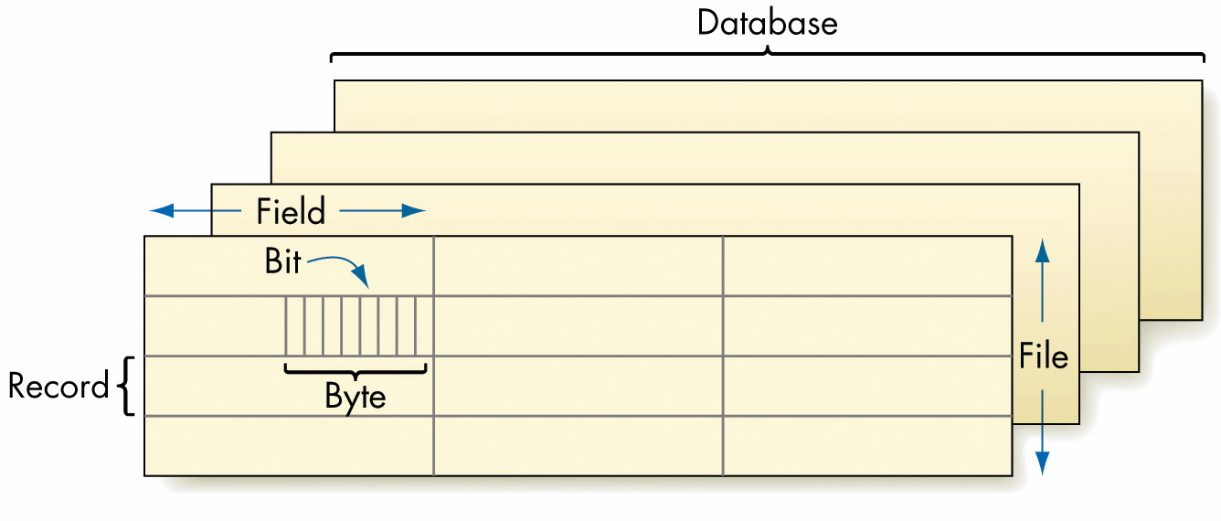
Database Organization (Overview)
Figure 13.3: Data Organization Hierarchy

Slide 10
Data Organization (A Bottom-Up View)
Bit
  A binary digit, (0 or 1)
Byte
  A group of eight (8) bits
  Stores the binary rep. of a character / small integer
  A single unit of addressable memory
Field
  A group of bytes used to represent a string

Slide 11
Data Organization (continued)
Record
  A collection of related fields
Data File
  Related records are kept in a data file
Database
  Related files make up a database

Slide 12
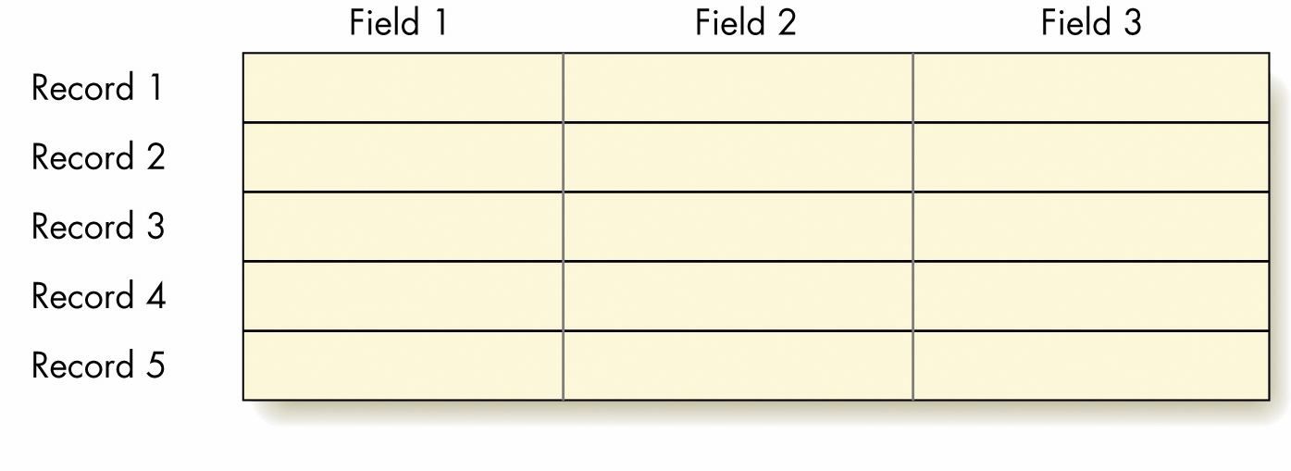
Database Files or Database Table
Figure 13.4: Records and Fields in a Single File
Eg: SCHEDULE-DB Table and Record
SCHEDULE-DB
Course | Day | Hour
UIT2201 | Tue | 1000

Slide 13
Outline
What is a Database and Evolution…
Organization of Databases
Foundations of Relational Database
DBMS and Query Processing
Concurrency Issue in Database

Slide 14
Database (with 3 Tables (Relations))
SCHEDULE-DB
Course | Day | Hour
UIT2201 | Tue | 1000
UIT2201 | Tue | 1100
CS1101 | Wed | 1300
CS1101 | Wed | 1400
GRADES-DB
Course | Stud-ID | Grade
UIT2201 | U071024 | A
UIT2201 | U081337 | C
UIT2201 | U072007 | B
CS1101 | U072007 | A
STUDENTS-DB
Stud-ID | Name | Address | Phone
U071024 | Albert Zan | 23 Sheares Hall | 4358
U081337 | Betty Yeo | 89 PGP | 6177
U072007 | Cathy Xin | 37 Raffles Hall | 1388

Slide 15
Foundations of Relational DB
Table (Relation) : information about an entity
  A set of records (eg: Schedule-DB Table)
Record (Tuple): data about an instance of the entity
  A row in the table; A tuple; Eg: (UIT2201, Tue, 10 AM)
Attribute (Fields): category of information/data
  Columns in the table (eg: Course, Day, Stud-ID, Grades)
Schema: A set of Attributes
  {Course, Day, Time} – SCHEDULE-DB
Database: A set of tables (relations)
  { SCHEDULE-DB, GRADES-DB, STUDENTS-DB }

Slide 16
Relational-DB Operations
SCHEDULE-DB
Course | Day | Hour
UIT2201 | Tue | 1000
UIT2201 | Tue | 1100
CS1101 | Wed | 1300
CS1101 | Wed | 1400
Insert (SCHEDULE-DB, (CS1102, Thu, 1100))
Delete (SCHEDULE-DB, (UIT2201, Tue, 1100))
Delete (SCHEDULE-DB, (UIT2201, * , * ))
Delete (SCHEDULE-DB, ( *, Tue, * ))
Lookup (SCHEDULE-DB, ( * , Wed, * ))

Slide 17
Typical Operations…
Insert a new Record
Deleting Records
  Delete a specific record
  Delete all records that match the specification X
Searching Records
  Look up all records that match the given specification X
Display some attributes (‘projection’)
Join Operation

Slide 18
Relational-DB and Abstract Algebra
Foundation of Relational DB is
  Relational Algebra (in abstract mathematics)
Tables are modelled as Relations (algebra)
  Specified by schema (conceptual model)
Operations on a Tables are
  modelled by Relational Operations
Typical Operations
  Insert, Delete, Lookup, Project, etc
(If interested, read article from course web-site)

Slide 19
Outline
What is a Database and Evolution…
Organization of Databases
Foundations of Relational Database
DBMS and Query Processing
Concurrency Issue in Database

Slide 20
Database Management Systems
DBMS (Database Mgmt Systems)
  Software system, maintains the files and data
Relational Database Model (and Design)
  Database specified via schema (conceptual models)
Database Query Processing
  To query the database (to get information)
  SQL (Structured Query Language)
    Specialized query language
Relationships between tables
  Established via primary keys and foreign keys

Slide 21
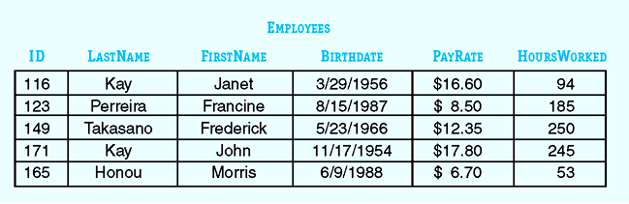
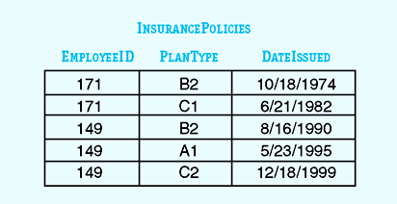
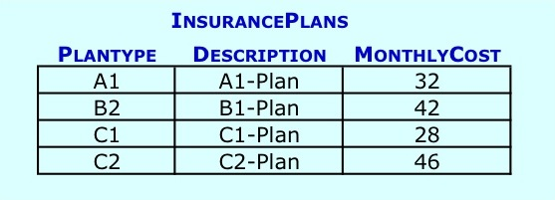
Database for Rugs-for-You

Slide 22
Query Processing with SQL
SQL is a DB Query Language
  Supported by many of the common DBMS
  Provide easy means to query a DBMS
  Provides easier means to insert/delete records
  Quite simple to use / can even learn on your own
Simplified SQL Queries (used in UIT2201)
  SELECT <some fields>
  FROM <some databases>
  WHERE <some conditions>;

Slide 23
Query Processing (simple, using SQL)
SQL Query
SELECT ID, LastName, FirstName, PayRate
FROM EMPLOYEES
WHERE (LastName = ‘KAY’);
Output of SQL Query
ID | LASTNAME | FIRSTNAME | PAYRATE
116 | Kay | Janet | $16.60
171 | Kay | John | $17.80

Slide 24
Query Processing (simple, using SQL)
SELECT ID, LastName, FirstName, HoursWorked
FROM EMPLOYEES
WHERE (HOURSWORKED > 200);
SELECT *
FROM EMPLOYEES
WHERE (PAYRATE > 15.00);

Slide 25
In SQL (a Query Language)….
SCHEDULE-DB
Course | Day | Hour
UIT2201 | Tue | 1000
UIT2201 | Tue | 1100
CS1101 | Wed | 1300
CS1101 | Wed | 1400
Simple SQL Queries
  SELECT *
  FROM SCHEDULE-DB
  WHERE (DAY=“Wed”)
  SELECT Day, Hour
  FROM SCHEDULE-DB
  WHERE (COURSE=“UIT2201”)
  SELECT Course, Hour
  FROM SCHEDULE-DB

Slide 26
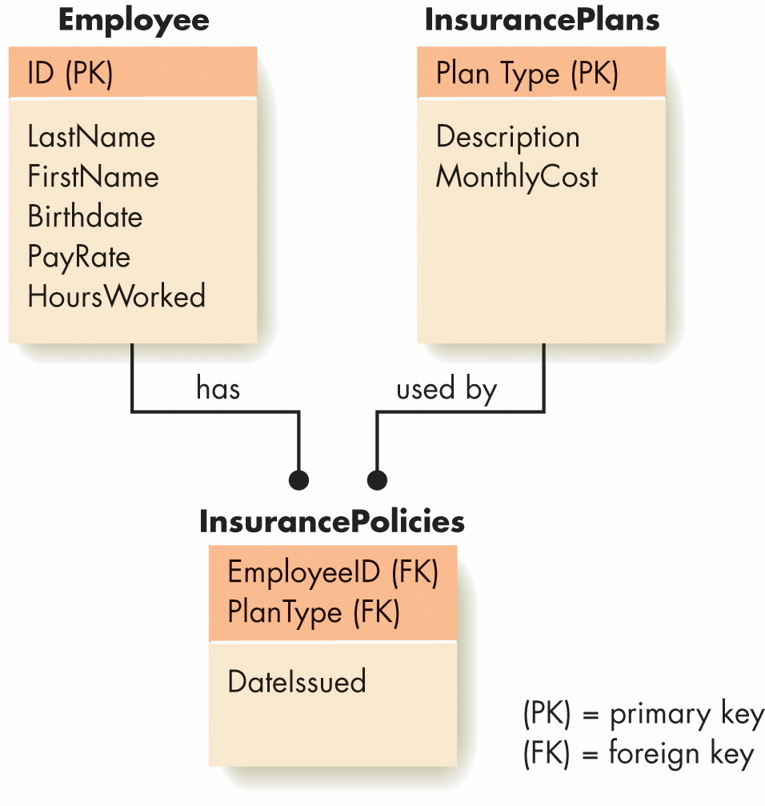
Primary Keys and Foreign Keys
Figure 13.8: Three Tables in the Rugs-For-You Database
(Readings: Primary & Foreign Keys, [SG3] Section 13.3)

Slide 27
SQL with Multiple Relations
In SQL, combining two or more tables
  that share common data (via keys)
  SQL uses a Join operation.
key
key
SELECT ID, LastName, FirstName, PlanType, DateIssued
FROM EMPLOYEES, INSURANCEPOLICIES
WHERE (LastName = “Takasano”) AND
(ID = EmployeeID);

Slide 28
Joins Operation (of Two Relations)
SCHEDULE-DB
Course | Day | Hour
UIT2201 | Tue | 10 AM
UIT2201 | Tue | 11 AM
CS1101 | Wed | 1 PM
CS1101 | Wed | 2 PM
VENUE-DB
Course | Room
UIT2201 | SR5
CS1101 | LT15
JOIN Operation
(SCHEDULE-DB.course
= VENUE-DB.course)
Course | Day | Hour | Room
UIT2201 | Tue | 10 AM | SR5
UIT2201 | Tue | 11 AM | SR5
CS1101 | Wed | 1 PM | LT15
CS1101 | Wed | 2 PM | LT15

Slide 29
More about JOIN operation
Check out animation of Join Op
Running time: O(mn) row operations
Join is an expensive operation!
May produce huge resultant tables;
Exercise great care with JOINs
(See examples in Tutorial)

Slide 30
QP: Declarative vs Procedural
SQL is a declarative language
  SQL query declare “what” you want
  DBMS+SQL auto-magically processes query
    to get the results in an efficient manner
  “How” does SQL do the job? [not given in query]
Procedural Query Processing (QP)
  The “how” of query processing
  Based on three basic primitives (from relational-alg)
  Primitives: e-project, e-select, e-join
  Specified “like” an algorithm
  [This is not covered in [SG3]. Read my notes

Slide 31
Why Learn Procedural QP
To understand how SQL does it work
  Namely, to “look under the hood”
  To see what is happening when we do query
QP uses 3 basic primitive query operations
  e-project, e-select, e-join
  These are most basic operations (like Scratch blocks)
  CANNOT modify their syntax / semantics

Slide 32
Three basic primitives
Basic Primitive Operation 1 – e-select
  e-select from <table> where <some condition>;
  (a row/record selector)
  includes ALL columns. (ALWAYS)
T1 ← e-select from SCHEDULE-DB where (DAY=“Tue”);
T4 ← e-select from SCHEDULE-DB where (HOUR=1200);
Basic Primitive Operation 2 – e-project
  e-project <some fields> from <table>;
  (a column/field selector)
  includes ALL rows. (ALWAYS)
P1 ← e-project COURSE, DAY from SCHEDULE-DB;
P6 ← e-project COURSE, HOUR from T1;

Slide 33
Basic primitives operations (2)
P1 ← e-project Course, Day from SCHEDULE-DB;
SCHEDULE-DB
Course | Day | Hour
UIT2201 | Tue | 1000
UIT2201 | Tue | 1100
CS1101 | Wed | 1300
CS1101 | Wed | 1400
S1
Course | Day | Hour
UIT2201 | Tue | 1000
UIT2201 | Tue | 1100
S1 ← e-select from SCHEDULE-DB
where (Day=“Tue”);
In e-select, ALL
columns are included
P1
Course | Day
UIT2201 | Tue
UIT2201 | Tue
CS1101 | Wed
CS1101 | Wed
In e-project,
ALL rows are included

Slide 34
Basic primitives operation – e-join
Basic Primitive Operation 3 – e-join
  e-join from <two tables> where <join-conditions>;
  Specify join conditions using primary/foreign keys;
  Two (2) tables at a time! (basic join operation)
  Includes all “satisfying” rows and columns
B1 ← e-join SCHEDULE-DB and VENUE-DB
where (SCHEDULE-DB.Course = VENUE-DB.Course);
W3 ← e-join P6 and VENUE-DB
where (P6.Course = VENUE-DB.Course);

Slide 35
Example of e-join
SCHEDULE-DB
Course | Day | Hour
UIT2201 | Tue | 10 AM
UIT2201 | Tue | 11 AM
CS1101 | Wed | 1 PM
CS1101 | Wed | 2 PM
VENUE-DB
Course | Room
UIT2201 | SR5
CS1101 | LT15
(SCHEDULE-DB.course
= VENUE-DB.course)
B1 ← e-join SCHEDULE-DB and VENUE-DB
where (SCHEDULE-DB.Course = VENUE-DB.Course);

Slide 36
Why not store everything in one Table?
STUDENT-SCHEDULE-DB
Stud-ID | Name | Phone | Course | Day | Hour | …
1024 | Albert Zan | 4358 | UIT2201 | Tue | 10 AM | …
1024 | Albert Zan | 4358 | UIT2201 | Tue | 11 AM | …
1337 | Cathy Xin | 1388 | CS1101 | Wed | 1 PM | …
1337 | Cathy Xin | 1388 | CS1101 | Wed | 2 PM | …
2007 | Betty Yeo | 6177 | UIT2201 | Tue | 10 AM
2007 | Betty Yeo | 6177 | UIT2201 | Tue | 11 AM
Problems:
  Duplication of data;
  Deletion Problem;
    What if Cathy Xin drops CS1101?

Slide 37
Other Issues: (for your reading)
Other Considerations in Databases
  Read Section 13.3.3 (pp. 604--606)

Slide 38
Database for use in Tutorials
STUDENT-INFO
Student-ID | Name | NRIC-ID | Address | Tel-No | Faculty | Major
U0801001S | Tue | S |  | 65162201 | SOC | CS
U0702007R | Tue | S |  | 65166234 | FASS | Econs
. . . | . . . | . . . | . . . | . . . | . . . | . . .
COURSE-INFO
Course-ID | Name | Day | Hour | Venue | Instructor
UIT2201 | CSITR | Tue | 1000 | USP-SR5 | LeongHW
CS6234 | Adv. Alg | Wed | 1600 | SR5(com1) | Panos
. . . | . . . | . . . | . . . | . . . | . . .
ENROLMENT
Student-ID | Course-ID
U0801001S | UIT2201
U0603528X | MA1101
. . . | . . .

Slide 39

Thank you!

Slide 41
What to modify/add for future…
Value added Services:
  Data Mining – frequent patterns
  Targeted marketing (Database marketing)
  Credit-card fraud,
  Handphone acct churning analysis

