Slide 1
Hardware (Part A)
Reading Materials:
  Chapter 4 of [SG]: The Building Blocks of HW
  Optional: Chapter 1 of [Brookshear]
OUTLINE
  The Binary Digital Computer
    Organization of Digital Computers
  Binary Numbers
  Boolean Logic and Basic Gates
  Basic Circuit Design

Slide 2
Chapter Objectives
In this chapter, you will learn about
  The Binary Numbering System
  Boolean Logic and Basic Gates
  Building Simple Computer Circuits
  Simple Control Circuits
This chapter focus on logic design
  How to represent and store information
  Applying symbolic logic to design gates
  Using gates to build circuits for addition, compare, simple control

Slide 3
The Binary Digital Computer
Organization of a Computer
Input Devices
Output Devices
CPU
Memory
Unit (Storage)

Slide 4
Analog/Digital Computer
…Up to now, whatever we have discussed could equally well be discussed in the context of either digital or analog computations…
We shall concentrate on digital computer
  Specifically, binary computers
  BINARY = two value (0 and 1) [ON/OFF]
Why binary computers?
  Physical components – transistors, etc
  Reliability of hardware components

Slide 5
Why use Binary Numbers?
1. Reliability
  Represent only two values (0 and 1), ON/OFF
  High margin of error
2. Nature of Hardware Devices
  Many devices are “two-state” devices
3. Persistence of Digital Data
  Can store and preserve digital data better

Slide 6
Why Binary Computers: Reliability
1. Reliability:
  computer store info using electronic devices
  electronic quantities measured by:
    voltage, current, charge, etc
  These quantities are not always reliable!
    esp. for old equipments
    Also, the range of voltage changes with advances in hardware technology

Slide 7
Why Binary: Nature of Hardware Devices
2. Many hw devices are “two-state” devices
  magnetized / demagnetized
    diskettes (3.5” floppy, Zip disks,…)
  direction of magnetization (cw / ccw)
    CORE memory (main memory)
  charged / discharged capacitor

Slide 8
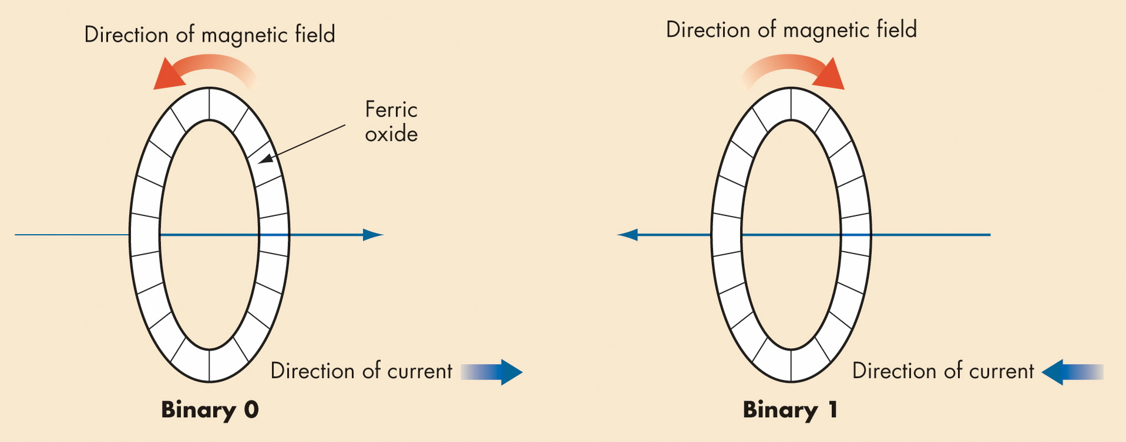
Binary Storage Devices
Magnetic Cores
  Historic device for computer memory
  Tiny magnetized rings:
  flow of current sets dir. of magnetic field
  Binary values 0 and 1
  represented by direction of magnetic field

Slide 9
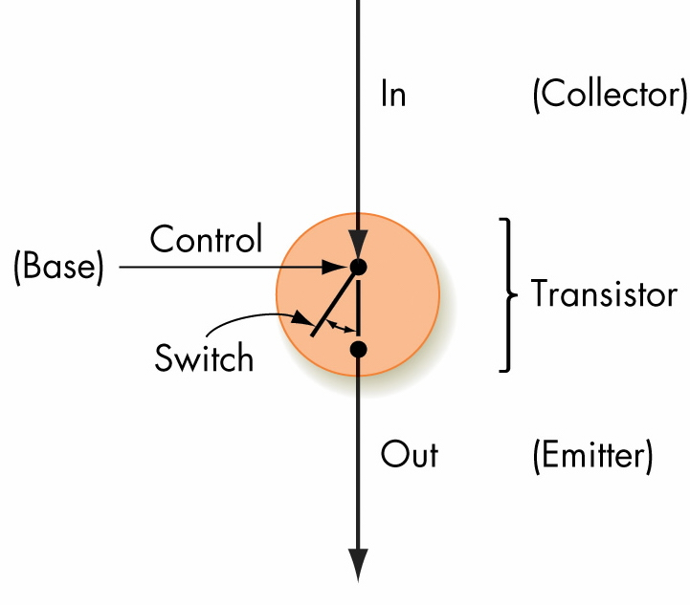
Binary Storage Devices (continued)
Transistors
  Solid-State Switches:
  permit or block current flow
  Control “switch” to change the state
  Constructed from semiconductor
A simplified model
of a transistor

Slide 10
Why Digital (not Analog): More Durable
Analog data poses difficulties
  very hard to store real numbers accurately
  or persistently (over time)
  eg: old photographs, movie reels, books
3. Solution: Store them digitally (high persistence)
  CD player uses approximation…
    instead of the exact frequency/volume (audio)
    But, the approximation is “good enough”
    Our ears not sensitive enough to tell difference
  Once we have digital data (reliability)
    also, can use various algorithms (eg: compression) for easier processing of the data….

Slide 11
Hardware: The Basic Building Blocks
  The Digital Computer
  Binary Numbers
    Binary number System
    From Decimal to Binary
    Binary Rep. of Numeric and Textual Information
    Rep. of Sound, Image Information
    Reliability of Binary Encoding
    READ: Sect. 4.2 of [SG] or Sect 1.4, 1.5, 1.7 of [A]
  Boolean Logic and Basic Gates
  Basic Circuit Design

Slide 12
2. The Binary Numbering System
Human represent and process information using a decimal system (base 10),
-- digits are 0,1,2,3,4,5,6,7,8,9
ALL Information inside a digital computer is stored as a collection of binary data (base 2)
-- digits are 0,1

Slide 13
Binary Numbers (vs Decimal Numbers)
Humans use Decimal number system
  7809 = 7×10³ + 8×10² + 0×10¹ + 9×10⁰
  Each digit is from {0,1,2,3,4,5,6,7,8,9} – Base 10
  (we happen to have 10 fingers.)
Computers use Binary number system
  (1101)₂ = 1×2³ + 1×2² + 0×2¹ + 1×2⁰ = 13
  Each binary digit (bit) is {0,1} – Base 2
  (IT people have 2 fingers (1 per hand))
Readings: Section 4.2 of [SG]

Slide 14
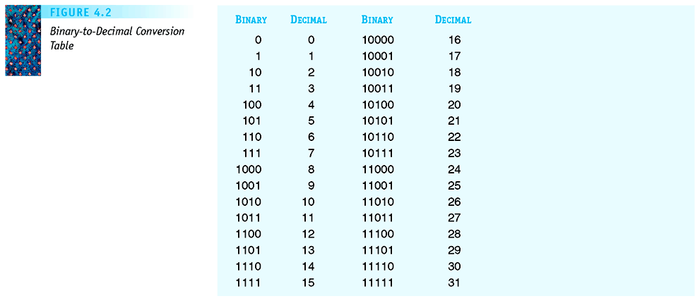
Figure 4.2
Binary-to-Decimal
Conversion Table
BINARY COUNTING:
One,
Ten
Eleven
One Hundred
One Hundred and One
One Hundred and Ten
One Hundred and Eleven
One Thousand

Slide 15
Converting from Decimal to Binary
Example: 43
Method: (repeated divide by 2)
  43 / 2 ----> Quotient: 21 Remainder: 1
  21 / 2 ----> Quotient: 10 Remainder: 1
  10 / 2 ----> Quotient: 5 Remainder: 0
  5 / 2 ----> Quotient: 2 Remainder: 1
  2 / 2 ----> Quotient: 1 Remainder: 0
  1 / 2 ----> Quotient: 0 Remainder: 1
(43)₁₀ = (101011)₂

Slide 16
Number of Bits Needed
Have seen that (43)₁₀ = (101011)₂
To represent decimal (43)₁₀ in binary,
we need 6 binary bits
In general, to represent decimal n,
we need k = lg (n +1) binary bits
  This is EXACTLY the process
  “Repeated-Divide-by-2 until we reach 0”

Slide 17
Self-Test Exercise:
In the previous worked example on converting decimal numbers to binary, at the end of all the dividing-by-two, we collect the digits by going backwards! Why?
  Hint: Try working this out yourself.
  Try going forward instead. What is the binary number you get. Convert it back to decimal and see what you will get. Use 6 and 4 as examples.
Exercise Algorithm Decimal-to-Binary on the following inputs. For each input, what is the output binary number and the value of k?
  (a) 8 (b) 13

Slide 18
Decimal to Binary (2) -- Algorithm
Algorithm: Decimal-to-Binary(n)
Input: Decimal number (n)₁₀
Output: Binary representation
(n)₁₀ = (b_{k-1} … b_{j} … b₀)₂
begin
let j ← 0;
let num ← n;
while (num > 0) do
b[j] ← num mod 2; // remainder
num ← num div 2; // divide by 2
j ← j + 1;
endwhile
while (j < k) do // pad preceding
b[j] ← 0; // bits with 0’s
j ← j + 1;
endwhile
Output B = (b[k-1] b[k-2] … b[1] b[0])
end.

Slide 19
Binary Representation of Numeric Data
Representing integers
  Decimal integers converted to binary integers
  Given k bits, (bit = binary digit)
  the largest unsigned integer is 2^{k} - 1
    Given 5 bits, the largest is 2⁵-1 = 31
    Sort 0, 1, 2, …, 31 = (2⁵-1), namely ( 0 .. 31)
    Question: What about 10 bits? ( 0.. ????)
  Signed integers must also include the sign-bit (to indicate positive or negative)

Slide 20
Binary Representation of Numeric Data…
Binary number representation – number of bits
  with 1 bit, can represent 2 numbers; [0,1]
  2 bits → 4 numbers, [0..3];
    00, 01, 10, 11
  3 bits → 8 numbers, [0..7];
    000, 001, 010, 011, …, 110, 111
  4 bits → 16 numbers, [0..15];
    0000, 0001, 0010, …, 1110, 1111
  …
With k bits → 2^{k} numbers, [0 .. 2^{k}–1]
Typical computers today work with
  16 or 32 bit numbers!

Slide 21
Binary Representation of Numeric Data…
Representing real numbers
  Real numbers may be put into binary scientific notation: a x 2^{b}
    Example: 101.11 x 2⁰
  Number then normalized so that first significant digit is immediately to the right of the binary point
    Example: .10111 x 2³
  Mantissa and exponent then stored
    they both need a sign-bit (positive/negative)

Slide 22
Number Representations
Read up on
  Signed magnitude numbers
  “floating point” representation of real numbers
    Mantissa, exponent
Readings: Section 4.? of [SG]

Slide 23
Binary Representation of Textual Information
Computers process numbers,
but also textual information
  non numeric data and text
  0 1 … 9 a b …z . | + * ( &
  special control characters eg: CR, tabs
ASCII (American Standard Code for Information Interchange) “as-kee”
  uses 7 bit code for each character
  Usually, a 0 is added in front
    “A” is 01000001
    “a” is 01100001

Slide 24
Binary Representation of Textual Information…
Characters are mapped into binary codes
  ASCII code set
  (8 bits per character; 256 character codes)
  UNICODE code set
  (16 bits, 65,536 character codes)
Using ASCII codes, we can represent
  numbers, letters (as characters)
  Names of people, sentences
    as sequences of characters
  “Hello World!”
    The above contains 12 characters
    (without the quotes “”)

Slide 25
Representation Basic Operations
Basic elementary operations of a computer
  Also represented in binary
Eg: Represent instructions (eg: ADD, SUB)
  we first assign them codes
    ADD 00 (* code for adding *)
    SUB 01 (* code for subtracting *)
    … …
  and then use the code to activate them

Slide 26
Binary Representation of Sound and Images
Multimedia data is sampled to store a digital form, with or without detectable differences
Representing sound data
  Sound data must be digitized for storage in a computer
  Digitizing means periodic sampling of amplitude values

Slide 27
Data Representation..
Analog data (eg: video, audio data)
  can be represented as digital data
  using approximation…
via a digitization process…
Accuracy depends on number of bits!
  the more bits, the more accurate…
audio, video
signals
digitization
process
digital
data

Slide 28
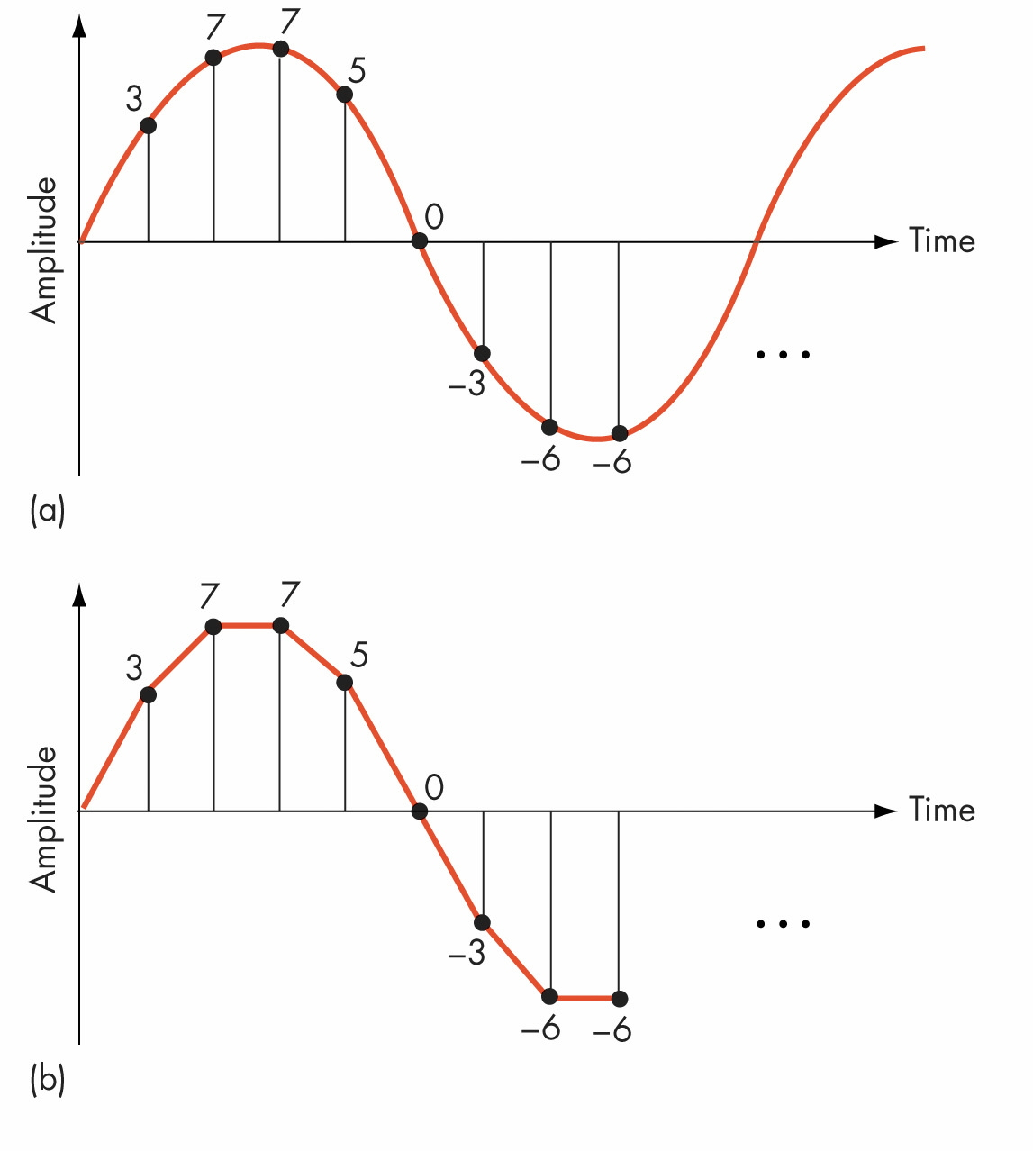
Figure 4.5
Digitization of an Analog Signal
(a) Sampling the Original
Signal
(b) Recreating the
Signal from the Sampled
Values

Slide 29
Data Representation – Analog Data?
What about analog data?
  Why is analog data problematic?
How to represent (2.1)₁₀ in binary?
  (10.1)₂ = (2.5)₁₀
  (10.01)₂ = (2.25)₁₀
  (10.001)₂ = (2.125)₁₀
  (10.0001)₂ = (2.0625)₁₀
  (10.00011)₂ = (2.09375)₁₀
  (10.000111)₂ = (2.109375)₁₀
  ……
CANNOT represent (2.1)₁₀ exactly in binary!!
  We can only give an approximation.
  Accuracy depends on the number of bits

Slide 30
Binary Representation of Sound (cont…)
  From samples, original sound may be approximated
  To improve the approximation:
    Sample more frequently
    Use more bits for each sample value

Slide 31
Binary Representation of Images (cont.)
Representing image data
  Images are sampled by reading color and intensity values at even intervals across the image
  Each sampled point is a pixel
  Image quality depends on number of bits at each pixel

Slide 32
Hardware: The Basic Building Blocks
  The Digital Computer
  Binary Numbers
  Boolean Logic and Basic Gates
    READING: Sect. 4.3 to 4.5 of [SG] & Notes
    Boolean Logic
    Basic Gates, Truth Tables
    Simple Combinatorial Circuits
    Simplification with Boolean Logic
  Basic Circuit Design

Slide 33
Boolean Logic and Gates: Boolean Logic
Boolean logic describes operations on true/false values
True/false maps easily onto bi-stable environment
Boolean logic operations on electronic signals may be built out of transistors and other electronic devices

Slide 34
Boolean Circuits
Computer operations based on logic circuits
  Logic based on Boolean Algebra
Logic circuits have
  inputs (each with value 0 or 1) T/F
  outputs
  state
Type of Logic Circuits:
  Combinational circuits: output depends only on input
  Sequential circuits: output depends also on past history (get sequence of output…)
GATES: Basic Building Blocks for Circuits

Slide 35
Basic Logic Gates (and Truth Tables)
AND Gate
OR Gate
NOT Gate
A | B | A • B
0 | 0 | 0
0 | 1 | 0
1 | 0 | 0
1 | 1 | 1
A
A • B
B
A | B | A + B
0 | 0 | 0
0 | 1 | 1
1 | 0 | 1
1 | 1 | 1
A
A + B
B
Magic number
3 again…
A | ~A
0 | 1
1 | 0
A
~A

Slide 36
Gates
Gates are hardware devices built from transistors to “implement” Boolean logic
AND gate
  Two input lines, one output line
  Outputs a 1 when both inputs are 1
OR gate
  Two input lines, one output line
  Outputs a 1 when either input is 1
NOT gate
  One input lines, one output line
  Outputs a 1 when input is 0, and vice versa

Slide 37
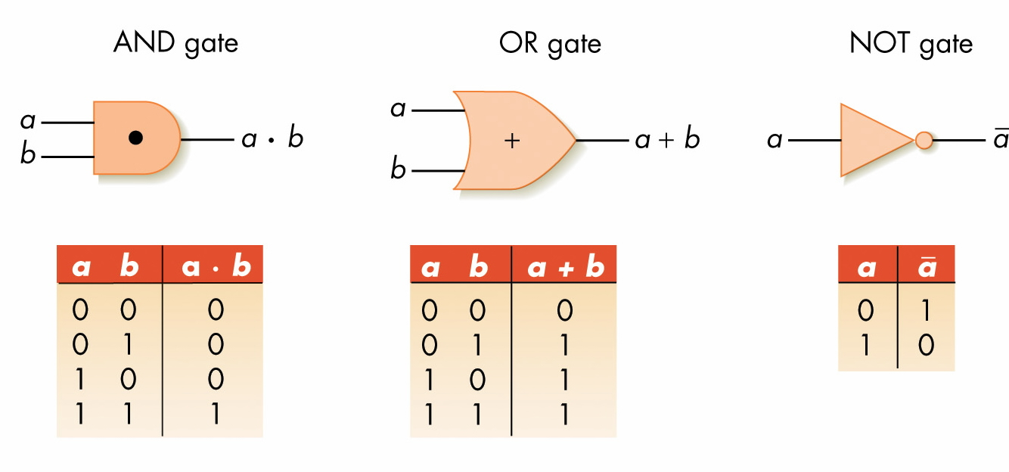
Figure 4.15
The Three Basic Gates and Their Symbols

Slide 38
What’s inside a Gate?
Gate made of physical components
  called transistors
  A transistor is formed by sandwiching a p-type silicon between two n-type silicon or vice versa.
In this course, we do not need to deal with the details of what’s inside a Gate.

Slide 39
Gates (continued)
Abstraction in hardware design
  Map hardware devices to Boolean logic
  Design more complex devices in terms of logic, not electronics
  Conversion from logic to hardware design may be automated

Slide 40
Simple Combinational Circuits
Built using a combination of logic gates
  output depends only on the input
  can also be represented by its truth table
Examples:
  C = ~(A • B)
  D = A•B + (~A • ~B)
  G = A + (B • ~C)
A
C
B
A•B
A
B
D
A
B

Slide 41
Combinational Circuits
G = A + (B • ~C)
Logic
Circuit
A
B
G
C
B • ~C
~C
A | B | C | ~C | B • ~C | G = A + B•~C
0 | 0 | 0 | 1 | 0 | 0
0 | 0 | 1 | 0 | 0 | 0
0 | 1 | 0 | 1 | 1 | 1
0 | 1 | 1 | 0 | 0 | 0
1 | 0 | 0 | 1 | 0 | 1
1 | 0 | 1 | 0 | 0 | 1
1 | 1 | 0 | 1 | 1 | 1
1 | 1 | 1 | 0 | 0 | 1
Truth
Table

Slide 42
Logic Circuits: An aside…
Possible Interpretation of G
  “Sound the buzzer if
    temperature of engine exceeds 200°F, or
    car is in gear and driver’s seat-belt is not buckled”
  We define…
    G: “Sound buzzer”
    A: “Temperature of engine exceeds 200°F”
    B: “Car is in gear”
    C: “driver’s seat-belt is buckled”
  G = A + (B • ~C)
HW: Give other interpretations…

Slide 43
Manipulation with Logical Expressions
Can manipulate / simplify logical expression
  subject to Algebraic Laws (Boolean algebra)
Examples:
  Commutative Laws
    (A + B) = (B + A)
    A • B = B • A (Note: shorthand A • B as AB)
  Associative Laws
    A + (B + C) = (A + B) + C
    A • (B • C) = (A • B) • C
  Distributive Laws
    A • (B + C) = (A • B) + (A • C)
    A + (B • C) = (A+B) • (A+C)
Complementary Law:
Given any boolean law,
change all “+” to “•”, and
change all “•” to “+”, and
change all “1” to “0” and
change all “0” to “1” to get
the complementary law.

Slide 44
Can Prove Laws by using Truth Tables
Can use the truth tables to prove laws
  ~(A+B) = (~A) • (~B) [DeMorgan’s Law]
A | B | A+B | ~(A+B)
0 | 0 | 0 | 1
0 | 1 | 1 | 0
1 | 0 | 1 | 0
1 | 1 | 1 | 0
A | B | ~A | ~B | ~A • ~B
0 | 0 | 1 | 1 | 1
0 | 1 | 1 | 0 | 0
1 | 0 | 0 | 1 | 0
1 | 1 | 0 | 0 | 0

Slide 45
HW: Prove the following laws…
Using Truth tables or otherwise, prove
  ~(A • B) = ~A + ~B [DeMorgan’s Law]
  ~(A + B) = ~A • ~B [DeMorgan’s Law]
  A • (B + C) = (A • B) + (A • C) [Distributive Law]
  A + (B • C) = (A+B) • (A+C) [Distributive Law]
  A + (A • B) = A [Absorption Law]
  A • (A + B) = A [Absorption Law]
  A + ~A = 1; A • ~A = 0;
  A • 1 = A; A + 0 = A;
  A • 0 = 0; A + 1 = 1;
Use these laws to
simplify your circuits.

Slide 46
More Basic Logic Gates
XOR Gate
NAND Gate
A | B | XOR
0 | 0 | 0
0 | 1 | 1
1 | 0 | 1
1 | 1 | 0
A
A ⊕ B
B
A | B | NAND
0 | 0 | 1
0 | 1 | 1
1 | 0 | 1
1 | 1 | 0
B
A NAND B
A
Question:
How many types of basic logic gates do we really need?

Slide 47
Logical Completeness
{ +, •, ~ } is logically complete
{ •, ~ } is logically complete
  (p + q) = ~( (~p) • (~q) )
{ +, ~ } is logically complete
{ +, • } is NOT logically complete
{ NAND } is logically complete
  (p NAND p) = (~p)
  (~p NAND ~q) = (p + q)

Slide 48
Building Computer Circuits: Introduction
Read [SG3]-Ch. 4.4.2 CAREFULLY.
A circuit is a collection of logic gates:
  Transforms a set of binary inputs into a set of binary outputs
  Values of the outputs depend only on the current values of the inputs
Combinational circuits have no cycles in them (no outputs feed back into their own inputs)

Slide 49
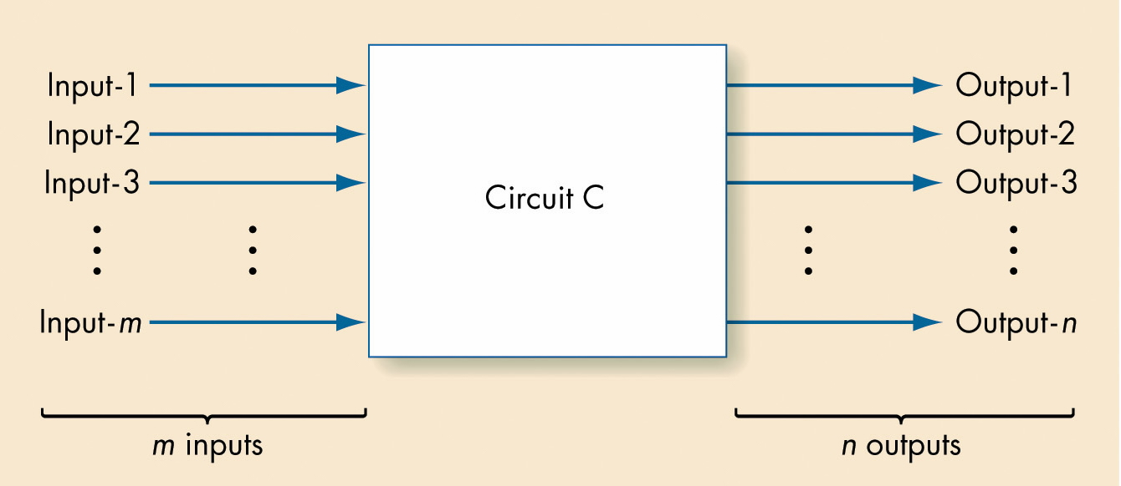
Figure 4.19
Diagram of a Typical Computer Circuit

Slide 50
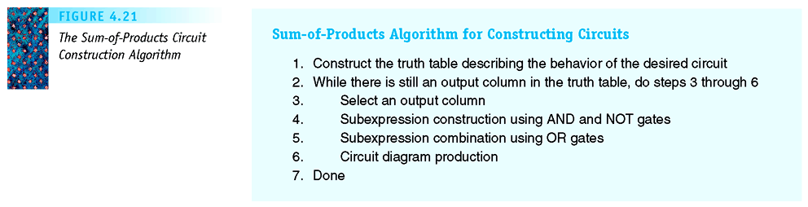
A Circuit Construction Algorithm
Truth Table → Boolean Expression → Logic Circuits
Fig. 4.21: The Sum-of-Products Circuit Construction Algorithm

Slide 51
A Circuit Construction Algorithm (cont…)
Sum-of-products algorithm
  Truth table captures every input/output possible for circuit
  Repeat process for each output line
    Build a Boolean expression using AND and NOT for each 1 of the output line
    Combine together all the expressions with ORs
    Build circuit from whole Boolean expression

Slide 52
From Truth Table → Logic Circuits
A | B | C | Output | X
0 | 0 | 0 | 0
0 | 0 | 1 | 0
0 | 1 | 0 | 0
0 | 1 | 1 | 0
1 | 0 | 0 | 0
1 | 0 | 1 | 1 | A(~B)C
1 | 1 | 0 | 1 | AB(~C)
1 | 1 | 1 | 1 | ABC
Output function:
X = A(~B)C +
AB(~C) +
ABC
Each row in the table is a logical term
  X = A(~B)C + AB(~C) + ABC
  = A(~B)C + AB(~C + C)
  = A(~B)C + AB
Boolean
Simplification

Slide 53
Examples of Circuit Design And Construction
Read [SG3]-Ch. 4.4.3
Two examples:
  Compare-for-equality circuit (comparator)
  Addition circuit (adder)
REMARKS: Both circuits can be built using the sum-of-products algorithm

Slide 54
Comparator Circuit
Given two n-bit strings, A and B
  A = (a_{n-1}, …,a₁, a₀) and B = (b_{n-1}, …,b₁, b₀)
Is A = B ?
  All the corresponding bits must be equal
  Namely, a₀= b₀, a₁= b₁,…, a_{n-2}= b_{n-2}, a_{n-1}= b_{n-1},
Some small examples
2-bit comparator
1-bit comparator
a₀
1-CE
a₀
1-CE
b₀
b₀
a₁
1-CE
b₁
Recurring Principle:
The Use of Top-Down Design

Slide 55
A 4-bit Comparator Circuit
4-bit
comparator
a₀
1-CE
b₀
a₁
1-CE
b₁
4-input
AND
a₂
1-CE
b₂
Constructed by suitably
combining simpler circuits
4-CE is made-from 1-CE’s
a₃
1-CE
b₃
Recurring Principle:
The Use of Top-Down Design

Slide 56
A Compare-for-equality Circuit (cont.)
1-CE circuit truth table
a | b | Output
0 | 0 | 1
0 | 1 | 0
1 | 0 | 0
1 | 1 | 1

Slide 57
A Compare-for-equality Circuit (cont…)
1-CE Boolean expression
  First case: (~a) * (~b)
  Second case: a * b
  Combined:
    (a*b) + (~a * ~b)

Slide 58
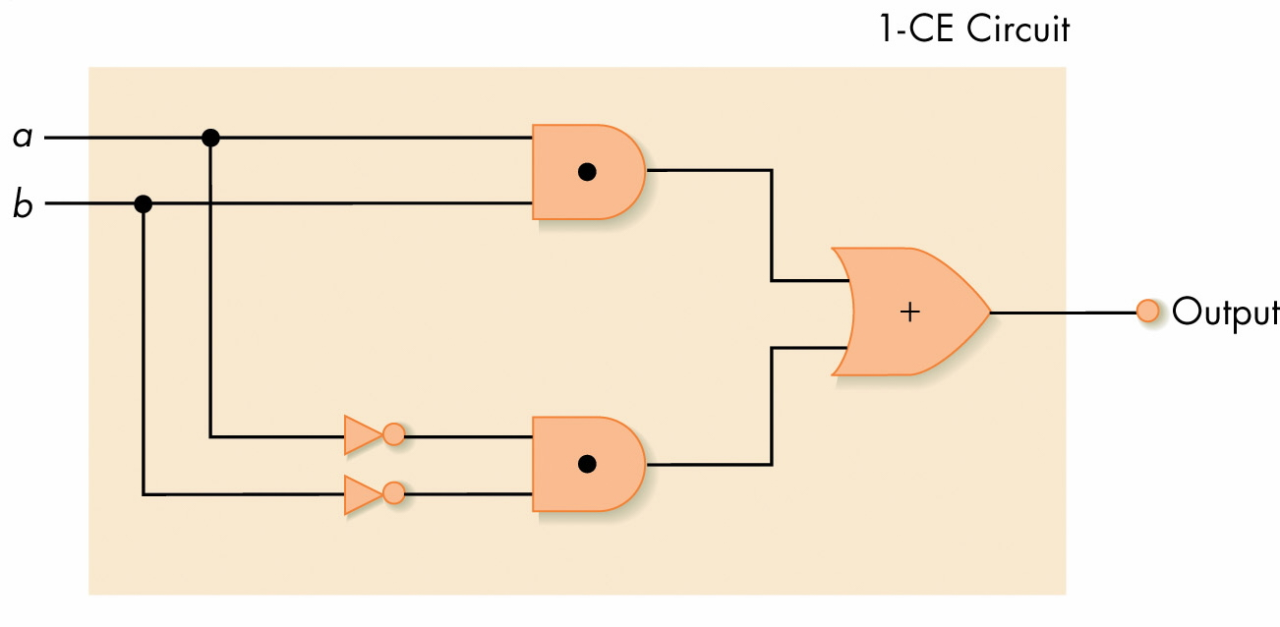
Figure 4.22
One-Bit Compare for Equality Circuit

Slide 59
Adding two Binary Numbers…
Similar to those for decimal # (simpler)
  Actually, use the same algorithm!
To add two bits, we have
  0 + 0 = 0
  0 + 1 = 1
  1 + 0 = 1
  1 + 1 = 0 (with carry 1)
What about adding three bits?
Adding two binary numbers: (do it yourself)
  101101100
  110101010

Slide 60
An Addition Circuit
Addition circuit
  Adds two unsigned binary integers, setting output bits and an overflow
  Built from 1-bit adders (1-ADD)
  Starting with rightmost bits, each pair produces
    A value for the output sum-bit
    A carry bit for next place to the left

Slide 61
An Addition Circuit (continued)
1-ADD truth table
  Input
    One bit from each input integer
    One carry bit (always zero for rightmost bit)
  Output
    One bit for output place value
    One “carry” bit

Slide 62
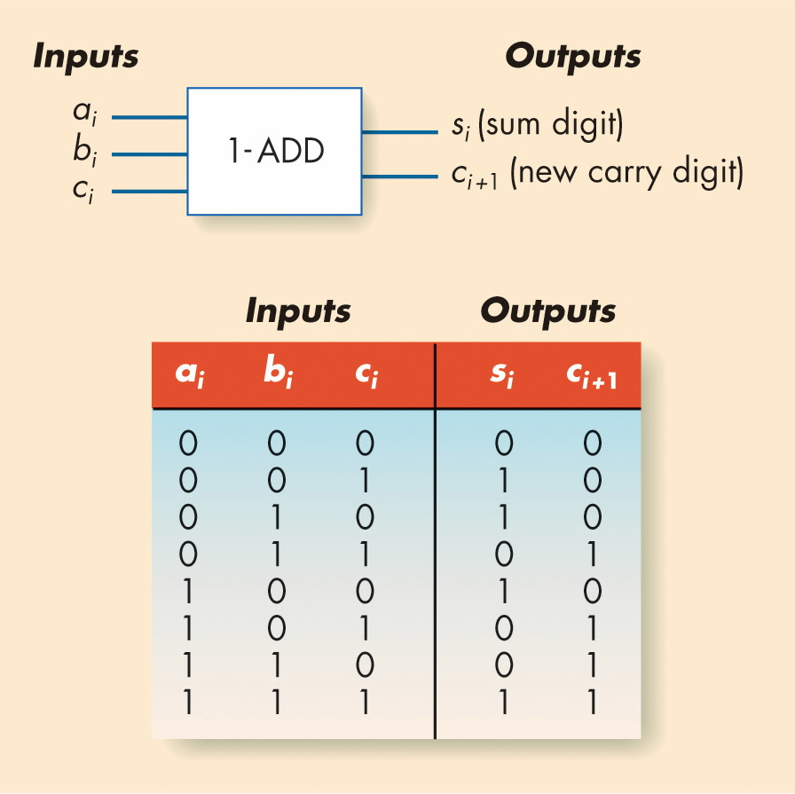
Figure 4.24
The 1-ADD Circuit and Truth Table

Slide 63
Design of the 1-ADD circuit
The 1-ADD circuit:
  Input: A_{i}, B_{i}, C_{i}
  Output: S_{i}, C_{i+1}
  Design: HW problem
A_{i} | B_{i} | C_{i} | S_{i} (sum) | C_{i+1} (carry)
0 | 0 | 0 | 0 | 0
0 | 0 | 1 | 1 | 0
0 | 1 | 0 | 1 | 0
0 | 1 | 1 | 0 | 1
1 | 0 | 0 | 1 | 0
1 | 0 | 1 | 0 | 1
1 | 1 | 0 | 0 | 1
1 | 1 | 1 | 1 | 1
A_{i}
B_{i}
C_{i}
C_{i+1}
S_{i}

Slide 64
An Addition Circuit (continued)
Building the full adder
  Put rightmost bits into 1-ADD, with zero for the input carry
  Send 1-ADD’s output value to output, and put its carry value as input to 1-ADD for next bits to left
  Repeat process for all bits

Slide 65
Design of an n-bit Full-Adder
A full n-bit Adder consists of
  consists of n “1-ADD” circuits in stages
  eg: A 4-bit Full-Adder
    consists of 4 “1-ADD” circuits
  (An example of design decomposition)
A₃
B₃
C₃
A₂
B₂
C₂
A₁
B₁
C₁
A₀
B₀
C₀
C₄
S₃
C₃
S₂
C₂
S₁
C₁
S₀

Slide 66
Control Circuits
Do not perform computations
Choose some operation or select data line
Major types of controls circuits
  Multiplexors
    Select one of inputs to send to output
  Decoders
    Sends a 1 on one output line, based on what input line indicates

Slide 67
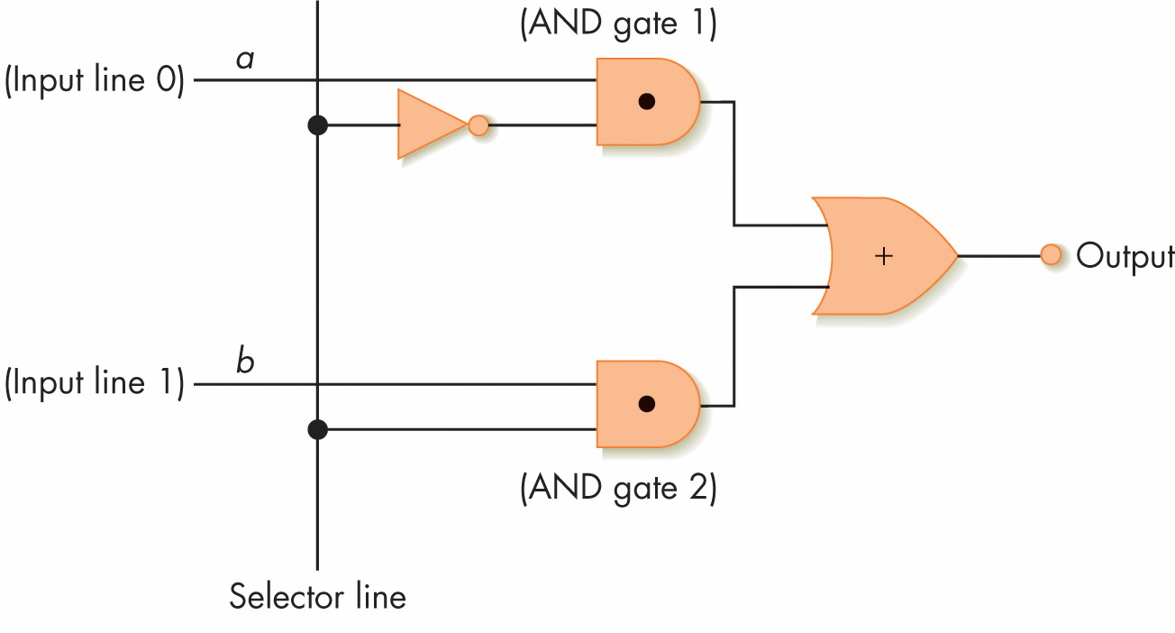
Two-Input Multiplexor Circuit (MUX)
D0
D1
S (Selector) | Output
0 | D0
1 | D1
S0
Figure 4.28
A Two-Input Multiplexor Circuit
Output = ~S0*D0 + S0*D1

Slide 68
Multiplexor Circuit (general)
Multiplexor form
  2^{N} regular input lines (D₀, D₁, … , D_{max})
  N selector input lines (S₀, …, S_{N-1})
  1 output line
Multiplexor purpose
  Given a code number for some input,
  Selects that input to pass along to its output

Slide 69
Next: A Decoder Circuit
Decoder
  Form
    N input lines
    2^{N} output lines
  N input lines indicate a binary number, which is used to select one of the output lines
  Selected output sends a 1, all others send 0

Slide 70
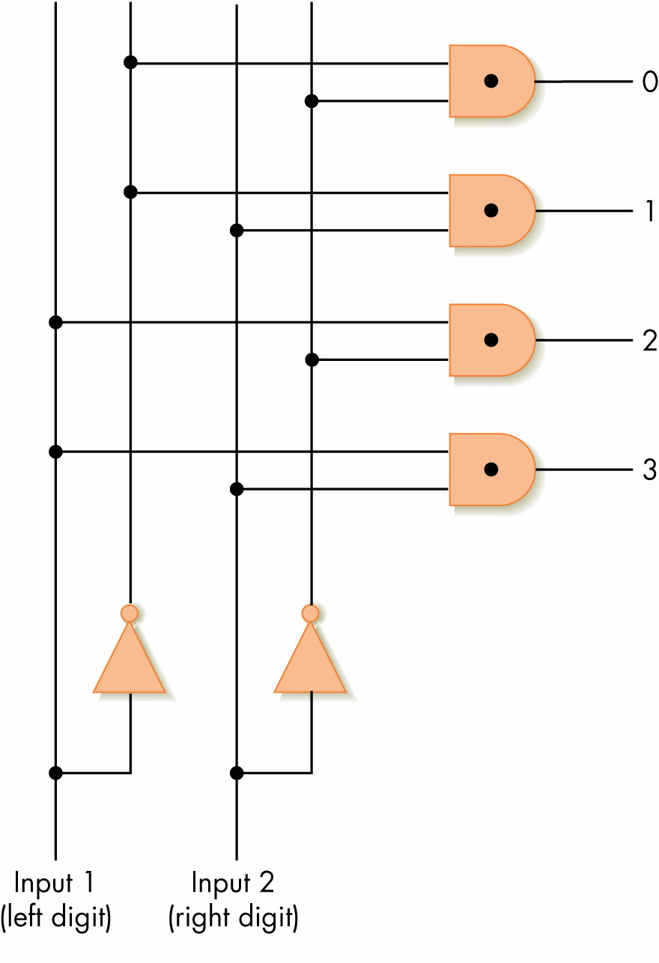
2-to-4 Decoder Circuit
A0
Figure 4.29
A 2-to-4 Decoder Circuit
A1
A2
D1 | D0 | A0 | A1 | A2 | A3
0 | 0 | 1 | 0 | 0 | 0
0 | 1 | 0 | 1 | 0 | 0
1 | 0 | 0 | 0 | 1 | 0
1 | 1 | 0 | 0 | 0 | 1
A3
S1
S0

Slide 71
Control Circuits (continued)
Decoder purpose
  Given a number code for different operations, trigger just that operation to take place
  Numbers might be codes for arithmetic:
  eg: add, subtract, etc.
  Decoder signals which operation to perform

Slide 72
Sequential Circuits
Circuits that can “store” information
Built using a combination of logic gates
  output depends on the input, and
  the past history (state of the circuit)
  can also be represented by its truth table
Example:
  Initially, Set=Reset=0
  Set=1 → State=1
  Reset=1 → State=0
Output
Set
Reset

Slide 73
Basic Sequential Circuit (A Memory Unit)
Output
Flip Flop (Logical View)
  Memory Element
  State: 0 or 1
  Change of state controlled by
  input signal at each TIME STEP
Flip Flop
  Initially, Set = 0; Reset = 0
  If we momentarily let Set=1, then Output=1
    “The value of Output =1 will persist
    even if the value of Set goes back to 0”
  If we momentarily let Reset=1, Output=0
    “Value persist even if Reset goes back to 0”
  THEREFORE, can use Flip-Flop as Memory Unit
  Stores 1-bit info (State 0 or 1)
Set
Reset

Slide 74
Summary
Digital computers use binary representations of data: numbers, text, multimedia
Binary values create a bistable environment, making computers reliable
Boolean logic maps easily onto electronic hardware
Circuits are constructed using Boolean expressions as an abstraction
Computational and control circuits may be built from Boolean gates

Slide 75
If you are new to all these
  read the textbook [SG]-Chapter 4
  do the exercises in the book
… The End …

Slide 76

Thank you!

