Slide 1
For last lecture…
Covered (for FUN and knowledge)
Some problems, we have fast solutions;
Some problems, we don’t have fast soln;
Some problems, we don’t know yet if we can find fast solutions;
Some problems, we can’t have an algorithm

Slide 2
To put it in another way…
Covered (for FUN and knowledge)
Computability
Turing Machine & Church-Turing Thesis
Non-Computability (Halting Problem)
InCompleteness Theorem (Barber fallacy)
Efficient (polynomial time)
Inefficient Algorithms (exponential time)
NP-completeness &
Approximation Algorithms (Bin Packing)

Slide 3
Theory: Models of Computation
Readings:
Chapter 11 & Chapter 3.6 of [SG]
Content:
What is a Model
Model of Computation
Model of a Computing Agent
Model of an Algorithm
TM Program Examples
Computability (Church-Turing Thesis)
Computational Complexity of Problems

Slide 4
Theory: Goals
To give a model of computation
to be able to reason about the capabilities of computers
To study the properties of computation
rather than being lost in the details of the machine hw/sw
To study
what computers may be able to do, and
what they cannot do
To study
What can be done quickly, and
what cannot be done quickly

Slide 5
Self Readings:
Section 11.1 – 11.3.1
Introduction, Models, Computing Agents

Slide 6
Theory: Models of Computation
Content:
What is a Model
Model of Computation
Model of a Computing Agent
Model of an Algorithm
TM Program Examples
Computability (Church-Turing Thesis)
Computational Complexity of Problems

Slide 7
Theory: Goals
We will construct a model of computation.
A simple, functional description of a computer
to capture essence of computation
suppress details
easy to study and reason about
→ Turing Machine ←
(there are several other models)

Slide 8
Turing Machine (a picture!)
Alphabet = {0,1,b,$}
…
b
0
0
1
0
1
$
b
…
Infinite Tape
(with tape symbols)
Machine with Finite number of States
Tape Head (to read, then write)
(move Left/Right)
M

Slide 9
Turing Machine (what is it?)
“The Hardware” consists of…
An infinite tape consisting of cells
on which letters may be written
Letters comes from a fixed FINITE alphabet
A tape head which can
Read one cell at a time
write to one cell at a time.
Move left/right by one cell
A FINITE set of states.
At any given time, machine is in one of the states

Slide 10
Turing Machine (what is it?)
Skipped in this semester
“The Hardware” consists of…
An infinite tape consisting of cells
on which letters may be written
Letters comes from a fixed FINITE alphabet
A tape head which can
Read one cell at a time
write to one cell at a time.
Move left/right by one cell
A FINITE set of states.
At any given time, machine is in one of the states

Slide 11
Turing Machine (how it works!)
Skipped in
Fall 2016
A Turing Machine Instruction:
(Q1, s1, s2, Q2, D)
If (current state is Q1) and (reading symbol s1) then
Write symbol s2 onto the tape,
go into new state Q2,
moves one step in direction D (left or right)
Very Simple machine…
But, as powerful (computation wise) as any computer
Remark: This is the software…

Slide 12
Example: Bit Inverter
Skipped in
Fall 2016
Problem: Bit Inverter
Input: A string of 0’s and 1’s
Output: The “inverted” string
0 changed to 1
1 changed to 0
Examples:
00101 → 11010
10110 → 01001

Slide 13
Bit Inverter Machine (State Diagram)
Skipped in
Fall 2016
Figure 11.4
TM Program:
(S1,0,1,S1,R) // change 0 to 1
(S1,1,0,S1,R) // change 1 to 0

Slide 14
Bit Inverter Machine (State Diagram)
Skipped in
Fall 2016
Figure 11.4
State 2
$ / $ / L
TM Program:
(S1,0,1,S1,R) // change 0 to 1
(S1,1,0,S1,R) // change 1 to 0
(S1,$,$,S2,L) // end-state (2)

Slide 15
TM (Bit Inverter program)
Skipped in
Fall 2016
…
b
0
0
1
0
1
$
b
…
Input = 00101$
TM Program:
(S1,0,1,S1,R) ←
(S1,1,0,S1,R)
S1

Slide 16
TM (Bit Inverter program) - 2
Skipped in
Fall 2016
…
b
1
0
1
0
1
$
b
…
TM Program:
(S1,0,1,S1,R) ←
(S1,1,0,S1,R)
S1

Slide 17
TM (Bit Inverter program) - 3
Skipped in
Fall 2016
…
b
1
1
1
0
1
$
b
…
TM Program:
(S1,0,1,S1,R)
(S1,1,0,S1,R) ←
S1

Slide 18
TM (Bit Inverter program) - 4
Skipped in
Fall 2016
…
b
1
1
0
0
1
$
b
…
TM Program:
(S1,0,1,S1,R) ←
(S1,1,0,S1,R)
S1

Slide 19
TM (Bit Inverter program) - 5
Skipped in
Fall 2016
…
b
1
1
0
1
1
$
b
…
TM Program:
(S1,0,1,S1,R)
(S1,1,0,S1,R) ←
S1

Slide 20
TM (Bit Inverter program) - 6
Skipped in
Fall 2016
…
b
1
1
0
1
0
$
b
…
TM Program:
(S1,0,1,S1,R)
(S1,1,0,S1,R)
(S1,$,$,S2,L) ←
S1

Slide 21
TM (Bit Inverter program) - 7
Skipped in
Fall 2016
…
b
1
1
0
1
0
$
b
…
TM Program:
(S1,0,1,S1,R)
(S1,1,0,S1,R)
(S1,$,$,S2,L)
S2
No more Moves!!

Slide 22
Odd Parity Bit
Skipped in
Fall 2016
Problem: Parity Bit
an extra bit appended to end of string
to ensure the “expanded” string has an odd number of 1’s
Used for detection of error (eg: transmission)
Examples:
00101 → 001011
10110 → 101100

Slide 23
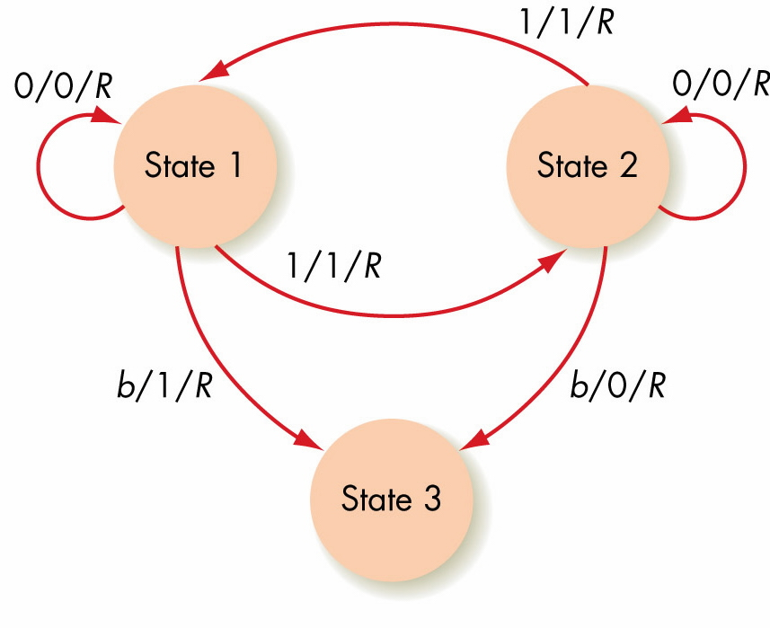
Odd Parity Bit Machine (State Diagram)
Skipped in
Fall 2016
TM Program:
1.(S1,0,0,S1,R)
2.(S1,1,1,S2,R)
3.(S2,0,0,S2,R)
4.(S2,1,1,S1,R)
5.(S1,b,1,S3,R)
6.(S2,b,0,S3,R)
Figure 11.5

Slide 24
Another Problem (in diff. notations)
Skipped in
Fall 2016
Suppose initially on the tape we have
$11111 B 111111111 BBBBBBBBBB…….
We want the TM to
convert first set of 1s to 0’s and
convert second set of 1’s to 2’s and
then return to the initial left most cell ($).
Note:
Alphabet = {0,1,2,B,$} and Initially at leftmost cell

Slide 25
Example (Algorithm)
$11111 B 111111111 BBBBBBBBBB
Step 1: Initially it reads $,
and moves the head right, and goes to Step 2.
Step 2: If the symbol being read is 1,
then write a 0, move the head right, and Repeat Step 2.
If the symbol being read is B,
then move right, and go to Step 3.
Step 3: If the symbol begin read is 1,
then write a 2, move the head right, and repeat Step 3.
If the symbol being read is B, then go to Step 4.
Step 4: If the symbol being read is 0, 1, 2 or B, then move left.
If the symbol being read is $, then stop.

Slide 26
Example (TM Program)
Alphabet = {$,0,1,2,B}
States = {Q1, Q2, Q3, Q4}
Q1 is the starting state
Transition Table:
HW: Translate this transition
table into a TM program
using notations of [SG]
TM State | Symbol Read
 | $ | B | 0 | 1 | 2
Q1 | $,R,Q2
Q2 |  | B,R,Q3 |  | 0,R,Q2
Q3 |  | B,L,Q4 |  | 2,R,Q3
Q4 | STOP | B,L,Q4 | 0,L,Q4 | 1,L,Q4 | 2,L,Q4

Slide 27
Church-Turing Thesis
If there exists an algorithm to do a symbol manipulation task, then there exists a Turing machine to do that task.
NOT a Theorem, but a thesis.
A statement that has to be supported by evidence.
Issue: Definition of computing device not clear.
Mathematically:
There is a (Partial) Functions which take strings to strings

Slide 28
Church-Turing Thesis (cont)
Two parts to writing a Turing machine for a symbol manipulation task
Encoding symbolic information as strings of 0s and 1s (eg: numbers, sound, pictures, etc)
Writing the Turing machine instructions to produce the encoded form of the output

Slide 29
Figure 11.9
Emulating an Algorithm by a Turing Machine

Slide 30
Limits of Computabiltiy:
Based on Church-Turing thesis, TM defines limits of computability
TM = ultimate model of computing agent
TM program = ultimate model of algorithm
Are all problems solvable using a TM?
Uncomputable or unsolvable problems
problem for which we can prove that no TM exists that will solve it.

Slide 31
Solvable Problems
Bit Inversion
Computing the Parity Bit
Division by 4 (or 8 or 16…)
Sorting n numbers,
Finding the sum of n numbers,
Pattern Matching
Finding subset with largest sum,
etc., etc

Slide 32
Computability
Q: Can we solve every problem?
In Mathematics:
Godel’s Theorem: Not every true theorem about natural numbers can be proven.
In Computer Science:
Not every problem can be solved.
Example: Halting Problem

Slide 33
Computability: The Halting Problem
Halting Problem: Given any program P, and any input x:
Does program P stop when run on input x?
Result: Halting Problem is not computable.
Namely, there is no algorithm SOLVE(P,x) such that for all P and x, we can answer
P
SOLVE
Yes / No
x

Slide 34
Informal Proof (by contradiction)
Rough Overview of the Proof:
First, assume there is such a program Solve(P,x)
Then, “thru a sequence of logical steps” prove that we obtain a contradiction.
This implies that the original assumption must be false; (i.e., Solve(P,x) does not exist)
P
SOLVE
Yes / No
x

Slide 35
First, Assume program Solve(P,x) exist
SuperSolve(P,x);
begin
1. If SOLVE(P,x) outputs NO
2. then stop
3. else goto step 5
4. endif
5. goto step 5. // infinite loop!!
End
Fact 1: Suppose “P running on x” does not halt;
Then in Step 1 Solve(P,x) outputs NO, then in Step 2, SuperSolve(P,x) halts;
Fact 2: Suppose “P running on x” halts;
Then in Step 1, Solve(P,x) outputs YES, then in Step 3,5 SuperSolve(P,x) runs into infinite loop (does not halt);

Slide 36
Now, to derive the contradiction….
Fact 1: If “P running on x” does not halt;
Then in Step 1, Solve(P,x) outputs NO,
then in Step 2, SuperSolve(P,x) halts;
Fact 2: If “P running on x” halts Then in Step 1, Solve(P,x) outputs YES, then in Step 3,5 SuperSolve(P,x) runs into infinite loop (Step 5) (does not halt);
Fact 1 and Fact 2 are true for all programs P and all x;
So, what if we set P = SuperSolve?
Then Fact 1 and Fact 2 becomes…

Slide 37
Now, to derive the contradiction….
Fact 1: If “SuperSolve running on x” does not halt;
Then in Step 1, Solve(SuperSolve,x) outputs NO,
then in Step 2, SuperSolve(SuperSolve,x) halts;
Fact 2: If “SuperSolve running on x” halts Then in Step 1, Solve(SuperSolve,x) outputs YES, then in Step 3,5 SuperSolve(SuperSolve,x) runs into infinite loop (Step 5) (does not halt);
Fact 1 and Fact 2 are true for all programs P and all x;
So, what if we set P = SuperSolve?
Then Fact 1 and Fact 2 becomes…
CONTRADICTION in both case!!

Slide 38
The Halting Problem: Some Remarks
The general Halting Problem is unsolvable;
But, it does not mean apply to a specific program
Example: Consider this program. Does it halt?
1. k ← 1; 2. while (k >0) do 3. print (“I love UIT2201, thank you.”); 4. endwhile; 5. print (“Everyone in UIT2201 goes to Paris”);

Slide 39
Unsolvable Problems (continued)
There are many other unsolvable problems
No program can be written to decide whether any given program always stops eventually, no matter what the input
No program can be written to decide whether any two programs are equivalent (will produce the same output for all inputs)
No program can be written to decide whether any given program run on any given input will ever produce some specified output

Slide 40
Computational Complexity of Solvable Problems
Now, turn attention to solvable problems…
Suppose problem can be solved by the computer.
Question: How much time does it take?
Problem: Searching for a Number x Algorithms: Linear Search Θ(n), Binary Search Θ(lg n)
Order of Growth: (and the Θ-notation)
Complexity “order” is more important than constant factors
eg: 1000 lg n vs 0.5 n (this is just Θ(lg n) vs Θ(n) )
eg: 1000n vs 0.001n² (or Θ(n) vs Θ(n²) )

Slide 41
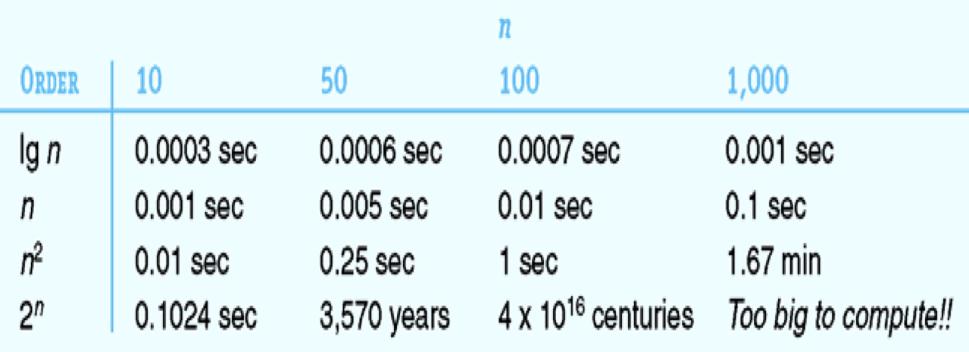
Recall this table?
From the textbook [SG3]

Slide 42
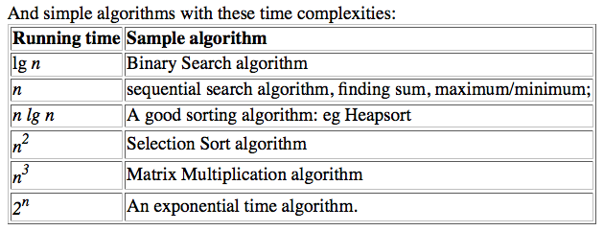
Order of Growth of Running Time
In tutorial, we extended the table:
Different sample algorithms,
With different time complexities.

Slide 43
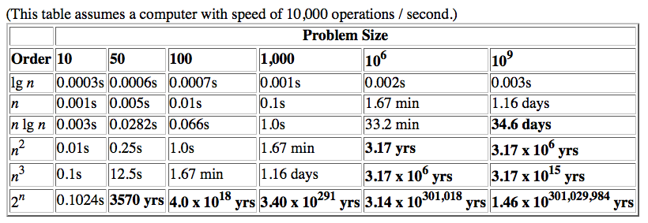
Order of Growth of Running Time
Rate of growth of the running time
On a slow computer (speed = 10,000 ops / second)
Note difference between
Polynomial time complexity (n, n lg n, n²) and
Exponential time complexity ( 2^{n})

Slide 44
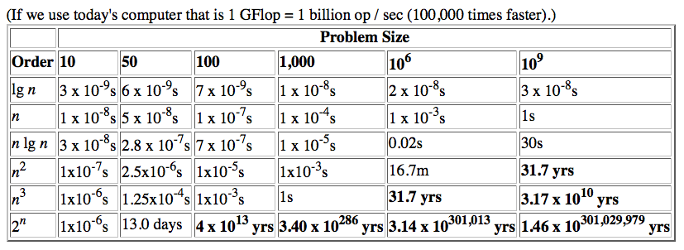
Order of Growth of Running Time
Rate of growth of the running time
On a fast computer (speed = 10⁹ ops / second)
Note difference between
Polynomial time complexity (n, n lg n, n²) and
Exponential time complexity ( 2^{n})

Slide 45
Fast and Slow Algorithms
Some Algorithms are fast
Binary search -- Θ (lg n) time
Finding maximum, minimum, counting, summing -- Θ(n) time
Selection sort – Θ(n²) time
Multiply two nxn matrix – Θ(n³) time
Some algorithms are Slow
Printing all subsets of n-numbers (Θ(2^{n}))
It may not be of much practical use
So, What is feasible?

Slide 46
Time Complexity of Algorithms
Algorithm is efficient if its time complexity a polynomial function of the input size
Example: O(n), O(n²), O(n³), O (lg n), O(n lg n), O(n⁵)
Algorithm is inefficient if its time complexity is an exponential function of the input size
Example: O(2^{n}), O(n 2^{n}), O(3^{n})
These algorithms are infeasible for big n.

Slide 47
Complexity of Problems
Given a problem, can we find an efficient algorithm to solve it?
Yes for some problems:
Finding the maximum of n numbers, Θ(n)
Finding the sum of n numbers, Θ(n)
Sorting n numbers, Θ(n²), faster ones Θ(n lg n)
computing the Hamming distance, Θ(n)
P : Class of problems that can be solved in polynomial time. (Also called easy problems)

Slide 48
Remarks:
The class P is invariant
under different types of machines
Turing machines, Pentium5, the world’s fastest supercomputer
Namely, if you can solve a problem B in polynomial time on a TM, then, then you can also solve B in polynomial time on supercomputer (and vice-versa)

Slide 49
Exponential Complexity Problems or Hard Problems
Some problems are inherently exponential time.
List all possible n-bit binary numbers; Θ(n 2^{n})
List at 2^{n} subsets of n objects; Θ(n 2^{n})
List all the n! permutations of {1,2,…,n}
These are “hard problems” that require exponential time to solve.

Slide 50
The Complexity class NP
Given a problem, instead of finding a solution, can verify a solution to the problem quickly?
Is it easier to verify a solution (as opposed to finding a solution)
NP – the class of problems that can be verified in polynomial time

Slide 51
Sample Problems in NP
There are many problem in NP
(easy to verify, apparently hard to find solution)
Examples:
Min-Difference Subsets
BinPack: packing small items into standard sized bins
TSP: Travelling Salesman Tour

Slide 52
Min-Diff subsets (from T9)
Given a set S = { 4, 2, 6, 8, 17, 5 },
How to divide into two subsets A and B so that the sum of A and B are as equal as possible (or the difference in the sum of A and B is as small as possible).
Example:
A = {4, 8, 6}, B = {2, 17, 5} Diff = 6
A = {2, 5, 8, 6}, B = {17, 4} Diff = 0

Slide 53
Min-Diff subsets: (Y/N answer)
Given a set S = { 4, 2, 6, 8, 17, 5 }, and K.
Can we divide into two subsets A and B so that difference in the sum is ≤ K.
Example: If we are given that K=3, it is easy to verify..
A = {4, 8, 6}, B = {2, 17, 5} Diff = 6 > K
A = {2, 5, 8, 6}, B = {17, 4} Diff = 0 ≤ K.
So, Min-Diff subsets is in class NP

Slide 54
Bin Packing Problem
See separate ppt file.

Slide 55
Traveling Salesman Problem (TSP)
Given:
N cities (SG, NY, London, Tokyo, Sydney, etc)
Cost of travel between each pair of cities
To Find: TSP tour of all the cities
SG, to NY, London, Tokyo, … and come back to SG.
Each city visited exactly once (except first and last city is both Spore)
Aim (Opt): To minimize the cost.
Aim2: Find TSP tour of cost less than X.

Slide 56
TSP (status)
To Date:
Many experts have tried.
Many heuristic algorithms proposed
But, no fast (polynomial time) algorithm that solves all instances of the TSP.
See examples here:
http://www-e.uni-magdeburg.de/mertens/TSP/TSP.html

Slide 57
Traveling Salesman Problem (2)
TSP: Apparently difficult to solve.
No polynomial time algorithm known.
However, easy to verify (if cost ≤ X)
if you are given a test tour,
Can verify solution in polynomial time!!
Summary of TSP:
Easy to verify solution. (in the class NP)
Difficult to solve (find optimal solution).

Slide 58
Hardest Problems in NP
The notion of the “Hardest” Problem in NP,
Among all the many problems in NP, some are the Hardest
If the hardest problem can be solved efficiently, then ALL the problems in NP can be solved efficiently.
In 1970, Stephen Cook proved that SAT is a Hardest Problem in NP.
Then, it was shown that TSP, Bin-Packing, and Min-Diff Subsets are also all Hardest Problems
Much of cryptography is based on these “hard” problems.

Slide 59
Biggest OPEN Problem
Is P = NP ?
The famous “P vs NP” problem.
One of the Millennium Prize Problems
US$1,000,000 for the first correct solution
http://en.wikipedia.org/wiki/P_versus_NP
http://www.claymath.org/millennium/P_vs_NP/

Slide 60
Summary
Models are an important way of studying physical and social phenomena
Church-Turing thesis: If there exists an algorithm to do a symbol manipulation task, then there exists a Turing machine to do that task
The Turing machine can be accepted as an ultimate model of a computing agent

Slide 61
Summary (continued)
A Turing machine program can be accepted as an ultimate model of an algorithm
Turing machines define the limits of computability
An uncomputable or unsolvable problem: We can prove that no Turing machine exists to solve the problem

Slide 62
The End…

