Slide 1
Algorithms Problem Solving
Readings: [SG] Ch. 2
Chapter Outline:
  Chapter Goals
  What are Algorithms
  Pseudo-Code to Express Algorithms
  Some Simple Algorithms [SG] Ch. 2.3
    Computing Array-Sum
    Structure of Basic Iterative Algorithm
  Examples of Algorithmic Problem Solving

Slide 2
Simple iterative algorithm: Array-Sum(A,n)
Input: List of numbers: A₁, A₂, A₃, …., A_{n}
Output: To compute the sum of the numbers
Note: Store numbers in array A[1], A[2], … , A[n]
Array-Sum(A, n);
(* Find the sum of A1, A2,…,An. *)
begin
Sum_SF ← 0;
k ← 1;
while (k <= n) do
Sum_SF ← Sum_SF + A[k];
k ← k + 1;
endwhile
Sum ← Sum_SF;
Print “Sum is”, Sum; return Sum;
end;
Sum_SF represents
the Sum-So-Far
Click to see alg. animation

Slide 3
Exercising Algorithm Array-Sum(A,n):
Input:
A[1] A[2] A[3] A[4] A[5] A[6] n=6
2 5 10 3 12 24
k Sum-SF Sum
? 0 ?
1 2 ?
2 7 ?
3 17 ?
4 20 ?
5 32 ?
6 56 ?
6 56 56
Processing:
Output:
Sum is 56

Slide 4
Structure of “basic iterative algorithm”
Name of Algorithm
Parameters: A and n
Some comments for human understanding
Array-Sum(A, n);
(* Find the sum of A1, A2,…,An. *)
begin
Sum_SF ← 0;
k ← 1;
while (k <= n) do
Sum_SF ← Sum_SF + A[k];
k ← k + 1;
endwhile
Sum ← Sum_SF;
Print “Sum is”, Sum
end;
Initialization block
Iteration block;
the key step where
most of the work
is done
Post-Processing block
Recall Recurring Principle:
The Power of Iterations
Structure of
Basic iterative algorithm

Slide 5
Re-use of “basic iterative algorithm”
Once an algorithm is developed,
  Give it a name (an abstraction): Array-Sum(A,n)
  It can be re-used in solving more complex problems
  It can be modified to solve other similar problems
Modify algorithm for Array-Sum(A,n) to…
  Calculate the average and sum-of-squares
  Search for a number; find the max, min
Develop a algorithm library
  A collection of useful algorithms
  An important tool-kit for algorithm development

Slide 6
Algorithms (Introduction)
Readings: [SG] Ch. 2
Chapter Outline:
  Chapter Goals
  What are Algorithms
  Pseudo-Code to Express Algorithms
  Some Simple Algorithms
  Examples of Algorithmic Problem Solving [Ch. 2.3]
    Searching Example,
    Finding Maximum/Largest
    Modular Program Design
    Pattern Matching

Slide 7
Algorithmic Problem Solving
Examples of algorithmic problem solving
  Sequential search: find a particular value in an unordered collection
  Find maximum: find the largest value in a collection of data
  Pattern matching: determine if and where a particular pattern occurs in a piece of text

Slide 8
Task 1: Looking, Looking, Looking…
Task
  Find a particular person’s name from an unordered list of telephone subscribers
Algorithm outline
  Start with the first entry and check its name, then repeat the process for all entries

Slide 9
Task 1: Looking, Looking, Looking…
Sequential search algorithm
  Re-use the basic iterative algorithm of Sum(A,n)
  Refers to a value in the list using an index i
  (or pointer/subscript)
  Uses the variable Found to exit the iteration
  as soon as a match is found
  Handles special cases
    like a name not found in the collection
Question: What to change in
  Initialization, Iteration, Post-Processing?

Slide 10
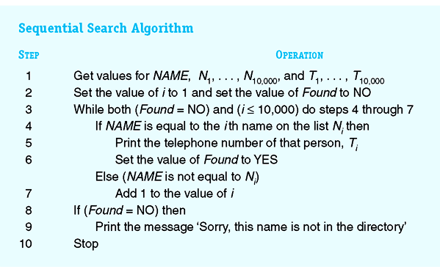
Task 1: Sequential Search Algorithm
Initialization block
Iteration block;
the key step where
most of the work
is done
Post-Processing block
Figure 2.9: The Sequential Search Algorithm

Slide 11
Algorithm Sequential Search (revised)
Preconditions: The variables NAME, m, and the arrays N[1..m] and T[1..m] have been read into memory.
Seq-Search(N, T, m, NAME);
begin
i ← 1;
Found ← No;
while (Found = No) and (i <= m) do
if (NAME = N[i])
then Print T[i]; Found ← Yes;
else i ← i + 1;
endif
endwhile
if (Found=No) then
Print NAME “is not found” endif
end;
Initialization block
Iteration block;
the key step where
most of the work
is done
Post-Processing block

Slide 12
Note the differences…
Seq-Search () is a high-level primitive
  It takes in something as input,
  Computes something,
  Return some computed values.
N, T
Seq-Search
m
Found
NAME

Slide 13
Task 2: Big, Bigger, Biggest
Task:
  Find the largest value from a list of values
Algorithm outline
  Keep track of the largest value seen so far
    Initialize: Set Largest-So-Far to be the first in the list
    Iteration: Compare each value to the Largest-So-Far, and keep the larger as the new largest
  Use location to remember where the largest is.
    Initialize: … (Do it yourself)
    Iteration: …. (Do it yourself)

Slide 14
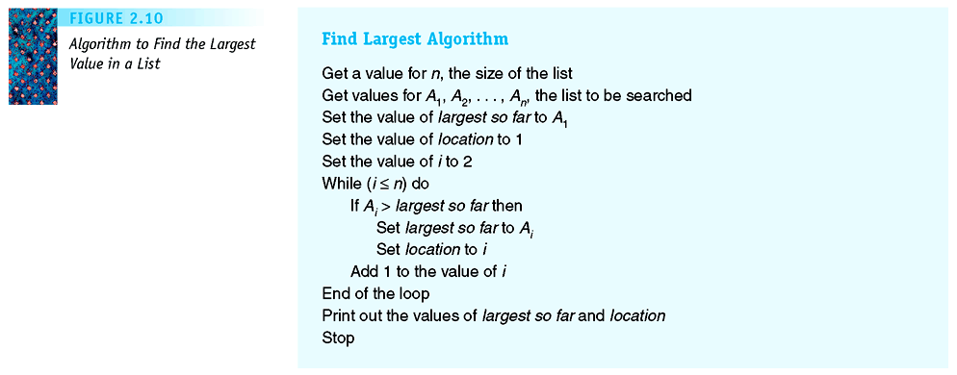
Task 2: Finding the Largest
Initialization block
Iteration block;
the key step where
most of the work
is done
Post-Processing block
Figure 2.10: Algorithm to Find the Largest Value in a List

Slide 15
Algorithm Find-Max
Preconditions: The variable n and the arrays A have been read into memory.
Find-Max(A,n); (* find max of A[1..n] *)
begin
Max-SF ← A[1]; Location ← 1;
i ← 2; (* why 2, not 1? *)
while (i <= n) do
if (A[i] > Max-SF) then
Max-SF ← A[i];
Location ← i;
endif
i ← i + 1
endwhile
Max ← Max-SF;
return Max, Location
end;
Initialization block
Iteration block;
the key step where
most of the work
is done
Post-Processing block

Slide 16
Modular Program Design
Software are complex
  HUGE (millions of lines of code) eg: Linux, Outlook
  COMPLEX; eg: Flight simulator
Idea: Divide-and-Conquer Method (or decomposition)
  Complex tasks can be divided and
  Each part solved separately and combined later.
Modular Program Design
  Divide big programs into smaller modules
  The smaller parts are
    called modules, subroutines, or procedures
    Design, implement, and test separately
  Modularity, Abstraction, Division of Labour
  Simplifies process of writing alg/programs

Slide 17
Task 3: Pattern Matching
Algorithm search for a pattern in a source text
  Given: A source text S[1..n] and a pattern P[1..m]
  Question: Find all occurrence of pattern P in text S?
1
2
3
4
5
6
7
8
9
S
C
A
T
A
T
C
A
T
A
P
A
T
A
1
2
3
Output of Pattern Matching Algorithm:
There is a match at position 2
There is a match at position 7

Slide 18
Example of Pattern Matching
k
1
2
3
4
5
6
7
8
9
S
C
A
T
A
T
C
A
T
A
P
A
T
A
1
2
3
Align pattern P with text S starting at pos k = 1;
Check for match (between S[1..3] and P[1..3])
Result – no match

Slide 19
Example of Pattern Matching
k
1
2
3
4
5
6
7
8
9
S
C
A
T
A
T
C
A
T
A
P
A
T
A
1
2
3
Align pattern P with text S starting at pos k = 2;
Check for match (between S[2..4] and P[1..3])
Result – match!
Output: There is a match at position 2

Slide 20
Example of Pattern Matching
k
1
2
3
4
5
6
7
8
9
S
C
A
T
A
T
C
A
T
A
P
A
T
A
1
2
3
Align pattern P with text S starting at pos k = 3;
Check for match (between S[3..5] and P[1..3])
Result – No match.

Slide 21
Example of Pattern Matching
k
1
2
3
4
5
6
7
8
9
S
C
A
T
A
T
C
A
T
A
P
A
T
A
1
2
3
Align pattern P with text S starting at pos k = 4;
Check for match (between S[4..6] and P[1..3])
Result – No match.

Slide 22
Example of Pattern Matching
k
1
2
3
4
5
6
7
8
9
S
C
A
T
A
T
C
A
T
A
P
A
T
A
1
2
3
Align pattern P with text S starting at pos k = 5;
Check for match (between S[5..7] and P[1..3])
Result – No match.

Slide 23
Example of Pattern Matching
Align S[k..(k+m–1)]
with P[1..m]
k
1
2
3
4
5
6
7
8
9
S
C
A
T
A
T
C
A
T
A
P
A
T
A
1
2
3
Align pattern P with text S starting at pos k = 6;
Check for match (between S[6..8] and P[1..3])
Result – No match.

Slide 24
Example of Pattern Matching
k
Note:
k = 7 is the last position to test;
After that S is “too short”.
In general, it is k = n–m+1
1
2
3
4
5
6
7
8
9
S
C
A
T
A
T
C
A
T
A
P
A
T
A
1
2
3
Align pattern P with text S starting at pos k = 7;
Check for match (between S[7..9] and P[1..3])
Result – match!
Output: There is a match at position 7

Slide 25
Pattern Matching: Decomposition
Task: Find all occurrences of the pattern P in text S;
Algorithm Design: Top Down Decomposition
  Modify from basic iterative algorithm (index k)
At each iterative step (for each k)
  Align pattern P with S at position k and
  Test for match between P[1..m] and S[k .. k+m –1]
Define an abstraction (“high level operation”)
Yes if S[k..k+m–1] = P[1..m]
No otherwise
Match(S, k, P, m) =

Slide 26
Pattern Matching: Pat-Match
Preconditions: The variables n, m, and the arrays S and P have been read into memory.
Pat-Match(S,n,P,m);
(* Finds all occurrences of P in S *)
begin
k ← 1;
while (k <= n-m+1) do
if Match(S,k,P,m) = Yes
then Print “Match at pos ”, k;
endif
k ← k+1;
endwhile
end;
Use the “high level operation”
Match(S,k,P,m)
which can be refined later.

Slide 27
Match of S[k..k+m-1] and P[1..m]
1
2
3
4
5
6
7
8
9
S
C
A
T
A
T
C
A
T
A
Align S[k..k+m–1]
with P[1..m]
(Here, k = 4)
P
A
T
A
1
2
3
i
Match(S,k,P,m);
begin
i ← 1; MisMatch ← No;
while (i <= m) and (MisMatch=No) do
if (S[k+i-1] not equal to P[i])
then MisMatch=Yes
else i ← i + 1
endif
endwhile
Match ← not(MisMatch); (* Opposite of *)
end;

Slide 28
Example: Match of S[4..6] and P[1..3]
1
2
3
4
5
6
7
8
9
S
C
A
T
A
T
C
A
T
A
Align S[k..k+m–1]
with P[1..m]
(Here, k = 4)
P
A
T
A
1
2
3
i
[k = 4] With i = 1,
Compare S[4] and P[1] (S[k+i-1] and P[i])
They are equal, so increment i

Slide 29
Example: Match of S[4..6] and P[1..3]
1
2
3
4
5
6
7
8
9
S
C
A
T
A
T
C
A
T
A
Align S[k..k+m–1]
with P[1..m]
(Here, k = 4)
P
A
T
A
1
2
3
i
[k = 4] With i = 2,
Compare S[5] and P[2] (S[k+i-1] and P[i])
They are equal, so increment i

Slide 30
Example: Match of T[4..6] and P[1..3]
1
2
3
4
5
6
7
8
9
S
C
A
T
A
T
C
A
T
A
Align S[k..k+m–1]
with P[1..m]
(Here, k = 4)
P
A
T
A
1
2
3
i
[k = 4] With i = 3,
Compare S[6] and P[3] (S[k+i-1] and P[i])
They are not equal, so set MisMatch=Yes

Slide 31
Our Top-Down Design
Our pattern matching alg. consists of two modules
Pat-Match(S,n,P,m)
“higher-level” view
Match(S,k,P,m)
“high-level” primitive
  Achieves good division-of-labour
Made use of top-down design and abstraction
  Separate “high-level” view from “low-level” details
  Make difficult problems more manageable
  Allows piece-by-piece development of algorithms
  Key concept in computer science

Slide 32
Pattern Matching: Pat-Match (1st draft)
Preconditions: The variables n, m, and the arrays S and P have been read into memory.
Pat-Match(S,n,P,m);
(* Finds all occurrences of P in S *)
begin
k ← 1;
while (k <= n-m+1) do
if Match(S,k,P,m) = Yes
then Print “Match at pos ”, k;
endif
k ← k+1;
endwhile
end;
Use the “high level primitive operation”
Match(S,k,P,m)
which can be de/refined later.

Slide 33
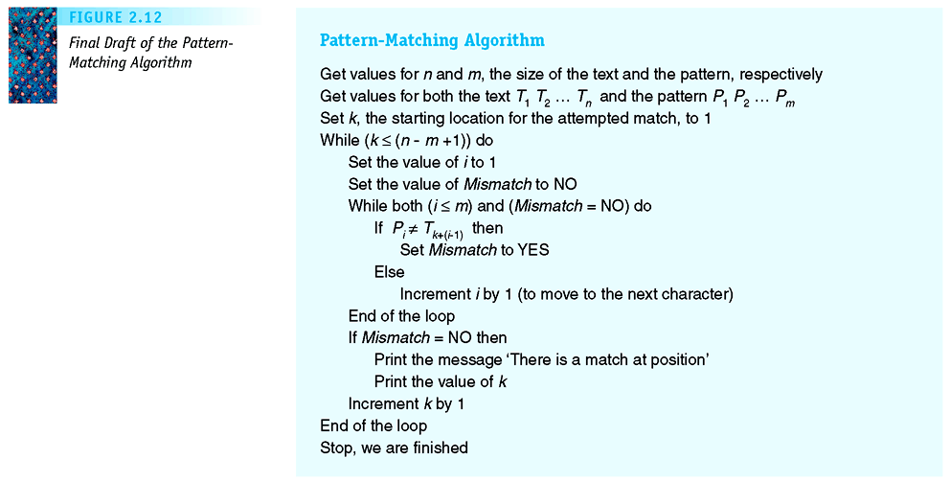
Pattern Matching Algorithm of [SG]
THINK:: How can Mismatch=NO here?
This part compute
Match(T,k,P,m)
Figure 2.12: Final Draft of the Pattern-Matching Algorithm

Slide 34
Pattern Matching Algorithm of [SG]
Pattern-matching algorithm
  Contains a loop within a loop
    External loop iterates through possible locations of matches to pattern
    Internal loop iterates through corresponding characters of pattern and string to evaluate match

Slide 35
Summary
Specify algorithms using pseudo-code
  Unambiguous, readable, analyzable
Algorithm specified by three types of operations
  Sequential, conditional, and repetitive operations
Seen several examples of algorithm design
  Designing algorithm is not so hard
  Re-use, Modify/Adapt, Abstract your algorithms
Algorithm design is also a creative process
  Top-down design helps manage complexity
  Process-oriented thinking helps too

Slide 36
Summary
Importance of “doing it”
  Test out each algorithm to find out
  “what is really happening”
  Run some of the animations in the lecture notes
If you are new to algorithms
  read the textbook
  try out the algorithms
  do the exercises
… The End …

Slide 37

Thank you!

Slide 38
Additional Slides (optional)…
The next slide is for your info only.
They give variants of algorithm using for-loop
  Sum and Pattern-Match
A reminder –
  for-loops will not be tested in UIT2201.

Slide 39
Variant of Sum(A,n) – with for-loop
We can also use a for-loop instead of a while-loop.
Sum2(A, n);
(* Find the sum of A1, A2,…, An. *)
begin
Sum_sf ← 0;
for k ← 1 to n do
Sum_sf ← Sum_sf + A[k];
endfor
Sum ← Sum_sf;
Print “Sum is”, Sum
end;
Note: This version is more compact, right?

Slide 40
Pattern Matching: Pat-Match (with for-loop)
Preconditions: The variables n, m, and the arrays T and P have been read into memory.
Pat-Match2(T,n,P,m);
(* Finds all occurrences of P in T *)
begin
for k ← 1 to n-m+1) do
if Match(T,k,P,m) = Yes
then Print “Match at pos ”, k;
endif
endfor
end;
Note: This version is more compact, isn’t it?

