Slide 1
Efficiency of Algorithms
Readings: [SG] Ch. 3
Chapter Outline:
  Attributes of Algorithms
  Measuring Efficiency of Algorithms
  Simple Analysis of Algorithms
  Polynomial vs Exponential Time Algorithms

Slide 2
Efficiency of Algorithms
Readings: [SG] Ch. 3
Chapter Outline:
  Attributes of Algorithms
    What makes a Good Algorithm
    Key Efficiency considerations
  Measuring Efficiency of Algorithms
  Simple Analysis of Algorithms
  Polynomial vs Exponential Time Algorithms

Slide 3
What are good algorithms?
Desirable attributes in an algorithm
  Correctness
  Simplicity (Ease of understanding)
  Elegance
  Efficiency
  Embrace Multiple Levels of Abstraction
  Well Documented, Multi-Platform

Slide 4
Attribute: Correctness, Simplicity
Correctness
  Does the algorithm solve the problem it is designed for?
  Does the algorithm solve all instances of the problem correctly?
Simplicity (Ease of understanding)
  Is it easy to understand,
  Is it clear, concise (not tricky)
  Is it easy to alter the algorithm?
  Important for program maintenance

Slide 5
Attributes: Abstraction, Elegance
Multiple Levels of Abstraction
  Decomposes problem into sub-problems
  Easier to understand at different levels of abstraction?
  Usable as modules (libraries) by others
Elegance
  How clever or sophisticated is the algorithm?
  Is pleasing and satisfying to the designer.

Slide 6
Attributes: Efficiency, etc…
Efficiency
  The amount of time the algorithm requires?
  The amount of space the algorithm requires?
  The most important attribute
  Especially for large-scale problems.
Well documented, multi-platform
  Is well-documented with sufficient details
  Not OS-dependent, company-dependent, computer-dependent

Slide 7
Attributes: Key Considerations…
When designing algorithms,
all computer scientists strive to achieve
Simplicity,
Elegance
Efficiency
plus
However, they are often contradictory
  Simple algorithms are often slow
  Efficient algorithms tend to be complicated
If you really want to learn how, take an algorithms course.

Slide 8
Efficiency of Algorithms
Readings: [SG] Ch. 3
Chapter Outline:
  Attributes of Algorithms
  Measuring Efficiency of Algorithms
    One Problem, Many algorithmic solutions
    Time complexity, Space complexity
    Θ notation, order of growth of functions
  Simple Analysis of Algorithms
  Polynomial vs Exponential Time Algorithms

Slide 9
One Problem, Many algorithmic solutions
Given an algorithmic problem,
  Many different algorithms to solve it
Problem: Searching for a name in a list;
Algorithms: Sequential search
binary search
interpolation search, etc
Slow, Take linear time
Fast, Take logarithmic time
Not covered in UIT2201

Slide 10
Sequential Search: Idea
Search for NAME among a list of n names
Start at the beginning and compare NAME to each entry in the list until a match is found

Slide 11
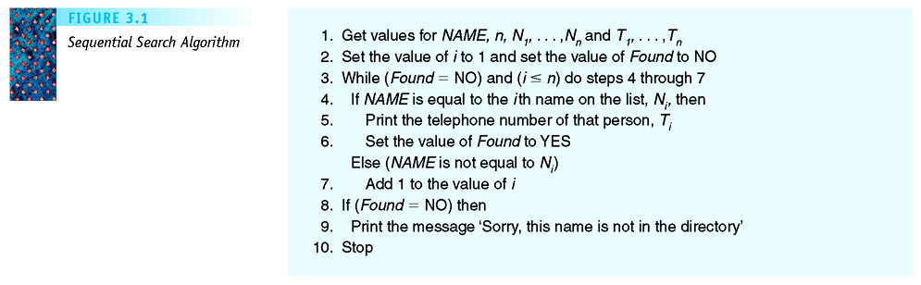
Sequential Search: Pseudo-Code
Initialization block
Iteration block;
the key step where
most of the work
is done
Post-Processing block
Figure 3.1: Sequential Search Algorithm

Slide 12
Recall: Algorithm Sequential Search
Precondition: The variables n, NAME and the arrays N and T have been read into memory.
Seq-Search(N, T, n, NAME);
begin
i ← 1;
Found ← No;
while (Found=No) and (i <= n) do
if (NAME = N[i])
then Print T[i]; Found ← Yes;
else i ← i + 1;
endif
endwhile
if (Found=No) then
Print NAME “is not found” endif
end;

Slide 13
Analysis of Algorithm (introduction)
Analysis of Algorithms
Analyze an algorithm to predict its efficiency – namely, the resources (time and space) that an algorithm need during its execution.
Time complexity T_{A}(n)
the time taken by an algorithm A
on problems with input size n
Space complexity S_{A}(n)
the space taken by an algorithm A
on problems with input size n

Slide 14
Sequential Search: Analysis
Comparison of the NAME against a name in the list N of names
  Central unit of work (dominant operation)
  Used for efficiency analysis
For lists with n entries
  Best case (best case is usually not important)
    NAME is the first name in the list
    1 comparison
    Θ(1)
Roughly means
a constant

Slide 15
Sequential Search: Analysis
For lists with n entries
  Worst case (usually the most important)
    NAME is the last name in the list
    NAME is not in the list
    n comparisons
    Θ(n)
  Average case (sometimes used)
    Roughly n/2 comparisons
    Θ(n)
Roughly means
“proportional to n”
Here ½n is also proportional to n.
The constant c in cn is not important.
Usually, we let c=1.

Slide 16
Sequential Search: Analysis
Space efficiency
  Uses 2n memory storage for the input names and telephone numbers
  A few more memory storage for variables (NAME, i, FOUND)
  Space is Θ(n)
  Very space efficient

Slide 17
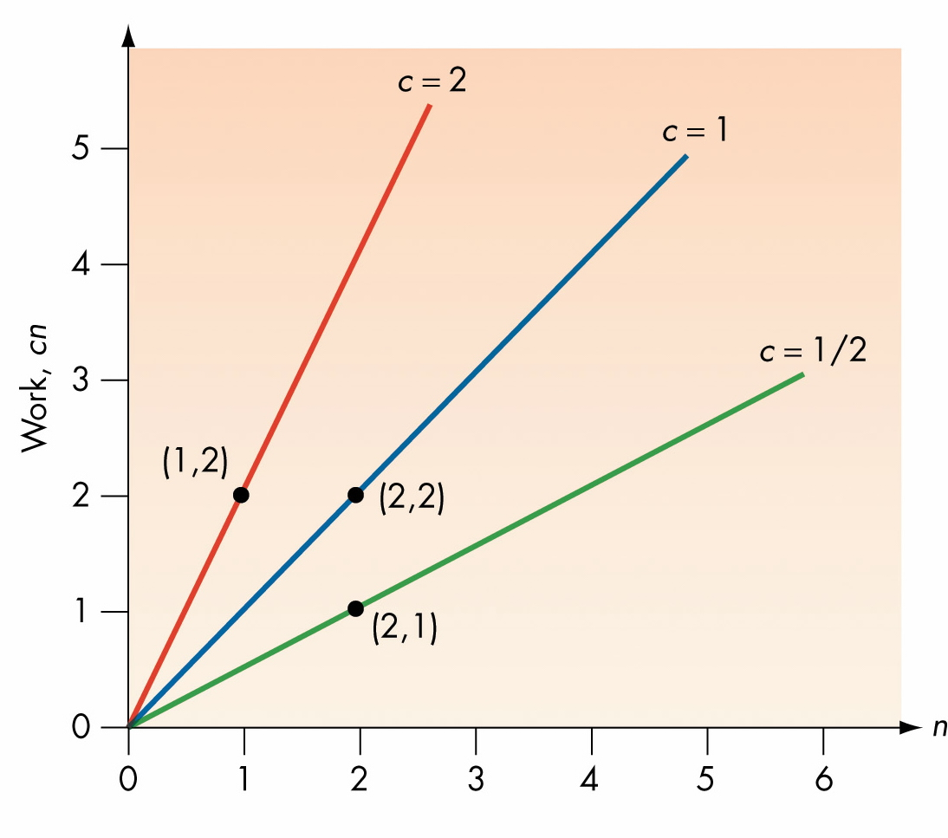
Viewing the Rate of Growth of T(n) = cn
Figure 3.4. Work = cn for Various Values of c

Slide 18
Order of Magnitude: Order n [Linear]
All functions that have a linear “shape” are considered equivalent
As n grows large, the order of magnitude dominates the running time
  minimizing effect of coefficients
  and lower-order terms
Order of magnitude n
  Written as Θ(n) [read as “theta-n”]
  Functions vary as a c x n, for some constant c
  Linear time

Slide 19
[SideTrack:
Why analyze only dominant operations]
In the analysis above,
  We only analyze the dominant operation
This sub-section gives why.
  Namely, why we can take short-cuts
It may help you better appreciate “analysis of algorithm”
  but, if you have difficulties with this part, you can skip it, without affecting anything else.

Slide 20
Analysis of Algorithm
To estimate running time of algorithm
  Without actually running the algorithm
Method…
  Estimate cost (work done) for each elementary operation
  Analyze the number of times each operation is executed during the algorithm
  Then, sum up the total cost (work done) by the algorithm
AIM: To conclude that we
  Only need to analyze the dominant operation

Slide 21
Analyzing Algorithm Sequential Search
Suppose we assume the following estimated costs
Statement | Cost | Statement | Cost
assignment | 20 | Print | 4
while, if | 5 | endwhile | 1
Seq-Search(N, T, n, NAME);
begin
i ← 1; Found ← No;
while (Found=No) and (i <= n) do
if (NAME = N[i])
then Print T[i]; Found ← Yes;
else i ← i + 1;
endwhile
if (Found=No) then
Print NAME “is not found” endif
end;
#times
1
1+1
n+1
n
*1
*n
n
1
1
1
cost
1
20
5
5
4+20
20
1
5
4
1
T(n) = (1+20+20) + (n+1)5 + n(5+20+1) + (4+20)+(5+4+1)
= 31n + 80 = Θ(n) ←← [proportional to n]

Slide 22
Analyzing Algorithm Sequential Search
Statement | Cost | Statement | Cost
assignment | 10 | Print | 20
while, if | 15 | endwhile | 0
Now, let’s assume a different set of estimated of costs
Seq-Search(N, T, n, NAME);
begin
i ← 1; Found ← No;
while (Found=No) and (i <= n) do
if (NAME = N[i])
then Print T[i]; Found ← Yes;
else i ← i + 1;
endwhile
if (Found=No) then
Print NAME “is not found” endif
end;
#times
1
1+1
n+1
n
*1+1
*n
n
1
1
1
cost
0
10
15
15
20+10
10
0
15
20
0
T(n) = (10+10) + (n+1)15 + n(15+10) + (20+10)+(15+20)
= 40n + 100 = Θ(n) ←← [also proportional to n]

Slide 23
From the two examples above…
Actual total cost different for
  The different sets of estimated costs for basic ops
But… Order of growth is the same
  for the different sets of estimated costs for basic ops
  All linear (but with different constants)
So… to simplify analysis
  Assign a constant cost Θ(1) for basic operation
  Can analyze only the dominant operation(s)
    Namely, the operation that is done “most often”
    Can also ignore “lower order” terms
    Such as operations that are done only once

Slide 24
Simplified Analysis
Statement | Cost | Statement | Cost
assignment | Θ(1) | Print | Θ(1)
while, if | Θ(1) | endwhile | Θ(1)
Only dominant ops,
Θ(1) cost per basic op
( Θ(1) means a constant)
Seq-Search(N, T, n, NAME);
begin
i ← 1; Found ← No;
while (Found=No) and (i <= n) do
if (NAME = N[i])
then Print T[i]; Found ← Yes;
else i ← i + 1;
endwhile
if (Found=No) then
Print NAME “is not found” endif
end;
#times
n
n
n
n
cost
Θ(1)
Θ(1)
Θ(1)
Θ(1)
Θ(1)
Θ(1)
Θ(1)
Θ(1)
Θ(1)
Θ(1)
T(n) = 4n x Θ(1) (counting only dominant ops)
= Θ(4n) = Θ(n) ←← [proportional to n]

Slide 25
Identifying the dominant operation
Name comparison is a
dominant operation
Seq-Search(N, T, n, NAME);
begin
i ← 1; Found ← No;
while (Found=No) and (i <= n) do
if (NAME = N[i])
then Print T[i]; Found ← Yes;
else i ← i + 1;
endwhile
if (Found=No) then
Print NAME “is not found” endif
end;
#times
n
cost
Θ(1)
Θ(1)
Θ(1)
Θ(1)
Θ(1)
Θ(1)
Θ(1)
Θ(1)
Θ(1)
Θ(1)
T(n) = n x Θ(1)
= Θ(n) ←← [proportional to n]

Slide 26
[END SideTrack:
Why analyze only dominant operations]
As the above examples show,
  Sufficient to analyze only dominant operation
  It gives the same running time in Θ notations
  But, it is MUCH simpler.
Conclusion:
  Sufficent to analyze only dominant operation
END of SideTrack: and remember…
  If you have difficulties with this sub-section, you can skip it, without affecting anything else.

Slide 27
Efficiency of Algorithms
Readings: [SG] Ch. 3
Chapter Outline:
  Attributes of Algorithms
  Measuring Efficiency of Algorithms
  Simple Analysis of Algorithms
    Selection Sort Algorithm
    Pattern Match Algorithm
    Binary Search Algorithm
  Polynomial vs Exponential Time Algorithms

Slide 28
Analysis of Algorithms
To analyze algorithms,
  Analyze dominant operations
  Use Θ-notations to simplify analysis
  Determine order of the running time
Can apply this at high-level pseudo-codes
  If high-level primitive are used
    Analyze running time of high-level primitive
    expressed in Θ notations
    multiply by number of times it is called
  See example in analysis of Selection Sort and Pattern-Matching

Slide 29
Sorting: Problem and Algorithms
Problem: Sorting
  Take a list of n numbers and rearrange them in increasing order
Algorithms:
  Selection Sort Θ(n²)
  Insertion Sort Θ(n²)
  Bubble Sort Θ(n²)
  Merge Sort Θ(n lg n)
  Quicksort Θ(n lg n)**
Not covered
in the course
** average case

Slide 30
Selection sort
Idea behind the algorithm…
  Repeatedly
    find the largest number in unsorted section
    Swap it to the end (the sorted section)
  Re-uses the Find-Max algorithm
A[m] is largest among A[1..j]
1
m
j
n
A:
swap
sorted

Slide 31
Selection Sort Algorithm (pseudo-code)
Selection-Sort(A, n);
begin
j ← n;
while (j > 1) do
m ← Find-Max(A,j);
swap(A[m],A[j]);
j ← j - 1;
endwhile
end;
A[m] is largest among A[1..j]
1
m
j
n
A:
swap
sorted

Slide 32
Example of selection sort
6
10
13
5
8
m
j
swap

Slide 33
Example of selection sort
6
10
13
5
8
6
10
8
5
13
j

Slide 34
Example of selection sort
6
10
13
5
8
6
10
8
5
13
m
j
swap

Slide 35
Example of selection sort
6
10
13
5
8
6
10
8
5
13
6
5
8
10
13
j

Slide 36
Example of selection sort
6
10
13
5
8
6
10
8
5
13
6
5
8
10
13
j
m
swap

Slide 37
Example of selection sort
6
10
13
5
8
6
10
8
5
13
6
5
8
10
13
6
5
8
10
13
j

Slide 38
Example of selection sort
6
10
13
5
8
6
10
8
5
13
6
5
8
10
13
6
5
8
10
13
m
j
swap

Slide 39
Example of selection sort
6
10
13
5
8
6
10
8
5
13
6
5
8
10
13
6
5
8
10
13
5
6
8
10
13
Done.
j

Slide 40
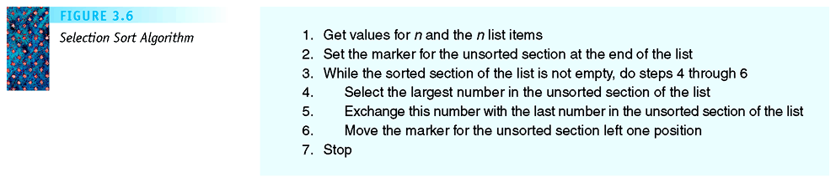
Selection Sort Algorithm [SG]
unsorted
Figure 3.6: Selection Sort Algorithm

Slide 41
What about the time complexity?
Dominant operation: comparisons
6
10
13
5
8
4 comparisons
6
10
8
5
13
3 comparisons
6
5
8
10
13
2 comparisons
6
5
8
10
13
1 comparisons
5
6
8
10
13
Done.
j

Slide 42
Analysis of Selection Sort
Find-Max for j numbers takes (j-1) comparisons
When sorting n numbers,
  (n-1) comparisons in iteration 1 (when j = n)
  (n-2) comparisons in iteration 2 (when j = n-1)
  (n-3) comparisons in iteration 3 (when j = n-2)
  . . . . . . . . . . . . . . .
  2 comparisons in iteration (n-2) (when j = 3)
  1 comparisons in iteration (n-1) (when j = 2)
Total number of comparisons:
  Cost = (n-1) + (n-2) + … + 2 + 1 = n(n-1)/2
  = Θ(n²)

Slide 43
Analysis of Selection Sort: Summary
Time complexity: Θ(n²)
  Comparisons: n(n-1)/2
  Exchanges: n (swapping largest into place)
  Overall time compexity: Θ(n²)
Space complexity: Θ(n)
  Θ(n) – space for input sequence,
  plus a few variables.
Selection Sort:
Time complexity: T(n) = Θ(n²)
Space complexity: S(n) = Θ(n)

Slide 44
Analysis of Pat-Match Algorithm
Our pattern matching alg. consists of two modules
Pat-Match(T, n, P, m)
“high-level” view
Match(T, k, P, m)
“high-level” primitive
  Acheives good division-of-labour
Overview: To analyze, we do bottom-up analysis
  First, analyze time complexity of Match(T,k,P,m)
    Note: This takes much more than Θ(1) operations
    Express in Θ notation (simplified).
  Then analyze Pat-Match

Slide 45
First, analyze Match high-level primitive
1
2
3
4
5
6
7
8
9
T
Align T[k..k+m–1]
with P[1..m]
(Here, k = 4)
C
A
T
A
T
C
A
T
A
P
A
T
A
Dominant Op is
comparison.
In worst case,
m comparisons.
So, Θ(m)
1
2
3
i
Match(T,k,P,m);
begin
i ← 1; MisMatch ← No;
while (i <= m) and (MisMatch=No) do
if (T[k+i-1] not equal to P[i])
then MisMatch=Yes
else i ← i + 1
endif
endwhile
Match ← not(MisMatch); (* Opposite of *)
end;

Slide 46
Next, Analyze Pat-Match Algorithm
Pat-Match(T,n,P,m);
(* Finds all occurrences of P in T *)
begin
k ← 1;
while (k <= n-m+1) do
if Match(T,k,P,m) = Yes
then Print “Match at pos ”, k;
endif
k ← k+1;
endwhile
end;
Dominant Operation:
high level op Match(T,k,P,m);
Match is called (n+1–m) times,
each call cost Θ(m) times
Total: Θ((n+1–m)m) = Θ(nm)

Slide 47
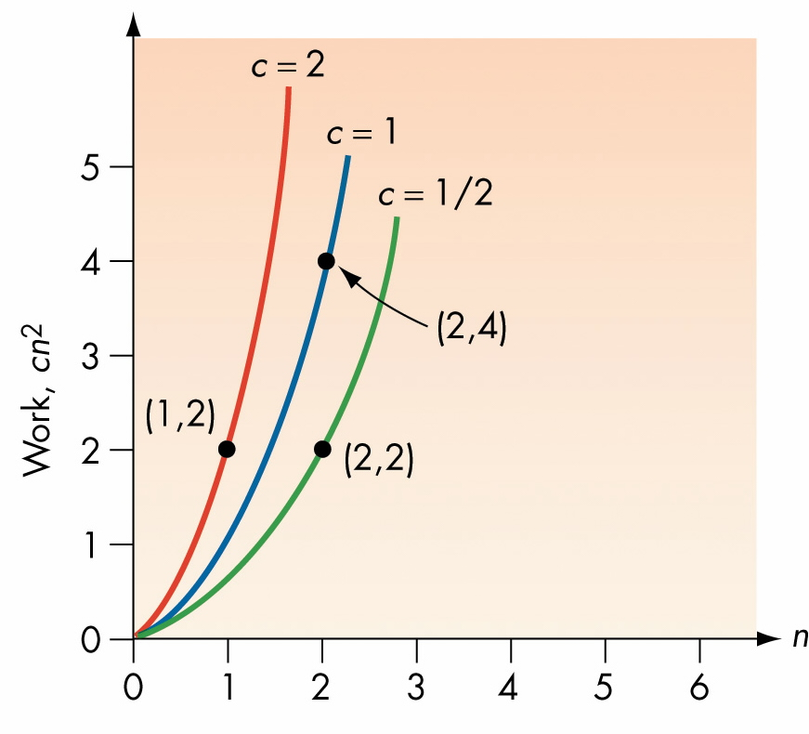
Viewing the Rate of Growth of T(n) = cn²
Figure 3.10: Work = cn² for various values of c

Slide 48
Order of Magnitude – Order n² [Quadratic]
All functions (with highest-order term) cn²
  have similar shape
  have same order of growth
Quadratic algorithm -- Θ(n²)
  an algorithm that does cn² work
    for some constant c
  order of magnitude is n²
  Θ(n²) (read, theta n-square)

Slide 49
Comparison: Order n vs Order n²
Have seen…
Algorithms of order n
  Sum, Find-Max, Find-Min, Seq-Search
Algorithm of order n²
  Selection sort
  Printing an n x n table

Slide 50
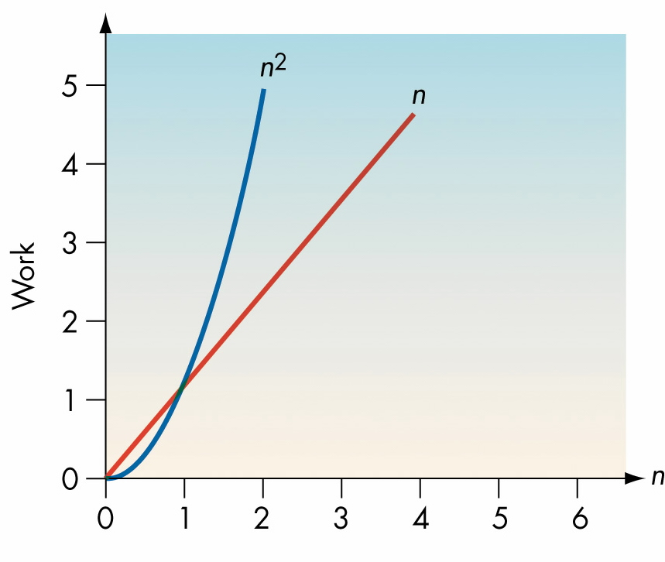
Rate of Growth Comparison: n² vs n
Figure 3.11: A Comparison of n and n²

Slide 51
Comparison: Θ(n²) vs Θ(n)
Anything that is Θ(n²) will eventually have larger values than anything that is Θ(n),
no matter what the constants are.
An algorithm that runs in time Θ(n) will outperform one that runs in Θ(n²)
Eg: compare T₁(n) = 1000n and T₂(n) = 10n²
See also tutorial problem.

Slide 52
A Very Fast Search Algorithm
If the list is sorted, that is
A₁≤ A₂ ≤ A₃ ≤ …. ≤ A_{n}
Then, we can do better when searching
  actually a lot better….
Can use “Binary Search”
Example: Find 9
3
5
7
8
9
12
15

Slide 53
Binary search
Find an element in a sorted array:
IDEA:
Check middle element.
Recursively search 1 subarray.
Example: Find 9
3
5
7
8
9
12
15

Slide 54
Binary search
Find an element in a sorted array:
IDEA:
Check middle element.
Recursively search 1 subarray.
Example: Find 9
3
5
7
8
9
12
15

Slide 55
Binary search
Find an element in a sorted array:
IDEA:
Check middle element.
Recursively search 1 subarray.
Example: Find 9
3
5
7
8
9
12
15

Slide 56
Binary search
Find an element in a sorted array:
IDEA:
Check middle element.
Recursively search 1 subarray.
Example: Find 9
3
5
7
8
9
12
15

Slide 57
Binary search
Find an element in a sorted array:
IDEA:
Check middle element.
Recursively search 1 subarray.
Example: Find 9
3
5
7
8
9
12
15

Slide 58
Binary search
Find an element in a sorted array:
IDEA:
Check middle element.
Recursively search 1 subarray.
Found!
Example: Find 9
3
5
7
8
9
12
15

Slide 59
Binary search – overview of algorithm
Find an element in a sorted array:
Have two pointers first, last on two ends
of the sub-array being search
1. Check middle element.
Here, mid = (first + last) / 2;
2. Recursively search 1 subarray.
Move one of the two pointers to update
the sub-array being search.
Either last ← mid – 1;
Or first ← mid + 1;

Slide 60
Binary Search Algorithm (pseudo-code)
BinarySearch(A,n,x);
(* search for x in a sorted array A[1..n] *)
begin
first ← 1; last ← n;
while (first <= last) do
mid ← (first + last) div 2;
if (x = A[mid])
then print “Found x in pos”, mid; Stop
else if (x < A[mid])
then last ← mid-1;
else first ← mid+1;
endif
endif
endwhile
print “x not found”;
end;

Slide 61
Binary Search – How fast is it? (1/3)
Starting with n numbers,
  Binary search repeatedly halves the size
  Until it reaches 1 element – to check
Eg: When n = 100
  After 1 step, size is ≤ 50
  After 2 steps, size is ≤ 25
  After 3 steps, size is ≤ 12
  After 4 steps, size is ≤ 6
  After 5 steps, size is ≤ 3
  After 6 steps, size is ≤ 1
  One last comparison, DONE!!
7 = log₂100 steps;
[Déjà vu?
repeated-halving]

Slide 62
Binary Search – How fast is it? (2/3)
Starting with n numbers,
  Binary search repeatedly halves the size
  Until it reaches 1 element – to check
# steps = lg n
= log₂n
Binary Search has complexity
  T(n) = Θ( lg n)
Recall facts about T(n) = lg n
  When 2^{k} = n [after taking lg-base-2]
  k = log₂n or lg n
  = # of steps of repeated-halving

Slide 63
Binary Search – How fast is it? (3/3)
Starting with n numbers,
  Binary search repeatedly halves the size
  Until it reaches 1 element – to check
# steps = lg n
= log₂n
Binary Search has complexity
  T(n) = Θ( lg n)
T(n) = Θ(lg n) is very fast!
n (# of element) | T(n) = lg n
1,000 | 10
1,000,000 | 20
1,000,000,000 | 30

Slide 64
Summary: Searching Algorithms
Sequential Search (Alg):
  Worst Case: n comparisons
  Best Case: 1 comparison
  Avg Case: n/2 comparisons
Binary Search (Alg):
  Worst Case: lg n comparisons
  Best Case: 1 comparison
  Avg Case: lg n comparisons*
  * How to get the Average Case? Answer: using mathematical analysis.
    This is OK (do-able) for small n (see example in tutorial).
    (Read Sect 3.4.2 of [SG3])
    For general n, analysis is complex (beyond the scope of this course)

Slide 65
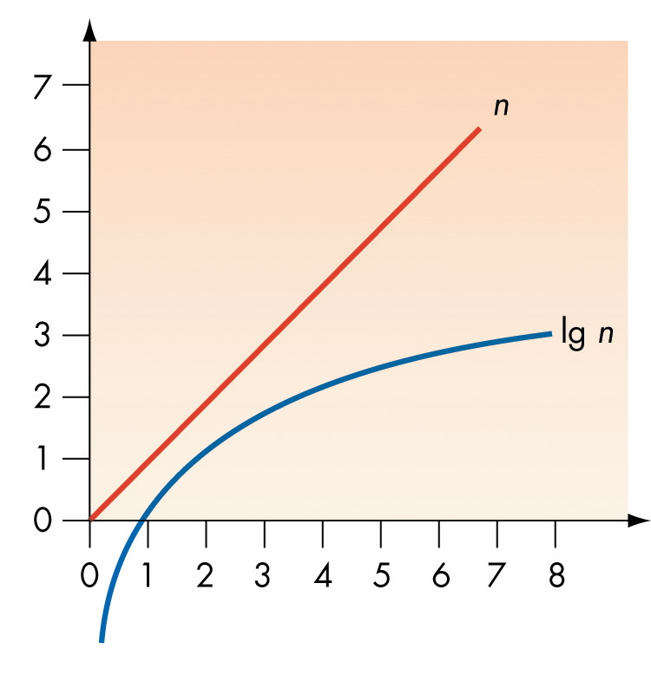
Comparison: order n vs order lg n
Figure 3.21. A Comparison of n and lg n

Slide 66
Complexity of Algorithms…
Logarithmic Time Algorithm
  Binary Search – Θ(lg n) time
A Linear Time Algorithm
  Sum(A,n) – Θ(n) time
  Sequential-Search(A,n,x) – Θ(n) time
A Quadratic Time Algorithm
  Selection Sort – Θ(n²) time
An Exponential Time Algorithm
  All-Subsets(A,n) – Θ(2^{n}) time

Slide 67
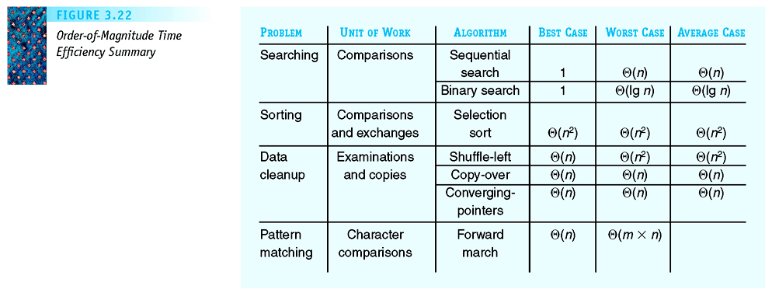
Complexity of Time Efficiency
Figure 3.22: Summary of Time Efficiency

Slide 68
Efficiency of Algorithms
Readings: [SG] Ch. 3
Chapter Outline:
  Attributes of Algorithms
  Measuring Efficiency of Algorithms
  Simple Analysis of Algorithms
  When things get out of hand
    Polynomial Time Algorithms (Tractable)
    Exponential Time Algorithms (Intractable)
    Approximation Algorithms
      (eg: Bin Packing)

Slide 69
When Things Get Out of Hand
Polynomially bound algorithms
  Time complexity is some polynomial order
  Example: Time complexity is of order of n²
Intractable algorithms
  Run time is worse than polynomial time
  Examples
    Hamiltonian circuit
    Bin-packing

Slide 70
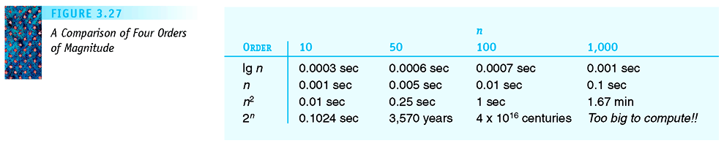
Comparison of Time Complexities
Figure 3.27: A Comparison of Four Orders of Magnitude
See extended table in tutorial problem

Slide 71
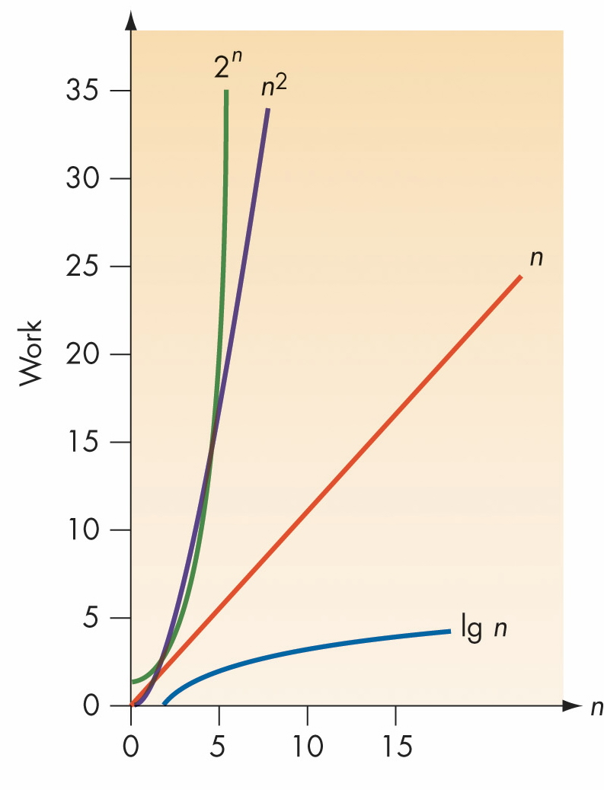
Figure 3.25: Comparisons of lg n, n, n², and 2^{n}

Slide 72
When Things Get Out of Hand (2)
Exponential algorithm
  Θ(2^{n})
  More work than any polynomial in n
Approximation algorithms
  Run in polynomial time but do not give optimal solutions
  Example: Bin Packing Algorithms

Slide 73
Summary of Chapter 3
Desirable attributes in algorithms:
  Correctness
  Ease of understanding
  Elegance
  Efficiency
Efficiency of an algorithm is extremely important
  Time Complexity
  Space Complexity

Slide 74
Summary of Chapter 3 (2)
To compare the efficiency of two algorithms that do the same task
  Measure their time complexities
Efficiency focuses on order of magnitude
  Time complexity in Θ-notations.
  In its simplest form (eg: Θ(n), Θ(n²))

Slide 75

Thank you!

