Slide 1
Recursive Algorithm
Recursive Algorithm
Recursive Algorithm
Recursive Algorithm
Recursive Algorithm
Recursive Algorithm
Recursive Algorithm
Recursive Algorithm
Recursive Algorithm
Recursive Algorithm
Recursive Algorithm
R ecursive Algorithm

Slide 2
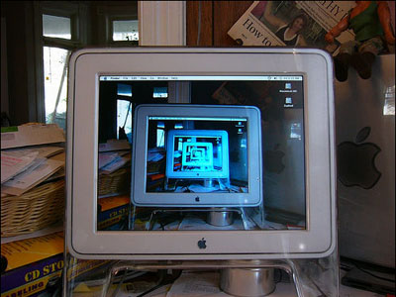
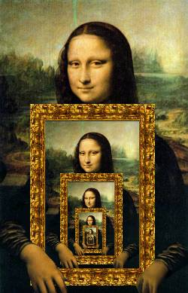
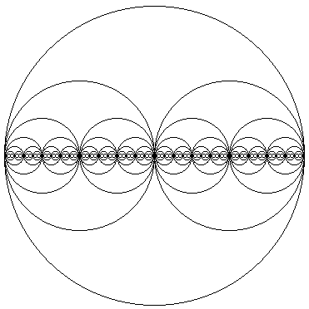
Examples of recursion…
Tomorrow

Slide 3
5. Recursion
A problem solving method of
“decomposing bigger problems into smaller sub-problems that are identical to itself.”
General Idea:
Solve simplest (smallest) cases DIRECTLY
usually these are very easy to solve
Solve bigger problems using smaller sub-problems
that are identical to itself (but smaller and simpler)
Abstraction:
To solve a given problem, we first assume that we ALREADY know how to solve it for smaller instances!!
Dictionary definition:
recursion
see recursion

Slide 4
5. Recursion
Dictionary definition:
recursion
see recursion
Simple Examples from Real Life…
TV within a TV
2 parallel mirrors
1 + the previous number
“Tomorrow”
Recursion Examples from the Web.
Recursive Trees (turtle) – here
Trees and Tower-of-Hanoi –
http://www.sussex.ac.uk/space-science/Nature/nature.html
Recursion and Biology – here

Slide 5
Palindromes
Short:
RADAR, MADAM
WOW, MUM, DAD, 20:02 20-02-2002
LOL, CIVIC, ROTOR, ROTATOR, RACECAR
Medium:
WAS IT A RAT I SAW
STEP ON NO PETS
NEVER ODD OR EVEN
DO GEESE SEE GOD
Long:
A MAN, A PLAN A CANAL PANAMA
ABLE WAS I ERE I SAW ELBA
I ROAMED UNDER IT AS A TIRED NUDE MAORI
Word-based Palindromes:
Fall leaves as soon as leaves fall

Slide 6
斗六高材生材高六斗
中山歸隱客隱歸山中
上海自來水來自海上
牙刷刷牙
茶煲煲茶
地拖拖地
人人为我、我为人人。
自我突破，突破自我

Slide 7
Palindromes
Word/Phrase-based Palindromes:
You can cage a swallow, can't you, but you can't swallow a cage, can you?
改变的环境影响人类的活动，活动的人类影响环境的改变。

Slide 9
Example: Fibonacci Numbers…
Definition of Fibonacci numbers
F₁ = 1,
F₂ = 1,
for n>2, F_{n} = F_{n-1} + F_{n-2}
Problem: Compute F_{n} for any n.
The above is a recursive definition.
F_{n} is computed in-terms of itself
actually, smaller copies of itself – F_{n-1} and F_{n-2}
Actually, Not difficult:
F₃ = 1 + 1 = 2 F₆ = 5 + 3 = 8 F₉ = 21 + 13 = 34
F₄ = 2 + 1 = 3 F₇ = 8 + 5 = 13 F₁₀ = 34 + 21 = 55
F₅ = 3 + 2 = 5 F₈ = 13 + 8 = 21 F₁₁ = 55 + 34 = 89
1, 1, 2, 3, 5, 8, 13, 21, 34, 55, 89, 144, …

Slide 10
Fibonacci Numbers: Recursive alg
Fibonacci(n) (* Recursive, SLOW *)
begin
if (n=1) or (n=2)
then Fibonacci(n) ← 1 (*simple case*)
else Fibonacci(n) ← Fibonacci(n-1) + Fibonacci(n-2)
endif
end;
The above is a recursive algorithm
It is simple to understand and elegant!
But, very SLOW

Slide 11
Recursive Fibonacci Alg -- Remarks
How slow is it?
Eg: To compute F(6)…
F(6)
F(5)
F(4)
F(4)
F(3)
F(3)
F(2)
F(3)
F(2)
F(2)
F(1)
F(2)
F(1)
F(2)
F(1)
HW: Can we compute it faster?

Slide 12
Example: Tower of Hanoi
A
B
C
A
B
C
Given: Three Pegs A, B and C
Peg A initially has n disks, different size, stacked up,
larger disks are below smaller disks
Problem: to move the n disks to Peg C, subject to
Can move only one disk at a time
Smaller disk should be above larger disk
Can use other peg as intermediate

Slide 13
Tower of Hanoi
How to Solve: Strategy…
Generalize first: Consider n disks for all n ≥ 1
Our example is only the case when n=4
Look at small instances…
How about n=1
Of course, just “Move disk 1 from A to C”
How about n=2?
“Move disk 1 from A to B”
“Move disk 2 from A to C”
“Move disk 1 from B to C”

Slide 14
Tower of Hanoi (Solution!)
General Method:
First, move first (n-1) disks from A to B
Now, can move largest disk from A to C
Then, move first (n-1) disks from B to C
Try this method for n=3
“Move disk 1 from A to C”
“Move disk 2 from A to B”
“Move disk 1 from C to B”
“Move disk 3 from A to C”
“Move disk 1 from B to A”
“Move disk 1 from B to C”
“Move disk 1 from A to C”

Slide 15
Algorithm for Towel of Hanoi (recursive)
Recursive Algorithm
when (n=1), we have simple case
Else (decompose problem and make recursive-calls)
Hanoi(n, A, B, C);
(* Move n disks from A to C via B *)
begin
if (n=1) then “Move top disk from A to C”
else (* when n>1 *)
Hanoi (n-1, A, C, B);
“Move top disk from A to C”
Hanoi (n-1, B, C, A);
endif
end;

