Slide 1
Artificial Intelligence
Reading Materials:
Ch 14 of [SG]
Also Section 9.4.2 Logic Programming
Additional Notes: (from web-site)
Contents:
Different Types of Tasks
Knowledge Representation
Recognition Tasks
Reasoning Tasks

Slide 2
For Spring 2012 semester
Will only cover:
Turing Test, Eliza
Division of Labour in AI
Formal Language for Knowledge Representation
Reasoning: Intelligent Search, Expert Systems
Parts of Ch. 14 covered
Ch. 14.1 Introduction
Ch. 14.2 Division of Labour
Ch. 14.3 Only Formal Language (Predicates)
Ch. 14.5 Reasoning Tasks
Will not cover
Knowledge Representation (except Formal Lang)
Recognition Tasks (Ch 14.4)
Robotics (Ch 14.6)

Slide 3
Artificial Intelligence…
Context so far…
Use algorithm to solve problem
Database used to organize massive data
Algorithms implemented using hardware
Computers linked in a network
Educational Goals for this Chapter:
The computer as a tool for
Solving more human-like tasks
Build systems that “think” independently
Can “intelligence” be encoded as an algorithm?

Slide 4
Introduction
Artificial intelligence (AI)
Explores techniques for incorporating aspects of “intelligence” into computer systems
Turing Test (Alan Turing)
A test for intelligent behavior of machines
Allows a human to interrogate two entities, both hidden from the interrogator
A human
A machine (a computer)

Slide 5
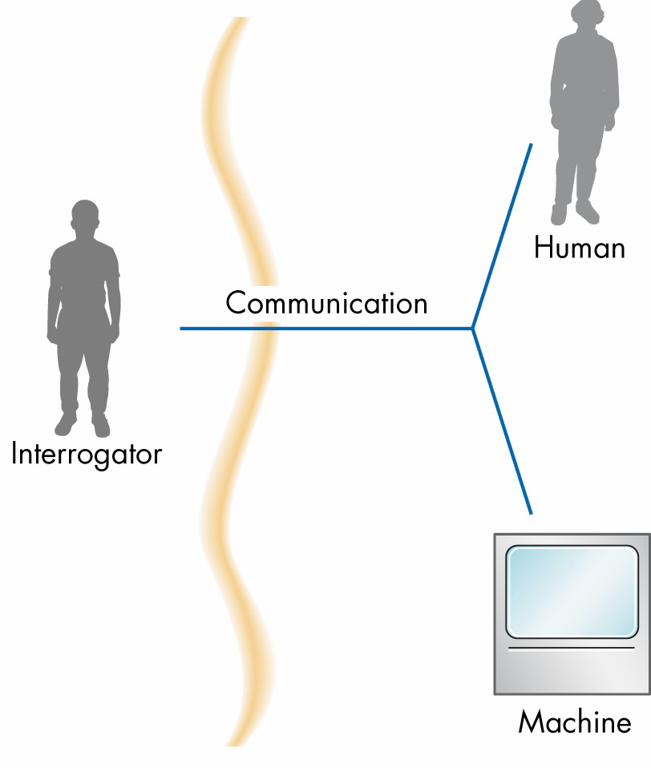
The Turing Test
If the interrogator is unable to determine which entity is the human and which the computer, then the computer has passed the test

Slide 6
Introduction (continued)
Artificial intelligence can be thought of as constructing computer models of human intelligence
Early attempt: Eliza (see notes, website)

Slide 7
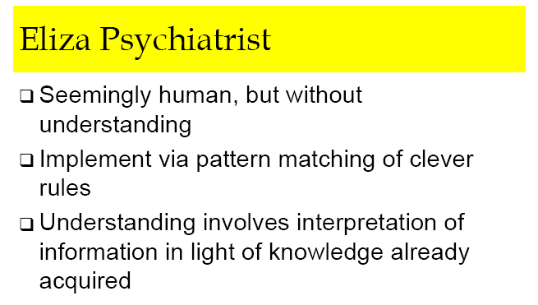

Slide 8
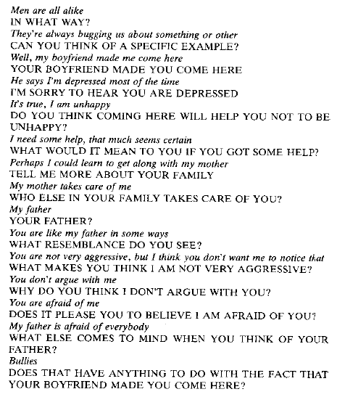
A Typical Conversation with Eliza

Slide 9
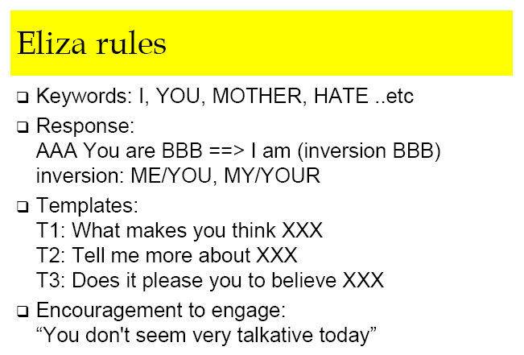
Is Eliza really “intelligent”?
How Eliza does it…

Slide 10
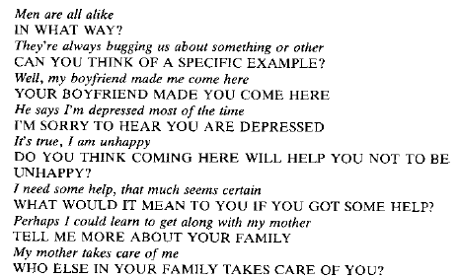
Eliza Conversation revisited
Encouragement
Encouragement
simple inversion
template “I am ..”
template “do you…”
template “what …”
template “tell me…”
template “who else…”
Finish the rest yourself

Slide 11
A Division of Labor
Categories of “human-like” tasks
Computational tasks
Recognition tasks
Reasoning tasks

Slide 12
A Division of Labor (continued)
Computational tasks
Tasks for which algorithmic solutions exist
Computers are better (faster and more accurate) than humans
Recognition tasks
Sensory/recognition/motor-skills tasks
Humans are better than computers
Reasoning tasks
Require a large amount of knowledge
Humans are far better than computers

Slide 13
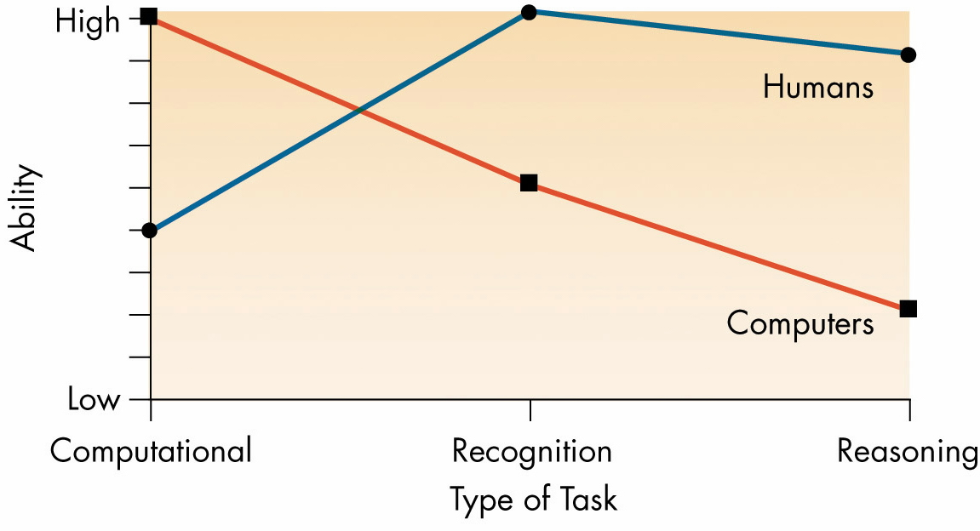
Figure 14.2: Human and Computer Capabilities

Slide 14
Artificial Intelligence
Skipped in
Spring 2012
Contents:
Different Types of Tasks
Knowledge Representation
Recognition Tasks
Modeling of Human Brain
Artificial Neural Networks
Reasoning Tasks
Skip Forward:

Slide 15
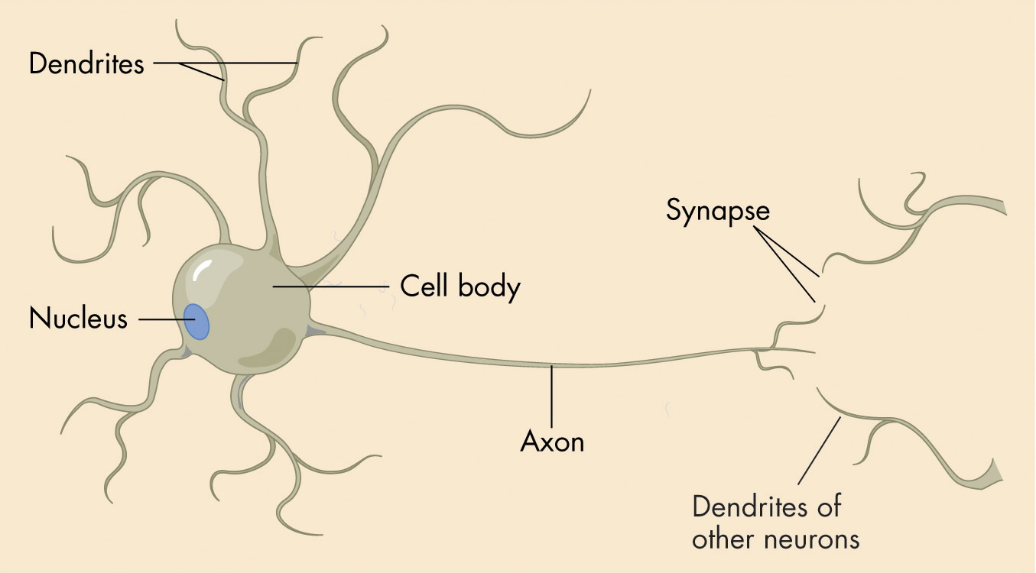
Recognition Tasks: Human
Skipped in
Spring 2012
A Neuron
Neuron – a cell in human brain; capable of:
Receiving stimuli from other neurons through its dendrites
Sending stimuli to other neurons thru’ its axon

Slide 16
Human Neurons: How they work
Skipped in
Spring 2012
Each neuron
Sums up activating and inhibiting stimuli it received – call the sum V
If the sum V equals or exceeds its “threshold” value, then neuron sends out its own signal (through its axon) [fires]
Each neuron can be thought out as an extremely simple computational device with a single on/off output;

Slide 17
Recognition Tasks (continued)
Skipped in
Spring 2012
Human brain: a connectionist architecture
A large number of simple “processors” with multiple interconnections
Von Neumann architecture
A small number (maybe only one) of very powerful processors with a limited number of interconnections between them

Slide 18
Recognition Tasks (continued)
Skipped in
Spring 2012
Artificial neural networks (neural networks)
Simulate individual neurons in hardware
Connect them in a massively parallel network of simple devices that act somewhat like biological neurons
The effect of a neural network may be simulated in software on a sequential-processing computer

Slide 19
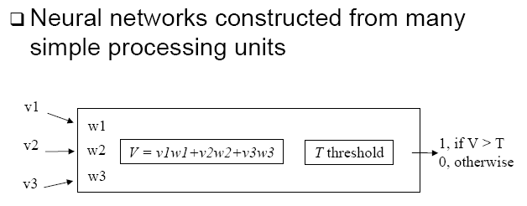
Modeling a single neuron
Skipped in
Spring 2012
An artificial neuron
Each neuron has a threshold value
Input lines carry weights that represent stimuli
The neuron fires when the sum of the incoming weights equals or exceeds its threshold value

Slide 20
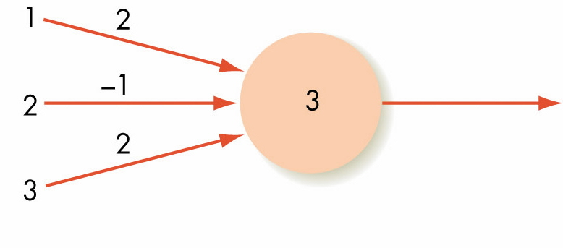
Operation of 1 neuron.
Skipped in
Spring 2012
Figure 14.5: One Neuron with Three Inputs
When can the output be 1? (neuron “fire”)
Can you modify the network and keep the same functionality?

Slide 21
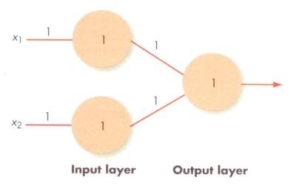
An OR gate (using ANN)
Skipped in
Spring 2012
Figure 14.7 A simple neural network
When can the output be 1? (neuron “fire”)
Can you draw a table for “x₁ x₂ Output”

Slide 22
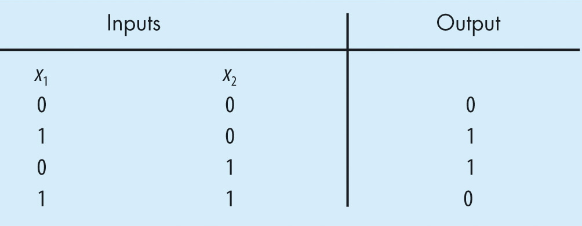
What about XOR gate?
Skipped in
Spring 2012
Figure 14.8. The Truth Table for XOR
Question: Can a simple NN be built to represent the XOR gate?

Slide 23
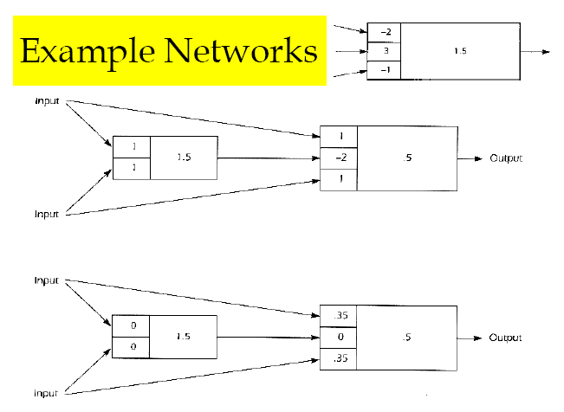
More Simple Neural Networks
Skipped in
Spring 2012
Your HW: Give the “truth table” for these NN;

Slide 24
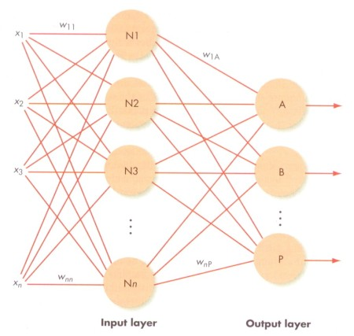
Recognition Tasks (continued)
Skipped in
Spring 2012
ANN (sample)

Slide 25
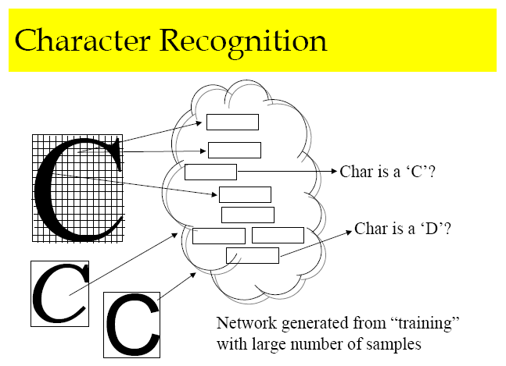
Neural Network – with Learning
Skipped in
Spring 2012
Real Neural Networks:
Uses back-propagation technique to train the NN;
After training, NN used for character recognition;
Read [SG] for more details.

Slide 26
NN (continued)
Skipped in
Spring 2012
Some Success stories…
NN successfully used for small-scale license plate recognition – of trucks at PSA gates;
Between 2003-2006, NN also used for recognizing license plates at NUS carpark entrances.

Slide 27
Recognition Tasks (summary)
Skipped in
Spring 2012
Neural network
Both the knowledge representation and “programming” are stored as weights of the connections and thresholds of the neurons
The network can learn from experience by modifying the weights on its connections

Slide 28
Artificial Intelligence
Contents:
Different Types of Tasks
Knowledge Representation
Recognition Tasks
Reasoning Tasks
Intelligent Search
Intelligent Agents
Knowledge-Based Systems

Slide 29
Reasoning Tasks
Human reasoning requires the ability to draw on a large body of facts and past experience to come to a conclusion
Artificial intelligence specialists try to get computers to emulate this characteristic
Related Story: Bill Gates and Pancake Flipping

Slide 30
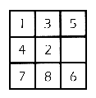
Intelligent Search Example (Ch. 14.5.1)
Solving a Puzzle (the 9-Puzzle)
Involves
Planning
Learning from past experience
Simulated/Modelling by
Searching a State-graph
State Graph can be Very BIG
Searching for “Goal State”
How to guide the search to make it more efficient.

Slide 31
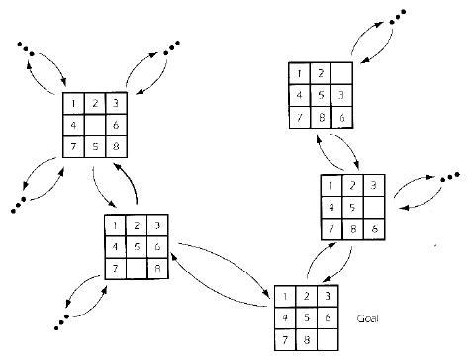
State Graph for 8-Puzzle

Slide 32
Intelligent Searching
State-space graph:
After any one node has been searched, there are a huge number of next choices to try
There is no algorithm to dictate the next choice
State-space search
Finds a solution path through a state-space graph

Slide 33
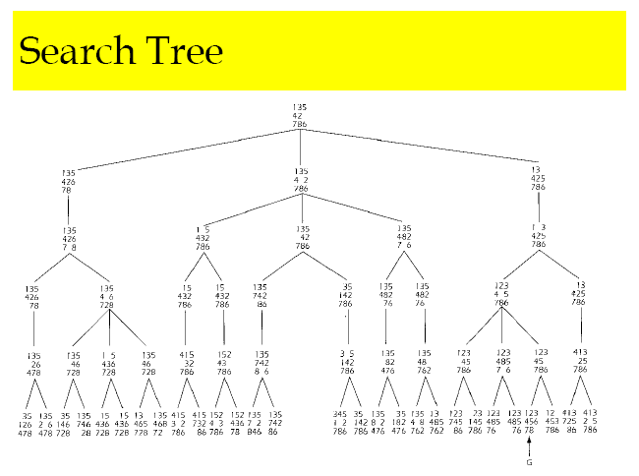
The Search Tree for the 9-Puzzle

Slide 34
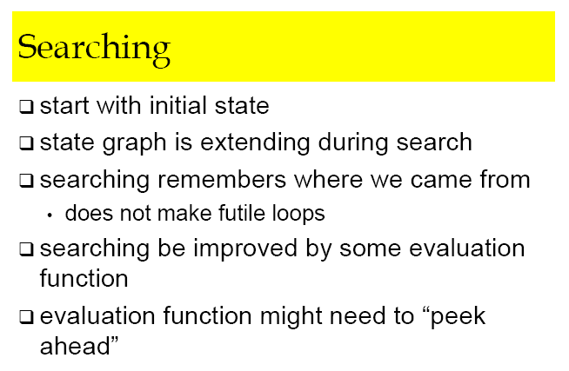
Search Strategy for 9-Puzzle

Slide 35
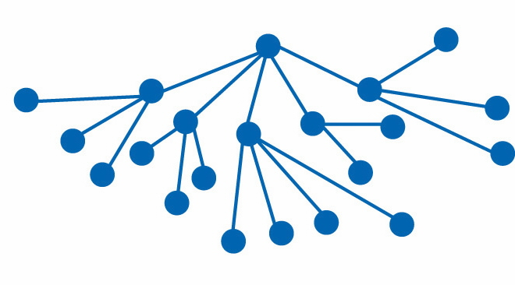
Figure 14.12
A State-Space Graph with Exponential Growth

Slide 36
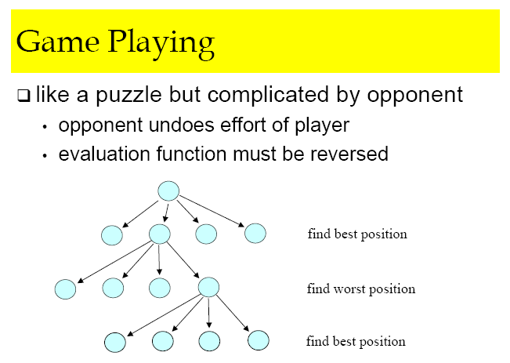
AI in Game Playing

Slide 37
Intelligent Searching (continued)
Each node represents a problem state
Goal state: the state we are trying to reach
Intelligent searching applies some heuristic (or an educated guess) to:
Evaluate the differences between the present state and the goal state
Move to a new state that minimizes those differences

Slide 38
Intelligent State Space search…
See notes (pdf) for concrete example
Some Success stories…
AI in chess playing – Deep Blue (1997)
Deep Blue evaluate 200M positions/sec, or 50B positions in 3min
Other games: Othello, checkers, etc

Slide 39
Swarm Intelligence (Ch. 14.5.2)
Skipped in
Spring 2012
Swarm intelligence
Models the behavior of a colony of ants
Model with simple agents that:
Operate independently
Can sense certain aspects of their environment
Can change their environment
May “evolve” and acquire additional capabilities over time

Slide 40
Intelligent Agents (Ch. 14.5.3)
Skipped in
Spring 2012
An intelligent agent: software that interacts collaboratively with a user
Initially, an intelligent agent
simply follows user commands
Over time, the intelligent agent
initiates communication, takes action, and performs tasks on its own
using its knowledge of the user’s needs and preferences

Slide 41
Intelligent Agents (where used)
Skipped in
Spring 2012
Wizards (assistants) for Office Software
Personalized Web Search Engines
Push info, news, advertisements etc

Slide 42
Expert Systems (Ch. 14.5.4)
Rule-based systems
Also called expert systems or knowledge-based systems
Attempt to mimic the human ability to engage pertinent facts and combine them in a logical way to reach some conclusion
Read also Sect 9.4.2 of [SG2/3] (Logic Programming)

Slide 43
Expert Systems (continued)
A rule-based system must contain
A knowledge base: set of facts about subject matter
An inference engine: mechanism for selecting relevant facts and for reasoning from them in a logical way
Many rule-based systems also contain
An explanation facility: allows user to see assertions and rules used in arriving at a conclusion

Slide 44
Expert Systems (continued)
A fact can be
A simple assertion
A rule: a statement of the form if . . . then . . .
Modus ponens (method of assertion)
The reasoning process used by the inference engine

Slide 45
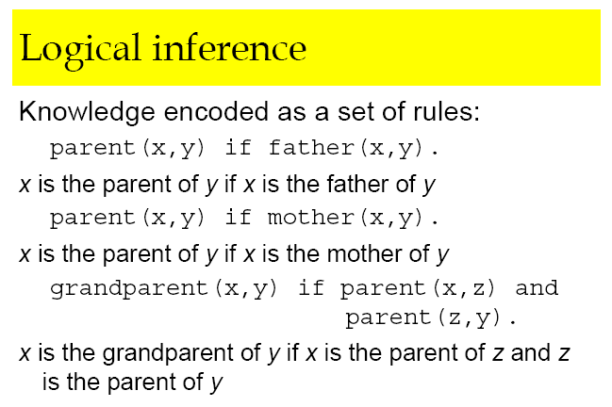
Knowledge Based System:

Slide 46
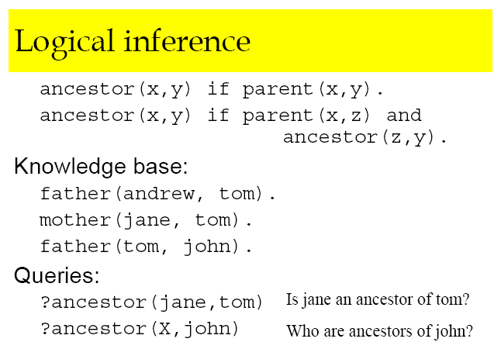
Knowledge-Based System…

Slide 47
Expert Systems (continued)
Inference engines can proceed through
Forward chaining
Backward chaining
Forward chaining
Begins with assertions and tries to match those assertions to “if” clauses of rules, thereby generating new assertions

Slide 48
Expert Systems (continued)
Backward chaining
Begins with a proposed conclusion
Tries to match it with the “then” clauses of rules
Then looks at the corresponding “if” clauses
Tries to match those with assertions, or with the “then” clauses of other rules

Slide 49
Expert Systems (continued)
A rule-based system is built through a process called knowledge engineering
Builder of system acquires information for knowledge base from experts in the domain

Slide 50
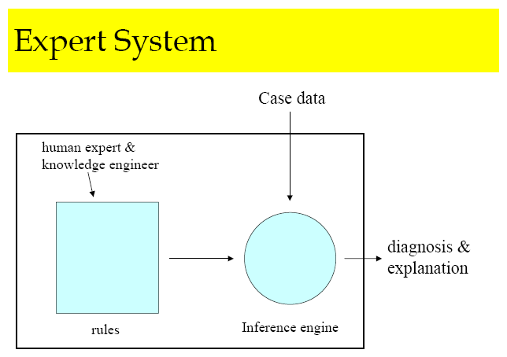
Expert Systems: Structure

Slide 51
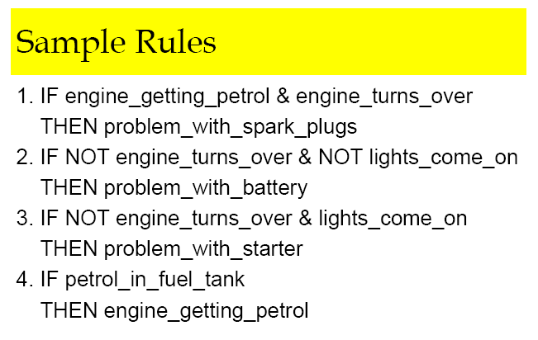
Expert Systems: Rules

Slide 52
Summary
Artificial intelligence explores techniques for incorporating aspects of intelligence into computer systems
Categories of tasks: computational tasks, recognition tasks, reasoning tasks
Neural networks simulate individual neurons in hardware and connect them in a massively parallel network

Slide 53
Summary
Swarm intelligence models the behavior of a colony of ants
An intelligent agent interacts collaboratively with a user
Rule-based systems attempt to mimic the human ability to engage pertinent facts and combine them in a logical way to reach some conclusion

Slide 55
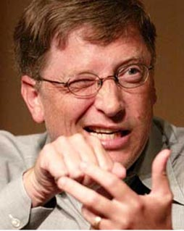
Did you know that …
I used to
flip
pancakes.
Bill Gates [比尔 盖茨] , Microsoft

Slide 56
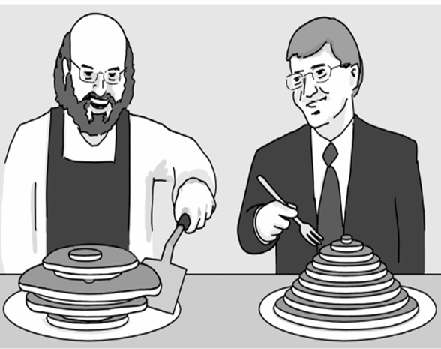
Did Bill Gates really flip pancakes?
Given an initial pancake configuration...
You want to get a “sorted” configuration …
Constraints: can only flip … (using a spatula)
Source: Neil Jones and Pavel Pevzner, 2004 “Introduction to BioInformatics Algorithms”.
Example …
Bill Gates & Christos Papadimitriou:, “Bounds For Sorting By Prefix Reversal.” Discrete Mathematics, Vol 27, pp 47-57, 1979.
Notes:
What’s the story? Bill Gates actually did do some research work while he was in Harvard.
He actually has a paper published on this problem.
His professor, Christos Papadimitrious, is a famous CS theoretician (now at UB-Berkeley).
Details on paper: “Bounds for sorting prefix reversal”, Discrete Mathematics, 27 (1979).
Story that motivates problem: The chef in our place is sloppy, and when he prepares a stack of pancakes they come out all different sizes. Therefore, when I deliver them to a customer, on the way to the table, I rearrange them (so that the smallest winds up on top, and so on, down to the largest at the bottom) by grabbing several from the top and flipping them over, repeating this (varying the number I flip) as many times as necessary. If there are n pancakes, what is the maximum number of flips that I will ever have to use to rearrange them?

Slide 57
More pancake-flipping examples…
2 flips
Abstraction skills,
Problem Solving skills
3 flips
? flips

Slide 58
An Initial Algorithm (Greedy)
Simple Idea:
“Sort” the biggest unsorted pancake first…
Unsorted
Sorted
Largest unsorted

Slide 59
Is Greedy “the best” possible?
Answer: NO
A Counter Example:
Greedy method
Better way

Slide 60
Solution Space…

Slide 61
Search Tree… (systematically search the search space)

