Slide 1
UIT2201: Lecture 1
Lecture Outline:
  The Pervasive Computer
  Examples of Uses / Computer Applications
  Simple and also Difficult
  Similar and also Different
  Algorithms
Readings: [SG] Ch. 1 & Lecture Notes
(esp Ch. 1-1 to 1.2)

Slide 2
A Computer Revolution…
The Pervasive Computer
  Computer are Everywhere
  They are capable of doing things for us
Some examples of what they do
  Email, bank accounts, music-box,
  Game machine, MSN, Facebook, Youtube
Computer applications are
  both similar and different
  both simple and complex

Slide 3
Example-1: Email (electronic mail)
Scenario:
Professor Preparata (franco@cs.brown.edu) at Brown Univ wants to send email to me (leonghw@comp.nus.edu.sg).
Simple:
  Prof Preparata’s computer takes a string of characters and passes on to my computer.
Complicated:
  How does Prof Preparata’s computer know what to do with the string of letters?
  What does address leonghw@comp.nus.edu.sg mean?
  Where is that?

Slide 4
Example-1: Email … the steps
The computer at Brown University
  First, Text Processing.
  detects address to send to,
  detects which is the message part, and so on, etc
Server/Router :
  address ending with “.sg”
  send to a some gateway computer,
  which in turn will send it to a computer in Singapore.
This computer in Singapore
  comp.nus.edu.sg --> send to a computer in SoC.
The computer in School of Computing
  stores it away in a mail file.
  When I log in and execute my mail reader,
  it shows me all the messages filed in the mail file.
  I can then ask it to show me the mail from Prof Preparata.

Slide 5
Actual Example:
Prof. Preparata sends
email from Brown Univ
Prof. Leong receives and
reads the email in NUS SOC
dooby.cs.brown.edu
null.cs.brown.edu
stfimaphost0.comp.nus.edu.sg
salt.cs.brown.edu
postfix0.comp.nus.edu.sg
avs0.comp.nus.edu.sg
via internet

Slide 6
Detailed email headers: an example
Return-Path: <franco@cs.brown.edu>
X-Original-To: leonghw@staffunix-mb.comp.nus.edu.sg
Received: from postfix0.comp.nus.edu.sg (postfix0.comp.nus.edu.sg [192.168.21.67])
by stfimaphost0.comp.nus.edu.sg (Postfix) with ESMTP id 1A88515C63
for <leonghw@staffunix-mb.comp.nus.edu.sg>; Thu, 10 Jan 2008 05:30:55 +0800(SGT)
...<other intermediate machines @NUS-SOC deleted>...
X-Virus-Scanned: amavisd-new at comp.nus.edu.sg
X-Spam-Flag: NO ...<other spam-check related stuff deleted>...
Received: from postfix0.comp.nus.edu.sg ([192.168.21.67])
by localhost (avs0.comp.nus.edu.sg [192.168.20.24]) (amavisd-new, port 10024)
with ESMTP id K-33z-FlCzIl for <leonghw@comp.nus.edu.sg>;
Thu, 10 Jan 2008 05:30:47 +0800 (SGT)
Received: from salt.cs.brown.edu (salt.cs.brown.edu [128.148.32.122])
by postfix0.comp.nus.edu.sg (Postfix) with ESMTP
for <leonghw@comp.nus.edu.sg>; Thu, 10 Jan 2008 05:30:46 +0800 (SGT)
...<other intermediate machines at Brown University deleted>...
Received: by dooby.cs.brown.edu (Postfix, from userid 1069)
id 5E9C0491C2; Wed, 9 Jan 2008 16:30:45 -0500 (EST)
Date: Wed, 9 Jan 2008 16:30:45 -0500
To: Leong Hon Wai <leonghw@comp.nus.edu.sg>
Cc: "Franco P. Preparata" <franco@cs.brown.edu>
Subject: Re: NUS-Brown...
...<other details deleted>...
User-Agent: Mutt/1.5.13 (2006-08-11)
From: franco@cs.brown.edu (Franco P. Preparata)
Hon-Wai,
<details of email deleted>... Click [here] for source file.
So long, franco

Slide 7
Example-1: Email
So, what makes it work?
  To do all this work we need
    various machines to be linked together
    network using communication lines (the engineering folks)
    Machines need to know what to do with individual messages,
    detect the addresses, sender, message content etc.
Why is it Complicated?
  Huge Volume – things become complex because we need to do this for hundreds of millions of users, sending and receiving tons of mail.
  Communication lines, networks, computers may fail, etc.

Slide 8
Side Track: One Data, Multiple Views
Contents of a folder
  List view, details, icon, tiles, etc
Powerpoint file,
  Normal view, outline, slide-sorter, slide-show
Your email “data” is the same
  But its appearance is different when using different email-programs (outlook, unix-shells, web-mail [gmail, hotmail, yahoo])

Slide 9
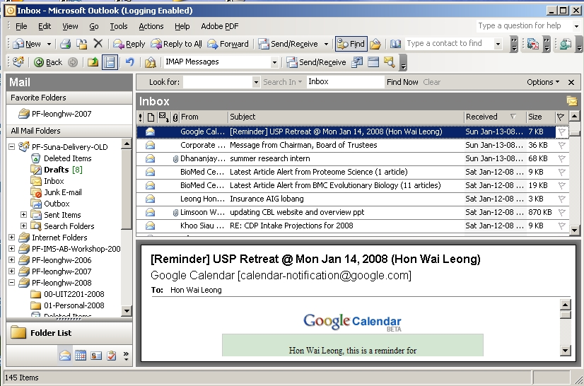
Example: My Mail using Outlook

Slide 10
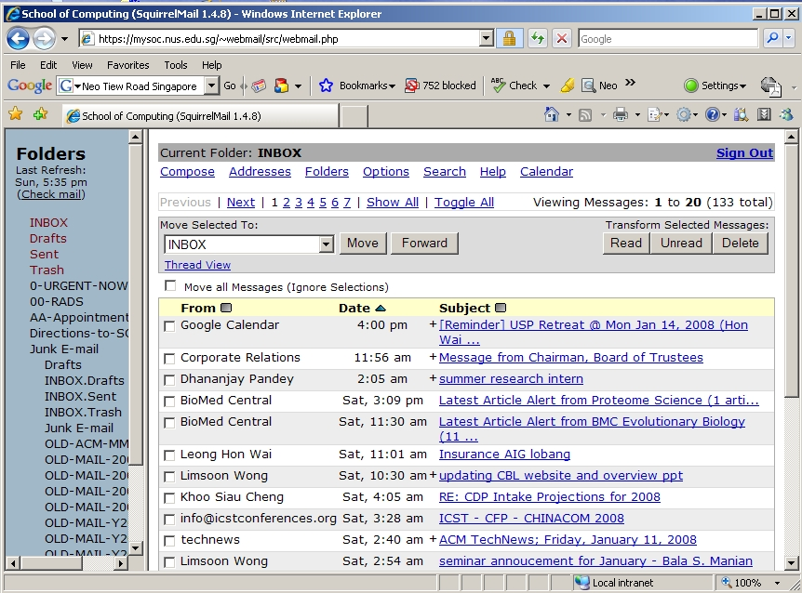
Example: My Mail using webmail

Slide 11
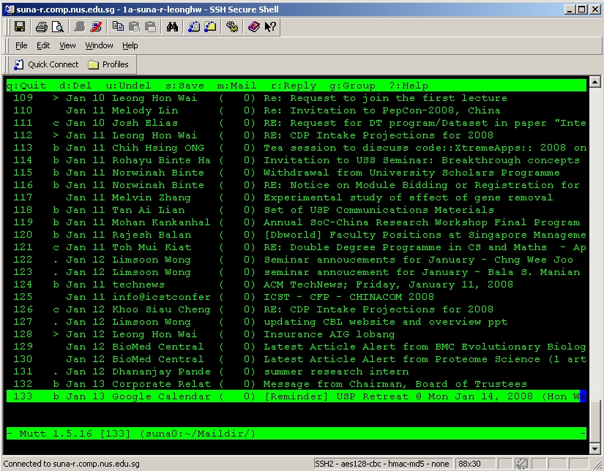
Example: My Mail using Unix-shell

Slide 12
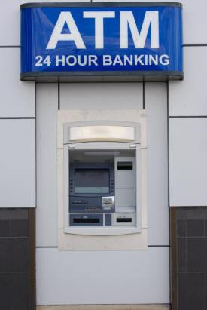
Example-2: Bank Account & ATM
Scenario: Maintaining Bank Accounts
Isn’t it simple?
  Depositing money is just addition, and
  withdrawing is just subtraction.
Issues and Complications
  Thousands of customers, at hundreds of branches.
  To do the crediting to the correct account.
  Simultaneous access.
  Information needs to travel from the ATM machine to the computer, and back.

Slide 13
Example-2: Bank Account
Similar to Email in some ways.
  Needs processing, network of computer,
  so, we can use lots of similar hardware and software.
But, also Different:
  We need different kind of buttons on the ATM machine,
  We need to do printing on a different kind of paper,
  We need to read the ATM card, count money etc.

Slide 14
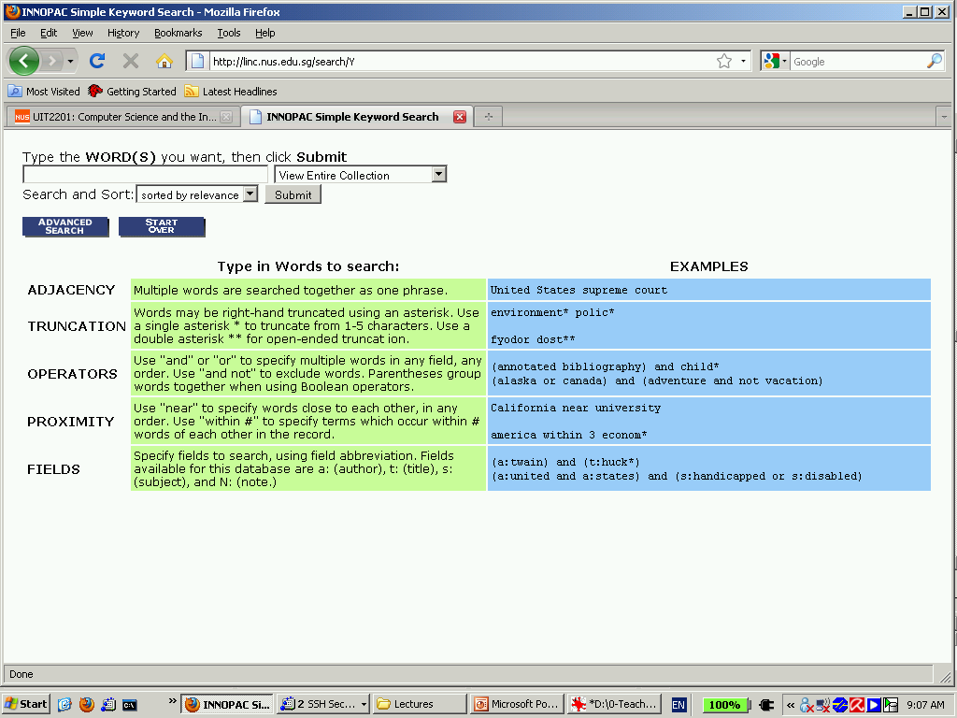
NUS Library Search -- LINC

Slide 15
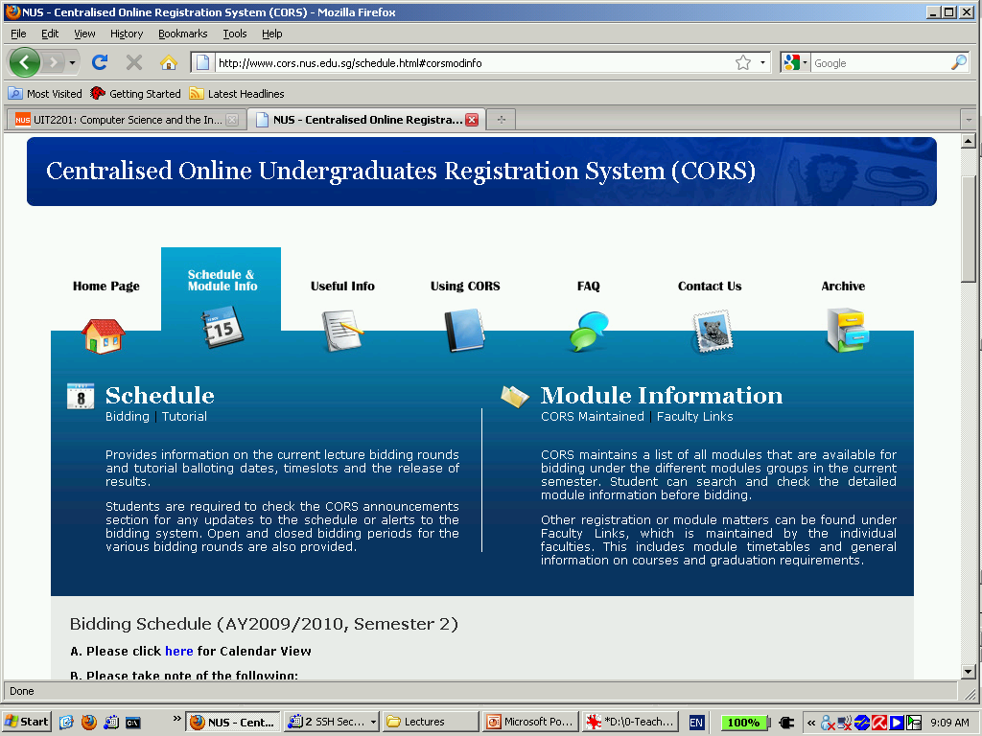
NUS Course Registration -- CORS

Slide 16
Example-3: LINC, CORS
Scenario: LINC (library system)
  Store and maintain information on library collection
  Have a database of items (books),
  Can search, reserve,
Similarities:
  Computer, hardware about the same.
Differences:
  Different interface
  Different software
  Difference functionalities
What about CORS?

Slide 17
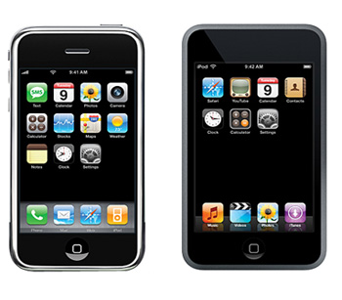
Example-4: MP3 Player
MP3 music player
  Similar to LINC database
    You may search, access information in similar way.
  Different
    now your machine interprets the information differently.
    It converts the message into sound: a different interface.

Slide 18
More Examples: Video Games
Scenario: 3D Walkthrough in Video Games
Question: is it similar to what we have seen so far? YES!
  Computer stores info on the 3D structure (scene),
  Project to 2D computer screen
    works out mathematically the projection from 3D scene to 2D
  Software gets “your position” and “action”
    and appropriately updates the 2D picture on your screen.
Similarities:
  ATM also shows a different picture
    for different accounts you access and different operation you want.
  The calculations for 3D walkthrough are very complicated,
    but is similar to those for other applications.

Slide 19
Intelligent Computer – Capabilities
Common Capabilities
  User Interface
    “the face” of the computer
  Database
    Information store
    Different types of info…
  Database Retrieval
    Fast, diverse
  Data Transmission
    Fast, accurate, secure
  Complex Data Processing

Slide 20
Intelligent Computer – functionalities
Can do Email, library search, etc.
  store large amount of information
  find a particular piece of wanted information
  move the information quickly
  produce new information from old information quickly
  the changes need to be specified in a step by step manner → Algorithm.

Slide 21
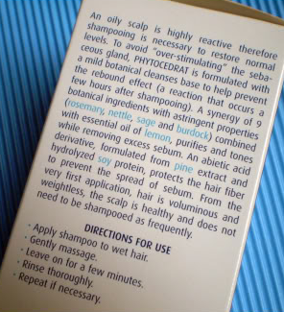
Algorithm
al go rithm [SG3] A well-ordered collection of unambiguous and effectively computable operations that, when executed, produces a result and halts in a finite amount of time.
Informally: an algorithm is an ordered sequence of instructions that is guaranteed to solve a specific problem.
Example of an algorithm (in everyday life):
  Step 1: Wet your hair
  Step 2: Lather your hair
  Step 3: Rinse your hair
  Step 4: Lather your hair
  Step 5: Rinse your hair
  Step 6: Stop.

Slide 22
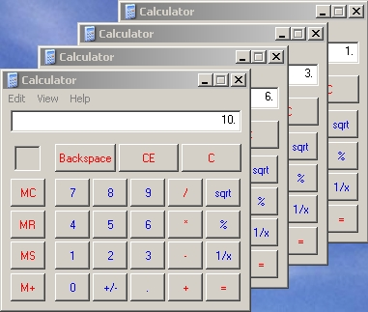
Example Problem: Adding 1 to 100
Problem: What is 1+2+3….+99+100 ?
Straight-forward “Calculator” Method:
  0+1=1; 1+2=3; 3+3=6; 6+4=10; 10+5=15; 15+6=21; … …
  Repeatedly add “the next number” to “the sum”
  At the beginning, start “the sum” with 0.

Slide 23
Problem: Adding 1 to 100 [Gauss!]
Problem: What is 1+2+3….+99+100 ?
Straight-forward “Calculator” Method:
  0+1=1; 1+2=3; 3+3=6; 6+4=10; 10+5=15; 15+6=21; … …
  Repeatedly add “the next number” to “the sum”
  At the beginning, start “the sum” with 0.
Side Track: Gauss’s Method
  1 + 100 = 101;
  2 + 99 = 101;
  3 + 98 = 101;
  … … …
  50+ 51 = 101;
100/2 pairs,
each sum to 101

Slide 24
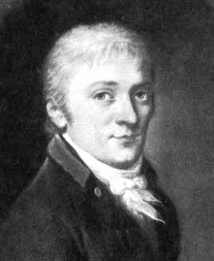
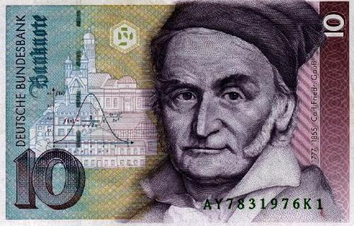
More about Gauss
Carl Friedrich Gauss
  (30 April 1777 – 23 February 1855)
  Prince of Mathematics
  Contributed to number theory, statistics,
  analysis, differential geometry, geodesy,
  geophysics, electrostatics, astronomy
  and optics.
Links:
  http://en.wikipedia.org/wiki/Carl_Friedrich_Gauss
  http://betterexplained.com/articles/techniques-for-adding-the-numbers-1-to-100/
  http://mathforum.org/library/drmath/view/57919.html
  http://www.jimloy.com/algebra/gauss.htm

Slide 25
Expressing Method as an Algorithm
Straight-forward “Calculator” Method:
  0+1=1; 1+2=3; 3+3=6; 6+4=10; 10+5=15; 15+6=21; … …
  Repeatedly add “the next number” to “the sum”
  At the beginning, start “the sum” with 0.
Now, express the above method as an Algorithm!
  Let Sum represent “the sum”
  Let k represent “the next number”
  Question:
    Where are the steps that are repeated?
    What changes in-between each repetition?

Slide 26
Algorithm to Find sum from 1 to 100
  0+1=1; 1+2=3; 3+3=6; 6+4=10; 10+5=15; 15+6=21; … …
  Repeatedly add “the next number” to “the sum”
  At the beginning, start “the sum” with 0.
ALGORITHM Sum-1-to-100;
sum ← 0
k ← 1
repeat: add k to sum
add 1 to k
Is (k > 100)?
no → goto repeat
yes → goto finish
Finish: print out the value of sum
Iterations
Q: How many iterations?
(DIY)

Slide 27
Simulating an Algorithm
  0+1=1; 1+2=3; 3+3=6; 6+4=10; 10+5=15; 15+6=21; … …
ALGORITHM Sum-1-to-100;
sum ← 0
k ← 1
repeat: add k to sum
add 1 to k
Is (k > 100)?
no → goto repeat
yes → goto finish
Finish: print out the value of sum
1 2 3 4 5 6 7 8 …
k
sum
DIY: Simulate the running
of the algorithm…

Slide 28
Intelligent Computer – How?
Problem of summing from 1 to 100
  Can be automated and written into software
  But, it is an “easy” problem
Many real software problems are complex
  Operating Systems: Windows, Unix,
  Internet Browsers: IE, firefox
  Applications: MS Word, Excel, Powerpoint,
  Google search engine, CORS,
For these complex problems
  Specifying algorithms for them is very complex,
  Requires professional training and education
  They can also be automated and written into software

Slide 29
Intelligent Computer – How (cont…)
You are able to use the computer because
  professionals have already done to hard work to make it look simple from your end.
Complex Software make your life easy:
  Applications such as Word Processing, Email, etc require thousands or millions of lines of code.
  But, they are relatively easy to use.
Source of Computer “Intelligence”
  the variety of algorithms that we can come up with is where the versatility of computers come from.

Slide 30
Why is the Computer “Intelligent”
Human Intelligence
  We invent/design the algorithms
  We program them into software
“Programmed” into the computer
  Capabilities are “programmed into”
  Why is Google search so “smart”
  Is Google search “intelligent”?
Machine Intelligence
  A different notion, covered later in course.

Slide 31
So, where are we now….
SOME problems are simple for a Computer.
  Finding the books by particular author
  Computing average height of 1 billion people given the list of their heights.
But, we are not THERE yet…
  We still do not have working algorithms for
  all the problems you may want to solve.
Many “simple things” are HARD for Computer

Slide 32
What are still hard to compute?
Image Understanding / Computer Vision
  Face Recognition;
  Finding the ball in a soccer video
Natural Language Processing
Navigation or Motion Planning
References:
  http://en.wikipedia.org/wiki/AI-complete

Slide 33
What is Computer Science?
Computer Science is NOT just
  the study of computers
  the study of how to write computer programs
  the study of the uses and applications of computers and software
Computer Science is the study of algorithms, including
  their formal and mathematical properties,
  their hardware realizations,
  their linguistic realizations,
  their applications

Slide 34
The END

