Slide 1
Theory: Models of Computation
Readings:
  Chapter 11 & Chapter 3.6 of [SG]
Content:
  What is a Model
  Model of Computation
    Model of a Computing Agent
    Model of an Algorithm
    TM Program Examples
  Computability (Church-Turing Thesis)
  Computational Complexity of Problems

Slide 2
Theory: Goals
To give a model of computation
  to be able to reason about the capabilities of computers
To study the properties of computation
  rather than being lost in the details of the machine hw/sw
To study
  what computers may be able to do, and
  what they cannot do
To study
  What can be done quickly, and
  what cannot be done quickly

Slide 3
Self Readings:
Section 11.1 – 11.3.1
Introduction, Models, Computing Agents

Slide 4
Theory: Models of Computation
Content:
  What is a Model
  Model of Computation
    Model of a Computing Agent
    Model of an Algorithm
    TM Program Examples
  Computability (Church-Turing Thesis)
  Computational Complexity of Problems

Slide 5
Theory: Goals
We will construct a model of computation.
A simple, functional description of a computer
  to capture essence of computation
  suppress details
  easy to study and reason about
→ Turing Machine ←
  (there are several other models)

Slide 6
Turing Machine (a picture!)
Alphabet = {0,1,b,$}
…
b
0
0
1
0
1
$
b
…
Infinite Tape
(with tape symbols)
Machine with Finite number of States
Tape Head
(to read, then write)
(move Left/Right)
M

Slide 7
Turing Machine (what is it?)
“The Hardware” consists of…
An infinite tape consisting of cells
  on which letters may be written
  Letters comes from a fixed FINITE alphabet
A tape head which can
  Read one cell at a time
  write to one cell at a time.
  Move left/right by one cell
A FINITE set of states.
  At any given time, machine is in one of the states

Slide 8
Turing Machine (how it works!)
A Turing Machine Instruction:
(Q1, s1, s2, Q2, D)
If (current state is Q1) and (reading symbol s1) then
  Write symbol s2 onto the tape,
  go into new state Q2,
  moves one step in direction D (left or right)
Very Simple machine…
But, as powerful (computation wise) as any computer
Remark: This is the software…

Slide 9
Example: Bit Inverter
Problem: Bit Inverter
  Input: A string of 0’s and 1’s
  Output: The “inverted” string
    0 changed to 1
    1 changed to 0
Examples:
  00101 → 11010
  10110 → 01001

Slide 10
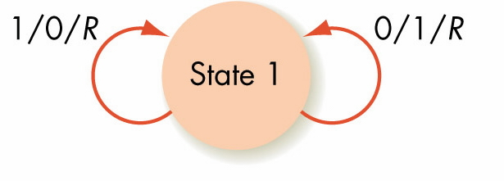
Bit Inverter Machine (State Diagram)
Figure 11.4
TM Program:
(S1,0,1,S1,R) // change 0 to 1
(S1,1,0,S1,R) // change 1 to 0

Slide 11
Bit Inverter Machine (State Diagram)
Figure 11.4
State 2
$ / $ / L
TM Program:
(S1,0,1,S1,R) // change 0 to 1
(S1,1,0,S1,R) // change 1 to 0
(S1,$,$,S2,L) // end-state (2)

Slide 12
TM (Bit Inverter program)
…
b
0
0
1
0
1
$
b
…
Input = 00101$
TM Program:
(S1,0,1,S1,R) ←
(S1,1,0,S1,R)
S1

Slide 13
TM (Bit Inverter program) - 2
…
b
1
0
1
0
1
$
b
…
TM Program:
(S1,0,1,S1,R) ←
(S1,1,0,S1,R)
S1

Slide 14
TM (Bit Inverter program) - 3
…
b
1
1
1
0
1
$
b
…
TM Program:
(S1,0,1,S1,R)
(S1,1,0,S1,R) ←
S1

Slide 15
TM (Bit Inverter program) - 4
…
b
1
1
0
0
1
$
b
…
TM Program:
(S1,0,1,S1,R) ←
(S1,1,0,S1,R)
S1

Slide 16
TM (Bit Inverter program) - 5
…
b
1
1
0
1
1
$
b
…
TM Program:
(S1,0,1,S1,R)
(S1,1,0,S1,R) ←
S1

Slide 17
TM (Bit Inverter program) - 6
…
b
1
1
0
1
0
$
b
…
TM Program:
(S1,0,1,S1,R)
(S1,1,0,S1,R)
(S1,$,$,S2,L) ←
S1

Slide 18
TM (Bit Inverter program) - 7
…
b
1
1
0
1
0
$
b
…
TM Program:
(S1,0,1,S1,R)
(S1,1,0,S1,R)
(S1,$,$,S2,L)
S2
No more Moves!!

Slide 19
Odd Parity Bit
Problem: Parity Bit
  an extra bit appended to end of string
  to ensure the “expanded” string has an odd number of 1’s
  Used for detection of error (eg: transmission)
Examples:
  00101 → 001011
  10110 → 101100

Slide 20
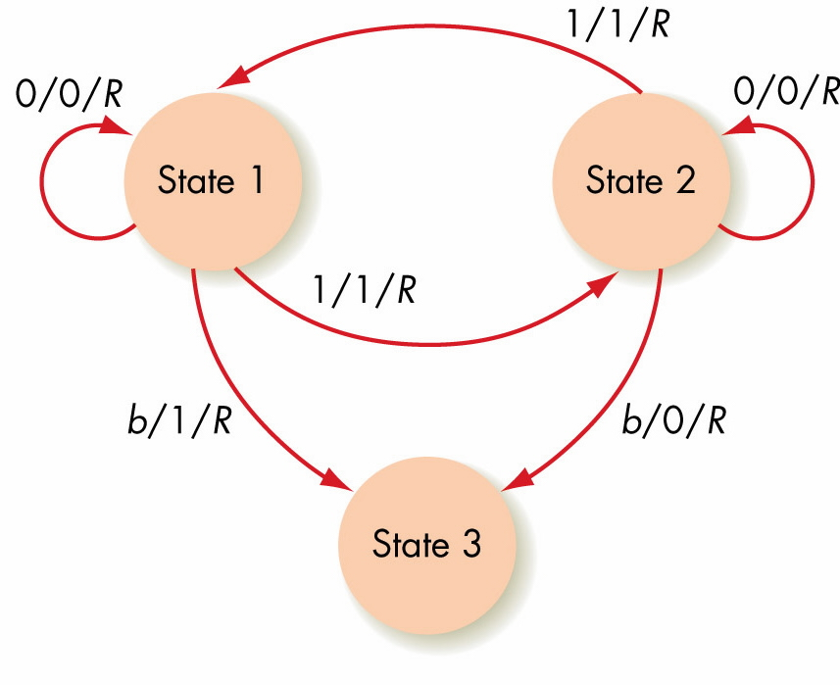
Odd Parity Bit Machine (State Diagram)
TM Program:
1.(S1,0,0,S1,R)
2.(S1,1,1,S2,R)
3.(S2,0,0,S2,R)
4.(S2,1,1,S1,R)
5.(S1,b,1,S3,R)
6.(S2,b,0,S3,R)
Figure 11.5

Slide 21
Another Problem (in diff. notations)
Suppose initially on the tape we have
$11111 B 111111111 BBBBBBBBBB…….
We want the TM to
  convert first set of 1s to 0’s and
  convert second set of 1’s to 2’s and
  then return to the initial left most cell ($).
Note:
Alphabet = {0,1,2,B,$} and Initially at leftmost cell

Slide 22
Example (Algorithm)
$11111 B 111111111 BBBBBBBBBB
Step 1: Initially it reads $,
  and moves the head right, and goes to Step 2.
Step 2: If the symbol being read is 1,
then write a 0, move the head right, and Repeat Step 2.
If the symbol being read is B,
then move right, and go to Step 3.
Step 3: If the symbol begin read is 1,
then write a 2, move the head right, and repeat Step 3.
If the symbol being read is B, then go to Step 4.
Step 4: If the symbol being read is 0, 1, 2 or B, then move left.
If the symbol being read is $, then stop.

Slide 23
Example (TM Program)
Alphabet = {$,0,1,2,B}
States = {Q1, Q2, Q3, Q4}
Q1 is the starting state
Transition Table:
HW: Translate this transition
table into a TM program
using notations of [SG]
TM State | Symbol Read
 | $ | B | 0 | 1 | 2
Q1 | $,R,Q2
Q2 |  | B,R,Q3 |  | 0,R,Q2
Q3 |  | B,L,Q4 |  | 2,R,Q3
Q4 | STOP | B,L,Q4 | 0,L,Q4 | 1,L,Q4 | 2,L,Q4

Slide 24
Church-Turing Thesis
If there exists an algorithm to do a symbol manipulation task, then there exists a Turing machine to do that task.
NOT a Theorem, but a thesis.
  A statement that has to be supported by evidence.
Issue: Definition of computing device not clear.
Mathematically:
  There is a (Partial) Functions which take strings to strings

Slide 25
Church-Turing Thesis (cont)
Two parts to writing a Turing machine for a symbol manipulation task
  Encoding symbolic information as strings of 0s and 1s (eg: numbers, sound, pictures, etc)
  Writing the Turing machine instructions to produce the encoded form of the output

Slide 26
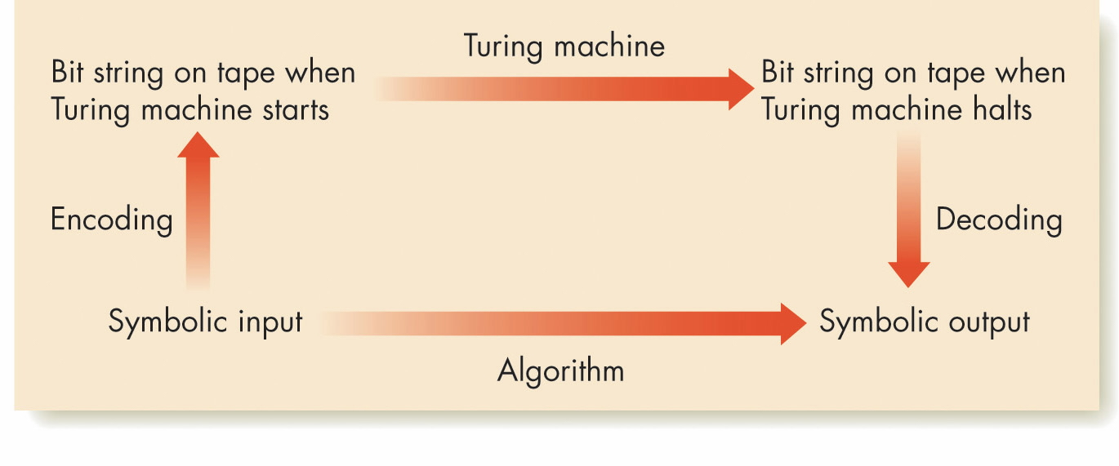
Figure 11.9
Emulating an Algorithm by a Turing Machine

Slide 27
Limits of Computabiltiy:
Based on Church-Turing thesis,
TM defines limits of computability
  TM = ultimate model of computing agent
  TM program = ultimate model of algorithm
Are all problems solvable using a TM?
  Uncomputable or unsolvable problems
    problem for which we can prove that
    no TM exists that will solve it.

Slide 28
Computability
Q: Can we solve every problem?
In Mathematics:
Godel’s Theorem: Not every true theorem about natural numbers can be proven.
In Computer Science:
Not every problem can be solved.
Example: Halting Problem

Slide 29
Computability: The Halting Problem
Halting Problem: Given any program P, and any input x:
Does program P stop when run on input x?
Result: Halting Problem is not computable.
Namely, there is no algorithm SOLVE(P,x) such that for all P and x, we can answer
P
SOLVE
Yes / No
x

Slide 30
Informal Proof (by contradiction)
Rough Overview of the Proof:
  First, assume there is such a program Solve(P,x)
  Then, “thru a sequence of logical steps” prove that we obtain a contradiction.
This implies that
the original assumption must be false;
(i.e., Solve(P,x) does not exist)
P
SOLVE
Yes / No
x

Slide 31
First, Assume program Solve(P,x) exist
SuperSolve(P,x);
begin
  1. If SOLVE(P,x) outputs NO
  2. then stop
  3. else goto step 5
  4. endif
  5. goto step 5. // infinite loop!!
End
Fact 1: Suppose “P running on x” does not halt;
  Then in Step 1 Solve(P,x) outputs NO,
  then in Step 2, SuperSolve(P,x) halts;
Fact 2: Suppose “P running on x” halts;
  Then in Step 1, Solve(P,x) outputs YES,
  then in Step 3,5 SuperSolve(P,x) runs into infinite loop (does not halt);

Slide 32
Now, to derive the contradiction….
  Fact 1: If “P running on x” does not halt;
  Then in Step 1, Solve(P,x) outputs NO,
    then in Step 2, SuperSolve(P,x) halts;
  Fact 2: If “P running on x” halts
  Then in Step 1, Solve(P,x) outputs YES,
  then in Step 3,5 SuperSolve(P,x) runs
  into infinite loop (Step 5) (does not halt);
Fact 1 and Fact 2 are true for all programs P and all x;
So, what if we set P = SuperSolve?
Then Fact 1 and Fact 2 becomes…

Slide 33
Now, to derive the contradiction….
  Fact 1: If “SuperSolve running on x” does not halt;
  Then in Step 1, Solve(SuperSolve,x) outputs NO,
    then in Step 2, SuperSolve(SuperSolve,x) halts;
  Fact 2: If “SuperSolve running on x” halts
  Then in Step 1, Solve(SuperSolve,x) outputs YES,
  then in Step 3,5 SuperSolve(SuperSolve,x) runs
  into infinite loop (Step 5) (does not halt);
Fact 1 and Fact 2 are true for all programs P and all x;
So, what if we set P = SuperSolve?
Then Fact 1 and Fact 2 becomes…
CONTRADICTION in both case!!

Slide 34
The Halting Problem: Some Remarks
The general Halting Problem is unsolvable;
But, it does not mean apply to a specific program
Example: Consider this program. Does it halt?
1. k ← 1;
2. while (k >0) do
3. print (“I love UIT2201, thank you.”);
4. endwhile;
5. print (“Everyone in UIT2201 goes to Paris”);

Slide 35
Unsolvable Problems (continued)
There are many other unsolvable problems
  No program can be written to decide whether any given program always stops eventually, no matter what the input
  No program can be written to decide whether any two programs are equivalent (will produce the same output for all inputs)
  No program can be written to decide whether any given program run on any given input will ever produce some specified output

Slide 36
Computational Complexity of
Solvable Problems
Now, turn attention to solvable problems…
Suppose problem can be solved by the computer.
  Question: How much time does it take?
Problem: Searching for a Number x
Algorithms: Linear Search Θ(n), Binary Search Θ(lg n)
Order of Growth: (and the Θ-notation)
  Complexity “order” is more important than constant factors
  eg: 1000 lg n vs 0.5 n (this is just Θ(lg n) vs Θ(n) )
  eg: 1000n vs 0.001n² (or Θ(n) vs Θ(n²) )

Slide 37
Complexity: Number of Operations

Slide 38
Execution time
Assuming a fast computer (1GigaHz)
  (1 billion operations per second)

Slide 39
Fast and Slow Algorithms
Some Algorithms are fast
  Binary search -- Θ (lg n) time
  Finding maximum, minimum, counting, summing -- Θ(n) time
  Selection sort – Θ(n²) time
  Multiply two nxn matrix – Θ(n³) time
Some algorithms are Slow
  Printing all subsets of n-numbers (Θ(2^{n}))
  It may not be of much practical use
So, What is feasible?

Slide 40
Time Complexity of Algorithms
Algorithm is efficient if its time complexity a polynomial function of the input size
  Example: O(n), O(n²), O(n³), O (lg n), O(n lg n), O(n⁵)
Algorithm is inefficient if its time complexity is an exponential function of the input size
  Example: O(2^{n}), O(n 2^{n}), O(3^{n})
  These algorithms are infeasible for big n.

Slide 41
Complexity of Problems
Given a problem,
can we find an efficient algorithm for it?
Yes for some problems:
  Finding the maximum,
  Finding the sum,
  Sorting n numbers,
  computing the Hamming distance
P : Class of problems that can be solved in polynomial time. (Also called easy problems)

Slide 42
Remarks:
The class P is invariant
  under different types of machines
  Turing machines, Pentium5, the world’s fastest supercomputer
  Namely, if you can solve a problem B in polynomial time on a TM, then, then you can also solve B in polynomial time on supercomputer (and vice-versa)

Slide 43
Exponential Complexity Problems or Hard Problems
Some problems are inherently exponential time.
  List all possible n-bit binary numbers;
  List at 2^{n} subsets of n objects;
  List all the n! permutations of {1,2,…,n}
These are “hard problems” that require exponential time to solve.

Slide 44
The Complexity class NP
Given a problem, instead of finding a solution, can verify a solution to the problem quickly?
Is it easier to verify a solution (as opposed to finding a solution)
NP – the class of problems that can be verified in polynomial time

Slide 45
Traveling Salesman Problem
Want to visit some cities:
  New York, London, Tokyo, … and come back to Spore.
  Each city visited exactly once
  (except first and last city is both Spore)
Given: Cost of travel between each pair of cities
Aim: To minimize the cost.
Aim2: Find tour of cost less than X.

Slide 46
Traveling Salesman Problem
TSP: Apparently difficult to solve.
  No polynomial time algorithm known.
However, if you are given a test tour,
  you can verify if the cost is less than X
  Can verify solution in polynomial time!!
Summary of TSP:
  Easy to verify answers.
  Difficult to find answers.
Reminder:
  Easy ---> polynomial time
  Difficult --> not polynomial time.

Slide 47
Sample Problems in NP
There are many problem in NP
  (easy to verify, apparently hard to find solution)
Examples:
  TSP: Travelling Salesman Tour
  BinPack: packing small items into standard sized bins
“Hardest” Problems in NP,
  Many natural problems such as TSP are in NP,
  but not known to be in P.
Much of cryptography is based on these “hard” problems.

Slide 48
Summary
Models are an important way of studying physical and social phenomena
Church-Turing thesis: If there exists an algorithm to do a symbol manipulation task, then there exists a Turing machine to do that task
The Turing machine can be accepted as an ultimate model of a computing agent

Slide 49
Summary (continued)
A Turing machine program can be accepted as an ultimate model of an algorithm
Turing machines define the limits of computability
An uncomputable or unsolvable problem: We can prove that no Turing machine exists to solve the problem

Slide 50
The End…

