Slide 1
Contextual Crowd Intelligence
Beng Chin Ooi
National University of Singapore
www.comp.nus.edu.sg/~ooibc

Slide 2
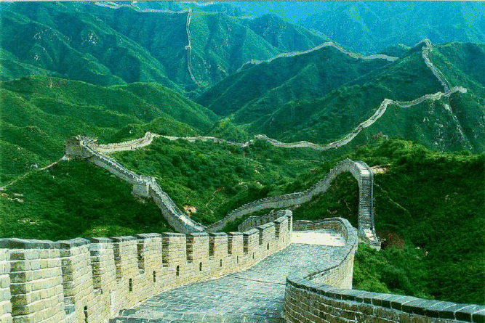
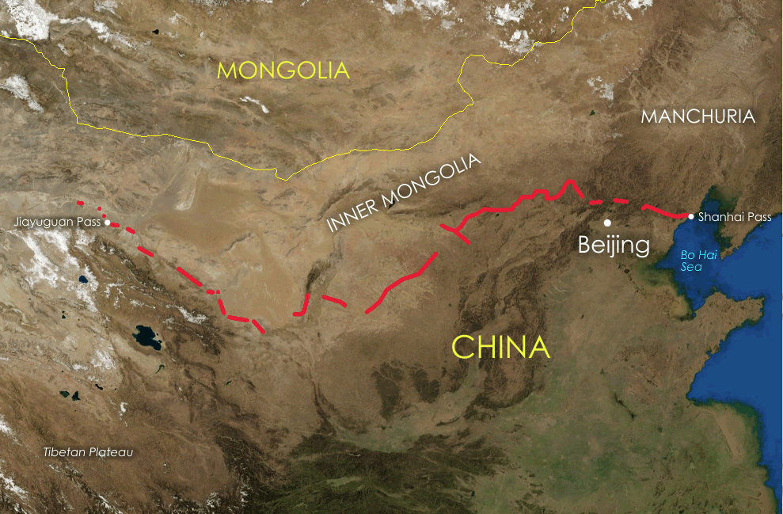
Crowd Intelligence
Use of crowd in contributing “useful” contents
Further use of these contents to infer, ascertain and enhance
Use of crowd in doing what machines cannot do well -- Crowdsourcing
Entity Resolution
Are “IBM” and “Big Blue” the same company?
Classification
What make is the car in the image?
Subjective Sorting
Which pictures better visualize “the Great Wall”?
Others: Translation, Tagging, etc.
Simple and domain dependent
Privacy is a major obstacle
Can we exploit the human intelligence a bit more?

Slide 3
“Embedding” Crowdsourcing in DBMS
Most applications are industry/domain specific -- users are the experts
Exceptional cases that are important but may be too hard to formalize and rules/patterns may be evolving over times
Knowledge management at work
Making humans who are subject matter experts as part of the feedback loop to continuously enhance the database processing → a hybrid human-machine DB processing
Notes:
Most applications are industry or domain specific, and vendors have been selling systems built based on “best practices”. However, it is also always the case that one size does not fit all.
There are exceptional cases that are not easy to capture or formalize, and rules and patterns may evolve over time. These rules provide some forms of weak classifiers.
Most companies/organizations also want to capture as much knowledge as possible, so that processes can be improved etc.
What we hope to do is to make human…

Slide 4
Example: Healthcare Predictive Analytics
ID | Disease (f1) | Lab (f2) | Medication (f3) | Temperature (f4) | ….. | Risk level
Patient 1 | Diabetes | v12 | v13 | v14 | … | ?
Patient 2 | Diabetes | v22 | v23 | v24 | … | ?
Patient 3 | Hypertension | v32 | v33 | v34 | … | ?
…
Medical Care Table
Questions often asked by healthcare professionals:
Who have “high risk”?
How many have contacted the medical team?
What are the outcomes? Recurrence, deterioration, reasons etc.
To predict, pre-empt, prevent for better healthcare outcome!
Notes:
Healthcare is a popular area for big data analytics. Suppose we manage to integrate the data from multiple sources, it is not straightforward to label patients based on their health, reactions to treatments or illnesses.

Slide 5
Possible Approach
Build a rule-based system to assess the risks
Difficulty: Missing the class labels of the training samples
Approach: Leverage the crowd to derive the class labels for the training samples
Doctors are HIT workers for filling the missing labels and testing the system
The quality of workers is expected to be high
Towards hybrid human-machine processing

Slide 6
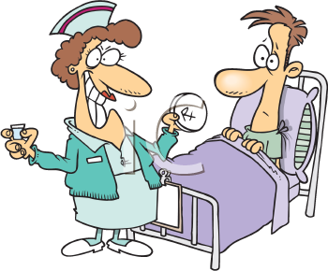
Humans As Part of the Evolving Process
Phase 1: Build the classifier
Historical data of patients
1.2
1.1
1.3
Classifier
Rules
Real-time data/feed
3.2
2.2
2.3
2.1
Predictor
Can we really include domain experts (eg. users / employees) and contextual intelligence in enhancing the “intelligence” and hence “usability” of DBMS?
3.1
Phase 2: Predict the severity
Phase 3: Adjust the classifier
Notes:
Let us take a look on how human can be part of an evolving process to answer many useful predictive questions.
Here is an example in the healthcare predictive analytics.
As we know, every hospital has the historical data of patients (one simple example is shown in the previous slide), on which existing tools (eg., classifiers) can perform to answer many predictive questions (e.g., risk assessment). We believe that by keeping the experts (i.e., doctors, healthcare providers) in the loop (1.2), the system can significantly increase the accuracy of the predictor. For instance, the doctors will assess patient profiles that the system does not predict well or provide some “heuristic” rules that they have in mind. The machine would exploit these “intelligent knowledge" to build a high-accuracy classifier. This process is shown in Phase 1 in the figure.
Next, when new information or live feed about patients (e.g., new lab test result) arrives, the system can perform the prediction based on the set of rules (built in the first step) and inform the doctors immediately (Phase 2). This can really save life in many situations, since doctors can intervene sooner.
Lastly, based on the feedback from the doctors, the system can adjust the classifier to improve its accuracy (Phase 3).
All in all, the system evolves over time. With the assistance of doctors’ intelligence, we can eventually arrive at a very high accurate predictor.
Can we include domain experts (eg. users / employees) and contextual intelligence in enhancing the “intelligence” and hence “usability” of DBMS?
We believe that it is possible.

Slide 7
Possible Impacts
Reduce “localization/customization”
Improve accuracy on Analytics
Expert users decide on “best practices”
→More effective decision making

