Slide 1
Placing Conditional Disclosure of Secrets in the Communication Complexity Universe
Benny Applebaum Prashant Nalini Vasudevan
Notes:
Give some context for information theoretic cryptography.

Slide 2




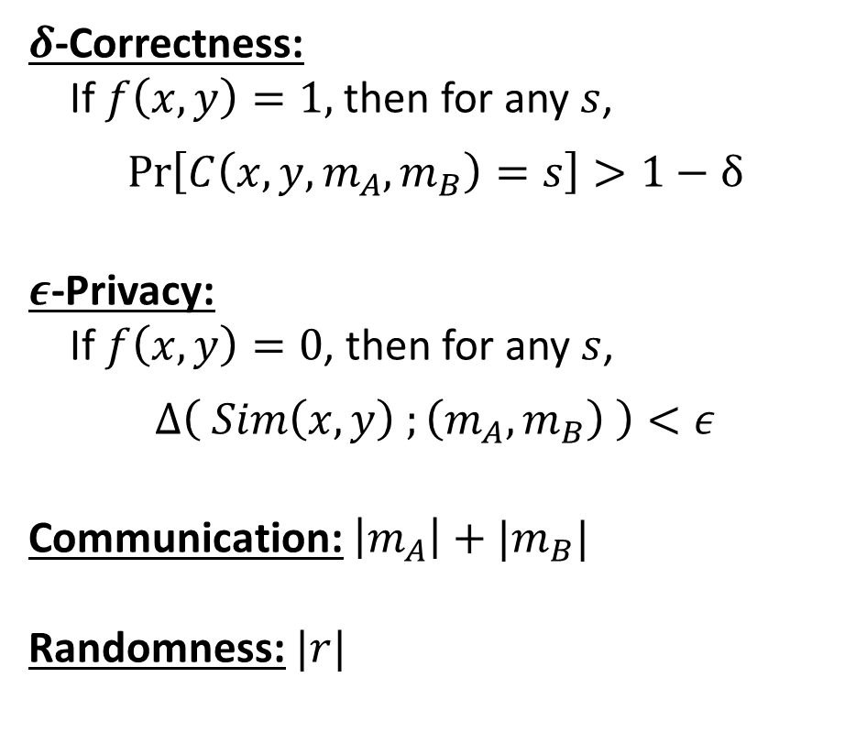




Conditional Disclosure of Secrets [GIKM00]
$$f:{\left\{0,1\right\}}^{n}×{\left\{0,1\right\}}^{n}→\{0,1\}$$
$δ$-Correctness:
If $f\left(x,y\right)=1,$ then for any $s$,
$$\operatorname{Pr}\left[C\left(x,y,m_{A},m_{B}\right)=s\right]>1−δ$$
$ε$-Privacy:
If $f\left(x,y\right)=0$, then for any $s$,
$$Δ\left( Sim\left(x,y\right) ;\left(m_{A},m_{B}\right) \right)<ε$$
Communication: $\left|m_{A}\right|+|m_{B}|$
Randomness: $|r|$
Secret $s$
$$x$$
A
B
$$y$$
Randomness $r$
$$m_{A}$$
$$m_{B}$$
C
$$x, y$$
Notes:
Say delta and epsilon small constant like 0.1 if left unspecified. s is single bit unless specified.

Slide 3
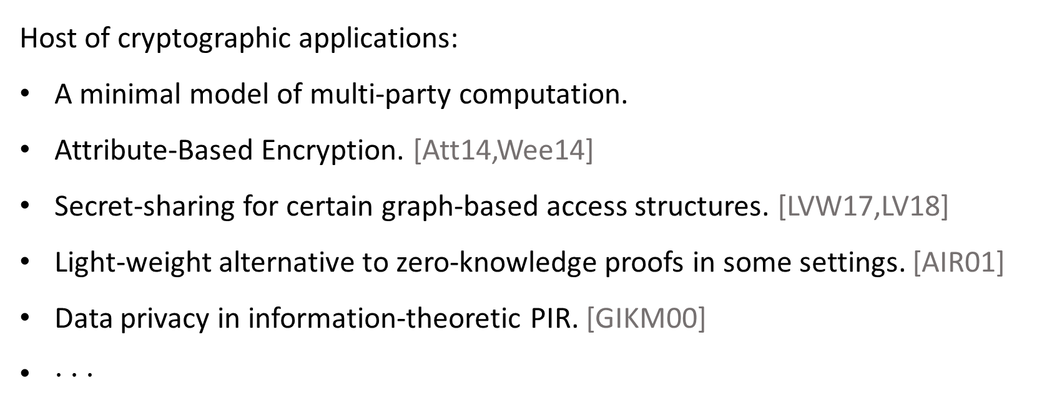
Connections and Applications
Host of cryptographic applications:
A minimal model of multi-party computation.
Attribute-Based Encryption. [Att14,Wee14]
Secret-sharing for certain graph-based access structures. [LVW17,LV18]
Light-weight alternative to zero-knowledge proofs in some settings. [AIR01]
Data privacy in information-theoretic PIR. [GIKM00]
$⋅ ⋅ ⋅$

Slide 4
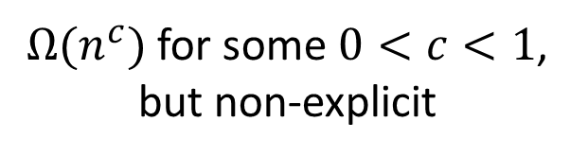
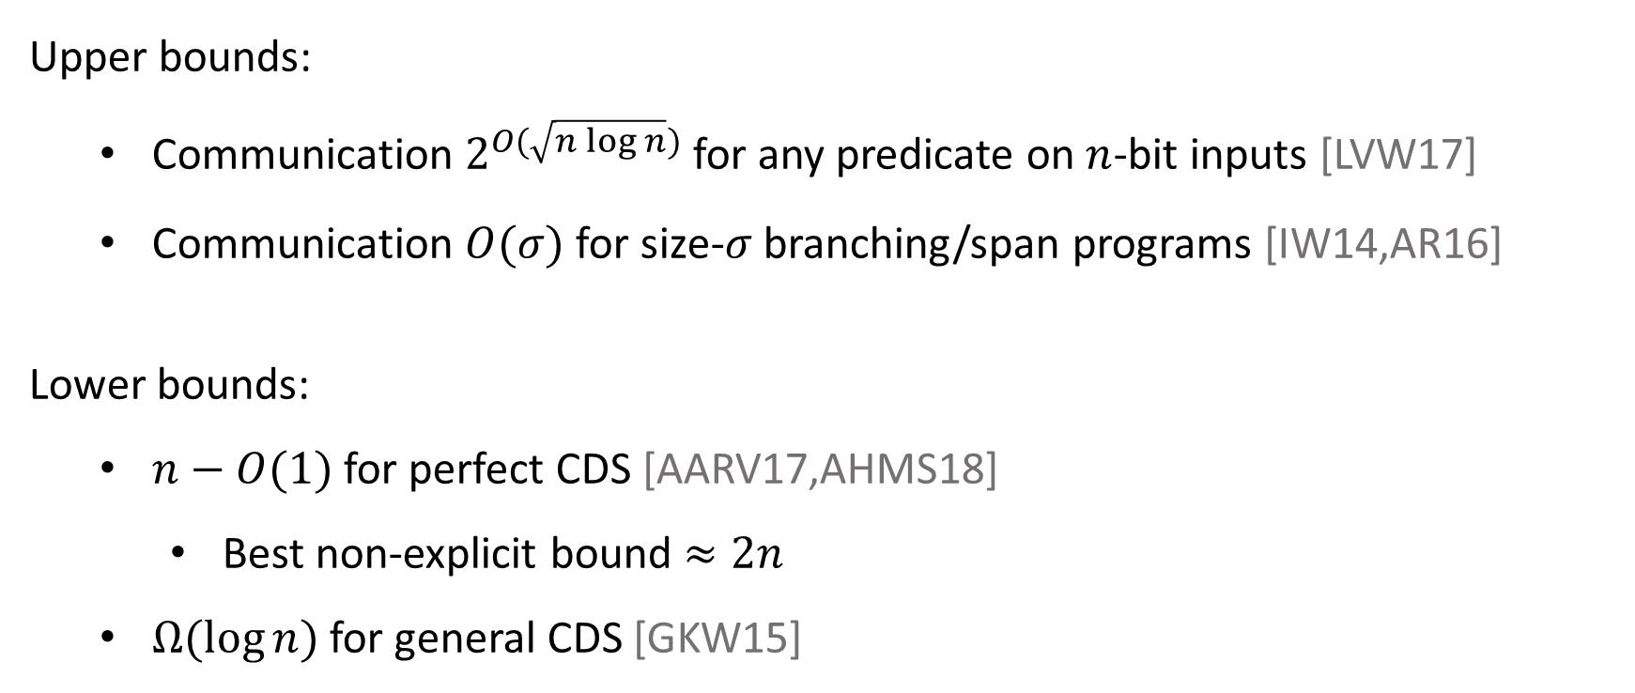
The Story So Far
Upper bounds:
  Communication $2^{O(\sqrt{n\log{n}})}$ for any predicate on $n$-bit inputs [LVW17]
  Communication $O(σ)$ for size-$σ$ branching/span programs [IW14,AR16]
Lower bounds:
  $n−O(1)$ for perfect CDS [AARV17,AHMS18]
    Best non-explicit bound $≈2n$
  $Ω(\log{n) }$for general CDS [GKW15]
Extend to more predicates
$Ω(n^{c})$ for some $0<c<1$, but non-explicit

Slide 5
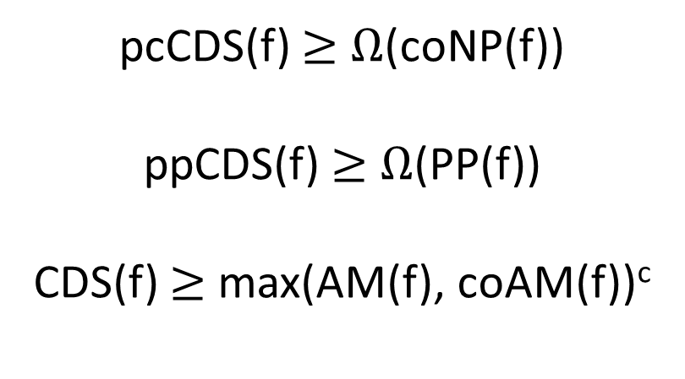
This Work
Lower-bounds on perfect and imperfect CDS
in terms of communication complexity measures
pcCDS(f) $≥$ $Ω$(coNP(f))
ppCDS(f) $≥$ $Ω$(PP(f))
CDS(f) $≥$ max(AM(f), coAM(f))^{c}
Notes:
Say that these imply most known lower bounds (for partially perfect CDS) and gave new bounds for several predicates.

Slide 6








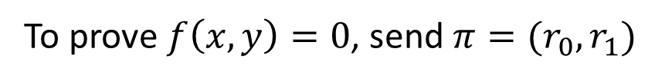





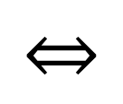
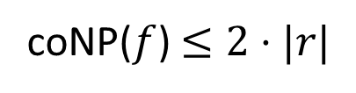


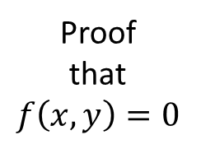
Perfectly Correct CDS $≥$ coNP
$$f:{\left\{0,1\right\}}^{n}×{\left\{0,1\right\}}^{n}→\{0,1\}$$
$$s$$
$$x$$
A
B
$$y$$
A
B
$$r$$
$$x$$
$$y$$
Proof
that
$$f\left(x,y\right)=0$$
$$m_{A}$$
$$m_{B}$$
$$π$$
$$π$$
C
C
$$x, y$$
$$x, y$$
$$f\left(x,y\right)=1$$
$$⇔$$
$∄r_{0},r_{1}$ that lead to same $(m_{A},m_{B})$ for $s=0$ and $s=1$
To prove $f\left(x,y\right)=0$, send $π=(r_{0},r_{1})$
coNP($f$) $≤2⋅|r|$

Slide 7

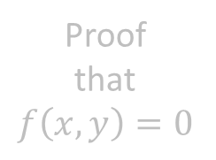

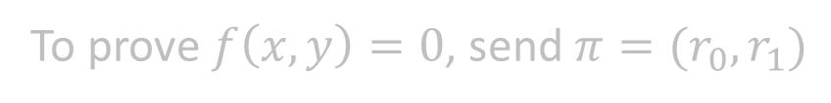



Perfectly Correct CDS $≥$ coNP
$$f:{\left\{0,1\right\}}^{n}×{\left\{0,1\right\}}^{n}→\{0,1\}$$
$$s$$
$$x$$
A
B
$$y$$
Lemma:
Randomness in CDS can be “sparsified” by sub-sampling. That is,
$\left|r\right|≤\left|m_{A}\right|+\left|m_{B}\right|+O(log\left(n\right))$
$$r$$
Proof
that
$$f\left(x,y\right)=0$$
$$m_{A}$$
$$m_{B}$$
C
$$x, y$$
Proof sketch:
Pick a set $R$ of $r$’s that preserve distributions of $(m_{A},m_{B})$.
Such $R$ exists of size roughly $2^{\left|m_{A}\right|+\left|m_{B}\right|}$.
Use $log⁡(\left|R\right|)$ random bits to index into this set.
$$f\left(x,y\right)=1$$
$$⇔$$
$∄r_{0},r_{1}$ that lead to same $(m_{A},m_{B})$ for $s=0$ and $s=1$
To prove $f\left(x,y\right)=0$, send $π=(r_{0},r_{1})$
Similar to Newman’s theorem.
coNP($f$) $≤2⋅|r|$

Slide 8
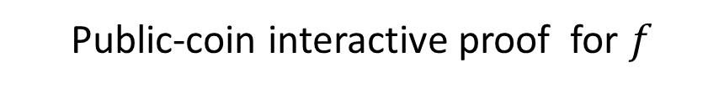

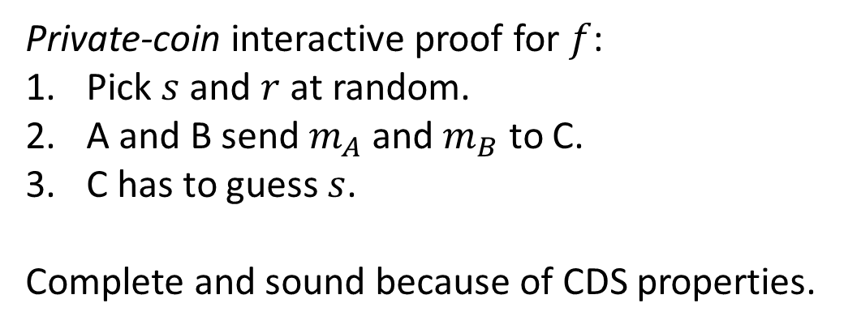

Imperfect CDS $≥$ AM
Public-coin interactive proof for $f$
$$s$$
$$x$$
A
B
$$y$$
A
B
$$r$$
$$x$$
$$y$$
$$r$$
$$m_{A}$$
$$m_{B}$$
$$π$$
$$π$$
C
C
$$x, y$$
$$x, y$$
Private-coin interactive proof for $f$:
Pick $s$ and $r$ at random.
A and B send $m_{A}$ and $m_{B}$ to C.
C has to guess $s$.
Complete and sound because of CDS properties.
Made public-coin using standard techniques. [Bab85,GS89]

Slide 9
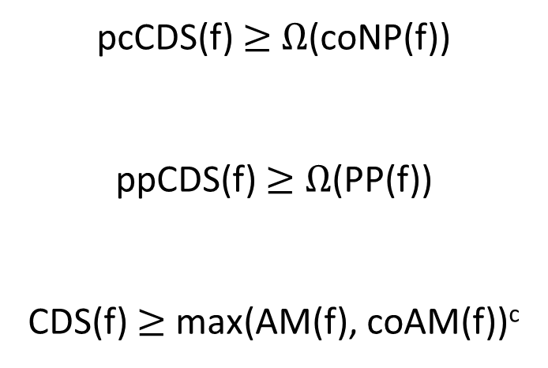
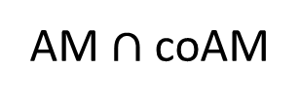
Our Lower Bounds
coAM
AM$∩$ coAM
PP
pcCDS(f) $≥$ $Ω$(coNP(f))
ppCDS(f) $≥$ $Ω$(PP(f))
CDS(f) $≥$ max(AM(f), coAM(f))^{c}
coNP
General
CDS
Perfectly Correct
CDS
Perfectly Private
CDS
Perfect
CDS

Slide 10
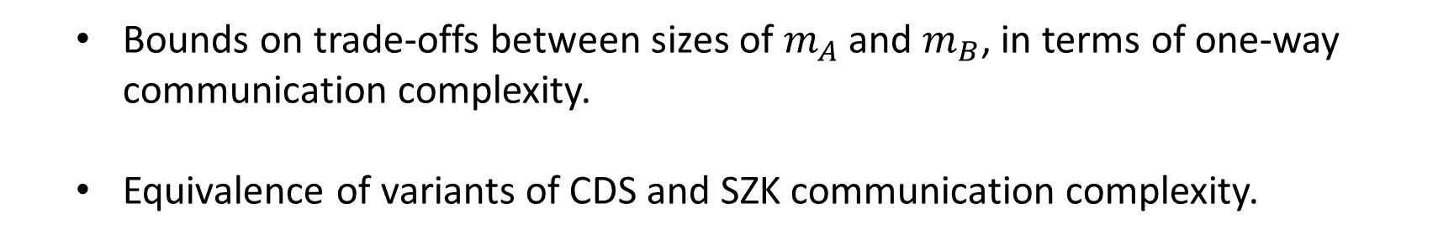
Other Results
  Bounds on trade-offs between sizes of $m_{A}$ and $m_{B}$, in terms of one-way communication complexity.
  Equivalence of variants of CDS and SZK communication complexity.

Slide 11
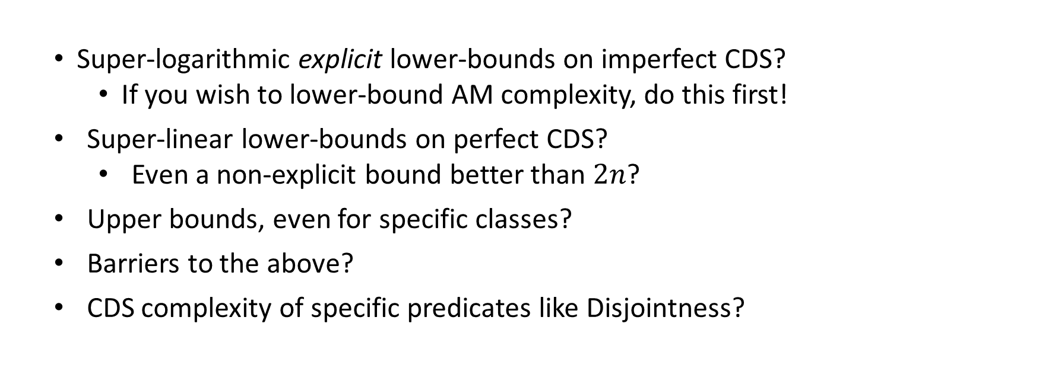
Summary
  We related complexity of CDS to various communication measures.
    Imply better non-explicit lower bounds and tight bounds for several predicates.
  Super-logarithmic explicit lower-bounds on imperfect CDS?
    If you wish to lower-bound AM complexity, do this first!
  Super-linear lower-bounds on perfect CDS?
    Even a non-explicit bound better than $2n$?
  Upper bounds, even for specific classes?
  Barriers to the above?
  CDS complexity of specific predicates like Disjointness?

Slide 12
To be passed upon request

Slide 13



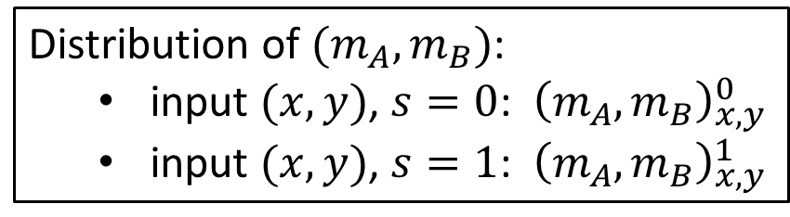


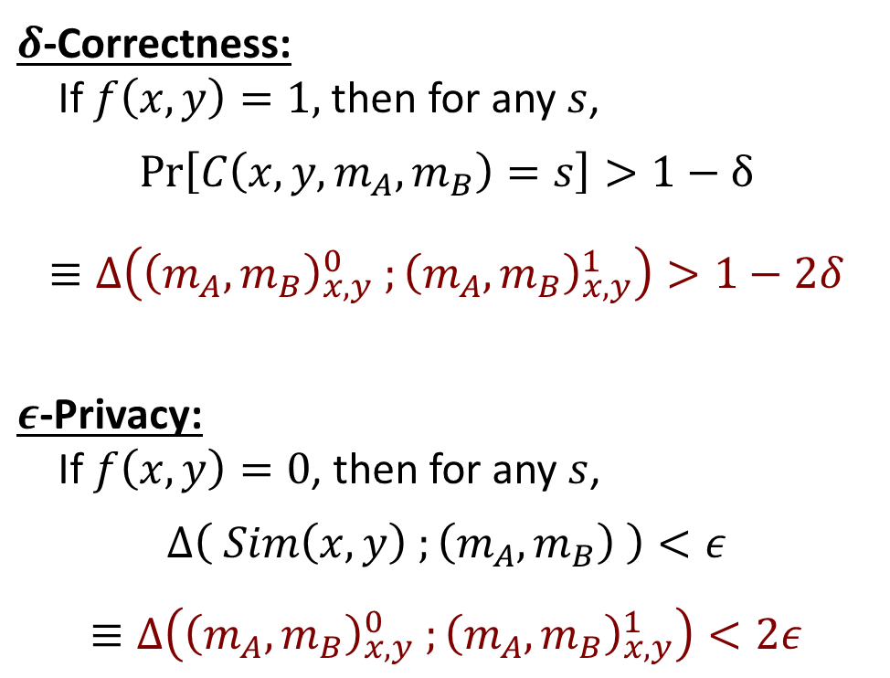


CDS and Statistical Difference
Randomness $r$
$δ$-Correctness:
If $f\left(x,y\right)=1,$ then for any $s$,
$$\operatorname{Pr}\left[C\left(x,y,m_{A},m_{B}\right)=s\right]>1−δ$$
$$≡Δ\left({\left(m_{A},m_{B}\right)}_{x,y}^{0} ;{\left(m_{A},m_{B}\right)}_{x,y}^{1}\right)>1−2δ$$
$ε$-Privacy:
If $f\left(x,y\right)=0$, then for any $s$,
$$Δ\left( Sim\left(x,y\right) ;\left(m_{A},m_{B}\right) \right)<ε$$
$≡Δ\left({\left(m_{A},m_{B}\right)}_{x,y}^{0} ;{\left(m_{A},m_{B}\right)}_{x,y}^{1}\right)<2ε$
$$x$$
A
B
$$y$$
Secret $s$
$$m_{A}$$
$$m_{B}$$
C
$$x, y$$
Distribution of $(m_{A},m_{B})$:
  input $(x,y)$, $s=0$: ${\left(m_{A},m_{B}\right)}_{x,y}^{0}$
  input $(x,y)$, $s=1$: ${\left(m_{A},m_{B}\right)}_{x,y}^{1}$

Slide 14
Notes
Is SZK in PSPACE?
Do known circuit lower bound barriers for AM extend to CDS?
Why is SZK not in AM-coAM?
How to introduce coNP and all for broad audience?
Why was CDS first introduced?
Be clear about where randomness is public and private.
Is any super-constant bound known for AM at all? If not, bounds on CDS are better!
Get an example of predicate that separates perfect CDS from imperfect CDS.
  Non-equality
  For greater than and non-equality, we had no lower bounds even for perfect CDS
  We had no lower-bound technique that tolerated privacy error

