Slide 1
Conditional Disclosure of Secrets: Lower Bounds and Perspectives
Prashant Nalini Vasudevan
Based on work with Benny Applebaum, Barak Arkis, and Pavel Raykov

Slide 2




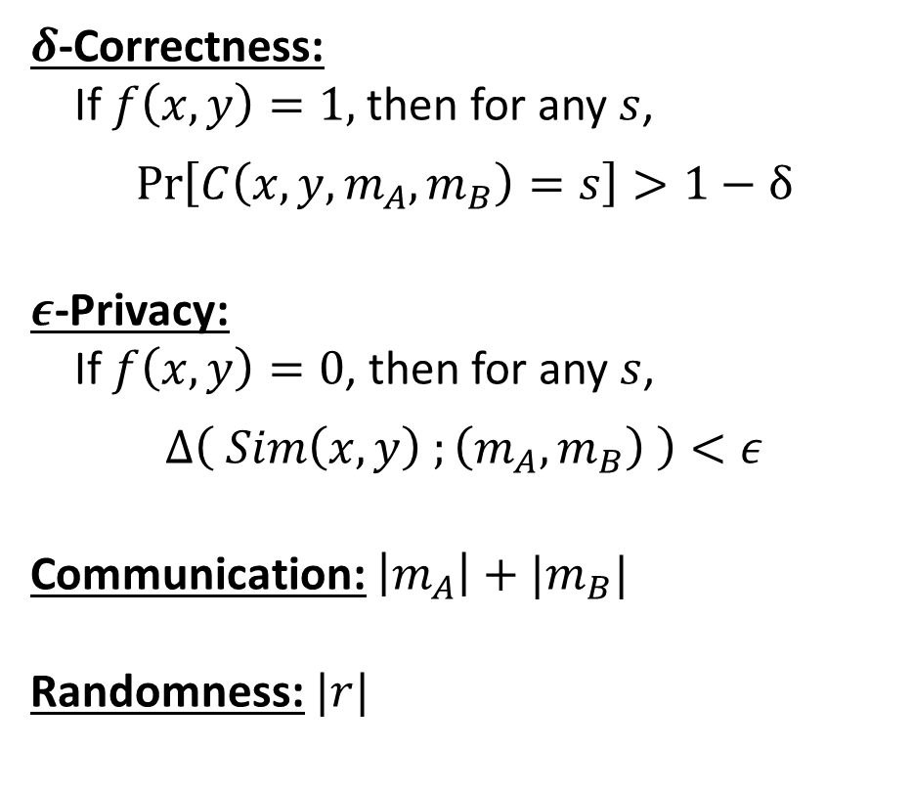




Conditional Disclosure of Secrets [GIKM00]
$$f:{\left\{0,1\right\}}^{n}×{\left\{0,1\right\}}^{n}→\{0,1\}$$
$δ$-Correctness:
If $f\left(x,y\right)=1,$ then for any $s$,
$$\operatorname{Pr}\left[C\left(x,y,m_{A},m_{B}\right)=s\right]>1−δ$$
$ε$-Privacy:
If $f\left(x,y\right)=0$, then for any $s$,
$$Δ\left( Sim\left(x,y\right) ;\left(m_{A},m_{B}\right) \right)<ε$$
Communication: $\left|m_{A}\right|+|m_{B}|$
Randomness: $|r|$
Secret $s$
$$x$$
A
B
$$y$$
Randomness $r$
$$m_{A}$$
$$m_{B}$$
C
$$x, y$$
Notes:
Say delta and epsilon small constant like 0.1 if left unspecified. s is single bit unless specified.

Slide 3
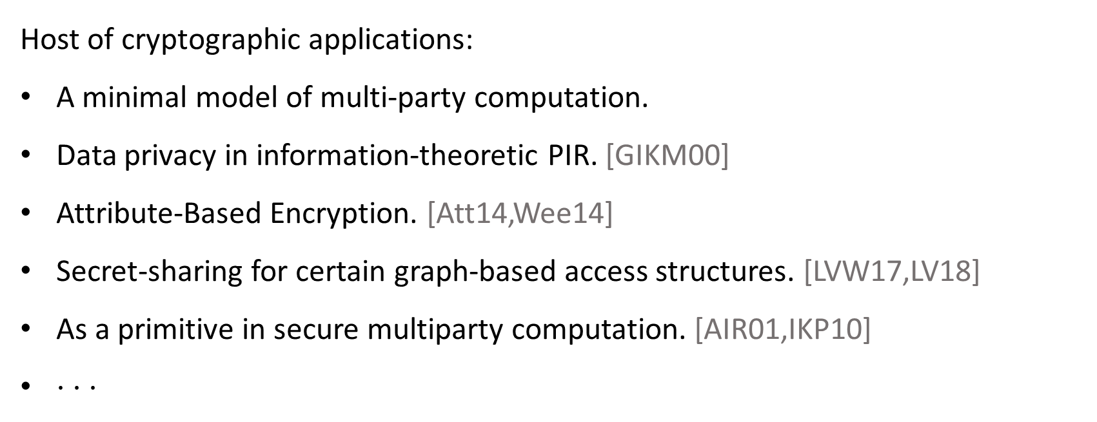
Connections and Applications
Host of cryptographic applications:
A minimal model of multi-party computation.
Data privacy in information-theoretic PIR. [GIKM00]
Attribute-Based Encryption. [Att14,Wee14]
Secret-sharing for certain graph-based access structures. [LVW17,LV18]
As a primitive in secure multiparty computation. [AIR01,IKP10]
$⋅ ⋅ ⋅$

Slide 4
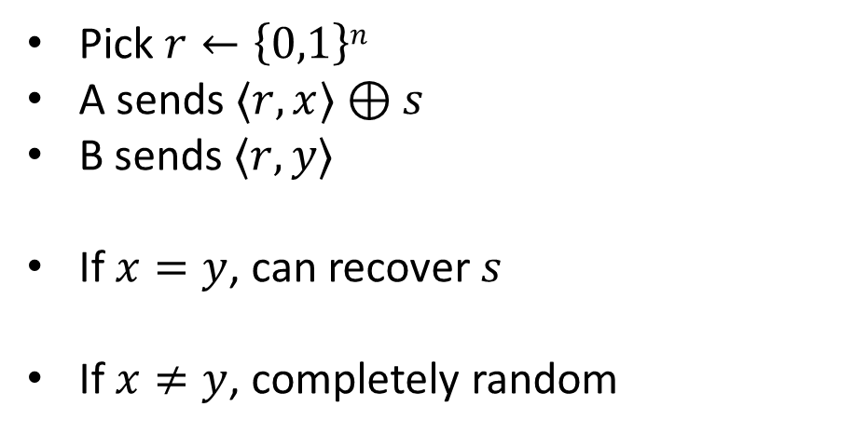
Example: Equality
Secret $s$
$$x$$
A
B
$$y$$
Pick $r←\left\{0,1\right\}n$
A sends $〈r,x〉⊕s$
B sends $〈r,y〉$
If $x=y$, can recover $s$
If $x≠y$, completely random
Randomness $r$
$$m_{A}$$
$$m_{B}$$
C
$$x, y$$

Slide 5
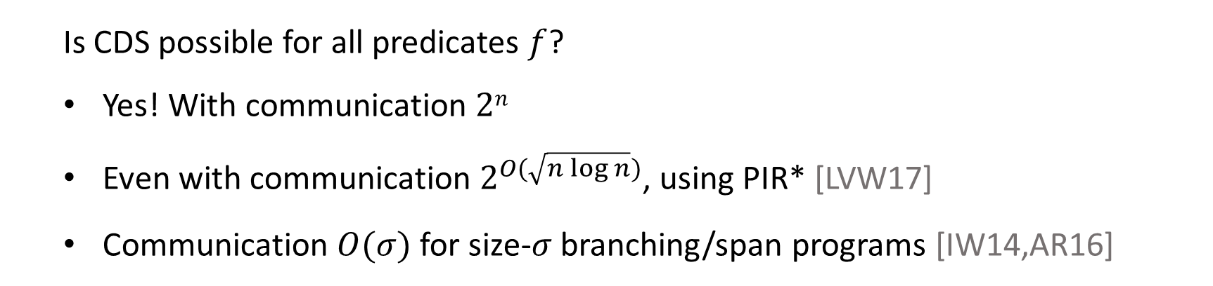
Upper Bounds
  Is CDS possible for all predicates $f$?
  Yes! With communication $2n$
  Even with communication $2^{O(\sqrt{n\log{n}})}$, using PIR* [LVW17]
  Communication $O(σ)$ for size-$σ$ branching/span programs [IW14,AR16]

Slide 6
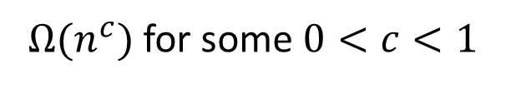
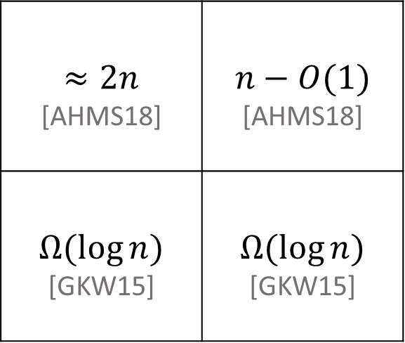
Lower Bounds
Non-Explicit
Explicit
$$≈2n$$ [AHMS18] | $$n−O(1)$$ [AHMS18]
$$Ω(\log{n)}$$ [GKW15] | $$Ω(\log{n)}$$ [GKW15]
Extend to more predicates
Perfect CDS
General CDS
Still almost exponentially
smaller than known
upper bounds
$Ω(n^{c})$ for some $0<c<1$
Notes:
No a priori trivial lower-bound.. Still almost exponentially smaller than best upper bounds

Slide 7
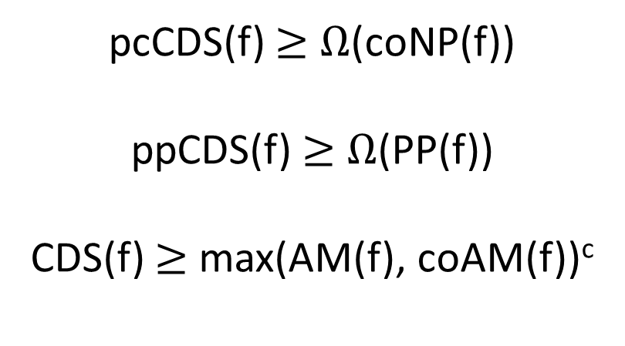
CDS and Communication Complexity
Lower-bounds on perfect and imperfect CDS
in terms of communication complexity measures
pcCDS(f) $≥$ $Ω$(coNP(f))
ppCDS(f) $≥$ $Ω$(PP(f))
CDS(f) $≥$ max(AM(f), coAM(f))^{c}
Notes:
Say that these imply most known lower bounds (for partially perfect CDS) and gave new bounds for several predicates.

Slide 8

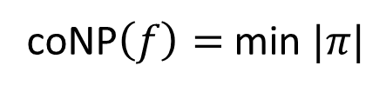






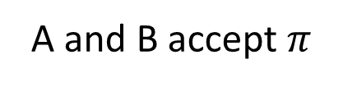

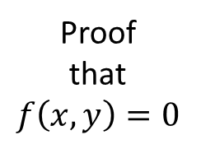
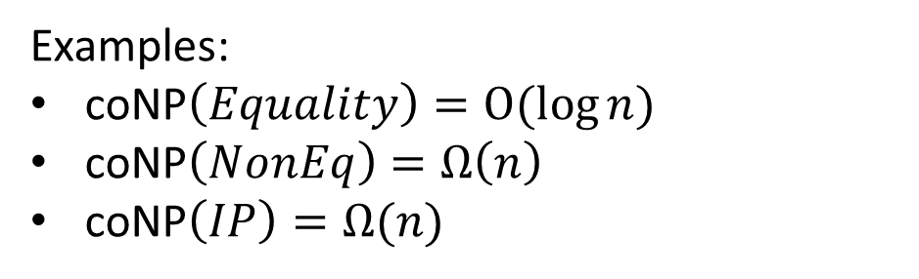
Perfectly Correct CDS > coNP
$$f:{\left\{0,1\right\}}^{n}×{\left\{0,1\right\}}^{n}→\{0,1\}$$
$$x$$
A
B
$$y$$
$$⇔$$
Proof
that
$$f\left(x,y\right)=0$$
A and B accept $π$
$$f\left(x,y\right)=0$$
$$π$$
$$π$$
C
coNP$\left(f\right)=$ min $|π|$
$$x, y$$
Examples:
coNP$\left(Equality\right)=O(\log{n})$
coNP$\left(NonEq\right)=Ω\left(n\right)$
coNP$\left(IP\right)=Ω(n)$

Slide 9



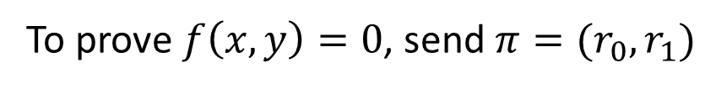





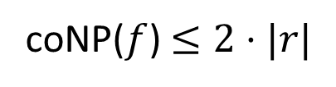

Perfectly Correct CDS > coNP
$$f:{\left\{0,1\right\}}^{n}×{\left\{0,1\right\}}^{n}→\{0,1\}$$
$$s$$
$$x$$
A
B
$$y$$
A
B
$$r$$
$$x$$
$$y$$
Proof
that
$$f\left(x,y\right)=0$$
$$m_{A}$$
$$m_{B}$$
$$π$$
$$π$$
C
C
$$x, y$$
$$x, y$$
$$f\left(x,y\right)=1$$
$$⇔$$
$∄r_{0},r_{1}$ that lead to same $(m_{A},m_{B})$ for $s=0$ and $s=1$
To prove $f\left(x,y\right)=0$, send $π=(r_{0},r_{1})$
coNP($f$) $≤2⋅|r|$

Slide 10

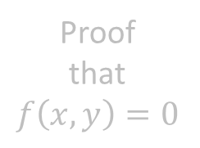

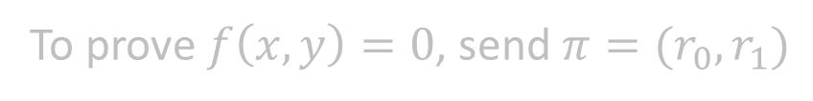



Perfectly Correct CDS > coNP
$$f:{\left\{0,1\right\}}^{n}×{\left\{0,1\right\}}^{n}→\{0,1\}$$
$$s$$
$$x$$
A
B
$$y$$
Lemma:
Randomness in CDS can be “sparsified” by sub-sampling. That is,
$\left|r\right|≤\left|m_{A}\right|+\left|m_{B}\right|+O(log\left(n\right))$
$$r$$
Proof
that
$$f\left(x,y\right)=0$$
$$m_{A}$$
$$m_{B}$$
C
$$x, y$$
Proof sketch:
Pick a set $R$ of $r$’s that preserve distributions of $(m_{A},m_{B})$.
Such $R$ exists of size roughly $2^{\left|m_{A}\right|+\left|m_{B}\right|}$.
Use $log⁡(\left|R\right|)$ random bits to index into this set.
$$f\left(x,y\right)=1$$
$$⇔$$
$∄r_{0},r_{1}$ that lead to same $(m_{A},m_{B})$ for $s=0$ and $s=1$
To prove $f\left(x,y\right)=0$, send $π=(r_{0},r_{1})$
Similar to Newman’s theorem.
coNP($f$) $≤2⋅|r|$
Notes:
Similar to Newman’s theorem.

Slide 11
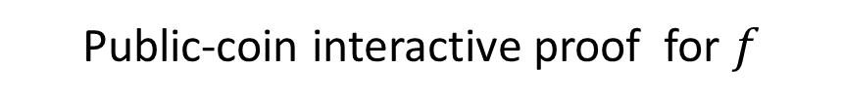
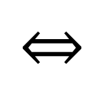




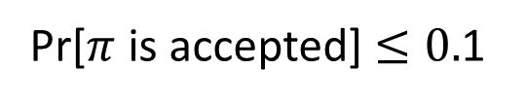
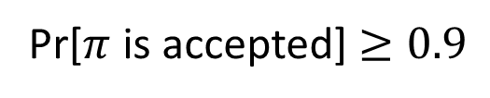
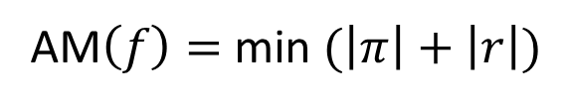
General CDS > AM
Public-coin interactive proof for $f$
$$x$$
A
B
$$y$$
Pr[$π$ is accepted] $≥0.9$
$$⇔$$
$$f\left(x,y\right)=1$$
$$r$$
Pr[$π$ is accepted] $≤0.$1
$$⇔$$
$$f\left(x,y\right)=0$$
$$π$$
$$π$$
C
AM$\left(f\right)=$ min $(\left|π\right|+\left|r\right|)$
$$x, y$$
No explicit non-trivial lower-bounds known

Slide 12
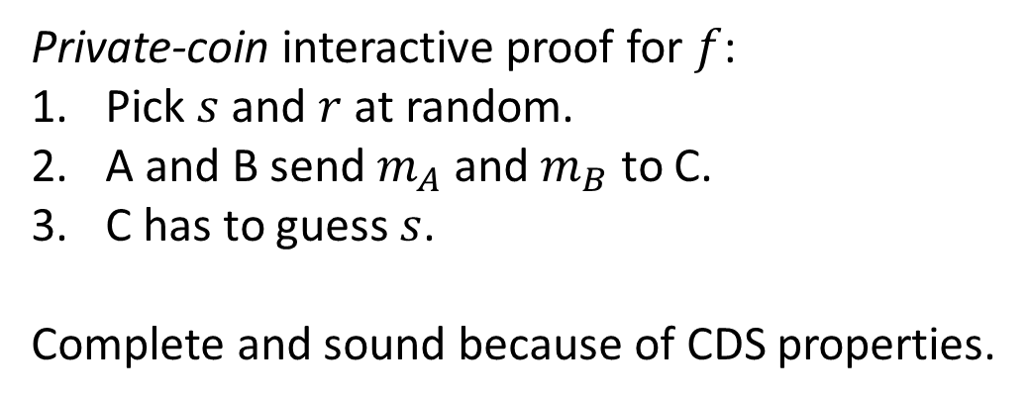
General CDS > AM
Public-coin interactive proof for $f$
$$s$$
$$x$$
A
B
$$y$$
A
B
$$r$$
$$x$$
$$y$$
$$r$$
$$m_{A}$$
$$m_{B}$$
$$π$$
$$π$$
C
C
$$x, y$$
$$x, y$$
Private-coin interactive proof for $f$:
Pick $s$ and $r$ at random.
A and B send $m_{A}$ and $m_{B}$ to C.
C has to guess $s$.
Complete and sound because of CDS properties.
Made public-coin using standard techniques. [Bab85,GS89]

Slide 13
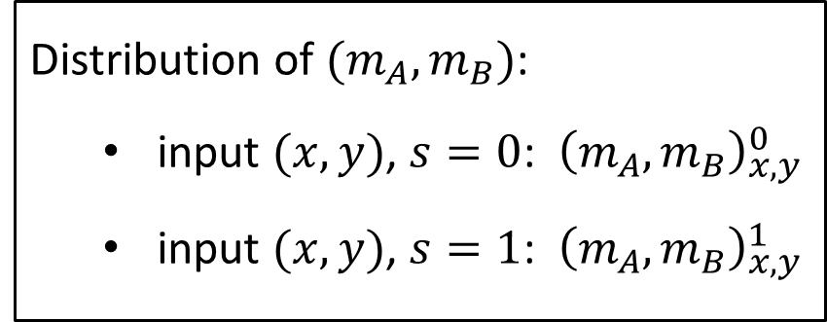
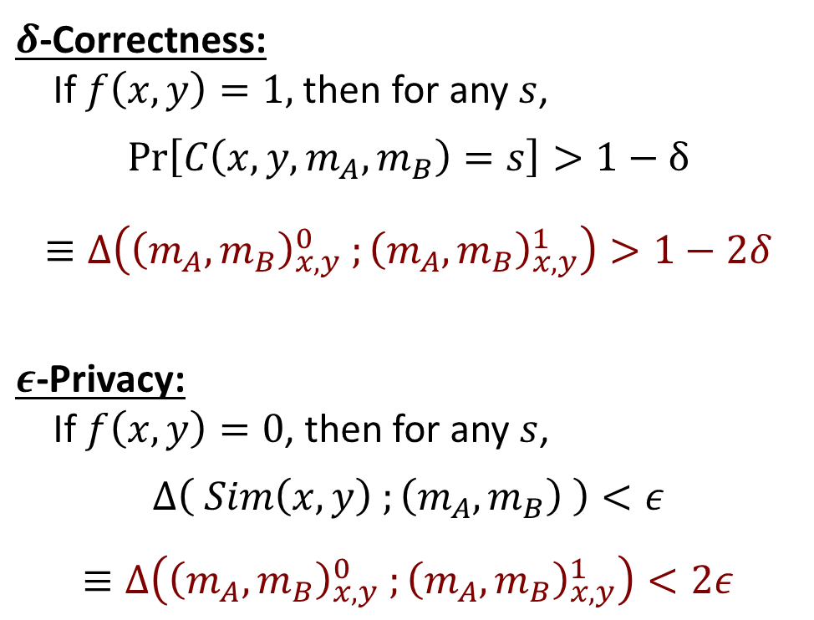
CDS, Statistical Difference, and Statistical ZK
$$s$$
$$x$$
A
B
$$y$$
$δ$-Correctness:
If $f\left(x,y\right)=1,$ then for any $s$,
$$\operatorname{Pr}\left[C\left(x,y,m_{A},m_{B}\right)=s\right]>1−δ$$
$$≡Δ\left({\left(m_{A},m_{B}\right)}_{x,y}^{0} ;{\left(m_{A},m_{B}\right)}_{x,y}^{1}\right)>1−2δ$$
$ε$-Privacy:
If $f\left(x,y\right)=0$, then for any $s$,
$$Δ\left( Sim\left(x,y\right) ;\left(m_{A},m_{B}\right) \right)<ε$$
$≡Δ\left({\left(m_{A},m_{B}\right)}_{x,y}^{0} ;{\left(m_{A},m_{B}\right)}_{x,y}^{1}\right)<2ε$
$$r$$
$$m_{A}$$
$$m_{B}$$
C
$$x, y$$
Distribution of $(m_{A},m_{B})$:
  input $(x,y)$, $s=0$: ${\left(m_{A},m_{B}\right)}_{x,y}^{0}$
  input $(x,y)$, $s=1$: ${\left(m_{A},m_{B}\right)}_{x,y}^{1}$
Notes:
Say something about completeness for SZK.

Slide 14

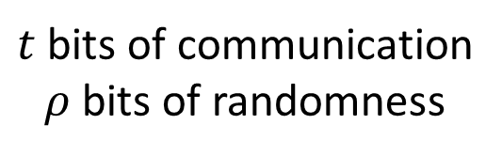



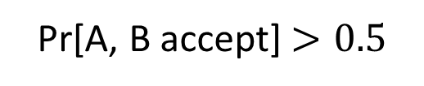


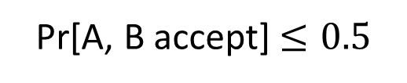

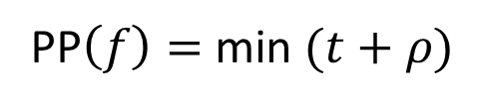
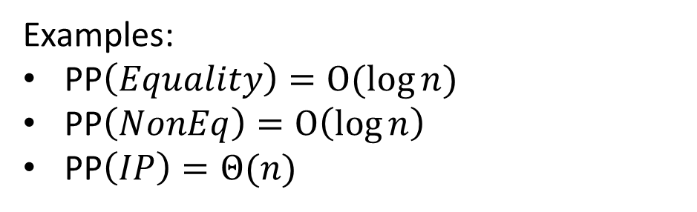
Perfectly Private CDS > PP
Randomised protocol for $f$
$$⇔$$
$$x$$
A
B
$$y$$
Pr[A, B accept] $>0.5$
$$f\left(x,y\right)=1$$
Pr[A, B accept] $≤0.5$
$$⇔$$
$$f\left(x,y\right)=0$$
$t$ bits of communication
$ρ$ bits of randomness
PP$\left(f\right)=$ min $(t+ρ)$
Examples:
PP$\left(Equality\right)=O(\log{n})$
PP$\left(NonEq\right)=O\left(\log{n}\right)$
PP$\left(IP\right)=Θ(n)$

Slide 15
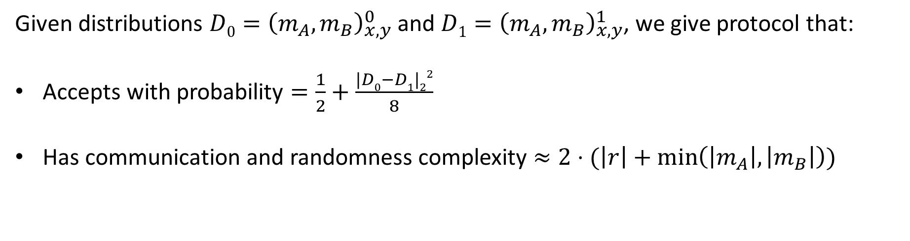
Perfectly Private CDS > PP
Randomised protocol for $f$
$$s$$
$$x$$
A
B
$$y$$
$$r$$
$$x$$
A
B
$$y$$
$$m_{A}$$
$$m_{B}$$
C
$$x, y$$
Given distributions $D0={\left(m_{A},m_{B}\right)}_{x,y}^{0}$ and $D1={\left(m_{A},m_{B}\right)}_{x,y}^{1}$, we give protocol that:
Accepts with probability $=\frac{1}{2}+\frac{|D0−D1|22}{8}$
Has communication and randomness complexity $≈2⋅(\left|r\right|+\min\left(\left|m_{A}\right|,\left|m_{B}\right|\right))$

Slide 16



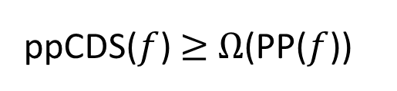
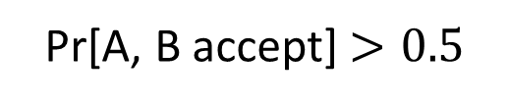

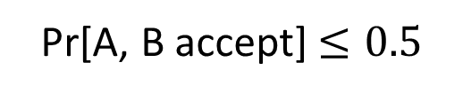
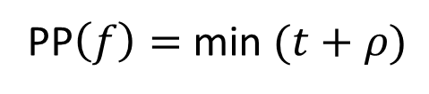
Perfectly Private CDS > PP
Randomised protocol for $f$
Pr[A, B accept] $>0.5$
$$⇔$$
$$f\left(x,y\right)=1$$
$$⇔$$
$$x$$
A
B
$$y$$
Pr[A, B accept] $≤0.5$
$$f\left(x,y\right)=0$$
$t$ bits of communication
$ρ$ bits of randomness
PP$\left(f\right)=$ min $(t+ρ)$
ppCDS($f$) $≥$ $Ω$(PP($f$))
Based on techniques used to show that PZK is in PP [BCHTV17]

Slide 17
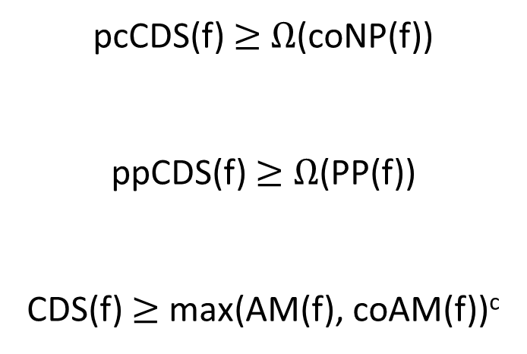
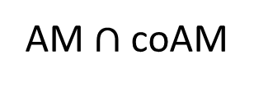
Our Lower Bounds
coAM
AM$∩$ coAM
PP
pcCDS(f) $≥$ $Ω$(coNP(f))
ppCDS(f) $≥$ $Ω$(PP(f))
CDS(f) $≥$ max(AM(f), coAM(f))^{c}
coNP
General
CDS
Perfectly Correct
CDS
Perfectly Private
CDS
Perfect
CDS

Slide 18
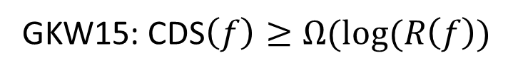
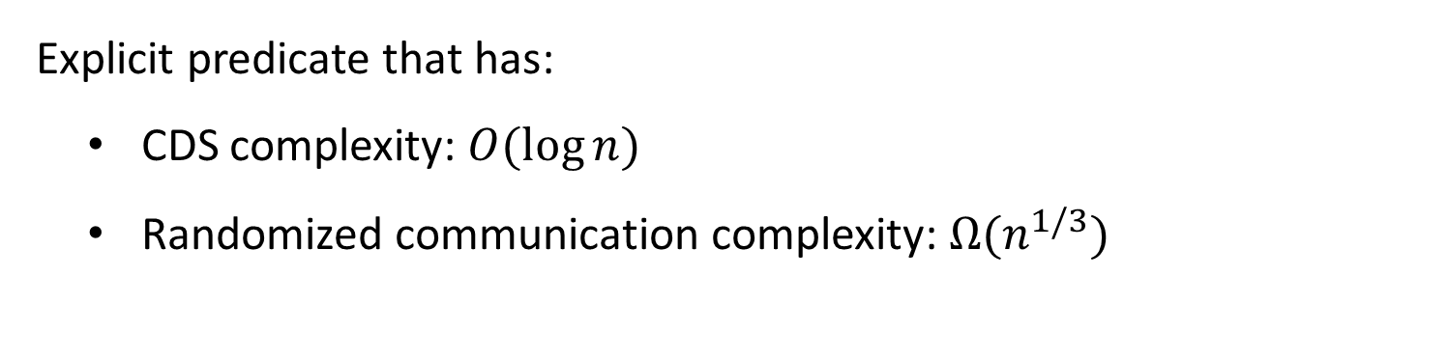
Separations
Explicit predicate that has:
  CDS complexity: $O(\log{n)}$
  Randomized communication complexity: $Ω(n^{1/3})$
Inspired by oracle separations between SZK and other classes [Aar12], and the Pattern Matrix method [She11]
GKW15: CDS$\left(f\right)≥Ω(log⁡(R\left(f\right))$

Slide 19
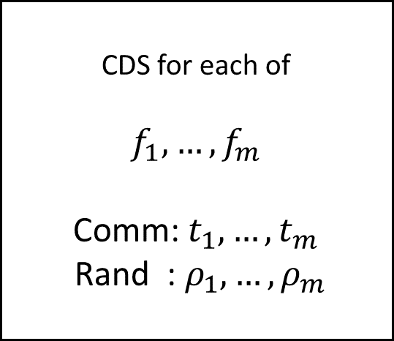
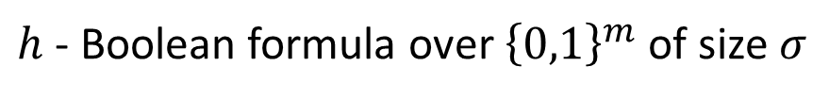
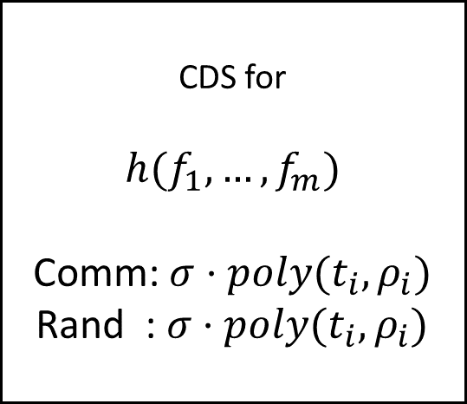
Closure
$h$ - Boolean formula over ${\left\{0,1\right\}}^{m}$ of size $σ$
CDS for each of
$$f_{1}, …, f_{m}$$
Comm: $t_{1},…,t_{m}$
Rand : $ρ_{1},…,ρ_{m}$
CDS for
$$h(f_{1},…,f_{m})$$
Comm: $σ⋅poly(t_{i},ρ_{i})$
Rand : $σ⋅poly(t_{i},ρ_{i})$
Construction uses transformations for Statistical Difference [SV03,Oka96], and PSM protocols [FKN94]
Notes:
Point out that dependence on s is linear.

Slide 20
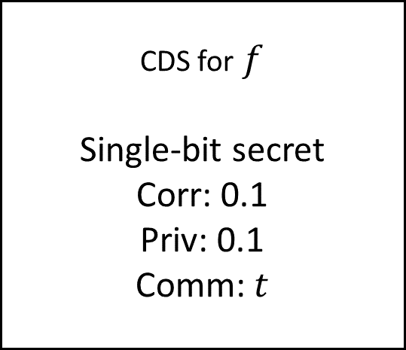
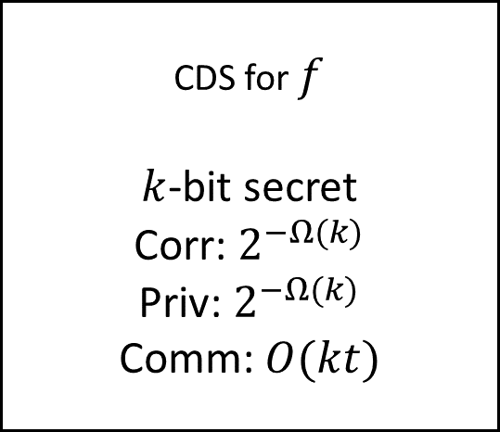
Amplification
CDS for$f$
Single-bit secret
Corr: 0.1
Priv: 0.1
Comm: $t$
CDS for $f$
$k$-bit secret
Corr: $2^{−Ω(k)}$
Priv: $2^{−Ω(k)}$
Comm: $O(kt)$
Construction uses constant-rate ramp secret-sharing schemes [CCGdHV07]
Incomparable version follows from the Polarization Lemma for Statistical Distance [SV03]

Slide 21
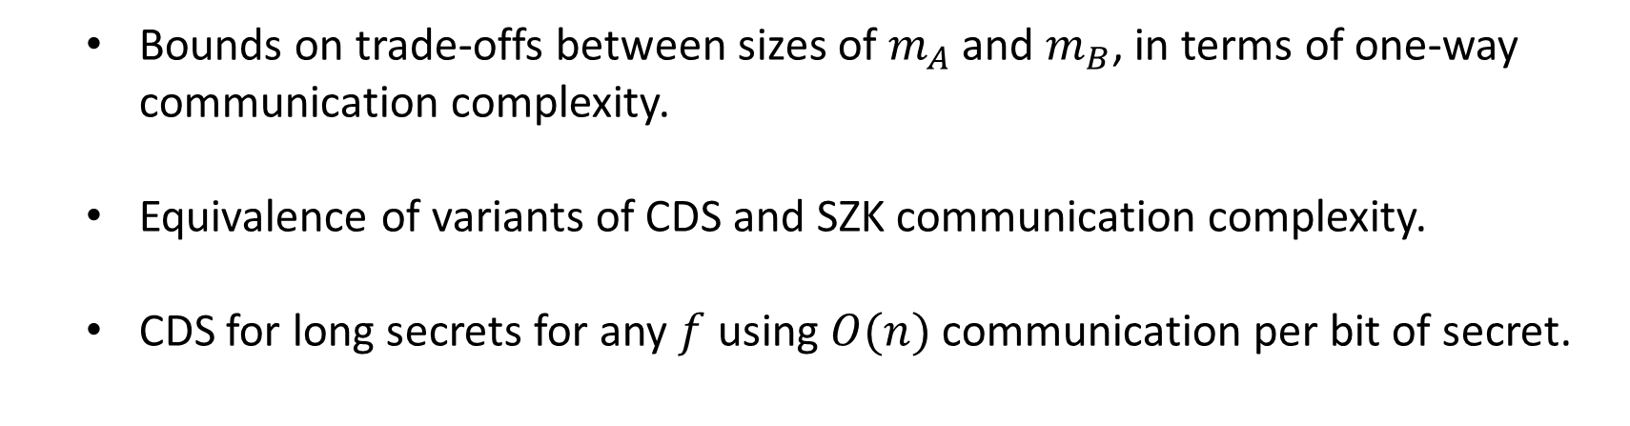
Other Results
  Bounds on trade-offs between sizes of $m_{A}$ and $m_{B}$, in terms of one-way communication complexity.
  Equivalence of variants of CDS and SZK communication complexity.
  CDS for long secrets for any $f$ using $O(n)$ communication per bit of secret.

Slide 22
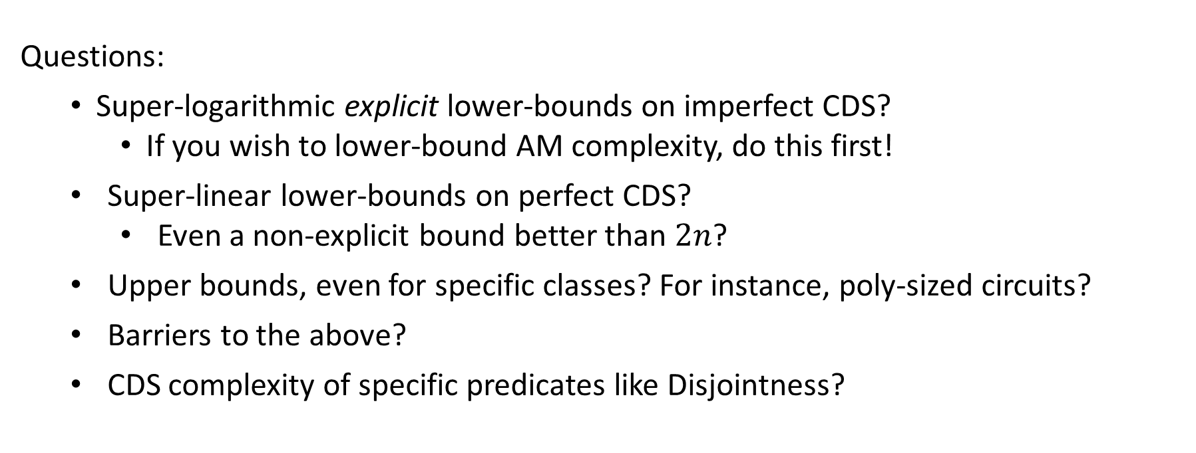
Summary
  Related complexity of CDS to various communication measures
  and used connection to Statistical Difference / SZK to show various properties
Questions:
  Super-logarithmic explicit lower-bounds on imperfect CDS?
    If you wish to lower-bound AM complexity, do this first!
  Super-linear lower-bounds on perfect CDS?
    Even a non-explicit bound better than $2n$?
  Upper bounds, even for specific classes? For instance, poly-sized circuits?
  Barriers to the above?
  CDS complexity of specific predicates like Disjointness?
Notes:
Current lower bound techniques for PSM still apply for CDS and all.

Slide 23
To be passed upon request

Slide 24


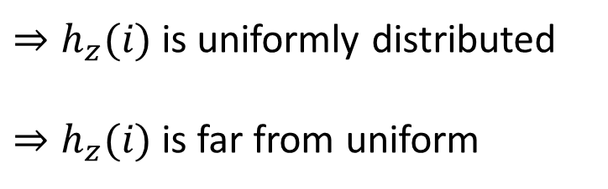


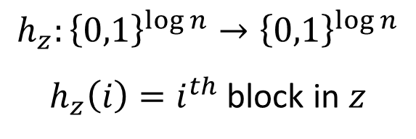

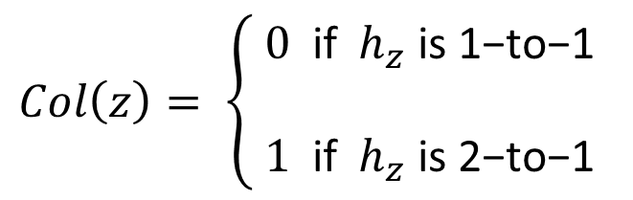
Collision Problems
$$n\log{n}$$
$$h_{z}:{\left\{0,1\right\}}^{\log{n}}→{\left\{0,1\right\}}^{\log{n}}$$
$h_{z}\left(i\right)=i^{th}$ block in $z$
$$z$$
$$⋅ ⋅ ⋅$$
$$\log{n}$$
$n$ blocks
$$Col\left(z\right)= \left\{\begin{aligned}0 \text{if} h_{z} \text{is}\text{ 1−}\text{to}\text{−1} \\ \\ 1 \text{if} h_{z} \text{is}\text{ 2−}\text{to}\text{−1 }\end{aligned}\right.$$
$⇒h_{z}(i)$ is uniformly distributed
$⇒h_{z}(i)$ is far from uniform

Slide 25











Collision Problems
$$4n\log{n}$$
$$x$$
$$⋅ ⋅ ⋅$$
$$\text{0 0 1 0 1 0 1 0 0 1 1 1 1 0 0 1}$$
$$y$$
$$⋅ ⋅ ⋅$$
$$PCol\left(x,y\right)=Col(x\left[y\right])$$
$$\text{ 3 } \text{ 2} \text{ 2} \text{ 4 }$$
$$x[y]$$
$$\text{ 1 } \text{ 0} \text{ 1} \text{ 1 }$$
$$⋅ ⋅ ⋅$$
$$n\log{n}$$
$$R\left(PCol\right)>Ω(n^{1/3})$$
([Amb05,Kut05] + [She11])
$$linCDS\left(PCol\right)>Ω(n^{1/6})$$
(left + [GKW15])

Slide 26












Collision Problems
$$x$$
$$⋅ ⋅ ⋅$$
A
$$\text{0 0 1 0 1 0 1 0 0 1 1 1 1 0 0 1}$$
$$i$$
$$s$$
C
$$x,y$$
$$y$$
$$⋅ ⋅ ⋅$$
B
$$\text{ 3 } \text{ 2} \text{ 2} \text{ 4 }$$
Use PSM [FKN94] to send:
$h_{x\left[y\right]}(i)$ if $s=0$
$r←{\left\{0,1\right\}}^{\log{n}}$ if $s=1$
If $PCol\left(x,y\right)=0$, both are the same distribution, else they are far apart.
$$x[y]$$
$$\text{ 1 } \text{ 0} \text{ 1} \text{ 1 }$$
$$⋅ ⋅ ⋅$$
$$\log{n}$$
$n$ blocks

Slide 27

Amortization
For any predicate $f:{\left\{0,1\right\}}^{n}×{\left\{0,1\right\}}^{n}→\{0,1\}$ and $m>2^{2^{2n}}$, there is a perfect CDS protocol for $f$ with $m$-bit secrets with communication complexity $O(mn)$.
Proven using techniques from the amortization of branching programs [Pot16].
$m$-fold repetition of best known general protocol [LVW17]: $m⋅2^{O(\sqrt{n\log{n}})}$

Slide 28






Perfectly Private CDS > PP
Randomised protocol for $f$
$$s$$
$$x$$
A
B
$$y$$
$$r$$
$$x$$
A
B
$$y$$
$$m_{A}$$
$$m_{B}$$
C
$$x, y$$
$$f\left(x,y\right)=1$$
$$⇒$$
$$Δ\left({\left(m_{A},m_{B}\right)}_{x,y}^{0} ;{\left(m_{A},m_{B}\right)}_{x,y}^{1}\right)>1−2δ$$
$$⇒$$
$$\left|{\left(m_{A},m_{B}\right)}_{x,y}^{0} −{\left(m_{A},m_{B}\right)}_{x,y}^{1}\right|2>exp(−|mA,mB|/2)$$
$$⇒$$
$$f\left(x,y\right)=0$$
$$Δ\left({\left(m_{A},m_{B}\right)}_{x,y}^{0} ;{\left(m_{A},m_{B}\right)}_{x,y}^{1}\right)=0$$
$$⇒$$
$$\left|{\left(m_{A},m_{B}\right)}_{x,y}^{0} −{\left(m_{A},m_{B}\right)}_{x,y}^{1}\right|2=0$$

Slide 29



Perfectly Private CDS > PP
Randomised protocol for $f$
$$s$$
$$x$$
A
B
$$y$$
$$r$$
$$x$$
A
B
$$y$$
$$m_{A}$$
$$m_{B}$$
C
$$x, y$$
Given samplable distributions $D0={\left(m_{A},m_{B}\right)}_{x,y}^{0}$ and $D1={\left(m_{A},m_{B}\right)}_{x,y}^{1}$
With prob. ¼, $a,b←D0$ , accept if $a=b$, and with prob. ½ otherwise
With prob. ¼, same for $D1$
With prob. ½, $a←D0, b←D1$, reject if $a=b$, with prob. ½ otherwise
Pr[accept] $=\frac{1}{2}+\frac{|D0−D1|22}{8}$
Communication, randomness cost
= 2 x that of sampling $D0,D1$

Slide 30
Notes
Is SZK in PSPACE?
Is the LVW construction perfect? Looks like it.
Do known circuit lower bound barriers for AM extend to CDS?
Why is SZK not in AM-coAM?
How to introduce coNP and all for broad audience?
Why was CDS first introduced? Data privacy in PIR.
Be clear about where randomness is public and private.
Is any super-constant bound known for AM at all? If not, bounds on CDS are better!
Get an example of predicate that separates perfect CDS from imperfect CDS.
  Non-equality
  For greater than and non-equality, we had no lower bounds even for perfect CDS
  We had no lower-bound technique that tolerated privacy error
What is the “lightweight alternative to ZK proofs [AIR01]”? Changed now.

