Slide 1
Cryptography from Information Loss
Marshall Ball Elette Boyle Akshay Degwekar
Apoorvaa Deshpande Alon Rosen Vinod Vaikuntanathan
Prashant Nalini Vasudevan

Slide 2
Hardness + Structure Crypto
A hard problem with sufficient structure
Worst-case,
Average-case,
some variants
Many possibilities
and dimensions
What is sufficient?

Slide 3
Hardness + Structure Crypto
Ostrovsky ’91 | Average-case Hardness | Statistical Zero Knowledge Proofs (SZK) | One-Way Functions (OWF)
Ostrovsky-Wigderson ’93 | Worst-case Hardness | SZK | Auxiliary-input OWF
Applebaum-Raykov ’16 | Worst-case Hardness | Randomized Encodings | OWF
Ball et al ’18 | Fine-grained Worst-case Hardness | Low-degree poly representation | Proofs of Work
This work | Worst-case Hardness | Lossy reductions | OWF
This work | Average-case Hardness++ | Compressing reductions | Collision-Resistant Hash Functions
Ong-Vadhan ‘08, Berman et al ‘18, …
Notes:
Maybe show this again at the end after people know the terms here.
We pull together things studied by others for different reasons for our own nefarious purposes.

Slide 4
Lossy Reductions
Randomized poly-time algorithm $R$ is a reduction from language $L$ to $L’$ if:
$$x∈L⇒ Pr⁡[R\left(x\right)∈L^{′}]≥0.9$$
$$x∉L⇒ Pr⁡[R\left(x\right)∉L^{′}]≥0.9$$
Reduction $R$ is $t$-compressing if, for any input $x$ of size $n$,
$$\left|R\left(x\right)\right|≤t\left(n\right)$$
(often studied implicitly in parametrized complexity, see [Downey-Fellows ‘13])
Example:
All problems in $P$ have a 1-compressing reduction to a trivial language
Various parametrized problems, notably Vertex Cover parameterized by size of the cover
Notes:
Give some examples.

Slide 5
Lossy Reductions
Examples:
Any random self-reduction, e.g. for Quadratic Residuosity is $≈$1-lossy
Given $n×n$ matrix $M$ over field $F$, is $\det\left(M\right)=0$?
Multiplying by random full rank matrix $R$ gives random matrix $RM$ with the same span as $M$
Roughly, $\left(\frac{n^{2}}{4}\log\left|F\right|\right)$-lossy reduction
Randomized poly-time algorithm $R$ is a reduction from language $L$ to $L’$ if:
$$x∈L⇒ Pr⁡[R\left(x\right)∈L^{′}]≥0.9$$
$$x∉L⇒ Pr⁡[R\left(x\right)∉L^{′}]≥0.9$$
Reduction $R$ is $t$-compressing if, for any input $x$ of size $n$,
$$\left|R\left(x\right)\right|≤t\left(n\right)$$
(often studied implicitly in parametrized complexity, see [Downey-Fellows ‘13])
Reduction $R$ is $t$-lossy if, for every random variable $X$ over inputs of size $n$,
$$I\left(X;R\left(X\right)\right)≤t\left(n\right)$$
(inspired by definitions in communication complexity, e.g. those in [Braverman et al ‘13])
Notes:
Give some examples.

Slide 6
Related Concepts
Kernelization
reduction compresses to size poly in some given parameter of input
pervasive in parametrized complexity and algorithms
Instance-compression [Harnik-Naor ‘10, Bodlaender et al ’08]
reduction compresses to size poly in witness-length
Randomized encodings [Ishai-Kushilevitz ‘00, Applebaum et al ‘04]
$≈1$-lossy reductions to some unspecified language
pervasive in theoretical cryptography
Worst-case to average-case Karp reductions
$≈1$-lossy reductions to a specified language
Notes:
Add citations everywhere.

Slide 7
Loss and Cryptography
For language $L$ and function $m$,
$$OR_{m}∘L=\left\{\left(x_{1},…,x_{m\left(n\right)}\right) \right| \left|x_{i}\right|=n∧ ∃i:x_{i}∈L\}$$
Example:
Given $m$ matrices $M_{1},…,M_{m}$ of dimension $n×n$ over field $F$, is there an $i$ such that $\det\left(M_{i}\right)=0$?
Let $M=M_{1}M_{2}⋯M_{m}$
$\det\left(M\right)=0$ iff $\det\left(M_{i}\right)=0$ for some $i$
$\left(n^{2}\log\left|F\right|\right)$-compressing reduction from $OR_{m}∘L$ to $L$ for any $m$
Notes:
Too many different notions, like instance-compression, etc.. Maybe blur the differences for clarity.
Drucker’s conclusion was negative for crypto. We turn it into a positive.
How much compression did Harnik-Naor need? Ans: they need instance-compression, which means compression to poly in witness length, here poly(n).
Harnik-Naor also show OT from OWF with witness-retrievable compression, and some applications to attacks on bounded storage model constructions.

Slide 8
Loss and Cryptography
For language $L$ and function $m$,
$$OR_{m}∘L=\left\{\left(x_{1},…,x_{m\left(n\right)}\right) \right| \left|x_{i}\right|=n∧ ∃i:x_{i}∈L\}$$
Harnik-Naor ’10: $poly\left(n\right)$-compressing reduction for $OR_{m}∘SAT$ for all $m$
$⇒$ Collision-Resistance Hashing from OWFs (big deal)
Fortnow-Santhanam ’11: Such reduction for $OR_{m}∘SAT$ $⇒$ PH collapses
Drucker ‘12: $\left(m log⁡(n)\right)$-compressing reduction from $OR_{m}∘L$ to any$L^{′}$
$⇒L∈SZK$
lossy
Notes:
Too many different notions, like instance-compression, etc.. Maybe blur the differences for clarity.
Drucker’s conclusion was negative for crypto. We turn it into a positive.
How much compression did Harnik-Naor need? Ans: they need instance-compression, which means compression to poly in witness length, here poly(n).
Harnik-Naor also show OT from OWF with witness-retrievable compression, and some applications to attacks on bounded storage model constructions.

Slide 9
Statistical Zero Knowledge
Complete Problem: Statistical Difference
Input: Circuits $C_{0}$ and $C_{1}$ that both output $n$ bits
$$SD_{NO}=\left\{ \left(C_{0},C_{1}\right) \right| Δ_{TV}\left(C_{0},C_{1}\right)≥2/3 \}$$
$$SD_{YES}=\left\{ \left(C_{0},C_{1}\right) \right| Δ_{TV}\left(C_{0},C_{1}\right)≤1/3 \}$$
Essentially: Are two given distributions close or far?
Average-case hard problem in $SZK$ $⇒$ OWF
[Ostrovsky ’91]
Notes:
Contains many problems important for crypto.

Slide 10
Loss and Cryptography
For language $L$ and function $m$,
$$OR_{m}∘L=\left\{\left(x_{1},…,x_{m\left(n\right)}\right) \right| \left|x_{i}\right|=n∧ ∃i:x_{i}∈L\}$$
Harnik-Naor ’10: $poly\left(n\right)$-compressing reduction for $OR_{m}∘SAT$ for all $m$
$⇒$ Collision-Resistance Hashing from OWFs (big deal)
Fortnow-Santhanam ’11: Such reduction for $OR_{m}∘SAT$ $⇒$ PH collapses
Drucker ‘12: $\left(m log⁡(n)\right)$-compressing reduction from $OR_{m}∘L$ to any$L^{′}$
$⇒L∈SZK$
lossy
Notes:
Too many different notions, like instance-compression, etc.. Maybe blur the differences for clarity.
Drucker’s conclusion was negative for crypto. We turn it into a positive.
How much compression did Harnik-Naor need? Ans: they need instance-compression, which means compression to poly in witness length, here poly(n).
Harnik-Naor also show OT from OWF with witness-retrievable compression, and some applications to attacks on bounded storage model constructions.

Slide 11
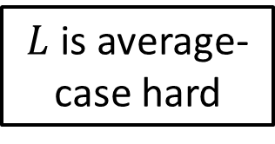
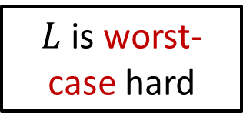
Loss and Cryptography
$L$ is worst-case hard
Redn from $OR_{m}∘L$ to $L$
$\left(\frac{m}{100}\right)$-lossy
+
OWF
$L$ is average-case hard
+
Redn from $OR_{m}∘L$ to $L^{′}$
$\left(m log⁡(n)\right)$-lossy
OWF
Drucker ‘12: $\left(m log⁡(n)\right)$-compressing reduction from $OR_{m}∘L$ to any$L^{′}$
$⇒L∈SZK$
lossy

Slide 12
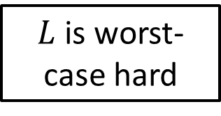
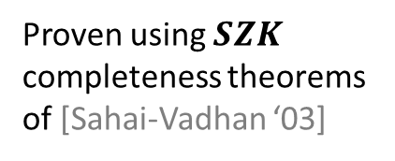
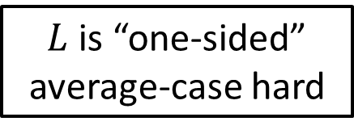
Loss and Cryptography
$$L∈SZK$$
[Drucker ‘12]
$L$ is worst-case hard
Redn from $OR_{m}∘L$ to $L$
$\left(\frac{m}{100}\right)$-lossy
+
OWF
Proven using $SZK$ completeness theorems of [Sahai-Vadhan ‘03]
Essentially
[Drucker ‘12]
$L$ is “one-sided” average-case hard
$L$ is “one-sided” average-case hard
Notes:
Note that one-sided hardness is something we define?

Slide 13
Kinds of Hardness (of a language $L$)
Worst-case:
$∀$alg $A ∃x:A\left(x\right)≠L\left(x\right)$
Average-case:
$∃$dist $D: ∀$alg $A$:
$\underset{x←D}{Pr}\left[A\left(x\right)=L\left(x\right)\right]≤\frac{1}{2}+ε$
One-sided Average-case:
$∃$dist $N⊈L: ∀$alg $A: ∃$dist $Y_{A}⊆L:$
$$\underset{x←N}{Pr}\left[A\left(x\right)=1\right]≈\underset{x←Y_{A}}{Pr}\left[A\left(x\right)=1\right]$$
Two-sided Average-case:
$∃$dists $N⊈L,Y⊆L: ∀$alg $A$:
$$\underset{x←N}{Pr}\left[A\left(x\right)=1\right]≈\underset{x←Y}{Pr}\left[A\left(x\right)=1\right]$$

Slide 14
Loss and Cryptography
$$L∈SZK$$
[Drucker ‘12]
$L$ is worst-case hard
Redn from $OR_{m}∘L$ to $L$
$\left(\frac{m}{100}\right)$-lossy
+
OWF
Proven using $SZK$ completeness theorems of [Sahai-Vadhan ‘03]
Essentially
[Drucker ‘12]
$L$ is “one-sided” average-case hard
$L$ is “one-sided” average-case hard
Notes:
Note that one-sided hardness is something we define?

Slide 15
Loss and One-Sided Hardness
Reduction $R$: $∃i:x_{i}∈L⇔y∈L$
$$D$$
$$x_{1}$$
$$D$$
$$x_{2}$$
Loss: $I\left(x_{1},…,x_{m};y\right)≤\frac{m}{100}$
$$R$$
$$y$$
$$x$$
$$x_{i}$$
Idea: $y$ cannot contain much information about all of the $x_{i}$’s
$$D$$
$$x_{m}$$
Disguising Distribution Lemma [Drucker ‘12]:
There is a distribution $D$ supported within $\overline{L}$ such that for any $x∈\overline{L}$, the distribution of $y$ above is almost the same.
$$D_{0}$$

Slide 16
Loss and One-Sided Hardness
$y←D_{0}$ is contained in $\overline{L}$
If $x∈L$, $y$ is contained in $L$
$$D$$
$$x_{1}$$
$$D$$
$$x_{2}$$
$$R$$
$$y$$
$L$ is worst-case hard $⇒$
$∀$ efficient $A$, $∃$ distribution over $L$ that
$A$ cannot distinguish from $D_{0}$
$$x$$
$$x_{i}$$
$$D$$
$$x_{m}$$
One-sided: $D_{0}$ is fixed, other dist is not
Disguising Distribution Lemma [Drucker ‘12]:
There is a distribution $D$ supported within $\overline{L}$ such that for any $x∈\overline{L}$, the distribution of $y$ above is almost the same.
$$D_{0}$$

Slide 17
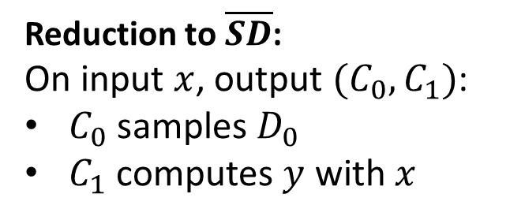
Loss and SZK
If $x∈\overline{L}$, dist. of $y$ is close to $D_{0}$
If $x∈L$, dist. of $y$ is far from $D_{0}$
$$D$$
$$x_{1}$$
$$D$$
$$x_{2}$$
Reduction to $\overline{SD}$:
On input $x$, output $(C_{0},C_{1})$:
$C_{0}$ samples $D_{0}$
$C_{1}$ computes $y$ with $x$
$$R$$
$$y$$
$$x$$
$$x_{i}$$
$$D$$
$$x_{m}$$
$$⇒L∈SZK$$
Disguising Distribution Lemma [Drucker ‘12]:
There is a distribution $D$ supported within $\overline{L}$ such that for any $x∈\overline{L}$, the distribution of $y$ above is almost the same.
$$D_{0}$$

Slide 18
Loss and Cryptography
$$L∈SZK$$
[Drucker ‘12]
$L$ is worst-case hard
Redn from $OR_{m}∘L$ to $L$
$\left(\frac{m}{100}\right)$-lossy
+
If $SD$ is one-sided avg-case hard, then OWF
OWF
Essentially
[Drucker ‘12]
$L$ is “one-sided” average-case hard
$L$ is “one-sided” average-case hard
Notes:
Note that one-sided hardness is something we define?

Slide 19
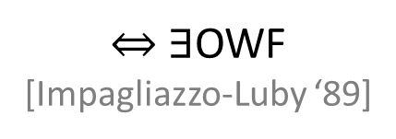
SZK and One-Way Functions
$$SD_{NO}=\left\{ \left(C_{0},C_{1}\right) \right| Δ_{TV}\left(C_{0},C_{1}\right)≥2/3 \}$$
Given: $SD$ is one-sided hard with distribution $N$ over $SD_{NO}$
$$SD_{YES}=\left\{ \left(C_{0},C_{1}\right) \right| Δ_{TV}\left(C_{0},C_{1}\right)≤1/3 \}$$
$f(b,x,r)$: use $r$ to sample $\left(C_{0},C_{1}\right)←N$, output $(C_{0},C_{1},C_{b}\left(x\right))$
Claim: Adversary $A$ cannot sample random inverses for $f$
$⇔$ $∃$OWF
[Impagliazzo-Luby ‘89]
For any distribution $Y$ over $SD_{YES}$, consider
$f_{Y}\left(b,x,r\right):$ sample $\left(C_{0},C_{1}\right)←Y$, output $\left(C_{0},C_{1},C_{b}\left(x\right)\right)$
If $Δ_{TV}(C_{0},C_{1})$ is larger, $b$ is more biased given $C_{b}(x)$
Successful “random inverse sampler” $A$ outputs $b$ with higher probability when given $f(b,x,r)$ than if given $f_{Y}(b,x,r)$
So can distinguish between $N$ and any $Y$, contradiction
Notes:
Skipped issues of error in the reduction, etc..

Slide 20
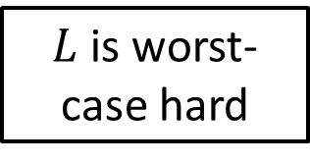
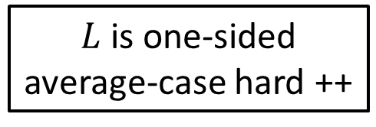
Our Results
$L$ is worst-case hard
Redn from $OR_{m}∘L$ to $L$
$\left(\frac{m}{100}\right)$-lossy
+
OWF
Redn from $MAJ_{m}∘L$ to $L′$
$\left(\frac{m}{100}\right)$-lossy
(via Randomized Encodings, like [Applebaum-Raykov ‘16])
Errorless redn from $OR_{m}∘L$ to $L^{′}$
$O\left(m log\left(n\right)\right)$-lossy
(it’s complicated … )
$L$ is one-sided average-case hard ++
Errorless redn from $OR_{m}∘L$ to $L^{′}$
$\left(\frac{m}{100}\right)$-compressing
+
CRHF
(along the lines of [Ishai et al ‘05])

Slide 21
Collision-Resistant Hashing
$H_{n}=\left\{ h_{k}:{\left\{0,1\right\}}^{m\left(n\right)}→{\left\{0,1\right\}}^{ℓ\left(n\right)}\right\}$ $\left(ℓ\left(n\right)≪m\left(n\right)\right)$
$Gen(n)$: sample a distribution over $k$
$Eval(k,x)$: evaluate $h_{k}(x)$
For any adversary $A$, with $k←Gen(n)$, and $\left(x,x^{′}\right)←A\left(k\right)$,
$$\operatorname{Pr}\left[x=x^{′}∧h_{k}\left(x\right)=h_{k}\left(x^{′}\right)\right]≤negl(n)$$
$L$ is one-sided average-case hard ++
Errorless redn from $OR_{m}∘L$ to $L^{′}$
$\left(\frac{m}{100}\right)$-compressing
+
CRHF
(along the lines of [Ishai et al ‘05])

Slide 22
Collision-Resistant Hashing
$Gen(n)$:
Sample $2⋅m\left(n\right)$ instances $(y_{1,0},y_{1,1},y_{2,0},…,y_{2m,1})$ from $N$, each of size $n$
Output $k=(y_{1,0},y_{1,1},y_{2,0},…,y_{2m,1})$
$Eval(k,x)$:
Output $R(y_{1,x_{1}},y_{2,x_{2}},…,y_{m,x_{m}})$
NO distribution $N$
Reduction $R$
$L$ is one-sided average-case hard ++
Errorless redn from $OR_{m}∘L$ to $L^{′}$
$\left(\frac{m}{100}\right)$-compressing
+
CRHF
(along the lines of [Ishai et al ‘05])

Slide 23
Collision-Resistant Hashing
$Gen(n)$:
Sample $2⋅m\left(n\right)$ instances $(y_{1,0},y_{1,1},y_{2,0},…,y_{2m,1})$ from $N$, each of size $n$
Output $k=(y_{1,0},y_{1,1},y_{2,0},…,y_{2m,1})$
$Eval(k,x)$:
Output $R(y_{1,x_{1}},y_{2,x_{2}},…,y_{m,x_{m}})$
If adversary $A$ finds collisions with probability $ε$, consider distinguisher $B$ that:
given input $y$, samples $k=(y_{1,0},y_{1,1},y_{2,0},…,y_{2m,1})$,
replaces a random $y_{i,b}$ with $y$ to get $k′$
runs $A(k^{′})$ to get $(x,x^{′})$
if $(x,x^{′})$ is valid collision and they differ at bit $i$, then output 1; else 0
$$\underset{y←N}{Pr}\left[B\left(y\right)=1\right]≥ε/m \underset{y←Y}{Pr}\left[B\left(y\right)=1\right]=0$$

Slide 24
Summary
New sufficient conditions for hardness being useful
Worst-case hardness to OWFs
Average-case hardness to CRHFs
Concepts of lossy reductions and one-sided average-case hardness

Slide 25
Questions
Lossy self-reductions for ($OR$ of) currently unusable hard problems?
Would enable OWFs from their worst-case hardness
$SZK$-complete problems
Would show a converse of [Drucker ‘12]
Lattice problems, e.g., the Gap Shortest Vector Problem
OWFs known from worst-case hardness for gap $\tilde{Θ}(n)$
Contained in $SZK$ for gap $Ω\left(\sqrt{\frac{n}{\log{n}}}\right)$
Even showing one-sided avg-case hardness of the above problems would be sufficient for OWFs
Can lossy reductions be profitably used in place of Randomized Encodings in any of its applications?
Computational notions of information loss?

Slide 26
Lattices

Slide 27
To be passed upon request

Slide 28
Ideas
Information loss may be inadvertent and indiscriminate, but we can still use it to get deliberate information loss
Foundations of the theory of cryptography
Lots of hardness unusable, lots of useful things not hard, where is sweet spot? What makes hardness useful?
We identify one such thing
Towards an understanding of useful hardness (which is what crypto is)
Any good examples of information losing reductions?
Full-rank-ness by multiplying with random matrices
DDH, QR and all, but that loses all other info
QR is good example for OR-compression and all, right?

