Slide 1
Design and Analysis of Algorithms
L2: Solving Recurrences and Master Theorem
Diptarka Chakraborty
Steven Halim
Sanjay Jain

Slide 2
Design and Analysis of Algorithms
Last week: We studied about algorithms and asymptotics.
Asymptotic analysis (to express running time as a function of input size)

Slide 3
Analyzing running time of an algorithm
We first consider recursive algorithms.
First step: Find some recurrence relation for time (dependent on input size).
Second step: Solve the recurrence

Slide 4

Example: Merge Sort
MergeSort $(A,i,j)$
If $i=j$, then Done.
Let $k=⌊\frac{i+j}{2}⌋$
MergeSort$(A,i,k)$
MergeSort$(A,k+1,j)$
Merge $(A,i,k,j)$

Slide 5
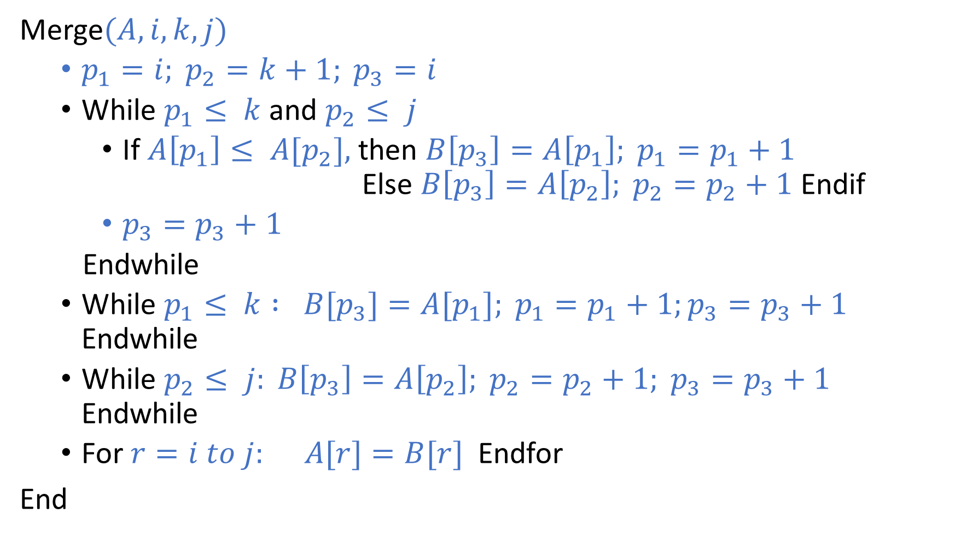
Merge$(A,i,k,j)$
$p_{1}=i; p_{2}=k+1; p_{3}=i$
While $p_{1}≤ k$and $p_{2}≤ j$
If $A\left[p_{1}\right]≤ A[p_{2}],$then $B\left[p_{3}\right]=A\left[p_{1}\right]; p_{1}=p_{1}+1$ Else $B\left[p_{3}\right]=A\left[p_{2}\right]; p_{2}=p_{2}+1$Endif
$p_{3}=p_{3}+1$
Endwhile
While $p_{1}≤ k : B[p_{3}]=A[p_{1}]; p_{1}=p_{1}+1;p_{3}=p_{3}+1$ Endwhile
While $p_{2}≤ j: B\left[p_{3}\right]=A\left[p_{2}\right]; p_{2}=p_{2}+1; p_{3}=p_{3}+1$ Endwhile
For $r=i to j: A[r]=B[r]$Endfor
End

Slide 6
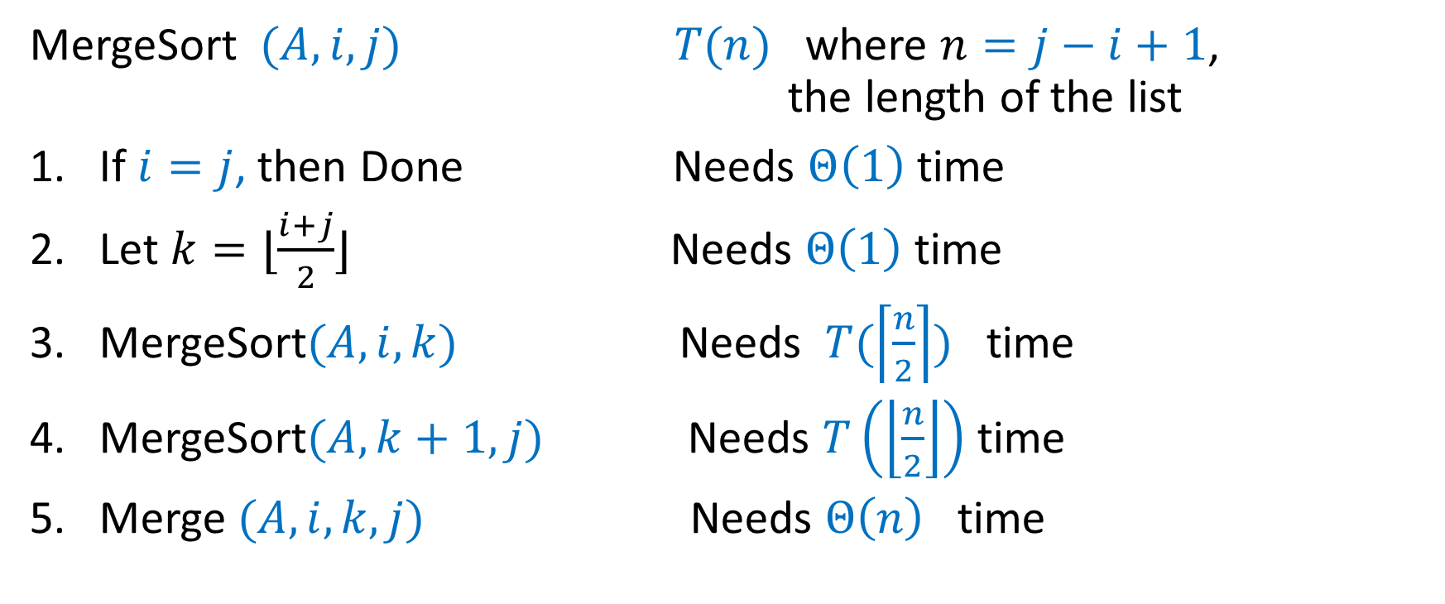
Example: Merge Sort
MergeSort $(A,i,j)$ $T(n)$ where $n=j−i+1$, the length of the list
If $i=j$, then Done Needs $Θ\left(1\right)$ time
Let $k=⌊\frac{i+j}{2}⌋$ Needs $Θ\left(1\right)$ time
MergeSort$(A,i,k)$ Needs $T(\left\lceil \frac{n}{2}\right\rceil )$ time
MergeSort$(A,k+1,j)$ Needs $T\left(\left\lfloor \frac{n}{2}\right\rfloor \right)$ time
Merge $(A,i,k,j)$ Needs $Θ\left(n\right)$ time

Slide 7
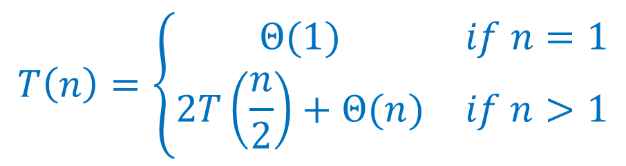
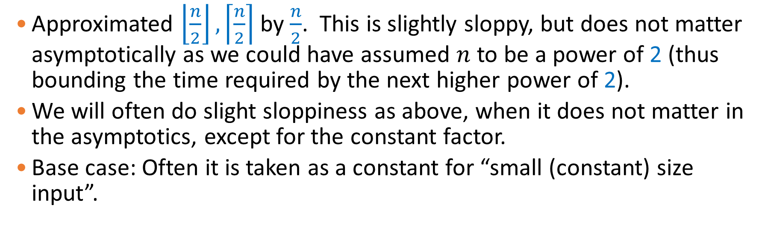
Recurrence equation for MergeSort
$$T\left(n\right)=\left\{\begin{matrix}Θ(1) & if n=1 \\ 2T\left(\frac{n}{2}\right)+Θ(n) & if n>1\end{matrix}\right.$$
Approximated $\left\lfloor \frac{n}{2}\right\rfloor , \left\lceil \frac{n}{2}\right\rceil$ by $\frac{n}{2}$. This is slightly sloppy, but does not matter asymptotically as we could have assumed $n$ to be a power of 2 (thus bounding the time required by the next higher power of 2).
We will often do slight sloppiness as above, when it does not matter in the asymptotics, except for the constant factor.
Base case: Often it is taken as a constant for “small (constant) size input”.

Slide 8
Solving recurrence equations
Though not always easy, one can usually come up with recurrence equations by looking at the algorithm.
Sometimes it needs some smartness/art to come up with right recurrence equation which we know how to solve.
In this lecture we concentrate on how to solve recurrence equations.

Slide 9
Solving recurrence equations: Some techniques
Telescoping method
Recursion tree
Master method
Substitution method

Slide 10
Telescoping method

Slide 11
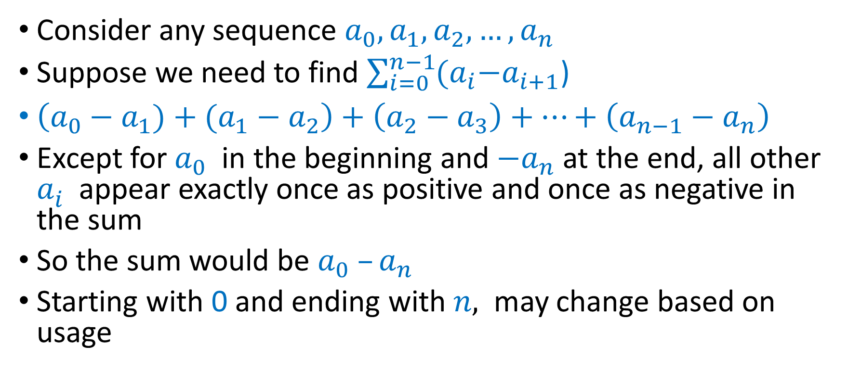
Telescoping Method
Consider any sequence ${a_{0}, a}_{1},a_{2},…, a_{n}$
Suppose we need to find $\sum_{i=0}^{n−1}{{(a}_{i}−a_{i+1}}$)
$\left(a_{0}−a_{1})+(a_{1}−a_{2}\right)+\left(a_{2}−a_{3}\right)+…+\left(a_{n−1}−a_{n}\right)$
Except for $a_{0}$ in the beginning and ${−a}_{n}$ at the end, all other $a_{i}^{ }$ appear exactly once as positive and once as negative in the sum
So the sum would be $a_{0} –a_{n}$
Starting with 0 and ending with $n,$ may change based on usage

Slide 12

Telescoping series
Example
$\sum_{m=1}^{n−1 }{ \frac{1}{ m\left(m+1\right)}}$
$\frac{1}{m\left(m+1\right)}$ = $\frac{1}{m}−\frac{1}{m+1}$
Thus, $\sum_{m=1}^{n−1 }{\frac{1}{ m\left(m+1\right)}}= \sum_{m=1}^{n−1}{ (\frac{1}{m}−\frac{1}{m+1})}$
$=\left(\frac{1}{1}−\frac{1}{2}\right)+\left(\frac{1}{2}−\frac{1}{3}\right)+ …. \left(\frac{1}{n−1}−\frac{1}{n}\right)$
$a_{1}=1, a_{2}=2, …, a_{n}=n$
Sum is: $1 −\frac{1}{n}$

Slide 13
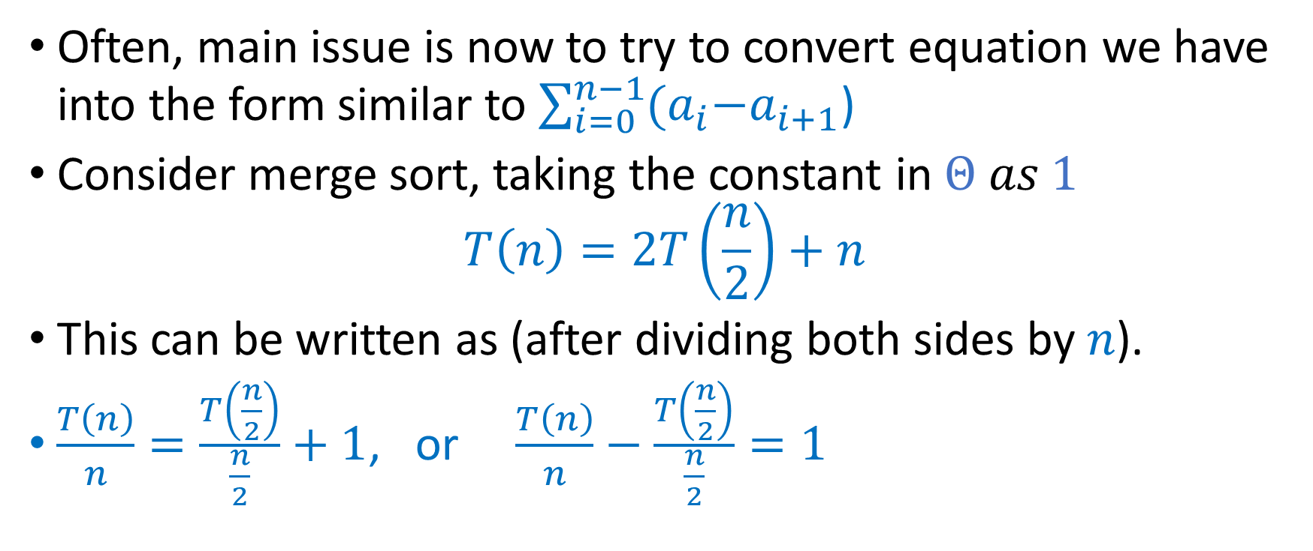
Telescoping Method
Often, main issue is now to try to convert equation we have into the form similar to $\sum_{i=0}^{n−1}{{(a}_{i}−a_{i+1}}$)
Consider merge sort, taking the constant in $Θ as 1$ $T\left(n\right)=2T\left(\frac{n}{2}\right)+n$
This can be written as (after dividing both sides by $n$).
$\frac{T\left(n\right)}{n}=\frac{T\left(\frac{n}{2}\right)}{\frac{n}{2}}+1$, or $\frac{T\left(n\right)}{n}−\frac{T\left(\frac{n}{2}\right)}{\frac{n}{2}}=1$

Slide 14
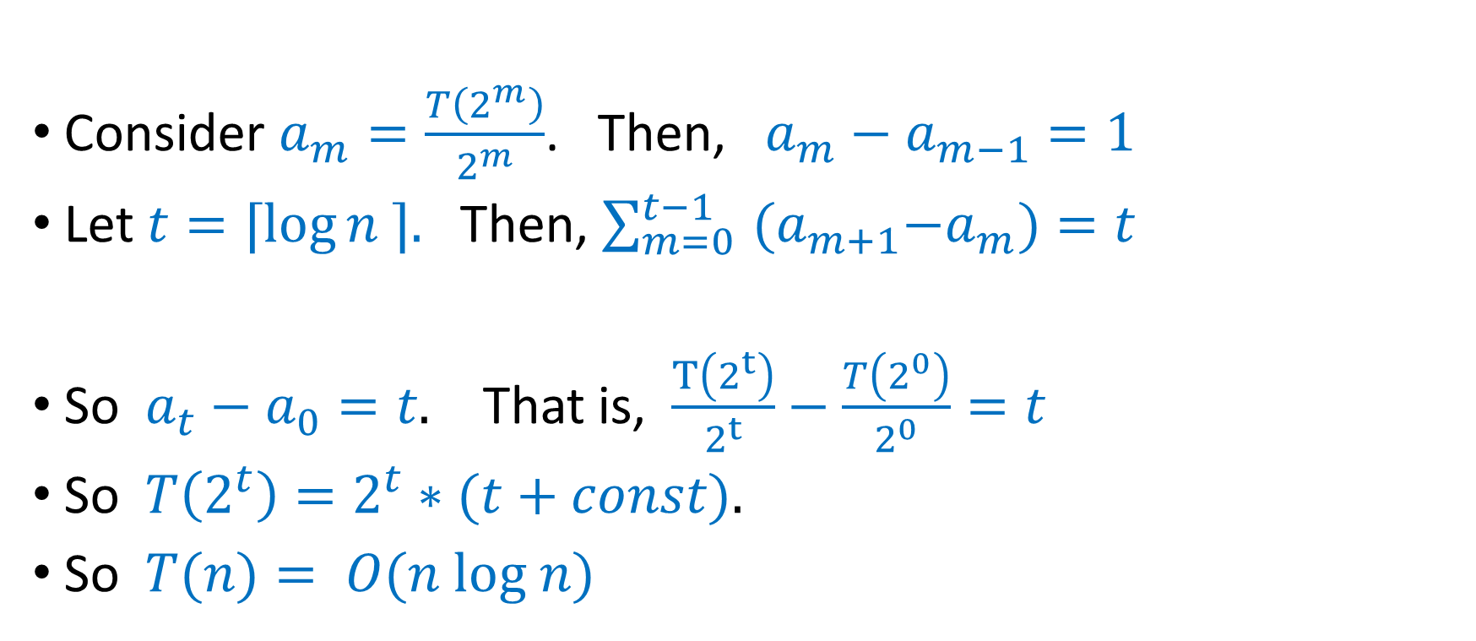
Telescoping Method
Consider $a_{m}=\frac{T\left(2^{m}\right)}{2^{m}}$. Then, $a_{m}−a_{m−1}=1$
Let $t=⌈\log{n ⌉. }$Then, $\sum_{m=0 }^{t−1 }{{(a}_{m+1}−a_{m})=t}$
So $a_{t}−a_{0}=t.$ That is, $\frac{T\left(2^{t}\right)}{2^{t}}−\frac{T\left(2^{0}\right)}{2^{0}}=t$
So $T\left(2^{t}\right)=2^{t}∗(t+const).$
So $T(n)= O(n log n)$

Slide 15
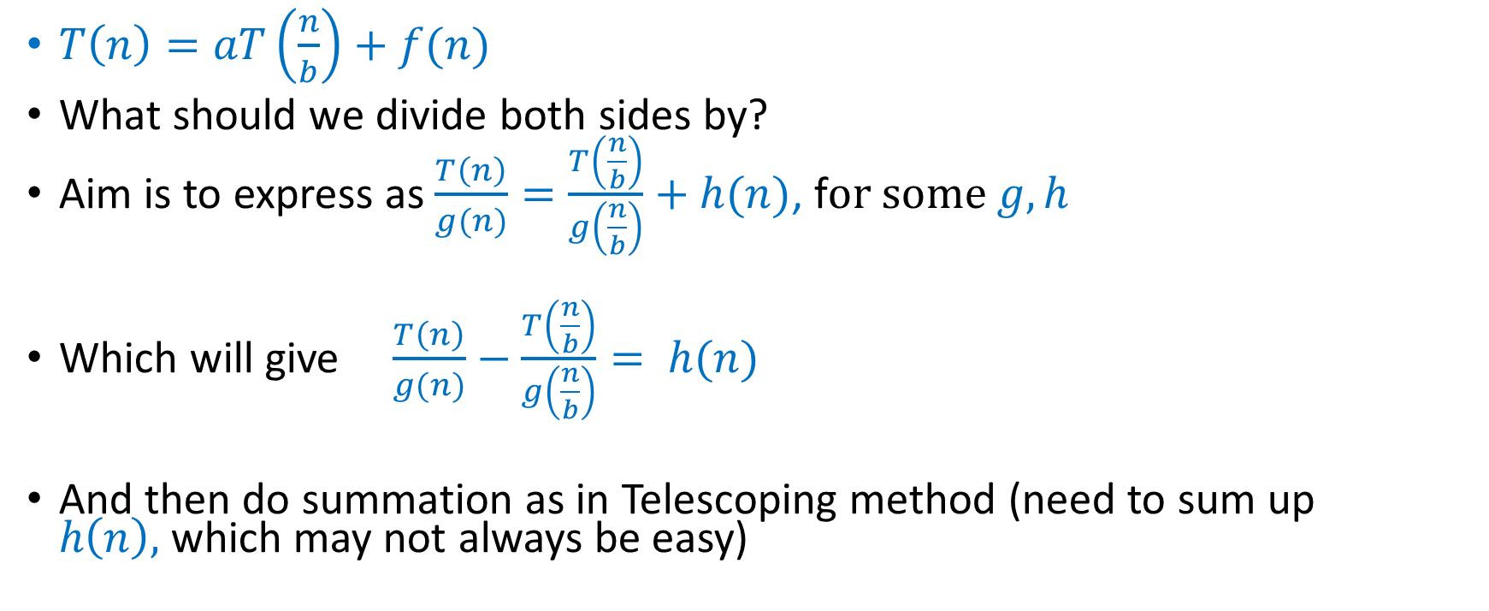
Other recurrences using Telescoping Method
$T\left(n\right)=aT\left(\frac{n}{b}\right)+f(n)$
What should we divide both sides by?
Aim is to express as $\frac{T\left(n\right)}{g(n)}=\frac{T\left(\frac{n}{b}\right)}{g\left(\frac{n}{b}\right)}+h(n)$, f$or some g, h$
Which will give $\frac{T\left(n\right)}{g(n)}−\frac{T\left(\frac{n}{b}\right)}{g\left(\frac{n}{b}\right)}= h(n)$
And then do summation as in Telescoping method (need to sum up $h\left(n\right),$which may not always be easy)

Slide 16
Recursion tree
Also see https://visualgo.net/en/recursion

Slide 17
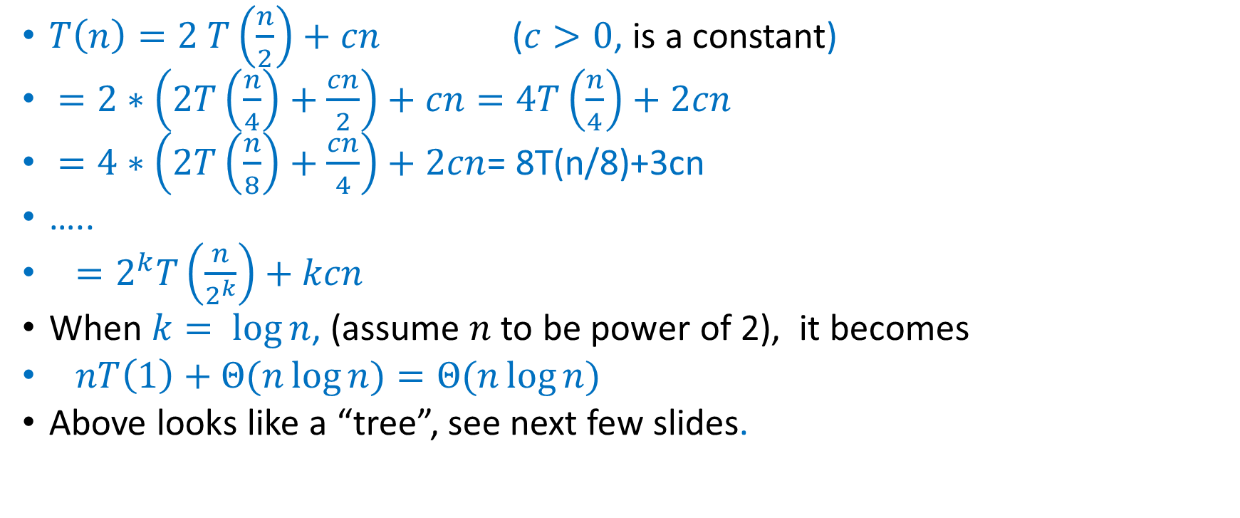
Recursion Tree Method
$T\left(n\right)=2 T\left(\frac{n}{2}\right)+cn$ ($c>0$, is a constant)
$=2∗\left(2T\left(\frac{n}{4}\right)+\frac{cn}{2}\right)+cn=4T\left(\frac{n}{4}\right)+2cn$
$=4∗\left(2T\left(\frac{n}{8}\right)+\frac{cn}{4}\right)+2cn$= 8T(n/8)+3cn
…..
$=2^{k}T\left(\frac{n}{2^{k}}\right)+kcn$
When $k= log⁡n$, (assume $n$ to be power of 2), it becomes
$nT\left(1\right)+Θ(n\log{n)}=Θ(n\log{n)}$
Above looks like a “tree”, see next few slides.

Slide 18
Recursion tree:
Solve T(n) = 2T(n/2) + cn, where c > 0 is constant.
T(n)
Use this custom code at https://visualgo.net/en/recursion for a visualization of this recursion tree
if (n == 1) /* base case */
return 1;
else /* recursive caseS */
return f(n/2) + f(n/2);

Slide 19
Recursion tree
Solve T(n) = 2T(n/2) + cn, where c > 0 is constant.
cn
T(n/2)
T(n/2)

Slide 20
Recursion tree
Solve T(n) = 2T(n/2) + cn, where c > 0 is constant.
cn
cn/2
cn/2
T(n/4)
T(n/4)
T(n/4)
T(n/4)

Slide 21
Recursion tree
Solve T(n) = 2T(n/2) + cn, where c > 0 is constant.
cn
cn/2
cn/2
cn/4
cn/4
cn/4
cn/4
…
Θ(1)

Slide 22
Recursion tree
Solve T(n) = 2T(n/2) + cn, where c > 0 is constant.
cn
cn/2
cn/2
h = log n
cn/4
cn/4
cn/4
cn/4
…
Θ(1)

Slide 23
Recursion tree
Solve T(n) = 2T(n/2) + cn, where c > 0 is constant.
cn
cn
cn/2
cn/2
h = log n
cn/4
cn/4
cn/4
cn/4
…
Θ(1)

Slide 24
Recursion tree
Solve T(n) = 2T(n/2) + cn, where c > 0 is constant.
cn
cn
cn/2
cn/2
cn
h = log n
cn/4
cn/4
cn/4
cn/4
…
Θ(1)

Slide 25
Recursion tree
Solve T(n) = 2T(n/2) + cn, where c > 0 is constant.
cn
cn
cn/2
cn/2
cn
h = log n
cn/4
cn/4
cn/4
cn/4
cn
…
…
Θ(1)

Slide 26
Recursion tree
Solve T(n) = 2T(n/2) + cn, where c > 0 is constant.
cn
cn
cn/2
cn/2
cn
h = log n
cn/4
cn/4
cn/4
cn/4
cn
…
…
Θ(1)
Number of leaves = n
Θ(n)

Slide 27
Recursion tree
Solve T(n) = 2T(n/2) + cn, where c > 0 is constant.
cn
cn
cn/2
cn/2
cn
h = log n
cn/4
cn/4
cn/4
cn/4
cn
…
…
Θ(1)
Number of leaves = n
Θ(n)
Total = Θ(n log n)

Slide 28
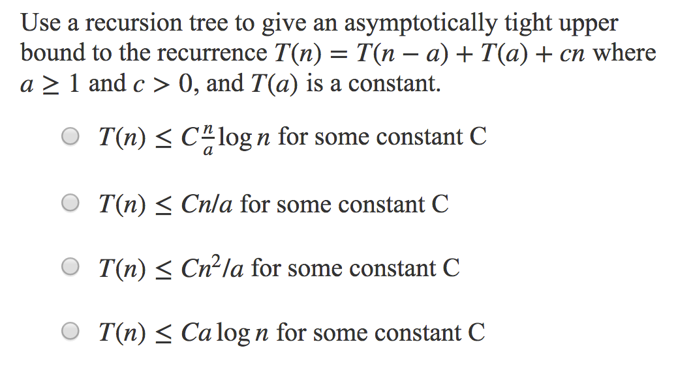
Question 1
Note, C (UPPER CASE) is different from c (lower case)

Slide 29
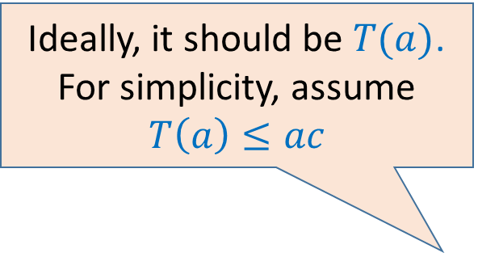
Answer of Question 1
T(n) = T(n-a) + T(a) + cn
Answer: T(n) ≤ Cn²/a
cn
c(n-a)
T(a)
c(n-2a)
T(a)
height =n/a
Ideally, it should be $T(a)$. For simplicity, assume $T\left(a\right)≤ac$
...
2ac
T(a)
ac
T(a)

Slide 30
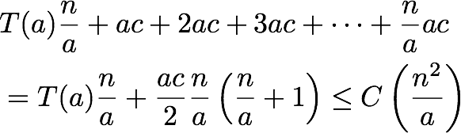
Answer of Question 1
T(n) = T(n-a) + T(a) + cn
Recursion tree height is n/a
At depth k, computation: T(a) + c(n-ka).
Summed over height, we get:
Arithmetic Series

Slide 31
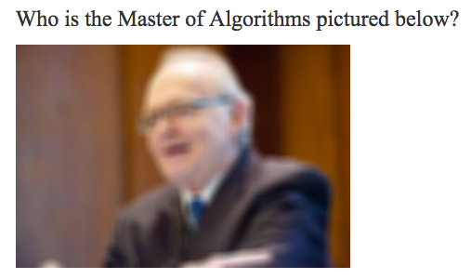

Question 2

Slide 32
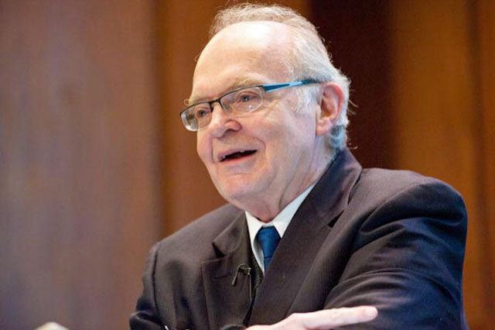
Answer
Donald Knuth
Turing Award winner
Author of The Art of Computer Programming
Has been called “father of analysis of algorithms”. Popularized asymptotic notation. Creator of TeX typesetting system.

Slide 33
Announcement
Written Assignment 1 will be uploaded in Canvas tomorrow afternoon
All the instructions will be provided then

Slide 34
Master Theorem/Method

Slide 35
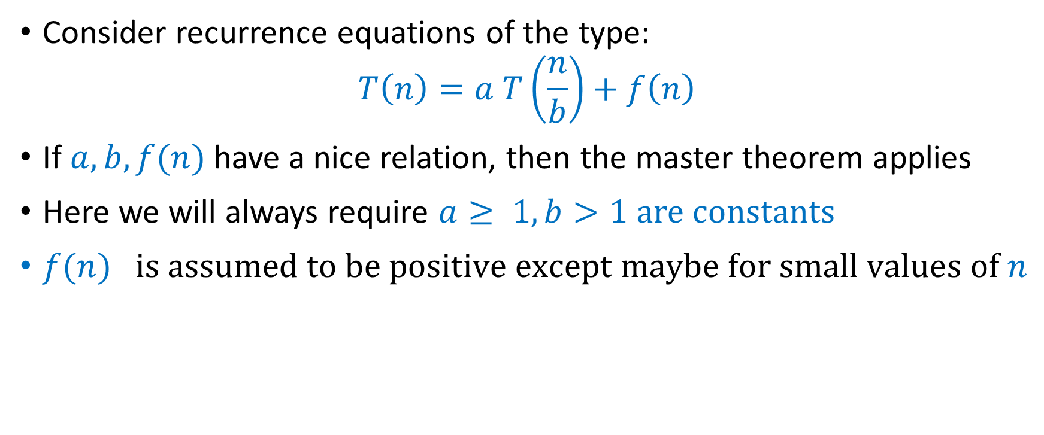
The master theorem
Consider recurrence equations of the type:
$$T\left(n\right)=a T\left(\frac{n}{b}\right)+f\left(n\right)$$
If $a, b, f(n)$have a nice relation, then the master theorem applies
Here we will always require $a≥ 1, b>1$are constants
$f(n) is assumed to be positive except maybe for small values of n$

Slide 36
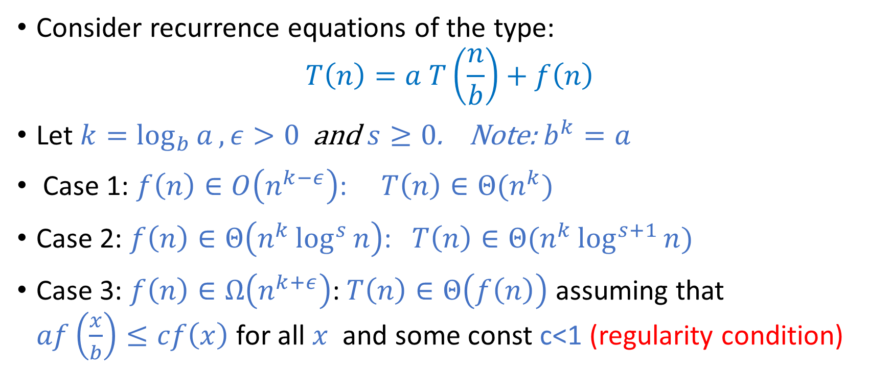
The master theorem
Consider recurrence equations of the type:
$$T\left(n\right)=a T\left(\frac{n}{b}\right)+f\left(n\right)$$
Let $k=\log_{b}{a}, ε>0$ and $s≥0$. Note: $b^{k}=a$
Case 1: $f\left(n\right)∈O\left(n^{k−ε}\right)$: $T\left(n\right)∈Θ(n^{k})$
Case 2: $f\left(n\right)∈Θ\left(n^{k}\log^{s}{n}\right)$: $T\left(n\right)∈Θ(n^{k}\log^{s+1}{n)}$
Case 3: $f\left(n\right)∈Ω\left(n^{k+ε}\right)$: $T\left(n\right)∈Θ\left(f\left(n\right)\right)$ assuming that $af\left(\frac{x}{b}\right)≤cf\left(x\right)$ for all $x$ and some const c<1 (regularity condition)

Slide 37

Examples:
$T\left(n\right)=9 T\left(\frac{n}{3}\right)+n^{1.5}$
$k=\log_{3}{9=2}$
Case 1 applies
$T\left(n\right)∈Θ\left(n^{2}\right)$

Slide 38

Examples:
$T\left(n\right)=9 T\left(\frac{n}{3}\right)+3n^{2}$
$k=\log_{3}{9=2}$
Case 2 applies
$T\left(n\right)∈Θ\left(n^{2}\log{n}\right)$

Slide 39
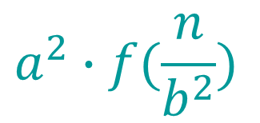
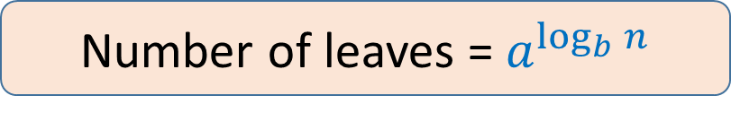
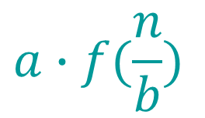
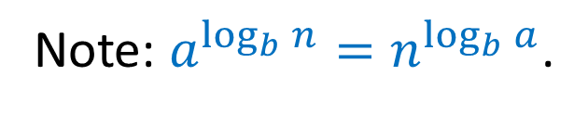


Proof Idea:
T(n) = a T(n/b) + f (n)
Recursion tree:
f (n)
f (n)
a branches
…
$$a∙f(\frac{n}{b})$$
f (n/b)
f (n/b)
f (n/b)
a branches
$$\log_{b}{n}$$
$$a^{2}∙f(\frac{n}{b^{2}})$$
f (n/b²)
f (n/b²)
…
f (n/b²)
…
……
Τ (1)
$$a^{\log_{b}{n}}T(1)$$
Note: $a^{\log_{b}{n}}=n^{\log_{b}{a}}$.
Number of leaves = $a^{\log_{b}{n}}$

Slide 40
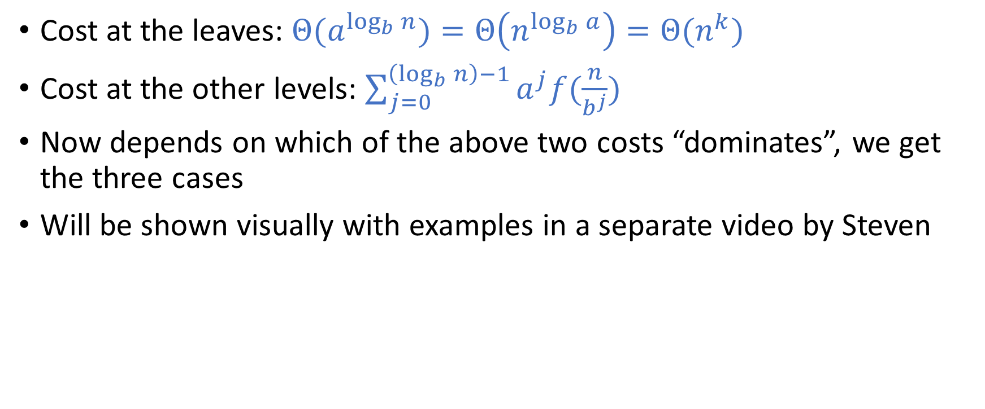
Proof:
Cost at the leaves: $Θ({a^{\log_{b}{n}})=Θ\left(n^{\log_{b}{a}}\right)=Θ(n}^{k})$
Cost at the other levels: $\sum_{j=0}^{\left(\log_{b}{n}\right)−1}{a^{j}f(\frac{n}{b^{j}})}$
Now depends on which of the above two costs “dominates”, we get the three cases
Will be shown visually with examples in a separate video by Steven

Slide 41
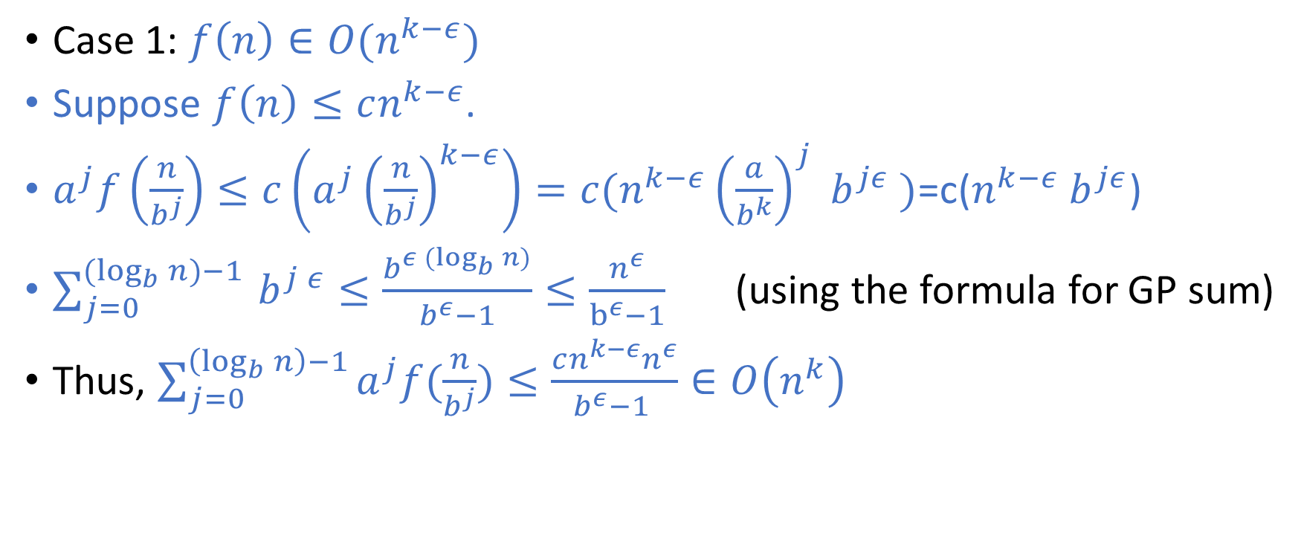
Proof:
Case 1: $f\left(n\right)∈O(n^{k−ε})$
Suppose $f\left(n\right)≤cn^{k−ε}$.
$a^{j}f\left(\frac{n}{b^{j}}\right)≤c\left(a^{j}{\left(\frac{n}{b^{j}}\right)}^{k−ε}\right)=c(n^{k−ε}{\left(\frac{a}{b^{k}}\right)}^{j} b^{jε} )$=c($n^{k−ε} b^{jε}$)
$\sum_{j=0}^{{(log}_{b}{n)−1 }}{b^{j ε}≤\frac{b^{ε(\log_{b}{n)}}}{b^{ε}−1}}≤\frac{n^{ε}}{b^{ε}−1}$ (using the formula for GP sum)
Thus, $\sum_{j=0}^{\left(\log_{b}{n}\right)−1}{a^{j}f(\frac{n}{b^{j}})}≤\frac{cn^{k−ε}n^{ε}}{b^{ε}−1 }∈O\left(n^{k}\right)$

Slide 42
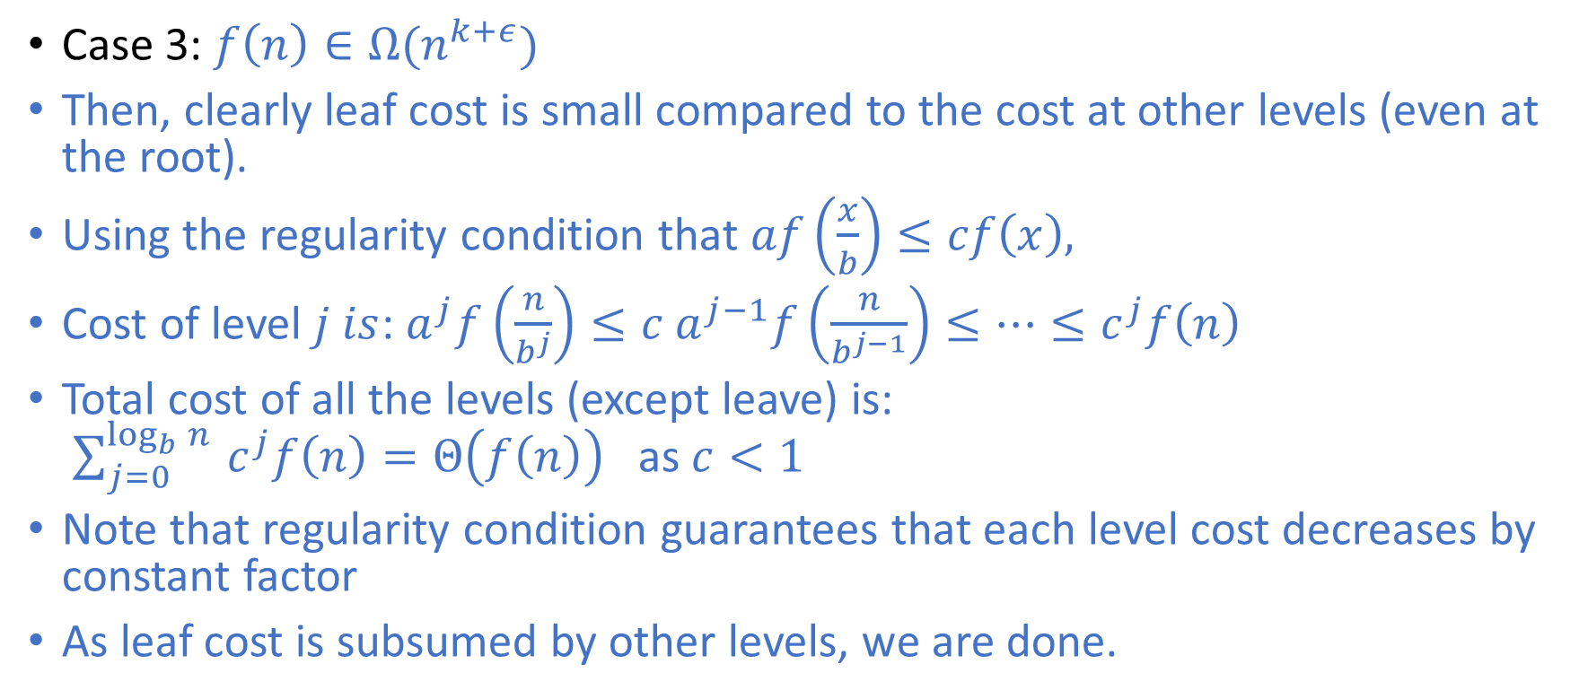
Proof:
Case 3: $f\left(n\right)∈Ω(n^{k+ε})$
Then, clearly leaf cost is small compared to the cost at other levels (even at the root).
Using the regularity condition that $af\left(\frac{x}{b}\right)≤cf\left(x\right),$
Cost of level $j is$: $a^{j}f\left(\frac{n}{b^{j}}\right)≤{c a^{j−1}f\left(\frac{n}{b^{j−1}}\right)≤…≤c}^{j}f\left(n\right)$
Total cost of all the levels (except leave) is: $\sum_{j=0}^{\log_{b}{n }}{c^{j}f\left(n\right)}=Θ\left(f\left(n\right)\right)$ as $c<1$
Note that regularity condition guarantees that each level cost decreases by constant factor
As leaf cost is subsumed by other levels, we are done.

Slide 43
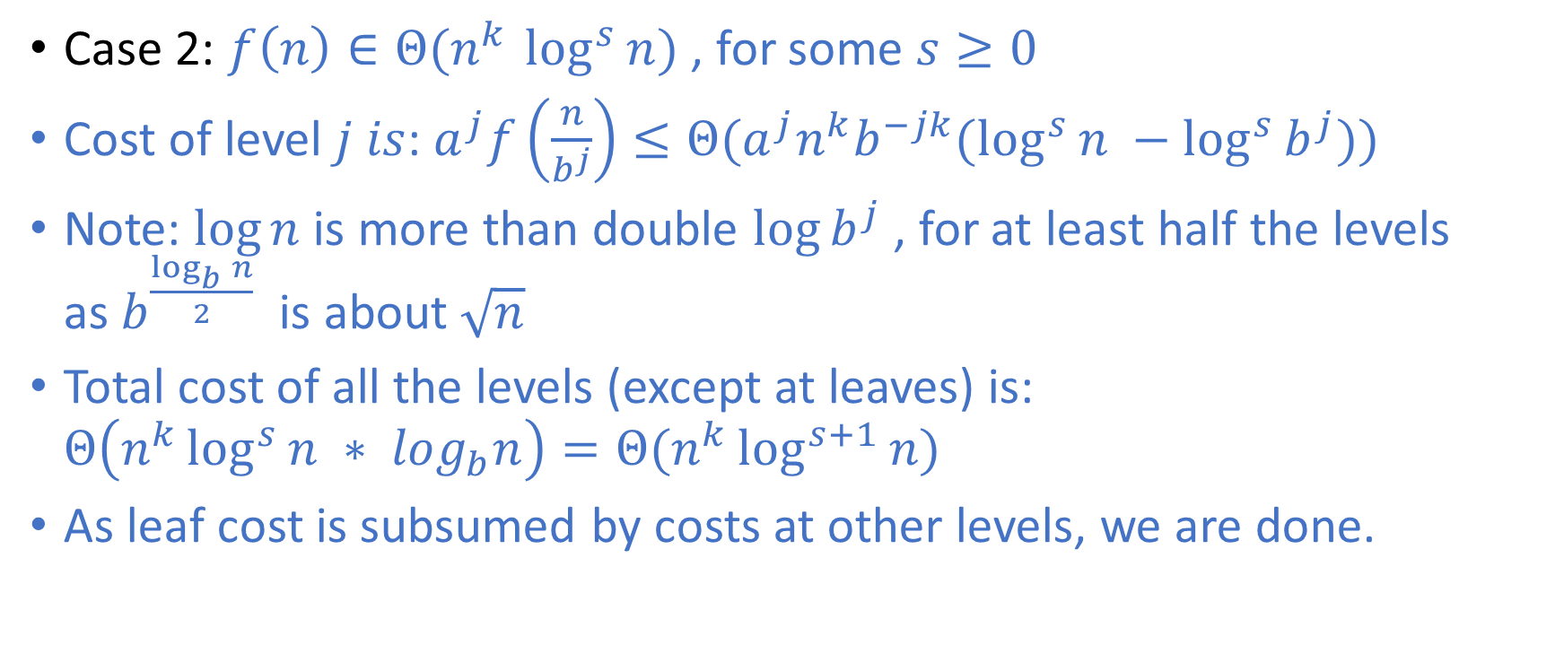
Proof:
Case 2: $f\left(n\right)∈Θ(n^{k }\log^{s}{n})$ , for some $s≥0$
Cost of level $j is$: $a^{j}f\left(\frac{n}{b^{j}}\right)≤Θ(a^{j}n^{k}b^{−jk}(\log^{s}{n −\log^{s}{b^{j}))}}$
Note: $log⁡n$ is more than double $log⁡b^{j}$ , for at least half the levels as $b^{\frac{\log_{b}{n}}{2}}$is about $\sqrt{n}$
Total cost of all the levels (except at leaves) is: $Θ\left(n^{k}\log^{s}{n ∗ log_{b}n}\right)=Θ(n^{k}\log^{s+1}{n)}$
As leaf cost is subsumed by costs at other levels, we are done.

Slide 44
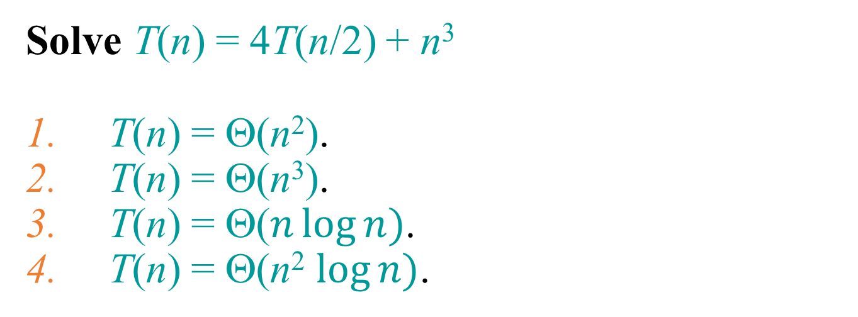
Question 3
Solve T(n) = 4T(n/2) + n³
T(n) = Θ(n²).
T(n) = Θ(n³).
T(n) = Θ($n\log{n})$.
T(n) = Θ(n² $\log{n})$.

Slide 45
Answer of Question 3
T(n) = 4T(n/2) + n³
a = 4, b = 2 ⇒ n^{logba} = n²; f (n) = n³.
CASE 3: f (n) = Ω(n^{2 + ε}) for ε = 1
and 4(n/2)³ ≤ cn³ (reg. cond.) for c = 1/2.
∴ T(n) = Θ(n³).

Slide 46

Can we always use master method?
T$(n) =8T(\frac{n}{2}) +\frac{n^{3}}{\log{n}}$
$a=8, b=2, k=2$
None of the cases apply

Slide 47
Substitution method

Slide 48
Substitution Method
Guess and answer and verify (usually by induction)

Slide 49
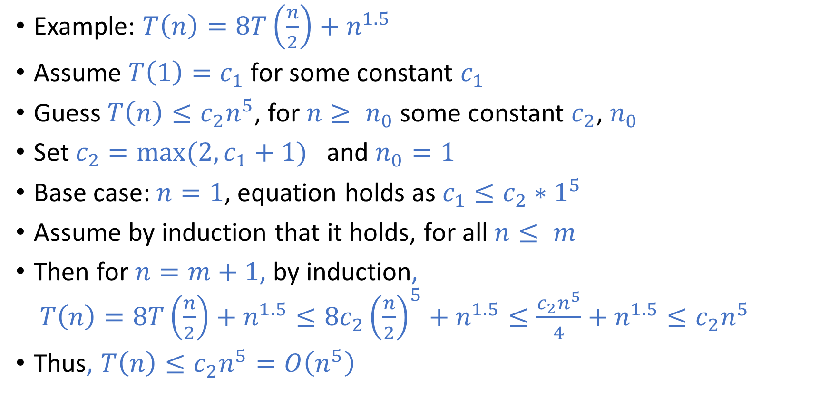
Subsitution Method
Example: $T\left(n\right)=8T\left(\frac{n}{2}\right)+n^{1.5}$
Assume $T\left(1\right)=c_{1}$for some constant $c_{1}$
Guess $T\left(n\right)≤c_{2}n^{5}$, for $n≥ n_{0}$some constant $c_{2}$, $n_{0}$
Set $c_{2}={max⁡(2,c}_{1}+1)$ and $n_{0}=1$
Base case: $n=1$, equation holds as $c_{1}≤c_{2}∗1^{5}$
Assume by induction that it holds, for all $n≤ m$
Then for $n=m+1$, by induction, $T\left(n\right)=8T\left(\frac{n}{2}\right)+n^{1.5}≤8{c_{2}\left(\frac{n}{2}\right)}^{5}+n^{1.5}≤\frac{c_{2}n^{5}}{4}+n^{1.5}≤c_{2}n^{5 }$
Thus, $T\left(n\right)≤c_{2}n^{5}=O\left(n^{5}\right)$

Slide 50

Subsitution Method
We may not get tight bounds, as we may overguess the bound as in previous slide.
Can we guess $T\left(n\right)∈O(n^{3})$ and try to prove it by induction?

Slide 51
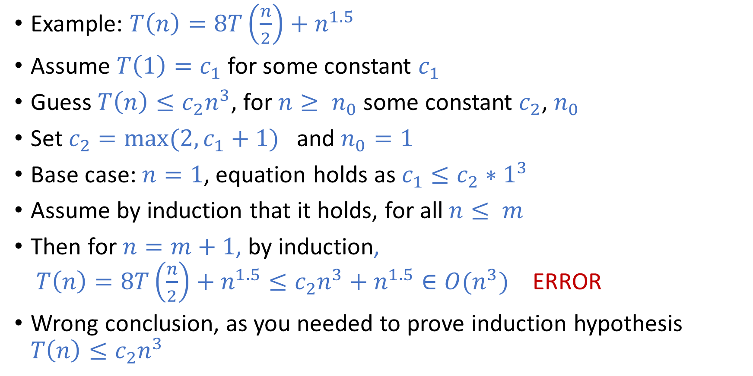
Subsitution Method: Wrong proof
Example: $T\left(n\right)=8T\left(\frac{n}{2}\right)+n^{1.5}$
Assume $T\left(1\right)=c_{1}$for some constant $c_{1}$
Guess $T\left(n\right)≤c_{2}n^{3}$, for $n≥ n_{0}$some constant $c_{2}$, $n_{0}$
Set $c_{2}={max⁡(2,c}_{1}+1)$ and $n_{0}=1$
Base case: $n=1$, equation holds as $c_{1}≤c_{2}∗1^{3}$
Assume by induction that it holds, for all $n≤ m$
Then for $n=m+1$, by induction, $T\left(n\right)=8T\left(\frac{n}{2}\right)+n^{1.5}≤c_{2}n^{3}+n^{1.5}∈O(n^{3})$ ERROR
Wrong conclusion, as you needed to prove induction hypothesis $T\left(n\right)≤c_{2}n^{3}$

Slide 52
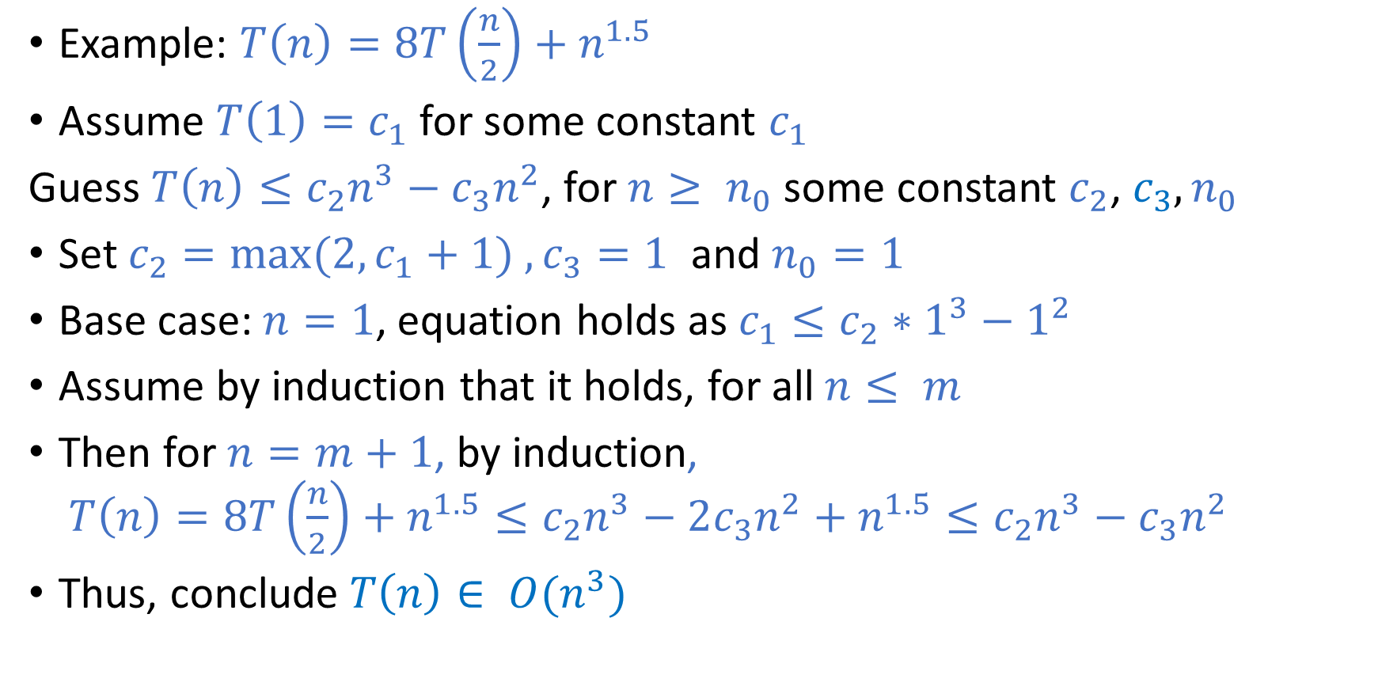
Subsitution Method:
Example: $T\left(n\right)=8T\left(\frac{n}{2}\right)+n^{1.5}$
Assume $T\left(1\right)=c_{1}$for some constant $c_{1}$
Guess $T\left(n\right)≤c_{2}n^{3}−c_{3}n^{2}$, for $n≥ n_{0}$some constant $c_{2}$, $c_{3}, n_{0}$
Set $c_{2}={max⁡(2,c}_{1}+1) , c_{3}=1$ and $n_{0}=1$
Base case: $n=1$, equation holds as $c_{1}≤c_{2}∗1^{3}−1^{2}$
Assume by induction that it holds, for all $n≤ m$
Then for $n=m+1$, by induction, $T\left(n\right)=8T\left(\frac{n}{2}\right)+n^{1.5}≤c_{2}n^{3}−2c_{3}n^{2}+n^{1.5}≤c_{2}n^{3}−c_{3}n^{2}$
Thus, conclude $T\left(n\right)∈ O(n^{3})$

Slide 53
Substitution Method
Guessing not easy
Verification: need to be very careful

Slide 54
Acknowledgement
The slides are modified from previous editions of this course and similar course elsewhere. Mainly from slides of Prof Diptarka Chakraborty and Steven Halim from last year, which also used material from:
Erik D. Demaine and Charles E. Leiserson, Surender Baswana, Leong Hon Wai, Lee Wee Sun, Ken Sung

