Slide 1

Committee Selection with Non-Proportional Weights
Yucheng Sun, Haifeng Yu, Ruomu Hou
National University of Singapore
Department of Computer Science
Presenter

Slide 2




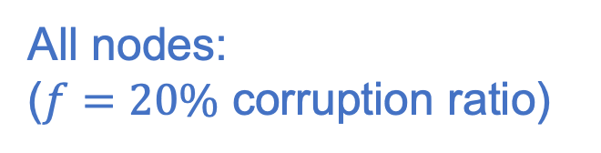
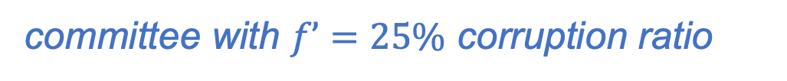
Background: Proof-of-Stake Blockchain
Nodes have stake (i.e., ETH ). Corruption ratio is $f$.
All nodes:
($f=20\%$ corruption ratio)
……
committee
selection
(our focus)
block2
block1
run consensus to confirm block
blocks form
blockchain
block
block0
committee with $f’=25\%$ corruption ratio
Blockchain:
block0
block1
block3
block4
block5
block6
……

Slide 3
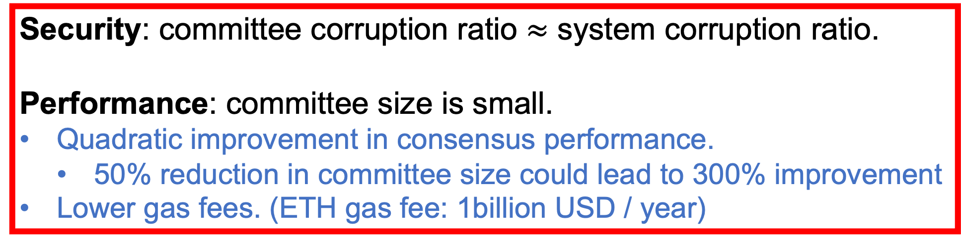
What are Goals of Committee Selection?
Committee selection: select a small committee (e.g., to run consensus in PoS blockchains).
Security: committee corruption ratio $≈$ system corruption ratio.
Performance: committee size is small.
Quadratic improvement in consensus performance.
50% reduction in committee size could lead to 300% improvement
Lower gas fees. (ETH gas fee: 1billion USD / year)

Slide 4

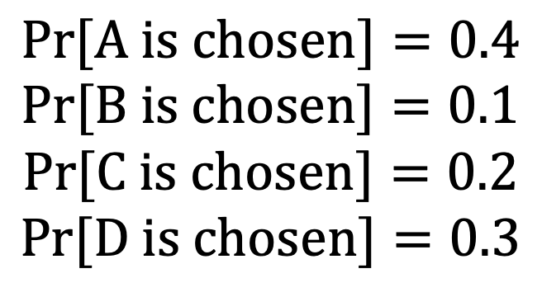





A Naïve Committee Selection Scheme
Repeat for $n$ times:
Randomly choose a node by stake to join committee
“By stake”:
$$Pr[A is chosen]=0.4$$
$$Pr[B is chosen]=0.1$$
$$Pr[C is chosen]=0.2$$
$$Pr[D is chosen]=0.3$$
$$s_{A}=0.4$$
$$s_{B}=0.1$$
$$s_{c}=0.2$$
$$s_{D}=0.3$$
Stakes are normalized (sum to 1)

Slide 5
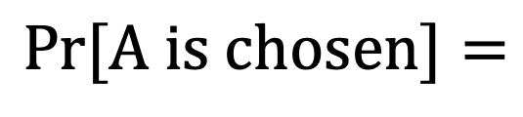
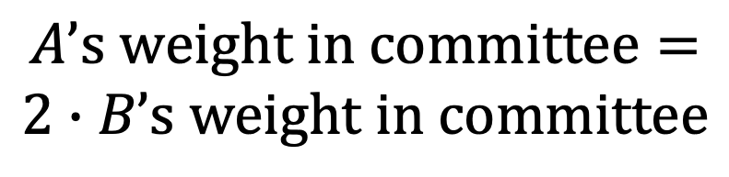




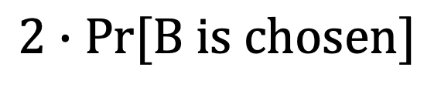
Proportionality in Committee Selection
Algorand SOSP17
Ouroboros Crypto17
GearBox CCS22
……
Fait-Accompli CCS23
……
Proportionality: standard principle in existing works.
“A node should NOT over/under-represent its stake”
Example 1:
Choose a member:
$$Pr[A is chosen]=$$
$$s_{A}=0.4$$
$$s_{B}=0.2$$
$$2∙Pr[B is chosen]$$
Example 2:
A and B have same chance being chosen
$$A’s weight in committee=$$
$$2∙B’s weight in committee$$
$$s_{A}=0.4$$
$$s_{B}=0.2$$

Slide 6
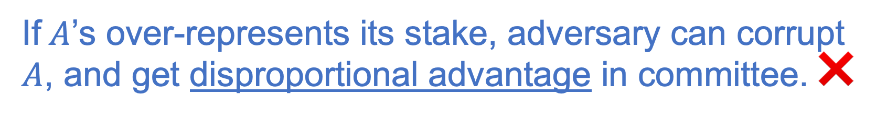

Proportionality Offers Strong Guarantee
Without proportionality, some committee members necessarily over-represent their stake.
If $A$’s over-represents its stake, adversary can corrupt $A$, and get disproportional advantage in committee. ❌
$$A$$
Proportionality $⟺$ No room for exploitation
Proportional schemes are called “perfect” schemes in [CCS23].
[CCS23] Peter Gaži, Aggelos Kiayias, and Alexander Russell. Fait Accompli Committee Selection: Improving the Size-Security Tradeoff of Stake-Based Committees.

Slide 7
Our Work: Non-Proportional Designs
Suprisingly, we discover proportionality is sub-optimal.
Nodes over/under-representing their stake is good!
*despite* that adversary corrupt nodes over-representing their stake
We develop a framework to explore non-proportional designs.
Reduce committee size by 50% (which could lead to 300% improvement in consensus performance, etc.)
[CCS23] calls proporitonality schemes as “perfect schemes”

Slide 8
Proportionality is Sub-Optimal: Example
We evaluate SOTA committee selection scheme [CCS23], which is proportional.
Only peak error matters.
[CCS23] Peter Gaži, Aggelos Kiayias, and Alexander Russell. Fait Accompli Committee Selection: Improving the Size-Security Tradeoff of Stake-Based Committees.

Slide 9
Proportionality is Sub-Optimal: Example
Consider a non-proportional variant:
nodes’ stake are over/ under-represented by ~10%.
Error already improves.
[CCS23] Peter Gaži, Aggelos Kiayias, and Alexander Russell. Fait Accompli Committee Selection: Improving the Size-Security Tradeoff of Stake-Based Committees.

Slide 10
Explore Non-Proportional Designs
So far:
Non-proportional committee selection designs are surprisingly better.
Next:
We developed an algorithmic framework to explore non-proportional designs.
Despite potentially infinite space
Despite difficulty of reasoning about worst-case adversary
Details are in our paper ☺

Slide 11
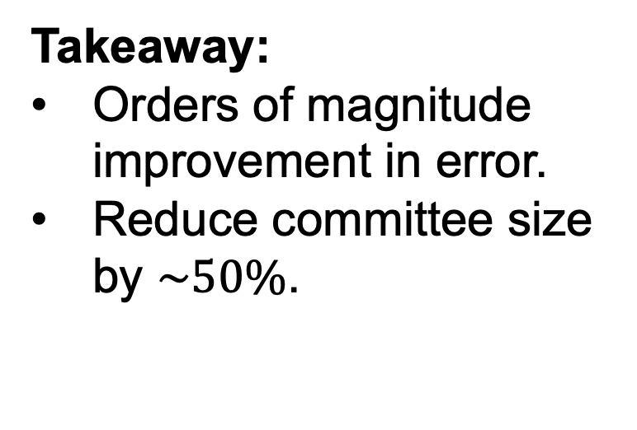
Empirical Improvement is Large
We evaluate under 6 real-world stake distributions: Ethereum, Cardano, Solana, Dogecoin, Bitcoin, BitcoinCash.
We compare with all existing designs (SOTA is [CCS23]).
[CCS23] Peter Gaži, Aggelos Kiayias, and Alexander Russell. Fait Accompli Committee Selection: Improving the Size-Security Tradeoff of Stake-Based Committees.
Takeaway:
Orders of magnitude improvement in error.
Reduce committee size by $\sim 50\%$.
Results for Ethereum

Slide 12
Conclusion
An interesting new world to explore……
New “Non-Proportionality” world:
Our work on committee selection [CCS25]
🤔️……
“Proportionality” world:
Committee selection in [Algorand17,Ouroboros17,LaKSA21,GearBox22] ……
FA committee selection scheme [CCS23]
…

