Slide 1

Robust and Low-degree Overlay for Secure
Flooding Against Resource-bounded Adversaries
Yucheng Sun, Ruomu Hou, Haifeng Yu
National University of Singapore
Department of Computer Science
Presenter

Slide 2

Permissionless Blockchains
Blockchains:
A append-only distributed data structure
Permissionless:
Open (everyone can join)
Attacks (adversary can join)
…
…
F
E
…
…
A
D
…
B

Slide 3
Blockchains Security
Blockchain security has two critical “pillars”
Blockchain Security
Our work
Concensus Security
Flooding Security
Everyone agrees!
Nakamoto Consensus …
Byzantine Agreement …
Key assumption in blockchains:
Messages reach everyone!
Go hand-in-hand with concensus.

Slide 4
Secure Flooding
The crux of secure flooding is to build overlay graph that is
Connected
Low-degree
“Good” overlay

Slide 5

Secure Flooding: Overlay is Connected
Secure Flooding: Need messages to reach everyone
Messages are sent through an overlay topology/graph
Security of Flooding needs: Connectivity of overlay graph

Slide 6
Secure Flooding: Overlay is Connected
Secure Flooding: Need messages to reach everyone
Messages are sent through an overlay topology/graph
Security of Flooding needs: Connectivity of overlay graph

Slide 7
Secure Flooding: Overlay is Connected
Secure Flooding: Need messages to reach everyone
Messages are sent through an overlay topology/graph
Security of Flooding needs: Connectivity of overlay graph

Slide 8


Secure Flooding: Small Degree
(max) degree in the overlay cannot be too large
  Due to limited resource (i.e., bandwidth)
node degree too large $⇒$ cannot sustain the required degree $⇒$ Not secure!
Security of Flooding needs: Low-degree of overlay graph

Slide 9
Secure Flooding
The crux of secure flooding is to build overlay graph that is
Connected
Low-degree
“Good” overlay

Slide 10

Building Overlay: Simple Random Graph
When there is no attack, a simple random graph suffices.
node degree is only $O(log⁡n)$

Slide 11
Building Overlay: Sybil Attack
In reality, simple random graph fails.
Reason: many bad nodes in permissionless blockchains.
  “Sybil attacks”
Honest nodes not connected

Slide 12
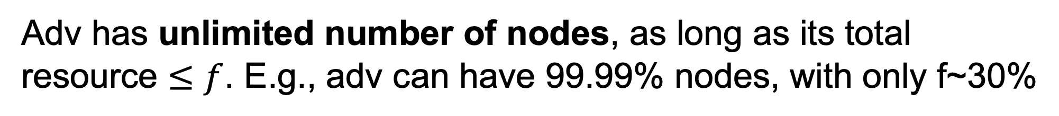
Building Overlay: Defend Sybil Attack
Basic idea for defending sybil attack:
constrain the adversary by resources (stake / computation)
“common knowledge” in blockchain community
Nodes with large stake
Nodes with smaller stake
Adv has unlimited number of nodes, as long as its total resource $≤f$. E.g., adv can have 99.99% nodes, with only f~30%

Slide 13
Building Overlay: Prior Attempts
A new problem arising in recent years.
Only two prior attempts with provable guarantees [CCS 22’, AsiaCrypto 22’].
Theory-oriented.
All try to build good overlay topology to do secure flooding.

Slide 14
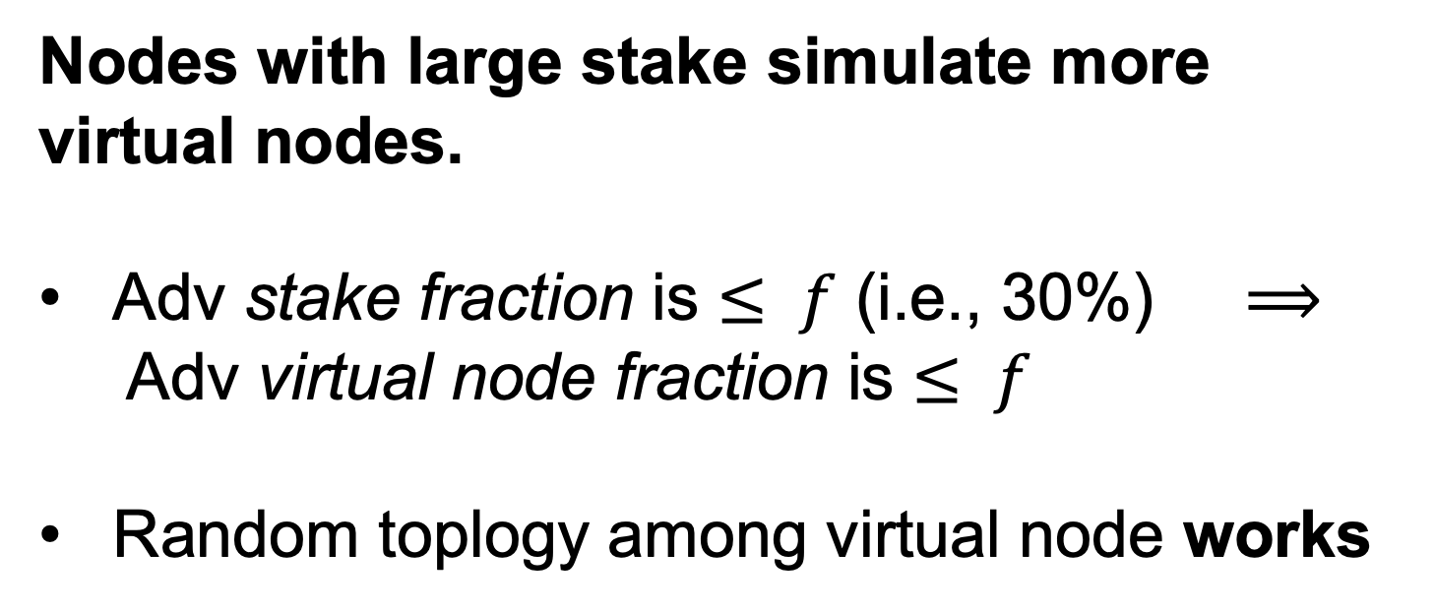
Building Overlay: Prior Attempts
All adopt the idea of virtual nodes.
Nodes with large stake simulate more virtual nodes.
Adv stake fraction is $≤ f$ (i.e., 30%) $⟹$
Adv virtual node fraction is $≤ f$
Random toplogy among virtual node works

Slide 15
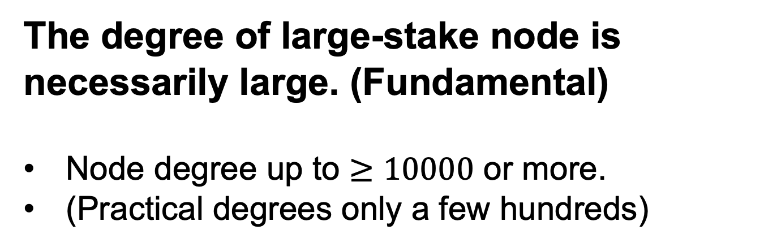
Our 1st Contribution: a Key Observation
All prior designs fail to have practical degrees.
Degree is too large in practical settings.
The degree of large-stake node is necessarily large. (Fundamental)
Node degree up to $≥10000$ or more.
(Practical degrees only a few hundreds)

Slide 16

Our 1st Contribution: a Key Observation
All prior designs fail to have practical degrees.
Degree is large ($≥10000$ or more). Due to resource-disparity.

Slide 17
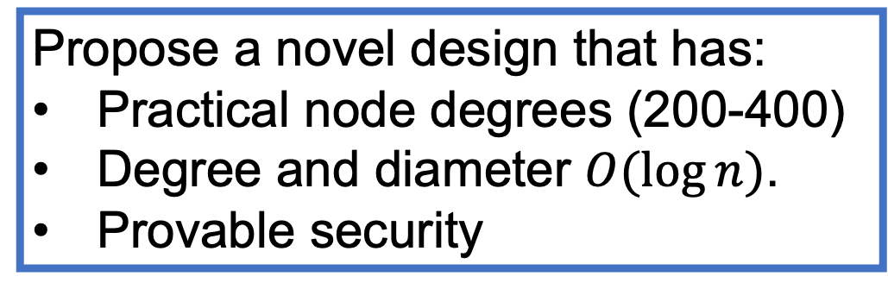
2nd Contribution: first practical solution
Not using virtual nodes.
Propose a novel design that has:
Practical node degrees (200-400)
Degree and diameter $O(log⁡n)$.
Provable security
Prior designs fail to be practical. Degree ≥ 10000.
Our work
AsiaCrypto 22’
CCS 22’
First set of theory works.
Heuristic Overlay Topology:
Bitcoin
Ethereum
……
Insecure. Many existing attacks on the topology.

Slide 18
Technical Highlights

Slide 19

Some Formalism
$n$ nodes in total. Proof-of-stake context (generalizable to PoW). Nodes’ stake is $s_{1}≥s_{2}≥s_{3}≥…≥s_{n}>0$.
Assume $Σ_{i}s_{i}=1$
Adversary’s can control any $≤f$ stake (e.g., $f=30\%$).

Slide 20

Key Idea: Groups with Bounded Disparity
We put nodes into $O(log⁡n)$ disjoint groups. Nodes in each group are similar (in stake): bounded disparity.
A random topology with $O(log⁡n)$ degree within a group will work (if a group has a constant fraction of honest nodes).
Connecting the groups would then connect all nodes.
3 key steps of our Algorithm
Groups with smaller-stake nodes
Groups with larger-stake nodes

Slide 21
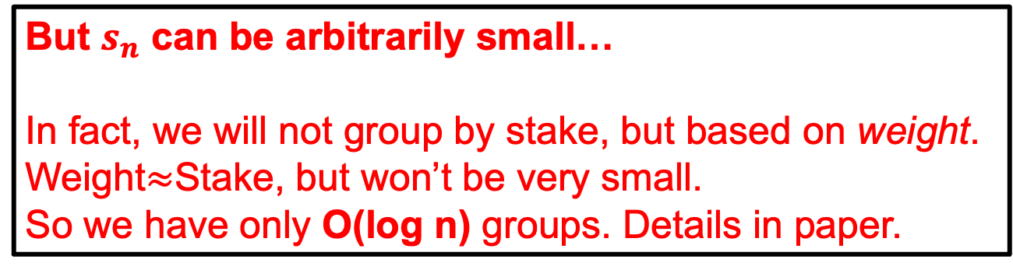

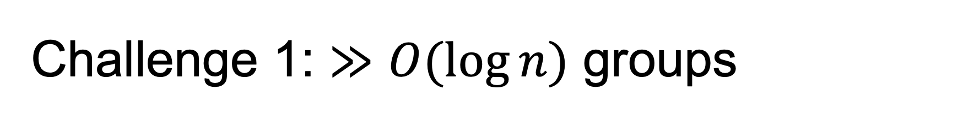
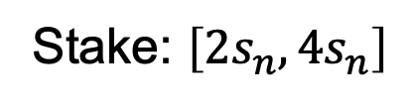
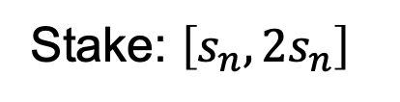
Challenge 1: $≫O(log⁡n)$ groups
Naive idea: the minimum stake is $s_{n}>0$. Then let each group contain nodes with stake:
$$\left[s_{n},2s_{n}\right],\left[2s_{n},4s_{n}\right], ……,[2^{a}s_{n}, 1]$$
Then the stake in each group is bounded.
Only O(log n) groups, if $s_{n}=Ω(\frac{1}{poly(n)})$
But $s_{n}$ can be arbitrarily small…
In fact, we will not group by stake, but based on weight.
Weight$≈$Stake, but won’t be very small.
So we have only O(log n) groups. Details in paper.
Stake: $\left[s_{n},2s_{n}\right]$
Stake: $\left[{2s}_{n},4s_{n}\right]$
……

Slide 22

Key Idea: Groups with Bounded Disparity
We put nodes into $O(log⁡n)$ disjoint groups. Nodes in each group are similar (in stake): bounded disparity.
A random topology with $O(log⁡n)$ degree within a group will work (if a group has a constant fraction of honest nodes).
Connecting the groups would then connect all nodes.
Groups with smaller-stake nodes
Groups with larger-stake nodes

Slide 23


Challenge 2: Adversary Targets a Group
In a group with bounded stake disparity, a random topology with $O(log⁡n)$ degree within a group will work (if a group has a constant fraction of honest nodes).
However, adversary can target a group, so that the remaining honest nodes are small. Thus hard to connect.

Slide 24

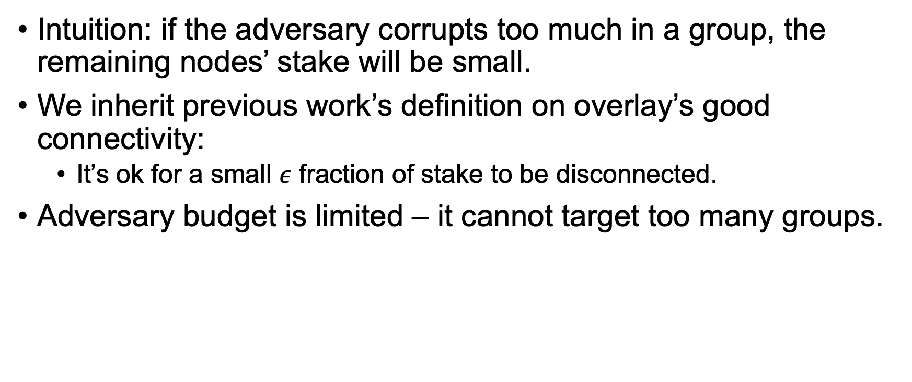
Solve Challenge 2: Targets a Group
Intuition: if the adversary corrupts too much in a group, the remaining nodes’ stake will be small.
We inherit previous work’s definition on overlay’s good connectivity:
  It’s ok for a small $ε$ fraction of stake to be disconnected.
Adversary budget is limited – it cannot target too many groups.

Slide 25

Key Idea: Groups with Bounded Disparity
We put nodes into $O(log⁡n)$ disjoint groups. Nodes in each group are similar (in stake): bounded disparity.
A random topology with $O(log⁡n)$ degree within a group will work (if a group has a constant fraction of honest nodes).
Connecting the groups would then connect all nodes.
Groups with smaller-stake nodes
Groups with larger-stake nodes

Slide 26
Challenge 3: Make Groups Connect
The groups still need to connect with each other, how?
Idea: each group randomly selects some leaders. Leaders connect to each other.
Issue is some group may not have a leader. Thus disconnected.
  If a group is tagrted by the adversary, which can likely happen. But the remaining honest stake is very tiny.

Slide 27
Challenge 3: Make Groups Connect
The groups still need to connect with each other, how?
Idea: each group randomly selects some leaders. Leaders connect to each other.
Issue is some group may not have a leader. Thus disconnected.
  If a group is not targeted by the adversary, this happens with very small probability.

Slide 28
Challenge 3: Make Groups Connect
The groups still need to connect with each other, how?
Idea: each group randomly selects some leaders. Leaders connect to each other.
Issue is some group may not have a leader. Thus disconnected.
  Either bad scenario is counted towards error.

Slide 29

Key Idea: Groups with Bounded Disparity
1. Instead, we put nodes into $O(log⁡n)$ disjoint groups. Nodes in each group are similar (in stake): bounded disparity.
2. A random topology with $O(log⁡n)$ degree within a group will work (if a group has a constant fraction of honest nodes).
3. Connecting the groups would then connect all nodes.
Theorem 1:
For any $f∈\left(0,1\right]$, $ε,δ∈\left(0,1\right]$, our toplogy can use $O(\log{n})$ groups, $O(\log{n})$ in-group degree, and $O(1)$ leaders per group such that except w.p. $δ$, there is only $≤ε$ fraction of disconnected stake, under the worst-case adversary.
The degree and diameter of our topology are both $O(\log{n})$.

Slide 30
More Technical Details
Our topology has several parameters:
  Degree of the in-group topology (K).
  Number of leaders to select (L).
  The bound on stake weight in a group (G, which is not necessarily 2).
We design a novel parameter search algorithm to find appropriate (K, L, G).
Key challenge that adversary has exponential # of strategies.
Our novel idea: reduce the adv’s exponential strategy space into a polynomial space, based on properties of our topology. More details in paper.

Slide 31
Practical Node Degrees
Our node degree ranges from 200-400 under practical settings.
For comparison, prior works’ degree under same settings reaches ≥10000.

Slide 32
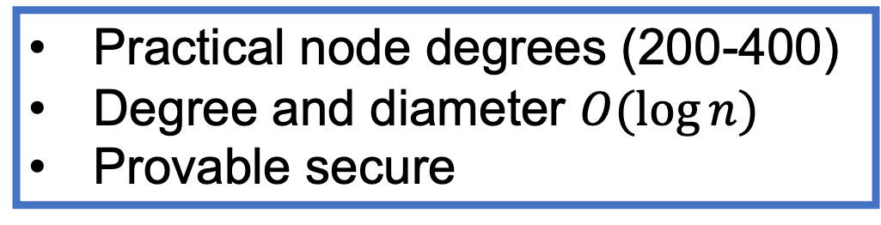
Conclusion
lacks of understanding in flooding problem in prior arts
a novel overlay topology design for secure flooding
practical results, with provable security
Practical node degrees (200-400)
Degree and diameter $O(log⁡n)$
Provable secure
Prior designs fail to be practical. Degree ≥ 10000.
Our work
AsiaCrypto 22’
CCS 22’
First set of theory works.
🤔️
Heuristic Overlay Topology:
Bitcoin
Ethereum
……
Insecure. Many existing attacks on the topology.

